Slide 1
Timed Transition Systems and Timed Automata
中国科学院软件研究所
计算机科学国家重点实验室
张文辉
http://lcs.ios.ac.cn/~zwh/

Slide 2
Prerequisites
  Sets
  Relations
  Graphs
  Automata

Slide 3
自动售茶机
s0
取钱
1
2
s1
s2
取茶
1
2
1
2
2
s3
s6
s7
s4
1
找钱/取钱
退钱
出茶
s5

Slide 4
自动售茶机
s0
取钱
1
2
s1
s2
取茶
1
2
1
2
2
s3
s6
s7
s4
1
{x}
找钱/取钱
退钱
出茶
s5
x>=10
x<10

Slide 5
时间迁移系统

Slide 6
系统运行过程描述：例子
s0
t0
无约束
无约束
y=1,t=1
x=1,t=0
无约束
无约束
s1
t1
x==0||t==0
y==0||t==1
<2
<1
s2
t2
<8
y=0
x=0
<5
s3
t3

Slide 7
状态变化图:
b,{u},true
z0
b,{u},u<1
a,{v},true
z35
z12
z67
z20
z46
z47
z78
z55
z24
z97
a,{v},true
b,{u},u<1
b,{},u<5

Slide 8
时间变化
b,{u},true
z0
b,{u},u<1
a,{v},true
z12
0.0 5.0 5.1 5.7 5.9 10.4
b a a b b
z0 z12 z12 z12 z20 24
u=0.0, u=5.0, u=0.1, u=0.7, u=0.9, u=4.5
u=0.0, u=0.0, u=0.1, u=0.7, u=0.0, u=4.5
v=0.0, v=5.0, v=5.1, v=0.6, v=0.2, v=4.7
v=0.0, v=5.0, v=0.0, v=0.0, v=0.2, v=4.7
z20
z24
b,{},u<5

Slide 9
时间迁移系统
动作信息
系统状态
时钟变量
状态变化
初始状态
符号
抽象状态
变量集合
五元组
状态集合
时间迁移系统

Slide 10
时间迁移系统：例子
标号集合：
状态集合：
时钟变量集合：
迁移关系：
初始状态集：
{ a, b }
{ z0, z1, z2, z3, … }
{ u, v }
{ (z0,a,{v},true,z12), … }
{ z0 }
时钟变量相关公式

Slide 11
Clocks
X: A set of clock variables
Q: A set of time constants
Let x range over X. Let c range over Q.
The set of clock formulas Φ(X) is as follows:
φ ::= x ≤ c | c ≤ x | ¬φ | φ∧φ

Slide 12
Valuations
  Let R be the set of real numbers.
A valuation is a function v: X→R.
Notation
v+t denote v’ such that v’(x)=v(x)+t for all x ∈X.
t*v denotev’ such that v’(x)=t*v(x) for all x ∈X.
[Y->t]v denote v’ such that:
v’(x)=t for all x ∈Y, and v’(x)=v(x) for all x ∈X\Y.

Slide 13
Timed Transition Systems (TTS)
Definition
A TTS is a quintuple <Σ,S,X,Δ,I>
  Σ : A finite set of symbols
  S : A finite set of states
  X: A finite set of clock variables
  Δ ⊆ S x Σ x 2^{X} x Φ(X) x S : A transition relation
  I ⊆ S : A set of initial states

Slide 14
Example: Σ
{a,b,c}
Notes:
x=0
x=0 → x=1
y=0 → y=1
y=1 → y=0

Slide 15
Example: S
s0
s1
s2
s3
Notes:
x=0
x=0 → x=1
y=0 → y=1
y=1 → y=0

Slide 16
Example: X={x,y,z}
s0
s1
s2
s3
Notes:
x=0
x=0 → x=1
y=0 → y=1
y=1 → y=0

Slide 17
Example: Δ
x<2,a,{x.y}
s0
s1
b
b
c
c
a
s2
s3

Slide 18
Example: I
x<2,a,{x.y}
s0
s1
b
b
c
c
a
s2
s3

Slide 19
Basic Concepts

Slide 20
States
The set of valuations: V=X→R.
A state is an element of S x V.

Slide 21
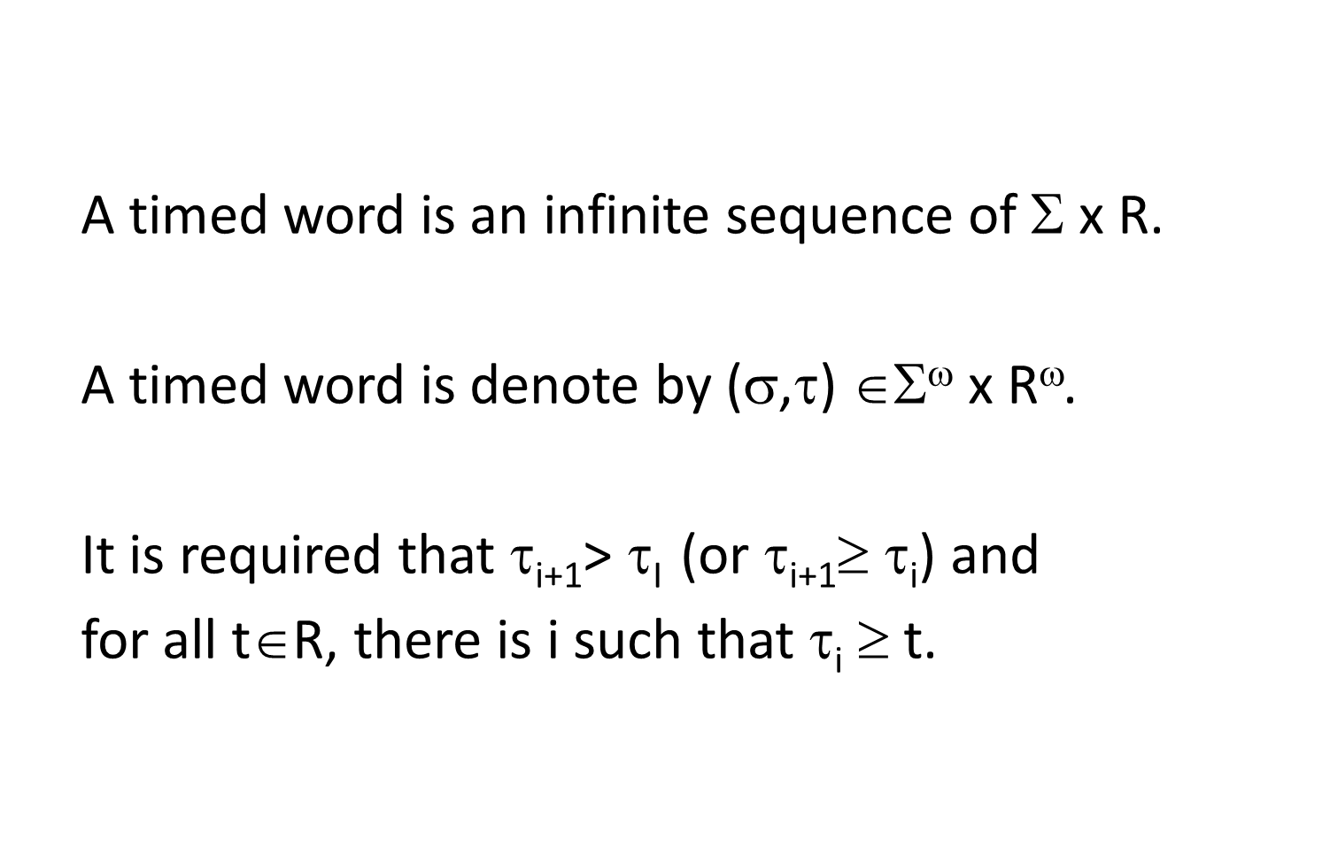
Timed Words

Slide 22
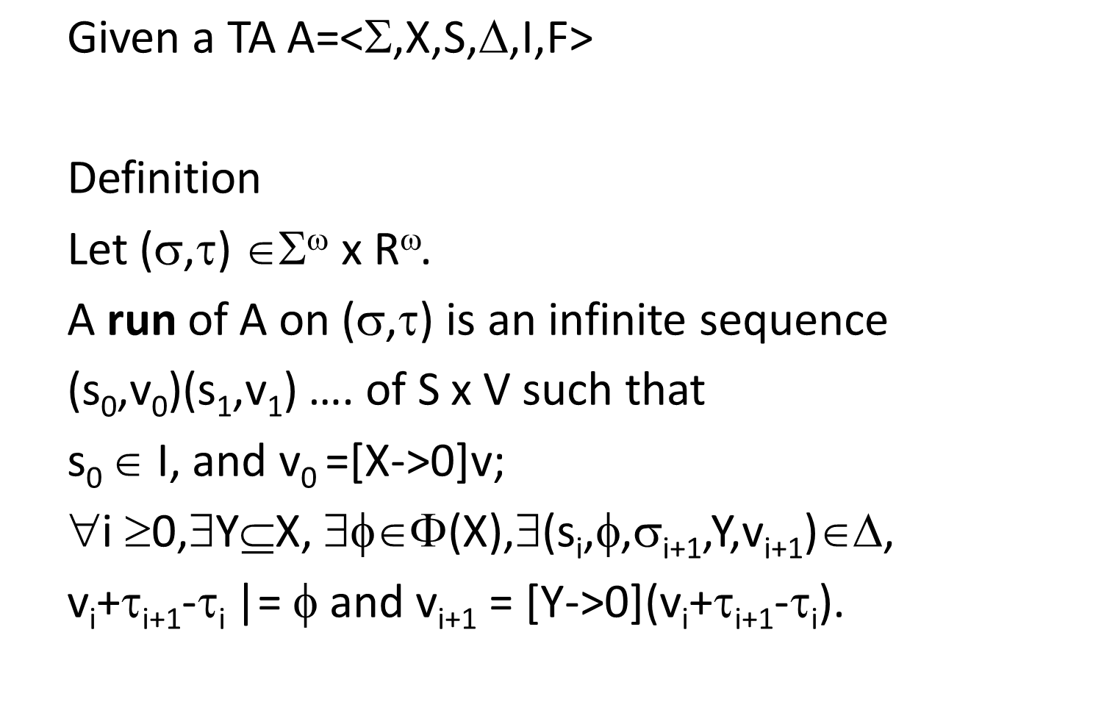
Runs

Slide 23
Words over Runs
Definition
A timed word over a run r of A is
an infinite sequence (σ,τ) ∈Σ^{ω} x R^{ω}
such that r is a run on (σ,τ).

Slide 24
时间迁移系统：例子
d, y>2
a
b
c
S0
S1
S2
S3
x:=0
y:=0
x<1

Slide 25
时间迁移系统：例子
A=<Σ,S,X,Δ,I>其中
Σ={a,b,c,d}
S={s0,s1,s2,s3}
X={x,y}
Δ={
(s0,a,{x},true,s1), (s2,c,{},x<1,s3),
(s1,b,{y},true,s2), (s3,d,{},y>2,s0)
}
I={s0}

Slide 26
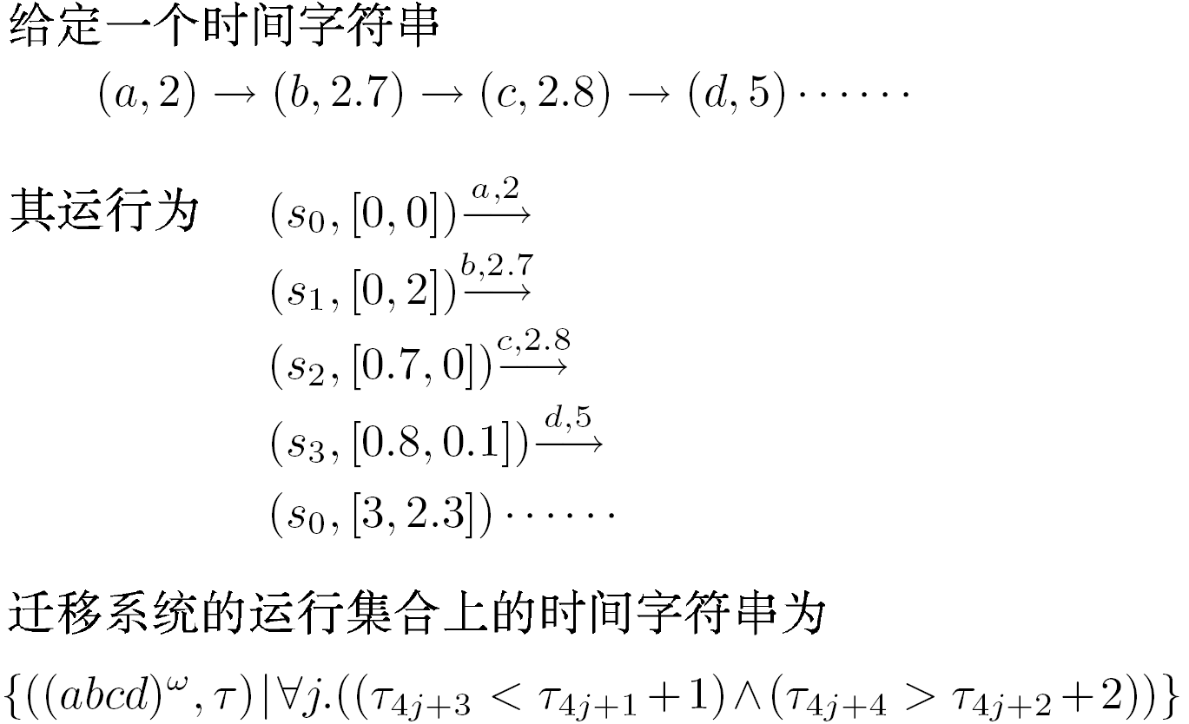
时间迁移系统：运行

Slide 27
Timed-Automaton
Definition
A timed automaton is a sextuple <Σ,S,X,Δ,I,F>
  Σ : A finite set of symbols
  S : A finite set of states
  X: A finite set of clock variables
  Δ ⊆ S x Σ x 2^{X} x Φ(X) x S : A transition relation
  I ⊆ S : A set of initial states
  F ⊆ S : A set of acceptance states

Slide 28
Example: F={s1,s3}
x<2,a,{x.y}
s0
s1
b
b
c
c
a
s2
s3

Slide 29
Accepting Runs
Let inf(r) be the set of states
that appear infinitely many times on r.
Definition
An accepting run of A is a run r of A
such that inf(r)∩F≠∅.

Slide 30
Accepting Words
Definition
An accepting word of A is
a word over some accepting run of A.

Slide 31
Language
Definition
The language of A is
the set of accepting words of A.
The language of A is denoted L(A).

Slide 32
时间Buchi自动机1
b
b, x<2
a, x:=0
S1
S0
S2
S3
S2
a
a, x:=0

Slide 33
时间Buchi自动机1
A=<Σ,S,X,Δ,I,F> 其中
Σ={a,b}
S={s0,s1,s2,s3}
X={x,y}
Δ={ (s0,a,{},true,s1), (s0,a,{x},true,s2),
(s1,b,{},true,s0), (s2,b,{},x<2,s3),
(s3,a,{x},true,s2)
}
I={s0}
F={s2}

Slide 34
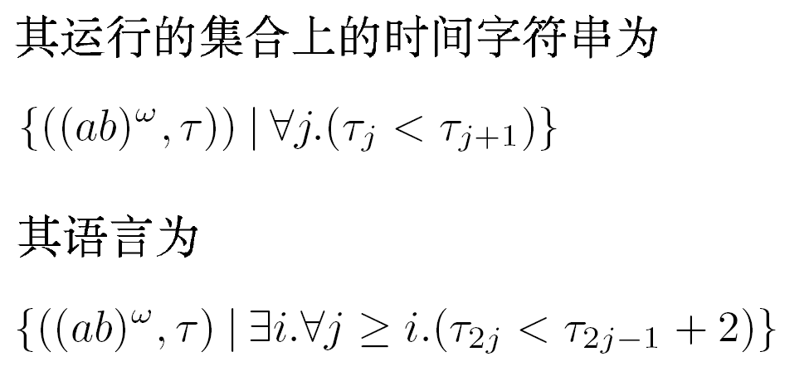
时间Buchi自动机1：运行/语言

Slide 35
时间Buchi自动机2
b, y:=0, y<1
a, x:=0
b, y:=0
S0
S1
S2
S3
S2
x=1
a, x:=0, x=1

Slide 36
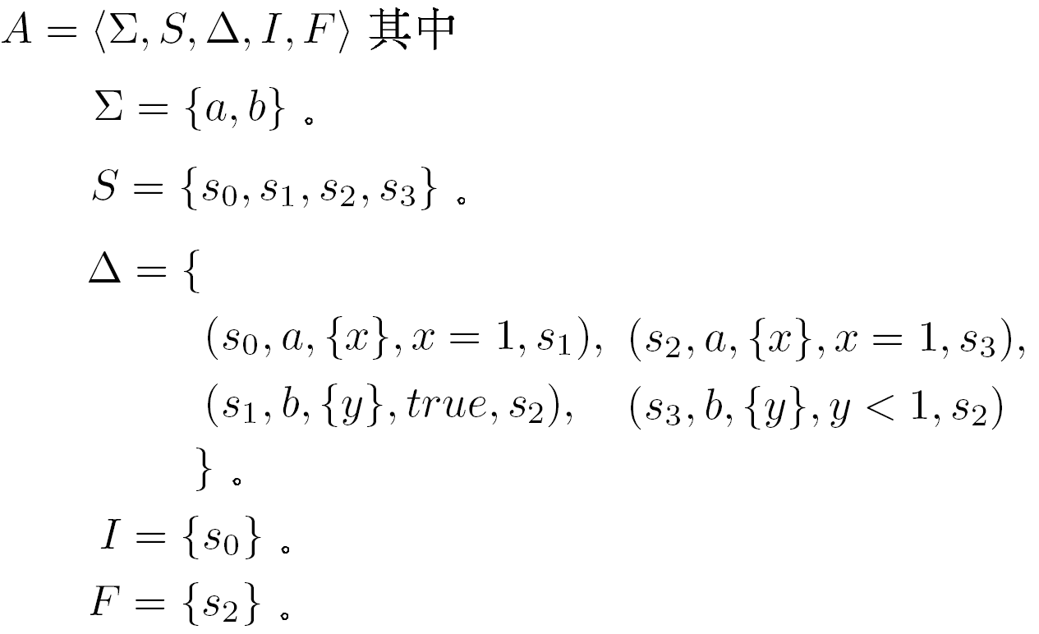
时间Buchi自动机2

Slide 37
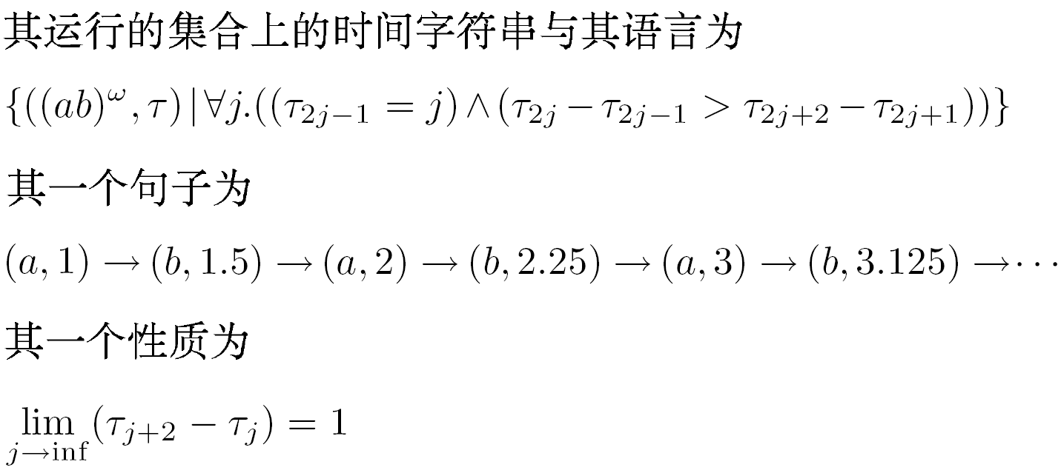
时间Buchi自动机2：运行/语言

Slide 38
Basic Properties

Slide 39
Operations
Union
Intersection
Not closed under complementation.

Slide 40
Emptiness Problem
Let A be a TA.
L(A)=∅?
PSPACE-complete.

Slide 41
Questions?
q1

