Slide 1
Propositional Linear Temporal Logic
中国科学院软件研究所
计算机科学国家重点实验室
张文辉
http://lcs.ios.ac.cn/~zwh/
Notes:
Note: 50m

Slide 2
课程主要内容(2)
程序逻辑
线性时序逻辑

Slide 3
Contents
Examples of Properties
Propositional LTL
Applications of PLTL
Summary

Slide 4
Examples of Properties

Slide 5
Example: Design of Mutual Exclusion
initialization
start
start
request
request
wait
wait
[else]
[else]
[condition 1]
[condition 1]
work in CR
work in CR
exit
exit
work in NCR
work in NCR

Slide 6
Example
s0
t0
y=1,t=1
x=1,t=0
s1
t1
Initial States
s0
t0
x=0
y=0
t=0
x==0||t==0
y==0||t==1
s2
t2
y=0
x=0
s3
t3

Slide 7
s0,t0,0,0,0
s1,t0,0,1,1
s0,t1,1,0,0
5
6
s2,t0,0,1,1
s1,t1,1,1,0
s1,t1,1,1,1
s0,t2,1,0,0
9
10
s3,t0,0,0,1
s2,t1,1,1,0
s1,t2,1,1,1
s0,t3,0,0,0
12
13
s3,t1,1,0,0
s1,t3,0,1,1
s3,t2,1,0,0
s2,t3,0,1,1
s3,t3,0,0,0
s3,t3,0,0,1
6
13
12
10
9
13
12
5

Slide 8
Examples of Properties
Safety
Inevitability
Response
Immediate Response
Priority
First Come – First Served

Slide 9
Propositional Linear Temporal Logic

Slide 10
Examples of Properties
Safety:
Inevitability
Response
Imm. Response
Priority
FCFS
G (!(a=s2∧b=t2))
F (a=s2∨b=t2)
G (a=s1 → F (a=s2))
G (a=s1 → X (a=s2))
G (a=s1∧b!=t1∧b!=t2 → (a=s2 R b!=t2))
G (a=s1∧b!=t1∧b!=t2 → (b!=t2 U a=s2))

Slide 11
Propositional Linear Temporal Logic

Slide 12
Syntax of PLTL
Let AP be a set of proposition symbols.
Definition
Let p range over AP.
The set Φ of PLTL formulas is defined as follows.
Φ == p | Φ∧Φ | Φ∨Φ | ¬Φ |
X Φ | G Φ | F Φ | Φ R Φ | Φ U Φ

Slide 13
Examples of Properties
Safety:
Expectancy
Response
Imm. Response
Priority
FCFS
G (!(a=s2∧b=t2))
F (a=s2∨b=t2)
G (a=s1 → F (a=s2))
G (a=s1 → X (a=s2))
G (a=s1∧b!=t1∧b!=t2 → (a=s2 R b!=t2))
G (a=s1∧b!=t1∧b!=t2 → (b!=t2 U a=s2))

Slide 14
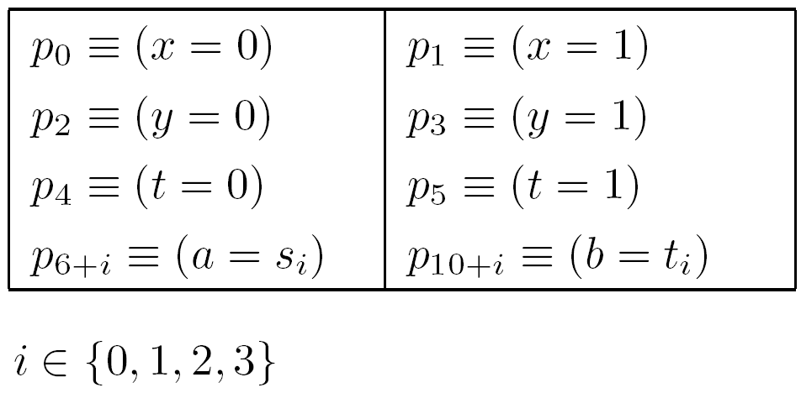
Proposition Symbols
Let AP be the set of proposition symbols
{p0,p1,…,p13} with the following meaning:

Slide 15
Examples of Properties
Safety:
Expectancy
Response
Imm. Response
Priority
FCFS
G (¬(p8∧p12))
F (p8 ∨ p12)
G (p7 → F p8)
G (p7 → X p8)
G (p7∧¬p11∧¬p12 → (p8 R ¬p12))
G (p7∧¬p11∧¬p12 → (¬p12 U p8))

Slide 16
Semantics

Slide 17
Linear Structures
A linear structure is a triple M=<S,ζ,L>
  S : A finite set of states
  ζ ∈ S^{ω} : A sequence of states
  L: S → 2^{AP} is a labeling function

Slide 18
Definition: M |= φ or ζ |= φ
ζ |= φ is defined as follows:
ζ |= p, if p ∈ AP and p ∈ L(ζ₀)
ζ |= ¬φ, if ζ |= φ
ζ |= φ∨ψ, if ζ |= φ or ζ |= ψ
ζ |= φ∧ψ, if ζ |= φ and ζ |= ψ
ζ |= X φ, if ζ¹ |= φ
ζ |= F φ, if ∃i≥0, ζ^{i} |= φ
ζ |= G φ, if ∀i≥0, ζ^{i} |= φ
ζ |= φUψ, if ∃i≥0, ζ^{i} |= ψ and ∀0≤j<i, ζ^{j} |= φ
ζ |= φRψ, if ∀i≥0, (∀0≤j<i, ζ^{j} |= φ) → ζ^{i} |= ψ

Slide 19
Satisfiability and Validity

Slide 20
Satisfiability and Validity
Definition
A formula φ is satisfiable,
if there is a linear structure M such that M |= φ.
Definition
A formula φ is valid,
if for every linear structure M, we have M |= φ.

Slide 21
Satisfiability and Validity Checking
The complexities of PLTL satisfiability and
validity checking are PSPACE-complete.

Slide 22
Equivalences
Definition
A formula φ is equivalent to a formula ψ, if
for all models M, (M |= φ iff M |= ψ).

Slide 23
Dual Operators
X φ ≡ ¬X¬ φ
G φ ≡ ¬F¬ φ
φ R ψ ≡ ¬(¬φ U ¬ψ)

Slide 24
Recursion
G φ ≡ φ∧ X G φ
F φ ≡ φ∨ X F φ
φ R ψ ≡ ψ ∧ (φ ∨ X (φR ψ))
φ U ψ ≡ ψ ∨ X (φU ψ)

Slide 25
Definable Operators
Let p₀∈ AP be given.
Let ⊥ denote (p₀ ∧ ¬p₀)
F φ ≡ ¬⊥ U φ
G φ ≡ ⊥ R φ
φ R ψ ≡ ψ U (φ∧ψ) ∨ G ψ

Slide 26
Example: Proofs of Some Equivalences
X φ ≡ ¬X¬ φ
φ R ψ ≡ ψ U (φ∧ψ) ∨ G ψ
These equivalences can be proved by applying
the semantics.
例子x1(1)
Notes:
45

Slide 27
Minimal Complete Set of Temporal Operators

Slide 28
Minimal Complete Set
X,F,G,R,U
F is expressible by U
G is expressible by R
R is expressible by U
Then {X,U} is a complete set.
{X,U} is also a minimal complete set.

Slide 29
Examples for Orthogonality of X and U
{p}
{p}
{p}
{p}

Slide 30
Orthogonality of X and U
{}
{p}
{}
{p}
s0 |= (¬p U p)
not (s0’ |= (¬p U p))
X:
Propositional formulas
¬, ∧, ∨
X ψ

Slide 31
Orthogonality of X and U
{}
{}
{p}
s0
s1
s2
s0…|= X¬p
not (s1…|= X¬p)
U:
Propositional formulas
¬, ∧, ∨
ϕ U ψ

Slide 32
Expressivity

Slide 33
Expressivity of Subsets of PLTL
L(U,X)
L(U)
L(X)

Slide 34
Expressivity of Subsets of PLTL
L(U,X)
L(U)
L(F,X)
L(F)
L(X)

Slide 35
Expressivity
PLTL = star free regular ω-languages

Slide 36
Dual Operators and the Negation Normal Form (NNF)

Slide 37
NNF
Definition
A formula is in NNF, if the negation symbol is
only applied to atomic formulas.
Every formula is equivalent to a formula in NNF.

Slide 38
PLTL Proof System

Slide 39
Proof System for L(U,F,G,X)
Axioms for temporal logics formulas
Proof rules for temporal formulas
Propositional proof system

Slide 40
Axioms for Temporal Logics Formulas
1. G¬p ↔ ¬Fp
2. G(p→q)→(Gp→Gq)
3. Gp→p
4. Gp→Xp
5. Gp→XGp
6. G(p→Xp)→(p→Gp)
7. X¬p↔ ¬Xp
8. X(p→q)→(Xp→Xq)
9. pUq↔(q∨(p∧X(pUq))
10. pUq→Fq

Slide 41
Proof Rule (Generalization, G)
|- p
---------
|- Gp

Slide 42
Propositional proof system
Axioms: all tautologies are axioms
Proof Rule (MP):
p → q p
------------------------
q

Slide 43
Proof System
The proof system is sound and complete.
例子x1(2)

Slide 44
Applications of PLTL

Slide 45
PLTL as a Specification Language
System Models: Labled Kripke Structures (K)
System Specifications: Formulas of PLTL (ϕ)
例子x1(3)

Slide 46
PLTL as a Specification Language
K=<S,R,I,L>.
K ,π |= φ, if <S,π,L> |= φ .
K |= φ, if K ,π |= φ for every computation π.

Slide 47
PLTL as a Specification Language
System Models: Labeled Kripke Structures (K)
System Specifications: Formulas of PLTL (ϕ)
Verification of correctness
Solving the model checking problem: K |= ϕ

Slide 48
PLTL as a Specification Language
Let ϕ be a propositional formula.
K |= Gϕ -- ϕ is a safety property
K |= Fϕ -- ϕ is an inevitability property
K |= G¬ϕ -- ϕ is a reachability property
K |= Fϕ -- ϕ is a aviodability property

Slide 49
Model Checking
Definition
Given a model K and a formula φ.
The model checking problem is the problem of
checking whether K |= φ holds.
The complexity of model checking is
PSPACE-complete.

Slide 50
Questions?
q1

