Slide 1
Computation Tree Logic
中国科学院软件研究所
计算机科学国家重点实验室
张文辉
http://lcs.ios.ac.cn/~zwh/pv
Notes:
Note: 50m

Slide 2
课程主要内容(2)
程序逻辑
分枝时序逻辑
线性时序逻辑

Slide 3
Contents
Examples of Properties
Computation Tree Logic (CTL)
Applications of CTL
Summary

Slide 4
Examples of Properties

Slide 5
Example: Design of Mutual Exclusion
initialization
start
start
request
request
wait
wait
[else]
[else]
[condition 1]
[condition 1]
work in CR
work in CR
exit
exit
work in NCR
work in NCR

Slide 6
Example
s0
t0
y=1,t=1
x=1,t=0
s1
t1
Initial States
s0
t0
x=0
y=0
t=0
x==0||t==0
y==0||t==1
s2
t2
y=0
x=0
s3
t3

Slide 7
s0,t0,0,0,0
s1,t0,0,1,1
s0,t1,1,0,0
5
6
s2,t0,0,1,1
s1,t1,1,1,0
s1,t1,1,1,1
s0,t2,1,0,0
9
10
s3,t0,0,0,1
s2,t1,1,1,0
s1,t2,1,1,1
s0,t3,0,0,0
12
13
s3,t1,1,0,0
s1,t3,0,1,1
s3,t2,1,0,0
s2,t3,0,1,1
s3,t3,0,0,0
s3,t3,0,0,1
6
13
12
10
9
13
12
5

Slide 8
Examples of Properties
Safety
Inevitability
Response
Immediate Response
Priority
First Come – First Served
Globally Exists a Branch such that F(a=s2)

Slide 9
Computation Tree Logic

Slide 10
Examples of Properties
Safety:
Expectancy
Response
Imm. Response
Priority
FCFS
GE..
AG (!(a=s2∧b=t2))
AF (a=s2∨b=t2)
AG (a=s1 → AF (a=s2))
AG (a=s1 → AX (a=s2))
AG (a=s1∧b!=t1∧b!=t2 → A(a=s2 R b!=t2))
AG (a=s1∧b!=t1∧b!=t2 → A(b!=t2 U a=s2))
AG (EF(a=s2))

Slide 11
Computation Tree Logic (CTL)

Slide 12
Syntax of CTL
Let AP be a set of proposition symbols.
Definition
Let p range over AP.
The set Φ of CTL formulas is defined as follows.
Φ == p | Φ∧Φ | Φ∨Φ | ¬Φ |
AX Φ | AG Φ |AF Φ | A(Φ R Φ) | A(Φ U Φ) |
EX Φ | EG Φ |EF Φ | E(Φ R Φ) | E(Φ U Φ)

Slide 13
Examples of Properties
Safety:
Expectancy
Response
Imm. Response
Priority
FCFS
GE..
AG (!(a=s2∧b=t2))
AF (a=s2∨b=t2)
AG (a=s1 → AF (a=s2))
AG (a=s1 → AX (a=s2))
AG (a=s1∧b!=t1∧b!=t2 → A(a=s2 R b!=t2))
AG (a=s1∧b!=t1∧b!=t2 → A(b!=t2 U a=s2))
AG (EF(a=s2))

Slide 14
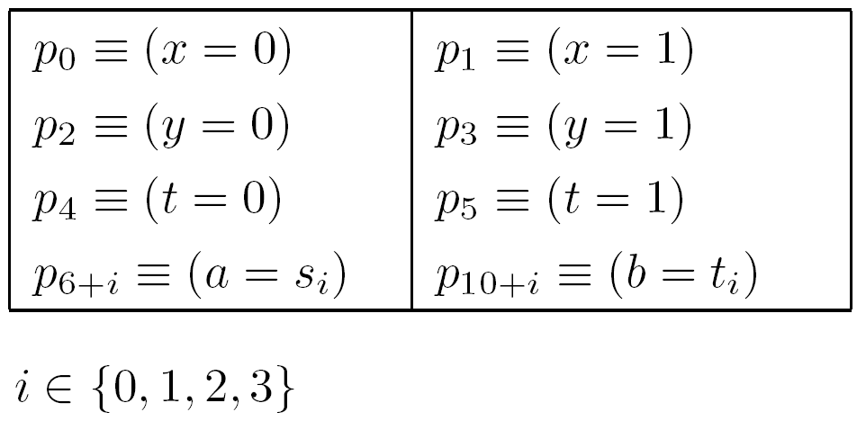
Proposition Symbols
Let AP be the set of proposition symbols
{p0,p1,…,p13} with the following meaning:

Slide 15
Examples of Properties
Safety:
Expectancy
Response
Imm. Response
Priority
FCFS
GE…
AG (¬(p8∧p12))
AF (p8 ∨ p12)
AG (p7 → AF p8)
AG (p7 → AX p8)
AG (p7∧¬p11∧¬p12 → A(p8 R ¬p12))
AG (p7∧¬p11∧¬p12 → A(¬p12 U p8))
AG (EF (p8))

Slide 16
Semantics

Slide 17
Kripke Structures
Let K=<S,R,I,L> be a Kripke structure.
  S : A finite set of states
  R ⊆ S x S : A total transition relation
  I ⊆ S : A set of initial states
  L: S → 2^{AP} is a labeling function

Slide 18
Semantics: M|= φ
A CTL formula may be interpreted on
a Kripke structure.
(1) Define M,s |= φ for a state s
(2) Define M |= φ as follows:
M |= φ if M,s |= φ for every initial state s.

Slide 19
Semantics: M,u|= φ
Definition
M,u |= p, if p ∈ AP and p ∈ L(u)
M,u |= ¬φ, if M,u |= φ
M,u |= φ∨ψ, if M,u |= φ or M,u |= ψ
M,u |= φ∧ψ, if M,u |= φ and M,u |= ψ
M,u |= A ψ, if for every path π of u, (M,π |= ψ)
M,u |= E ψ, if there is a path π of u, (M,π |= ψ)

Slide 20
Semantics: M,π |= ψ
Definition
M,π |= X φ, if M,π₁ |= φ
M,π |= F φ, if ∃i≥0, (M,π_{i} |= φ)
M,π |= G φ, if ∀i≥0, (M,π_{i} |= φ)
M,π |= φUψ, if ∃i≥0, M,π_{i} |= ψ and ∀0≤j<i, M,π_{j}|=φ
M,π |= φRψ, if ∀i≥0, (∀0≤j<i, M,π_{j}|= φ)→M,π_{i}|=ψ

Slide 21
Satisfiability and Validity

Slide 22
Satisfiability and Validity
Definition
A formula φ is satisfiable, if there is a model
M such that M |= φ.
Definition
A formula φ is valid, if for every model M,
M|= φ holds.

Slide 23
Satisfiability and Validity Checking
The complexities of CTL satisfiability and
validity checking are EXPTIME-complete.

Slide 24
Equivalences

Slide 25
Equivalences
Definition
A formula φ is equivalent to a formula ψ, if
for all models M, M |= φ iff M |= ψ.

Slide 26
Examples of Equivalences
EX φ ≡ ¬AX¬ φ
E(φ R ψ) ≡ E(ψ U (φ∧ψ)) ∨ EG ψ
These equivalences can be proved by applying
the semantics.

Slide 27
Dual Operators and the Negation Normal Form (NNF)

Slide 28
Dual Operators
EX φ ≡ ¬AX¬ φ
EG φ ≡ ¬AF¬ φ
E(φ R ψ) ≡ ¬A(¬φ U ¬ψ)
EF φ ≡ ¬AG¬ φ
E(φ U ψ) ≡ ¬A(¬φ R ¬ψ)

Slide 29
NNF
Definition
A formula is in NNF, if the negation symbol is
only applied to atomic formulas.
Every formula is equivalent to a formula in NNF.

Slide 30
Recursive Equations

Slide 31
Operators R and U
E(φ R ψ) ≡ ψ ∧ (φ ∨ EX E(φ R ψ))
E(φ U ψ) ≡ ψ ∨ (φ ∧ EX E(φ U ψ))
A(φ R ψ) ≡ ψ ∧ (φ ∨ AX A(φ R ψ))
A(φ U ψ) ≡ ψ ∨ (φ ∧ AX A(φ U ψ))

Slide 32
Operators G and F
Let p₀∈ AP be given.
Let ⊥ denote (p₀ ∧ ¬p₀)
Then
EG ψ ≡ E(⊥ R ψ)
EF ψ ≡ E(¬⊥ U ψ)

Slide 33
Minimal Complete Set of Temporal Operators

Slide 34
Minimal Complete Set
EX,EF,EG,ER,EU
ER is expressible by EU and EG
EF is expressible by EU
Then {EX,EU,EG} is a complete set.
{EX,EU,EG} is also a minimal complete set.

Slide 35
Expressivity

Slide 36
Expressivity of Subsets of CTL
EU,EG,EX
EU
EG
EX

Slide 37
Expressivity of Subsets of CTL
EU,EG,EX
EU
EG
EF
EX

Slide 38
CTL Proof System

Slide 39
Proof System for {EX,EU,EG,EF,AX,AU,AG,AF}
Axioms for temporal logics formulas
Proof rules for temporal formulas
Propositional proof system

Slide 40
Axioms for Temporal Logics Formulas
EFp ↔ E(¬⊥ U p)
AGp ↔ ¬EF¬p
AFp ↔ A(¬⊥ U p)
EGp ↔ ¬AF ¬p
EX(p ∨ q) ↔ EXp ∨ EXq
AXp ↔ ¬EX ¬p
E(p U q) ↔ (q ∨(p ∧ EXE(p U q))
A(p U q) ↔ (q ∨ (p ∧AXA(p U q))
EX¬⊥ ∧ AX¬⊥

Slide 41
Axioms for Temporal Logics Formulas
AG(r →(¬q ∧EXr)) →(r → ¬A(p U q))
AG(r →(¬q ∧ EXr)) →(r → ¬AFq)
AG(r →(¬q ∧(p → AXr))) →(r → ¬E(p U q))
AG(r →(¬q ∧ AXr)) →(r → ¬EFq)
AG(p → q) →(EXp → EXq)

Slide 42
Proof Rule (Generalization)
|- p
---------
|- AGp

Slide 43
Propositional proof system
Axioms: all tautologies are axioms
Proof Rule (MP):
|- p → q |- p
------------------------
|- q

Slide 44
Proof System
The proof system is sound and complete.

Slide 45
Applications of CTL

Slide 46
CTL as a Specification Language
System Models: Kripke Structures (K)
System Specifications: Formulas of CTL (ϕ)
Verification of correctnes
Solving the model checking problem: K |= ϕ

Slide 47
Model Checking

Slide 48
Model Checking
Definition
Given a model K and a formula φ.
The model checking problem is the problem of
checking whether K |= φ holds.

Slide 49
Model Checking
The complexity of model checking is
P-complete.

Slide 50
Questions?

