Slide 1
CTL and μ-Calculus
中国科学院软件研究所
计算机科学国家重点实验室
张文辉
http://lcs.ios.ac.cn/~zwh/
Notes:
Note: 50m

Slide 2
Computation Tree Logic

Slide 3
Computation Tree Logic

Slide 4
Syntax of CTL
Let AP be a set of proposition symbols.
Definition
Let p range over AP.
The set Φ of CTL formulas is defined as follows.
Φ == p | Φ∧Φ | Φ∨Φ | ¬Φ |
AX Φ | AG Φ |AF Φ | A(Φ R Φ) | A(Φ U Φ) |
EX Φ | EG Φ |EF Φ | E(Φ R Φ) | E(Φ U Φ)

Slide 5
Specification
M |= ϕ
I ⊆ [[ϕ]]

Slide 6
Formulas
[[ϕ ∧ ψ]] = [[ϕ]] ∩ [[ψ]]
[[ϕ ∨ ψ]] = [[ϕ]] ∪ [[ψ]]
[[¬ϕ ]] = S \ [[ϕ]]

Slide 7
Minimal Complete Set
EX,EF,EG,ER,EU,
AX,AF,AG,AR,AU
EF is expressible by EU
ER is expressible by EU and EG
Then {EX,EG,EU} is a complete set.

Slide 8
Formulas
[[p]] = { s | p∈L(s) }
[[EX ϕ]] = { s | s→s’, s’ ∈ [[ϕ]] }
[[E(ϕ U ψ)]] = ?
[[EG(ψ)]] = ?

Slide 9
Recursive Equations
E(φ U ψ) ≡ ψ ∨ (φ ∧ EX(E(φ U ψ)))
E(φ R ψ) ≡ ψ ∧ (φ ∨ EX(E(φ R ψ)))
[[E(φ U ψ)]] ≡ [[ψ]] ∪ ([[φ ]]∩ EX([[E(φ U ψ)]])
[[EG(ψ)]] ≡ [[ψ]] ∩ EX([[EG(ψ)]])

Slide 10
Recursive Equations
E(φ U ψ) ≡ ψ ∨ (φ ∧ EX(φ U ψ))
f(Z)=ψ ∨ (φ ∧ EX(Z))
Then E(φ U ψ) is a fixpoint of f.
f: pow(S)→ pow(S)

Slide 11
Fixpoint
f(Z)=ψ ∨ (φ ∧ EX(Z))
f is monotonic; f is continuous
pow(S) is a complete lattice.
f has a least and a greatest fixpoint
μZ.f(Z), μf
νZ.f(Z), νf

Slide 12
Fixpoint
μf = ∪ { f^{k}(⊥) | k∈N }
We prove: [[E(φ U ψ)]] = μf
Then we have:
E(φUψ) = μZ.f(Z) = μZ.(ψ ∨ (φ ∧ EX(Z))
证明

Slide 13
Recursive Equations
EG(ψ) ≡ ψ ∧ EX(EG(ψ))
f(Z)=ψ ∧ EX(Z)
Then EG(ψ) is a fixpoint of f.
f: pow(S)→ pow(S)

Slide 14
Fixpoint
f(Z)=ψ ∧ EX(Z)
f is monotonic; f is continuous
pow(S) is a complete lattice.
f has a least and a greatest fixpoint
μZ.f(Z), μf
νZ.f(Z), νf

Slide 15
Fixpoint
νf = ∩ { f^{k}(S) | k∈N }
We prove: [[EG(ψ)]] = νf
Then we have:
EG(ψ) = νZ.f(Z) = νZ.(ψ ∧ EX(Z))
证明

Slide 16
Fixpoint Formulation of CTL
[[p]] = { s | p∈L(s) }
[[EX ϕ]] = { s | s→s’, s’ ∈ [[ϕ]] }
E(φUψ) = μZ.(ψ ∨ (φ ∧ EX(Z)))
E(φRψ) = νZ.(ψ ∧ (φ ∨ EX(Z)))
EFψ = μZ.(ψ ∨ EX(Z))
EGψ = ν Z.(ψ ∧ EX(Z))

Slide 17
Fixpoint Formulation of CTL
[[AX ϕ]] = { s | (s→s’)➔s’∈[[ϕ]] }
A(φUψ) = μZ.(ψ ∨ (φ ∧ AX(Z)))
A(φRψ) = νZ.(ψ ∧ (φ ∨ AX(Z)))
AFψ = μZ.(ψ ∨ AX(Z))
AGψ = ν Z.(ψ ∧ AX(Z))

Slide 18
Model Checking
M |= φ
I ⊆ [[φ]
例子

Slide 19
μ-Calculus

Slide 20
Syntax of μ-Calculus
Let AP be a set of proposition symbols.
Definition
Let p range over AP.
The set Φ of μ-calculus formulas is as follows.
Φ == p | Z | Φ∧Φ | Φ∨Φ | ¬Φ |
<.> Φ | [.] Φ | μZ.Φ | νZ.Φ
Variables are in the scope of even number of neg.

Slide 21
Semantics

Slide 22
Semantics
e: VAR → pow(S )
[[p]]e = { s | p∈L(s) }
[[Z]]e = e(Z)
[[<.>ϕ]] = { s | s→s’, s’ ∈ [[ϕ]]e }
[[ [.]ϕ]] = { s | (s→s’) ⇒ (s’∈[[ϕ]]e) }
[[ϕ ∧ ψ]]e = [[ϕ]]e ∩ [[ψ]] e
[[ϕ ∨ ψ]]e = [[ϕ]]e ∪ [[ψ]]e
[[¬ϕ ]]e = S \ [[ϕ]]e

Slide 23
Semantics
[[μZ.φ]]e = ∩{ Y⊆S | [[φ]]e(Z/Y) ⊆ Y }
[[νZ.φ]]e = ∪{ Y⊆S | Y ⊆ [[φ]]e(Z/Y) }

Slide 24
Closed Formulas
Formulas without free variables.
The semantics of such a formula does not depend
on the initial assignment e.
[[ϕ]] = [[ϕ]]e for any e

Slide 25
Example
νZ.(p∧[.][.]Z)
p is true at all even places along all paths

Slide 26
Satisfiability
The complexity is EXPTIME-complete.

Slide 27
Applications of μ-Calculus

Slide 28
μ-Calculus as a Specification Language
System Models: Kripke Structures (K)
System Specifications: Closed Formulas (ϕ)
K |= ϕ
I ⊆ [[ϕ]]

Slide 29
Model Checking
Definition
Given a model K and a formula φ.
The model checking problem is the problem of
checking whether K |= φ holds.

Slide 30
Model Checking
The complexity of model checking is
in NP ∩ coNP.

Slide 31
μ-Calculus with Actions

Slide 32
Syntax of μ-Calculus
Let AP be a set of proposition symbols.
Definition
Let p range over AP.
The set Φ of μ-calculus formulas is as follows.
Φ == p | Z | Φ∧Φ | Φ∨Φ | ¬Φ |
<a>Φ | [a]Φ | μZ.Φ | νZ.Φ
Variables are in the scope of even number of neg.

Slide 33
Semantics
Interpreted on
Doubly Labeled Transition Systems

Slide 34
ω-Automaton
Definition
A Buchi automaton (BA) is a quintuple <Σ,S,Δ,I,F>
  Σ : A finite set of symbols
  S : A finite set of states
  Δ ⊆ S x Σ x S : A transition relation
  I ⊆ S : A set of initial states
  F ⊆ S : A set of acceptance states

Slide 35
Labeled Transition Systems
Definition
A LTS is a quadruple <Σ,S,Δ,I>
  Σ : A finite set of symbols
  S : A finite set of states
  Δ ⊆ S x Σ x S : A transition relation
  I ⊆ S : A set of initial states

Slide 36
Doubly Labeled Transition Systems
AP: A set of propositions.
Definition
A DLTS is a quintuple M=<Σ,S,Δ,I,L>
  Σ : A set of action symbols
  S : A finite set of states
  Δ ⊆ S x Σ x S : A total transition relation
  I ⊆ S : A set of initial states
  L: S → 2^{AP} is a labeling function

Slide 37
例子：自动售茶机/标号迁移系统
s0
取钱
1
2
s1
s2
取茶
1
2
1
2
2
s3
s6
s7
s4
1
找钱/取钱
退钱
出茶
s5

Slide 38
例子：简化自动售茶机模型
s0
取钱
1
2
s1
s2
1
2
1
2
出茶/取茶
2
s3
s4
1
找钱/取钱
s5

Slide 39
例子：双标号自动售茶机模型
p: 存钱数目
q: 可行动作
{p0,q0}
s0
1
2
{p1,q0}
{p2,q0}
s1
s2
1
2
1
2
出茶/取茶
2
s3
{p4,q1}
s4
{p2,q0}
1
找钱/取钱
s5
{p3,q2}

Slide 40
Semantics
Let e: VAR → pow(S )
[[p]]e = { s | p∈L(s) }
[[Z]]e = e(Z)
[[<a>ϕ]] = { s | s→ª s’, s’ ∈ [[ϕ]]e }
[[ [a]ϕ]] = { s | (s→ª s’) ⇒ (s’∈[[ϕ]]e) }
[[ϕ ∧ ψ]]e = [[ϕ]]e ∩ [[ψ]] e
[[ϕ ∨ ψ]]e = [[ϕ]]e ∪ [[ψ]]e
[[¬ϕ ]]e = S \ [[ϕ]]e

Slide 41
Semantics
[[μZ.φ]]e = ∩{ Y⊆S | [[φ]]e(Z/Y) ⊆ Y }
[[νZ.φ]]e = ∪{ Y⊆S | Y ⊆ [[φ]]e(Z/Y) }

Slide 42
Applications of μ-Calculus

Slide 43
μ-Calculus as a Specification Language
System Models: DLTS (M)
System Specifications: Closed Formulas (ϕ)
M |= ϕ
I ⊆ [[ϕ]]
例子

Slide 45
练习：自动售茶机模型(标号Kripke结构)
{p0,q0}
s0
{p1,q0}
{p2,q0}
s1
s2
s3
{p4,q1}
s4
{p2,q0}
s5
{p3,q2}

Slide 46
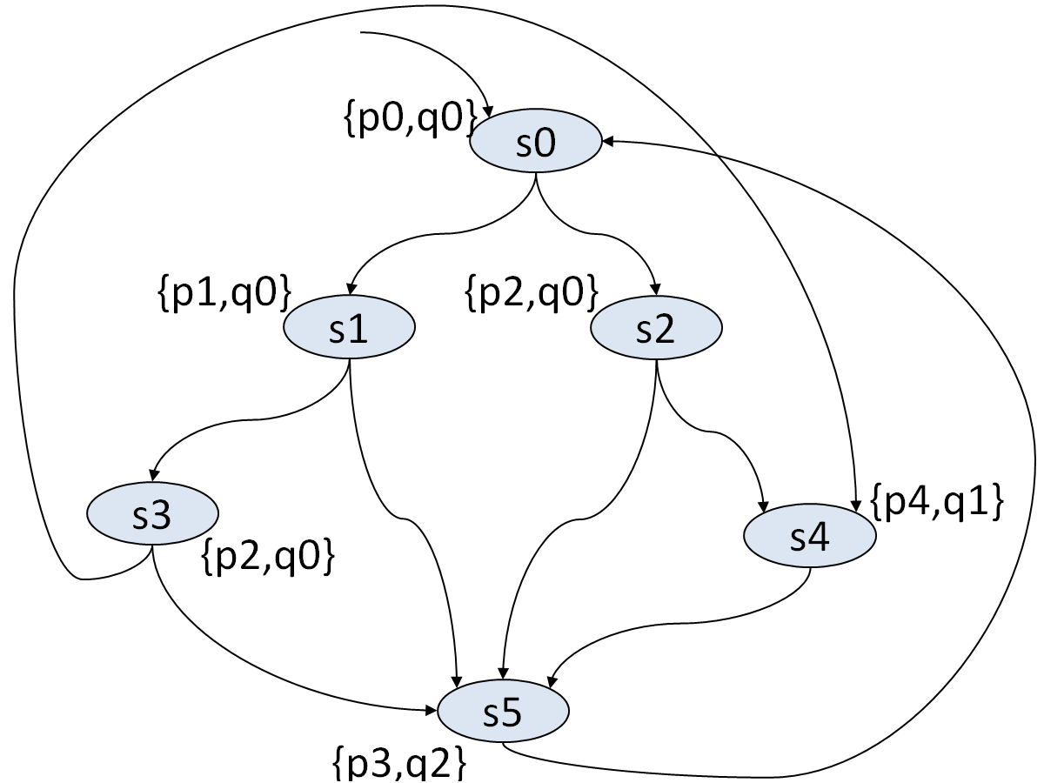
练习题1：
设M为简化自动售茶机模型。
用限界语义验证M是否满足
A(q0 U q2 )和
EG(q0 ∨ q2)，
分别给出最小的
可以确定以上公式
是否满足的界。

Slide 47
练习题2：
设M为简化自动售茶机模型。
用简化自动机模型M计算
[[A(q0 U q2)]]和
[[EG(q0∨q2)]]，
并讨论该模型
是否满足这些公式。

