Slide 1

PAPER NO. 1571326725
AN AREA-OPTIMIZED 8-BIT
DEEP LEARNING ACCELERATOR
FOR GAN IMAGE GENERATION
ON GF180MCU
William Anthony, I Made Medika Surya W.M., John Ruben Saragi,
Mahardhika Putra Adipratama, Fairuz Aquilla Rahagi,
Trio Adiono, and Infall Syafalni
Bandung Institute of Technology, Bandung, Indonesia
APSIPA ASC 2026
01
Notes:
PRACTICE PACING: 0.41 minutes. Main talk totals 20 minutes. Timing appears only in speaker notes.
TOPIC: Title
Good morning. I am William Anthony from Bandung Institute of Technology. This work investigates how to make a small GAN image-generation accelerator use chip area more efficiently. Our main idea is to examine how the accelerator stores its results. By reorganizing one underused buffer, we reduce die area by 24 percent while maintaining correct operation through the routed hardware design. I will explain why that buffer matters, how we changed it, and what the improvement costs.
SOURCE: Supplied paper, An Area-Optimized 8-bit Deep Learning Accelerator for GAN Image Generation on GF180MCU. Title and abstract.

Slide 2

I. CONTEXT
PAPER NO. 1571326725 GAN ACCELERATOR ON GF180MCU
What does a GAN do?
GAN = Generative Adversarial Network
Latent input
A set of numbers
Trained generator
Learned visual patterns
→
→
Synthetic image
A classifier predicts a label. A generator creates an image.
Here: handwritten-digit images, generated from a 64-value latent vector
02
Notes:
PRACTICE PACING: 0.73 minutes. Main talk totals 20 minutes. Timing appears only in speaker notes.
Before discussing the chip, let us make the task clear. GAN stands for generative adversarial network. A classifier might look at a handwritten digit and predict its label. A generator creates a new image from numbers. In this work, a vector with 64 values enters a trained generator, which produces 784 pixel values. Those pixels form a small handwritten-digit image. The example on the right is output from the hardware path. We use the term synthetic because the image comes from the model. The latent input is the numerical starting point for generation. The useful hardware question is how to execute this learned computation with limited resources. Keep this distinction in mind: the generator creates pixel values, and our accelerator performs the dense arithmetic needed to calculate them. Pause on the input-to-image flow before moving on.
SOURCE: Goodfellow et al., Generative Adversarial Nets, https://arxiv.org/abs/1406.2661. Supplied paper, Sections III and VI, Figure 6.

Slide 3
I. CONTEXT
PAPER NO. 1571326725 GAN ACCELERATOR ON GF180MCU
Why do people use GANs?
Use | Purpose | Representative research
Synthetic training images | Expand scarce training data | GAN Augmentation, 2018
Image-to-image translation | Learn a mapping between image types | pix2pix, CVPR 2017
Image super-resolution | Generate plausible finer detail | SRGAN, CVPR 2017
Common goal: learn useful image structure from examples
This paper studies a small digit generator as a hardware test case.
These applications provide context. They are not evaluated on this accelerator.
03
Notes:
PRACTICE PACING: 0.62 minutes. Main talk totals 20 minutes. Timing appears only in speaker notes.
Why use a generator at all? One reason is to create additional training examples when real data are scarce. GAN augmentation research has explored this in image segmentation. Another use is image-to-image translation. The pix2pix work learns mappings such as an edge representation to an image. A third use is super-resolution. SRGAN uses an adversarial objective to produce visually plausible finer detail. These examples explain why generative image computation matters to signal and image processing. They also have limits. A visually plausible result is not a guarantee of factual detail, and synthetic training data require task-specific evaluation. Our paper does not implement those larger applications. It uses a compact handwritten-digit generator to study how generative inference maps onto a small physical accelerator. The connection is that useful image generation requires computation, and the cost of storing and moving its intermediate data matters.
SOURCE: GAN Augmentation: https://arxiv.org/abs/1810.10863; pix2pix: https://arxiv.org/abs/1611.07004; SRGAN: https://arxiv.org/abs/1609.04802. Applications are background context only.

Slide 4
I. CONTEXT
PAPER NO. 1571326725 GAN ACCELERATOR ON GF180MCU
GAN training and generator inference
Real training images
TRAINING, BEFORE DEPLOYMENT
Latent input
→
Generator
→
Discriminator
Real or generated?
Training feedback updates both networks
THIS HARDWARE STUDY
Pretrained generator inference
No on-chip training or discriminator
04
Notes:
PRACTICE PACING: 0.73 minutes. Main talk totals 20 minutes. Timing appears only in speaker notes.
The word adversarial describes the training process. A generator produces samples and a discriminator learns to distinguish generated samples from real training data. Their competing objectives provide the learning signal. After training, the generator can produce samples without running the discriminator. That distinction is essential for understanding the hardware scope. This paper starts from a pretrained generator. The accelerator executes its dense-layer integer dot products. It does not train either network and does not include a discriminator. Host software supplies weights and inputs, then performs the remaining bias and activation operations. So when we say GAN accelerator, the specific supported workload is the arithmetic of this small GAN generator during inference. This narrower scope lets us examine the memory organization, verify each numerical step, and complete physical implementation in an open-source flow.
SOURCE: Goodfellow et al., https://arxiv.org/abs/1406.2661; supplied paper, Sections III, VI and VII.

Slide 5
I. CONTEXT
PAPER NO. 1571326725 GAN ACCELERATOR ON GF180MCU
Research goal: use less chip area for image generation
The earlier chip reserved too much memory for its results.
Same trained
image generator
Smaller result
memory
Smaller physical
accelerator
→
→
We test the area benefit, the time penalty and numerical correctness.
Why it matters: unused memory still occupies chip area.
05
Notes:
PRACTICE PACING: 0.73 minutes. Main talk totals 20 minutes. Timing appears only in speaker notes.
TOPIC: Research purpose and motivation
Why is this research important? An accelerator must do more than produce the right numerical result. Its hardware must also fit within a practical physical design. Memory organization matters because a memory macro occupies its full area even when the application uses only a small part of its capacity. In our earlier accelerator, the result buffer stored very little data but required three SRAM macros. That made it a clear opportunity for improvement. Our purpose is to reduce that physical cost while preserving the generator workload and numerical correctness. For signal-processing researchers, the broader lesson is that how we store intermediate results can strongly affect the hardware required to execute an algorithm.
SOURCE: Supplied paper, An Area-Optimized 8-bit Deep Learning Accelerator for GAN Image Generation on GF180MCU. Section I.
Expanded motivation: Generative image applications motivate efficient inference hardware. The practical contribution here is a reproducible physical design for a small test workload. A fixed memory macro consumes its full footprint even when most locations are unused. Our experiment tests whether matching the buffer to the array geometry reduces area without introducing an unacceptable system-level delay. The purpose is to make this hardware implementation more resource-efficient, with a measured trade-off. The paper does not demonstrate a deployed medical, super-resolution or image-translation system. Give the audience time to connect the preceding GAN examples to this concrete hardware question.
PLAIN-ENGLISH EXPLANATION: The research question is whether we can preserve the same quantized computation while storing its results more efficiently. SRAM means static random-access memory. A macro is a predesigned physical block with a fixed size. An almost-empty macro still consumes its entire footprint.

Slide 6
I. CONTEXT
PAPER NO. 1571326725 GAN ACCELERATOR ON GF180MCU
The generator turns 64 numbers into 784 pixels
64 input
values
256 neurons
ReLU
256 neurons
ReLU
784 pixels
tanh
→
→
→
ReLU keeps positive values. tanh limits the output range.
28 × 28 grayscale image
282,624 multiply–accumulate operations per image
A multiply–accumulate (MAC) multiplies two numbers and adds the product to a running sum.
06
Notes:
PRACTICE PACING: 0.73 minutes. Main talk totals 20 minutes. Timing appears only in speaker notes.
TOPIC: GAN generator and workload
The workload is a small multilayer-perceptron GAN generator. It starts with a latent vector containing 64 values. Two hidden layers, each with 256 neurons, expand that input. The final layer produces 784 values, which form a 28-by-28 grayscale image. The hidden layers use ReLU and the output layer uses tanh. Generating one image requires 282,624 multiply-accumulate operations. This workload provides a compact way to test dense neural computation on custom hardware. The accelerator supports generator inference. Training and the discriminator are outside the hardware scope. Point to each layer in sequence, then pause on the output image.
SOURCE: Supplied paper, An Area-Optimized 8-bit Deep Learning Accelerator for GAN Image Generation on GF180MCU. Section III and Figure 1.

Slide 7
III. METHODOLOGY
PAPER NO. 1571326725 GAN ACCELERATOR ON GF180MCU
Dense layers map to 324 hardware tiles
Layer | Dense operation | Useful outputs/tile | Tiles/image
L0 + ReLU | 256 × 64 | 4 | 64
L2 + ReLU | 256 × 256 | 4 | 64
L4 + tanh | 784 × 256 | 4 | 196
Total | 282,624 useful MACs | 4 | 324
For each tile: four weight rows enter A; the input vector enters B.
K = 256 is accumulation time. L0 pads its 64 inputs to that depth.
A single latent input uses one PE column for useful neurons. Batching can use the other columns.
07
Notes:
PRACTICE PACING: 0.83 minutes. Main talk totals 20 minutes. Timing appears only in speaker notes.
Each layer is evaluated four output neurons at a time. L0 and L2 each have 256 outputs, so each requires 64 tiles. L4 has 784 outputs, so it requires 196 tiles. The total is 324. In the generator schedule, four weight rows load A and the shared input vector loads B. Although the hardware array contains sixteen PEs, one column produces the four useful outputs for a single latent input. The remaining columns produce unused results. K is the number of accumulation steps, not the array width. The hardened default is 256; L0 has only 64 genuine input terms and uses a padded tail. This distinction explains both the workload mapping and the later utilization result.
SOURCE: Supplied paper, Sections III, IV and VII, IX-A.

Slide 8
II. PROBLEM
PAPER NO. 1571326725 GAN ACCELERATOR ON GF180MCU
The earlier result memory was 93.75% unused
What must be stored? | How much memory was reserved?
16 results × 3 bytes each | 3 memory blocks × 256 bytes
48 bytes needed | 768 bytes reserved
6.25% used
93.75% unused
Each tile is one small block of computation with 16 results.
A larger neural layer needs more tiles, not a larger result buffer.
08
Notes:
PRACTICE PACING: 0.83 minutes. Main talk totals 20 minutes. Timing appears only in speaker notes.
TOPIC: Only 6.25% of result memory was used
The main problem appears in the result buffer. Our four-by-four processing-element array produces sixteen accumulated results. Each contains 24 bits, so the buffer needs only 48 bytes. However, the predecessor stores these results across three 256-by-8 SRAM macros. Each macro holds one byte plane. Together they provide 768 bytes, giving an occupancy of only 6.25 percent. A larger neural layer does not change this tile-level requirement. The array still produces sixteen results per tile. The operand buffers face a different constraint: they must supply eight bytes every compute cycle. Their macro count supports bandwidth. That distinction directs our optimization toward the result buffer.
SOURCE: Supplied paper, An Area-Optimized 8-bit Deep Learning Accelerator for GAN Image Generation on GF180MCU. Section IV-B.
PLAIN-ENGLISH EXPLANATION: One byte contains eight bits. Each accumulated result uses 24 bits, or three bytes. The fixed four-by-four array produces sixteen results for a tile, so result storage remains 48 bytes even when an entire neural layer is larger.

Slide 9
III. METHODOLOGY
PAPER NO. 1571326725 GAN ACCELERATOR ON GF180MCU
Sixteen arithmetic units share input data
A: 4 row lanes
B: 4 column lanes
8 bytes each cycle
PE
PE
PE
PE
→
PE
PE
PE
PE
C result memory
Holds 16 results
→
PE
PE
PE
PE
PE = processing element
One multiply-and-add unit
PE
PE
PE
PE
SRAM = static random-access memory
Each PE keeps a 24-bit running sum.
A tile accumulates over 256 cycles.
The arithmetic stays the same. Only result storage changes.
09
Notes:
PRACTICE PACING: 0.83 minutes. Main talk totals 20 minutes. Timing appears only in speaker notes.
TOPIC: Accelerator architecture and tile execution
The accelerator uses sixteen processing elements arranged in a four-by-four array. Each PE multiplies two signed eight-bit operands and adds the product to a local 24-bit accumulator. Keeping the running sum inside each PE gives an output-stationary dataflow. The native accumulation depth is 256. The same sixteen PEs accumulate over 256 cycles. The controller clears the accumulators, runs the computation, and signals completion. A writeback sequencer then transfers the results into the result buffer. This separation between computation and result storage lets us change the buffer organization while preserving the arithmetic datapath. Point to the local accumulator and then trace its writeback path.
SOURCE: Supplied paper, An Area-Optimized 8-bit Deep Learning Accelerator for GAN Image Generation on GF180MCU. Section IV-A and Figures 2-4.
PLAIN-ENGLISH EXPLANATION: This simplified diagram replaces the detailed circuit drawing for the main talk. A and B supply input values and weights. Sixteen processing elements operate in parallel and keep their own running sums. The C memory receives the results after computation. The native accumulation depth of 256 is a time dimension, not an array of 256 units.
PLAIN-ENGLISH EXPLANATION: Each A lane is broadcast along a row and each B lane down a column. A and B are generic operand roles. For the generator mapping in Section VII, A holds weight rows and B holds the input vector. Every PE retains its local sum, which is output-stationary dataflow. The operand SRAM requirement is four bytes from each bank per cycle.

Slide 10
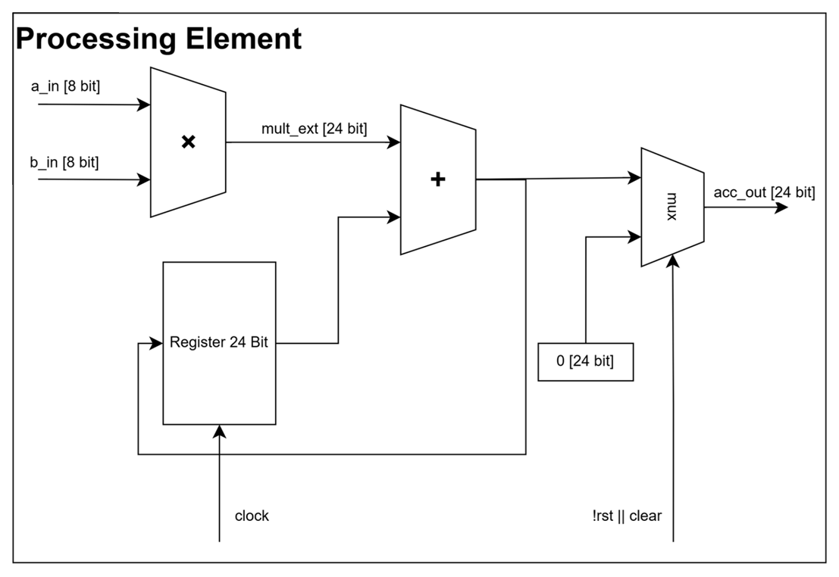
III. METHODOLOGY
PAPER NO. 1571326725 GAN ACCELERATOR ON GF180MCU
PE datapath: multiply, extend, add and store
1 Multiply signed 8-bit a and b
The product is 16 bits
2 Sign-extend to 24 bits
Preserve the signed value
3 Add to the 24-bit register
Feedback keeps the running sum
acc[n] = acc[n−1] + a[n] × b[n]
10
Notes:
PRACTICE PACING: 1.24 minutes. Main talk totals 20 minutes. Timing appears only in speaker notes.
This is the processing-element datapath from Figure 3. The multiplier takes two signed eight-bit operands and produces a sixteen-bit product. Sign extension copies the sign into the upper bits so that the product can be added correctly in a twenty-four-bit datapath. The adder combines the new product with the previous accumulator value. The register stores that sum for the next enabled cycle, forming the feedback path. CLEAR resets the running sum, and enable controls accumulation. After 256 valid products, the register contains one dot-product result. All sixteen PEs have this same local datapath. The memory optimization changes where these completed results are stored, while preserving these arithmetic operations.
SOURCE: Supplied paper, Section IV-A, Equation 1 and Figure 3 left.

Slide 11
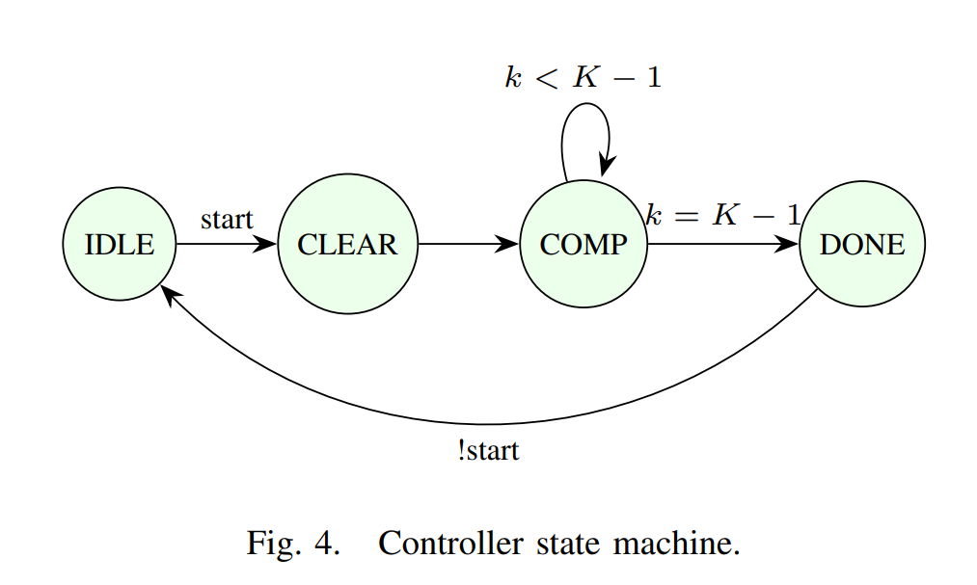
III. METHODOLOGY
PAPER NO. 1571326725 GAN ACCELERATOR ON GF180MCU
Controller FSM: IDLE, CLEAR, COMPUTE and DONE
State | Action
IDLE | Wait for START
CLEAR | Reset accumulators
COMPUTE | Accumulate and step address
DONE | Hold done until START = 0
K = 256 terms
Loop while k < 255
Exit when k = 255
Result writeback has its own sequencer and writeback-done flag.
11
Notes:
PRACTICE PACING: 1.14 minutes. Main talk totals 20 minutes. Timing appears only in speaker notes.
The finite-state machine has four states. IDLE waits for START. CLEAR zeroes every PE accumulator. COMPUTE enables the array and steps through the operand addresses. The k counter repeats while k is below K minus one, and reaches the last term at 255 when K is 256. DONE holds the completion flag until START falls, after which the controller returns to IDLE. The result buffer has a separate writeback sequencer; it is not a fifth state of this FSM. That sequencer serializes the sixteen accumulators and raises writeback-done. Operand SRAM reads have a one-cycle latency, so the top level delays PE enable and completion flags by a cycle to align computation with valid data. Distinguish compute done from writeback done.
SOURCE: Supplied paper, Section IV-A and Figure 4; SRAM alignment in Section IV-B.

Slide 12
III. METHODOLOGY
PAPER NO. 1571326725 GAN ACCELERATOR ON GF180MCU
One smaller memory stores the same 16 results
BEFORE: 3 memories in parallel
AFTER: 1 memory, 3 byte accesses
256 bytes
Result byte 1
256 bytes
Result byte 2
256 bytes
Result byte 3
64-byte memory
48 bytes used
One result: 3 bytes at the same address
One result: bytes at addresses 0, 1 and 2
77% less result-memory area
Trade-off: saving all 16 results takes 48 cycles instead of 16.
12
Notes:
PRACTICE PACING: 1.14 minutes. Main talk totals 20 minutes. Timing appears only in speaker notes.
TOPIC: Memory folding cuts buffer area by 77%
Our main transformation moves the byte planes into the address space. Previously, three macros supplied the three bytes of a result in parallel. In the new design, one macro stores those bytes sequentially. For each result, the address equals three times the result index plus the byte-plane index. Sixteen results therefore occupy 48 locations in a 64-byte memory. This reduces result-buffer area by 77 percent and removes two SRAM macros. The trade-off is access time. Writing sixteen 24-bit results now takes 48 cycles instead of sixteen. Reads also require several accesses to assemble one result, so the controller and its callers must follow a new timing contract. The design principle is that storage width can be exchanged for access time when the workload can tolerate the delay.
SOURCE: Supplied paper, An Area-Optimized 8-bit Deep Learning Accelerator for GAN Image Generation on GF180MCU. Section IV-B and Equation 2.
PLAIN-ENGLISH EXPLANATION: The address example shows result zero. Result one occupies addresses three, four and five, and so on. The memory contains the same 48 bytes as before, but bytes move sequentially rather than three at once. The 77-percent figure is physical buffer area reduction, not total chip area reduction.

Slide 13
III. METHODOLOGY
PAPER NO. 1571326725 GAN ACCELERATOR ON GF180MCU
Memory folding changes both write and read timing
Operation | Earlier C memory | Folded C memory
Write one 24-bit result | 3 bytes in parallel | 3 byte-plane accesses
Write the full 16-result tile | 16 cycles | 48 cycles
Read one 24-bit result | Wide access | Assemble 3 bytes; valid on the 4th cycle
Address = 3 × word + plane
Word 0 uses addresses 0, 1, 2. Word 1 uses 3, 4, 5.
Writes hold address and data until acknowledgement. A new read address restarts assembly.
13
Notes:
PRACTICE PACING: 1.04 minutes. Main talk totals 20 minutes. Timing appears only in speaker notes.
The result buffer stores sixteen twenty-four-bit values as three byte planes. Its address is three times the word index plus the plane index. The write caller holds address and data steady until the final byte plane is acknowledged. This expands tile writeback from sixteen to forty-eight cycles. For reads, the bank gathers three bytes and also accounts for the SRAM registered output latency, producing valid data on the fourth cycle after read enable rises. A changing word address must restart this assembly, even if enable remains high. Otherwise bytes from different results can interleave. This is why memory folding requires a controller and verification change rather than only substituting a smaller SRAM.
SOURCE: Supplied paper, Section IV-B, Equation 2 and Section VII.

Slide 14
III. METHODOLOGY
PAPER NO. 1571326725 GAN ACCELERATOR ON GF180MCU
8-bit numbers balance image error and hardware size
INT8 means a signed 8-bit integer. Lower pixel error is better.
Number format | Mean pixel error (gray levels) | Area of one PE (µm²) | Weight storage (KiB)
INT4: 4 bits | 22.26 | 6,245 | 138
INT8: 8 bits | 1.22 | 15,963 | 276
INT16: 16 bits | 0.01 | 47,037 | 552
INT8 reduces error greatly versus INT4, with less area than INT16.
Test: 10 inputs and 7,840 pixels against an FP64 reference. This measures pixel error.
14
Notes:
PRACTICE PACING: 0.83 minutes. Main talk totals 20 minutes. Timing appears only in speaker notes.
TOPIC: INT8 balances error and hardware cost
We selected eight-bit arithmetic by comparing numerical error with hardware cost. The evaluation uses ten latent inputs, covering 7,840 output pixels, against an exact FP64 reference. INT4 reduces hardware size, but its mean pixel error reaches 22.26 grayscale levels. INT16 reduces that error to 0.01 but requires almost three times the PE area of INT8 and doubles weight storage and transfer volume. INT8 gives a mean error of 1.22 grayscale levels and matches the eight-bit SRAM interface. For this generator and evaluation sample, it provides a useful balance. These results describe pixel differences from the reference rather than a broad perceptual-quality benchmark.
SOURCE: Supplied paper, An Area-Optimized 8-bit Deep Learning Accelerator for GAN Image Generation on GF180MCU. Section VI-B, Table I.

Slide 15
III. METHODOLOGY
PAPER NO. 1571326725 GAN ACCELERATOR ON GF180MCU
Quantized dot products become pixels through the host
HOST
Quantize weights
and tile inputs
DLA ENGINE
INT8 products
24-bit sums
HOST
Rescale, add bias
and apply activation
→
→
One scale per tensor comes from its maximum absolute value.
Hidden layers: rescale + bias + ReLU, then requantize to INT8.
Output layer: fixed-point conversion + tanh lookup, then grayscale pixels.
Seven testbenches pass, including full-image and serial routed-netlist simulations.
15
Notes:
PRACTICE PACING: 1.04 minutes. Main talk totals 20 minutes. Timing appears only in speaker notes.
TOPIC: Host flow and end-to-end verification
The accelerator performs integer dot products. The host handles the surrounding neural-network operations. It prepares quantized inputs and weights, schedules tiles, and applies bias, rescaling and activation functions. The final tanh uses a lookup table to produce grayscale pixels. Verification covers seven testbenches, including individual computations, a full image and the serial interface. The full-image and serial-interface tests also run against the routed nine-macro netlist and reproduce the Python reference exactly. Bit-exact means agreement with the defined quantized reference. It does not mean identical output to the floating-point model. This matters because folding memory changes access timing and can introduce errors even when the arithmetic remains unchanged.
SOURCE: Supplied paper, An Area-Optimized 8-bit Deep Learning Accelerator for GAN Image Generation on GF180MCU. Sections VI-VII, Figures 5-6.
PLAIN-ENGLISH EXPLANATION: Per-tensor scale factors are recorded in a manifest and reused by the testbench. The host math is integer so that software and hardware follow the same rounding and scaling contract. The output tanh is a lookup table rather than an on-chip nonlinear unit.

Slide 16
III. METHODOLOGY
PAPER NO. 1571326725 GAN ACCELERATOR ON GF180MCU
A four-wire bridge fits the available chip pads
HOST
SCLK, MOSI, CS_N
MISO returns data
SYNCHRONIZED
SERIAL BRIDGE
DLA ENGINE
A, B and C memories
→
→
53 core signal bits, but only 20 general-purpose digital pads are available.
Write frame | Command | Address | Data
20 bits, MSB first | 2 bits | 10 bits | 8 bits
WRITE A/B loads data. START launches a tile. READ C returns a 24-bit result.
16
Notes:
PRACTICE PACING: 0.93 minutes. Main talk totals 20 minutes. Timing appears only in speaker notes.
The core exposes 53 signal bits, while the shuttle slot provides twenty general-purpose digital pads. The wrapper uses a four-wire serial bridge: SCLK, MOSI, chip select and MISO. All three inputs are double-flop synchronized to the core clock, and SCLK is edge-detected as data, avoiding a second clock domain. Write frames send a two-bit command, ten-bit address and eight-bit data word, most significant bit first. Commands load A or B, start a tile or read a twenty-four-bit C result. Rising chip select safely aborts a frame. Three direct status flags expose busy, done and writeback-done. With core clock and reset, nine pads are used. After folding, the host leaves nine core clocks after the final read-address bit, equivalent to an idle serial bit at SCLK no faster than core-clock divided by eight.
SOURCE: Supplied paper, Section V.

Slide 17
III. METHODOLOGY
PAPER NO. 1571326725 GAN ACCELERATOR ON GF180MCU
Open-source hardening uses one 3.3 V supply
STRUCTURAL RTL
Explicit PE array
and hard SRAMs
LIBRELANE
Synthesis, placement
and routing
PHYSICAL MACRO
GDS, LEF
and timing views
→
→
GF180MCU 180 nm process; native 3.3 V logic matches 3.3 V SRAM and I/O.
Nine SRAMs form a 3 × 3 floorplan. Final clock target: 40 ns (25 MHz).
The nine-macro block is signed off. Updated padring integration and silicon testing remain.
17
Notes:
PRACTICE PACING: 0.93 minutes. Main talk totals 20 minutes. Timing appears only in speaker notes.
The accelerator is hardened through LibreLane using the GF180MCU open process design kit. Structural RTL and a synthesis blackbox definition preserve foundry SRAM macros instead of inferring large register banks. An earlier version mixed five-volt logic and 3.3-volt SRAM. Migrating to the native 3.3-volt cell library gives a single-supply design compatible with the SRAM and I/O cells. Three library-flow integration bugs required source fixes. The macros are explicitly placed on a three-by-three grid with routing channels. SRAM power is connected on Metal3, and signal routing extends to Metal5. Physical and timing views feed later padring integration. The nine-macro block meets the forty-nanosecond target, but the predecessor alone completed the earlier chip-level integration. Updated integration and silicon measurements remain future work.
SOURCE: Supplied paper, Sections V and VIII-A/B.

Slide 18
III. METHODOLOGY
PAPER NO. 1571326725 GAN ACCELERATOR ON GF180MCU
Moving one memory block removes antenna violations
Antenna checks flag wires that may collect damaging charge during fabrication.
Placement | Remaining antenna violations
Original grid, density 56 | 1
Original grid, density 54 | 1
B/C memory swap, both densities | 0
Diagnosis: repeated failures pointed to one distant input-memory block.
Move that block closer to the arithmetic array to shorten its wiring.
18
Notes:
PRACTICE PACING: 1.04 minutes. Main talk totals 20 minutes. Timing appears only in speaker notes.
TOPIC: Antenna closure through macro placement
A second contribution concerns physical implementation. Antenna checks identify routing structures that can accumulate damaging charge during fabrication. Five placement-density settings all left at least one violating net. The useful evidence came from the net names. Repeated violations pointed to outputs from one B-buffer macro, located far from the processing array. We moved that macro into the center and placed the small result buffer in the corner. The swap achieved zero antenna violations at two density settings. An independent diode-margin adjustment also achieved closure. The lesson is that a stalled density sweep can provide diagnostic information. Tracking which nets violate can reveal a placement problem that violation counts alone conceal.
SOURCE: Supplied paper, An Area-Optimized 8-bit Deep Learning Accelerator for GAN Image Generation on GF180MCU. Section VIII-B, Table II.

Slide 19
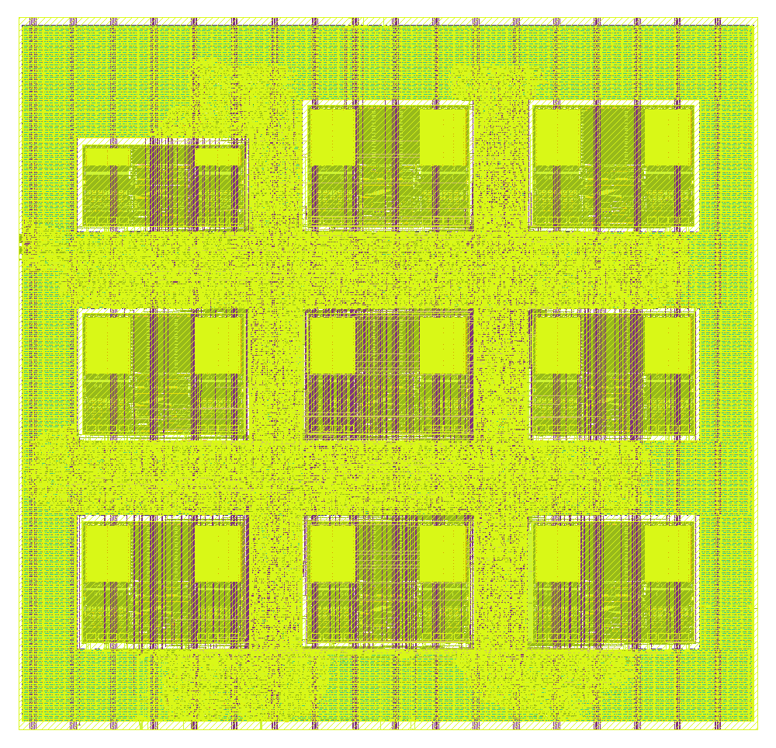
IV. RESULTS
PAPER NO. 1571326725 GAN ACCELERATOR ON GF180MCU
24% smaller chip area for 11.7% more on-chip time
Metric | Earlier design | This work
Memory blocks (SRAM) | 11 | 9
Die area (mm²) | 2.400 | 1.822
Estimated power (mW) | 162 | 133
On-chip time/image (ms) | 3.54 | 3.95
Same process, 3.3 V supply and 25 MHz clock
Physical checks and timing pass.
Power is estimated, not measured on silicon.
SRAM = static random-access memory
19
Notes:
PRACTICE PACING: 1.24 minutes. Main talk totals 20 minutes. Timing appears only in speaker notes.
TOPIC: Smaller design with clean macro sign-off
The final macro uses nine SRAM macros on a die measuring 1,375 by 1,325 micrometers. Die area decreases from 2.400 to 1.822 square millimeters, a reduction of 24 percent. Pause here. Estimated power decreases from 162 to 133 milliwatts, or 18 percent. These are tool estimates using the flow's default switching activity. The design passes DRC, LVS, GDS XOR and antenna checks and meets the 40-nanosecond clock requirement across nine timing corners. Setup margin also improves, although hold margin becomes slightly thinner. On-chip time increases from 3.54 to 3.95 milliseconds per image. These are macro-level implementation results. The updated design still requires chip-level padring integration and silicon validation.
SOURCE: Supplied paper, An Area-Optimized 8-bit Deep Learning Accelerator for GAN Image Generation on GF180MCU. Section VIII, Figure 7 and Table III.
PLAIN-ENGLISH EXPLANATION: The left picture is the final physical layout. Die area is the whole accelerator macro footprint, while core area excludes the surrounding margin. The controlled baseline uses the same process and clock. DRC checks geometric design rules; LVS checks layout connectivity against the circuit; XOR compares layout outputs; antenna checks fabrication-charge limits. Timing passes nine modeled process, voltage and interconnect conditions. The nine-macro design still requires updated padring integration and silicon validation.

Slide 20
IV. RESULTS
PAPER NO. 1571326725 GAN ACCELERATOR ON GF180MCU
Weight transfer sets the image-generation time
Throughput = useful operations per second. Latency = time to finish one image.
What is included? | Operation rate | Time per image
Peak array capacity, ideal use | 0.8 GOPS | Not an image measurement
Useful chip work + result storage | 0.143 GOPS* | 3.95 ms
Full schedule, including serial transfers | 263 kOPS* | 2.149 s
Only 0.47 images/s end to end; weight loading takes 98.85% of the time.
GOPS = billion operations/s. kOPS = thousand operations/s. One MAC counts as two operations.
*Useful rates derived from the paper’s operation count and elapsed times; not silicon measurements.
20
Notes:
PRACTICE PACING: 1.24 minutes. Main talk totals 20 minutes. Timing appears only in speaker notes.
There are three different performance numbers, and their scopes must stay clear. Peak array capacity is sixteen MACs per cycle times 25 megahertz times two operations per MAC, or 0.8 GOPS. That capacity is not the useful throughput of this image schedule. Using 282,624 useful MACs and the measured on-chip simulation interval gives approximately 0.143 GOPS over 3.95 milliseconds, including writeback. The full serial schedule takes 2.149 seconds, corresponding to about 263 thousand useful operations per second and 0.47 images per second. Communication times are calculated from protocol frame lengths. Weight loading accounts for 98.85 percent of total latency. The current matrix-vector mapping also uses only four of sixteen PEs for useful neurons. Therefore the design is optimized for physical area, and the present schedule remains limited by utilization and weight streaming.
SOURCE: Supplied paper, Section IX-A and Table IV. Useful throughput derived as 2 x 282,624 divided by the stated elapsed time.

Slide 21
IV. RESULTS
PAPER NO. 1571326725 GAN ACCELERATOR ON GF180MCU
Previous work uses different technologies and workloads
Design | Chip tech. (nm) | Reported area (mm²) | Peak speed (GOPS) | Peak speed/power (GOPS/W) | Open tools and process kit
DianNao [3] | 65 | 3.02 | 452 | 932 | No
Eyeriss [4] | 65 | 12.25 | 67.2 | 242 | No
Wang et al. [7] | 40 | 11.97 | 54.61 | 567 | No
OpenSpike [5] | 130 | 33.3 | Not given | 56.8 | Yes
This work | 180 | 1.761* | 0.8 | 6.0** | Yes
Our contribution: a measured area reduction within an open implementation flow.
Different nodes, workloads and area bases prevent a direct performance ranking.
*Core area. **Estimated power. GOPS = billion operations/s. Prior image latencies are not given in Table V.
21
Notes:
PRACTICE PACING: 0.93 minutes. Main talk totals 20 minutes. Timing appears only in speaker notes.
This table restores all four previous accelerators listed in the paper, including DianNao and Wang and colleagues, and includes the reported efficiency figures. Peak throughput follows the paper convention of two operations per MAC. OpenSpike peak throughput is not supplied in Table V, so it remains blank. These are different workloads and process technologies, and the source table does not report directly comparable image-generation latency. We should not invent latency numbers or present a normalized speedup. Our strongest controlled baseline is the eleven-macro predecessor: same process, supply, library and clock. The revised macro reduces die area by 24 percent and estimated power by 18 percent, while on-chip latency increases from 3.54 to 3.95 milliseconds, or 11.7 percent. End-to-end overhead is approximately 0.04 percent for this serial schedule. The contribution is the measured area trade-off and open implementation rather than leading raw throughput.
SOURCE: Supplied paper, Tables III-V and Sections VIII-C and IX. References: [3] Chen et al., DianNao, ASPLOS 2014; [4] Chen et al., Eyeriss, IEEE JSSC 2017; [7] Wang et al., IEEE AICAS 2024; [5] Modaresi et al., OpenSpike, ISCAS 2023.

Slide 22
V. CONCLUSION
PAPER NO. 1571326725 GAN ACCELERATOR ON GF180MCU
Smaller result storage makes this accelerator smaller
24% less chip area
How: replace 3 oversized result memories with 1 smaller memory.
Cost: 11.7% longer on-chip time, about 0.04% longer total image time.
Next: reuse weights across images, improve transfers, then validate silicon.
Thank you
22
Notes:
PRACTICE PACING: 0.83 minutes. Main talk totals 20 minutes. Timing appears only in speaker notes.
TOPIC: Conclusions and next steps
To conclude, this research shows that examining memory organization can produce a substantial physical improvement in a small neural accelerator. Folding the result buffer reduces its area by 77 percent and enables a 24 percent reduction in die area. Added end-to-end latency is approximately 0.04 percent under the evaluated serial schedule. The work also shows how identifying recurring violating nets can guide antenna closure. Next priorities are batching inputs to improve weight reuse, reducing transfer overhead with burst writes, and integrating the updated macro into the padring before silicon validation. The main takeaway is simple: matching memory organization to the workload can make custom neural hardware substantially smaller. Thank you. I welcome your questions.
SOURCE: Supplied paper, An Area-Optimized 8-bit Deep Learning Accelerator for GAN Image Generation on GF180MCU. Section X.

Slide 23
APPENDIX A1
PAPER NO. 1571326725 GAN ACCELERATOR ON GF180MCU
Appendix: questions and technical evidence
A2 Why MNIST and GF180MCU?
A10 All seven verification tests
A3 Host responsibilities and chip status
A11 Read-latency bugs and contracts
A4 Accumulator width and accuracy
A12 Complete antenna sweep
A5 Memory folding and bandwidth
A13 Physical flow and library fixes
A6 Latency breakdown and utilization
A14 Full timing and area metrics
A7 Area, power and sign-off evidence
A15 Final floorplan-size selection
A8 Serial interface and next steps
A16 Original architecture diagrams
A9 GAN background references
A1
Notes:
APPENDIX: for audience questions, outside the 20-minute main talk.
Use these backup slides only when a question needs more detail. The main presentation ends at Conclusions and next steps.
SOURCE: Supplied paper

Slide 24
APPENDIX A2
PAPER NO. 1571326725 GAN ACCELERATOR ON GF180MCU
Why this generator and this process?
Why MNIST rather than a larger image generator?
A compact workload for checking the full numerical and hardware path.
The paper evaluates a 28 × 28 MLP generator, not large-image GAN performance.
Why GF180MCU at 180 nm?
The open PDK supports the paper’s fully open-source implementation flow.
The contribution concerns area and reproducibility at this implementation scale.
Broader workloads require new mapping, memory and quality evaluations.
A2
Notes:
APPENDIX: for audience questions, outside the 20-minute main talk.
MNIST provides a compact test case whose complete generated image can be checked against a software reference. The contribution concerns memory organization and physical implementation. It does not establish that this accelerator is suitable for modern high-resolution generators. GF180MCU provides the open-PDK setting used in the paper. Older process technology and the 3.3-volt operating point limit comparisons with advanced-node commercial accelerators. Avoid claiming that 180 nm is the best process for all GAN applications.
SOURCE: Supplied paper, Sections I, III, VIII and IX-B.

Slide 25
APPENDIX A3
PAPER NO. 1571326725 GAN ACCELERATOR ON GF180MCU
What runs on the accelerator?
Function | Where it runs
GAN training and discriminator | Outside this accelerator
Quantization and tile scheduling | Host
Signed INT8 dot products | Accelerator
Bias, ReLU and requantization | Host
tanh lookup and grayscale conversion | Host
Current evidence: nine-macro accelerator sign-off and routed-netlist tests
Updated padring integration and silicon validation remain next steps.
A3
Notes:
APPENDIX: for audience questions, outside the 20-minute main talk.
The hardened block is a tile engine rather than an autonomous complete GAN system. In simulation, Python and a Verilog testbench provide host functionality. For chip use, the planned host is a microcontroller using the serial protocol. The predecessor completed chip-level sign-off, but the paper explicitly says the nine-macro version has not yet completed the updated padring integration. Bit-exact routed-netlist results are simulation evidence, not measurements from fabricated silicon.
SOURCE: Supplied paper, Sections V-VII and X.

Slide 26
APPENDIX A4
PAPER NO. 1571326725 GAN ACCELERATOR ON GF180MCU
Why 24-bit accumulation and INT8?
256 products require headroom beyond an 8-bit output
Full signed-INT8 bound: 256 × (−128) × (−128) = 4,194,304
Signed 24-bit range: −8,388,608 to +8,388,607
Format | Mean error | Maximum error | Weights (KiB)
INT4 | 22.26 | 255 | 138
INT8 | 1.22 | 72 | 276
INT16 | 0.01 | 1 | 552
FP16 | 0.06 | 5 | 552
10 latents and 7,840 pixels. Pixel agreement does not establish perceptual quality.
A4
Notes:
APPENDIX: for audience questions, outside the 20-minute main talk.
A 24-bit accumulator safely covers a sum of 256 full-range signed eight-bit products. A conservative magnitude bound is 4,194,304, which fits in a signed 24-bit result. The output is later rescaled by the host. INT8 is a measured compromise: mean pixel error is 1.22 grayscale levels on the ten-latent sample, but the maximum is 72, so avoid claiming that every pixel is almost unchanged. Bit-exact verification compares hardware with the quantized reference. It does not imply zero error against floating point. FP16 was evaluated numerically but no FP16 hardware datapath was built, so the paper does not report its area.
SOURCE: Supplied paper, Sections IV-A, VI-B and Table I. Accumulator range is arithmetic derived from signed INT8 bounds.

Slide 27
APPENDIX A5
PAPER NO. 1571326725 GAN ACCELERATOR ON GF180MCU
Why can C shrink while A and B cannot?
Buffer | Requirement | Consequence
A operands | Four 8-bit lanes every compute cycle | Four single-port SRAMs
B operands | Four 8-bit lanes every compute cycle | Four single-port SRAMs
C results | 16 values of 24 bits per tile | 48 bytes, accessed sequentially
C address = 3 × word + plane
word: 0 to 15 plane: 0 to 2 used addresses: 0 to 47
64 × 8 is the shallowest available macro in this SRAM family.
A5
Notes:
APPENDIX: for audience questions, outside the 20-minute main talk.
The eight operand macros meet simultaneous bandwidth requirements. Each single-port, eight-bit macro supplies one byte per cycle, and the array needs four A and four B bytes. Reducing depth does not reduce that lane count. The C buffer has fixed capacity of sixteen 24-bit results and can trade parallel byte access for sequential byte access. Its folded address range is zero to 47. The wrapper must restart a read sequence when its word address changes and must expose the correct valid timing. This transformation is useful when the system can tolerate the resulting latency.
SOURCE: Supplied paper, Section IV-B and Equation 2.

Slide 28
APPENDIX A6
PAPER NO. 1571326725 GAN ACCELERATOR ON GF180MCU
Latency breakdown and compute utilization
Stage | Time (ms) | Share
Weight loading | 2,123.4 | 98.85%
Input loading | 4.9 | 0.23%
START commands | 1.2 | 0.06%
Compute + writeback | 4.0 | 0.18%
Result readback | 15.3 | 0.71%
305 cycles/tile × 324 tiles = 98,820 cycles = 3.95 ms
Four of sixteen PEs produce useful neurons for a single latent input.
A6
Notes:
APPENDIX: for audience questions, outside the 20-minute main talk.
Use this breakdown when asked why end-to-end latency is much greater than on-chip processing. The per-tile engine interval is one CLEAR cycle, 256 accumulation cycles and 48 writeback cycles, giving 305 cycles. Across 324 tiles that is 98,820 cycles or 3.9528 milliseconds at 25 megahertz. Stage times in the table are rounded, and protocol communication time is calculated rather than measured on silicon. The single-latent matrix-vector schedule produces useful neurons in only one PE column, so on-chip useful throughput is about 17.9 percent of peak. The full serial link dominates total time. Future batching and burst transfers require implementation and benchmark validation.
SOURCE: Supplied paper, Section IX-A and Table IV.

Slide 29
APPENDIX A7
PAPER NO. 1571326725 GAN ACCELERATOR ON GF180MCU
How strong is the area and power evidence?
Metric | 11 macros | 9 macros | Interpretation
Die area (mm²) | 2.400 | 1.822 | 24% reduction
Core area (mm²) | 2.326 | 1.761 | 24% reduction
C-buffer area (µm²) | 203,314 | 45,861 | 77% reduction
Power estimate (mW) | 162 | 133 | 18% reduction
Worst hold slack (ns) | +0.150 | +0.116 | Positive, but thinner
Power is a tool estimate using default switching activity.
Zero DRC, LVS, XOR and antenna violations; timing closes across nine corners.
A7
Notes:
APPENDIX: for audience questions, outside the 20-minute main talk.
The strongest comparison is against the eleven-macro predecessor because both use GF180MCU, the same 3.3-volt cell family and a 40-nanosecond clock. The 24-percent result is die-area reduction. Core area is 1.761 square millimeters in the new design, while die area is 1.822. Do not mix those denominators in comparisons. The power values are flow estimates and are not measured silicon consumption or a task-specific energy benchmark. All nine static-timing corners pass. Setup margin improves, but worst hold slack decreases slightly. Cross-paper comparisons involve different workloads and process nodes.
SOURCE: Supplied paper, Section VIII-C and Tables III and V.

Slide 30
APPENDIX A8
PAPER NO. 1571326725 GAN ACCELERATOR ON GF180MCU
What limits performance, and what comes next?
Why use a serial interface?
The accelerator exposes 53 signal bits, but the slot offers 20 general-purpose digital pads.
A synchronized four-wire bridge reduces the interface requirement.
What would improve image-generation time?
Batch latent inputs to reuse weights and occupy the unused columns.
Use burst writes to avoid repeating command and address bits for every byte.
A wider link alone leaves the weight-reuse problem unresolved.
A8
Notes:
APPENDIX: for audience questions, outside the 20-minute main talk.
The four-wire bridge uses SCLK, MOSI, CS_N and MISO, with additional direct status flags. The inputs are synchronized to the core clock, and the paper evaluates SCLK at one eighth of the core clock. The current write frame contains 20 bits: two command bits, ten address bits and eight data bits. A burst protocol could amortize command and address overhead. The schedule also sends the padded L0 weight tail; pre-zeroing that tail reduces the reported calculated total to about 1.83 seconds. The paper emphasizes that widening the bus alone still leaves weight loading dominant because there is no reuse across images. Proposed improvements require implementation and measurement.
SOURCE: Supplied paper, Sections V and IX-A.

Slide 31
APPENDIX A9
PAPER NO. 1571326725 GAN ACCELERATOR ON GF180MCU
Background references and evidence scope
GAN basics
Goodfellow et al., Generative Adversarial Nets, 2014
https://arxiv.org/abs/1406.2661
Examples of GAN applications
Isola et al., pix2pix, CVPR 2017: arxiv.org/abs/1611.07004
Ledig et al., SRGAN, CVPR 2017: arxiv.org/abs/1609.04802
Bowles et al., GAN Augmentation, 2018: arxiv.org/abs/1810.10863
All accelerator results come from the supplied GF180MCU paper.
A9
Notes:
APPENDIX: for audience questions, outside the 20-minute main talk.
These references support the general introduction to GANs and their applications. All numerical accelerator claims come from the supplied paper. Application examples are background motivation and were not evaluated on this accelerator.
SOURCE: https://arxiv.org/abs/1406.2661; https://arxiv.org/abs/1611.07004; https://arxiv.org/abs/1609.04802; https://arxiv.org/abs/1810.10863; supplied paper.

Slide 32
APPENDIX A10
PAPER NO. 1571326725 GAN ACCELERATOR ON GF180MCU
Verification covers arithmetic, protocol and routing
Test | Coverage
1. Single-lane GEMM | Integer dot-product arithmetic
2. Full N = 4, K = 256 tile | Every A and B memory macro
3. One layer row | Tiled layer mapping
4. Complete 784-pixel image | Full generator path
5. Pad-level serial protocol | External host behavior
6. Routed full-image simulation | Post-route datapath correctness
7. Routed serial simulation | Post-route interface correctness
All seven match Python golden vectors. “Bit-exact” refers to the quantized reference.
A10
Notes:
APPENDIX: for audience questions, outside the 20-minute main talk.
The seven tests progress from one arithmetic lane to a complete generated image and the pad-level serial protocol. The last two replay the full-image and serial cases on the routed nine-macro netlist, including inserted buffers and antenna diodes. All reproduce the software golden vectors. This evidence confirms digital simulation correctness, not fabricated-silicon measurements or floating-point equivalence.
SOURCE: Supplied paper, Section VII and Figure 6.

Slide 33
APPENDIX A11
PAPER NO. 1571326725 GAN ACCELERATOR ON GF180MCU
Read latency caused interface-specific bugs
Caller or condition | Required behavior
Word address changes | Restart the byte-plane read sequence
On-chip RTL caller | Allow the fourth-cycle result-valid contract
Registered serial read-enable | An extra wait cycle and reasserted enable
Testbench sampling | Five clock edges where RTL callers use four
Host serial READ C | Leave nine core clocks after the last address bit
Changing one wide access into several narrow accesses changes every caller.
A11
Notes:
APPENDIX: for audience questions, outside the 20-minute main talk.
These are different timing boundaries, so the counts should not be treated as interchangeable. The result-bank contract is four cycles after read-enable rises. The serial bridge registers that enable, adding a cycle relative to the combinational on-chip caller. Testbench sampling needs five edges where an RTL caller counts four. The host protocol reserves nine core clocks after the last address bit. Address changes must restart assembly, and the serial wait state must reassert the pulse-type enable. These were actual verification issues identified after folding.
SOURCE: Supplied paper, Sections IV-B, V and VII.

Slide 34
APPENDIX A12
PAPER NO. 1571326725 GAN ACCELERATOR ON GF180MCU
Full antenna sweep identifies the failing macro
Placement | Density | Violating nets | Worst ratio / limit
Original grid | 63 | 1 | 2.18
Original grid | 59 | 2 | 1.73
Original grid | 56 | 1 | 1.09
Original grid | 54 | 1 | 1.10
Original grid | 51 | 4 | 1.49
B/C swap | 56 | 0 | —
B/C swap | 54 | 0 | —
Original grid, diode margin 50 | 56 | 0 | —
GEN_B_COLS[1] repeatedly violated. Moving it inward closed the issue.
A12
Notes:
APPENDIX: for audience questions, outside the 20-minute main talk.
This reproduces Table II rather than only the two successful settings. All runs were otherwise DRC-, LVS- and timing-clean. A worst antenna ratio above one violates the rule. The repeated GEN_B_COLS[1] net names pointed to the macro in the far corner. Moving it inward and swapping C outward reached zero at densities 56 and 54. Independently increasing the diode margin from 25 to 50 also reached zero with the original topology. These independent checks support the diagnosis.
SOURCE: Supplied paper, Section VIII-B and Table II.

Slide 35
APPENDIX A13
PAPER NO. 1571326725 GAN ACCELERATOR ON GF180MCU
Physical hardening and library integration details
Implementation choice | Reason
Native 3.3 V standard cells | Match SRAM and foundry I/O supply
SRAM blackbox synthesis define | Avoid replacing memories with flip-flops
Explicit 3 × 3 macro grid | Maintain routing channels
SRAM power connections on Metal3 | SRAM power pins reach that layer
Signal routing through Metal5 | Provide routing resources
Diodes at placement, router repair disabled | Avoid the flow’s repair reroute pin-access failure
Library fixes: missing corner variable, exclusion-file mismatch and six cell models with $random.
A13
Notes:
APPENDIX: for audience questions, outside the 20-minute main talk.
The third-party native-3.3-volt library required three integration fixes: a missing timing-corner variable, a synthesis-exclusion filename mismatch, and non-synthesizable random initializers in six sequential-cell models. The macro uses a behavioral memory model for simulation and a blackbox for synthesis. Power pins are connected through the power network rather than tied in RTL. Cell padding leaves access for antenna diodes. In-router antenna repair failed because its verification reroute could not access already-placed clock-net diodes, so the flow relies on placement and pre-inserted diodes.
SOURCE: Supplied paper, Sections IV-B and VIII-A/B.

Slide 36
APPENDIX A14
PAPER NO. 1571326725 GAN ACCELERATOR ON GF180MCU
Full area and timing comparison
Metric | 11 macros | 9 macros
SRAM area (µm²) | 745,485 | 588,032
Instance count | 93,172 | 79,676
Wirelength (mm) | 867 | 812
Worst setup slack (ns) | +15.12 | +16.24
Worst hold slack (ns) | +0.150 | +0.116
Worst clock skew (ns) | 0.65 | 0.44
Critical path (ns) | 24.88 | 23.76
Nine STA corners pass: 3 process/voltage/temperature points × 3 interconnect corners.
A14
Notes:
APPENDIX: for audience questions, outside the 20-minute main talk.
This completes Table III alongside the die area, core area, C-buffer area, power and latency values elsewhere in the deck. Slow-corner setup is evaluated at SS, 125 degrees Celsius and 3.0 volts; fast-corner hold at FF, minus 40 degrees Celsius and 3.6 volts. Three PVT points crossed with three interconnect corners give nine static-timing cases. The critical path is SRAM read, operand selection, MAC and accumulator. Its 23.76-nanosecond value suggests around 42 megahertz timing headroom, but the actual signed-off operating target remains 25 megahertz. Hold margin depends on clock skew and is not improved simply by lengthening the period.
SOURCE: Supplied paper, Section VIII-C and Table III.

Slide 37
APPENDIX A15
PAPER NO. 1571326725 GAN ACCELERATOR ON GF180MCU
Why this final floorplan size?
Die size (µm) | Outcome
1400 × 1350 | Clean swapped topology; larger footprint
1375 × 1325 | Selected design; zero violations
1350 × 1300 | Two antenna nets over the limit: 1.04× and 1.01×
The intermediate shrink saved 2,171 instances and cost 0.22 ns of setup margin.
Further shrinking tightened channels enough to cause congestion. The search stopped there.
A15
Notes:
APPENDIX: for audience questions, outside the 20-minute main talk.
After antenna closure, the floorplan search kept the swapped topology and scaled only die size and macro coordinates. Moving from 1400 by 1350 to 1375 by 1325 micrometers saved 2,171 instances with 0.22 nanoseconds less setup margin. The smaller 1350 by 1300 case left two marginal antenna violations. Density changes worsened both directions, supporting congestion rather than a random placement issue. Memory macros still occupy 33.4 percent of core area, compared with about 21 percent for placed cells. The plane-walking controller adds 35 flip-flops while saving 157,453 square micrometers of SRAM macro area.
SOURCE: Supplied paper, Sections VIII-B/C and Figure 7.

Slide 38
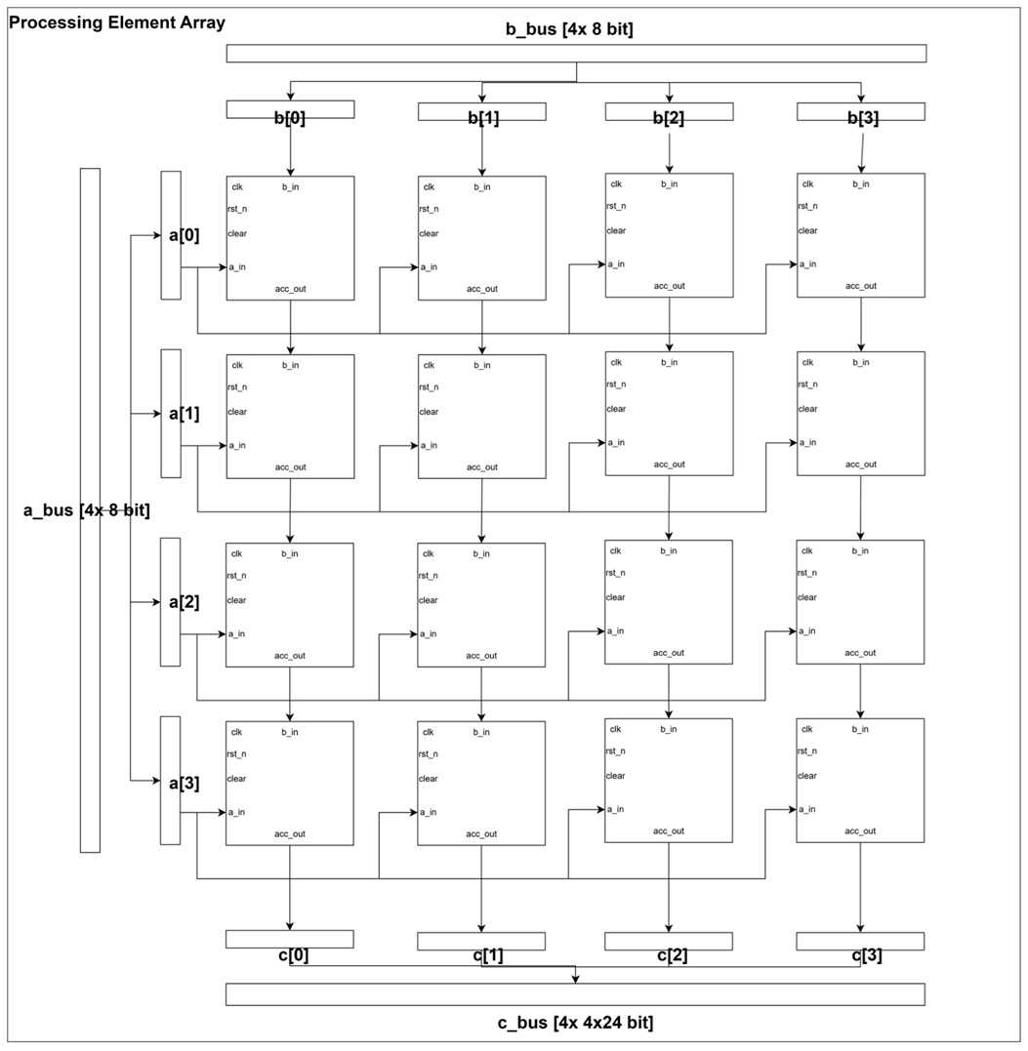
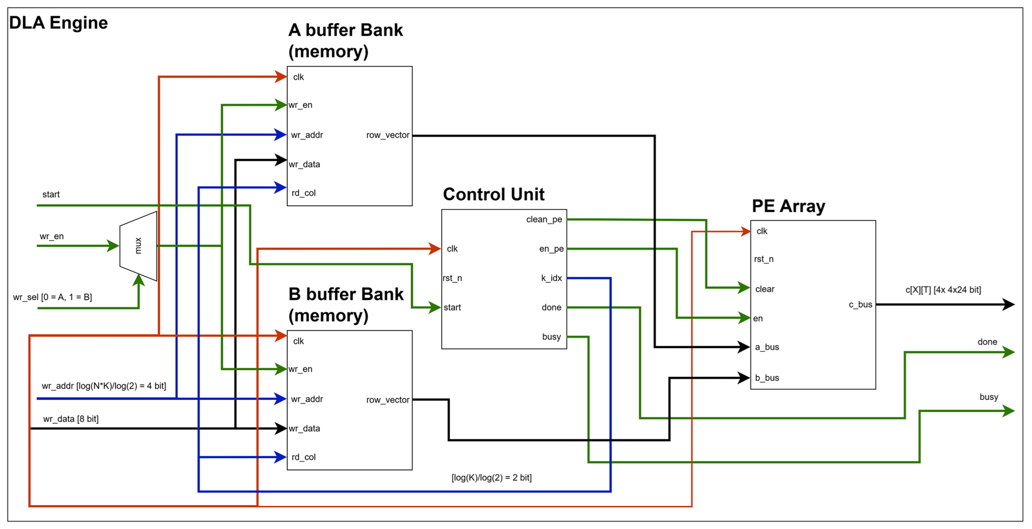
APPENDIX A16
PAPER NO. 1571326725 GAN ACCELERATOR ON GF180MCU
Original top-level and PE-array diagrams
Figure 2: buffers, control and array connections
Figure 3: row/column broadcasts
A16
Notes:
APPENDIX: for audience questions, outside the 20-minute main talk.
Use these exact source figures for questions about wiring. A provides row lanes and B column lanes to the generic array. Each row/column broadcast reaches multiple PEs, whose accumulators are local. The control unit generates the operand index, clear, enable, busy and done. A separate writeback path moves sixteen results to C. In the generator tile schedule, Section VII assigns weight rows to A and the shared input vector to B.
SOURCE: Supplied paper, Figures 2 and 3 right, Sections IV and VII.

