Slide 1





PAPER NO. 1571326725
AN AREA-OPTIMIZED 8-BIT DEEP LEARNING ACCELERATOR
FOR GAN IMAGE GENERATION ON GF180MCU
William Anthony, I Made Medika Surya W.M., John Ruben Saragi, Mahardhika Putra Adipratama,
Fairuz Aquilla Rahagi, Trio Adiono, and Infall Syafalni
Bandung Institute of Technology, Bandung, Indonesia
E-mail: {13223048, 13222021, 13222049, 13222081, 13222107}@mahasiswa.itb.ac.id,
tadiono@itb.ac.id, infall@ieee.org
Start Slide

Slide 2
I. INTRODUCTION
PAPER NO. 1571326725 AN AREA-OPTIMIZED 8-BIT DEEP LEARNING ACCELERATOR FOR GAN IMAGE GENERATION ON GF180MCU
https://www.geeksforgeeks.org/deep-learning/generative-adversarial-network-gan blah blah explanation

Slide 3
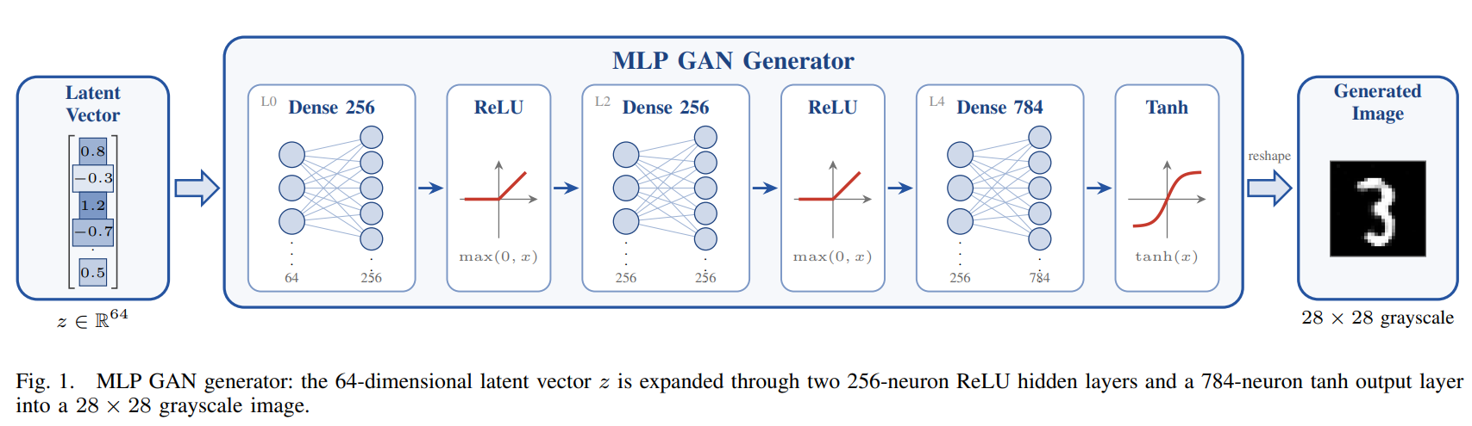
I. INTRODUCTION
PAPER NO. 1571326725 AN AREA-OPTIMIZED 8-BIT DEEP LEARNING ACCELERATOR FOR GAN IMAGE GENERATION ON GF180MCU
Generative Adversarial Networks are a compact workload for testing neural inference on custom hardware. The generator used here is a small MNIST multi-layer perceptron turning a 64-dimensional latent vector into a 28×28 image; its arithmetic is dense matrix multiplication, so it maps onto a small array of multiply–accumulate units. An earlier version expressed this as behavioral loops and register memory arrays

Slide 4
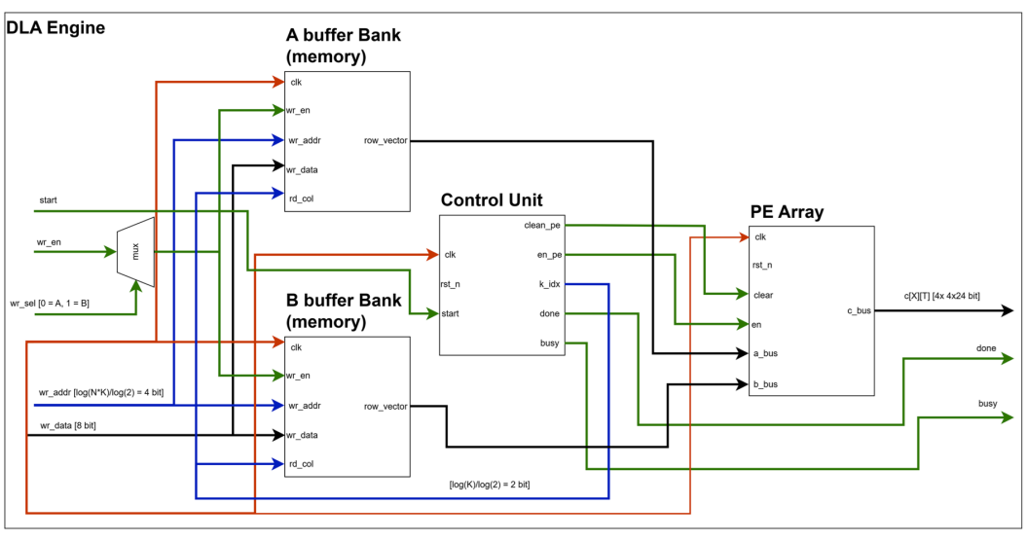
IV. HARDWARE ARCHITECTURE
PAPER NO. 1571326725 AN AREA-OPTIMIZED 8-BIT DEEP LEARNING ACCELERATOR FOR GAN IMAGE GENERATION ON GF180MCU
DLA Engine

Slide 5
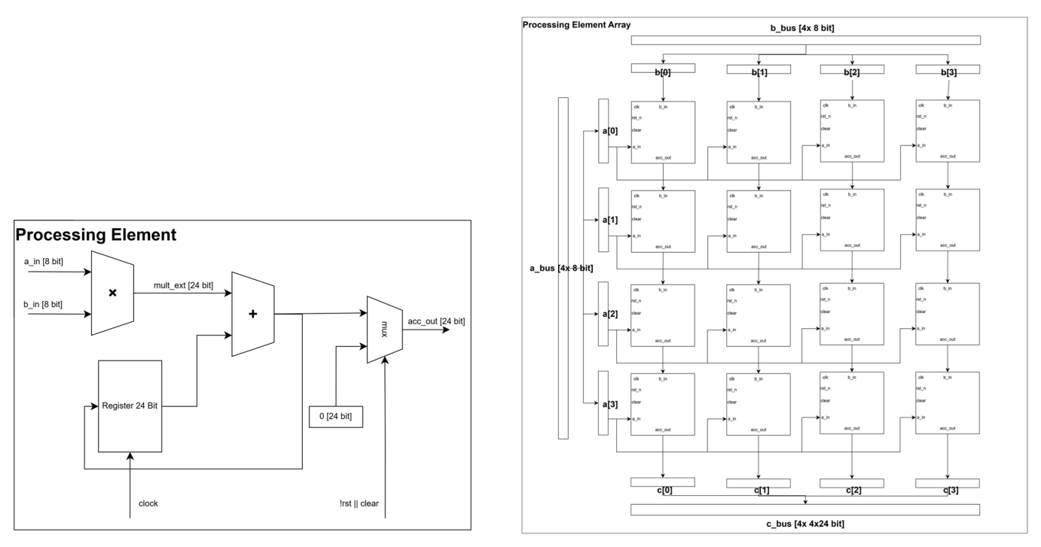
IV. HARDWARE ARCHITECTURE
PAPER NO. 1571326725 AN AREA-OPTIMIZED 8-BIT DEEP LEARNING ACCELERATOR FOR GAN IMAGE GENERATION ON GF180MCU
Processing Elements

Slide 6
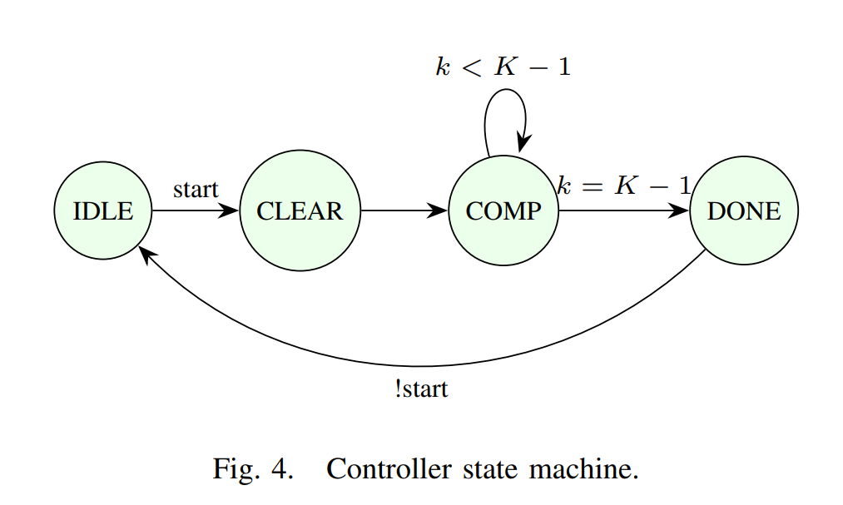
IV. HARDWARE ARCHITECTURE
PAPER NO. 1571326725 AN AREA-OPTIMIZED 8-BIT DEEP LEARNING ACCELERATOR FOR GAN IMAGE GENERATION ON GF180MCU
FSM

Slide 7
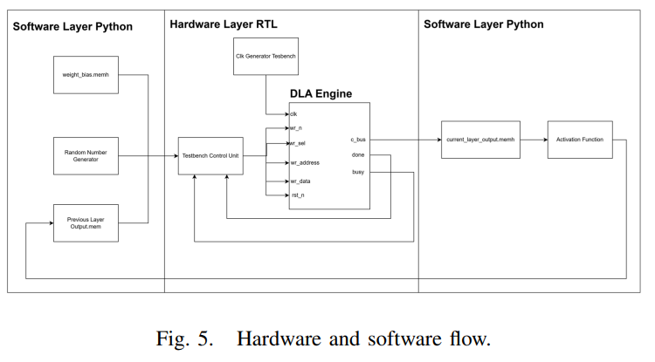
V. SOFTWARE AND HARDWARE
PAPER NO. 1571326725 AN AREA-OPTIMIZED 8-BIT DEEP LEARNING ACCELERATOR FOR GAN IMAGE GENERATION ON GF180MCU
Here is how blah blah

Slide 8
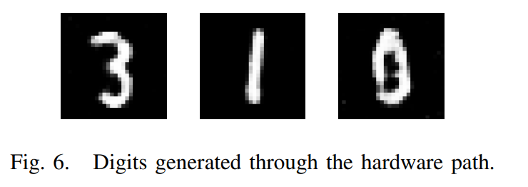
V. SOFTWARE AND HARDWARE
PAPER NO. 1571326725 AN AREA-OPTIMIZED 8-BIT DEEP LEARNING ACCELERATOR FOR GAN IMAGE GENERATION ON GF180MCU
Here is how blah blah

Slide 9
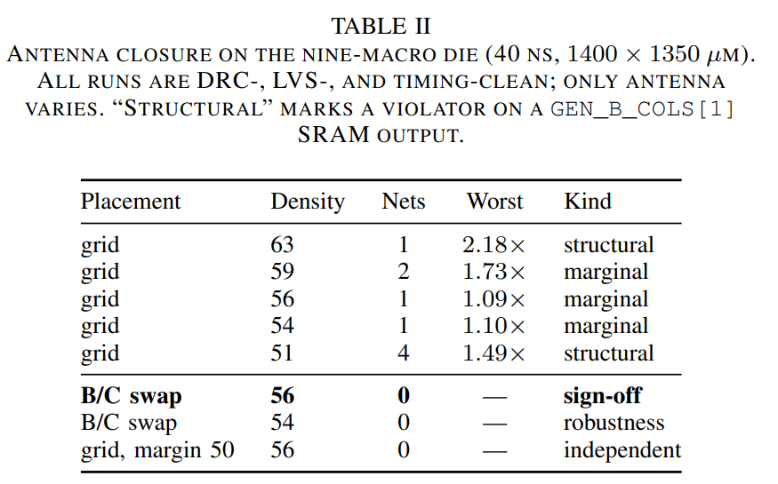
V. SOFTWARE AND HARDWARE
PAPER NO. 1571326725 AN AREA-OPTIMIZED 8-BIT DEEP LEARNING ACCELERATOR FOR GAN IMAGE GENERATION ON GF180MCU
Here is how blah blah

Slide 10
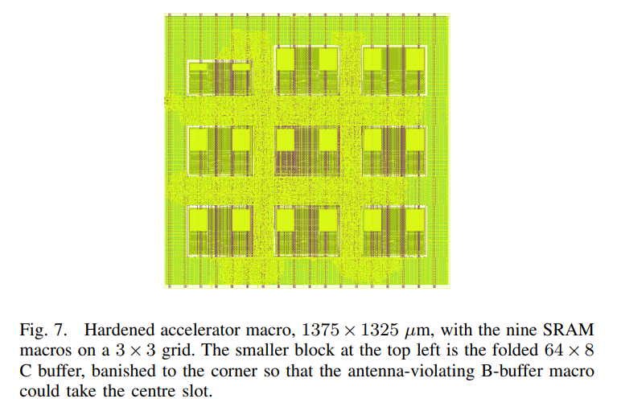
V. SOFTWARE AND HARDWARE
PAPER NO. 1571326725 AN AREA-OPTIMIZED 8-BIT DEEP LEARNING ACCELERATOR FOR GAN IMAGE GENERATION ON GF180MCU
Here is how blah blah

Slide 11
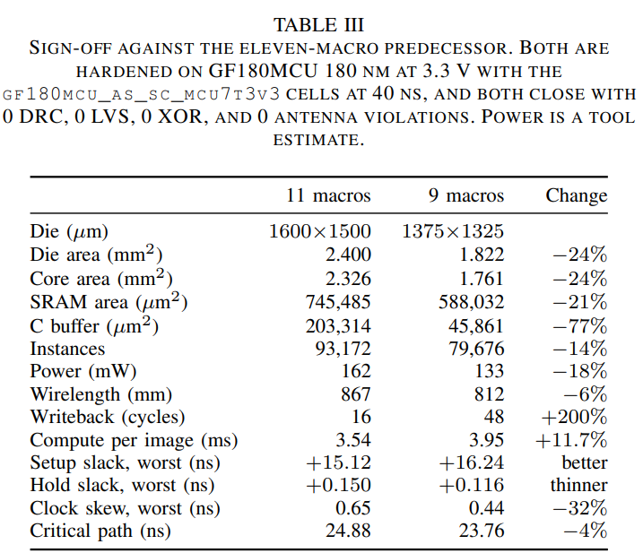
V. SOFTWARE AND HARDWARE
PAPER NO. 1571326725 AN AREA-OPTIMIZED 8-BIT DEEP LEARNING ACCELERATOR FOR GAN IMAGE GENERATION ON GF180MCU
Here is how blah blah

Slide 12
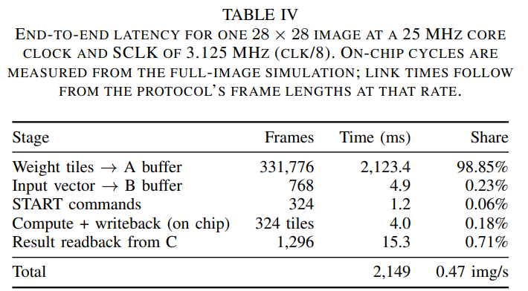
V. SOFTWARE AND HARDWARE
PAPER NO. 1571326725 AN AREA-OPTIMIZED 8-BIT DEEP LEARNING ACCELERATOR FOR GAN IMAGE GENERATION ON GF180MCU
Here is how blah blah

Slide 13
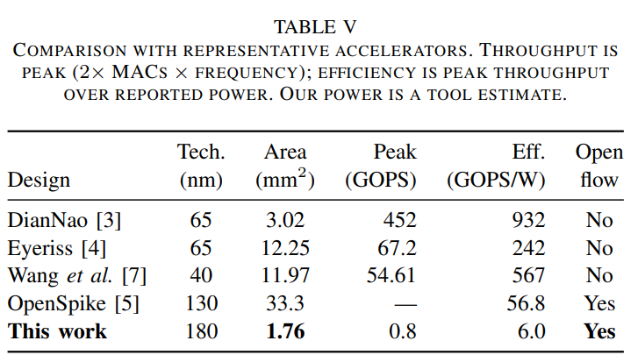
COMPARISON
PAPER NO. 1571326725 AN AREA-OPTIMIZED 8-BIT DEEP LEARNING ACCELERATOR FOR GAN IMAGE GENERATION ON GF180MCU
Here is how blah blah

