Slide 1

Walmart Historical Sales Analysis
Socioeconomic Factors On Sales

Slide 2

Analysis Purpose
Determine relationship between historical sales & socioeconomic factors
This Photo by Unknown Author is licensed under CC BY-NC
Notes:
Walmart stakeholders have requested to see the relationship between historical store sales and specific socioeconomic factors to try and understand future affects

Slide 3
Socioeconomic Factors Considered
Unemployment Rate
Regional Fuel Prices
CPI (Consumer Price Index)
Notes:
A consumer price index measures changes in the price level of a weighted average market basket of consumer goods and services purchased by household

Slide 4
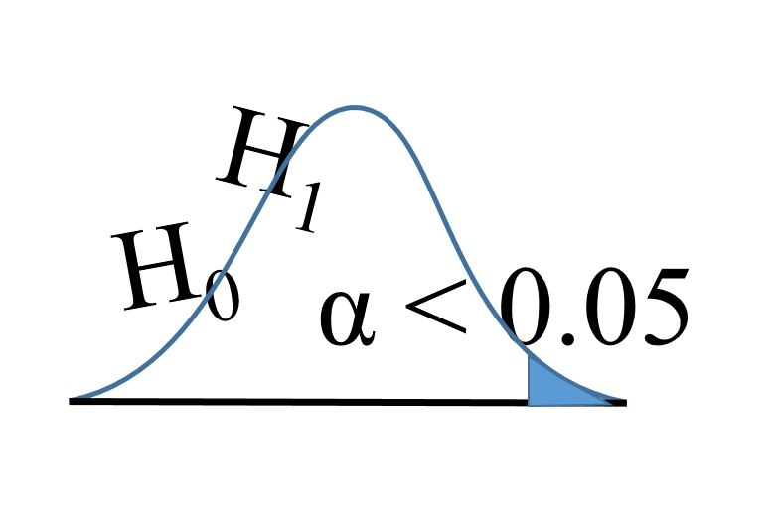
Hypotheses
H1
Is there a statistically significant correlation between store sales and unemployment?
(Null Hypotheses)
Ho: μ1 - μ2 = 0 : There is no statistically significant correlation between stores sales and unemployment
H2
Is there a statistically significant correlation between store sales and CPI?
(Null Hypotheses)
Ho: μ1 - μ2 = 0 : There is no statistically significant correlation between stores sales and CPI
H3
Is there a statistically significant correlation between store sales and regional fuel prices?
(Null Hypotheses)
Ho: μ1 - μ2 = 0 : There is no statistically significant correlation between stores sales and regional fuel prices
This Photo by Unknown Author is licensed under CC BY

Slide 5

Data Overview
Kaggle
Sales data from 45 Walmart stores ranging from 2010-02-05 to 2012-11-01

Slide 6
Methods
Statistical Correlation Analysis
Correlation analysis is a statistical method used to evaluate the strength of relationship between two quantitative variables.
Pearson's correlation coefficient (r) is a measure of the strength of the association between the two variables

Slide 7

Analysis Results

Slide 8
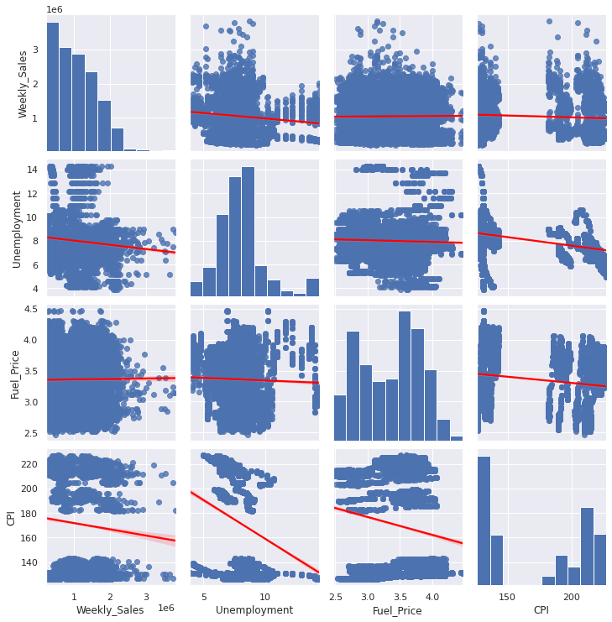
1. Sales & Unemployment 2. Sales & CPI 3. Sales & Regional Fuel Prices

Slide 9
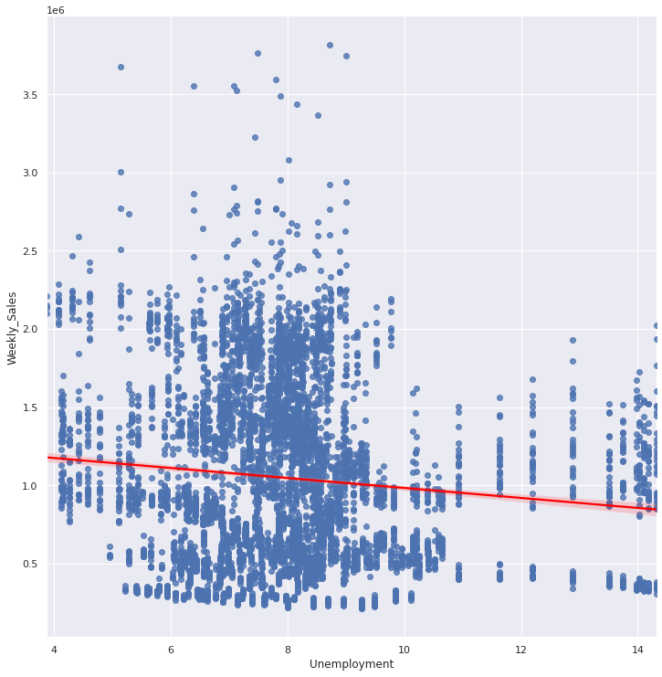
Sales & Unemployment
Do weekly sales have any correlation with unemployment?
Answer:
(Coefficient = -0.106, P.Value = 1.3448365210357873e-17)
There is a negative coefficient between Weekly Sales and Unemployment.
Ho: μ1 - μ2 = 0 (Reject Null Hypotheses)
Ha: μ1 - μ2 ≠ 0
-We REJECT the Null Hypothesis that there's no significant statistical correlation between weekly sales and unemployment.

Slide 10
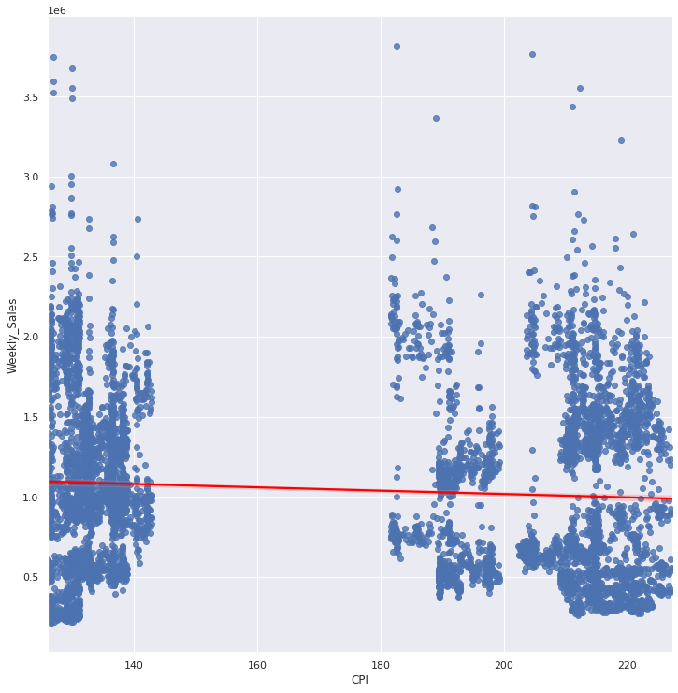
Sales & CPI
Do weekly sales have any correlation with CPI?
Answer:
(-0.0726341, 5.438292612224682e-09)
There is a weak negative coefficient between sales and CPI.
Ho: μ1 - μ2 = 0 (Reject Null Hypotheses)
Ha: μ1 - μ2 ≠ 0
We REJECT the Null Hypothesis that there's no significant statistical correlation between weekly sales and CPI.

Slide 11
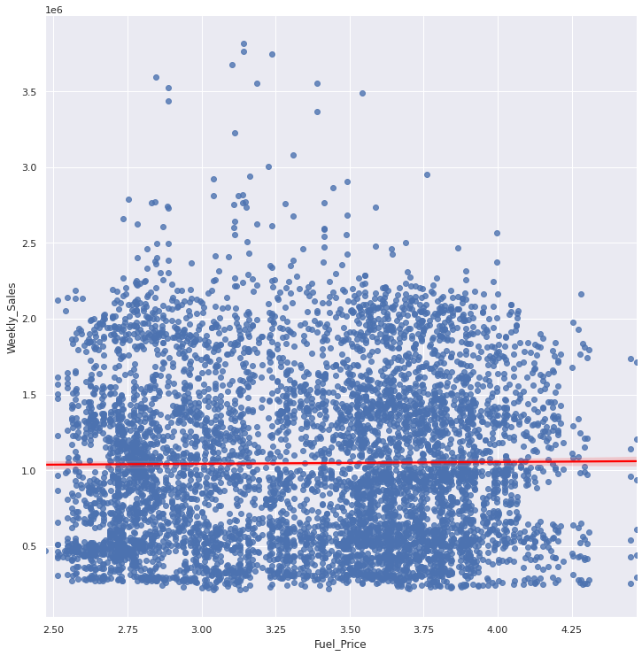
Sales & Regional Fuel Price
Do weekly sales have any correlation with fuel price?
Answer:
(0.0094637, 0.447828)
There appears to be significant correlation between sales and fuel price.
Ho: μ1 - μ2 = 0 (Fail to Reject Null Hypotheses)
Ha: μ1 - μ2 ≠ 0
We FAIL to reject the null hypothesis that there is no statistically significant correlation between sales and regional fuel prices

Slide 12
Conclusion
Historically it appears that the following is true:
There is an apparent correlation between sales and the unemployment rate.
There is a weak correlation between sales and CPI (Consumer Price Index)
There appears to be no visible correlation between sales and regional fuel prices

Slide 13
Possible Recommendations
During times of higher unemployment rate or When the CPI is high, stores should closely watch sales in order to reduce the amount of inventory ahead of a possible change.

