Slide 1
網路安全之入侵偵測系統實務
教育部
新型態資安實務課程計畫
Intrusion-detection system
授課教師:
資訊安全基礎實務課程 A practical introduction to security

Slide 2
課程宗旨
本課程教授學生網路防禦技術常用的入侵偵測系統技術
課程將以所提供的Ubuntu linux環境教導學生使用snort設定偵測規則
課程實際以syn flood 攻擊進行網路偵測的實際演練

Slide 3
入侵偵測系統

Slide 4
IDS
入侵檢測系統（Intrusion-detection system,IDS）是一種網路安全裝置或應用軟體，可以監控網路傳輸或者系統，檢查是否有可疑活動或者違反企業的政策。偵測到時發出警報或者採取主動反應措施。
https://en.wikipedia.org/wiki/Intrusion_detection_system
An intrusion detection system (IDS) is a device or software application that monitors a network or systems for malicious activity or policy violations. Any malicious activity or violation is typically reported either to an administrator or collected centrally using a security information and event management (SIEM) system.
A SIEM system combines outputs from multiple sources, and uses alarm filtering techniques to distinguish malicious activity from false alarms.

Slide 5
IDS類型
[1]network intrusion detection systems (NIDS)
a system that analyzes incoming network traffic
[2]host-based intrusion detection systems (HIDS)
A system that monitors important operating system files

Slide 6
IDS技術類型
[1] signature-based detection
recognizing bad patterns, such as malware
[2]anomaly-based detection
detecting deviations from a model of "good" traffic, which often relies on machine learning)

Slide 7
Snort入侵偵測系統

Slide 8


Snort是一套開放原始碼的
網路入侵預防軟體與網路入侵檢測軟體。
Snort使用了以偵測簽章（signature-based）與通訊協定的偵測方法。
Snort被認為是全世界最廣泛使用的入侵預防與偵測軟體。
1998年，Martin Roesch撰寫了一個名為Snort的軟體，被其定位成簡單輕巧的入侵偵測軟體。

Slide 9
Snort運作模式
三個模式進行運作：
[1]偵測模式（Sniffer Mode）：此模式下，Snort將在現有的網域內擷取封包，並顯示在螢幕上。
[2]封包紀錄模式（packet logger mode）：此模式下，Snort將已擷取的封包存入儲存媒體中（如硬碟）。
[3]上線模式（inline mode）：此模式下，Snort可對擷取到的封包做分析的動作，並根據一定的規則來判斷是否有網路攻擊行為的出現。

Slide 10
Snort偵測規則

Slide 11

Structure of Rule
Rule header：
The rule header contains information about what action a rule takes.
Rule option：
The options part contains additional criteria for matching a rule against data packets.
A rule may detect one type or multiple types of intrusion activity. Intelligent rules should be able to apply to multiple intrusion signatures.

Slide 12
Snort rule
Snort v2.3.3 Rule法則有3250條分成48大類型
Rule | 數目 | Rule | 數目
attack-responses.rules | 17 | p2p.rules | 8
backdoor.rules | 77 | policy.rules | 21
bad-traffic.rules | 14 | pop2.rules | 4
chat.rules | 30 | pop3.rules | 28
ddos.rules | 33 | porn.rules | 27
deleted.rules | 271 | rpc.rules | 129
dns.rules | 23 | rservices.rules | 13
dos.rules | 22 | scan.rules | 20
experimental.rules | 0 | shellcode.rules | 21
exploit.rules | 83 | smtp.rules | 60
finger.rules | 14 | snmp.rules | 17
ftp.rules | 69 | sql.rules | 56
icmp-info.rules | 23 | telnet.rules | 16
icmp.rules | 125 | tftp.rules | 12
imap.rules | 40 | virus.rules | 1
info.rules | 8 | web-attacks.rules | 45
local.rules | 0 | web-cgi.rules | 308
misc.rules | 62 | web-client.rules | 29
multimedia.rules | 10 | Web-coldfusion.rules | 36
mysql.rules | 3 | web-frontpage.rules | 35
netbios.rules | 435 | web-iis.rules | 141
nntp.rules | 13 | web-misc.rules | 400
oracle.rules | 320 | web-php.rules | 126
other-ids.rules | 3 | x11.rules | 2

Slide 13
Structure of rule header
Example:
Alert icmp any any -> any any (msg: "Ping with TTL=100"; ttl: 100;)

Slide 14
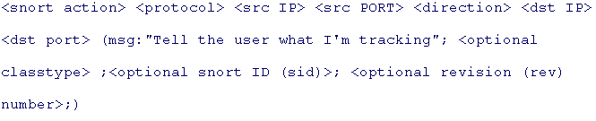
Snort rules format
The Snort rules have a basic format that expands for more specific needs.
Snort rule language keywords
Snort action
Protocol
Source IP
Source ports
Direction
Destination IP
Destination port
Message
Class type
Snort Identification (SID) number
Revision number

Slide 15
Snort rule language keywords-1
Snort action
This can be one of three keywords. alert sends an alarm on this signature. log doesn't create an alarm, it just log this alarm (to a file, for example). pass is used mostly for policy based IDS. It tells the Snort engine to pass only packets that match the signature, no matter what else is in the packet(s).
Protocol
This keyword tells Snort what protocol to monitor. It can be one of the more common protocols like tcp, udp, and icmp. Or it can be IP in general to monitor another IP protocol
Source IP
This is the host or group of IP addresses from which Snort will be looking for the connection to originate
Source ports
This is the originating port from which Snort will be looking for the connection to start.
Direction
This tells Snort whether to look for the connection to start from your source IP or from your destination IP. This can be in the form of -> for source-to-destination, <- for destination-to-source, or <-> for bidirectional traffic.

Slide 16
Snort rule language keywords-2
Destination IP
This is the destination IP or group of IP addresses where Snort will look for the connection to end
Destination port
This is the destination port of the traffic
Message
This is the comment field of a Snort alarm.
Class type
This is a priority helper. If you're using a tool like Barnyard to prioritize alarms into those that need to be looked at immediately or those that can wait until a slower time during the shift/day/etc., this is the way to mark them.
Snort Identification (SID) number
This is the "unique" number assigned to your rule. If you create your own rule, the convention is to number it starting above 10,000.
Revision number
This is an optional keyword, but you will find it useful once you start creating multiple rules.

Slide 17
Example-1
DDoS – TFN2K
alert icmp $EXTERNAL_NET any -> $HOME_NET any
(msg："DDOS tfn2k icmp possible communication";
icmp_id：0; itype：0; content："AAAAAAAAAA";
reference：arachnids,425; classtype：attempted-dos; sid：222; rev：2;)
此條規則存放在DDoS.rules檔中，主要目的為偵測TFN2K所發動的DDoS攻擊，從rule header表示此規則只對送達目標主機的icmp封包進行比對，由"itype"與"icmp_id"兩個選項可知，如果該封包的icmp type與id值皆為0且內容包含"AAAAAAAAAA"，便產生alert。

Slide 18
Example-2
BufferOverflow
alert tcp $EXTERNAL_NET any -> $HOME_NET 22
(msg："EXPLOIT ssh CRC32 overflow filler";
flow：to_server,established;
content："|00 00 00 00 00 00 00 00 00 00 00 00 00 00 00 00 00 00|";
reference：bugtraq,2347; reference：cve,2001-0144;
reference：cve,2001-0572; classtype：shellcode-detect; sid：1325; rev：6;)
此規則存放於exploit.rules中，由rule header部分首先可以分析出
此規則只針對流經目標主機22 port的tcp封包進行檢查，由rule option中的
“flow：to_server,established”與“content”表示如果本地主機與外部主機
已建立連線且本地端主機送出request，並且在該request封包中含有
"00 00 00 00 00 00 00 00 00 00 00 00 00 00 00 00 00 00"的字串，便產生alert。

Slide 19
Rule Action
alert - generate an alert using the selected alert method, and then log the packet
log - log the packet
pass - ignore the packet
activate - alert and then turn on another dynamic rule
dynamic - activated by an activate rule , then act as a log rule

Slide 20
Direction Operator
The direction field determines the source and destination addresses and port numbers in a rule.The following rules apply to the direction field:
1. ->
2. <-
3. <>

Slide 21
Rule Option
Four major categories of rule options.
meta-data These options provide information about the rule but do not have any act during detection
payload These options al look for data inside the packet payload and can be inter-related
non-payload These options look for non-payload data
post-detection These options are rule specic triggers that happen after a rule has "red".

Slide 22
Rule Option (Cont.)
Category | Keywords
1. Meta-Data | msg、reference、sid、 rev、 classtype、 priority
2. Payload | content、nocase、rawbytes、depth、offset、distance、within、uricontent、isdataat、pcre、byte_test、byte_jump、regex、content-list
3. Non-Payload | fragoffset、ttl、tos、id、ipopts、fragbits、dsize、flags、flow、seq、ack、window、itype、icode、icmp_id、icmp_seq、rpc、ip_proto、sameip
4. Post-detection | logto、session、react、sesp、tag

Slide 23
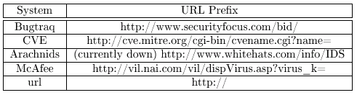
1. Meta-Data
Msg
Reference
Sid
Rev
Classtype
Priority

Slide 24
2. Payload
Content (The content keyword has a number of modier keywords.)
Nocase
Rawbytes
Depth
Offset
Distance
Within

Slide 25
2. Payload (Cont.)
Uricontent
Isdataat
Pcre
byte_test
byte_jump
Regex
content-list

Slide 26
3. Non-Payload
Fragoffset
Ttl
Tos
Id
Ipopts
Fragbits
Dsize

Slide 27
3. Non-Payload
Flags
Flow
Seq
Ack
Window
Itype
Icode

Slide 28
3. Non-Payload
icmp_id
icmp_seq
Rpc
ip_proto
sameip

Slide 29
4. Post-detection
Logto
Session
React
Sesp
tag

Slide 30
入侵偵測系統實務演練
syn flood 攻擊

Slide 31
SYN flood DOS

Slide 32
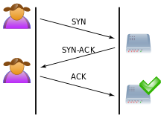
正常的TCP三向交握(three-way handshake)
https://en.wikipedia.org/wiki/SYN_flood

Slide 33
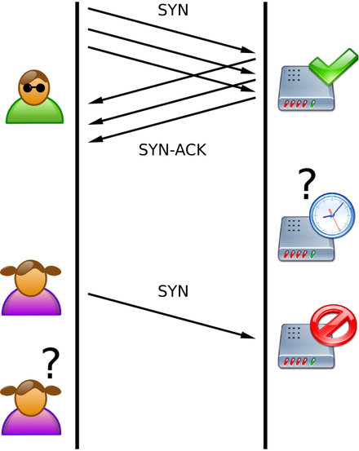
SYN flood DOS
使用者與伺服器之間正常連線狀況，三向交握正確的進行。
因為阻斷服務攻擊的結果正常使用者與伺服器嘗試建立連線遭拒。
攻擊者傳送許多封包就是不送"ACK"回到伺服器。該連線因此處於半開狀態並吞食伺服器資源。
https://en.wikipedia.org/wiki/SYN_flood

Slide 34

使用hping3進行
SYN flood DOS
攻擊測試

Slide 35

使用hping3進行SYN flood DOS 攻擊測試
官方網址:http://www.hping.org/
hping3是一款免費的封包生成器和分析器。
功能:可用于安全稽核、防火牆規則測試、網路測試、埠掃描、性能測試，壓力測試(DOS)
Kali linux已整合hping3
https://tools.kali.org/information-gathering/hping3
特色:
幾乎可以發送任意類型的TCP/IP資料包。
功能強大但是每次只能向一個IP位址發送資料包，還能夠在兩個相互包含的通道之間傳送檔。

Slide 36
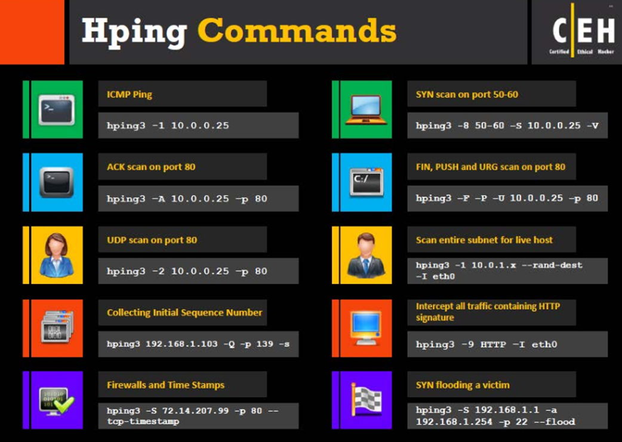
使用hping3進行SYN flood DOS 攻擊測試
http://man.linuxde.net/hping3

Slide 37

使用hping3進行SYN flood DOS 攻擊測試
set SYN flag
dest port
被攻擊的機器 IP
hping3 -S -p 80 --flood 192.168.3.102
sent packets as fast as possible. Don't show replies.
https://tools.kali.org/information-gathering/hping3

Slide 38
使用hping3進行SYN flood DOS 攻擊測試
參考資料與進階研讀
http://man.linuxde.net/hping3
https://mochazz.github.io/2017/07/23/hping3/
https://blog.kkbruce.net/2010/08/hping.html#.W_vkIzgzaUk

Slide 39

測試環境
測試環境: KALI_2018ver4.ova
測試環境: IDS201811.ova

Slide 40

使用hping3進行SYN flood DOS 攻擊測試
Snort偵測規則
alert tcp any any -> any 80 (flags: S; msg:"SYN flood DOS Attack"; flow: stateless; threshold: type both, track by_dst, count 70, seconds 10; sid:10001;rev:1;)
欄位 | 說明
tcp | tcp協定
any | 來源IP
any | 來源Port
any | 目的IP
80 | 目的Port
flags: S | SYN packet
msg | 當觸發此規則時所發出的警告訊息
flow: stateless | Trigger regardless of the state of the stream processor (useful for packets that are designed to cause machines to crash)
type both | Type both alerts once per time interval after seeing m occurrences of the event, then ignores any additional events during the time interval.
track by_dst | rate is tracked either by source IP address, destination IP address, or by rule. This means the match statistics are maintained for each unique source IP address, for each unique destination IP address, or they are aggregated at rule level.
count 70 | number of rule matching in s seconds that will cause event_filter limit to be exceeded. c must be nonzero value.
seconds 10 | time period over which count is accrued. s must be nonzero value.
sid:10001 | 規則編號
rev:1 | 規則版本

Slide 41
使用hping3進行SYN flood DOS 攻擊測試
日誌分析
[**] [1:10001:1] SYN flood DOS Attack [**]
[Priority: 0]
11/27-12:14:44.587159 08:00:27:26:72:66 -> 08:00:27:EE:BF:69 type:0x800 len:0x3C
192.168.2.92:2063 -> 192.168.2.103:80 TCP TTL:64 TOS:0x0 ID:31911 IpLen:20 DgmLen:40
******S* Seq: 0x2C946705 Ack: 0x34F5178C Win: 0x200 TcpLen: 20
欄位 | 說明
flood DOS Attack | 警告訊息
11/27-12:14:44.587159 | 觸發時間
08:00:27:26:72:66 | 來源MAC Address
08:00:27:EE:BF:69 | 目的MAC Address
192.168.2.92:2063 | 來源IP與Port
192.168.2.103:80 | 目的IP與Port
TCP | 協定
TTL:64 TOS:0x0 ID:31911 IpLen:20 DgmLen:40 ******S* Seq: 0x2C946705 Ack: 0x34F5178C Win: 0x200 TcpLen: 20 | packet header

Slide 42
SYN flood DOS
防禦技術
RFC 4987
TCP SYN Flooding Attacks and Common Mitigations
https://tools.ietf.org/html/rfc4987

Slide 43
SYN flood DOS 防禦技術
Filtering
Increasing Backlog
Reducing SYN-RECEIVED Timer
Recycling the Oldest Half-Open TCP
SYN Cache
SYN cookies
Hybrid Approaches
Firewalls and Proxies
https://en.wikipedia.org/wiki/SYN_flood
RFC 4987
TCP SYN Flooding Attacks and Common Mitigations
https://tools.ietf.org/html/rfc4987

Slide 44
小小測驗

