Slide 1

Spring
Discussions Reimagined.
Visions In Action.

Slide 2


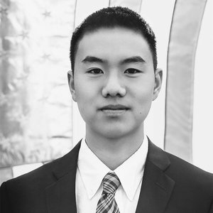
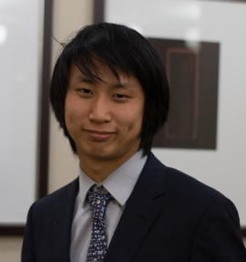


Spring
 | Dania Abu-Hussein | William Long | Samuel Z Liu
 | Business, Economics, & International Affairs | Computer Science & Government | Physics & Philosophy
 | Analyst at Wayfair | Software Engineer at Amazon | Software Engineer at Google
 | Founder of Bread for Life | Founder of Soccer for Everyone | Co-President of D4D

Slide 3

Social media can empower change
Spring

Slide 4

Spring
Observes or Learns About a Problem
Impulsive Share on Facebook or WhatsApp
Discussions with Friends or Family
Activate
Approach Institutions or Connections
Drop Out
Problem Statement:
Current dialogue is isolated with no view to action

Slide 5
Spring
Observes or Learns About a Problem
Impulsive Share on Facebook or WhatsApp
Discussions with Friends or Family
Activate
Approach Institutions or Connections
Drop Out
Our Vision:
Empower those who drop out for lack of time/resources
Generate & support projects (discussion, donation)

Slide 6
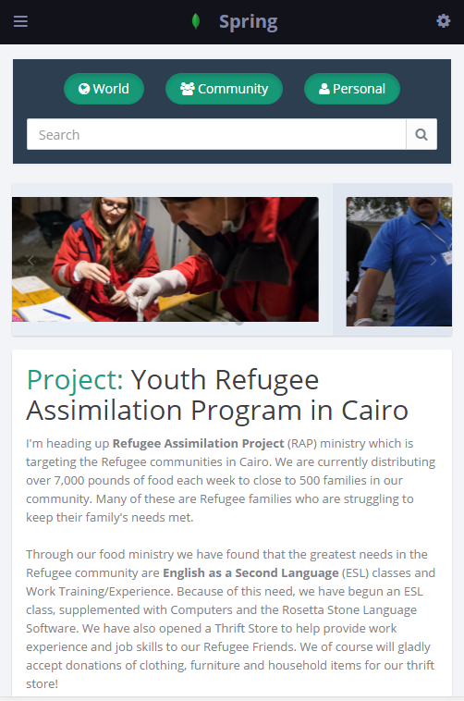



Means of Enablement:
Spring
Wireframe image here
Polling for an over-arching Vision
Crowdsourcing Projects as solutions to Problems
“Reaction” donation scheme

Slide 7







Technology Stack:
Spring
Frontend
Mobile
Convert
Backend

Slide 8






Similar Platforms in Different Markets:
Spring

Slide 9

Spring
Timeline & Vision
March 4
Spring is Envisioned
Late April
MVP Web + App are Rolled out
Early July
Final Web + App is Ready for Launch
& Marketing Released
October
Feedback #1 on UE & Marketing Strategy
Late December
… A steady implementation of Feedback results

Slide 10
Spring
Discussions Reimagined.
Visions In Action.
A Brighter Future: Enable The Arab Youth’s Next Step…
Creating a platform for discussion, engagement, and action
Allow for petitions, suggestions, and support for action

