Slide 1

Fast Algorithms for Walsh Hadamard Transform on Sliding Windows
Wanli Ouyang
Supervisor: Prof. W.K. Cham
The Chinese University of Hong Kong

Slide 2
Outline
Introduction
Our algorithm for order-4 and order-8 WHT
Our algorithm for order N WHT

Slide 3
Introduction
Walsh-Hadamard Transform (WHT) on sliding windows and its application
An existing algorithm for computing WHT

Slide 4
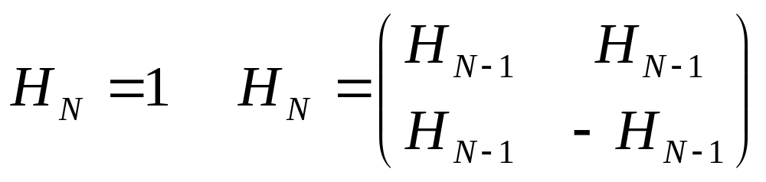
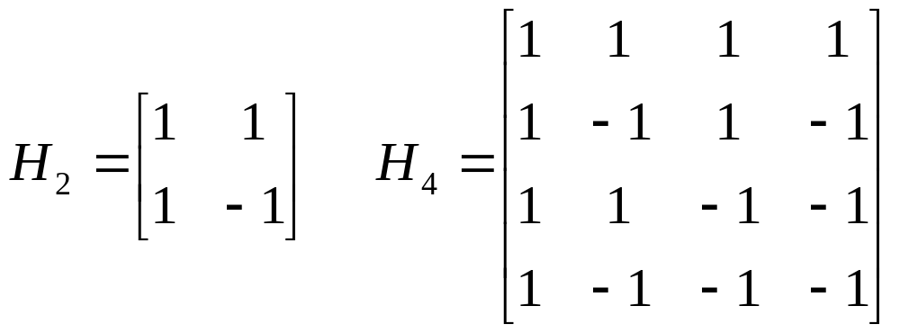
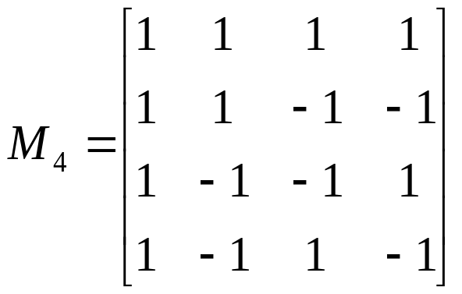
Walsh-Hadamard Transform (WHT)
Natural order
Sequency order

Slide 5







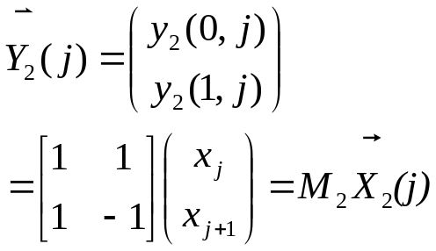
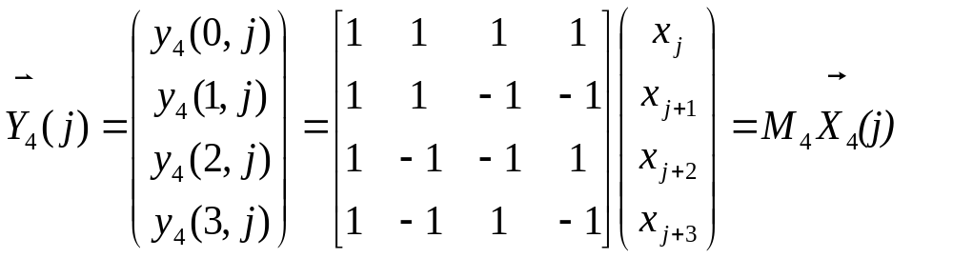
Definition
x_{j}
0 1 2 3 4 5 6 7 …..
15 6 10 8 8 5 10 1
K input signal elements x_{n} where n=0, 1, …, K-1, which will be divided into overlapping windows of size N. Let the jth input window be:
(j)= [x_{j}, x_{j+1}, …, x_{j+N－1}]^{T} for j = 0, 1, …K-N.
A 1-D order-N WHT transforms N real numbers into N real numbers. Let M_{N} be an order-N WHT matrix and
M_{N}= [ _{N}(0), _{N}(1), …, _{N}(N-1)]^{T}, where is the ith WHT basis vector.
Let y_{N}(i,j) be the ith WHT projection value for the jth window and
y_{N}(i,j) = _{N}(i)^{T} _{N}(j) for i = 0, 1, …N-1; j = 0, 1, …, K-N.
Y. Hel-Or and H. Hel-Or, “Real time pattern matching using projection kernels,” PAMI, vol. 27, no. 9, pp. 1430-1445, Sept. 2005.

Slide 6
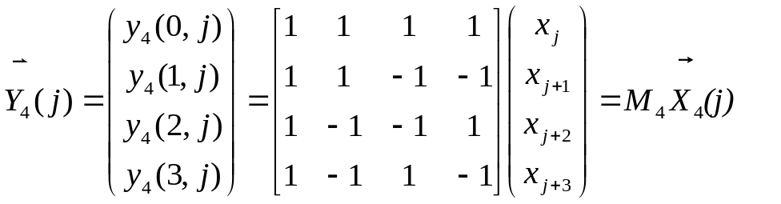
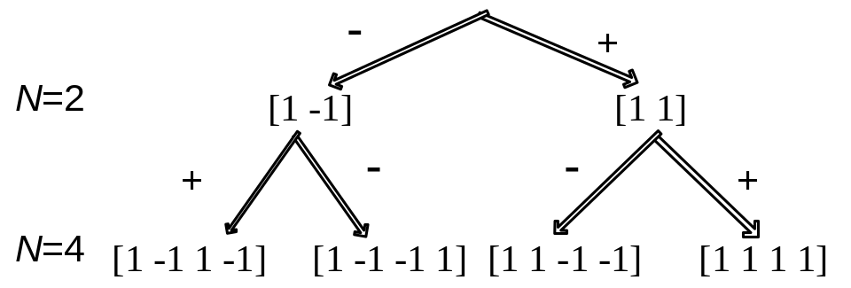
WHT on sliding (overlapped) windows
0 1 2 3 4 5 6 7 …..
x_{j}
15 6 10 8 8 5 10 1
y₂(0,j)
[1 1]
21 16 18 16 13 15 11
y₄(0,j)
[1 1 1 1]
39 32 31 31 24
0 1 2 3 4 5 …..
y₄(0,0)
y₄(0,1)
y₄(0,2)

Slide 7
Application: Pattern (or Template) Matching
  Template matching, which aims to find a particular pattern in an image, can be regarded as a problem (or model) under pattern recognition.
  Template matching is also useful in signal processing, computer vision, image and video processing .
  For example, image based rendering, image compression, object detection, video compression

Slide 8

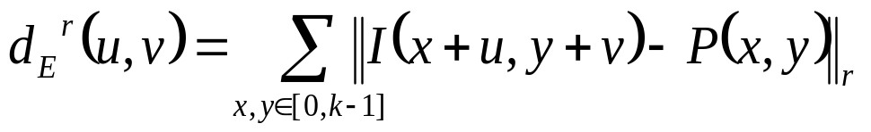
Basic Operation of Template Matching
n
I(u,v)
• • • • • • • • • • • • •
• • • • • • • • •
n
k
P(x,y)
k
Given a pattern P(x,y), we are to find a matched window within an image I(u,v). For pixel location (u,v), the following distance is calculated:
The smaller d_{E}^{r}(u,v) at a particular (u,v), the more similar the window is to the pattern. In practice, windows whose distance is smaller than a threshold are accepted as a match.

Slide 9
n
Computational Requirement
• • • • • • • • • • • • •
• • • • • • • • •
n
k
k
A 2D k×k pattern is to be matched within an image of size n×n, the complexity of various methods are:
 | Average # Operations per Pixel | Search space | Integer Arithm. | Run Time for searching in a 1000x1000 Image using a 1.8 GHz PIII
 |  |  |  | 16x16 pattern | 32x32 pattern | 64x64 pattern
Exhaustive search | + : 2k² *: k² | n² | Yes | 1.33 s | 4.86 s | 31.3 s
Fourier | + : 36 log n * : 24 log n | n² | No | 3.5 s | 3.5 s | 3.5 s
WHT | ^{+:} 2logk +ε ^{+:} 3/2 +ε | 2n²logk | Yes | 54 Msec | 78 Msec | 125 Msec
Y. Hel-Or and H. Hel-Or, “Real time pattern matching using projection kernels,” PAMI, vol. 27, no. 9, pp. 1430-1445, Sept. 2005.

Slide 10
Introduction
Walsh-Hadamard Transform (WHT) on sliding windows and its application
An existing algorithm for computing WHT

Slide 11

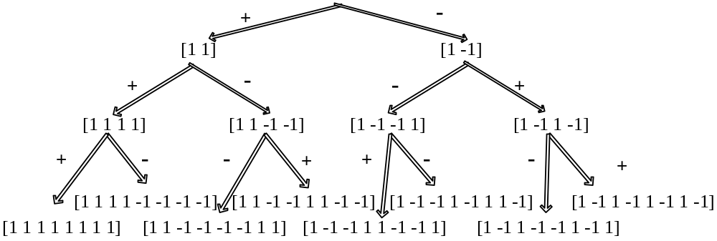
Hel-Or’s algorithm for computing WHT
Project all windows on all projection vectors:
For order-N WHT, Hel-or’s algorithm: 2N-2 adds per window
Example:
6 additions per window for order-4 WHT
14 additions per window for order-8 WHT
Y. Hel-Or and H. Hel-Or, “Real time pattern matching using projection kernels,” PAMI, vol. 27, no. 9, pp. 1430-1445, Sept. 2005.

Slide 12
Outline
Introduction
Our algorithm for order 4 and order 8 WHT
Our algorithm for order-N WHT

Slide 13
What the algorithm is?
WHT on sliding windows
1D- WHT (Row-column method)
A fast algorithm (same output)

Slide 14
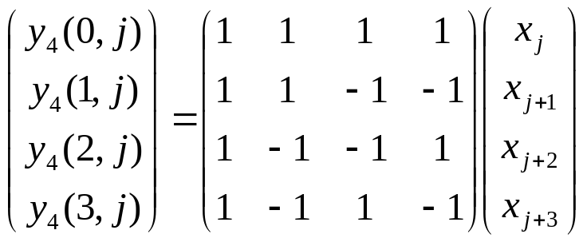
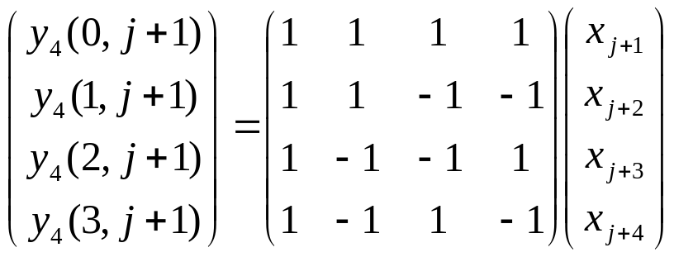
Our algorithm - order 4 WHT
 | x_{j} | x_{j+1} | x_{j+2} | x_{j+3} | x_{j+4}
y₄(0, j) | 1 | 1 | 1 | 1
y₄(0, j+1) |  | 1 | 1 | 1 | 1
y₄(0, j+1) - y₄(0, j) | -1 | 0 | 0 | 0 | 1
y₄(0, j+1) – y₄(0, j) = - x_{j} + x_{j+4}
 | x_{j} | x_{j+1} | x_{j+2} | x_{j+3} | x_{j+4}
y₄(3, j) | 1 | -1 | 1 | -1
y₄(3, j+1) |  | 1 | -1 | 1 | -1
y₄(3, j+1)+y₄(3, j) | 1 | 0 | 0 | 0 | -1
y₄(0, j+1) = y₄(0, j) – (x_{j} – x_{j+4})
y₄(3, j+1) = – y₄(3, j) + (x_{j} – x_{j+4})

Slide 15
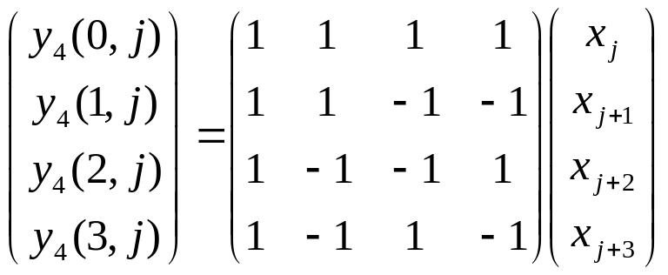
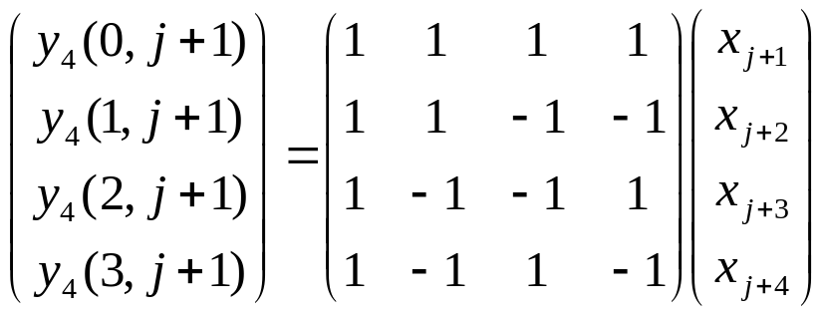
Our algorithm - order 4 WHT
 | x_{j} | x_{j+1} | x_{j+2} | x_{j+3} | x_{j+4}
y₄(2, j) | 1 | -1 | -1 | 1
y₄(1, j+1) |  | 1 | 1 | -1 | -1
y₄(1, j+1)+y₄(2, j) | 1 | 0 | 0 | 0 | -1
y₄(1, j+1) = - y₄(2, j) + (x_{j} - x_{j+4})
 | x_{j} | x_{j+1} | x_{j+2} | x_{j+3} | x_{j+4}
y₄(1, j) | 1 | 1 | -1 | -1
y₄(2, j+1) |  | 1 | -1 | -1 | 1
y₄(2, j+1)- y₄(1, j) | -1 | 0 | 0 | 0 | 1
y₄(2, j+1) = y₄(1, j) – (x_{j} - x_{j+4})

Slide 16
Our algorithm - order 4 WHT
 | x_{j} | x_{j+1} | x_{j+2} | x_{j+3} | x_{j+4} | Proposed algorithm | Hel-or’s algorithm
y₄(0, j) | 1 | 1 | 1 | 1 |  | y₄(0, j+1) = y₄(0, j) – (x_{j} － x_{j+4}) | y₄(0, j) = y₂(0, j) + y₂(0, j+2)
y₄(0, j+1) |  | 1 | 1 | 1 | 1
y₄(2, j) | 1 | -1 | -1 | 1 |  | y₄(1, j+1) =－y₄(2, j)+(x_{j}－x_{j+4}) | y₄(1, j) = y₂(0, j)－y₂(0, j+2)
y₄(1, j+1) |  | 1 | 1 | -1 | -1
y₄(1, j) | 1 | 1 | -1 | -1 |  | y₄(2, j+1) = y₄(1, j)－ (x_{j} － x_{j+4}) | y₄(2, j) = y₂(1, j)－y₂(1, j+2)
y₄(2, j+1) |  | 1 | -1 | -1 | 1
y₄(3, j) | 1 | -1 | 1 | -1 |  | y₄(3, j+1) = －y₄(3, j)+(x_{j}－x_{j+4}) | y₄(3, j) = y₂(1, j) + y₂(1, j+2)
y₄(3, j+1) |  | 1 | -1 | 1 | -1
d₄(j)= (x_{j} - x_{j+4})
5 additions

Slide 17
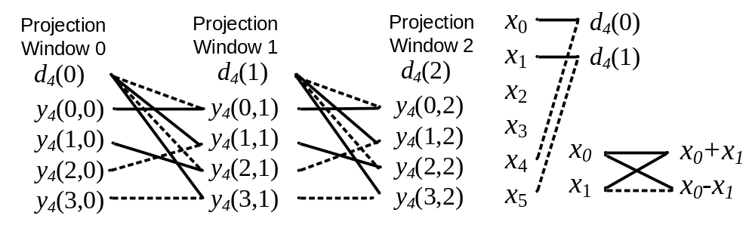
Data flow diagram for order-4 WHT
d₄(j)=(x_{j} - x_{j+4})
y₄(0, j+1) = y₄(0, j) – (x_{j} － x_{j+4})
y₄(1, j+1) =－y₄(2, j)+(x_{j}－x_{j+4})
y₄(2, j+1)= y₄(1, j)－(x_{j} － x_{j+4})
y₄(3, j+1)= －y₄(3, j)+(x_{j}－x_{j+4})

Slide 18
Our algorithm - order 8 WHT
 | x_{j} | x_{j+1} | x_{j+2} | x_{j+3} | x_{j+4} | x_{j+5} | x_{j+6} | x_{j+7} | x_{j+8} | x_{j+9} | Proposed algorithm
y₈(0, j) | 1 | 1 | 1 | 1 | 1 | 1 | 1 | 1 |  |  | y₈(0,j+2) =y₈(0,j) – (x_{j}+x_{j+1} - x_{j+8} - x_{j+9})
y₈(0, j+2) |  |  | 1 | 1 | 1 | 1 | 1 | 1 | 1 | 1
- | -1 | -1 | 0 | 0 | 0 | 0 | 0 | 0 | 1 | 1
y₈(2, j) | 1 | 1 | -1 | -1 | -1 | -1 | 1 | 1 |  |  | y₈(1,j+2) = - y₈(2,j)+(x_{j}+x_{j+1} - x_{j+8} - x_{j+9})
y₈(1, j+2) |  |  | 1 | 1 | 1 | 1 | -1 | -1 | -1 | -1
+ | 1 | 1 | 0 | 0 | 0 | 0 | 0 | 0 | -1 | -1

Slide 19
Our algorithm - order 8 WHT
 | x_{j} | x_{j+1} | x_{j+2} | x_{j+3} | x_{j+4} | x_{j+5} | x_{j+6} | x_{j+7} | x_{j+8} | x_{j+9} | Proposed algorithm
y₈(0, j) | 1 | 1 | 1 | 1 | 1 | 1 | 1 | 1 |  |  | y₈(0, j+2) = y₈(0,j)-(x_{j}+x_{j+1} - x_{j+8} - x_{j+9})
y₈(0, j+2) |  |  | 1 | 1 | 1 | 1 | 1 | 1 | 1 | 1
y₈(2, j) | 1 | 1 | -1 | -1 | -1 | -1 | 1 | 1 |  |  | y₈(1, j+2) = - y₈(2,j)+(x_{j} + x_{j+1} - x_{j+8} - x_{j+9} )
y₈(1, j+2) |  |  | 1 | 1 | 1 | 1 | -1 | -1 | -1 | -1
y₈(1, j) | 1 | 1 | 1 | 1 | -1 | -1 | -1 | -1 |  |  | y₈(2, j+2) = y₈(1,j) - (x_{j} + x_{j+1}- x_{j+8} - x_{j+9} )
y₈(2, j+2) |  |  | 1 | 1 | -1 | -1 | -1 | -1 | 1 | 1
y₈(3, j) | 1 | 1 | -1 | -1 | 1 | 1 | -1 | -1 |  |  | y₈(3, j+2) = -y₈(3,0) + (x_{j} + x_{j+1} - x_{j+8} - x_{j+9})
y₈(3, j+2) |  |  | 1 | 1 | -1 | -1 | 1 | 1 | -1 | -1
x_{j} + x_{j+1} – (x_{j+8} + x_{j+9})
4 additions

Slide 20
Our algorithm - order 8 WHT
 | x_{j} | x_{j+1} | x_{j+2} | x_{j+3} | x_{j+4} | x_{j+5} | x_{j+6} | x_{j+7} | x_{j+8} | x_{j+9} | Proposed algorithm
y₈(4, j) | 1 | -1 | -1 | 1 | 1 | -1 | -1 | 1 |  |  | y₈(4,j+2) = - y₈(4,j)+(x_{j} - x_{j+1}- x_{j+8}+x_{j+9})
y₈(4, j+2) |  |  | 1 | -1 | -1 | 1 | 1 | -1 | -1 | 1
y₈(6, j) | 1 | -1 | 1 | -1 | -1 | 1 | -1 | 1 |  |  | y₈(5,j+2) = y₈(6,j) - (x_{j} - x_{j+1} - x_{j+8} + x_{j+9} )
y₈(5, j+2) |  |  | 1 | -1 | -1 | 1 | -1 | 1 | 1 | -1
y₈(5, j) | 1 | -1 | -1 | 1 | -1 | 1 | 1 | -1 |  |  | y₈(6,j+2) = - y₈(5,j) + (x_{j} - x_{j+1} - x_{j+8} + x_{j+9} )
y₈(6, j+2) |  |  | 1 | -1 | 1 | -1 | -1 | 1 | -1 | 1
y₈(7, j) | 1 | -1 | 1 | -1 | 1 | -1 | 1 | -1 |  |  | y₈(7,j+2) = y₈(7,j) - (x_{j} - x_{j+1} - x_{j+8} + x_{j+9} )
y₈(7, j+2) |  |  | 1 | -1 | 1 | -1 | 1 | -1 | 1 | -1
x_{j} - x_{j+1} – (x_{j+8} - x_{j+9})
4 additions

Slide 21
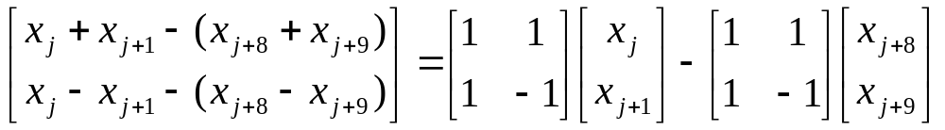
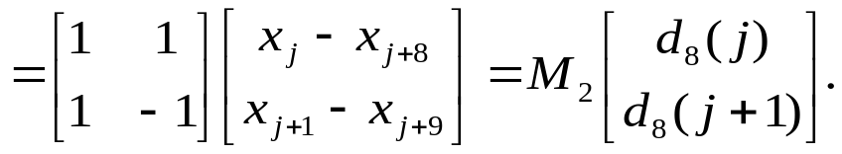

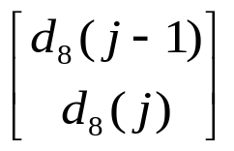

Our algorithm - order 8 WHT
x_{j} + x_{j+1} – (x_{j+8} + x_{j+9})
x_{j} – x_{j+1} – (x_{j+8} – x_{j+9})
8 additions
d₈(j)=(x_{j} - x_{j+8})
8 additions
1 addition
Order-2 WHT (2 additions)
11 additions

Slide 22
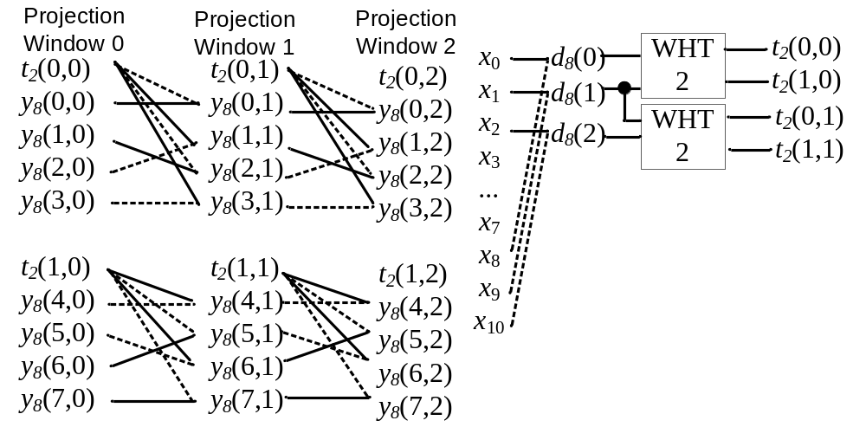
Data flow diagram for order 8 WHT

Slide 23
Computation comparison
For order N WHT, Hel-or’s algorithm: 2N-2 per window
Add/Sub per window for order 4 and 8
Order | Hel-Or’s | Our’s
4 | 6 | 5
8 | 14 | 11
! Our algorithm is faster for order 4 and 8
?
How about for order N

Slide 24
Outline
Introduction
Our algorithm for order-4 and order-8 WHT, comparison with Hel-or’s
Our algorithm for order N WHT

Slide 25
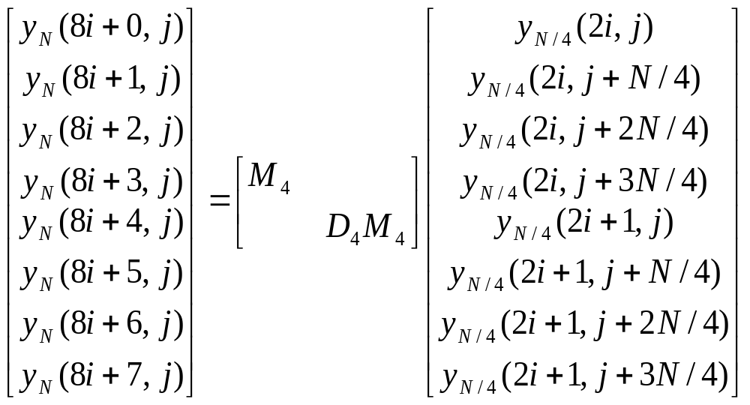
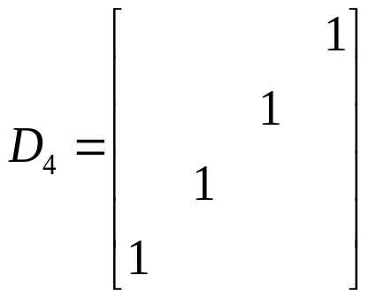
Our algorithm for order-N WHT
y_{N}(i,j) = _{N}(i)^{T} _{N}(j) for i = 0, 1, …N-1; j = 0, 1, …, K-N.
for i=0,1,…,N/8－1

Slide 26
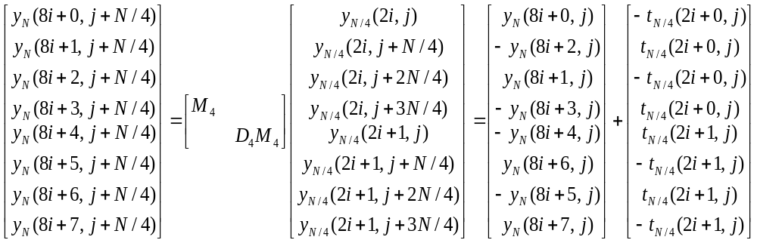
Our algorithm for order-N WHT
y_{N}(i,j) = _{N}(i)^{T} _{N}(j) for i = 0, 1, …N-1; j = 0, 1, …, K-N.
N additions
i = 0, 1, …N/8-1
t_{N/4}(i, j) = y_{N/4}(i, j) - y_{N/4}(i, j+N) for i = 0, …, N/4-1; j = 0, 1, …, K-5N/4.

Slide 27
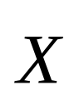


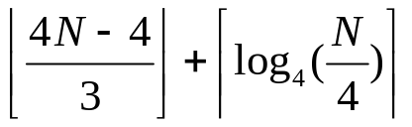
Our algorithm for order-N WHT
t_{N/4}(i, j) = y_{N/4}(i,j) - y_{N/4}(i, j+N)
= _{N/4}(i)^{T} _{N/4}(j) - _{N/4}(i)^{T} _{N/4}(j+N)
= _{N/4}(i) ^{T}[ _{N/4}(j) - _{N/4}(j+N) ]
= _{N/4}(i)^{T} _{N/4}(j).
_{N/4}(j) =
_{N/4}(j) - _{N/4}(j+N)
N additions
1 addition
Order N/4 WHT
3N/2-1

Slide 28
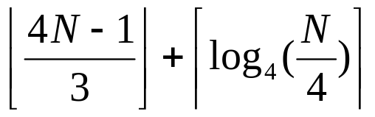
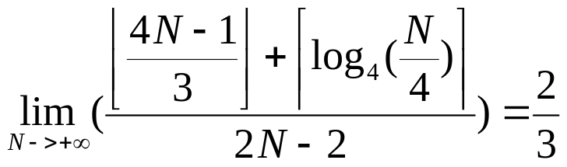
Computational comparison
Size | Hel-or’s | Ours A1 | Ours A2
4 | 6 | 5 | 5
8 | 14 | 11 | 11
16 | 30 | 23 | 22
32 | 62 | 47 | 44
N | 2N-2 | 3N/2-1

Slide 29
Thanks !

