Slide 1

Computing Sum of Pixels in a Rectangle and Haar-Like Features by Strip Sum
Student: Wanli Ouyang （歐陽萬里）
Supervisor: Prof. W.K. Cham
The Chinese University of Hong Kong

Slide 2
Outline
Introduction
The proposed algorithm
Experimental result
Conclusion

Slide 3
Outline
Introduction
The proposed algorithm
Experimental result
Conclusion

Slide 4
Introduction
Haar-like features and rectangle sum
Application

Slide 5

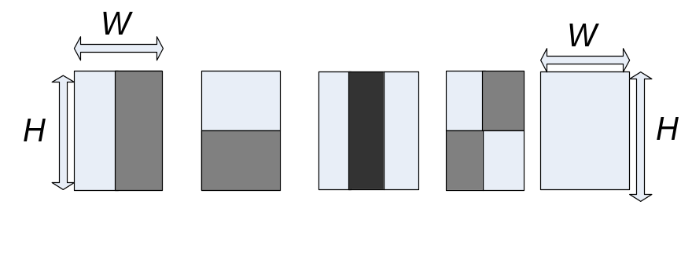




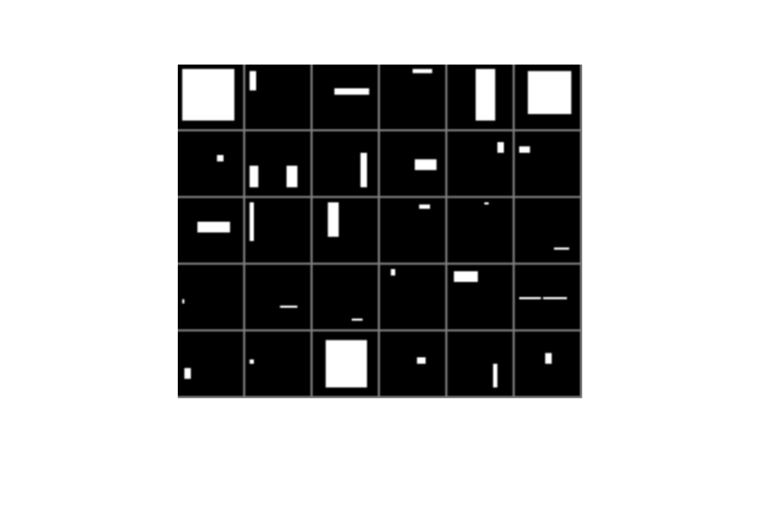
Haar-like features and rectangle sum
Simple.
Any size, any position, non-orthogonal, over-complete. Fast algorithm.
Sum of pixels in a rectangle:
rectangle sum
+1
-1
Extend
24×24: 160,000 features
W=H=4
P. Viola and M. Jones, “Rapid object detection using a boosted cascade of simple features,” CVPR pp. I: 511-I: 518, 2001.

Slide 6
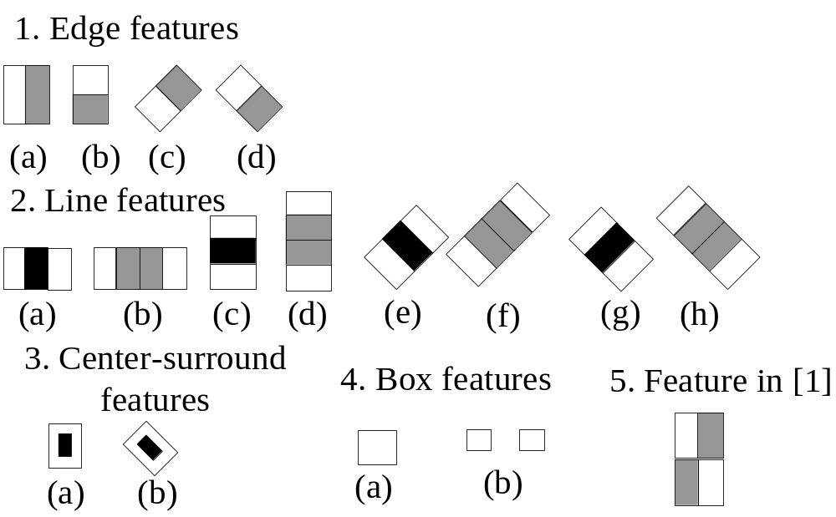
Extended Haar-like features
P. Viola and M. Jones, “Rapid object detection using a boosted cascade of simple features,” CVPR pp. I: 511-I: 518, 2001.
R. Lienhart, J. Maydt, “An extended set of Haar-like features for rapid object detection,” ICIP Vol. 1, pp.I-900 - I-903, Sept. 2002.
Feng Tang, R. Crabb, Hai Tao, “Representing Images Using Nonorthogonal Haar-Like Bases,” IEEE PAMI. Intell. Vol. 29(12), pp. 2120 – 2134, Dec. 2007.

Slide 7
Introduction
Haar-like features and rectangle sum
Application

Slide 8
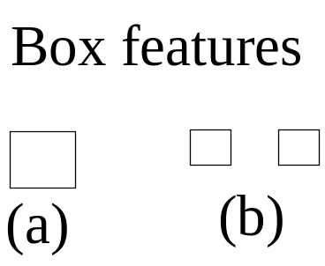
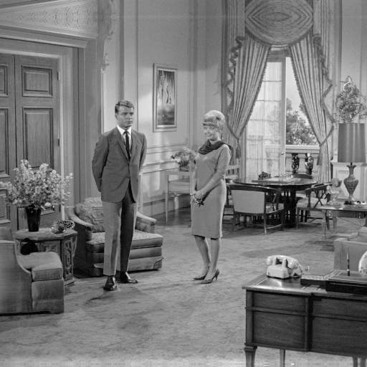
Haar-like features -- application
Face recognition
Template matching
F Tang, H Tao, Fast linear discriminant analysis using binary bases Volume 28, Issue 16, 1 December 2007, Pages 2209-2218
Feng Tang, R. Crabb, Hai Tao, “Representing Images Using Nonorthogonal Haar-Like Bases,” IEEE PAMI. Intell. Vol. 29(12), pp. 2120 – 2134, Dec. 2007.

Slide 9
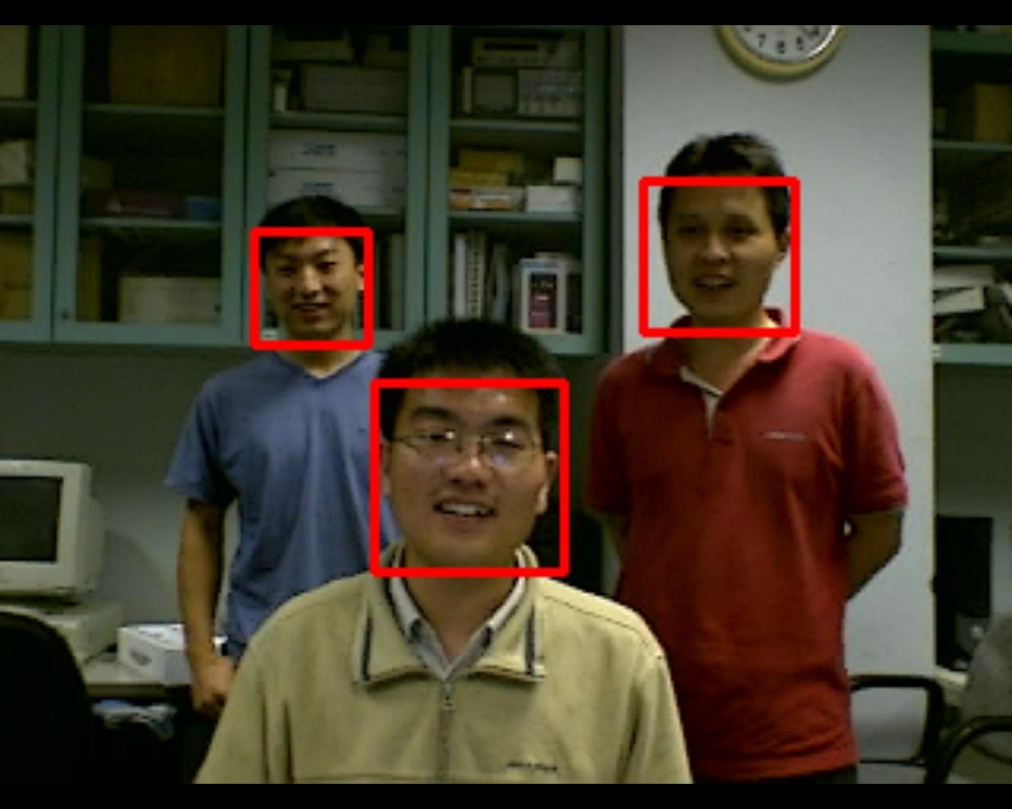
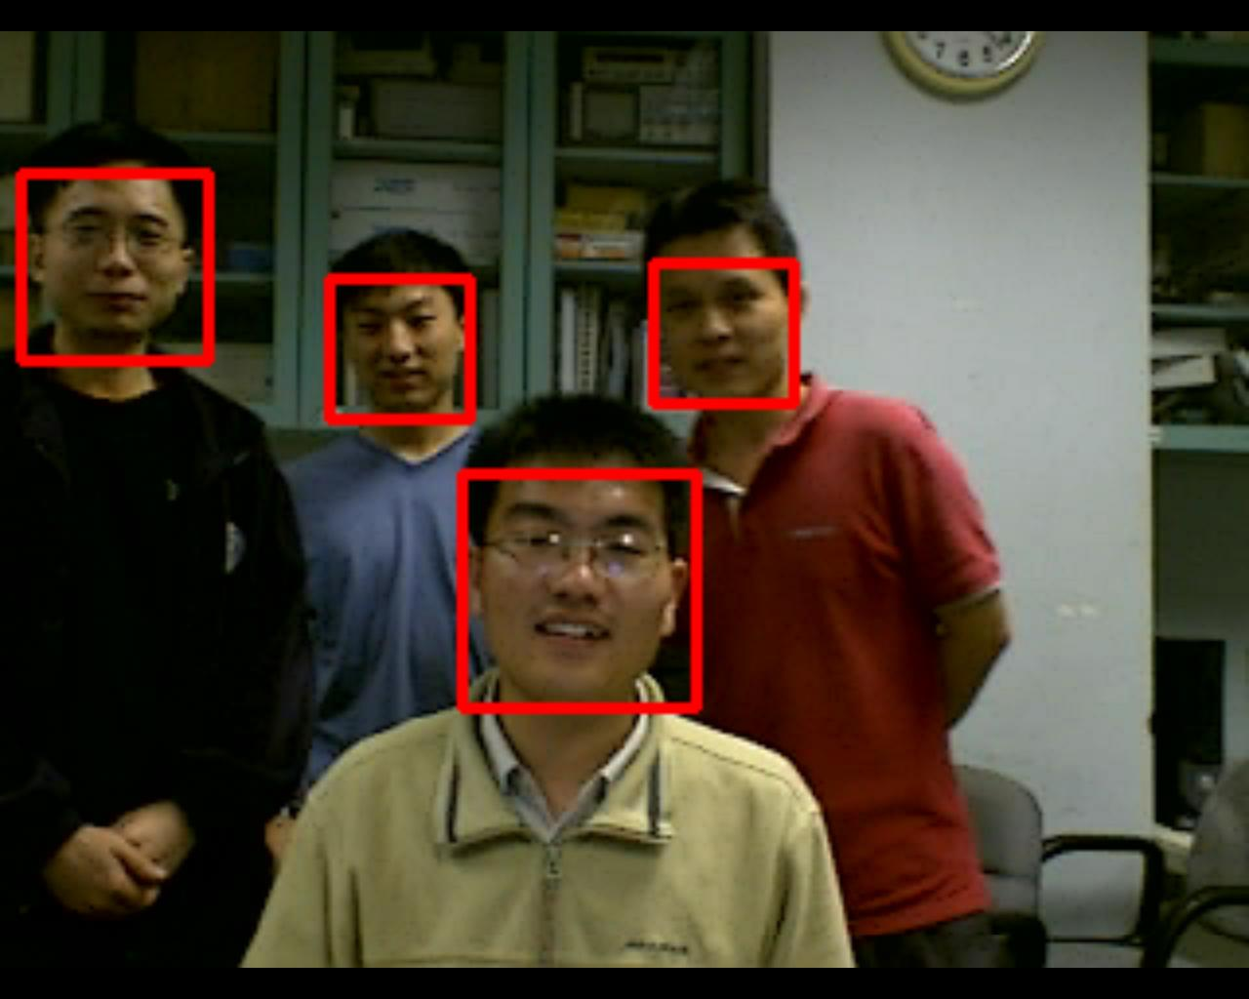
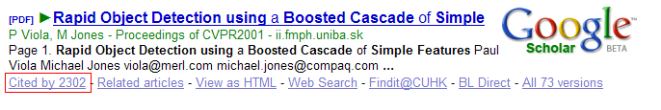
Haar-like features -- application
Face detection
From Project of Prof. Ngan and Liu Qiang
P. Viola and M. Jones, “Rapid object detection using a boosted cascade of simple features,” CVPR pp. I: 511-I: 518, 2001.

Slide 10
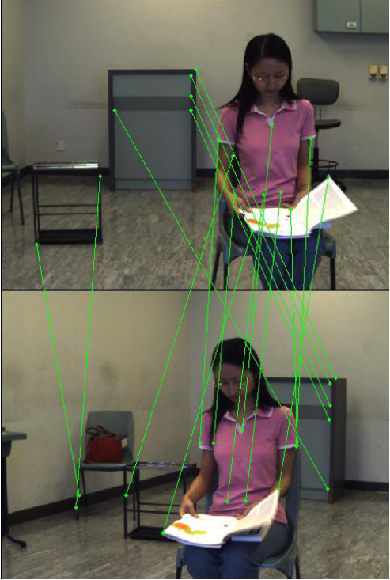
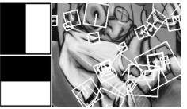
Haar-like features -- application
Feature matching
H. Bay, T. Tuytelaars, and L. Van Gool, “Surf: Speeded up robust features,” In The 9th ECCV, 2006
From Cui Chunhui’s seminar

Slide 11
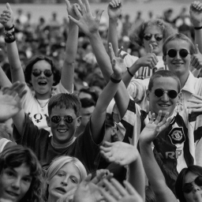
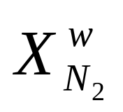
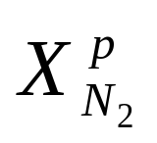
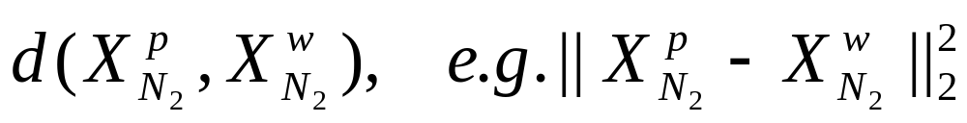
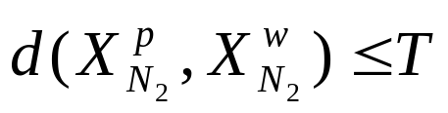
Pattern matching
Image
• • • • • • • • • • • • •
• • • • • • • • •
window
N
N
pattern
Pattern matching seeks a given pattern within an image. For each pixel, the distance between window and pattern is calculated:
The smaller the distance is, the more similar the window is to the pattern. In practice:
==> match!
Window matches the pattern or not
  Application

Slide 12
Pattern Matching application
Template matching is useful in signal processing, computer vision, image and video processing
For example, image based rendering, image compression, object detection, video compression, tracking, denoising, super resolution, texture synthesis, block matching in motion estimation, road/path tracking …

Slide 13
pattern matching
WHT has been successfully used for full search equivalent pattern matching.
We apply orthogonal Haar transform for full search equivalent pattern matching.
Y. Hel-Or and H. Hel-Or, “Real time pattern matching using projection kernels,” IEEE Trans. Pattern Analysis and Machine Intelligence, vol. 27, no. 9, pp. 1430-1445, Sept. 2005.

Slide 14
Outline
Introduction
The proposed algorithm
Experimental result
Conclusion

Slide 15
Outline
Introduction
The proposed algorithm
    Definition of rectangle sum and integral image
    Strip sum for computing rectangle sum
    Orthogonal Haar transform
Experimental result
Conclusion

Slide 16
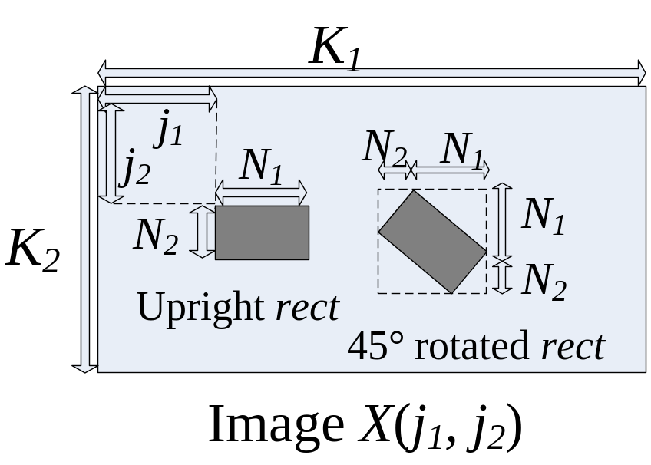
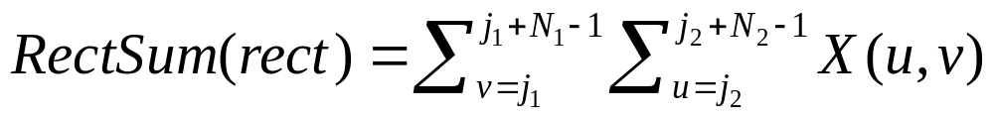
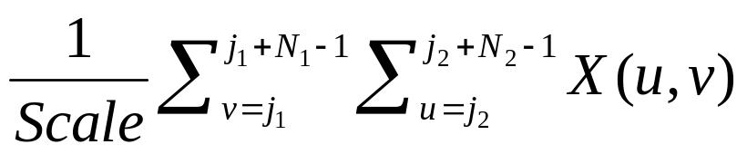
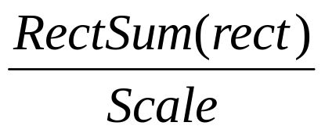
Rectangle sum - definition
A rectangle in the image X(j₁, j₂) is specified by:
rect = (j₁, j₂, N₁, N₂, θ),
  (j₁, j₂): upper left position
  (N₁, N₂): size of the rectangle.
  θ=0°: upright rectangle
  θ=45°: 45° rotated rectangle.
Related to dc component
N₁N ₂-1 additions
3 additions

Slide 17
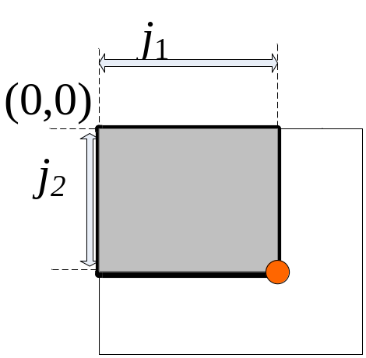
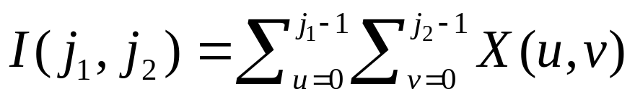
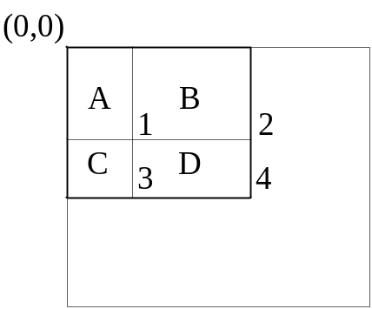
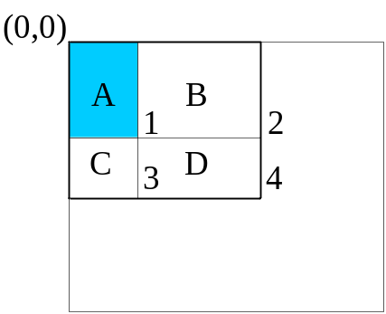
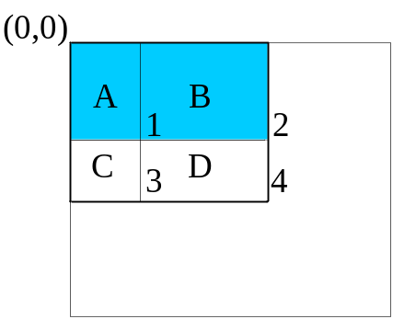
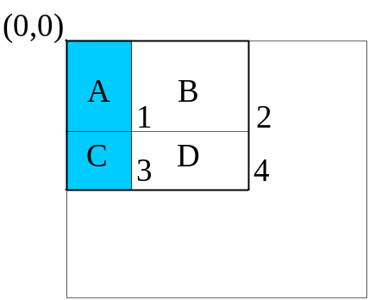
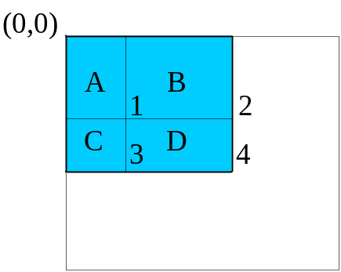
Integral image
The integral image I(j₁, j₂) is the sum of pixels above and to the left of (j₁, j₂)
1: A 2: A+B
3: A+C 4: A+B+C+D
A-D: rectangle sum
F.C. Crow. Summed-Area Tables for Texture Mapping. in Proc.11th Ann. Conf. Computer Graphics and Interactive Techniques, pp. 207-212, 1984.
P. Viola and M. Jones, “Rapid object detection using a boosted cascade of simple features,” CVPR pp. I: 511-I: 518, 2001.

Slide 18
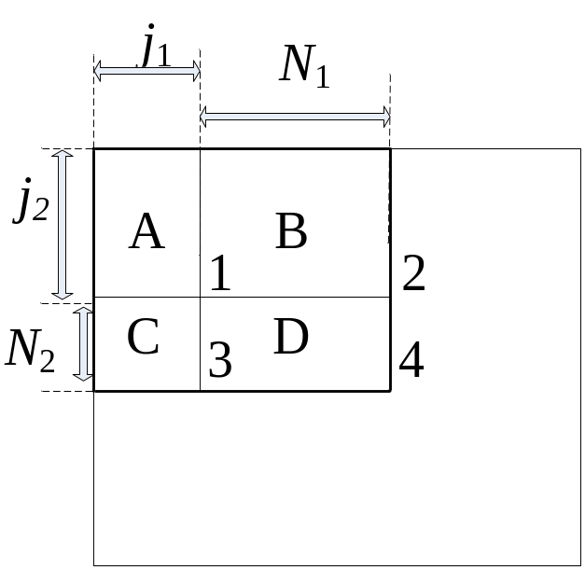
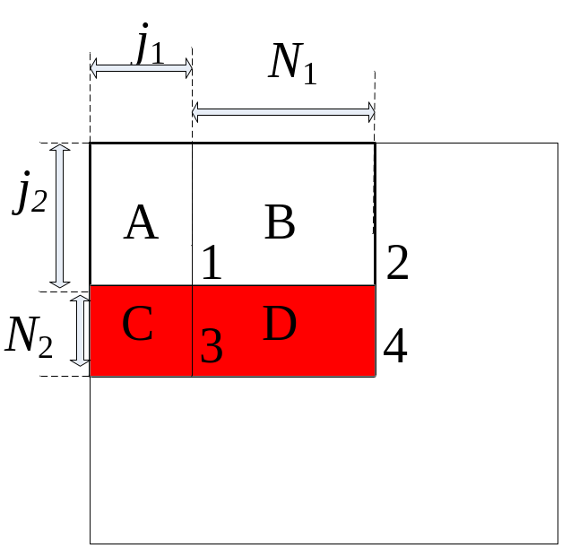
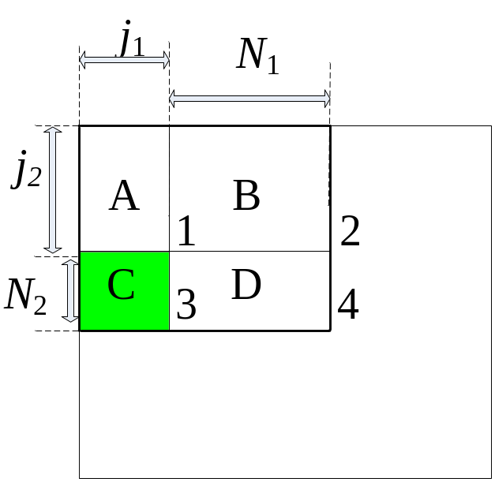
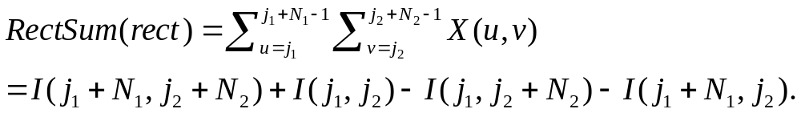
Integral image method
The integral image I(j₁, j₂) is the sum of pixels above and to the left of (j₁, j₂)
1: A 2: A+B
3: A+C 4: A+B+C+D
(0, 0)
D = 4 + 1 − 3 − 2
= 4 − 2 − (3 − 1)
A-D: rectangle sum
3 additions
4 1 3 2
F.C. Crow. Summed-Area Tables for Texture Mapping. in Proc.11th Ann. Conf. Computer Graphics and Interactive Techniques, pp. 207-212, 1984.
P. Viola and M. Jones, “Rapid object detection using a boosted cascade of simple features,” CVPR pp. I: 511-I: 518, 2001.

Slide 19
Outline
Introduction
The proposed algorithm
    Definition of rectangle sum and integral image
    Strip sum for computing rectangle sum
    Orthogonal Haar transform
Experimental result
Conclusion

Slide 20
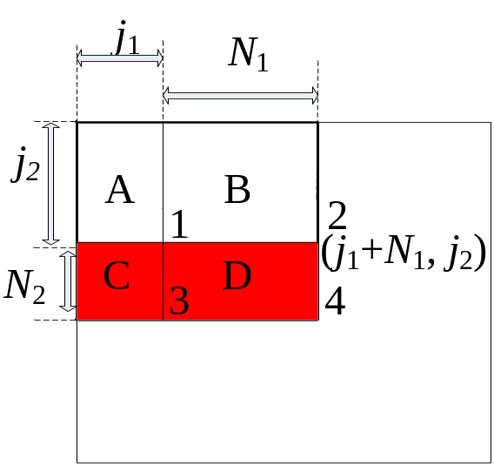
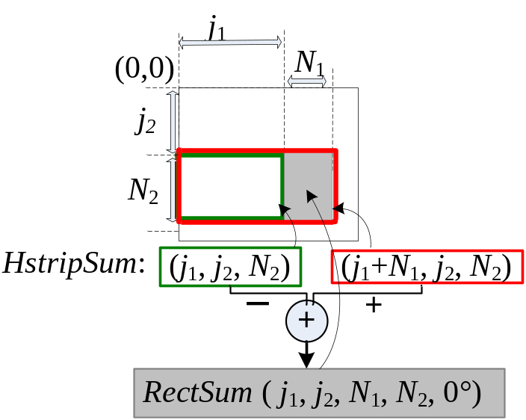

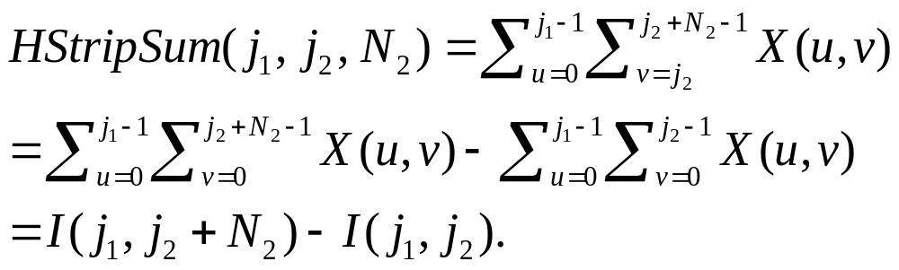
The proposed strip sum
D = 4 + 1 − 2 − 3
= 4 − 2 − (3 − 1)
(j₁, j₂)
HStrip= (j₁, j₂, N₂)
N₂
RectSum(j₁, j₂, N₁, N₂, 0°)
= [I(j₁+ N₁, j₂+N₂) – I(j₁+ N₁, j₂)] – [I(j₁, j₂+N₂) – I(j₁, j₂)]
= HStripSum(j₁+N₁, j₂, N₂) – HStripSum(j₁, j₂, N₂)
P. Viola and M. Jones, “Rapid object detection using a boosted cascade of simple features,” CVPR pp. I: 511-I: 518, 2001.

Slide 21

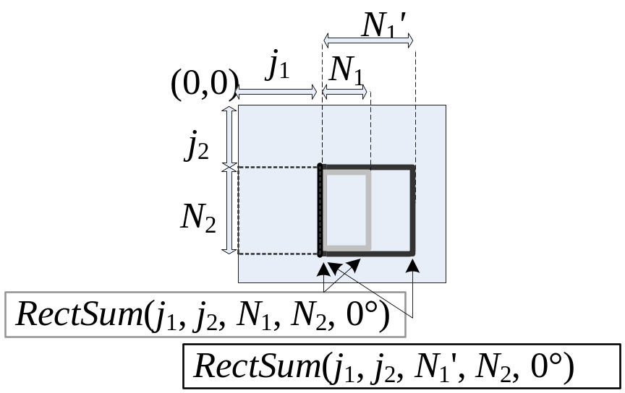
Constructing the strip sum
HStripSum(j₁, j₂, N₂) = I(j₁, j₂+N₂) – I(j₁, j₂)
1 addition
Compute 2 RectSum:
2 adds for strip sum;
6 adds for integral image.

Slide 22
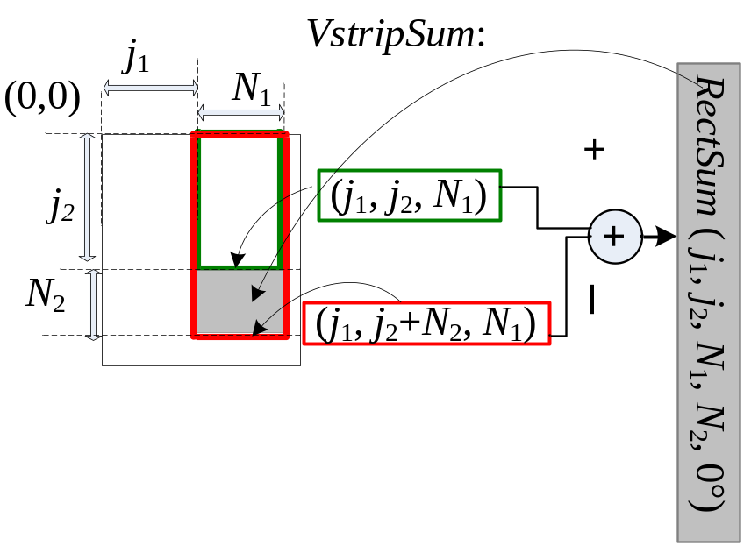

Other strips

Slide 23
Computational analysis
r=30
r rectangle sums of different sizes
Box: 4r Integral image: 3r+2
Strip sum:
  2 + Min{ Num(width), Num(height)} + r
These r rectangles have Num(width) different widths and Num(height) different heights.
Toy case
  Size 1×1 to N×N (1×1, 1×2, 2×1, 2×2, 1×3, 3×1, 2×3, … , N×N)
  r = N², Num(width)=Num(height)=N.
  Box: 4N² Integral image: 3N² + 2
  Strip sum: 2 + N + N²
D = 4 + 1 − 2 − 3
int.
Strip
Haar-like features
P. Viola and M. Jones, “Rapid object detection using a boosted cascade of simple features,” CVPR pp. I: 511-I: 518, 2001.
M. J. McDonnell. Box-filtering techniques. Comput. Graph. Image Process., 17: 65–70, 1981.

Slide 24
Haar-like features
P. Viola and M. Jones, “Rapid object detection using a boosted cascade of simple features,” CVPR pp. I: 511-I: 518, 2001.
R. Lienhart, J. Maydt, “An extended set of Haar-like features for rapid object detection,” ICIP Vol. 1, pp.I-900 - I-903, Sept. 2002.
Feng Tang, R. Crabb, Hai Tao, “Representing Images Using Nonorthogonal Haar-Like Bases,” IEEE PAMI. Intell. Vol. 29(12), pp. 2120 – 2134, Dec. 2007.

Slide 25
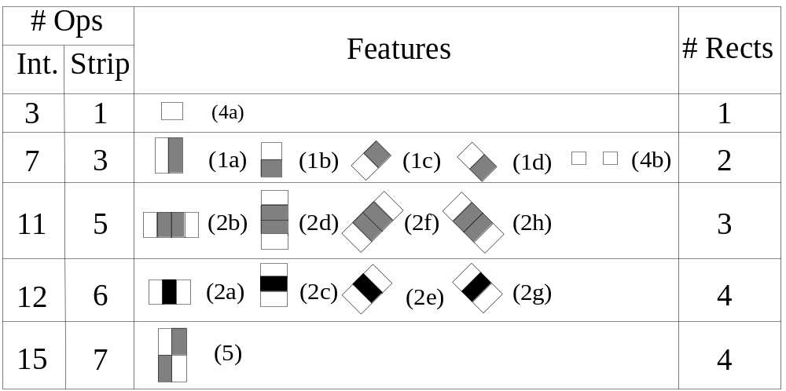
Computational analysis
Feature_{(1a)}=Rectsum₁ – Rectsum₂

Slide 26
Experiment – Face detection
OpenCV uses integral image method. In our implementation, we just replace the part that is used for computing the Haar like features.
CMU frontal face test set. All of the 130 images are used for face detection.
Methods | Integral Image | Strip Sum
Time | 23.6 Secs | 20.2 Secs
86% execution time
H. Rowley, S. Baluja, and T. Kanade. Neural network-based face detection. IEEE Patt. Anal. Mach. Intell., Vol. 20, pp. 22-38, 1998.
R. Lienhart, J. Maydt, “An extended set of Haar-like features for rapid object detection,” ICIP Vol. 1, pp.I-900 - I-903, Sept. 2002.
http://sourceforge.net/projects/opencvlibrary

Slide 27
Outline
Introduction
The proposed algorithm
    Definition of rectangle sum and integral image
    Strip sum for computing rectangle sum
    Orthogonal Haar transform
Experimental result
Conclusion

Slide 28

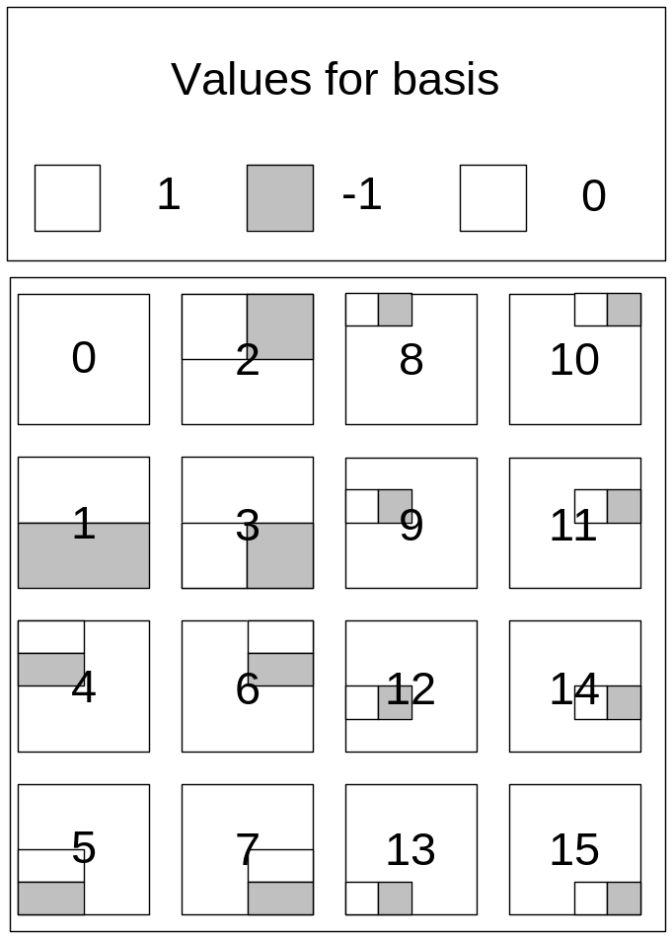
The proposed orthogonal Haar transform
OHT on sliding windows.
The same Haar feature has been considered as different basis for different window positions!
Basis 2 and 3 are the same Haar feature on different window positions.
2
3
2
3

Slide 29
The proposed orthogonal Haar transform
Basis 2 and 3 are the same Haar feature on different window positions.
Similarly for 4-7.
Similarly for basis 8-15.
Compute u basis:
u=2: 2 Haar features.
u=4: 3 Haar features.
u=8: 4 Haar features.
u=16: 5 Haar features.
u: 1+log₂u Haar features.
4 + 2.5log₂u additions for computing u OHT 2-D basis.

Slide 30
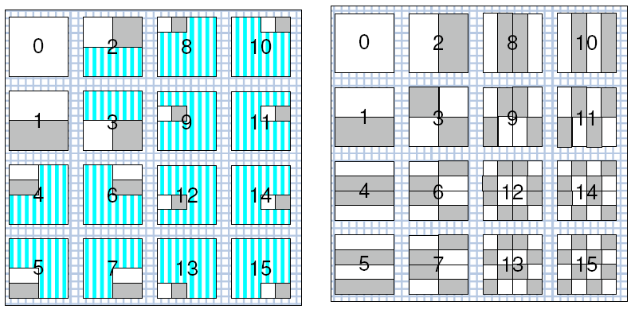
OHT and WHT
- example
4x4 OHT
4x4 WHT

Slide 31
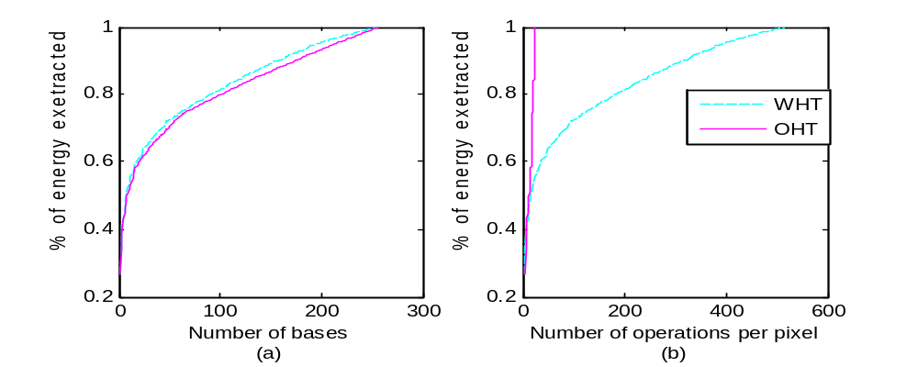
OHT and WHT
- Energy compaction ability
X: number of Basis
Y: Energy extracted
X: number of operations
Y: Energy extracted
Y. Hel-Or and H. Hel-Or. Real time pattern matching using projection kernels. TPAMI, 27(9):1430–1445, Sept. 2005.
G. Ben-Artz, H. Hel-Or, and Y. Hel-Or. The Gray-code filter kernels. TPAMI, 29(3):382– 393, Mar. 2007.
W. Ouyang and W. Cham. Fast algorithm for Walsh Hadamard transform on sliding windows. TPAMI, 32(1):165–171, Jan. 2010.

Slide 32
Outline
Introduction
The proposed algorithm
Experimental result
Conclusion

Slide 33
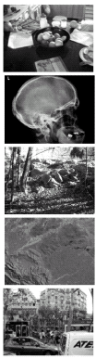
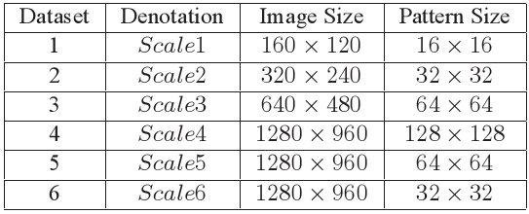
Datasets (1)
120 images selected from 3 different databases. MIT, medical and remote sensing.
F. Tombari etc. Full search-equivalent pattern matching with incremental dissimilarity approximations. IEEE TPAMI, 31(1):129–141, Jan.2009. 1,8, 9
http://people.csail.mit.edu/torralba/images.
http://zulu.ssc.nasa.gov/mrsid.
www.data-compression.info/corpora/lukascorpus

Slide 34
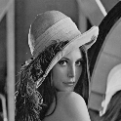
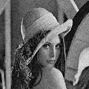

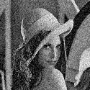

Datasets (2)
Noises: N1, N2, N3 and N4,
Variances: 100, 200, 400 and 800
PSNR: 28.1, 25.1, 22.1 and 19.2
N1
N2
N3
N4

Slide 35
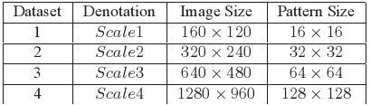
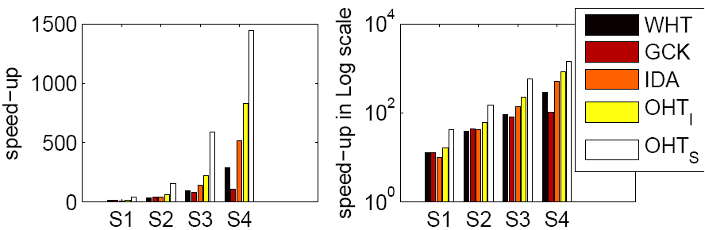
1. Evaluating algorithms on different sizes
Speedup over full search (FS) in pattern matching
OHT_{I}: OHT using integral image
OHT_{s}: OHT using strip sum
Time_{FS}/ Time_{WHT}
Time_{FS}/ Time_{GCK}
Time_{FS}/ Time_{IDA}
500s/1s = 500
Y. Hel-Or and H. Hel-Or, “Real time pattern matching using projection kernels,” IEEE Trans. Pattern Analysis and Machine Intelligence, vol. 27, no. 9, pp. 1430-1445, Sept. 2005.
G. Ben-Artzi, H. Hel-Or, and Y. Hel-Or, “The gray-code filter kernels,” IEEE Trans. Pattern Analysis and Machine Intelligence, vol. 29, no. 3, pp.382 – 393, Mar. 2007
F. Tombari etc. Full search-equivalent pattern matching with incremental dissimilarity approximations. IEEE TPAMI, 31(1):129–141, Jan.2009. 1,8, 9

Slide 36

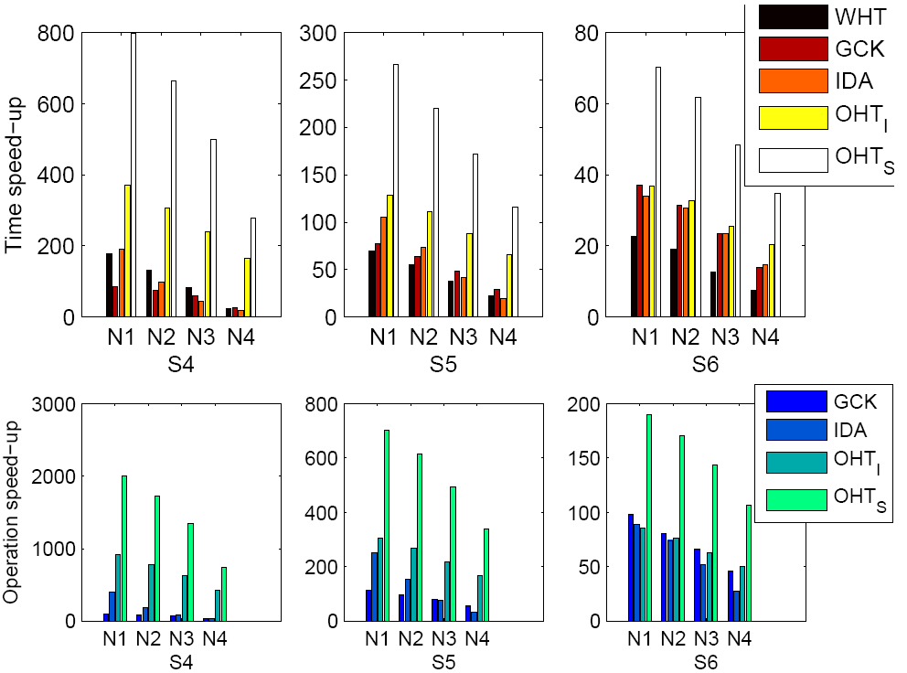
2. Evaluating algorithms on different pattern sizes and different noise levels
Speedup over FS.
Time??/ Time_{OHT}
Y. Hel-Or and H. Hel-Or, “Real time pattern matching using projection kernels,” IEEE Trans. Pattern Analysis and Machine Intelligence, vol. 27, no. 9, pp. 1430-1445, Sept. 2005.
G. Ben-Artzi, H. Hel-Or, and Y. Hel-Or, “The gray-code filter kernels,” IEEE Trans. Pattern Analysis and Machine Intelligence, vol. 29, no. 3, pp.382 – 393, Mar. 2007
F. Tombari etc. Full search-equivalent pattern matching with incremental dissimilarity approximations. IEEE TPAMI, 31(1):129–141, Jan.2009. 1,8, 9

Slide 37
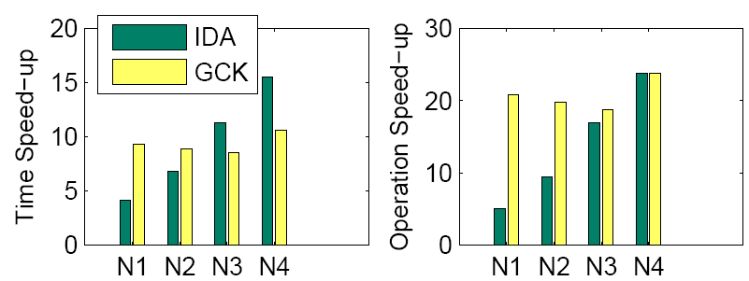
2. Evaluating algorithms on different pattern sizes and different noise levels (2)
At about 4-15 times the speed of IDA
At about 8-10 times the speed of GCK
G. Ben-Artzi, H. Hel-Or, and Y. Hel-Or, “The gray-code filter kernels,” IEEE Trans. Pattern Analysis and Machine Intelligence, vol. 29, no. 3, pp.382 – 393, Mar. 2007
F. Tombari etc. Full search-equivalent pattern matching with incremental dissimilarity approximations. IEEE TPAMI, 31(1):129–141, Jan.2009. 1,8, 9

Slide 38
Outline
Introduction
The proposed algorithm
Experimental result
Conclusion

Slide 39
Conclusion
A data structure (strip sum) that computes sum of pixels in a rectangle by 1 addition.
A transform (orthogonal Haar transform) that requires O(logu) additions per pixel to project N1xN2 input window onto u basis vectors.
Pattern matching using OHT Find the same result as Full Search (FS).
Experimental results show that it can achieve up to 10 times speed-up over GCK in pattern matching.

Slide 40

Thanks !

