Slide 1

Machine Learning Overview
Brian Wright, PhD

Slide 2
Themes
Machine Learning Lifecycle
Are you ready for Machine Learning?
Terms and Phases

Slide 3
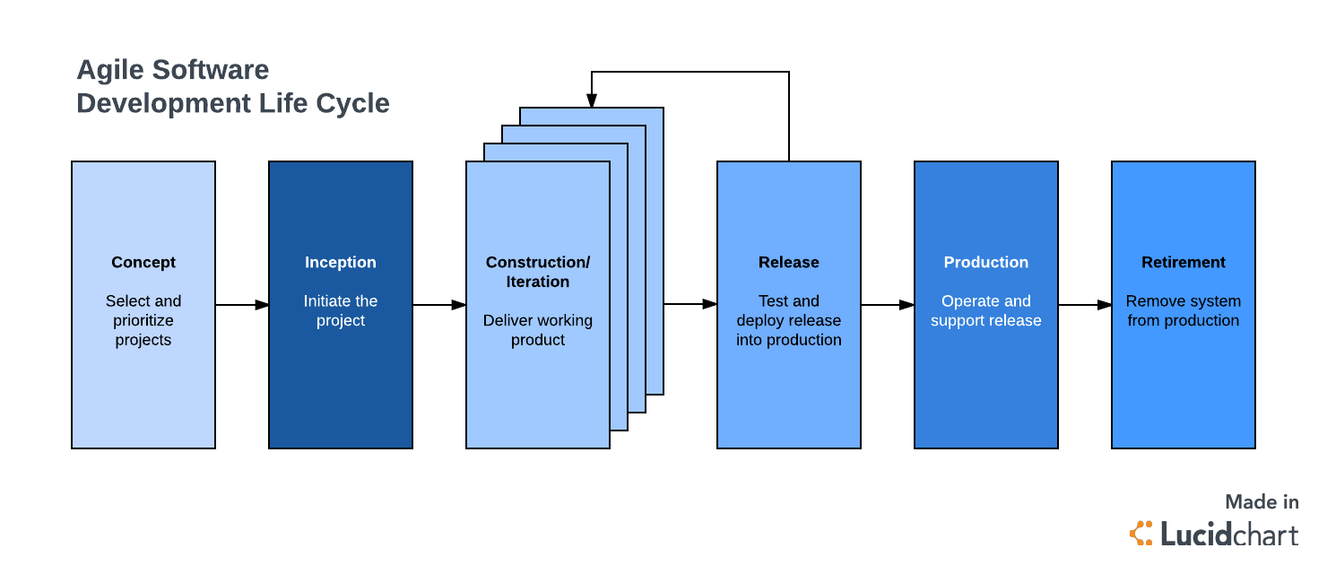
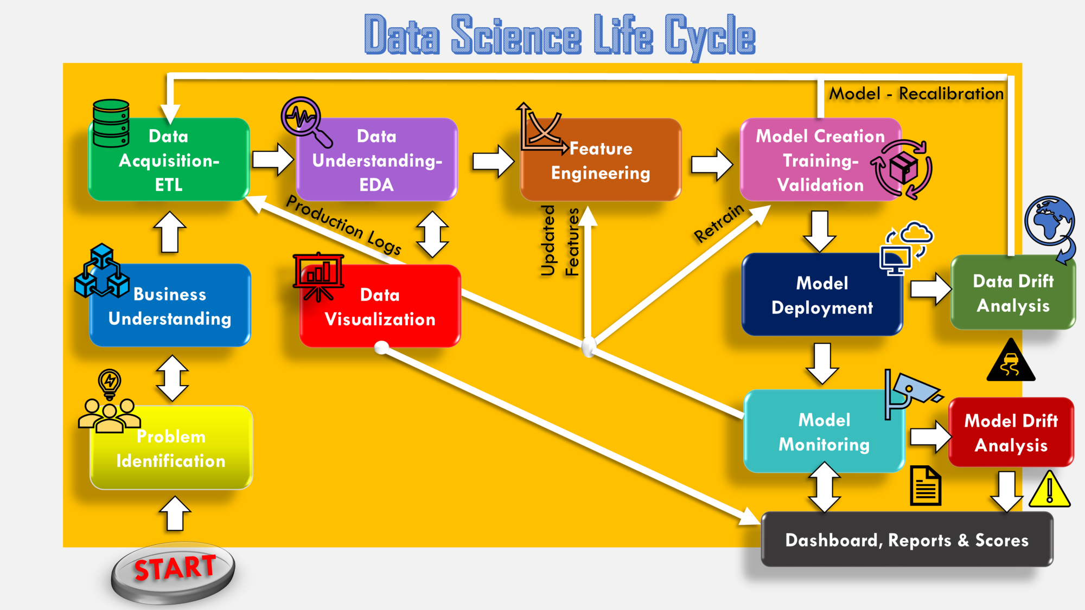
Engineering of Machine Learning Algos versus Software Development
Source: https://towardsdatascience.com/stoend-to-end-data-science-life-cycle-6387523b5afc

Slide 4
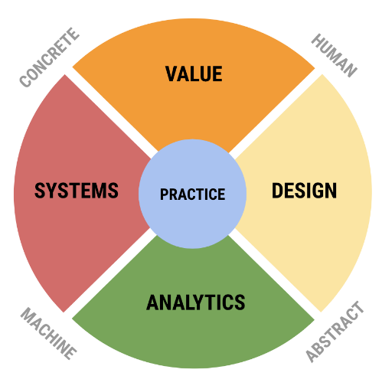
Brian’s Version of Data Science Lifecycle
Phase 2: Data Prep and Problem Exploration
G1
G2
Data Acquisition - ETL
Data Understanding - EDA
Initial Model(s) Building
Initial Model
Evaluation
Model Creation & Training
Evaluation Criteria Value Metric
Feature Engineering and Evaluation
Phase 1: Idea Development
Model Deployment
Optimization – Hyperpara and Evaluation
Business Understanding
Data Drift Analysis
Model Performance – Evaluation Value Metric
G3
Question ID
Phase 3: Solution Development
Model Drift Analysis – Model Evaluation
Gate Reviews
Reports – Dashboards - Products
Phase 4: Solution Deployment

Slide 5
Machine Learning Time

Slide 6
“A field of Computer Science that gives computers the ability to learn
without being explicitly programmed.”
Arthur Samuel (Coined the term in 1959 at IBM)
“The ability [for systems] to acquire their own knowledge, by
extracting patterns from raw data.”
Deep Learning, Goodfellow et al
“A computer program is said to learn from experience E with respect
to some set of tasks T and performance measure P if its performance
tasks in T, as measured by P, improves with experience E.”
- Tom Mitchell (Computer Scientist & Professor at Carnegie Mellon)

Slide 7
Machine vs. human
 | Machine | Human
Understanding context |  | ✔
Thinking through the problem |  | ✔
Asking the right questions |  | ✔
Selecting the right tools |  | ✔
Performing calculations quickly | ✔
Performing repetitive tasks | ✔
Following pre-defined rules | ✔
Interpreting results |  | ✔

Slide 8
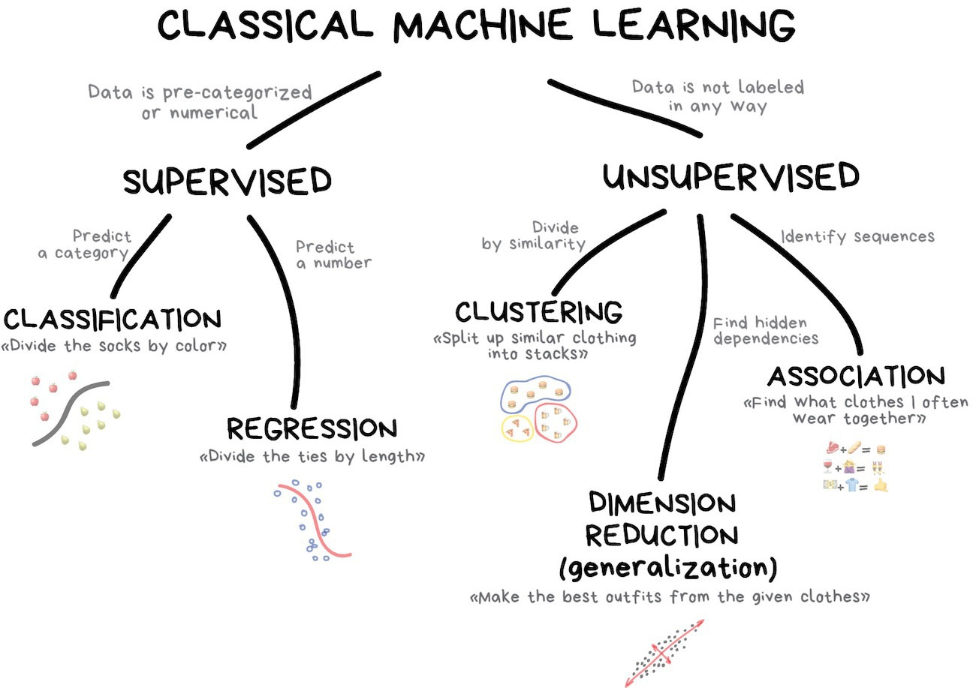

Slide 9


Supervised machine learning
Pattern discovery when inputs (x) and outputs (y) are known
Output y:
Political affiliation
Input x:
Voter
Examples: Classification and regression are supervised machine learning
Notes:
Throughout this course, we will be doing two main types of data analysis:
Supervised machine learning refers to when we know what outputs are available to us, so we can put them into categories that we define before we run any analysis. For example, if we want to know what some of the best quality wines are, we have a list of wines (our inputs) and we can also create categories of wine (bad, good, great). Then, we run the list through our algorithm and it will automatically put them into the predefined categories.
Both classification and regression are supervised machine learning.

Slide 10

Unsupervised machine learning
The data inputs (x) have no target outputs (y)
?
Input x:
Voter
Output y:
Not given
(to be discovered)
We want to impose structure on the inputs (x) to say something meaningful about the data
Notes:
On the other hand, we have unsupervised machine learning.
In this case, we don’t actually know what categories we want the output to be in. So we focus on organizing and dividing the data in such a way as to show us something meaningful about the data that we might not have considered before.
Let’s assume that we have the same wine list, but in this case, we’re not sure what type of output we want. We can create categories (by region, by year, price range, type) to find out which wines cluster together, and then analyze it to find new patterns and insights.

Slide 11
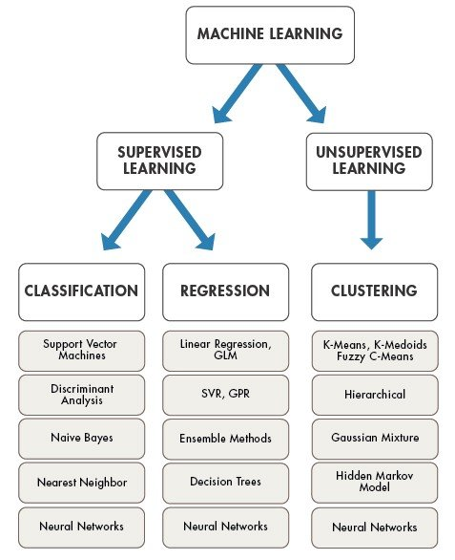

Slide 12
Machine Learning is a general use technology what does that mean?

Slide 13
Machine Learning Overview
A general-purpose technology or GPT is a term coined to describe a new method of producing and inventing that is important enough to have a protracted aggregate impact.
Similar to electricity or the internet, in that it can be applied across domains and work to improve market outcomes.

Slide 14
Machine Learning Overview
Twitter Data Usage
Error rates on ImageNet (10,000 labelled images) have been driven down from 30% in 2010 to less than 3% today.
Below 5% is important why?
Chess: Deep Blue (IBM AI) searched some 200 million positions per second, Kasparov was searching not more than 5–10 positions probably, per second. Yet he played almost at the same level….why?

Slide 15
Machine Learning Overview
However, before we all turn into robots consider two important facts:
We remain remarkably far away from what would be consider a similar general intelligence that can be compared to humans
Machines cannot do the full range of tasks that humans can do
We can then refer to jobs or activities that might be good cases for Machine Learning as SML or Suitable for Machine Learning
What are examples of tasks that might be SML and how do we know if our organizations are ready?

Slide 16
Machine Learning Overview
Successful implementation of ML requires very detailed specifications on what is to be learned and data to support that learning activity.
Including the development of engineering features through a series of trial-and-error and..
Then most importantly embedding these products into normal business operations in such a way that efficiencies can be realized.
Notes:
Mimic a human, often a group to learn processes

Slide 17
Machine Learning Overview
What tasks are most suitable for ML to take over:
Most recent successes are predicated on supervised learning
Competency is narrow as compared to the complexity of human decision making
Learning a function that maps well-defined inputs to well-defined outputs
If can predict Y given any value of X – still might not produce the actual causal effect
Large Data is present or can be created containing input-output pairs
The more training data available the more arcuate the model
Task provides clear feedback with well definable goals and metrics
If we know what to achieve – (optimize flight patterns not a single flight)
Where reasoning and diverse background knowledge is not necessary
Good at empirical associations but terrible at decision making that requires common sense of historical knowledge
No need for why the decision was made to be clear
NN could use millions numerical weights
Notes:
3 – Often we don’t know because humans don’t have the answer

Slide 18
Machine Learning Overview
A tolerance for error or sub-optimal solutions
ML use probabilistic outputs which means some error is always assumed
Function of item being learned should not change rapidly over time
Work best when the distribution of future test examples is the same roughly as the training set over time
If not the case systems need to be in place to refresh algorithms
Notes:
3 – Often we don’t know because humans don’t have the answer

Slide 19
How do machines learn?
The basic machine learning process can be divided into three parts.
Data Input: Past data or information is utilized as a basis for future decision-making
Abstraction: The input data is represented in a broader way through the underlying algorithm
Generalization: The abstracted representation is generalized to form a framework for making decisions
(reference Introduction to ML by Subramanian Chandramouli, Saikat Dutt, Amit Kumar Das (https://learning.oreilly.com/library/view/machine-learning/9789389588132/xhtml/chapter001.xhtml#ch1_1)

Slide 20
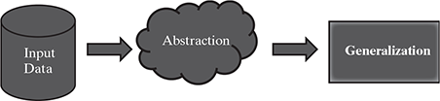

Slide 21
Brian’s Version of Data Science Lifecycle
Phase 2: Data Prep and Problem Exploration
G1
G2
Data Acquisition/ Representation
Data Understanding - EDA
Initial Model(s) Building
Initial Model
Evaluation
Model Creation & Training
Feature Engineering and Evaluation
Phase 3: Solution Development
Evaluation Criteria/Value Metric
Phase 1: Idea Development
Model Deployment
Final Model Development
Question ID
G3
Data Drift Analysis
Model Performance – Evaluation Value Metric
Business Understanding
Model Drift Analysis – Model Evaluation
Gate Reviews
Reports – Dashboards - Products
Phase 4: Solution Deployment

Slide 22
Overview of SOME Key ML Methods/Terms
Phase – 1 Idea Development
Prediction versus Inference
Independent Metric for Business Value
Target Variable and features
Classification versus Regression
Probabilistic Interpretation
Data acquisition/gathering
Phase – 2 Data Prep and Problem Exploration
Variable types and data types
Scaling and/or Normalizing Data/One-Hot Encoding
Missing Data
Baseline – prevalence
Data Partitioning/Sampling
EDA and (Summary Stats and Visuals)
Cross Validation
Phase – 3 – Solution Model Development
Parameters versus Hyperparameters
Thresholding
Feature Engineering
Bias versus Variance Tradeoff
Model Evaluation
Non-parametric modelling (random state)

Slide 23
Phase I

Slide 24
# Prediction versus Inference

Slide 25
# Prediction versus Inference
Goals of prediction are not centered on how the features are interacting or resulting in an event but are instead focused on the ability of the model to predicted an event.
Almost all ML methods are focused on predication not causation or inference.
This is why model performance is based largely on how well a model predicts not necessarily how much individual variables are contributing to error reduction.

Slide 26
Overview of Key ML Methods/Terms
Independent Metric for Business Value
A key part of building a solution using Machine Learning Techniques is having a metric that is independent of the model that can be used to determine if the model is providing value.
Examples
Recommender Engine for Netflix: Number of user clicks
Spam Block Predictor: Number of viruses in the network
Market Clustering: Did sales increase
Others?

Slide 27
Overview of Key ML Methods/Terms: Target Variable versus Features
Target variable – Is the variable that includes the patterns the machine learning algorithm is trying to learn. It is the variable of interest and key to evaluating the model output.
More simply it is the variable we are trying to predict.
Feature variables – Are the variables the model will use to learn the patterns of the target variable. The process of feature engineering can result in additional features.
More simply these are the variables used for predicting the target

Slide 28
Overview of Key ML Methods/Terms: Classification versus Regression
Classification is the process of developing a model to predict whether a target variable is in defined categories. This is driven by having either a binary or multi-level categorical variable as the target variable.
Examples:
Predicting whether someone is male, or female based on 1,000s of pictures.
Predicting whether a team will have a winning season or not based on player performance
Predicting whether a person will default on a loan or not
Key point: The predications of the model are not binary (1s or 0s) but are given as percentages indicating the likelihood that any one row of data belongs to any one category. In the case of target variables with multiple categories each row will get the same number of percent predictions as categories.

Slide 29
Overview of Key ML Methods/Terms: Classification versus Regression
Regression is the process of developing a model to predict a specific number or range of numbers. This is driven by having a continuous variable as the target variable for the model
Examples:
Predicting the score given the players playing a game.
Predicting an amount of rain given weather conditions
Predicting a persons weight based on various personal statistics

Slide 30
Overview of Key ML Methods/Terms: Probabilistic Interpretation
A significant portion of this class will focus on building models for classification. Classification is a much more common machine learning goal versus regression.
We all know the range of values for probabilities, 0 to 100, the key to understanding these outputs is to think of them as risk measures, with 100 being no risk and 0 being all the risk!
How the outputs are used will depend on your question.
Example: How certain do you want to be that a drug is effective as compared to whether a customer will open a marketing email? The results could both yield 75% probabilities but is that high enough?
Could also think of the outputs as a quantification of uncertainty, the question becomes given your problem how much uncertainty are you willing to accept?

Slide 31
Overview of Key ML Methods/Terms: Data Brainstorming
Data to Concept – Does the data available support the algo target and goal
How difficult is the data to gather?
Is the data large enough?
What is the rate of change of the data?
Do we believe this is the correct source and data content to address the problem?
Learning Difficulty – How complex or vague is the target variable?
Are there imbalances in the classes?
Does the data clearly link to the problem?
Has this data been used in the past, to what success?
Is the target difficult to measure or break into smaller components?
What risk level are you willing to accept given the question?

Slide 32
Phase II

Slide 33
Brian’s Version of Data Science Lifecycle
Phase 2: Data Prep and Problem Exploration
G1
G2
Data Acquisition/ Representation
Data Understanding - EDA
Initial Model(s) Building
Initial Model
Evaluation
Model Creation & Training
Feature Engineering and Evaluation
Phase 3: Solution Development
Evaluation Criteria/Value Metric
Phase 1: Idea Development
Model Deployment
Final Model Development
Question ID
G3
Data Drift Analysis
Model Performance – Evaluation Value Metric
Business Understanding
Model Drift Analysis – Model Evaluation
Gate Reviews
Reports – Dashboards - Products
Phase 4: Solution Deployment

Slide 34
Overview of SOME Key ML Methods/Terms
Phase – 1 Idea Development
Prediction versus Inference
Independent Metric for Business Value
Target Variable and features
Classification versus Regression
Probabilistic Interpretation
Data acquisition/gathering
Phase – 2 Data Prep and Problem Exploration
Variable types and data types
Baseline – prevalence
Scaling and/or Normalizing Data/One-Hot Encoding
Missing Data
Data Partitioning/Sampling
EDA (Summary Stats and Visuals)
Cross Validation
Phase – 3 – Solution Model Development
Parameters versus Hyperparameters
Thresholding
Feature Engineering
Bias versus Variance Tradeoff
Model Evaluation
Non-parametric modelling (random state)

Slide 35
Overview of Key ML Methods/Terms
Variable Types and Data Types
Five Atomic Variable Types in R
Numeric – number unlimited size
Integer – number with constraints on size
Complex – numbers and characters
Character – words
Factor – unique character class that is limited in the number of categories
Logical – True or False
Data Types
List - A list is an R-object containing different types of elements inside it like vectors, functions, and even another list inside it.
Vector - A vector in R is a series of data items of the same basic type (from above)
Array - is a list or vector with two or more dimensions
Matrix - A matrix is a two-dimensional rectangular data structure, created through the use of matrix function. Usually numeric, can’t have different data types, think of it as many vectors
Dataframe – A two dimensional object that can contain multiple variable types

Slide 36
Overview of Key ML Methods/Terms
Some useful variable and data type
str()
class()
names()
length()
dim()
Open up Rstudio and try these functions out on the mtcars dataset. See if you agree with the output.

Slide 37
Overview of Key ML Methods/Terms
Baseline – prevalence
The proportion of a particular population found to be in the positive class at a specific time. “Positive class” in this example is the class to which we are trying to learn. Percentage split across classes of our target variable.
Using mtcars again, what is the prevalence of vs variable?

Slide 38
Overview of Key ML Methods/Terms
Scaling and/or Normalizing Data/One-Hot Encoding
Many DS approaches require the data to be normalized or placed into a standard format so comparison between variables is possible.
For factor variables this measure creating individual columns for each level that are logical or Boolean 1s and 0s.
We will mostly use a min max scaler that will maintain the variance of the values but re-calculate them to be between 1 and 0.
Use the minmax scaling function in the gradDescent package and scale the mtcars dataset setting the results to a new object. What happens? What class is the object? Can you view the data.frame?

Slide 39
Overview of Key ML Methods/Terms
Missing Data
Large area of study concerning missing data. Here we just need to be aware of how to check for missing data and quick solutions
R comes with several functions/packages that handle missing data we are going to focus on the MICE package.
First you need to try to detect if there are patterns of missing data, is it random or not. If you detect patterns than you have to develop a strategy to deal with that issue.
MCAR – missing completely at random
MNAR - missing not at random
Start with the summary() function on a data frame
Load in the beaches dataframe from the data file and find the columns that have missing data using the summary function
Generally variables with more the about 5% missing values should be deleted or imputation needs to occur
Dig a little deeper and use the md.pattern() function in the Mice package.
Since there doesn’t appear to be a pattern we will use complete cases to remove the NAs.

Slide 40
Overview of Key ML Methods/Terms
Missing Data
Complete.cases() function creates a index to remove missing values
remove missing values from a vector
x <- x[complete.cases(x)]
remove from a data.frame
df <- df[complete.cases(df), ]
remove from individual rows
df <- df[complete.cases(df[ , c(row1, row2, ….)]), ]
Try the dataframe version on the beaches dataset, then use summary() to see if the missing datapoints are gone.
MICE package can also do imputation (NA replacement) very easily, lots of examples online on how to do these in very robust ways.

Slide 41
Overview of Key ML Methods/Terms
Partitioning and Sampling
We need to split our data into three sections (in most cases) to build machine learning models
Training – What we use to build the original model
Tune – Data used to evaluate initial outputs of a model after it’s been modified (example: changing the k in kNN) (Feature Engineering)
Test – Very last step to evaluate the quality of the model after training and tune
The function we will be using throughout the course will be the createDataPartition() function in the caret package.
The problem is that it’s not great at creating multiple partition, so we essentially use it twice to create a sample, then a sample of a sample.
Need to make sure to use the target variable to do stratified sampling, otherwise we could create imbalances in our samples.

Slide 42
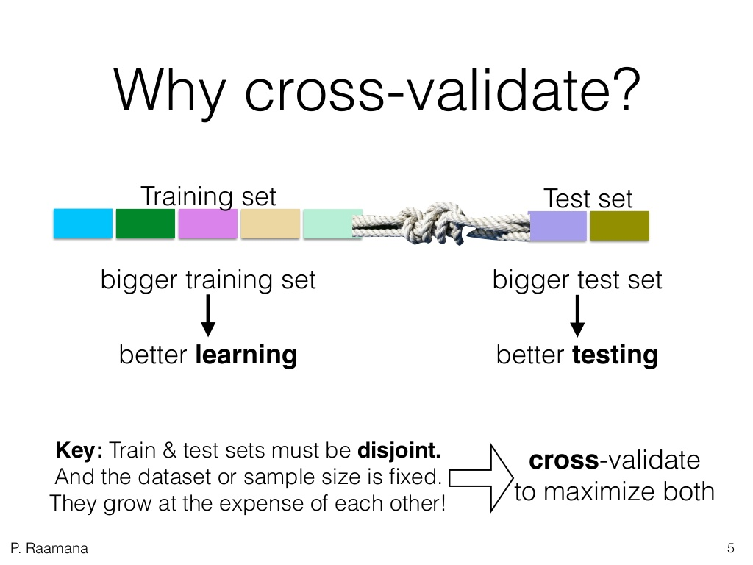
Cross- Validation

Slide 43
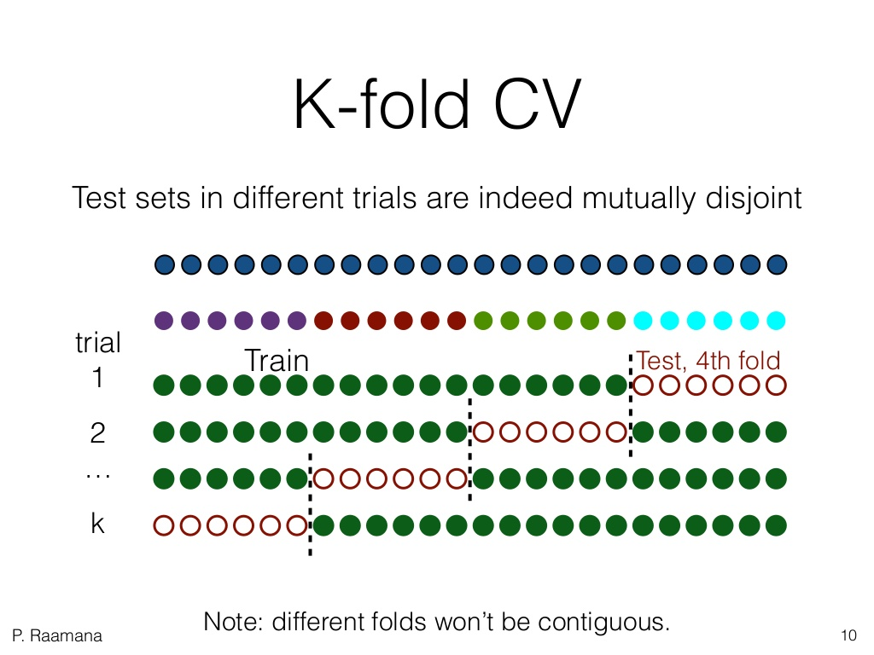
Cross-Validation

Slide 44
Phase III

Slide 45
Overview of SOME Key ML Methods/Terms
Phase – 1 Idea Development
Prediction versus Inference
Independent Metric for Business Value
Target Variable and features
Classification versus Regression
Probabilistic Interpretation
Data acquisition/gathering
Phase – 2 Data Prep and Problem Exploration
Variable types and data types
Baseline – prevalence
Scaling and/or Normalizing Data/One-Hot Encoding
Missing Data
Data Partitioning/Sampling
EDA (Summary Stats and Visuals)
Cross Validation
Phase – 3 – Solution Model Development
Parameters versus Hyperparameters
Thresholding
Feature Engineering
Bias versus Variance Tradeoff
Model Evaluation/Model Building Process - kNN

Slide 46
Brian’s Version of Data Science Lifecycle
Phase 2: Data Prep and Problem Exploration
G1
G2
Data Acquisition/ Representation
Data Understanding - EDA
Initial Model(s) Building
Initial Model
Evaluation
Model Creation & Training
Feature Engineering and Evaluation
Phase 3: Solution Development
Evaluation Criteria/Value Metric
Phase 1: Idea Development
Model Deployment
Final Model Development
Question ID
G3
Data Drift Analysis
Model Performance – Evaluation Value Metric
Business Understanding
Model Drift Analysis – Model Evaluation
Gate Reviews
Reports – Dashboards - Products
Phase 4: Solution Deployment

Slide 47
Overview of Key ML Methods/Terms
# Parameters versus Hyperparameters

Slide 48
Overview of Key ML Methods/Terms
Thresholding – The percentage point where our models will predict the result to be either a 0 or 1, in the typical binary case.
Adjust the threshold associated with indication of a positive class. The default is 50%, could be that we want to be extra careful and instead adjust that measure up to 75% or 90%.

Slide 49
Overview of Key ML Methods/Terms
# Feature Engineering – Combining or exploring different levels of variable that best work in your model.
We will see different examples of this throughout the rest of the class

Slide 50
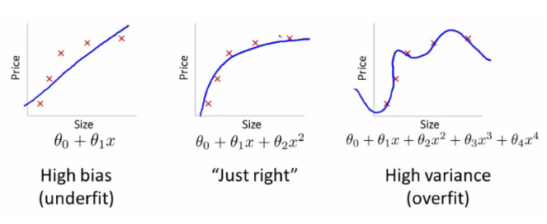
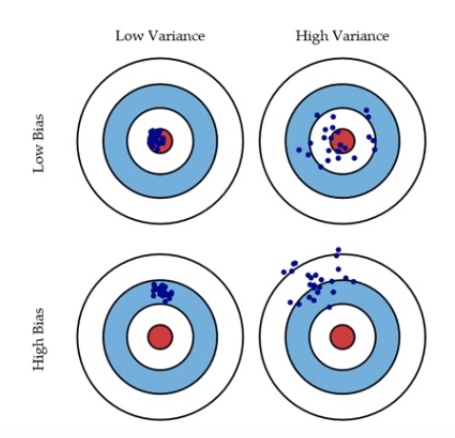
Bias Versus Variance

Slide 51
Overview of Key ML Methods/Terms
Model Evaluation – The metrics you use to assess model quality. There are a ton of this measures, and we are dedicating an entire week to the exploring these further. I’ll show some examples in the code for this week.
Everything is evaluation
G1
G2
Data Acquisition/ Representation
Data Understanding - EDA
Initial Model(s) Building
Initial Model
Evaluation
Model Creation & Training
Evaluation Criteria/Value Metric
Feature Engineering and Evaluation
Question ID
Model Deployment
Final Model Development
G3
Data Drift Analysis
Model Performance – Evaluation Value Metric
Business Understanding
Model Drift Analysis – Model Evaluation
Gate Reviews
Reports – Dashboards - Products

Slide 52
Extra Material

Slide 53
Bookings.com

Slide 54
Lesson Learned: Booking.com

Slide 55
Bookings.com
Swiss Army Knife– Their approach to ML is highly adoptable, meaning it can be used in a variety of settings – generate specific results or more generalizable depending on the inputs (data)
Offline Health Check– Use Randomized Control Trails (RCT) to test model outputs aligned with normative business metrics to assess quality (customer conversion)
Increase model performance doesn’t necessary translate to better gain in value
Notes:
Mimic a human, often a group to learn processes

Slide 56
Bookings.com
Make a Target Before you Shoot – Develop a clear understanding of the business case and target variable (what is date flexibility)
Learning Difficulty – How complex or vague is the target
Data to Concept – Does the data available support the algo target and goal
Selection Bias – Does the model perform better for a subset of the target
Speed Kills – ML algos, even simple ones, take a lot of computing power – to reduce user weight time (latency) measures should be taken
See page 1748 (sparsity, model redundancy, caching…etc.)
Notes:
Mimic a human, often a group to learn processes

Slide 57
Machine Learning Overview
Keep a watchful eye – Used specialized monitoring tools to understand how the models are performing in practice (even when the result was unclear)
Traditional Research Methods (Experimental Design) is a Best Practice Approach to ML –
“Experimentation through Randomized Controlled Trials is ingrained into Booking.com culture”
Notes:
Mimic a human, often a group to learn processes

Slide 58
Example of K-Means, What is Happening?
Given D :{2,4,10,12,3,11,20,25,30}, and k=2 clusters
Randomly assign the means: m₁=3, m₂=4
K₁={2,3}, K₂={4,10,12,11,20,25,30}, m₁=2.5, m₂=16
K₁={2,3,4}, K₂={10,12,11,20,25,30}, m₁=3, m₂=18
K₁={2,3,4,10}, K₂={12,11,20,25,30}, m₁=4.75, m₂=19.6
K₁={2,3,4,10,11,12}, K₂={20,25,30}, m₁=7, m₂=25
K₁={2,3,4,10,11,12}, K₂={20,25,30}, m₁=7, m₂=25
Stop, since the clusters and the means found in all subsequent iterations will be the same.

