Slide 1
Lecture: Graphing Effectively
Boxplots, group comparisons, and saving a publication-ready figure Bill Perry

Slide 2
Where We Left Off
Last time you:
Computed mean, median, SD, and SE — by hand and with summarize()
Fixed the length() trap with sum(!is.na())
Got tidy per-group tables with group_by() + summarize()
Note
✅ Key idea from Describing Your Data
You now have real numbers describing shady vs. sunny needles. Today we make those numbers visible — and save the result properly.
Note
Today’s roadmap
The ggplot grammar, recapped
Boxplots done right — with raw points
Axis labels and titles, done right
Mapping color by group
Histograms and density curves
Plotting mean ± SE directly
Faceting and a quick theme tour
Custom colors and legends with scale_color_manual()
ggsave(), for real this time

Slide 3
Part 1 · The ggplot Grammar, Recapped

Slide 4
The ggplot Grammar, Recapped
Every ggplot is three pieces joined with +:
data — which data frame
aes() — which columns map to x, y, color, fill…
geom — how to draw it
library(tidyverse) library(readxl) pine_df <- read_csv("data/pine_needles.csv")
Note
✅ Key idea
Everything today is the same three pieces — we’re just adding more layers and more polish on top of them.
Tip
🖐 Recap from Getting Started
ggplot(pine_df, aes(x = n_s, y = length_mm)) + geom_point()

Slide 5
Part 2 · Boxplot Anatomy

Slide 6
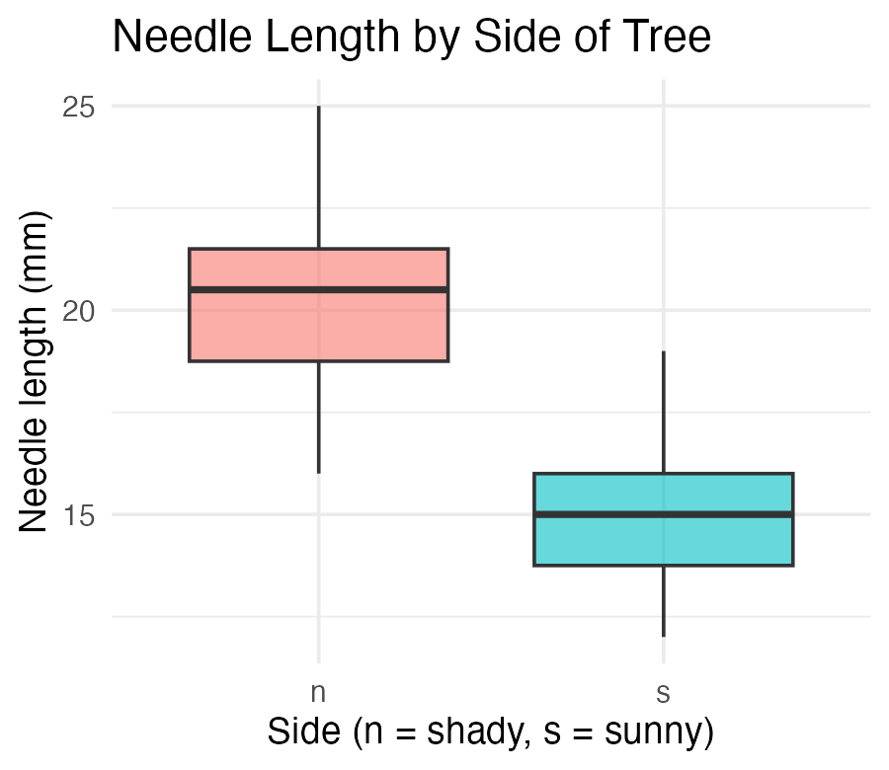
Boxplot Anatomy
pine_box_plot <- ggplot(pine_df, aes(x = n_s, y = length_mm, fill = n_s)) + geom_boxplot(alpha = 0.6, outlier.shape = NA) + labs( title = "Needle Length by Side of Tree", x = "Side (n = shady, s = sunny)", y = "Needle length (mm)", fill = "Side" ) + theme_minimal(base_size = 9) + theme(legend.position = "none") pine_box_plot
Boxplot anatomy:
Middle line = median
Box edges = 25th and 75th percentile (IQR)
Whiskers = 1.5 × IQR
Dots beyond whiskers = outliers
📖 R4DS §9 — Layers

Slide 7
Boxplot + Raw Points
Note
🔮 Predict first: With only 6 needles per side per tree, does a boxplot alone show you everything? What might it hide?

Slide 8
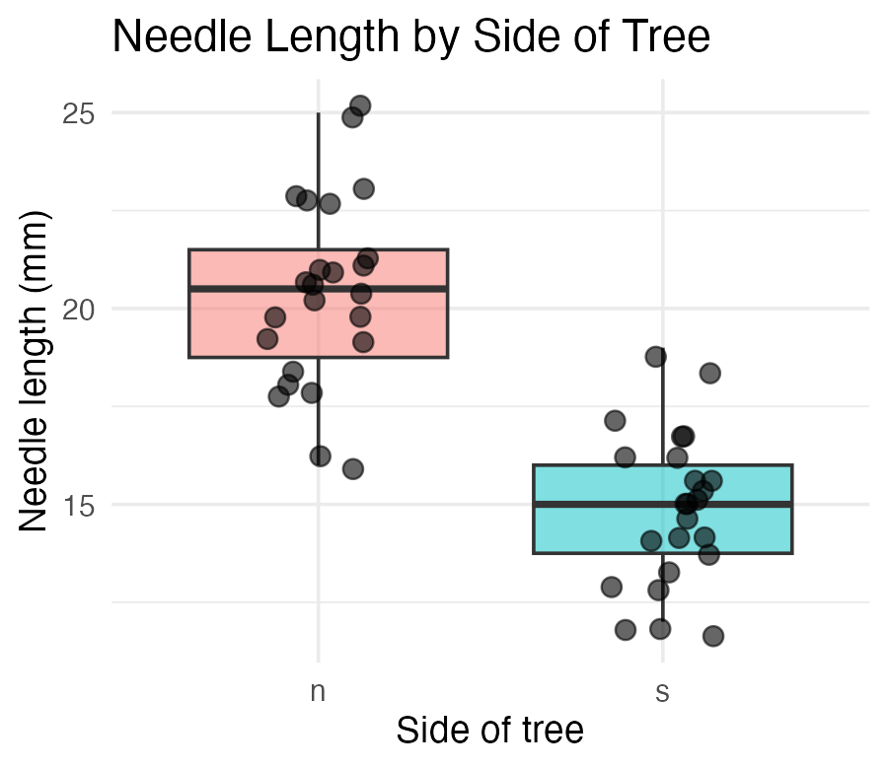
pine_jitter_plot <- ggplot(pine_df, aes(x = n_s, y = length_mm, fill = n_s)) + geom_boxplot(alpha = 0.5, outlier.shape = NA) + geom_point( position = position_jitter(width = 0.15, seed = 42), alpha = 0.6, size = 2 ) + labs( title = "Needle Length by Side of Tree", x = "Side of tree", y = "Needle length (mm)", fill = "Side" ) + theme_minimal(base_size = 9) + theme(legend.position = "none") pine_jitter_plot
position_jitter(width = 0.15) spreads points sideways so they don’t overlap
seed = 42 — same jitter layout every time you render
alpha = 0.6 — semi-transparent, so overlapping points are still visible
Tip
Always show the raw points alongside a boxplot when n is small — every point matters, and a box alone can hide a bimodal or lopsided pattern.

Slide 9
Part 2b · Axis Labels and Titles, Done Right

Slide 10
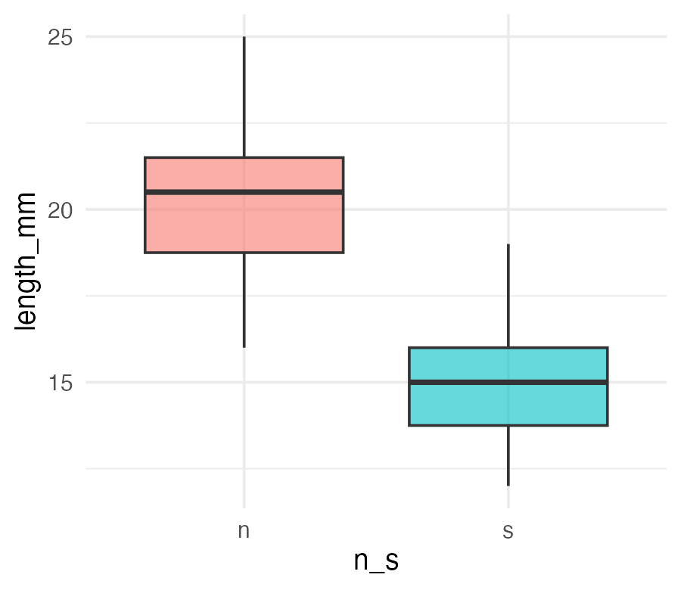
Before labs() — Never Ship This
ggplot(pine_df, aes(x = n_s, y = length_mm, fill = n_s)) + geom_boxplot(alpha = 0.6, outlier.shape = NA) + theme_minimal(base_size = 9) + theme(legend.position = "none")
Warning
⚠️ Watch out!
A plot with default column-name axes is a plot that only makes sense to you, today. Six months from now, even you may not remember what n_s meant.
Important
The x-axis reads n_s and the y-axis reads length_mm — the literal column names, not something a reader outside your lab would understand.

Slide 11
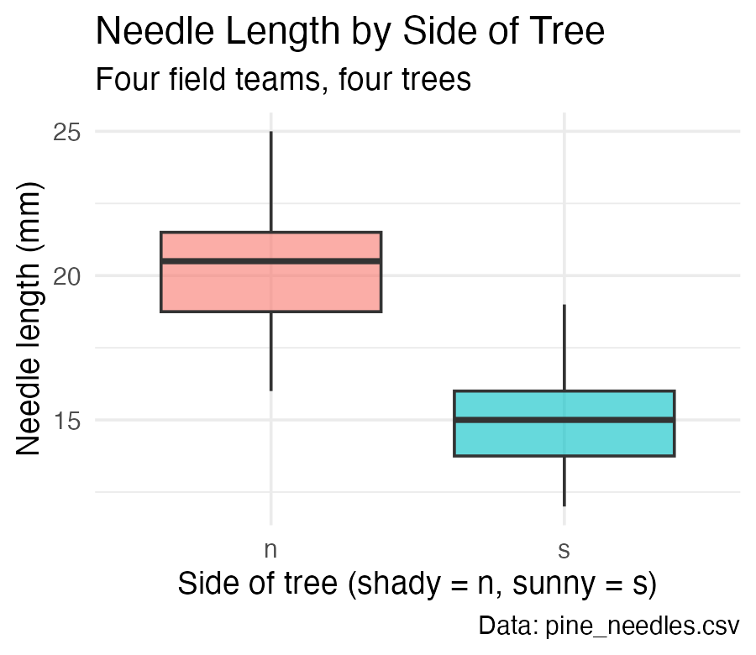
labs() — Every Piece of Text on the Plot
ggplot(pine_df, aes(x = n_s, y = length_mm, fill = n_s)) + geom_boxplot(alpha = 0.6, outlier.shape = NA) + labs( title = "Needle Length by Side of Tree", subtitle = "Four field teams, four trees", x = "Side of tree (shady = n, sunny = s)", y = "Needle length (mm)", fill = "Side", caption = "Data: pine_needles.csv" ) + theme_minimal(base_size = 9) + theme(legend.position = "none")
One function, five jobs:
Argument | Controls
title | main title
subtitle | smaller text under the title
x / y | axis labels
caption | small text, bottom-right
color/fill | legend title for that aesthetic
Note
✅ Key idea
labs() never touches the data or the statistics — only what a reader sees written on the plot. Change it freely.

Slide 12
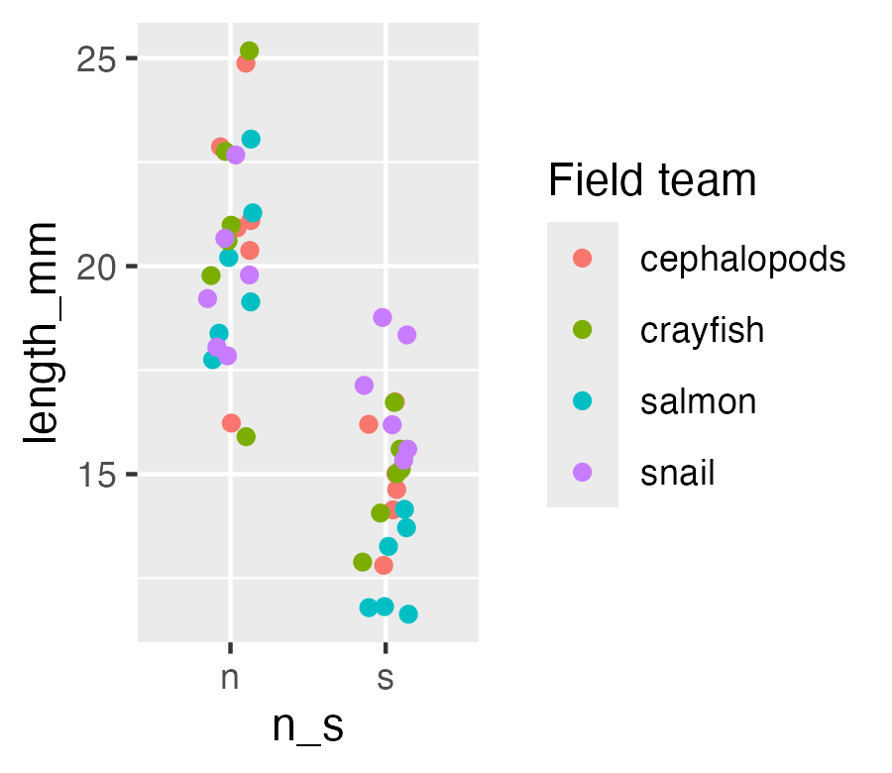
labs() — the Legend Title Trap
# Whichever aesthetic name you mapped, use that same name in labs() ggplot(pine_df, aes(x = n_s, y = length_mm, color = group)) + geom_point(position = position_jitter(width = 0.15, seed = 42)) + labs(color = "Field team") # matches aes(color = group)
Warning
⚠️ Watch out!
The legend title comes from whatever you write for the aesthetic you mapped — color = "Field team" in labs() relabels a color = mapping. Write fill = "..." instead and it does nothing, because this plot never mapped fill.

Slide 13
Part 3 · Mapping Color by Group

Slide 14
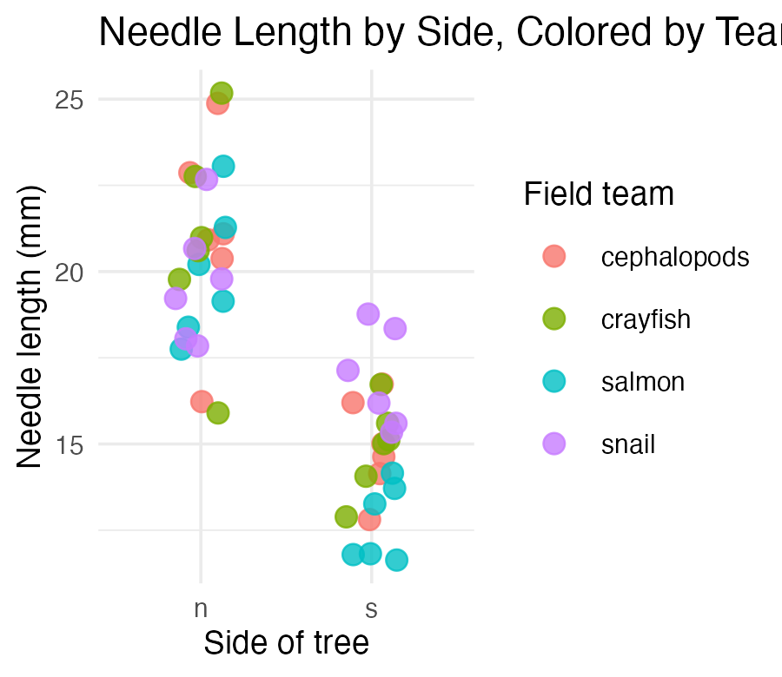
Mapping Color by Group
pine_team_plot <- ggplot(pine_df, aes(x = n_s, y = length_mm, color = group)) + geom_point( position = position_jitter(width = 0.15, seed = 42), size = 2.5, alpha = 0.8 ) + labs( title = "Needle Length by Side, Colored by Team", x = "Side of tree", y = "Needle length (mm)", color = "Field team" ) + theme_minimal(base_size = 9) pine_team_plot
color = group maps a third variable onto the plot — no new geom needed
ggplot auto-builds the legend and picks colors for you
Mapping inside aes() always means “vary this by data” — not “make everything this color”
Warning
⚠️ Watch out!
color = "darkblue" outside aes() sets one fixed color. color = group inside aes() maps colors to a variable. Mixing these up is one of the most common ggplot mistakes.

Slide 15
Part 3b · Histograms and Density — Seeing the Whole Distribution

Slide 16
Histograms — the Shape Behind the Summary
Note
🔮 Predict first: We found mean(length_mm) ≈ 17.7 in Describing Your Data, with a fairly small gap from the median. What shape do you expect the full distribution to have — symmetric, or skewed?

Slide 17
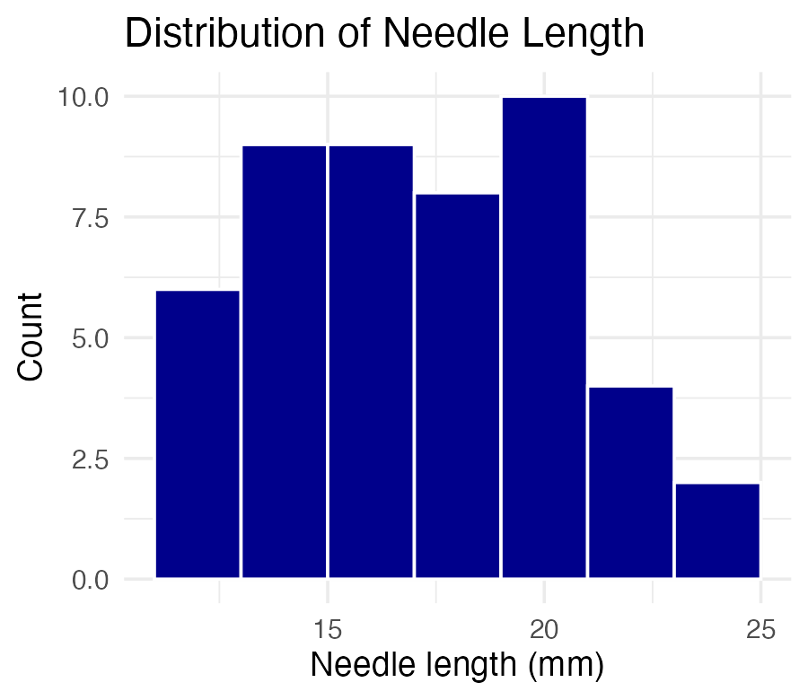
ggplot(pine_df, aes(x = length_mm)) + geom_histogram(binwidth = 2, fill = "darkblue", color = "white") + labs( title = "Distribution of Needle Length", x = "Needle length (mm)", y = "Count" ) + theme_minimal(base_size = 9)
binwidth sets the width of each bar in data units (here, 2mm)
Too wide hides structure; too narrow shows noise — try a few values
Tip
🖐 Try it yourself
Change binwidth = 2 to binwidth = 0.5 and to binwidth = 5. Which tells the real story?

Slide 18
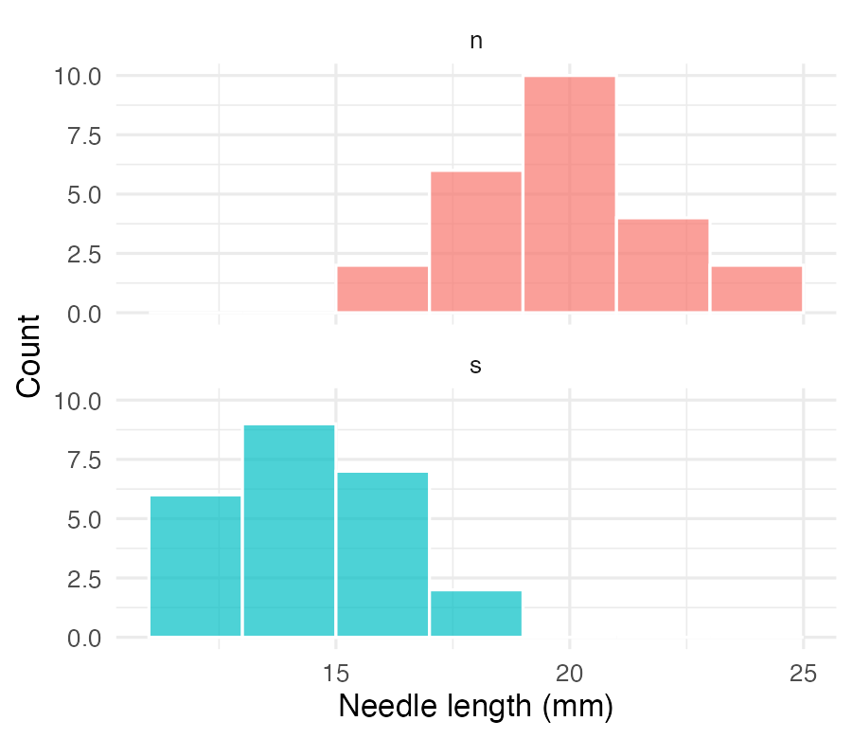
Histograms by Group — fill and facet_wrap() Together
ggplot(pine_df, aes(x = length_mm, fill = n_s)) + geom_histogram(binwidth = 2, color = "white", alpha = 0.7) + facet_wrap(~n_s, ncol = 1) + labs(x = "Needle length (mm)", y = "Count", fill = "Side") + theme_minimal(base_size = 8) + theme(legend.position = "none")
Note
✅ Key idea
Overlapping histograms on one panel are hard to read. Faceting stacks them into separate panels sharing an x-axis — same comparison, much clearer.

Slide 19
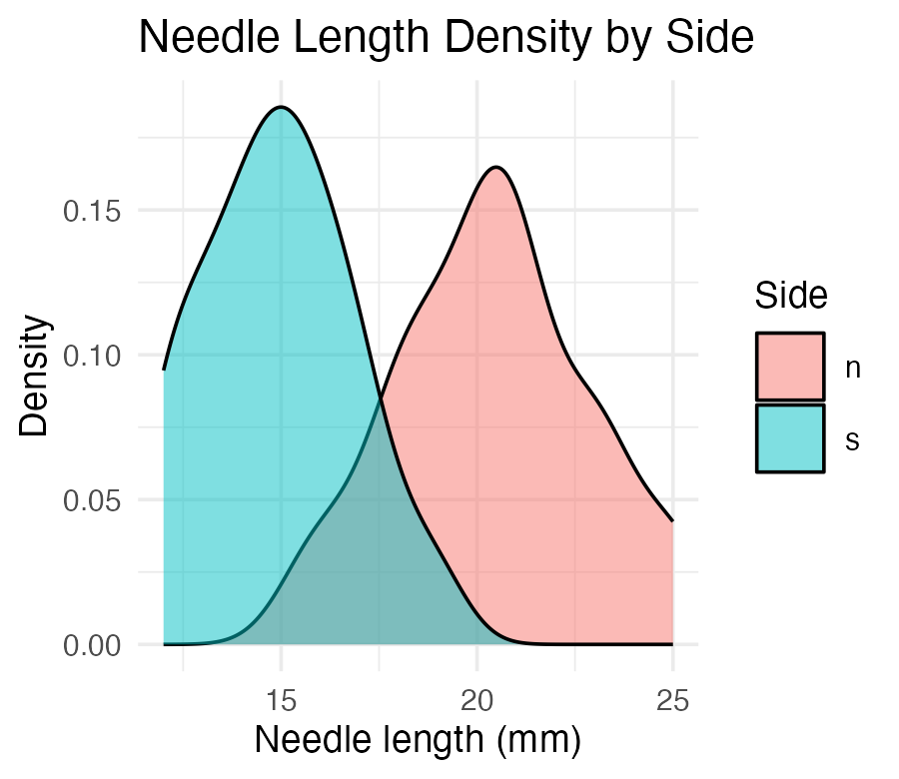
Density Curves — a Smoothed Alternative
ggplot(pine_df, aes(x = length_mm, fill = n_s)) + geom_density(alpha = 0.5) + labs( title = "Needle Length Density by Side", x = "Needle length (mm)", y = "Density", fill = "Side" ) + theme_minimal(base_size = 9)
Tip
📖 Histogram vs. density
A density curve is a smoothed histogram, rescaled so the area under each curve sums to 1. It overlays cleanly for group comparisons — no faceting required, at the cost of hiding the raw bin counts.

Slide 20
Part 4 · Mean ± SE — Plotted Directly

Slide 21
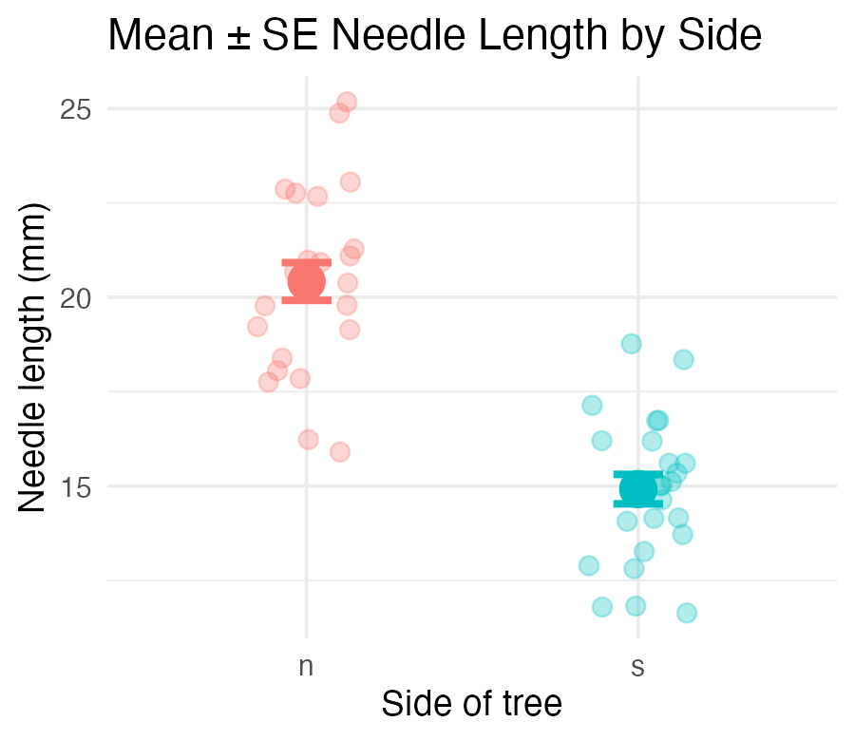
Mean ± SE — Plotted Directly
pine_mean_se_plot <- ggplot(pine_df, aes(x = n_s, y = length_mm, color = n_s)) + geom_point( position = position_jitter(width = 0.15, seed = 42), alpha = 0.3, size = 2 ) + stat_summary(fun = mean, geom = "point", size = 4) + stat_summary( fun.data = mean_se, geom = "errorbar", width = 0.15, linewidth = 0.9 ) + labs( title = "Mean ± SE Needle Length by Side", x = "Side of tree", y = "Needle length (mm)" ) + theme_minimal(base_size = 9) + theme(legend.position = "none") pine_mean_se_plot
Two stat_summary() layers:
call | draws
fun = mean | one large point at the mean
fun.data = mean_se | error bars for ± 1 SE
stat_summary() computes the mean and SE for you, straight from the raw data — no summarize() step required first.
Note
✅ Key idea
This is the exact same mean and SE you calculated by hand in Describing Your Data — now you can see them.

Slide 22
Part 5 · Faceting — One Panel Per Group

Slide 23
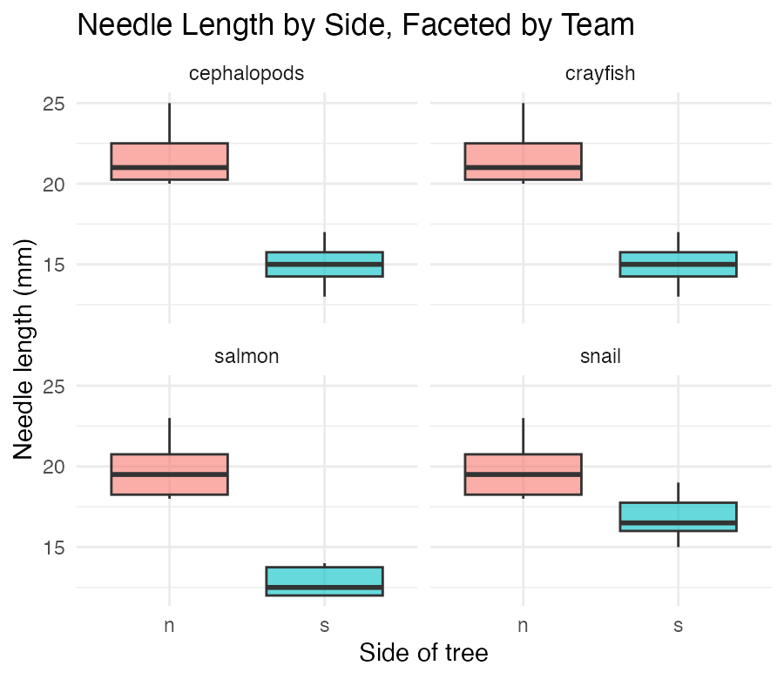
Faceting — One Panel Per Group
pine_facet_plot <- ggplot(pine_df, aes(x = n_s, y = length_mm, fill = n_s)) + geom_boxplot(alpha = 0.6, outlier.shape = NA) + facet_wrap(~group) + labs( title = "Needle Length by Side, Faceted by Team", x = "Side of tree", y = "Needle length (mm)" ) + theme_minimal(base_size = 7) + theme(legend.position = "none") pine_facet_plot
facet_wrap(~group) gives each field team its own small panel
Same x/y scale across panels — easy to compare
Useful the moment “does every group show the same pattern?” is the real question
Tip
🖐 Notice
A faceted plot answers a different question than a single colored plot: not just “is there an overall pattern,” but “does the pattern hold for everyone?”

Slide 24
Part 6 · A Quick Theme Tour

Slide 25
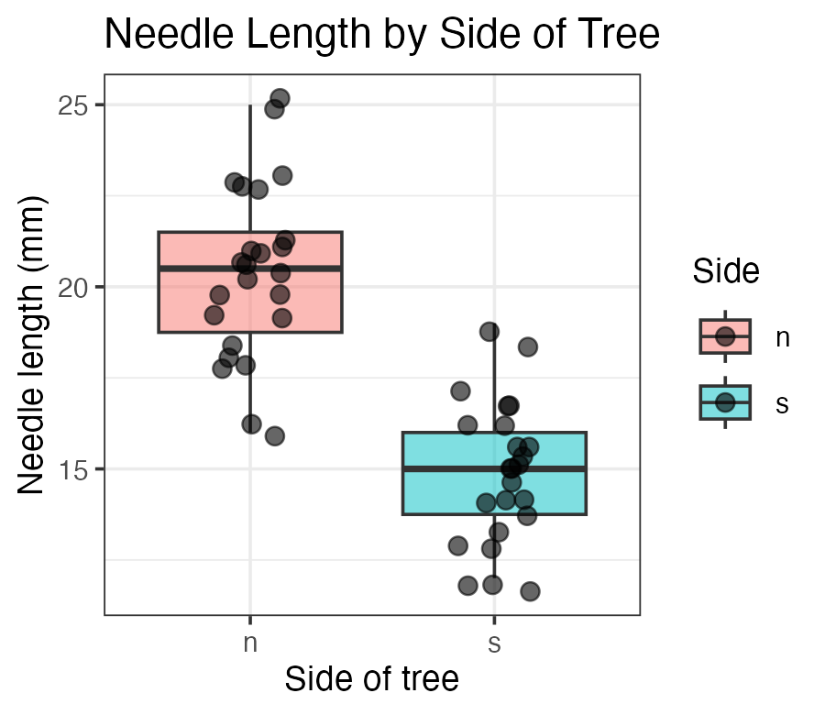
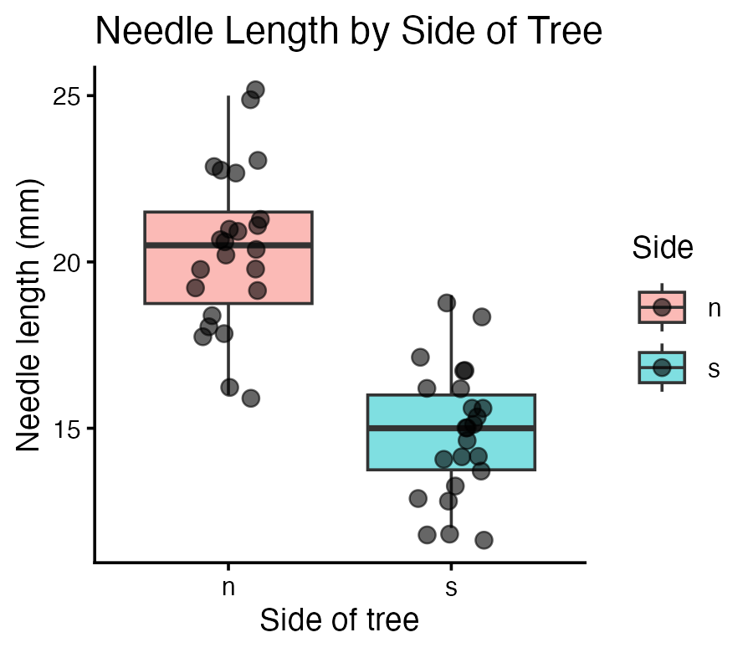
A Quick Theme Tour
pine_jitter_plot + theme_bw(base_size = 9)
theme_minimal() — light, few gridlines (what we’ve used so far)
theme_bw() — white background, black-and-white frame
theme_classic() — just x/y axis lines, no gridlines at all
Note
✅ Key idea
A theme changes appearance only — never the data or the statistics underneath. Pick one and use it consistently across a report.
pine_jitter_plot + theme_classic(base_size = 9)

Slide 26
Part 7 · Saving a Real Figure

Slide 27
Saving a Real Figure
ggsave( "figures/pine_needle_boxplot.png", plot = pine_jitter_plot, width = 3, height = 3, units = "in", dpi = 300 )
Warning
⚠️ Watch out!
ggsave() wants the filename first, then plot =. If you skip plot =, it saves whatever plot was drawn last — not necessarily the one you meant.
Note
✅ Key idea
Always set width, height, units, and dpi explicitly. Letting ggsave() guess gives you a plot sized for your screen, not for a report or a poster.

Slide 28
Part 8 · Custom Colors and Legends — scale_color_manual()

Slide 29
scale_color_manual() — Choosing Your Own Colors
Tip
🚀 Advanced / extra work — ggplot’s default colors are fine for exploring data, but a real figure often needs specific colors (journal style, colorblind-safe palettes, matching a poster). This is how you take control.

Slide 30
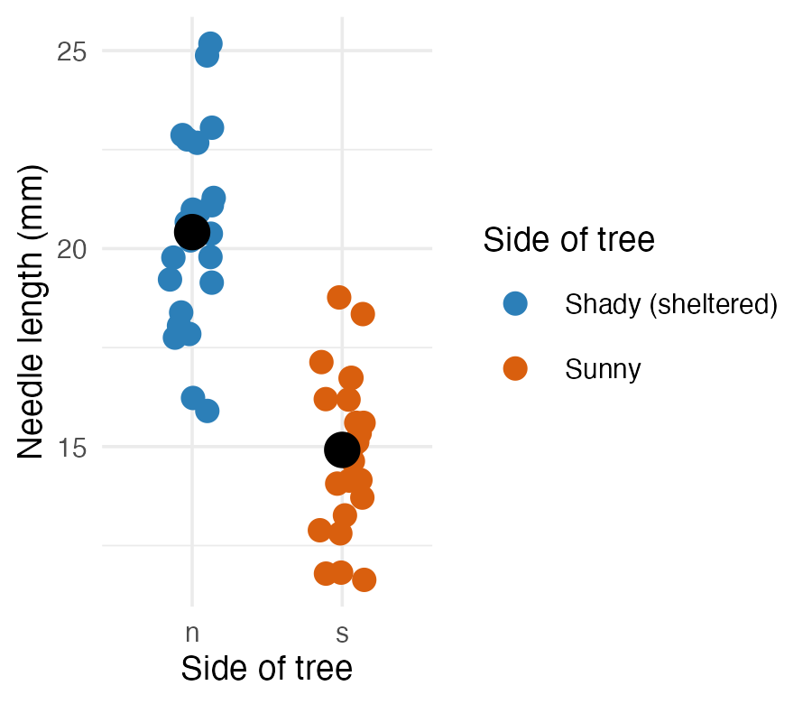
ggplot(pine_df, aes(x = n_s, y = length_mm, color = n_s)) + geom_point( position = position_jitter(width = 0.15, seed = 42), size = 2.5 ) + stat_summary(fun = mean, geom = "point", size = 4, color = "black") + scale_color_manual( name = "Side of tree", labels = c(n = "Shady (sheltered)", s = "Sunny"), values = c(n = "#2c7fb8", s = "#d95f0e") ) + labs(x = "Side of tree", y = "Needle length (mm)") + theme_minimal(base_size = 9)
Three arguments, matched by name:
Argument | Does what
name | the legend title
labels | text shown for each level
values | the actual color for each level
Note
✅ Key idea
labels and values are both named vectors, keyed by the raw values in your data (n, s) — not by the pretty text you want to display. ggplot looks up each raw value and substitutes the label/color you gave it.

Slide 31
scale_color_manual() — Getting the Names Wrong
# Typo: "sun" instead of the real value "s" ggplot(pine_df, aes(x = n_s, y = length_mm, color = n_s)) + geom_point() + scale_color_manual( values = c(n = "#2c7fb8", sun = "#d95f0e") )
Warning
⚠️ Watch out!
Every level that appears in your data must get an entry in values
(and in labels, if you supply it), spelled exactly as it appears in the column
check with unique(pine_df$n_s) first if you’re not sure
A missing or misspelled level draws as grey with a warning.

Slide 32
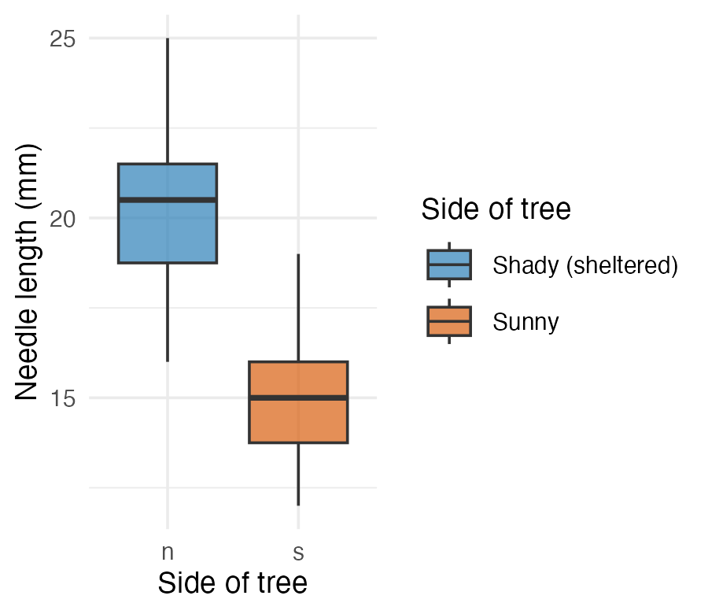
scale_fill_manual() — the fill Twin
ggplot(pine_df, aes(x = n_s, y = length_mm, fill = n_s)) + geom_boxplot(alpha = 0.7, outlier.shape = NA) + scale_fill_manual( name = "Side of tree", labels = c(n = "Shady (sheltered)", s = "Sunny"), values = c(n = "#2c7fb8", s = "#d95f0e") ) + labs(x = "Side of tree", y = "Needle length (mm)") + theme_minimal(base_size = 9)
Tip
🖐 Notice
Same three arguments, same pattern — scale_fill_manual() is scale_color_manual() for the fill aesthetic instead of color. A boxplot’s box is fill; its jittered points (if you added geom_point(color = ...)) would be color. A plot can need both at once.

Slide 33
Wrap-up
Today you:
Built boxplots with raw points overlaid, not hidden
Wrote real axis labels, titles, and legend titles with labs() — never shipped a default column name
Mapped a third variable with color = / fill = inside aes()
Built histograms and density curves to see a whole distribution’s shape
Plotted mean ± SE directly with stat_summary() — no separate summary table needed
Faceted a plot with facet_wrap() to check every group at once
Compared themes, and saved a real, correctly-sized figure with ggsave()
(Advanced) Set exact colors and legend text by hand with scale_color_manual() / scale_fill_manual()
Tip
🖐 Before next class
Finish the worksheet: build a mean ± SE plot faceted by group, pick a theme, and save it to figures/ at 3×3in, 300 dpi.
Note
Where this leads
You can now import, wrangle, describe, and visualize a dataset end to end. That full pipeline — raw data → clean → summarize → visualize — is the foundation every later statistical test builds on.

Slide 34
Getting unstuck
When code breaks — and it will, that is normal:
Read the error message out loud; it usually names the line
Check the usual suspects: library(tidyverse) loaded? Is color/fill inside aes() when it should be?
?function_name opens the help page
Bring the exact error (copy-paste it) to class or office hours
Note
✅ Key idea
Every working scientist googles error messages daily. Getting stuck is not failing — it is the job.

