Slide 1
Lecture: NMDS & Cluster Analysis
Community ordination Bill Perry

Slide 2
Part 1 · Why NMDS?

Slide 3
Introduction: Why NMDS?
The Problem with Ecological Community Data
Ecological community data presents unique challenges for traditional statistical methods
When sampling species abundances across sites
encounter data that is sparse (most species are absent from most sites) - many zeros
exhibits non-linear relationships between species and environmental gradients
has no clear distributional form
Principal Components Analysis (PCA) works beautifully for continuous environmental variables
assumes linear relationships
can leverage correlations between variables
for species abundance data - assumptions often fail spectacularly
NMDS offers a fundamentally different approach:
instead of trying to preserve exact distances or maximize variance explained
focuses on preserving the rank order of similarities between samples
makes it remarkably robust for ecological data.

Slide 4
NMDS - Multivariate Community Analysis
Data - built in R and other places
Code | Description of the variable
das | Distance from the source [km]
alt | Altitude [m a.s.l.]
pen | Slope [per thousand]
deb | Mean minimum discharge [m³s⁻¹]
pH | pH of water
dur | Calcium concentration (hardness) [mgL⁻¹]
pho | Phosphate concentration [mgL⁻¹]
nit | Nitrate concentration [mgL⁻¹]
amn | Ammonium concentration [mgL⁻¹]
oxy | Dissolved oxygen [mgL⁻¹]
dbo | Biological oxygen demand [mgL⁻¹]
Code | Common Name (English) | Family
Chb | Bullhead | Cottidae
Tru | Brown trout | Salmonidae
Vai | Minnow | Cyprinidae
Loc | Stone loach | Balitoridae
Omb | Grayling | Salmonidae
Bla | Souffia | Cyprinidae
Hot | Common nase | Cyprinidae
Tox | Sofie | Cyprinidae
Van | Dace | Cyprinidae
Che | Chub | Cyprinidae
Bar | Barbel | Cyprinidae
Lot | Burbot | Lotidae
Spi | Spirlin | Cyprinidae
Gou | Gudgeon | Cyprinidae
Bro | Pike | Esocidae
Per | Perch | Percidae
Tan | Tench | Cyprinidae
Gar | Roach | Cyprinidae
Lam | Brook lamprey | petromizonidae

Slide 5
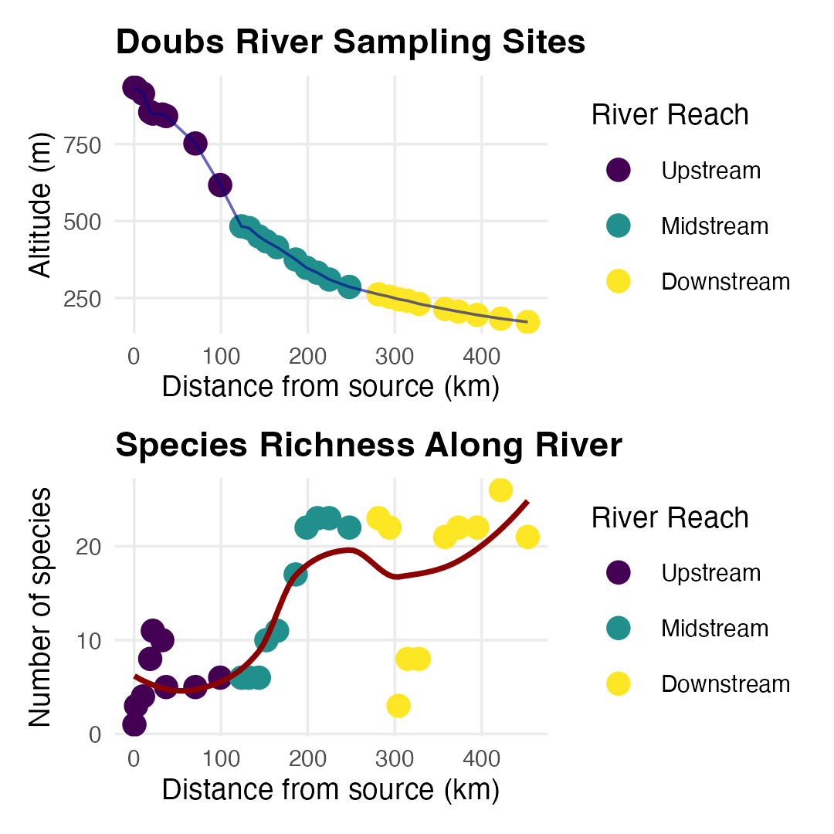
Today’s Data: The Doubs River
About the Doubs River Dataset
Study System:
Doubs River, France
29 sites from upstream to downstream
Collected by Verneaux (1973)
Classic community ecology dataset
Two Datasets:
Environmental: 11 water quality variables
Species: 27 fish species abundances (0-5 scale)
Research Questions:
How do fish communities change along the river?
Which environmental factors drive community composition?
Are there distinct community types?

Slide 6
Part 2 · The NMDS Algorithm

Slide 7
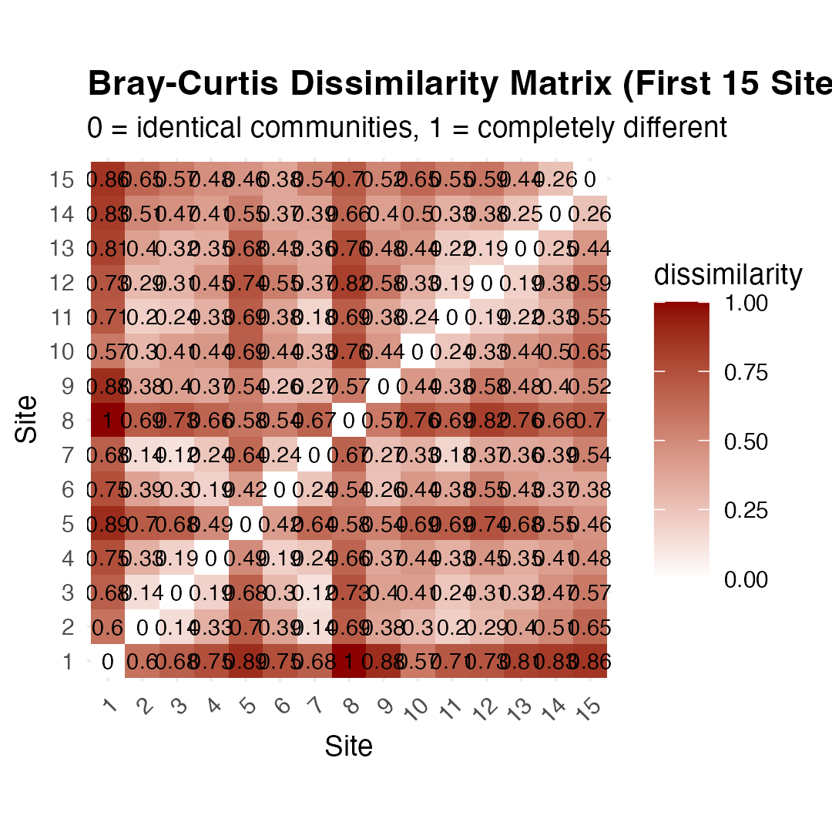
Non-metric Multidimensional Scaling (NMDS)
What is NMDS?
Overview of NMDS:
Purpose: Visualize dissimilarity between objects in 2D/3D space
Goal: Preserve rank order of distances, not exact distances
Method: Iterative re-positioning to minimize stress
Output: Ordination plot showing relationships between samples
Key Differences from PCA:
Uses dissimilarity matrices (not covariance)
Non-parametric (rank-based)
Better for non-linear ecological relationships
No assumption about data distribution
Before running NMDS - analyzing dissimilarity matrices not raw abundance data
dissimilarity matrix contains values for every pair of samples = “how different”
typically range from 0 (identical) to 1 (completely different).
Note
Gotelli & Ellison, A Primer of Ecological Statistics, Ch. 12 — The Analysis of Multivariate Data, covers ordination methods including NMDS.

Slide 8
Why Bray-Curtis for Community Data?
Bray-Curtis dissimilarity is standard choice for community data because it handles zeros appropriately (joint absences don’t contribute to similarity)
bounded between 0 and 1
weights by abundance (not just presence/absence) - ignores joint absences entirely
Similarity is based only on what’s actually present and shared between sites
performs well with sparse data
The formula is:
BCjk=i​|yij−yik|i​(yij+yik)
Where $y_{ij}$ is the abundance of species $i$ at site $j$
numerator sums up the absolute differences in abundance for each species between two sites
denominator sums up the total abundance at both sites
Bray-Curtis asks: “Of all the individuals at these two sites, what proportion would need to be moved to make the sites identical?”

Slide 9
The NMDS Algorithm
What NMDS Actually Does
NMDS tries to place samples in a low-dimensional space (usually 2D)
so rank order of distances in ordination matches rank order of dissimilarities in original matrix
Not your PCA which preserves exact distances (or variance)
NMDS only cares about relative ordering:
if site A is more similar to site B than to site C in the original data
then A should be closer to B than to C in the ordination

Slide 10
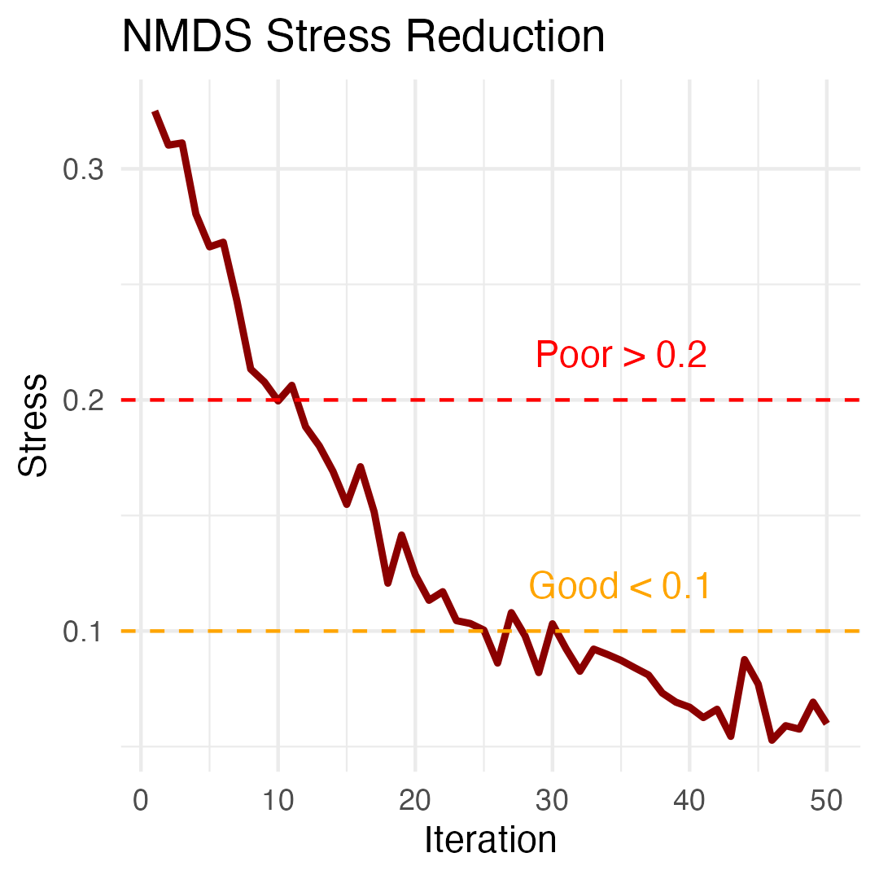
How NMDS Works step by step
The NMDS Algorithm:
Calculate dissimilarity matrix between all pairs of sites
Start with random configuration of points in 2D space
Calculate stress = difference between original distances and ordination distances
Move points to reduce stress
Repeat until stress cannot be reduced further
Try multiple random starts to avoid local minima
Stress Values:
< 0.1: Good representation
0.1-0.2: Acceptable
> 0.2: Poor representation

Slide 11
Part 3 · Stress and Model Diagnostics

Slide 12
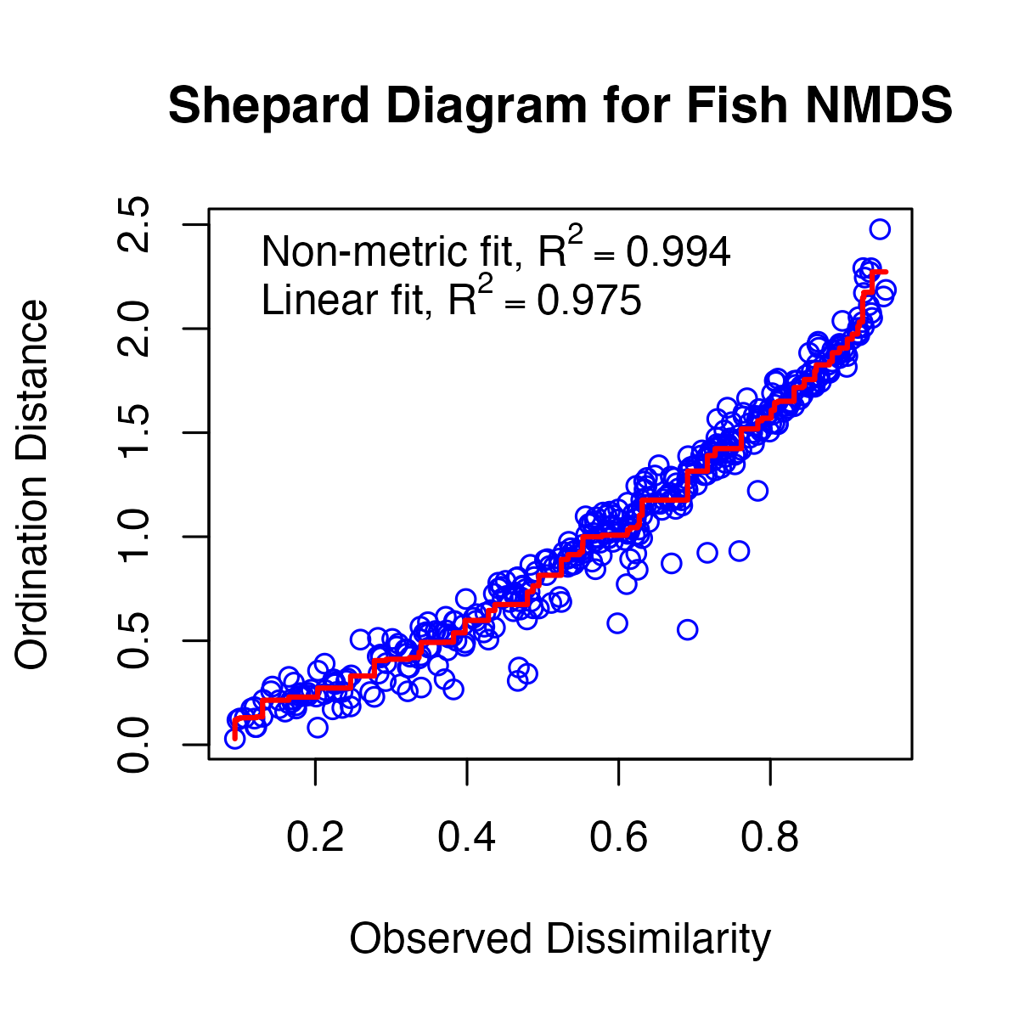
Understanding Stress
What is Stress?
Stress is key diagnostic for NMDS quality
measures disagreement between original dissimilarities and distances in ordination
stress is calculated by first ranking all pairwise dissimilarities
then calculating corresponding distances in the ordination
fitting a monotonic regression line to the relationship between these
finally computing sum of squared deviations from this line.
Lower stress means ordination better represents original relationships
The Shepard Diagram: Visualizing Stress
Shepard diagram (or stress plot) is primary diagnostic tool for NMDS
shows relationship between original dissimilarities (x-axis) and ordination distances (y-axis) with a fitted monotonic line
If NMDS is working well - points should closely follow the line
Scatter indicates loss of information.

Slide 13
Interpreting the Shepard Diagram
Shepard diagram
each point represents one pair of sites
x-axis shows their original Bray-Curtis dissimilarity
y-axis shows their distance in the 2D ordination
stepped line is a monotonic regression, = can only go up/stay flat not down
because NMDS preserves rank order - “stress” = scatter around line
Insights from our Shepard diagram:
minimal scatter
Stress Guidelines
Clarke (1993) widely-used guidelines for interpreting stress
<0.05 excellent representation w/no misinterpretation
0.05 - 0.10 good ordination - no real risk of false inferences
0.10 - 0.20 usable ordination but details at lower end interpreted cautiously
0.20 and 0.30 used with caution/potentially higher dimensions considered
>0.30 = random placement.

Slide 14
Choosing the Number of Dimensions
How do we know 2 dimensions is enough?
create a scree plot showing stress for different numbers of dimensions:

Slide 15
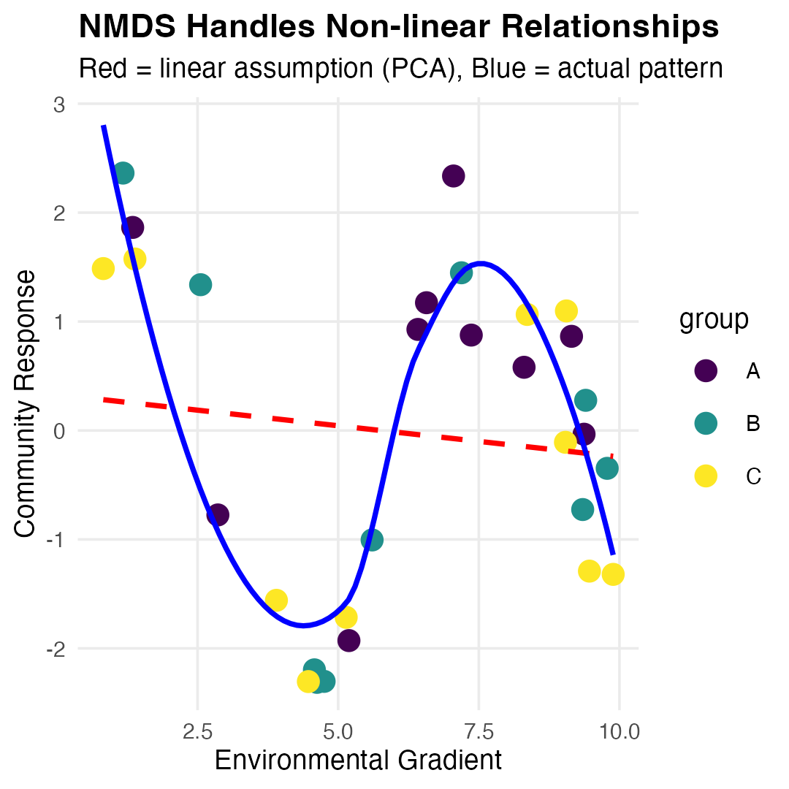
NMDS Assumptions
NMDS Assumptions:
✅ Few assumptions:
Samples are independent
Dissimilarity measure is appropriate
Sufficient data for stable solution
❌ No assumptions about:
Data distribution
Linear relationships
Homoscedasticity
Normality
This makes NMDS very robust for ecological data!

Slide 16
Part 4 · Running and Visualizing NMDS

Slide 17
NMDS in Practice
Running NMDS on Fish Communities
# Prepare species data (remove site column) spe_matrix <- doubs_spe %>% select(-site, -reach) %>% as.matrix() # Add small constant to avoid issues with zeros spe_matrix <- spe_matrix + 0.1 # Run NMDS with multiple random starts set.seed(123) fish_nmds <- metaMDS(spe_matrix, distance = "bray", # Bray-Curtis dissimilarity k = 2, trymax = 100) # 2 dimensions + Maximum tries ## Run 0 stress 0.07449349 ## Run 1 stress 0.1201175 ## Run 2 stress 0.1201749 ## Run 3 stress 0.1195174 ## Run 4 stress 0.1201175 ## Run 5 stress 0.1468615 ## Run 6 stress 0.1395204 ## Run 7 stress 0.09450578 ## Run 8 stress 0.07460885 ## ... Procrustes: rmse 0.02069815 max resid 0.09861179 ## Run 9 stress 0.1273318 ## Run 10 stress 0.1200159 ## Run 11 stress 0.1273318 ## Run 12 stress 0.07449349 ## ... Procrustes: rmse 4.373445e-06 max resid 1.595028e-05 ## ... Similar to previous best ## Run 13 stress 0.09450578 ## Run 14 stress 0.140665 ## Run 15 stress 0.07459993 ## ... Procrustes: rmse 0.02014078 max resid 0.09796964 ## Run 16 stress 0.1262615 ## Run 17 stress 0.07460885 ## ... Procrustes: rmse 0.02069823 max resid 0.09861196 ## Run 18 stress 0.09134568 ## Run 19 stress 0.07460885 ## ... Procrustes: rmse 0.02069807 max resid 0.09861147 ## Run 20 stress 0.07460885 ## ... Procrustes: rmse 0.02069863 max resid 0.09861444 ## *** Best solution repeated 1 times
cat("Final stress:", round(fish_nmds$stress, 3)) ## Final stress: 0.074

Slide 18
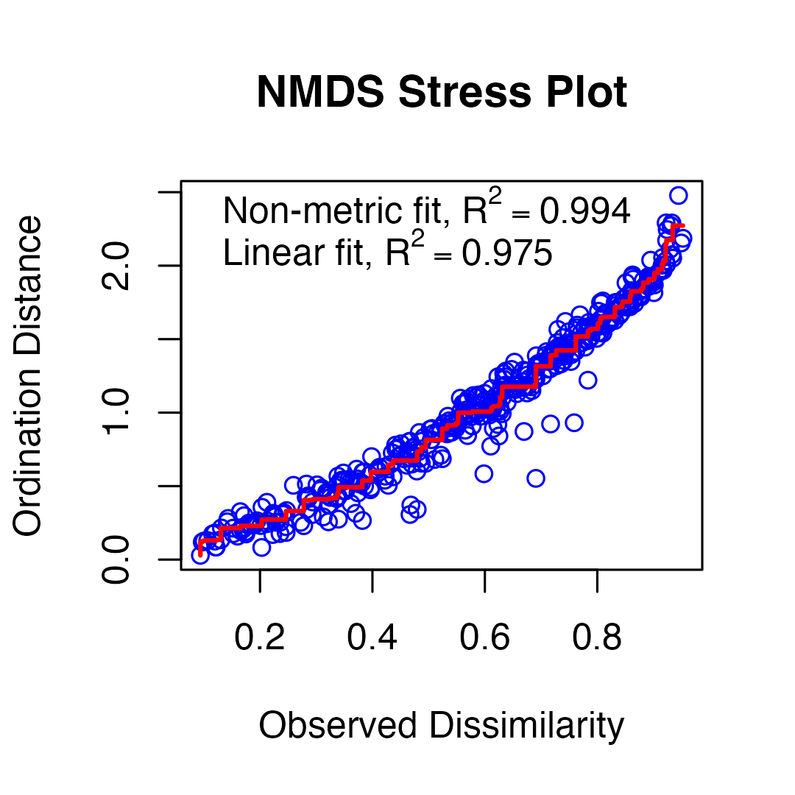
NMDS in Practice
Code Explanation:
fish_nmds <- metaMDS(spe_matrix, distance = "bray", # Bray-Curtis dissimilarity
k = 2, trymax = 100) # 2 dimensions + Maximum tries
metaMDS(): Main NMDS function from vegan package
distance = "bray": Bray-Curtis dissimilarity (best for abundances)
k = 2: Two dimensions for plotting
trymax = 100: Try 100 random starting configurations
Small constant added to avoid zero-distance issues

Slide 19
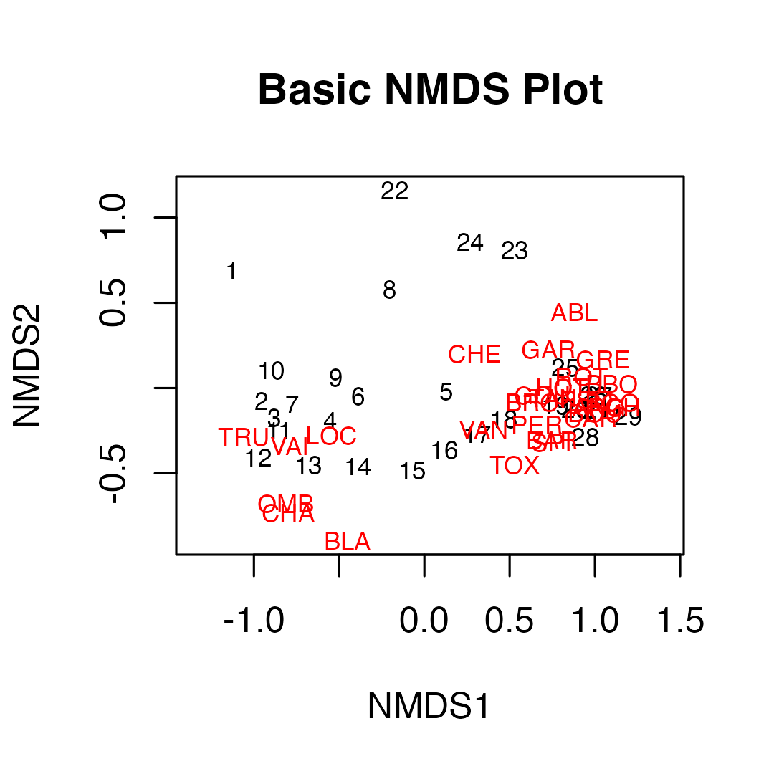
Interpreting NMDS Output
Understanding the Output:
Stress = 0.074 : This is “excellent”
Our 2D representation preserves the original distances well
Convergent solutions: Found stable solutions from multiple tries
Two dimensions: Axis 1 and Axis 2 have no inherent meaning (unlike PCA components)
No eigenvalues: NMDS doesn’t calculate variance explained per axis

Slide 20
Creating Enhanced NMDS Plots
What the NMDS Shows:
Clear separation between river reaches
Gradient pattern from upper to lower reaches
Sites within each reach are more similar to each other than to other reaches

Slide 21
Different plot using the actual hull definitions from vegan

Slide 22
Part 5 · PERMANOVA

Slide 23
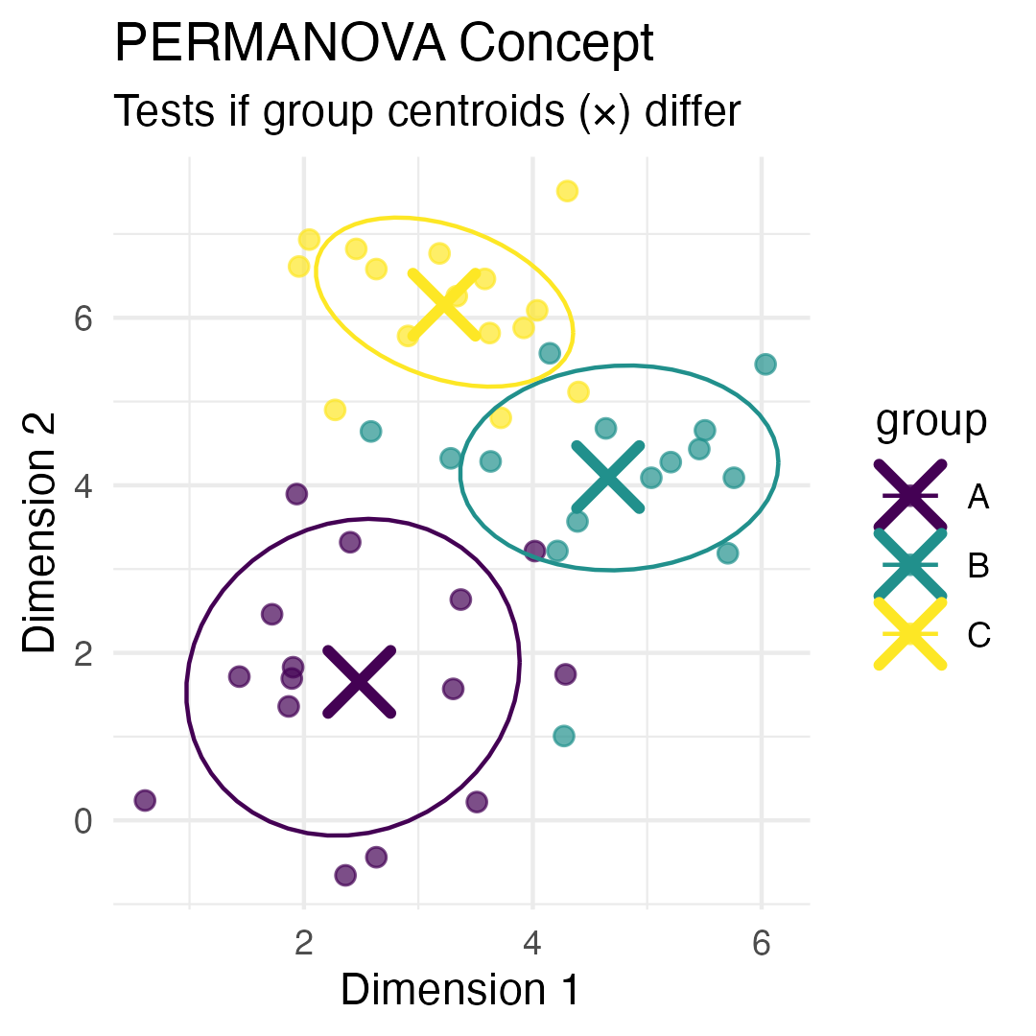
PERMANOVA: Testing Multivariate Differences
What is PERMANOVA?
PERMANOVA (Permutational Multivariate ANOVA):
Purpose: Test whether groups have different multivariate centroids
Method: ANOVA using distance matrices instead of raw data
Advantage: No distributional assumptions
Permutation: Creates null distribution by randomly reassigning group labels
Think of it as:
Multivariate version of ANOVA
Uses distances between samples instead of means
Tests: “Are the centers of these groups different in multivariate space?” .

Slide 24
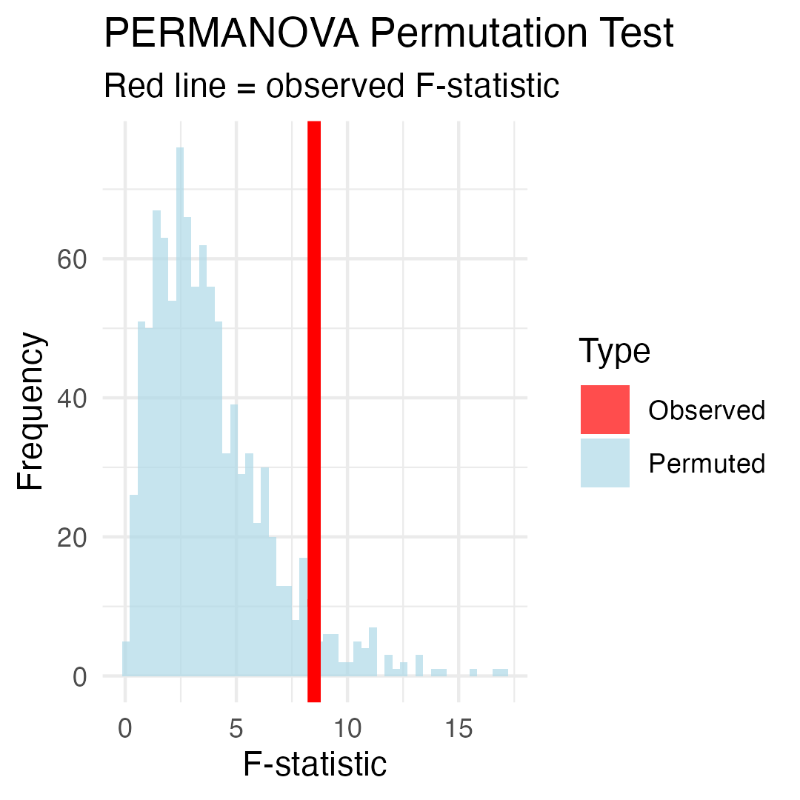
How PERMANOVA Works
PERMANOVA Algorithm:
Calculate distance matrix between all pairs of samples
Calculate F-statistic based on distances:
Between-group sum of squares
Within-group sum of squares
Permute group labels randomly (e.g., 999 times)
Recalculate F-statistic for each permutation
Compare observed F to permutation distribution
P-value = proportion of permuted F ≥ observed F
Why permutation?
No assumptions about data distribution
Creates empirical null distribution
Accounts for complex dependency structures

Slide 25
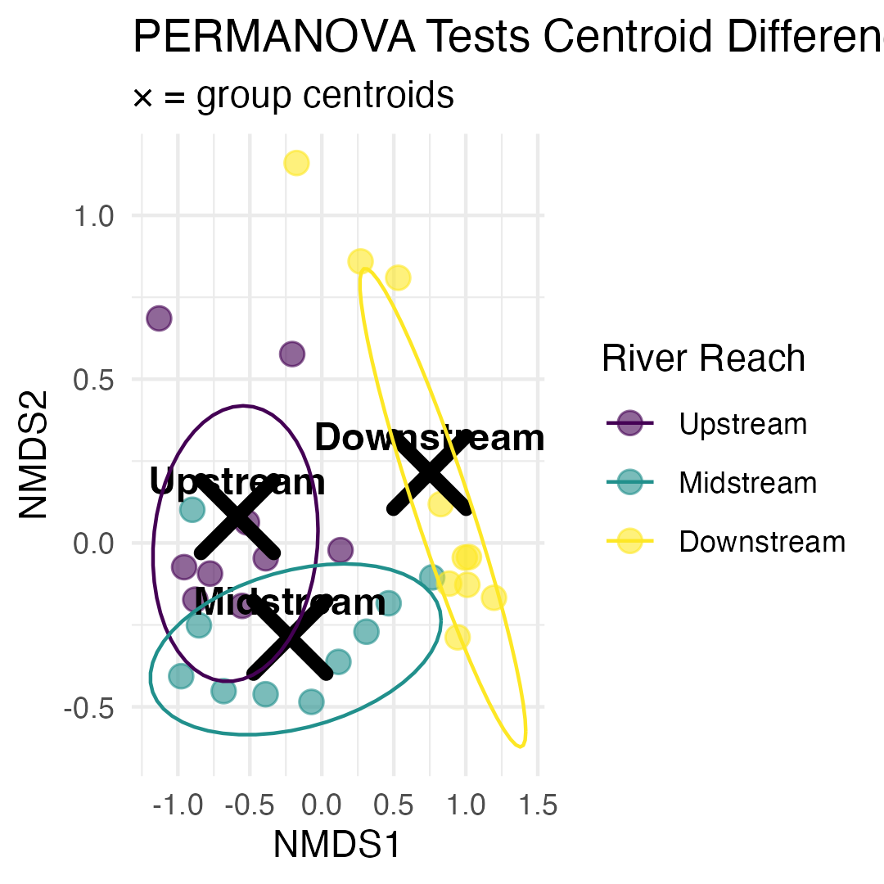
PERMANOVA Hypotheses
Research Question: “Do fish communities differ significantly between river reaches?”
Statistical Hypotheses:
H₀: The centroids of fish communities are the same across all river reaches (Upper = Middle = Lower)
H₁: At least one river reach has a different community centroid
In practical terms: -
H₀: River position doesn’t affect community composition
H₁: River position significantly affects community composition

Slide 26
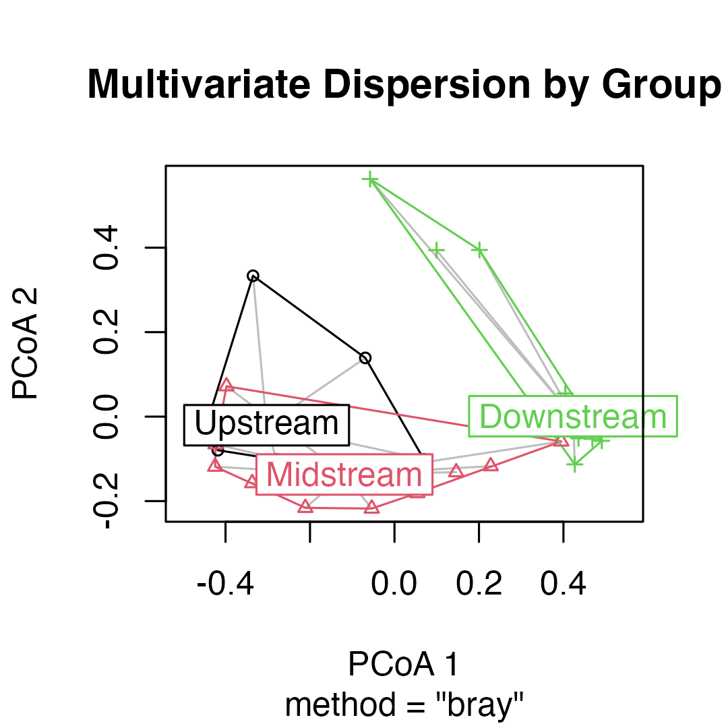
PERMANOVA Assumptions
PERMANOVA Assumptions:
✅ Required:
Independence: Samples are independent
Exchangeability: Under H₀, observations are exchangeable between groups
Homogeneity of dispersion: Groups have similar multivariate spread
❌ Not required:
Normality or other distribution
Linearity
Checking Assumptions:
Use betadisper() to test homogeneity of dispersion
If violated, PERMANOVA is testing dispersion differences and not location differences
## Homogeneity of dispersion test p-value: 0.8037
vegan::betadisper() converts bray-curtis to euclidean distances to calculate distance from sample to center
Principal Coordinates Analysis (PCoA) - ordination for distances between samples in a low-dimensional, Euclidean space

Slide 27
Running PERMANOVA
PERMANOVA on Fish Communities
Line-by-line interpretation:
reach: The factor being tested (river reach)
Df = 2: Degrees of freedom (3 groups - 1)
SumOfSqs: Between-group sum of squares
R2: Proportion of variance explained by reach
F: F-statistic (ratio of between/within group variation)
Pr(>F): P-value from permutation test
## Permutation test for adonis under reduced model ## Permutation: free ## Number of permutations: 999 ## ## adonis2(formula = spe_matrix ~ reach, data = doubs_env, permutations = 999, distance = "bray") ## Df SumOfSqs R2 F Pr(>F) ## Model 2 2.3631 0.42634 9.6614 0.001 *** ## Residual 26 3.1798 0.57366 ## Total 28 5.5429 1.00000 ## --- ## Signif. codes: 0 '***' 0.001 '**' 0.01 '*' 0.05 '.' 0.1 ' ' 1
What this means:
Significant result (p < 0.001): We reject H₀
River reach explains substantial variation in fish communities
Fish communities differ significantly between river reaches
Very few permutations gave F ≥ observed F

Slide 28
Pairwise PERMANOVA Tests
Interpretation of Pairwise Results:
All pairwise comparisons are statistically significant even after Bonferroni correction
Upper vs Lower shows the strongest difference (highest F-statistic)
Downstream comparisons to up and middle explains a substantial portion of variance (R² > 0.3)
Biological interpretation: Fish communities change progressively down the river
## pairs Df SumsOfSqs F.Model R2 p.value p.adjusted ## 1 Upstream vs Midstream 1 0.4068962 3.434528 0.1680747 0.021 0.063 ## 2 Upstream vs Downstream 1 1.8495110 15.490360 0.4767679 0.001 0.003 ## 3 Midstream vs Downstream 1 1.2829784 9.972485 0.3565105 0.001 0.003 ## sig ## 1 ## 2 * ## 3 *

Slide 29
Visualizing PERMANOVA Results
Results:

Slide 30
Part 6 · ANOSIM

Slide 31
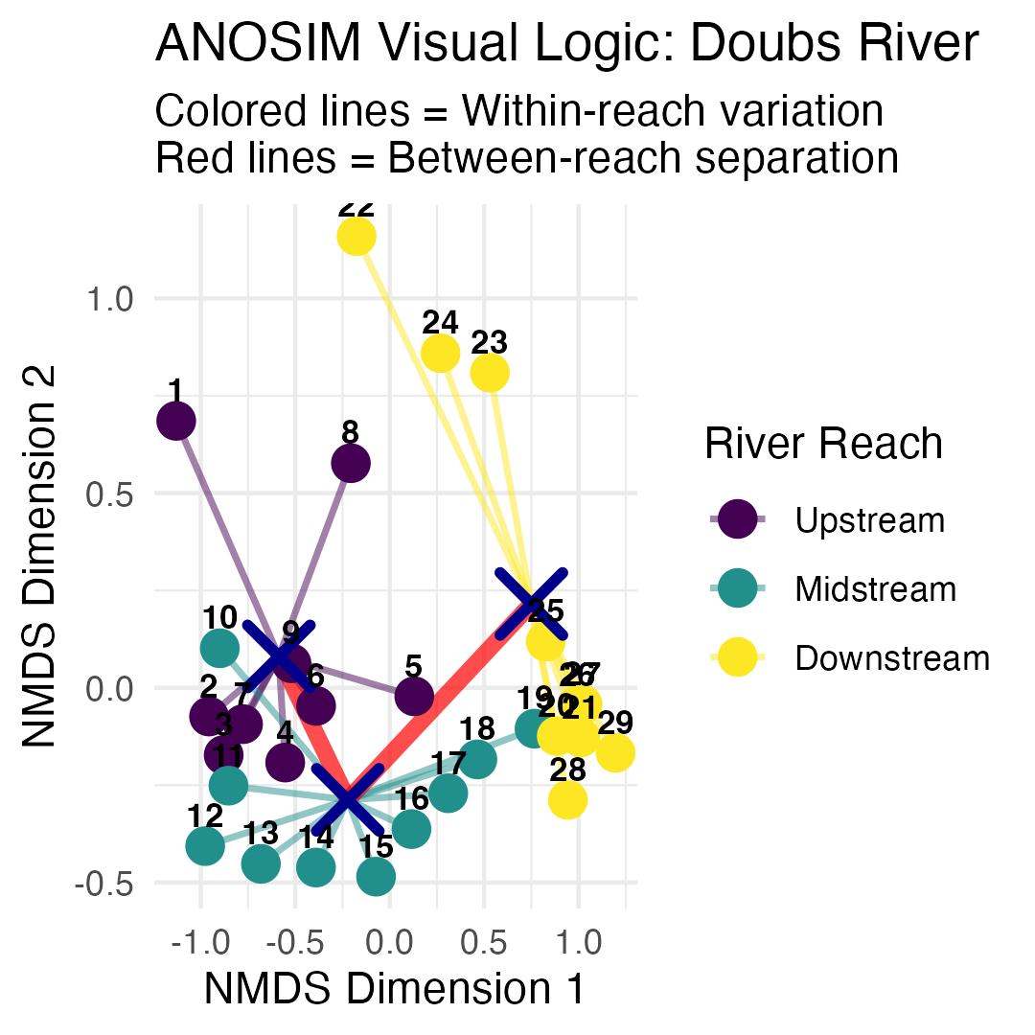
ANOSIM: Analysis of Similarities
ANOSIM (Analysis of Similarities):
Purpose: are samples w/in groups are more similar than samples between groups
Method: Based on rank dissimilarities
Statistic: R-statistic ranging from -1 to +1
Interpretation:
R ≈ 1: Groups are completely separated
R ≈ 0: Groups are indistinguishable
R < 0: More dissimilarity within groups than between
Differences from PERMANOVA:
ANOSIM uses ranks of distances
PERMANOVA uses actual distances
ANOSIM is more robust but less powerful

Slide 32
How ANOSIM Works
ANOSIM Algorithm:
Calculate dissimilarity matrix between all samples
Rank all dissimilarities from smallest to largest
Calculate mean rank of within-group dissimilarities (r̄w)
Calculate mean rank of between-group dissimilarities (r̄b)
Compute R-statistic: R = (r̄b - r̄w) / (N(N-1)/4) where N = total number of samples
Permute group labels and recalculate R many times
P-value = proportion of permuted R ≥ observed R
R-statistic interpretation:
R = 1: Perfect separation
R = 0: No separation
R = -1: More similar between groups than within
# Run ANOSIM anosim_result <- anosim(spe_matrix, doubs_env$reach, distance = "bray", permutations = 999) # Display results anosim_result ## ## Call: ## anosim(x = spe_matrix, grouping = doubs_env$reach, permutations = 999, distance = "bray") ## Dissimilarity: bray ## ## ANOSIM statistic R: 0.5082 ## Significance: 0.001 ## ## Permutation: free ## Number of permutations: 999

Slide 33
Running ANOSIM
ANOSIM Results Interpretation:
R = 0.5082 : This indicates “good” separation between groups
**p-value = 0.001 - significant result
Biological meaning: Fish communities well-separated between river reaches, with communities within each reach being much more similar to each other than to communities in other reaches
“Within” box is clearly lower than the “Between” box
sites within same river reach tend to be more similar to each other (lower dissimilarity ranks) than sites in different reaches (higher dissimilarity ranks)
R statistic of 0.51 quantifies this separation
there’s clear differentiation, but with some overlap.
Interpreting R:
R = 1 - Complete separation
all within-group dissimilarities smaller than between-group dissimilarities
R > 0.75 Well separated
R > 0.5 Separated, but overlapping
R > 0.25 Barely separated
R ≈ 0 No difference between groups

Slide 34
Part 7 · Comparing PERMANOVA and ANOSIM

Slide 35
ANOSIM vs PERMANOVA Comparison
## # A tibble: 2 × 6 ## Method `Test Statistic` `P-value` Interpretation `What it tests` Approach ## <chr> <chr> <dbl> <chr> <chr> <chr> ## 1 PERMANOVA F = 9.66 0.001 Groups have dif… Differences in… Uses ac… ## 2 ANOSIM R = 0.508 0.001 Excellent group… Overlap betwee… Uses ra…

Slide 36
ANOSIM vs PERMANOVA Comparison
When to use which:
PERMANOVA:
More powerful for detecting differences
Better for complex experimental designs
Can handle interactions and covariates
Preferred for most applications
ANOSIM:
More robust to outliers
Simpler interpretation
Good for initial exploratory analysis
Useful when distributions are very non-normal

Slide 37
PERMANOVA vs ANOSIM
What’s the Difference? Three Scenarios
Both methods test whether groups differ, but they ask different questions:
PERMANOVA asks: Do the group centroids differ in location?
Uses actual squared distances and partitions variance like ANOVA
ANOSIM asks: Are within-group dissimilarities smaller than between-group?
Uses ranked distances to compares rank distributions

Slide 38
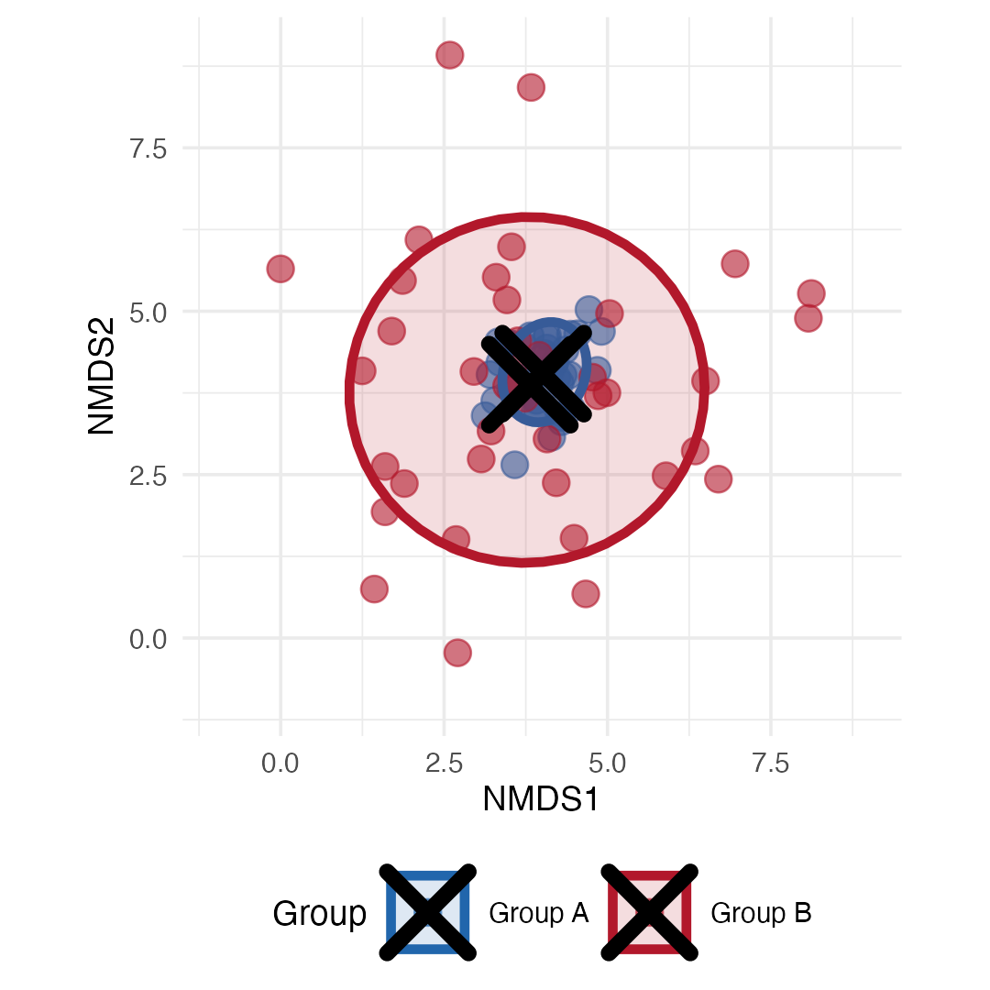
Scenario 2 is Key!
The Problem:
Groups A and B have the same centroid (same average community)
But Group B is much more variable (spread out)
PERMANOVA will detect this as “significant”!
Why?
PERMANOVA tests distances from points to centroids
More spread = larger distances = detected as “different”

Slide 39
Dispersion test for PERMANOVA
Solution: Always run betadisper() before interpreting PERMANOVA!
What PERMANOVA “Sees”

Slide 40
What ANOSIM “Sees”
This is different

Slide 41
Side-by-Side Comparison of PCA and ANOSIM
Comparison

Slide 42
Part 8 · Environmental Drivers and Wrap-Up

Slide 43
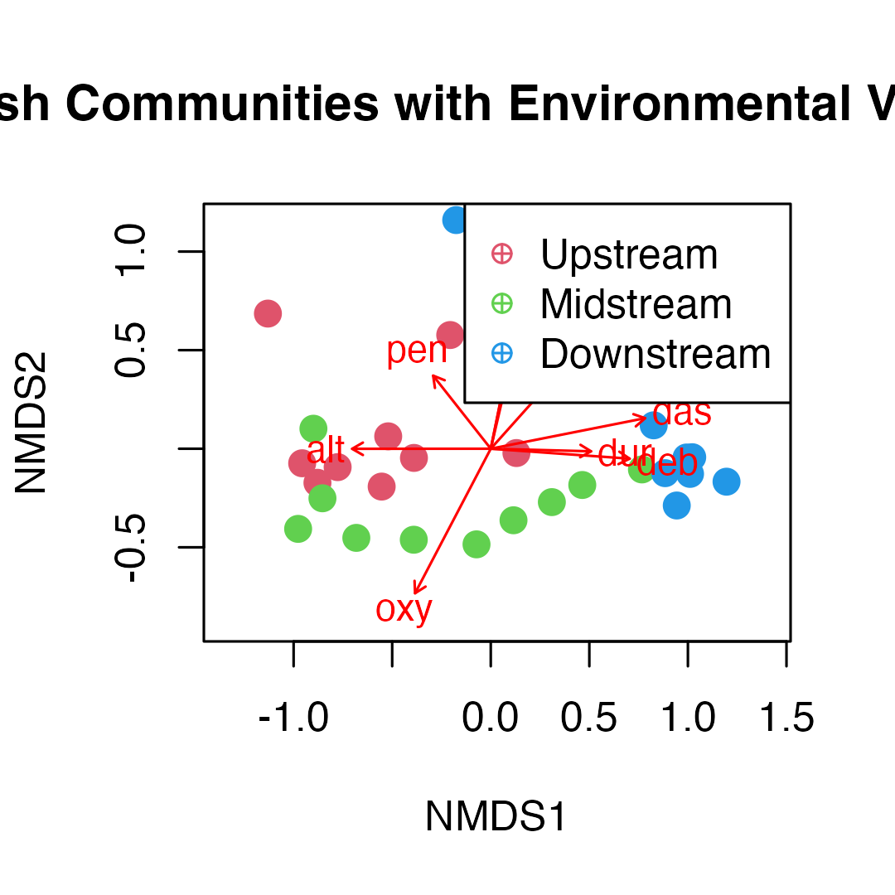
Environmental Drivers
Environmental Vector Results:
Which Environmental Variables Matter?
Significant variables (p < 0.05):
What this means:
variables significantly correlate w/ comm. comp
explain spatial arrangement of sites in NMDS
arrows show direction of max change for env. variables
Longer arrows = stronger correlations with ordination
Arrow direction = sites have high vs. low values of variable
distance from source (das) and altitude (alt) point opp. directions
(expected - altitude decreases as distance increases)
Oxygen (oxy) decreases downstream
BOD (dbo) increases downstream = more org. pollution
## ## ***VECTORS ## ## NMDS1 NMDS2 r2 Pr(>r) ## das 0.98098 0.19411 0.7284 0.001 *** ## alt -1.00000 -0.00057 0.5650 0.001 *** ## pen -0.61902 0.78538 0.2546 0.026 * ## deb 0.99744 -0.07146 0.5701 0.001 *** ## pH -0.09760 -0.99523 0.0746 0.374 ## dur 0.99967 -0.02575 0.2960 0.008 ** ## pho 0.22860 0.97352 0.5228 0.001 *** ## nit 0.66665 0.74537 0.5200 0.001 *** ## amm 0.19902 0.98000 0.5471 0.002 ** ## oxy -0.46402 -0.88583 0.7826 0.001 *** ## dbo 0.20211 0.97936 0.6883 0.001 *** ## --- ## Signif. codes: 0 '***' 0.001 '**' 0.01 '*' 0.05 '.' 0.1 ' ' 1 ## Permutation: free ## Number of permutations: 999

Slide 44
Environmental Gradient Analysis
Key Environmental Patterns:
Distance from source (das): Strong correlate with community change
Oxygen (oxy): Decreases downstream, affects fish communities
Biological oxygen demand (dbo): Increases downstream (pollution indicator)
Altitude (alt): Decreases downstream, associated with temperature changes

Slide 45
Summary and Conclusions
Key Findings
NMDS Results:
Stress =: Excellent representation
Clear gradient from upper to lower river reaches
Within-reach similarity greater between-reach similarity
PERMANOVA Results:
Highly significant differences between reaches (p < 0.001)
River reach explains substantial variance in community composition
All pairwise comparisons significant after correction
ANOSIM Results:
R = 0.508 p = 0.001 : Excellent separation
Confirms PERMANOVA findings with different approach
Strong within-group coherence
Environmental Drivers:
Distance from source: Primary gradient
Dissolved oxygen: Decreases downstream
Biological oxygen demand: Increases downstream
Multiple correlated factors drive community change
Biological Interpretation:
River continuum concept supported
Progressive community change from source to mouth
Environmental filtering shapes community assembly
Pollution gradient evident in lower reaches

Slide 46
Take-Home
NMDS (Non-metric Multidimensional Scaling):
Visualizes community dissimilarity in 2D/3D
Preserves rank order of distances (non-metric)
No distributional assumptions
Stress < 0.2 for acceptable solutions
Great for exploring ecological gradients
PERMANOVA (Permutational MANOVA):
Tests for differences in group centroids
Uses distance matrices, not raw data
No distributional assumptions
Can handle complex designs
Check dispersion homogeneity assumption
ANOSIM (Analysis of Similarities):
Tests group separation using rank distances
R-statistic: -1 (no separation) to +1 (complete)
More robust to outliers than PERMANOVA
Simpler but less powerful
Good for exploratory analysis
Environmental Drivers:
Use envfit() to correlate environment with ordination
Identifies which variables explain community patterns
Helps understand ecological mechanisms
Essential for management implications

