Slide 1
Lecture: Non-Parametric T-Tests
Rank-based tests Bill Perry

Slide 2
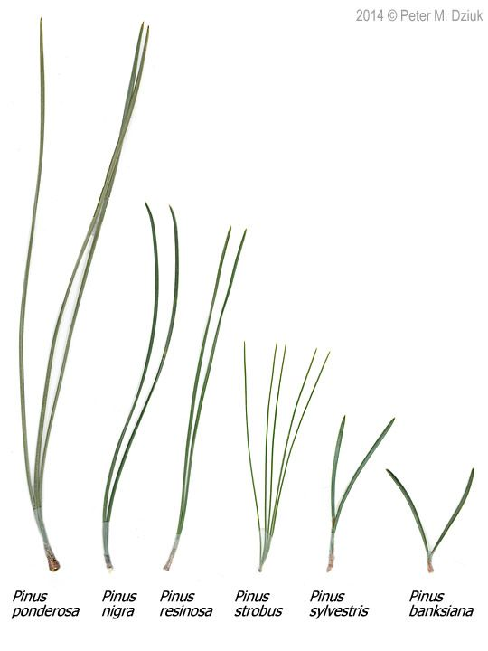
Where We Left Off
A brief review:
Hypotheses
One- and two-sided t-tests
Power — what it is and why we talk about it
Assumptions of parametric tests
What next — when assumptions fail!
we will always cover parametric tests first
then non-parametric approaches
later, other approaches use the appropriate underlying distribution when it isn’t normal, but Poisson or other
Note
✅ Key idea from last lecture
A t-test’s p-value is only trustworthy if its assumptions hold. Today is about what to do when they don’t.
Photo comparing needle length and bundle count across six pine species (Pinus ponderosa, nigra, resinosa, strobus, sylvestris, banksiana).

Slide 3

Today’s Overview
What we will cover today:
What are the assumptions again, and how do you assess them?
What to do when assumptions fail:
Robust tests
Rank-based tests
Permutation tests
Let’s work with the lake trout data, as the weights are pretty cool and the assumptions may or may not hold. This easily translates to any of the other data frames you might want to use.
Illustration of a lake trout in profile, showing its mottled brown-and-cream coloring and forked tail, the species whose weight and length data are used throughout this lecture.

Slide 4
Part 1 · Setting Up Our Analysis

Slide 5
Setting Up Our Analysis
# Load libraries library(car) # For diagnostic tests library(patchwork) library(tidyverse) # For data manipulation and visualization
lt_df <- read_csv("data/lake_trout.csv") head(lt_df)
# A tibble: 6 × 5 sampling_site species length_mm mass_g lake <chr> <chr> <dbl> <dbl> <chr> 1 I8 lake trout 515 1400 I8 2 I8 lake trout 468 1100 I8 3 I8 lake trout 527 1550 I8 4 I8 lake trout 525 1350 I8 5 I8 lake trout 517 1300 I8 6 I8 lake trout 607 2100 I8
Tip
🖐 Notice
Six lakes’ worth of trout: sampling_site, species, length_mm, mass_g, lake.

Slide 6
Calculating the Mode
# I had accidentally asked you to do mode in HW2 without # telling you how... here is one approach lt_df %>% filter(!is.na(mass_g)) %>% group_by(lake, mass_g) %>% summarise(count = n(), .groups = "drop_last") %>% arrange(desc(count)) %>% slice(1) %>% select(-count) %>% rename(mode_mass = mass_g)
# A tibble: 6 × 2 # Groups: lake [6] lake mode_mass <chr> <dbl> 1 I8 1000 2 Island Lake 2200 3 N 01 1000 4 NE 12 90 5 NE 14 1150 6 Toolik 340
Note
📖 New pattern
R has no built-in mode() function for statistical mode — this group_by() + count + slice(1) pattern is the standard workaround.

Slide 7
Part 2 · Assumptions of Parametric Tests

Slide 8
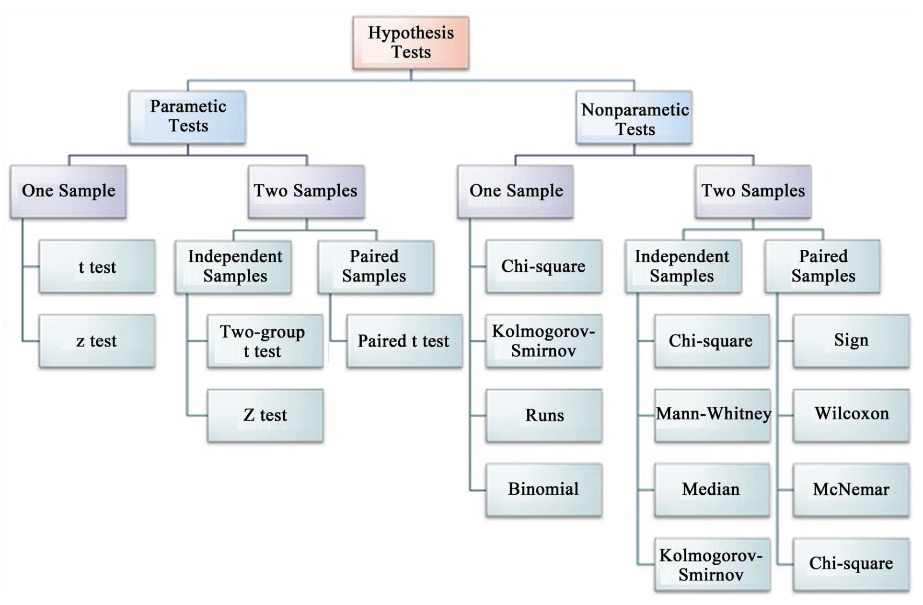
Parametric vs. Non-Parametric Tests
T-tests are parametric tests.
Parametric tests:
specify/assume the probability distribution the parameters came from
basic assumptions of parametric t-tests: random sampling, normality, equal variance (or Welch’s t-test), no outliers
Non-parametric tests: no assumption about the probability distribution/normality
Mukasa et al. 2021, DOI: 10.4236/ojbm.2021.93081
Note
📖 Reference
Whitlock & Schluter, Analysis of Biological Data, Ch. 13 — Handling Violations of Assumptions, is the core reference for this whole lecture.
Flowchart of hypothesis tests branching into parametric and nonparametric tests, each split into one-sample and two-sample (independent vs. paired) tests, listing specific tests under each branch (e.g., t test and z test under parametric one-sample; Mann-Whitney and Wilcoxon under nonparametric two-sample).

Slide 9
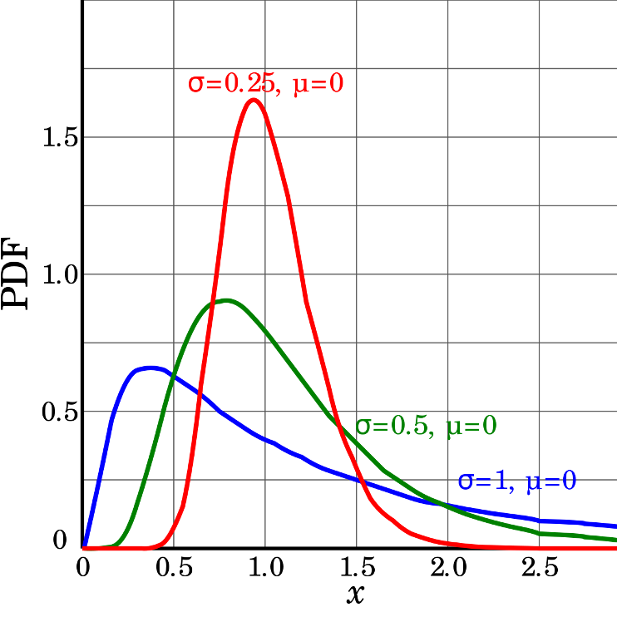
Assumptions of Parametric Tests — Overview
If a parametric test’s assumptions are violated, the test becomes unreliable
This is because the test statistic may no longer follow the distribution it’s supposed to
Most parametric tests are robust to mild/moderate violations of normality
Three probability density curves for a right-skewed distribution family at different sigma values (0.25, 0.5, 1) with mu = 0, showing how larger sigma produces a flatter, more spread-out, and less peaked skewed curve.

Slide 10
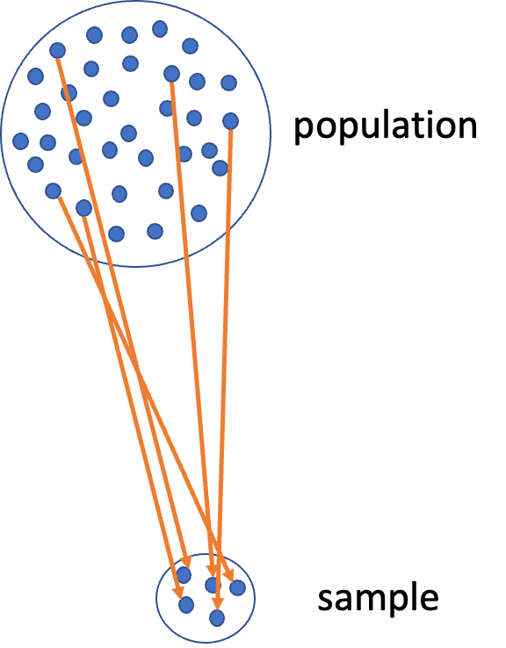
Assumptions — Random Sampling
Basic assumptions of parametric t-tests: random sampling, normality, equal variance, no outliers.
Random sampling:
samples are randomly collected from populations; part of experimental design
necessary for sample → population inference
Diagram of a large circle labeled ‘population’ full of dots, with orange arrows showing a subset being drawn down into a small circle labeled ‘sample’, illustrating random sampling from a population.

Slide 11
Assumptions — Normality Testing
Note
🔮 Predict first: We’re about to look at histogram, dotplot, boxplot, and QQ-plot views of the same NE 12 mass data. Which of the four do you expect to be most convincing about normality?

Slide 12
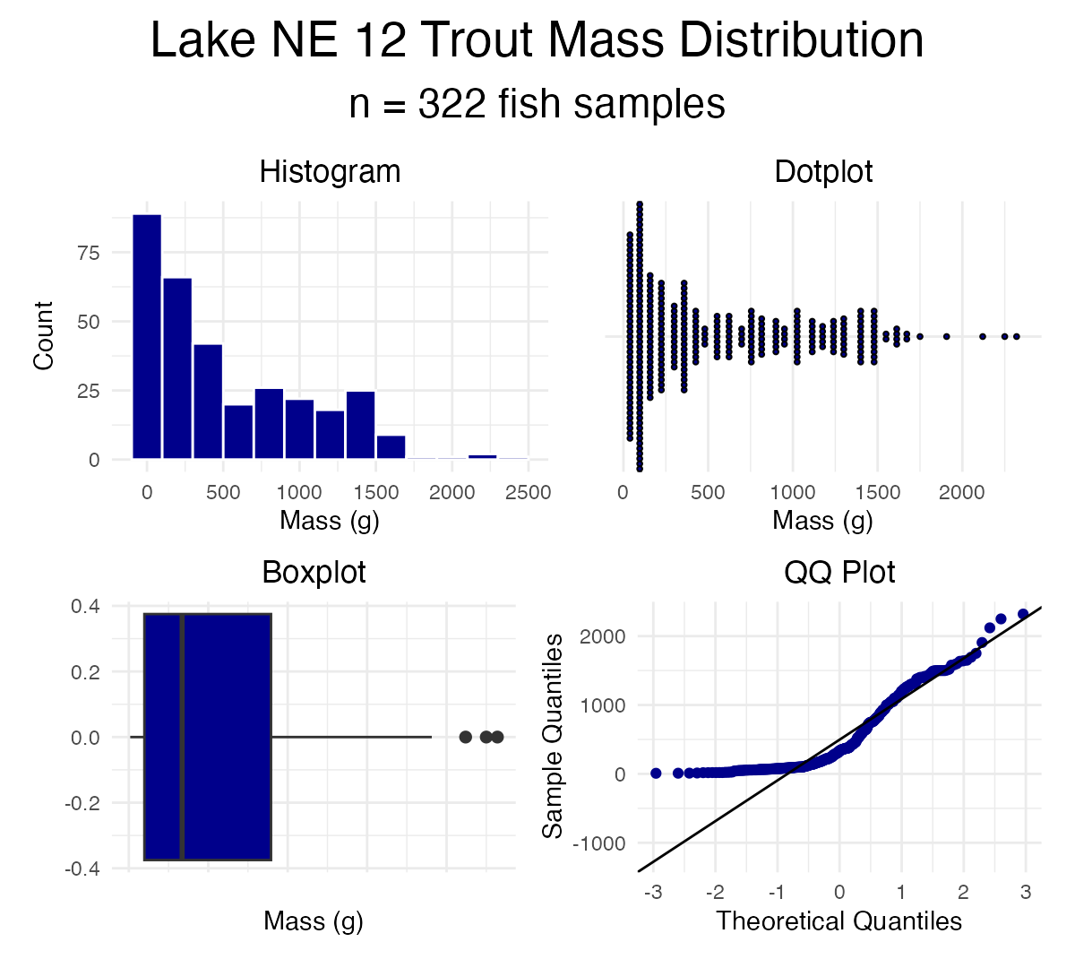
Let’s test normality for one lake — NE 12 — as if we were going to run a one-sample t-test. We need a new data frame with only NE 12 data, called ne12_data.
Normality: samples from a normally distributed population
Graphical tests: histograms, dotplots, boxplots, QQ-plots
“Formal” tests: Shapiro-Wilk test — sometimes not useful

Slide 13
Shapiro-Wilk Test for Normality
“Null hypothesis is that data is normally distributed.”
Normality: samples from a normally distributed population
Graphical tests: histograms, dotplots, boxplots, QQ-plots
“Formal” tests: Shapiro-Wilk test — sometimes not useful
Shapiro-Wilk normality test data: ne12_data$length_mm W = 0.94528, p-value = 1.56e-09

Slide 14
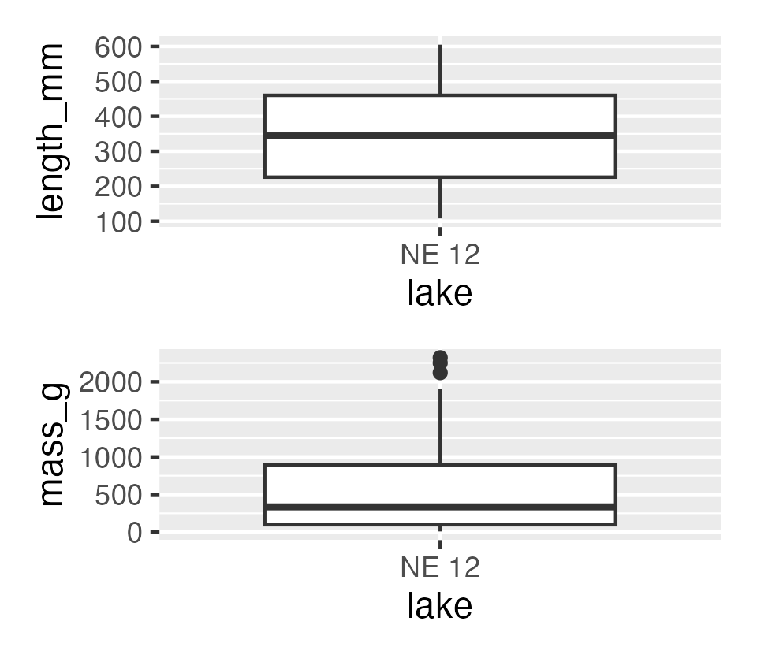
Testing the Equal Variance Assumption
Equal variance: samples are from populations with a similar degree of variability.
Graphical tests: boxplots
“Formal” tests: F-ratio test
When sample sizes are equal, parametric tests are most robust to violations of normality — less so for equal variance

Slide 15
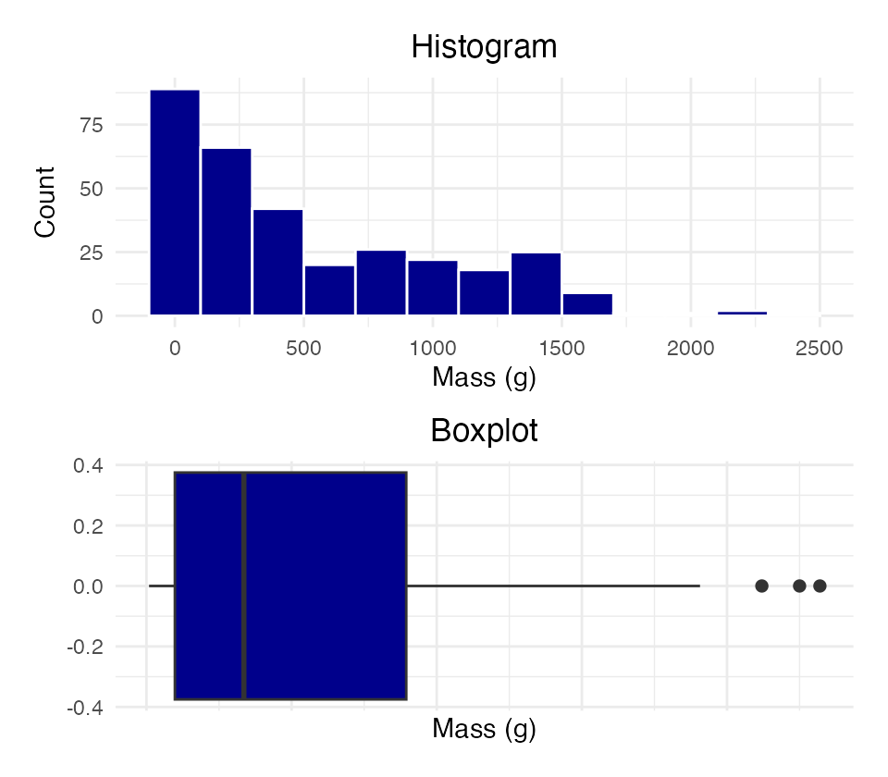
Testing for Outliers
No outliers: no “extreme” values very different from the rest of the sample.
Graphical tests: boxplots, histograms
“Formal tests”: Grubbs’ test — no one really does this
Warning
⚠️ Watch out!
Outliers are a problem for non-parametric tests as well — switching to a rank-based test doesn’t make an outlier stop mattering.

Slide 16
Part 3 · When Assumptions Fail

Slide 17
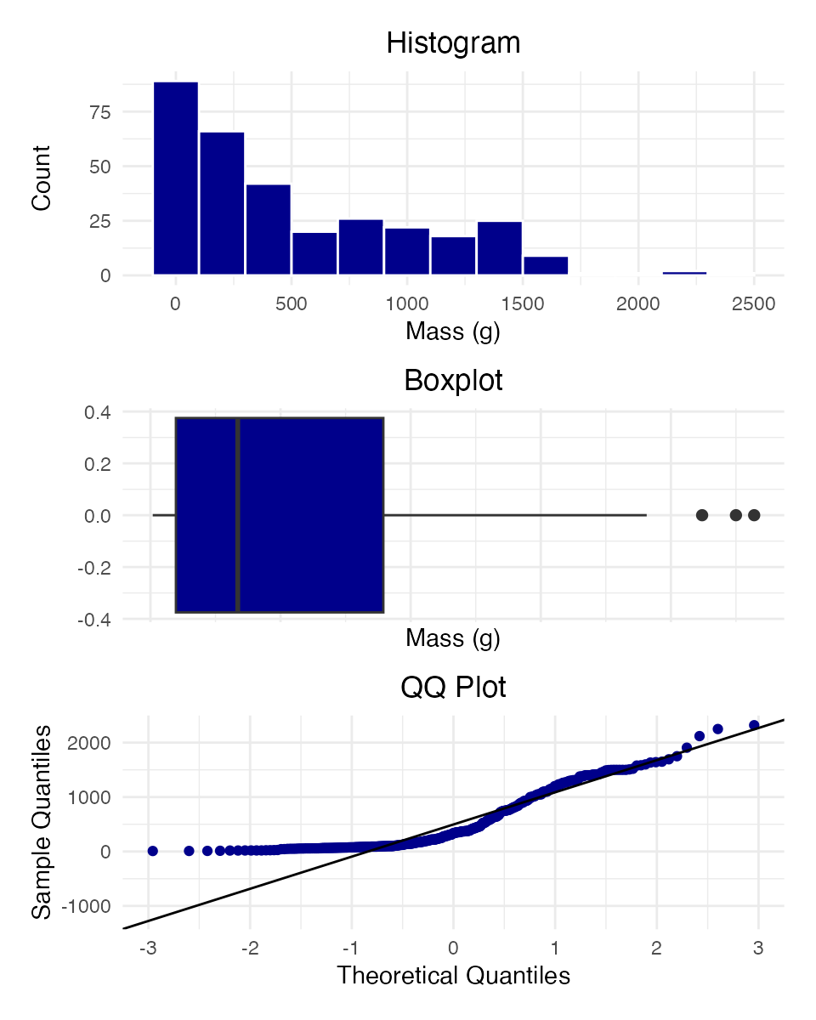
Alternative Tests When Assumptions Fail
What if t-test assumptions fail? Alternative tests, with more relaxed assumptions, are available. In which case would you use each?
Welch’s t-test: distribution normal but variance unequal
Mann-Whitney-Wilcoxon test: distribution not normal and/or outliers present (but both groups should still have similar distributions and ~equal variance)
Permutation test for two samples: distribution not normal (but both groups should still have similar distributions and ~equal variance)

Slide 18
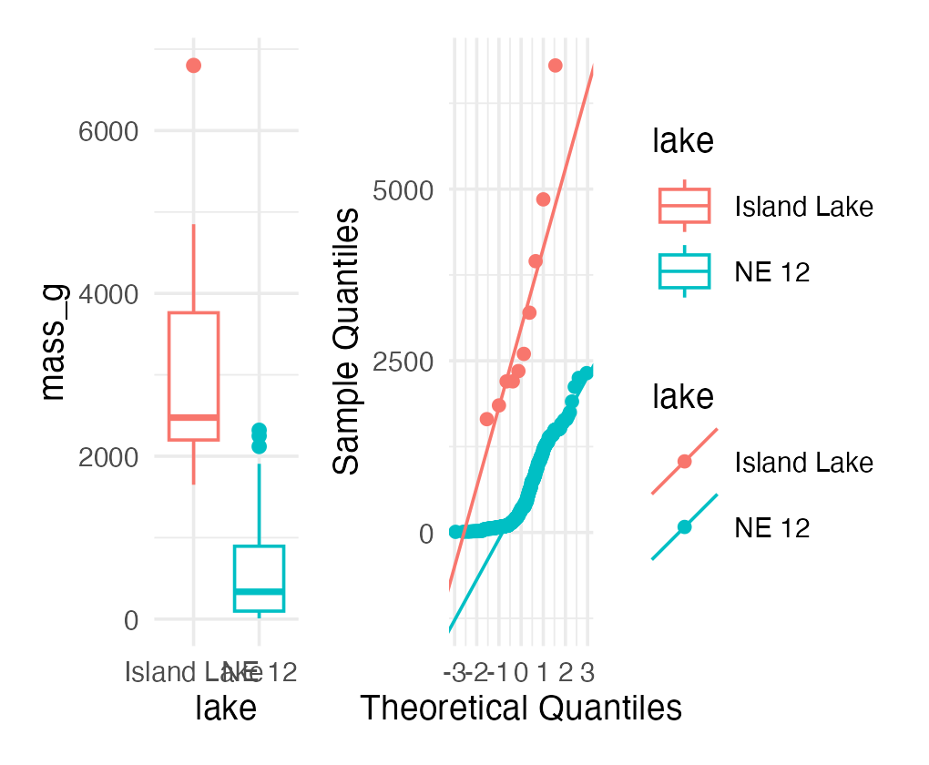
Understanding QQ-Plots
QQ-plots: a tool for assessing normality.
On x: theoretical quantiles from a standard normal distribution
On y: ordered sample values
Deviation from normal can be detected as deviation from a straight line

Slide 19
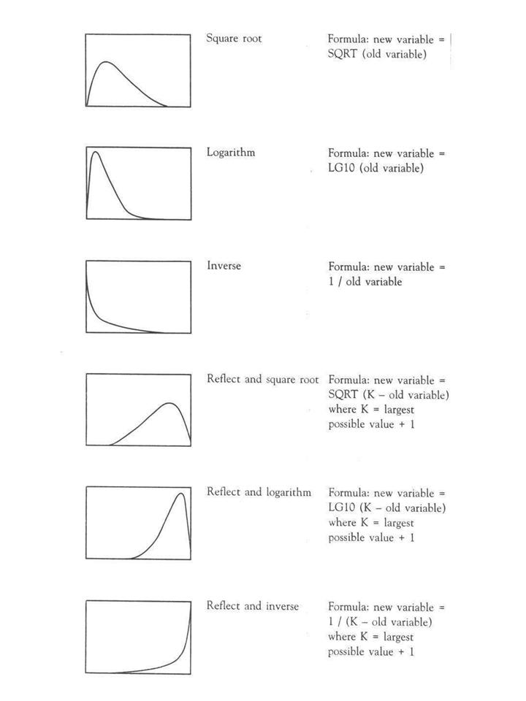
Data Transformations
In some cases, data can be mathematically “transformed” to meet the assumptions of parametric tests. This can be done in R and usually involves:
log₁₀ transformations
square root transformations
and many others
source
Reference chart of six common data transformations (square root, logarithm, inverse, and their ‘reflect and’ variants for left-skewed data), each shown as a small curve with its transformation formula, used to pick a transformation that matches a variable’s skew shape.

Slide 20
Part 4 · Welch’s T-Test

Slide 21
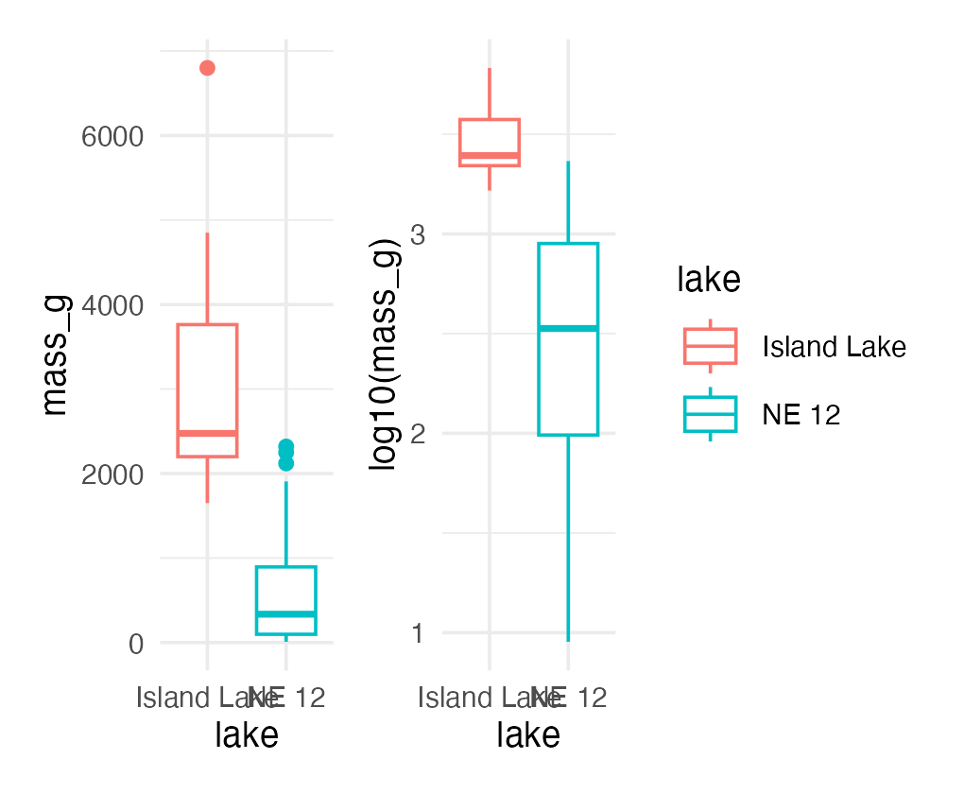
Robust Tests — Welch’s T-Test
Welch’s t-test:
a common “robust” test for the means of two populations
robust to violation of the equal-variance assumption; deals better with unequal sample sizes
still a parametric test (assumes normal distribution)
calculates a t statistic, but recalculates degrees of freedom based on sample sizes and s

Slide 22
Comparing Standard T-Test vs. Welch’s T-Test
Let’s compare a parametric t-test to a Welch’s t-test:
Standard: t.test(y1, y2, var.equal = TRUE, paired = FALSE)
Welch’s: t.test(y1, y2, var.equal = FALSE, paired = FALSE)
[1] "Standard t-test results for mass_g:"
Two Sample t-test data: mass_g by lake t = 14.181, df = 330, p-value < 2.2e-16 alternative hypothesis: true difference in means between group Island Lake and group NE 12 is not equal to 0 95 percent confidence interval: 2266.304 2996.360 sample estimates: mean in group Island Lake mean in group NE 12 3165.0000 533.6677
[1] "Welch's t-test results for mass_g:"
Welch Two Sample t-test data: mass_g by lake t = 5.1368, df = 9.0578, p-value = 0.0006016 alternative hypothesis: true difference in means between group Island Lake and group NE 12 is not equal to 0 95 percent confidence interval: 1473.676 3788.989 sample estimates: mean in group Island Lake mean in group NE 12 3165.0000 533.6677

Slide 23
Part 5 · Rank-Based Tests

Slide 24
Rank-Based Tests
Rank-based tests: no assumptions about distribution (non-parametric).
Ranks of data: observations are assigned ranks; sums (and signs, for paired tests) of ranks for groups are compared
Mann-Whitney U test — common alternative to the independent-samples t-test
Wilcoxon signed-rank test — alternative to the paired t-test
Assumptions: similar distributions for groups, equal variance
Less power than parametric tests
Best when normality can’t be met by transformation (weird distribution) or there are large outliers
Note
📖 Reference
Whitlock & Schluter, Ch. 13, covers the Mann-Whitney U test and Wilcoxon signed-rank test as the standard rank-based alternatives.

Slide 25
Mann-Whitney U Test Results
[1] "Mann-Whitney U test results mass_g:"
Wilcoxon rank sum test with continuity correction data: mass_g by lake W = 3205.5, p-value = 9.506e-08 alternative hypothesis: true location shift is not equal to 0
Tip
🖐 Notice
The test statistic is W, not t — a signal you’re reading rank-based test output, not a t-test.

Slide 26
Part 6 · Permutation Tests

Slide 27
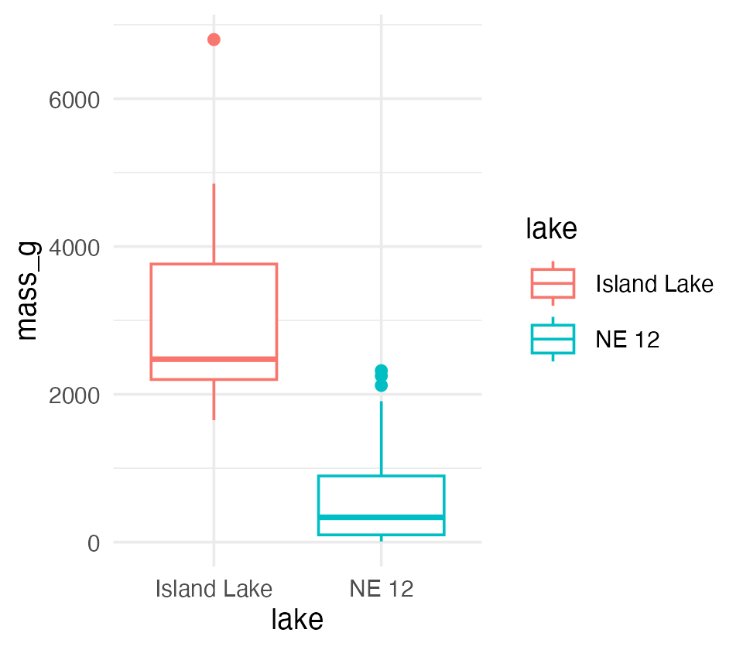
Permutation Tests — Concept
Permutation tests are based on resampling: reshuffling the original data
Resampling allows parameter estimation when the distribution is unknown, including SEs and CIs of statistics (means, medians)
A common approach is the bootstrap: resample with replacement many times, recalculate sample stats
We use the perm package
H₀: µ_A = µ_B, Hₐ: µ_A ≠ µ_B
Calculates the difference Δ in means between two groups

Slide 28
Permutation Tests — Method
Randomly reshuffle observations between groups (keeping n₍NE 12₎ = 323 and n₍Island₎ = 10), calculate Δ
Repeat > 1,000 times
Record the proportion of the differences in means as extreme as (or more extreme than) observed
This is equivalent to a p-value, and can be used in the “traditional” hypothesis-testing framework
Tip
🖐 For a graphical explanation
jwilber.me/permutationtest

Slide 29
Permutation Test Implementation
In R, using the perm package. Assumptions: both groups have a similar distribution; equal variance.
library(perm) ne12_perm_data <- isl_ne12_df %>% filter(lake == "NE 12") %>% pull(length_mm) # Randomly sample exactly 25 observations from NE 12 set.seed(123) ne12_perm_data <- sample(ne12_perm_data, size = 25, replace = FALSE) island_perm_data <- isl_ne12_df %>% filter(lake == "Island Lake") %>% pull(length_mm) observed_diff <- mean(ne12_perm_data, na.rm = TRUE) - mean(island_perm_data, na.rm = TRUE)
permTS(ne12_perm_data, island_perm_data, alternative = "two.sided", method = "exact.mc", control = permControl(nmc = 10000))
Exact Permutation Test Estimated by Monte Carlo data: GROUP 1 and GROUP 2 p-value = 2e-04 alternative hypothesis: true mean GROUP 1 - mean GROUP 2 is not equal to 0 sample estimates: mean GROUP 1 - mean GROUP 2 -333.08 p-value estimated from 10000 Monte Carlo replications 99 percent confidence interval on p-value: 0.000000000 0.001059383

Slide 30
Part 7 · Summary

Slide 31
Summary — Testing Assumptions
Key assumptions:
Random sampling — samples are randomly collected from populations
Normality — data follows a normal distribution
Equal variance — samples come from populations with similar variability
No outliers — no extreme values that can skew results
Note
Assessing assumptions
Key to do every time
Should be acknowledged in the manuscript

Slide 32
Summary — Data Transformations
When assumptions aren’t met, transformations may help normalize data:
Log transformation: log10(x) — useful for right-skewed data, multiplicative effects
Square root: sqrt(x) — useful for count data, moderately right-skewed distributions
Box-Cox: a more flexible family of power transformations
More specialized transformations exist, especially for percentages or proportions
Tip
🖐 Recall
We saw log10() shrink the gap between the NE 12 and Island Lake boxplots earlier — that’s the transformation working.

Slide 33
Summary — Parametric Test Options
1. Standard t-test
Strengths:
High statistical power when assumptions are met
Well understood and widely accepted
Weaknesses:
Sensitive to violations of normality, equal variance
Heavily influenced by outliers
2. Welch’s t-test
Strengths:
Robust to violations of the equal-variance assumption
Handles unequal sample sizes well
Still parametric (assumes normality)
Weaknesses:
Slightly less powerful than the standard t-test when variances are equal
Still assumes a normal distribution

Slide 34
Summary — Non-Parametric Options
3. Mann-Whitney-Wilcoxon test
Strengths:
Non-parametric: doesn’t assume normal distribution
Robust against outliers
Works with ordinal data
Weaknesses:
Less statistical power than parametric tests
Still assumes similar distributions and approximately equal variance
Tests median differences rather than mean differences
4. Permutation tests
Strengths:
Distribution-free: doesn’t assume a specific distribution
Can be applied to many types of test statistics
Handles small sample sizes well
Directly estimates p-values through resampling
Weaknesses:
Computationally intensive
Assumes exchangeability under the null hypothesis
Requires similar distributions and equal variance

Slide 35
Key Takeaway
Statistical tests have different strengths and assumptions. The choice should be guided by your data’s characteristics, not just convenience.
Always visualize your data before deciding on the appropriate test.
Note
✅ Key idea
Standard t-test → Welch’s → Mann-Whitney/Permutation isn’t a strict ladder of “better” tests — each answers a slightly different question (means vs. medians) under different assumptions. Pick based on what your data actually looks like.

