Slide 1
Lecture: Power and Type I & II Error
Errors and power Bill Perry

Slide 2
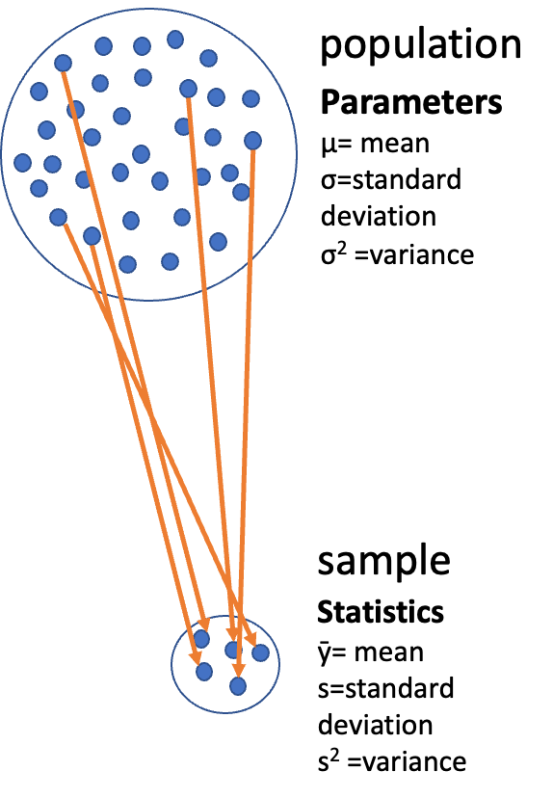
Where We Left Off
Covered last time:
Statistical inference fundamentals
Hypothesis testing principles
T-distributions
One-sample, two-sample, and paired t-tests
Note
✅ Key idea from last lecture
A t-test gives you a p-value and a decision — reject or fail to reject H₀. Today asks the next question: how good is that decision, and how often could it be wrong?
Note
Today’s objectives
Brief review
Hypothesis tests for two populations
Assumptions of parametric tests
Power of parametric tests
Introduction to non-parametric tests
Diagram of a large circle labeled ‘population’ full of dots with Greek-letter parameters (mu, sigma, sigma-squared), with orange arrows drawing a subset of dots down into a small circle labeled ‘sample’ with its statistics (y-bar, s, s-squared), illustrating that a sample is used to estimate unknown population parameters.

Slide 3
Part 1 · Statistical Hypothesis Testing

Slide 4

Statistical Hypothesis Testing
Major goal of statistics: inferences about populations from samples
assign a degree of confidence to inferences
Statistical hypothesis testing: a formalized approach to inference
Hypotheses ask whether samples come from populations with certain properties
Often interested in questions about population means — but other questions are of interest too
Note
📖 Reference
Gotelli & Ellison, A Primer of Ecological Statistics, Ch. 4 — Framing and Testing Hypotheses.
Photo of a mature pine tree with a gently leaning trunk and broad, layered branches of green needle clusters against a transparent background.

Slide 5
Part 2 · Hypothesis Components

Slide 6

Hypothesis Components
Useful hypotheses rely on specifying:
H₀ — the hypothesis of “no effect”
two samples from populations with the same mean
or a sample is from a population of mean = X
Hₐ (research or alternate hypothesis)
the opposite of H₀
predicts an effect of x on y
but does NOT suggest a direction — that’s a prediction
Photo of two separate green pine branches side by side, symbolizing the two groups or hypotheses (H0 vs. Ha) being compared.

Slide 7
Hypothesis Examples
Together, H₀ and Hₐ encompass all possible outcomes:
H₀: µ = 0, Hₐ: µ ≠ 0 — mean equals 0 or it does not
H₀: µ = 35, Hₐ: µ ≠ 35 — mean equals 35 or it does not
H₀: µ₁ = µ₂, Hₐ: µ₁ ≠ µ₂ — mean of population 1 equals mean of population 2, or it does not
H₀: µ > 0, Hₐ: µ ≤ 0 — can be directional: mean is greater than 0, or mean is not greater than 0
this becomes a one-sided test, since it predicts only one direction
Photo of two separate green pine branches side by side, symbolizing the two groups or hypotheses (H0 vs. Ha) being compared.

Slide 8
Part 3 · P-Values

Slide 9
Statistical Testing Framework
Statistical tests assess the likelihood of the null hypothesis being true.
If H₀ is likely false, Hₐ is assumed correct
More precisely: the long-run probability of obtaining our sample value (or a more extreme one) if the null hypothesis is true
p(data | H₀) — the probability of observing the data given that H₀ is true
Photo of two separate green pine branches side by side, symbolizing the two groups or hypotheses (H0 vs. Ha) being compared.

Slide 10
Understanding P-Values
Hypothesis tests are expressed as a p-value (0 = never, 1 = always).
Interpret a p-value as: the probability of obtaining a sample value of the statistic (or a more extreme one) if H₀ is true.
High p-value: high probability of obtaining our sample statistic under H₀
if H₀ were true, you would frequently observe data similar to your sample
your observed results are quite compatible with what H₀ predicts
Low p-value: low probability of obtaining our sample statistic under H₀
if H₀ were true, you would rarely observe data this extreme
your results are unusual under H₀ — either you witnessed a rare event, or H₀ may be incorrect
Photo of two separate green pine branches side by side, symbolizing the two groups or hypotheses (H0 vs. Ha) being compared.

Slide 11
P-Value Interpretation
Statistical test results:
p = 0.3 means that if I repeated the study 100 times, I would get this (or a more extreme) result due to chance 30 times
p = 0.03 means that if I repeated the study 100 times, I would get this (or a more extreme) result due to chance 3 times
Which p-value suggests H₀ is likely false?
At what point do we reject H₀?
p < 0.05 is the conventional “significance threshold” (α = alpha).
p < 0.05 means: if H₀ is true and we repeated the study 100 times, we would get this (or a more extreme) result less than 5 times due to chance.
Note
✅ Key idea
α is chosen before data collection. It’s a policy about how much Type I error risk you’re willing to accept — not something you pick after seeing the p-value.

Slide 12
Significance Levels and Interpretation
α is the rate at which we will reject a true null hypothesis (Type I error rate)
Lowering α lowers the likelihood of incorrectly rejecting a true H₀ (e.g., 0.01, 0.001)
Both hypotheses and α are specified BEFORE data collection and analysis
Traditionally, α = 0.05 is used as the cutoff for rejecting H₀. There is nothing magical about 0.05 — actual p-values should be reported, and α still needs to be decided prior to the study.
p-value range | Interpretation
P > 0.10 | No evidence against H₀ — data appear consistent with H₀
0.05 < P < 0.10 | Weak evidence against H₀ in favor of Hₐ
0.01 < P < 0.05 | Moderate evidence against H₀ in favor of Hₐ
0.001 < P < 0.01 | Strong evidence against H₀ in favor of Hₐ
P < 0.001 | Very strong evidence against H₀ in favor of Hₐ

Slide 13
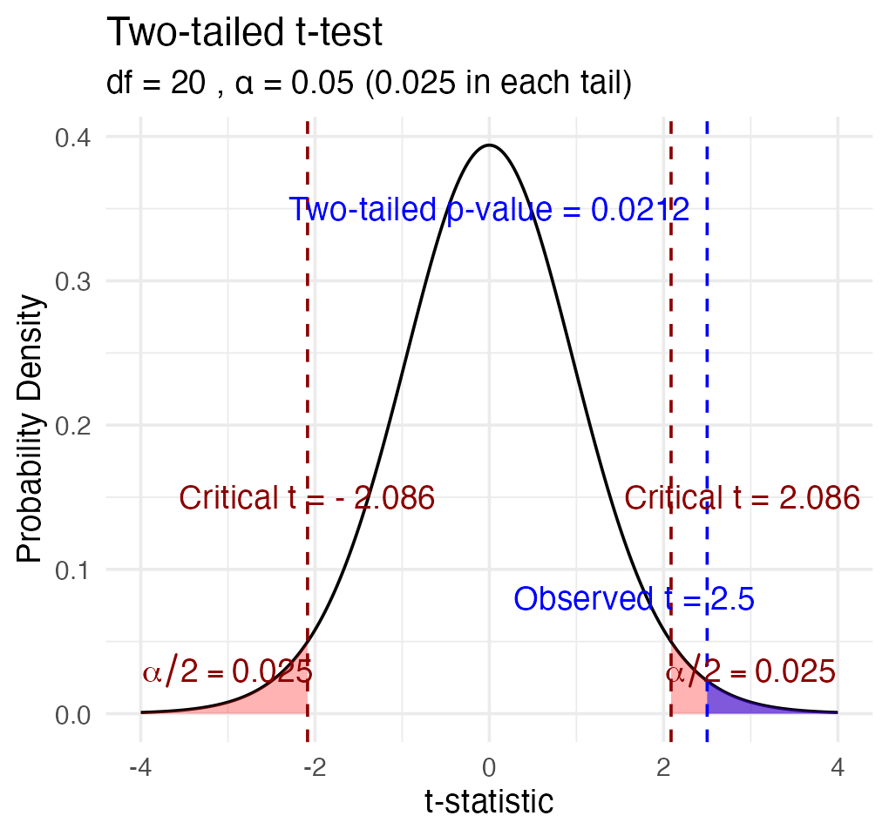
Understanding P-Values Visually
A p-value is the probability of observing the sample result (or something more extreme) if the null hypothesis is true.
Common interpretations:
p < 0.05: strong evidence against H₀
0.05 ≤ p < 0.10: moderate evidence against H₀
p ≥ 0.10: insufficient evidence against H₀
Common misinterpretations:
p-value is NOT the probability that H₀ is true
p-value is NOT the probability that results occurred by chance
Statistical significance ≠ practical significance
Note there’s a difference in how the hypotheses are stated for a one-sample vs. a two-sample t-test.

Slide 14
Part 4 · Historical Context

Slide 15

Historical Context
Screenshot of a Nature comment article titled ‘Scientists rise up against statistical significance,’ by Valentin Amrhein, Sander Greenland, Blake McShane and 800+ signatories, illustrated with a cartoon of two scientists shelving a book labeled ‘Statistical Significance’ in a dusty cabinet of retired scientific relics like phlogiston and spontaneous generation, symbolizing calls to retire strict significance thresholds.

Slide 16

Fisher’s Perspective
“If p is between 0.1 and 0.9 there is certainly no reason to suspect the hypothesis tested. If it is below 0.02 it is strongly indicated that the hypothesis fails to account for the whole of the facts. We shall not often be astray if we draw a conventional line at .05 …”
— R.A. Fisher, on the p-value as an informal measure of discrepancy between data and H₀
Vintage black-and-white photo of an older bearded man in glasses smoking a pipe outdoors, believed to depict R.A. Fisher, whose quote on interpreting p-values appears alongside it.

Slide 17
Part 5 · Decision Errors

Slide 18
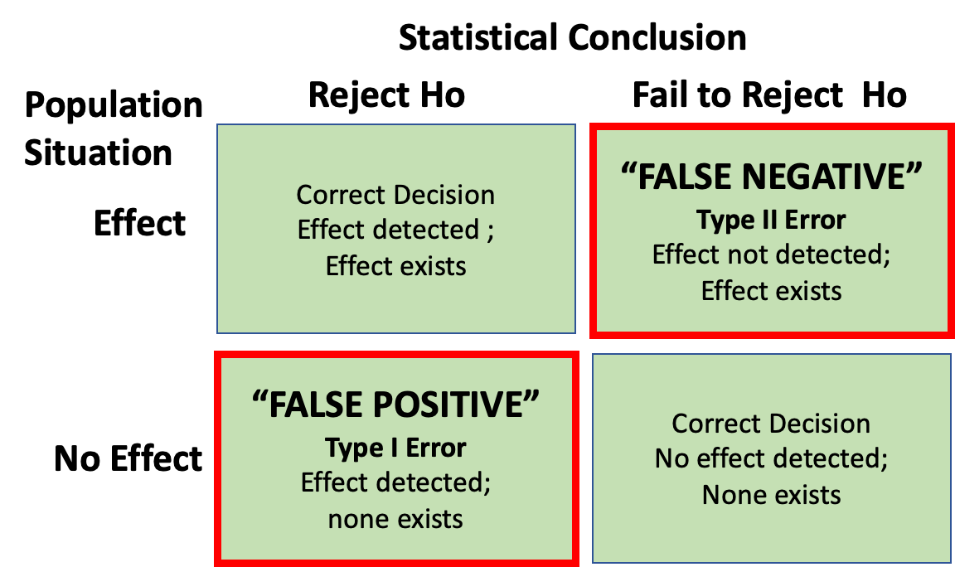
Decision Errors
Even good studies can reach incorrect conclusions
These are called “decision errors”
There are two types of decision errors
We want to know the probability of making each of them
Note
📖 Reference
Gotelli & Ellison, Ch. 4 — the “Errors in Hypothesis Testing” section covers exactly this material.
2x2 decision-error table crossing population situation (Effect exists vs. No Effect) with statistical conclusion (Reject H0 vs. Fail to Reject H0): correct decisions on the diagonal, a red-outlined ‘False Negative / Type II Error’ cell (fail to reject when an effect exists), and a red-outlined ‘False Positive / Type I Error’ cell (reject when no effect exists).

Slide 19
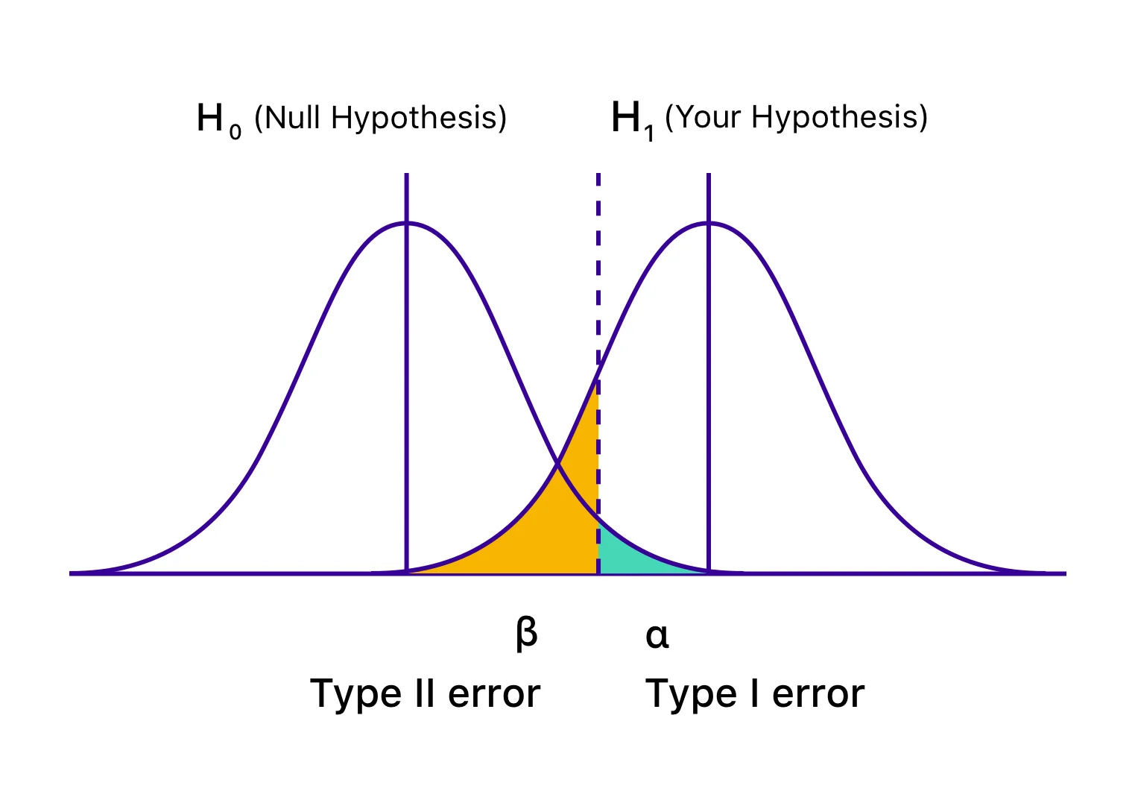
Type I and Type II Errors — Concept
Type I error rate, α: wrongly reject H₀ when it’s true
α = 0.05 means a Type I error rate of 5%
Type II error rate, β: wrongly fail to reject H₀ when it’s false
Power = 1 − β: the probability of correctly rejecting H₀ when Hₐ is true
Inverse relationship between Type I and Type II error — but not a straightforward one
Can result from chance — a sample not representative of the population
Which type of error is more dangerous?
the dotted line is α = 0.05
Two overlapping bell curves labeled H0 (Null Hypothesis) and H1 (Your Hypothesis), with a dashed vertical decision line where the small area of the H0 curve past the line is shaded teal and labeled alpha/Type I error, and the area of the H1 curve before the line is shaded orange and labeled beta/Type II error.

Slide 20
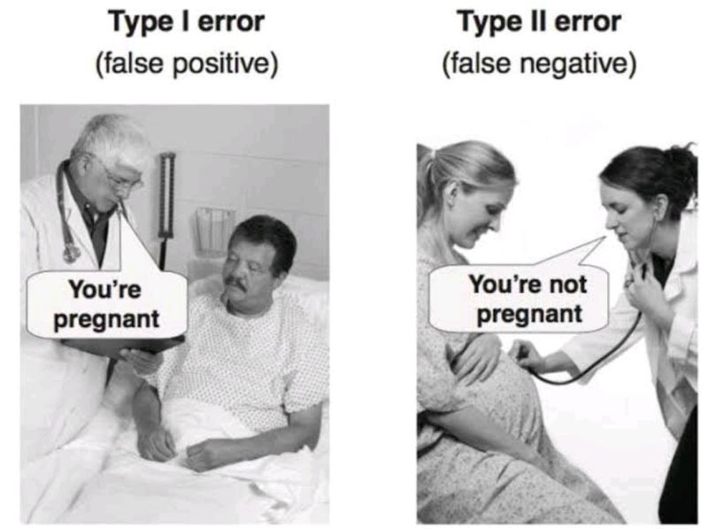
Type I and Type II Errors — Illustrated
When making decisions based on hypothesis tests, two types of errors can occur:
Type I Error (False Positive)
Rejecting H₀ when it’s actually true
Probability = α (significance level)
“Finding an effect that isn’t real”
Type II Error (False Negative)
Failing to reject H₀ when it’s actually false
Probability = β — “missing an effect that is real”
Statistical Power = 1 − β
Probability of correctly rejecting a false H₀
Increases with: larger sample size, larger effect size, lower variability, higher α level
The farther apart the means, or the lower the variance, the lower the β error — i.e., the higher the power.
Humorous side-by-side photo illustration: ‘Type I error (false positive)’ shows a doctor telling a male patient ‘You’re pregnant,’ and ‘Type II error (false negative)’ shows a doctor telling a visibly pregnant woman ‘You’re not pregnant.’

Slide 21
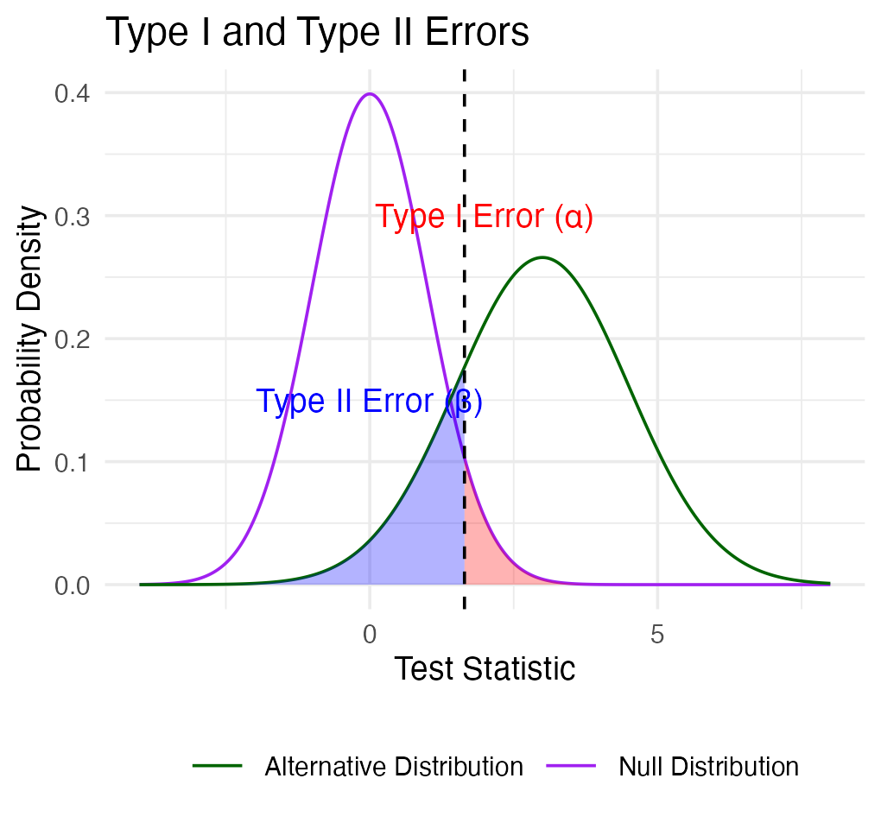
Type I and Type II Errors — From Real Distributions
When making decisions based on hypothesis tests, two types of errors can occur:
Type I Error (False Positive) — rejecting H₀ when it’s actually true. Probability = α.
Type II Error (False Negative) — failing to reject H₀ when it’s actually false. Probability = β.
Statistical Power = 1 − β — increases with larger sample size, larger effect size, lower variability, higher α level.
The farther apart the means, or the lower the variance, the lower the β error — i.e., the higher the power.

Slide 22
Practice Exercise: Interpreting Errors and Power
Tip
Practice Exercise: interpreting p-values and errors
Given the following scenarios, identify whether a Type I or Type II error might have occurred:
A researcher concludes that island mice size is larger, when in fact it is not.
A study fails to detect a real difference in mouse size on islands when there is one, and concludes there is no effect.
Let’s calculate the power of our t-test to detect a 1g difference in mass between sampling sites:
Pooled standard deviation — the combined standard deviation of both groups, weighted by their respective degrees of freedom
Cohen’s d — the standardized difference between means; here assuming a difference of 1 unit (g)
library(car) library(patchwork) library(tidyverse) library(readxl) m_df <- read_csv("data/mice_weights.csv") %>% filter(!is.na(mass_g)) sidney_df <- m_df %>% filter(sampling_site == "Sidney Island") vancouver_df <- m_df %>% filter(sampling_site == "Vancouver") n1 <- nrow(sidney_df) n2 <- nrow(vancouver_df) sd_pooled <- sqrt((var(sidney_df$mass_g) * (n1-1) + var(vancouver_df$mass_g) * (n2-1)) / (n1 + n2 - 2)) # delta = 0.423: the standardized effect size (Cohen's d) effect_size <- 1 / sd_pooled # Cohen's d df <- n1 + n2 - 2 alpha <- 0.05 power <- power.t.test(n = min(n1, n2), delta = effect_size, sd = 1, # Using standardized effect size sig.level = alpha, type = "two.sample", alternative = "two.sided") power
Two-sample t test power calculation n = 28 delta = 0.4231154 sd = 1 sig.level = 0.05 power = 0.3427604 alternative = two.sided NOTE: n is number in *each* group

Slide 23
Part 6 · Statistical Power

Slide 24
What if We Calculated Power for the Pine Needles You Measured?
pine_switch_df <- read_excel("data/class_pine needle length switched.xlsx") ps_df <- pine_switch_df %>% group_by(group, tree_no, tree_char, side) %>% summarise(length_mm = mean(length_mm, na.rm=TRUE)) ps_shady_df <- ps_df %>% filter(side == "shady") ps_sunny_df <- ps_df %>% filter(side == "sunny") pine_alpha <- 0.05 pine_n1 <- nrow(ps_shady_df) pine_n2 <- nrow(ps_sunny_df) pine_sd_pooled <- sqrt((var(ps_shady_df$length_mm) * (pine_n1-1) + var(ps_sunny_df$length_mm) * (pine_n2-1)) / (pine_n1 + pine_n2 - 2)) cat("Pooled SD:", round(pine_sd_pooled, 2), "mm\n\n")
Pooled SD: 2.58 mm
Note
📖 Reference
Whitlock & Schluter, Ch. 14 — Designing Experiments, includes planning the sample size needed for a study.
# More realistic effect sizes to test: observed_diff <- abs(mean(ps_shady_df$length_mm) - mean(ps_sunny_df$length_mm)) pine_effect_size_observed <- observed_diff / pine_sd_pooled cat("Effect size for observed", round(observed_diff, 2), "mm difference: Cohen's d =", round(pine_effect_size_observed, 2), "\n")
Effect size for observed 1.45 mm difference: Cohen's d = 0.56
pine_power_observed <- power.t.test(n = min(pine_n1, pine_n2), delta = pine_effect_size_observed, sd = 1, sig.level = pine_alpha, type = "two.sample", alternative = "two.sided") cat("Power for observed", round(observed_diff, 2), "mm difference:", round(pine_power_observed$power, 3), "\n")
Power for observed 1.45 mm difference: 0.182

Slide 25
What Is Power?
Statistical power represents the probability of detecting a true effect (rejecting the null hypothesis when it is false). With a power of 97%, there’s a 97% chance of detecting a true difference of X units between the means of the two groups, if such a difference actually exists.
A power analysis like this is typically done for one of these purposes:
Before data collection, to determine required sample size
After a study, to evaluate if the sample size was adequate
To determine the minimum detectable effect size with the given sample
Note
✅ Key idea
With 97% power, this test has excellent ability to detect the specified effect size. Generally, 80% power is considered acceptable — so 97% indicates a very well-powered study for detecting a difference of this size between the groups.

Slide 26
Part 7 · Error Bars

Slide 27
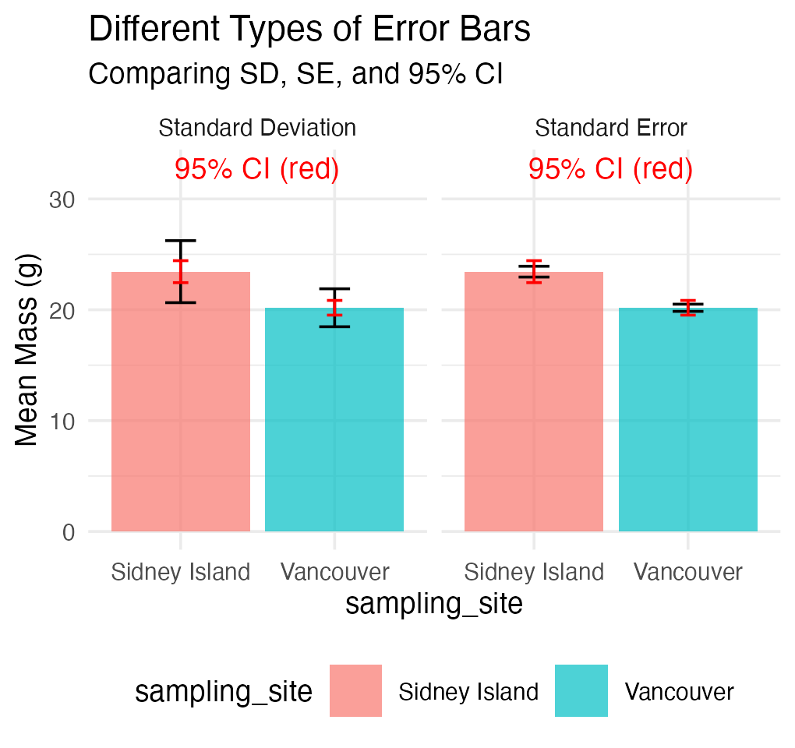
Error Bars and Their Interpretation
Error bars are graphical representations of the variability of data that show:
The precision of a measurement
The uncertainty around an estimate
A confidence interval for a parameter
Common types of error bars:
Standard Error (SE) — shows precision of the mean
Standard Deviation (SD) — shows variability in the data
Confidence Interval (CI) — shows the plausible range for a parameter
When interpreting graphs:
Always check what the error bars represent
Non-overlapping 95% CI bars suggest statistically significant differences
Error bars help assess both statistical and practical significance

Slide 28
Part 8 · Pseudoreplication

Slide 29
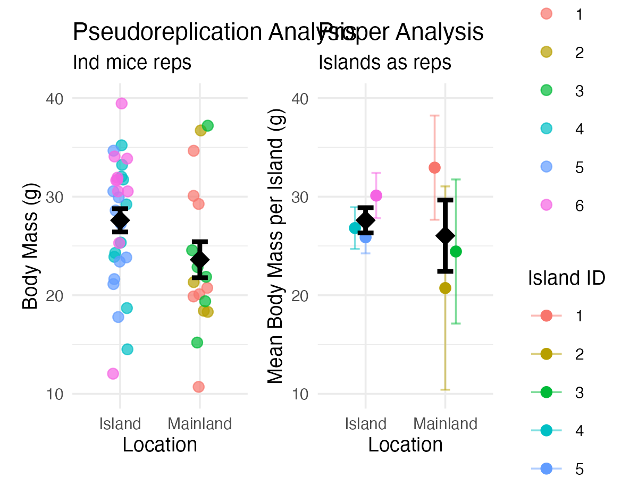
Sampling and Pseudoreplication
Pseudoreplication occurs when measurements that are not independent are analyzed as if they were independent.
A critical consideration in experimental design
Results in underestimated standard errors and confidence intervals
Leads to inflated Type I error rates (false positives)
Examples of pseudoreplication:
Measuring the same individual multiple times
Treating multiple fish from the same tank as independent
Using multiple data points from a single site
How to avoid pseudoreplication:
Identify the true experimental unit
Use appropriate statistical techniques (e.g., mixed models)
Be clear about the level of replication

Slide 30
Summary and Key Takeaways
Key concepts covered:
P-values measure evidence against the null hypothesis
Not the probability that H₀ is true
Should be interpreted in context with effect size
Hypothesis testing provides a framework for making decisions
Null and alternative hypotheses must be specified beforehand
α level determines the Type I error rate
Type I and Type II errors represent different kinds of mistakes
Type I (α): false positive — rejecting a true H₀
Type II (β): false negative — failing to reject a false H₀
Statistical power = 1 − β
Error bars communicate uncertainty in different ways
Always check what type of error bar is shown
CI bars help assess statistical significance
Pseudoreplication inflates significance
Identify true experimental units
Account for non-independence in analysis

