Slide 1
Lecture: Review
Course review Bill Perry

Slide 2
Lecture 19: Introduction to Logistic Regression

Slide 3
What is Logistic Regression?
Logistic regression is used when: - The response variable is binary (yes/no, 1/0, present/absent) - Data follows a binomial distribution (not normal) - We want to model the probability of an outcome

Slide 4
Today’s Example: Lizard Sexual Maturity
We’ll explore the relationship between body length and sexual maturity in female lizards - Response variable: Sexual maturity (mature: 1 = yes, 0 = no) - Predictor variable: Body length in cm - Question: Can we predict the probability of sexual maturity from body size?

Slide 5
Key Difference from Linear Regression
Linear regression: Models the actual values of Y
Logistic regression: Models the probability of Y = 1
Uses Generalized Linear Models (GLM) instead of General Linear Models

Slide 6
Step 1: Load and Explore the Data
# Load the lizard dataset lizards_df <- read.csv("data/lizards.csv") %>% clean_names() # First few rows head(lizards_df) ## length mature ## 1 10.2 0 ## 2 10.4 0 ## 3 11.8 0 ## 4 12.3 0 ## 5 13.8 0 ## 6 16.9 0

Slide 7
Step 2: Initial Data Visualization

Slide 8
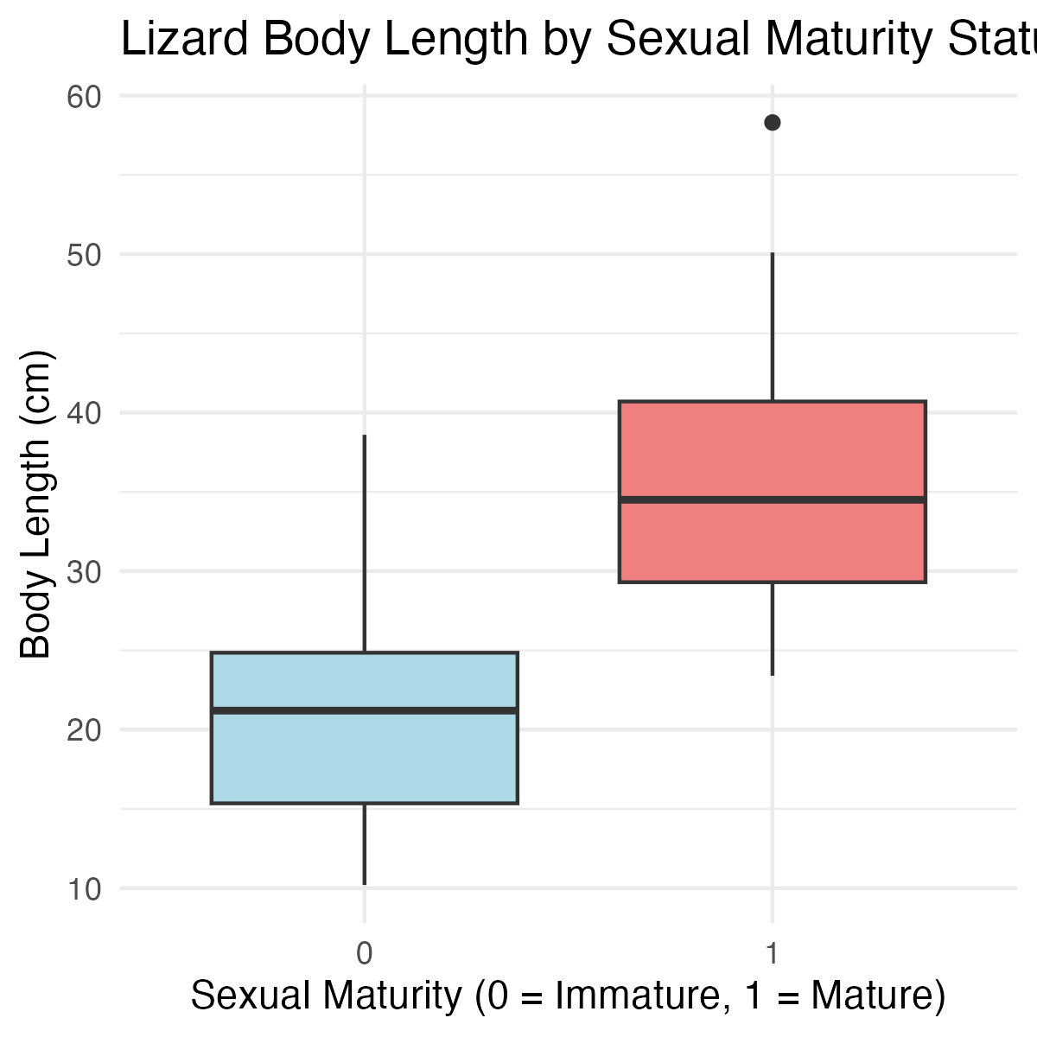
Creating a Boxplot
Let’s visualize how body length differs between sexually mature and immature lizards:
# Create boxplot showing length by maturity status maturity_boxplot <- ggplot(lizards_df, aes(x = factor(mature), y = length)) + geom_boxplot(fill = c("lightblue", "lightcoral")) + labs(title = "Lizard Body Length by Sexual Maturity Status", x = "Sexual Maturity (0 = Immature, 1 = Mature)", y = "Body Length (cm)") + theme_minimal() maturity_boxplot

Slide 9
What do we see?
There appears to be a relationship between size and sexual maturity
Mature lizards tend to be longer than immature ones
But there’s overlap - not a perfect separation
This suggests logistic regression might be appropriate

Slide 10
Step 3: Fit the Logistic Regression Model

Slide 11
Using glm() for Logistic Regression
The glm() function is similar to lm() but requires specifying the distribution family:
# Fit logistic regression model # family = binomial tells R we have binary data logistic_model <- glm(mature ~ length, data = lizards_df, family = binomial) # Get model summary summary(logistic_model) ## ## Call: ## glm(formula = mature ~ length, family = binomial, data = lizards_df) ## ## Coefficients: ## Estimate Std. Error z value Pr(>|z|) ## (Intercept) -6.6899 2.1401 -3.126 0.00177 ** ## length 0.2503 0.0775 3.229 0.00124 ** ## --- ## Signif. codes: 0 '***' 0.001 '**' 0.01 '*' 0.05 '.' 0.1 ' ' 1 ## ## (Dispersion parameter for binomial family taken to be 1) ## ## Null deviance: 60.176 on 43 degrees of freedom ## Residual deviance: 34.041 on 42 degrees of freedom ## AIC: 38.041 ## ## Number of Fisher Scoring iterations: 6

Slide 12
Interpreting the Model Output
Coefficients:
Intercept (β₀): -5.5847 - The log-odds when length = 0
Slope (β₁): 0.2503 - Change in log-odds for each 1 cm increase in length
P-values:
Both coefficients are significant (p < 0.05)
We reject the null hypothesis that β₁ = 0
There IS a relationship between length and sexual maturity
Understanding the Slope:
The positive slope (0.2503) indicates: - Longer lizards are more likely to be sexually mature - For each 1 cm increase in length, the log-odds of maturity increase by 0.2503

Slide 13
Step 4: Convert Log-Odds to Odds

Slide 14
Making the Results More Interpretable
Log-odds are hard to interpret. Let’s convert to odds:
# Extract the slope coefficient slope_coefficient <- coef(logistic_model)[2] # Convert log-odds to odds ratio odds_ratio <- exp(slope_coefficient) odds_ratio ## length ## 1.284388 # Interpretation # For every 1 cm increase in length, the odds of being sexually mature # increase by a factor of 1.284 (or about 28.4%)

Slide 15
Step 5: Create the Logistic Regression Plot

Slide 16
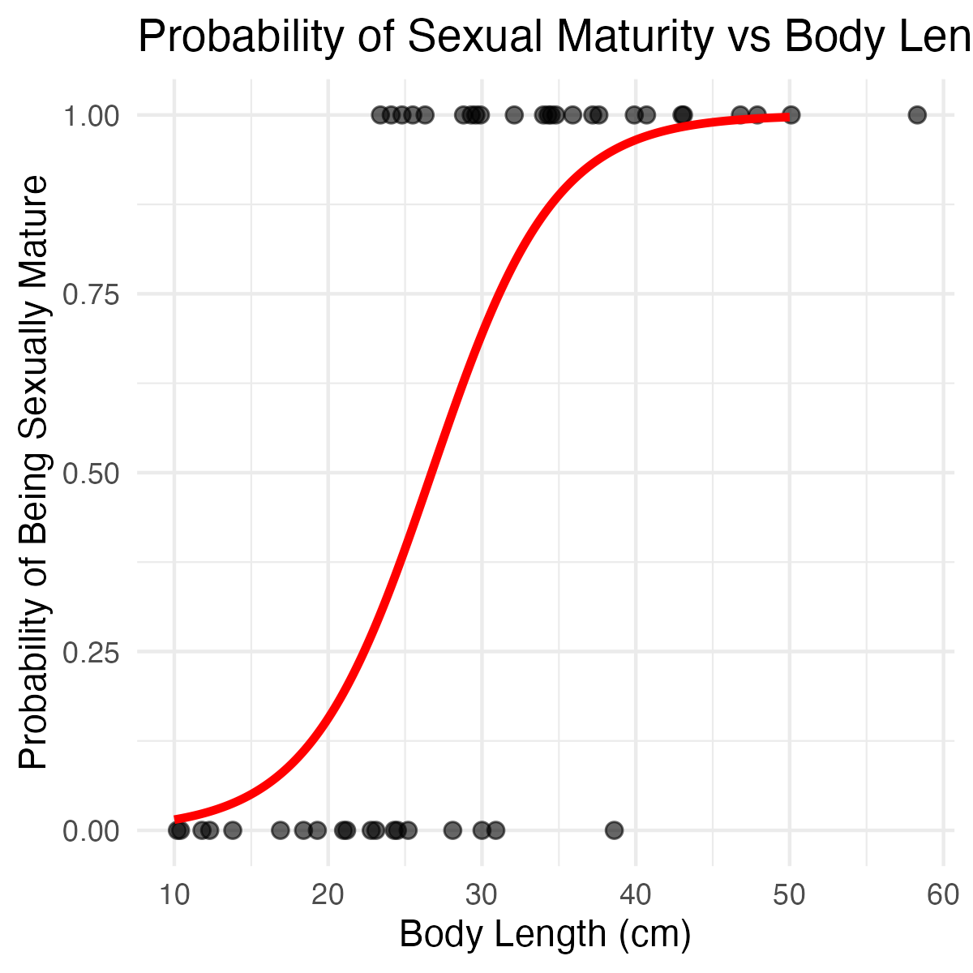
Visualizing the Probability Curve
# Create sequence of x-values for prediction xvals <- seq(from = 10, to = 50, by = 0.01) # Get predicted probabilities yvals <- predict(logistic_model, list(length = xvals), type = "response") # Create prediction dataframe for plotting prediction_df <- data.frame(length = xvals, probability = yvals)
# Create the logistic regression plot logistic_plot <- ggplot() + # Add data points geom_point(data = lizards_df, aes(x = length, y = mature), alpha = 0.6, size = 2) + # Add logistic curve geom_line(data = prediction_df, aes(x = length, y = probability), color = "red", size = 1.2) + labs(title = "Probability of Sexual Maturity vs Body Length", x = "Body Length (cm)", y = "Probability of Being Sexually Mature") + theme_minimal() logistic_plot

Slide 17
What the S-curve tells us:
The red line shows how probability changes with length
Small lizards (<20 cm) have very low probability of being mature
Large lizards (>40 cm) have very high probability of being mature
The steepest change occurs around 25-30 cm

Slide 18
Step 6: Making Predictions

Slide 19
Using the Model for Prediction
Let’s predict the probability of sexual maturity for specific lizard sizes:
# Predict for a 20 cm lizard prob_20cm <- predict(logistic_model, list(length = 20), type = "response") prob_20cm ## 1 ## 0.1565304 # Predict for a 30 cm lizard prob_30cm <- predict(logistic_model, list(length = 30), type = "response") prob_30cm ## 1 ## 0.6939292 # Predict for a 40 cm lizard prob_40cm <- predict(logistic_model, list(length = 40), type = "response") prob_40cm ## 1 ## 0.9651551

Slide 20
Interpretation:
A 20 cm lizard has about 14% probability of being sexually mature
A 30 cm lizard has about 70% probability of being sexually mature
A 40 cm lizard has about 96% probability of being sexually mature

Slide 21
Step 7: Model Fit Assessment

Slide 22
Calculating Pseudo-R2 Values
Unlike linear regression, logistic regression doesn’t have a traditional R². We use pseudo-R² instead:
# Calculate pseudo-R2 values using pscl package pseudo_r2 <- pR2(logistic_model) ## fitting null model for pseudo-r2 pseudo_r2 ## llh llhNull G2 McFadden r2ML r2CU ## -17.0204762 -30.0881077 26.1352630 0.4343122 0.4478763 0.6009400

Slide 23
Interpreting Pseudo-R2 Values
The last three values are the pseudo-R² statistics:
McFadden: Compares model to null model
r2ML: Maximum likelihood based R²
r2CU: Cragg-Uhler (Nagelkerke) R²
Values around 0.4-0.5 indicate moderate to good fit. Our model explains approximately 40-50% of the variation in sexual maturity status.

Slide 24
Step 8: Additional Diagnostics

Slide 25
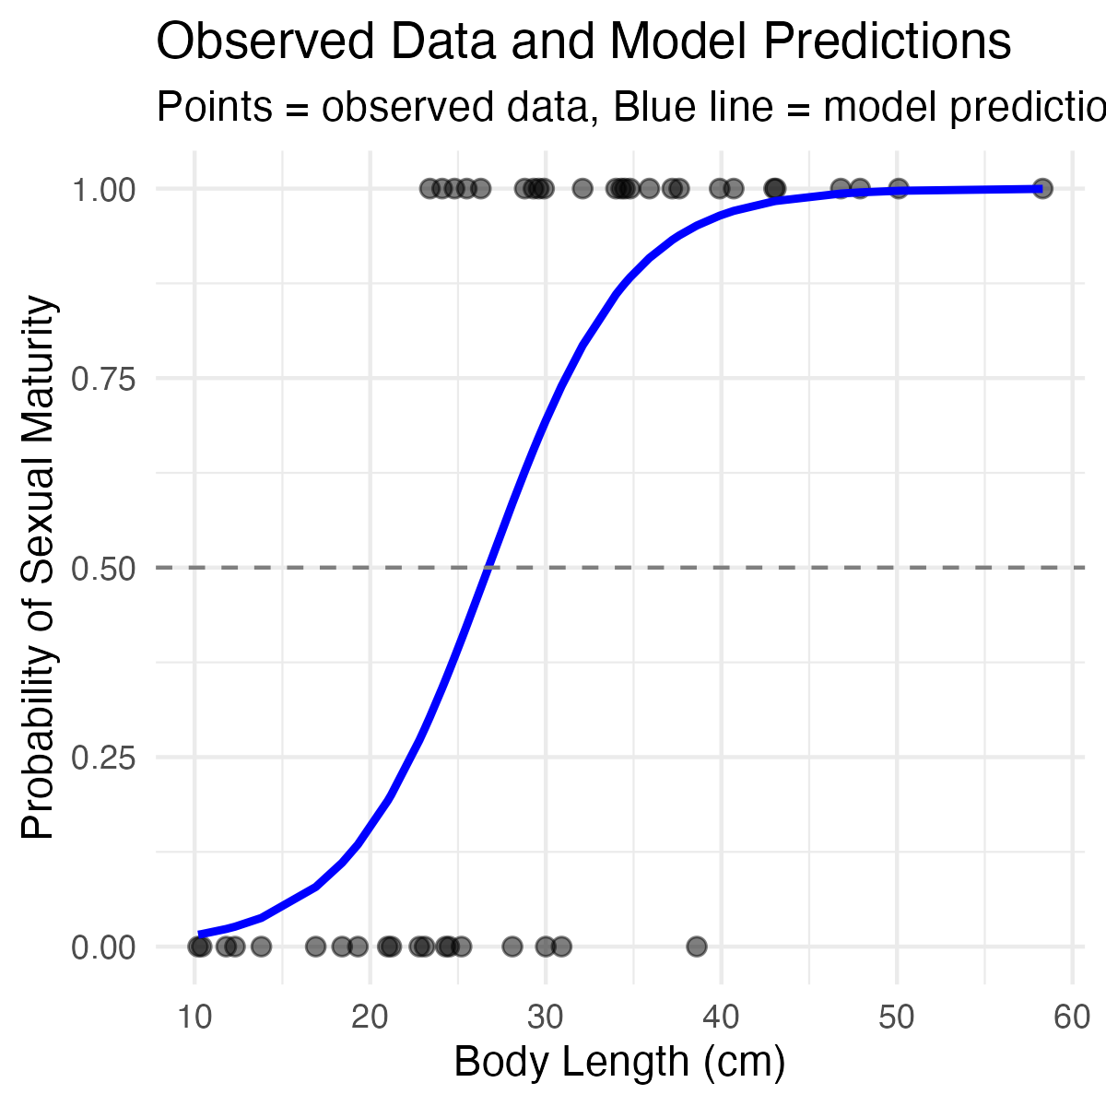
Creating a More Detailed Summary Plot
# Create a plot showing observed vs predicted probabilities lizards_df$predicted_prob <- predict(logistic_model, type = "response") diagnostic_plot <- ggplot(lizards_df, aes(x = length)) + # Add observed data as points geom_point(aes(y = mature), alpha = 0.5, size = 2) + # Add predicted probabilities geom_line(aes(y = predicted_prob), color = "blue", size = 1) + # Add 50% probability threshold geom_hline(yintercept = 0.5, linetype = "dashed", color = "gray50") + labs(title = "Observed Data and Model Predictions", x = "Body Length (cm)", y = "Probability of Sexual Maturity", subtitle = "Points = observed data, Blue line = model predictions") + theme_minimal() diagnostic_plot

Slide 26
Summary: Key Takeaways

Slide 27
What We Learned:
Logistic regression models probability of binary outcomes
Uses glm() with family = binomial
Coefficients represent changes in log-odds
Convert to odds ratios for interpretation: exp(coefficient)
Creates S-shaped probability curves
Use pseudo-R² to assess model fit

Slide 28
Our Results:
Significant positive relationship between body length and sexual maturity
Each 1 cm increase in length increases odds of maturity by ~28%
Model explains ~40-50% of variation in maturity status
Can predict probability of maturity for any given length

Slide 29
When to Use Logistic Regression:
Binary response variable (0/1, yes/no, success/failure)
Want to predict probabilities
Relationships that follow S-shaped curves
When assumptions of linear regression are violated

