Slide 1
Lecture: Study Design & Sampling
Designing studies Bill Perry

Slide 2
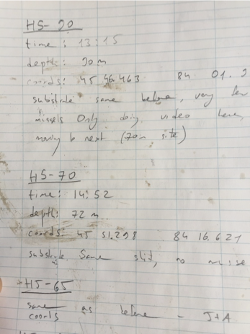
Where We Left Off
Covered last time:
What are the assumptions again, and how do you assess them?
What to do when assumptions fail:
Mann-Whitney Wilcoxon rank-sum test
Permutation tests
There’s also a paired Wilcoxon signed-rank test — it uses only the sign (+, 0, or −) of each pair’s difference, so it’s possible but not very powerful or widely used
Note
✅ Key idea from last lecture
A good test choice can’t rescue a badly designed study. Today is about the design decisions that come before you ever pick a test.
Photo of a handwritten field notebook page recording site data (site ID, time, depth, GPS coordinates, substrate notes) for three sampling stations, an example of real field-study record-keeping.

Slide 3
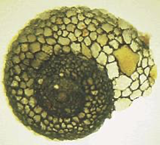
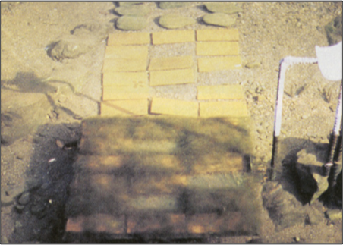
Today’s Overview
Today we’ll cover Chapter 1 in Whitlock and Schluter:
Study design
Causality in ecology
Experimental design: replication, controls, randomization, independence
Sampling in field studies
Power analysis: a priori and post hoc
Study design and analysis
Lamberti and Resh 1983
Close-up photo of a rock surface with a circular grazed patch (dark, cleared algae in the center) surrounded by a mosaic of ungrazed, algae-covered tiles, illustrating a herbivore grazing-scar pattern from a classic stream ecology study.
Photo of an experimental array of small tiles laid on a streambed, some darker with algal growth and others lighter/grazed clean, used in Lamberti and Resh’s (1983) study of caddisfly grazing effects on periphyton.

Slide 4
Part 1 · Study Design Fundamentals

Slide 5
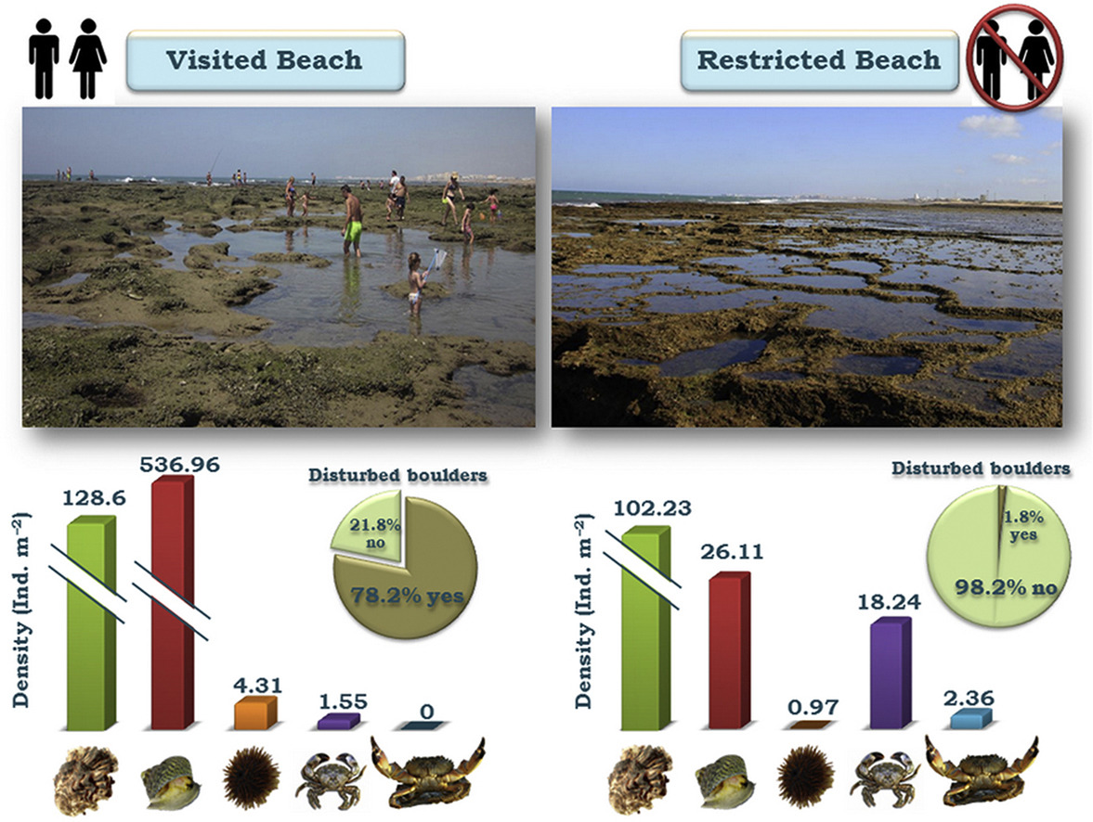
Study Design Fundamentals
Data analysis has close links to study design
Statistics cannot save a poorly designed study!
Key question: what is your research question?
Common scientific questions:
Spatial/temporal patterns in variable Y? — what are the problems with this data?
Effect of factor X on variable Y? — what should you be worried about, and how do you fix it?
Are values of variable Y consistent with hypothesis H?
What is the best estimate of parameter θ?
Note
📖 Reference
Gotelli & Ellison, A Primer of Ecological Statistics, Ch. 6 — Designing Successful Field Studies.
What sort of experiment is this design, and what are the issues with it?
Published figure comparing a visited tidepool beach (people wading among the rocks) to a restricted no-access beach, each with bar charts of invertebrate density by species and pie charts showing 78.2% of boulders disturbed at the visited beach versus only 1.8% at the restricted beach.

Slide 6
Part 2 · Causality in Ecology

Slide 7
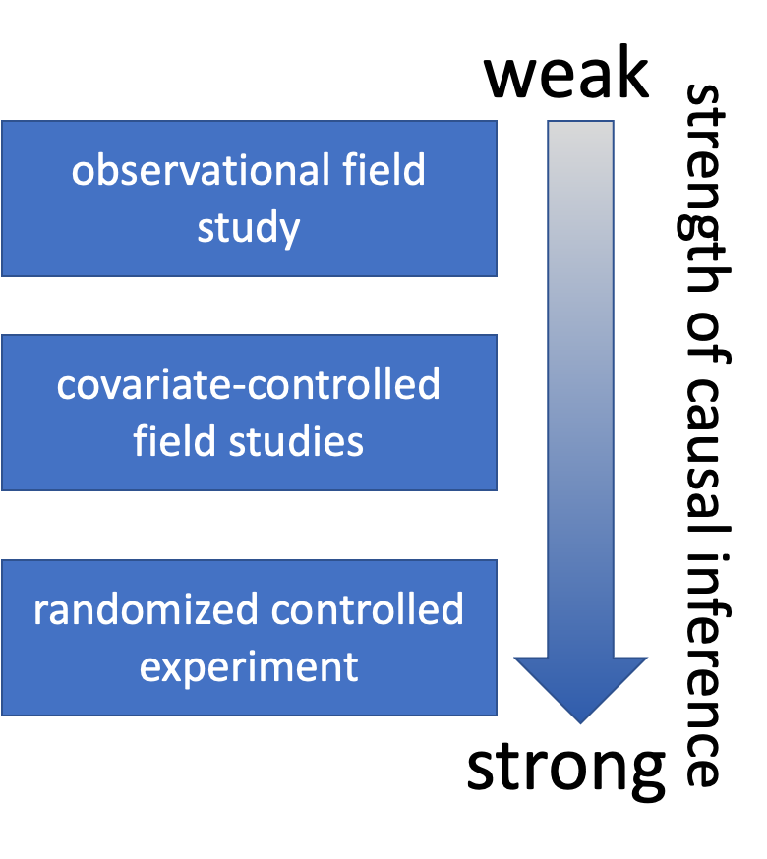
Causality in Ecology — Introduction
Common question: what is the cause of Y?
Causality is challenging; modern statistics lacks clear language for causality
Strength of causal inference varies with study design!
Key factor: control of confounding variables, non-independence, and correlated variables
Diagram of three study-design types (observational field study, covariate-controlled field study, randomized controlled experiment) stacked with a downward gradient arrow labeled ‘weak’ at top to ‘strong’ at bottom, showing the strength of causal inference increasing from observational studies to randomized experiments.

Slide 8

Causality in Ecology — Framework
Common question: what is the cause of Y?
Causality is challenging; modern statistics lacks clear language for causality
Strength of causal inference varies with study design
Key factor: control of confounding variables, non-independence, and correlated variables
Humorous meme of a dog looking out a window with text joking that its barking is the reason the mail carrier always leaves unharmed (‘I have the power of barking to thank for that’), a lighthearted example of mistaking correlation/coincidence for causation.

Slide 9
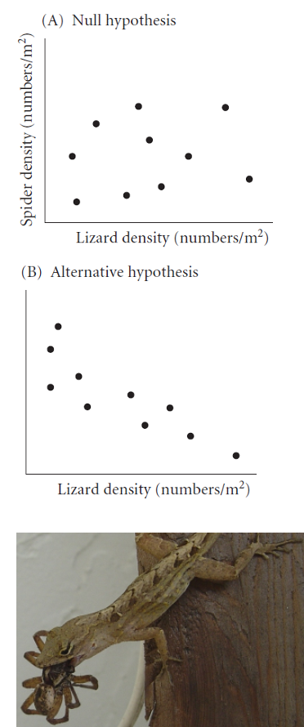
Causality Example
Example: Spider and lizard populations on small islands
Hypothesis: On small islands, lizard predation controls spider density
We’re interested in causality. How do we get there?
What type of experiment is this?
What are the potential problems with testing this hypothesis?
Three-part figure: (A) a scatterplot of spider density versus lizard density showing no relationship (null hypothesis), (B) a scatterplot showing spider density declining as lizard density increases (alternative hypothesis), and a photo below of a lizard eating a spider, illustrating a proposed predation mechanism.

Slide 10
Part 3 · Natural vs. Manipulative Experiments

Slide 11
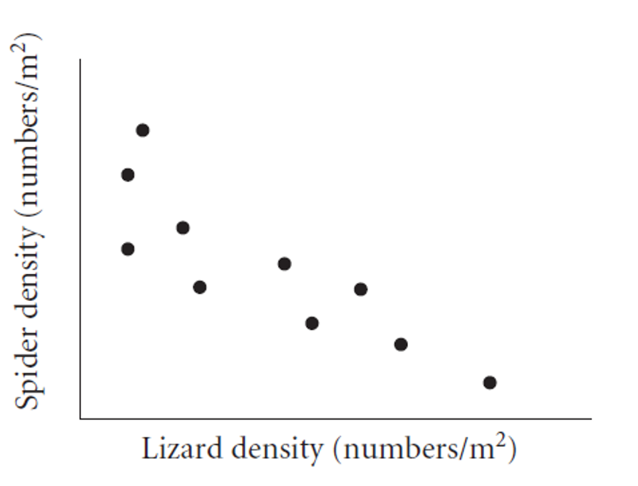
Natural Experiments
Not really experiments at all!
Utilizes natural variation in the predictor variable
E.g., survey plots across a natural gradient of lizard density
Potential problems:
Cannot determine the direction of the cause ↔ effect relationship
Uncontrolled variables may affect results
Scatterplot of spider density against lizard density across survey plots, showing a clear negative relationship, an example of a natural experiment using existing variation rather than manipulation.

Slide 12
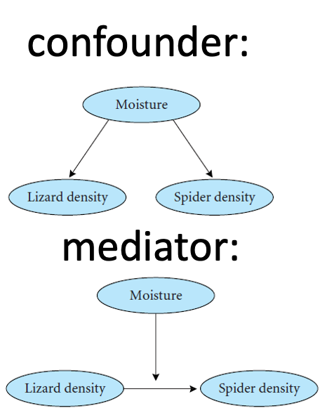
Strengthening Natural Experiments
Good design: stronger inference from natural experiments.
Reduce confounding (select plots similar in relevant ways)
Adjust for confounding (measure relevant covariates)
Identify and measure potential confounding variables
Two causal diagrams: a ‘confounder’ diagram where Moisture has arrows pointing to both Lizard density and Spider density (a third variable driving both), and a ‘mediator’ diagram where Moisture points to Lizard density which in turn points to Spider density (an indirect causal chain).

Slide 13
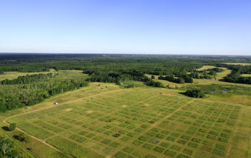
Manipulative Experiments
The experimenter directly manipulates the predictor variable and measures the response.
Randomized, controlled trials: the gold standard.
Challenges:
Often restricted to small “plots”; a scale-replication trade-off
Often restricted to small, short-lived organisms
Often limited to a small number of treatments; a treatment-replication trade-off
Still requires careful control of confounding variables!
Cedar Creek Ecosystem Science Reserve
Aerial photo of a large grid of manipulated experimental field plots surrounded by forest, part of the Cedar Creek Ecosystem Science Reserve’s long-term biodiversity experiments.

Slide 14
Part 4 · Experimental Design Principles

Slide 15
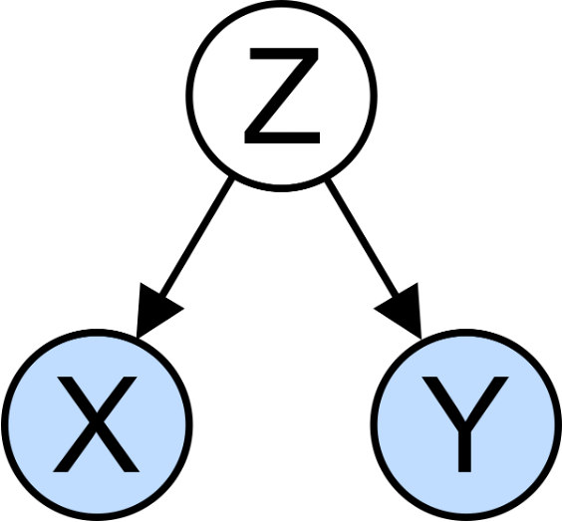
Experimental Design Principles
Main problem of study design & interpretation: confounding variables.
Is the result due to X, or other factors?
Good study design seeks to eliminate confounding through:
Replication
Randomization
Controls
Independence
Diagram of a confounding variable Z with arrows pointing to both X and Y, illustrating that a third variable can drive an apparent relationship between the two variables of interest.

Slide 16
Replication
Replication is important because:
Ecological systems are variable
Many statistical methods need an estimate of that variability
Without appropriate replication: is the difference due to the manipulation, or something else?
Warning
⚠️ Watch out!
Replication must be on the appropriate scale — match the scale of replication to the population of interest, or you’ll run into pseudoreplication (Hurlbert 1984, Pseudoreplication and the Design of Ecological Field Experiments).
The same tile-array photo repeated, shown here as an example of replicated experimental units on a streambed.

Slide 17
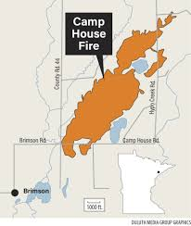
Replication Examples
Example 1: Effects of forest fire on soil invertebrate diversity — replicate samples from burnt and unburnt parts of a single forest. What hypothesis is this design addressing?
Example 2: Effects of copper on barnacle settling — 2 aquaria (+Cu, control), 5 settling plates in each. Are settling plates replicates?
Example 3: Effects of sewage discharge on water quality — 10 water samples above discharge, 10 below. Are samples replicates?
Map showing the burned area of the ‘Camp House Fire’ as an orange shape near Brimson, Minnesota, with roads and nearby towns labeled, illustrating a real forest-fire footprint for the burnt-versus-unburnt forest replication example.

Slide 18
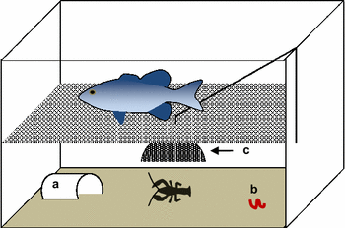
Consequences of Pseudoreplication
When you pseudoreplicate, you:
Underestimate variability
Increase the Type I error rate
Replicates must be on a scale appropriate to the population (and hypothesis!) of interest:
Different burnt/unburnt forest areas
Different aquaria
Different plants and streams
Diagram of an aquarium tank containing a fish, a shelter labeled (a), prey items labeled (b), and a barrier or structure labeled (c), used to illustrate the barnacle/copper-aquaria pseudoreplication example where settling plates within the same tank are not true replicates.

Slide 19
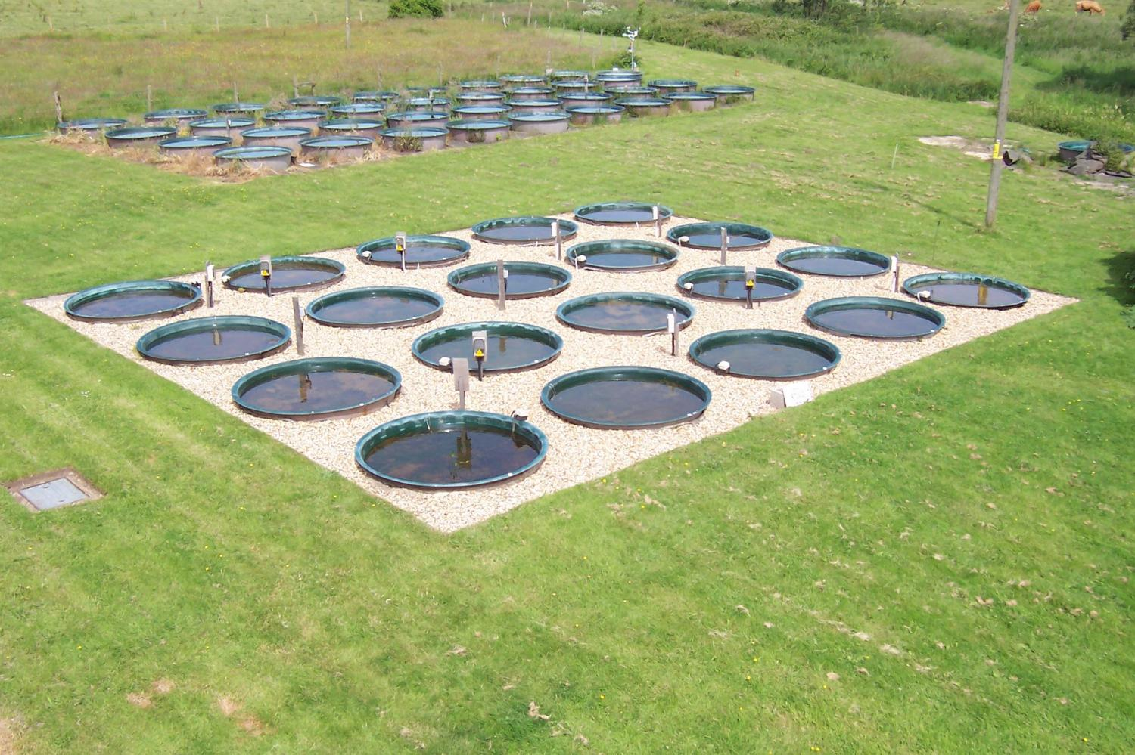
When Replication Is Difficult
What if replication is impossible, difficult, or expensive?
Example: effect of temperature on phytoplankton growth — 4 chambers (5, 10, 15, 20°C), 10 beakers in each. Are beakers true replicates?
Possible solutions:
Rerun the experiment a few times, changing the temperature of chambers — block by time
Try to account for all possible differences between chambers (light levels, humidity, contamination) — block by chamber
Aerial photo of an outdoor research facility with about 20 large circular tanks (mesocosms) arranged in a grid on gravel, plus additional smaller tanks in the background, illustrating replicated temperature-controlled growth chambers.

Slide 20
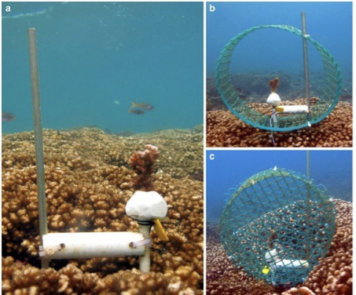
Controls or Reference?
Key question: is the response due to the manipulation/hypothesized mechanism, or an external factor?
Controls help address this question:
Experimental units treated exactly as the manipulated units, except for the manipulation under investigation
Can be tricky to implement; requires careful thought
Examples:
In toxicology, controls and treatment groups must both be injected, but the control does not receive the substance under study
Predator exclosures often produce “cage effects” — you need two controls: a grazer/predator control and a “cage control”
Three underwater photos on a coral reef: (a) a PVC-pipe apparatus with bait attached near the coral, and (b)-(c) a mesh cage/exclosure structure being lowered over the setup, illustrating a predator-exclusion control used to separate manipulation effects from confounds like cage artifacts.

Slide 21
Activity: Designing Controls
Warning
Activity: designing controls for pine experiments
Work in small groups to design appropriate controls for each experiment:
Testing whether pine needle length is affected by a particular fertilizer
Testing whether pine needle density affects water retention during drought, using enclosed branches
Testing whether sunlight exposure affects pine seedling growth, using shade cloth
For each experiment, identify:
What would be appropriate controls?
What factors need to be controlled besides the main variable?
Could there be “cage effects” or similar issues to consider?

Slide 22
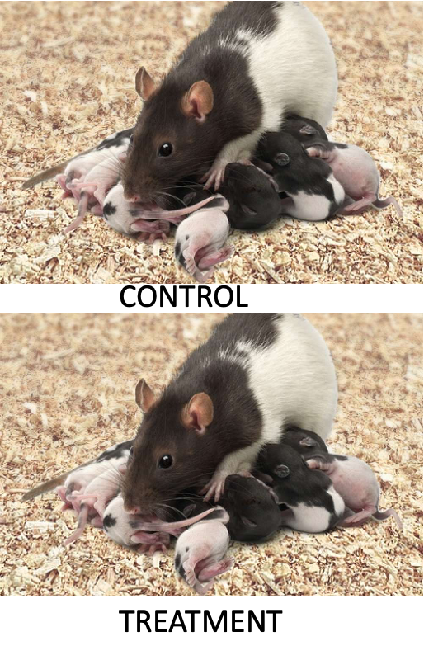
Independence
Independence of observations is an assumption of many statistical methods. Events are independent if the occurrence of one has no effect on the occurrence of another.
E.g., offspring of one mother for treatment, offspring of another for control
Temporal/spatial autocorrelation: a violation of independence.
Values of variables at a certain place/time are correlated with values at another place/time
“Everything is related to everything, but near things are more related than distant things”
Special methods exist to adjust for autocorrelation
Photo of a mother rat nursing a litter of newborn pups, illustrating the independence example: offspring from one mother are not independent replicates of each other.

Slide 23
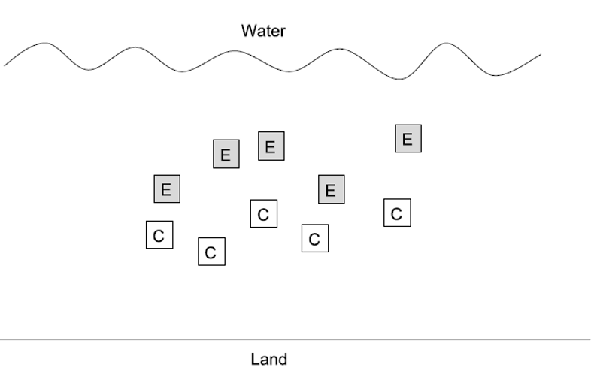
Randomization
Randomization helps deconfound “lurking” variables — it attempts to equalize the effects of confounders.
Random sampling from a population:
Experimental units should represent a random sample from the population of interest
Ensures unbiased population estimates and inference
E.g., animals in an experiment are a random subset of all animals that could have been used
Diagram of a shoreline (land at bottom, water at top) with shaded squares labeled E (experimental) and unshaded squares labeled C (control) interspersed randomly across the plots, illustrating random assignment of units to treatment and control.

Slide 24
Randomization in Practice
Allocation of experimental units to treatment/control:
Experimental units must have an equal chance of being allocated to control or experimental group
Properly done by random number generation
Randomization is essential at two levels:
Random selection from the population
Random assignment to treatments
Treatment Control 1 18 49 2 74 100 3 65 47 4 24 71 5 25 89

Slide 25
Part 5 · Sampling Design in Field Studies

Slide 26
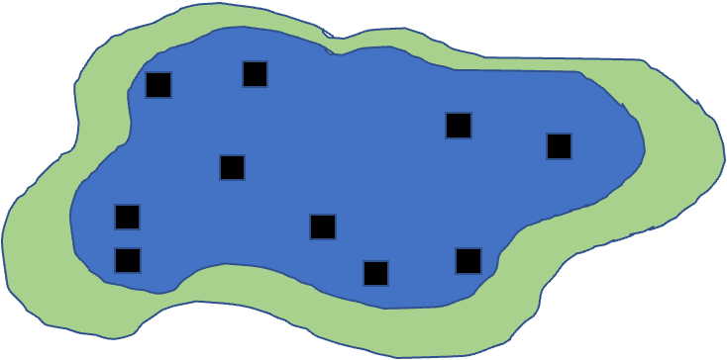
Sampling Design — Simple Random
Simple random design:
All individuals/sampling units have an equal chance of being selected
Assign a number to all possible units, select units using a random number generator
Often tricky in ecology; haphazard sampling is a common (imperfect) alternative
Most population estimates and tests assume random sampling
Note
📖 Reference
Gotelli & Ellison, Ch. 7 — A Bestiary of Experimental and Sampling Designs, covers all four sampling designs on this and the following three slides.
Diagram of a blue lake with black squares scattered haphazardly throughout the water, illustrating simple random sampling where every point has an equal chance of being sampled.

Slide 27
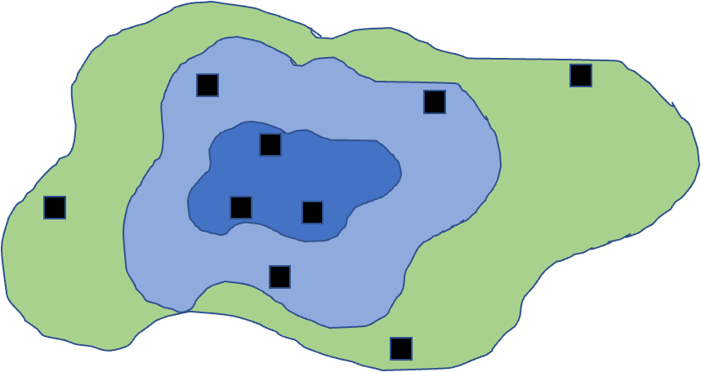
Sampling Design — Stratified
Stratified designs: if there are distinct strata (groups) in the population, you may want to sample each independently.
Samples collected from each stratum randomly, n proportional to the “size” of the stratum
Means and variances need to be estimated using a different procedure; strata are included in the model
Diagram of a lake divided into three concentric depth strata (shallow green, mid-depth light blue, deep dark blue), with sample points scattered within each stratum, illustrating stratified random sampling.

Slide 28
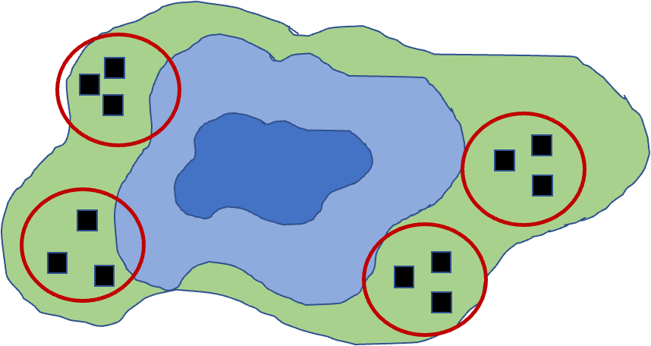
Sampling Design — Cluster
Cluster designs:
Focus on sampling subunits nested in larger units
Used when other designs are impractical (e.g., due to cost)
Mean calculation is easy; variance needs a modified procedure
Nested ANOVA is often the appropriate analytical method
Diagram of a lake with four red circles marking clusters, each containing three sample points, positioned around the shoreline, illustrating cluster sampling where whole groups near a location are sampled together.

Slide 29
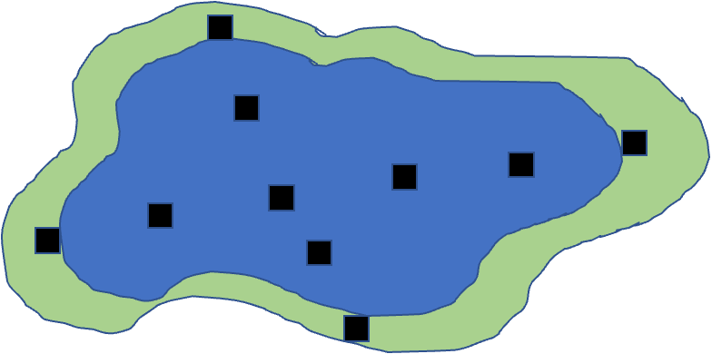
Sampling Design — Systematic
Systematic designs:
Sampling units evenly dispersed — “transect” sampling is common in ecology
Used to determine changes along a gradient
Risk: might coincide with some natural pattern
Diagram of a lake with sample points evenly spaced in a grid-like pattern across the water, illustrating systematic sampling along a regular interval rather than at random locations.

Slide 30
Activity: Field Sampling Pine Trees
Note
Activity: field sampling pine trees
Let’s consider sampling pine needles across campus:
In groups of 3–4, design a sampling strategy to:
Estimate average needle length across campus (simple random sampling)
Compare needle lengths between north and south campus areas (stratified sampling)
Study how needle length changes with distance from the main road (systematic sampling)
For each strategy, describe:
How many samples you would take
Where you would take them
What additional variables you might measure

Slide 31
Part 6 · Power Analysis

Slide 32
Power Analysis Wrap-Up
Power is an important aspect of experimental design:
Low power → higher likelihood of Type II error (1 − β)
A study’s power tells us how likely we are to see an effect if one really exists
Power analysis can be used:
Before the experiment (a priori): how many samples do we need? What effect size can we detect?
After the experiment (post hoc): was a finding of no effect due to a lack of true effect, or poor design?
Power is a function of: effect size (ES), sample size (n), standard deviation (σ), and α (typically 0.05)
$$\text{Power}∝\frac{ES⋅α⋅\sqrt{n}}{σ}$$
Note
📖 Reference
Whitlock & Schluter, Ch. 14 — Designing Experiments, covers planning the sample size needed for a study.

Slide 33
A Priori Power Analysis
Using power analysis to plan experiments:
Sample size calculation: how many samples will be needed? Need to know: desired power, variability, significance level, effect size.
Effect size calculation: what kind of effect can we find, given a particular design? Need to know: desired power, variability, significance level, n.
Cohen’s d — a standardized measure of effect size, particularly for comparing two means:
0.2 = small effect, 0.5 = medium effect, 0.8 = large effect
Tip
📖 Why standardize?
Cohen’s d helps determine the practical significance of a finding, as opposed to just statistical significance (p-values). A Cohen’s d of 0.8 means the groups differ by 0.8 standard deviations — large enough to be substantial in practical terms.

Slide 34
A Priori Power Analysis — Example
How many samples do you need to find this difference?
# A priori power analysis for t-test # How many samples needed per group? effect_size <- 0.8 # Cohen's d significance <- 0.05 desired_power <- 0.8 pwr.t.test(d = effect_size, sig.level = significance, power = desired_power, type = "two.sample")
Two-sample t test power calculation n = 25.52458 d = 0.8 sig.level = 0.05 power = 0.8 alternative = two.sided NOTE: n is number in *each* group
Tip
🖐 Notice
pwr.t.test() solves for whichever argument you leave out — here, n. Leave out a different argument (e.g., power) and it solves for that instead.

Slide 35
Post Hoc Power Analysis
Imagine you did not reject the null hypothesis — is the result still worth publishing?
Is a non-significant result due to low power (poor design), or an actual no-effect situation?
You have n and an estimate of σ
You need to define the effect size you wanted to detect
In return, you get an estimate of the experiment’s power
Cohen’s d is calculated as: d = (Mean1 − Mean2) / SD_pooled
Tip
🖐 Why it matters
Post hoc power can help convince reviewers that you are a good experimenter, but there really is no effect — please publish my non-significant finding!

Slide 36
Post Hoc Power Analysis — Example
# Post hoc power analysis # If we had n = 20 per group effect_size <- 0.5 # Medium effect size significance <- 0.05 sample_size <- 20 # per group pwr.t.test(n = sample_size, d = effect_size, sig.level = 0.05, type = "two.sample")
Two-sample t test power calculation n = 20 d = 0.5 sig.level = 0.05 power = 0.337939 alternative = two.sided NOTE: n is number in *each* group
Note
✅ Key idea
Same function as a priori power analysis — pwr.t.test() — just with n supplied and power left out to solve for instead.

Slide 37
Activity: Power Analysis for a Pine Needle Experiment
Important
Activity: power analysis for a pine needle experiment
Let’s design a study to compare needle lengths between exposed and sheltered pine trees:
# Based on pilot data, we have these estimates: exposed_mean <- 75 # mm sheltered_mean <- 85 # mm pooled_sd <- 12 # mm effect_size <- abs(exposed_mean - sheltered_mean) / pooled_sd effect_size
[1] 0.8333333
pwr.t.test(d = effect_size, sig.level = 0.05, power = 0.8, type = "two.sample")
Two-sample t test power calculation n = 23.60467 d = 0.8333333 sig.level = 0.05 power = 0.8 alternative = two.sided NOTE: n is number in *each* group

Slide 38
Activity: Power Curve Visualization
Important
Activity: power analysis for a pine needle experiment
Questions:
How many trees should we sample to achieve 80% power?
If we can only sample 5 trees per group, what is our power?
How would increasing variability (SD) affect our sample size requirements?

Slide 39
Part 7 · Wrap-Up

Slide 40
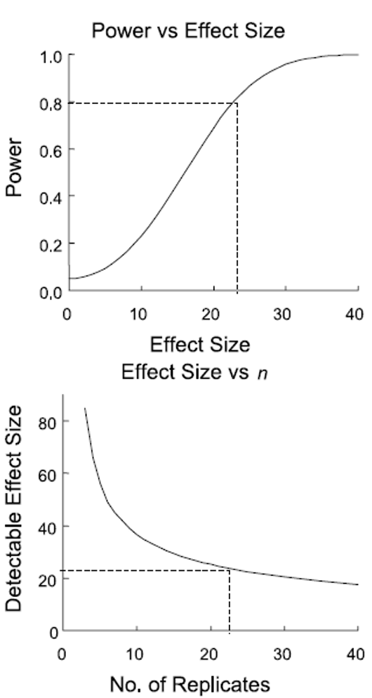
Study Design and Analysis
Study design is closely linked to statistical analysis
Recall: categorical vs. continuous variables; dependent vs. independent variables
The nature of your variables dictates the analytical approach:
Match your analysis to your design
You cannot “fix” a poor design with fancy statistics
Two stacked plots: statistical power rising with effect size and leveling off near 1.0, with a dashed line marking 80% power at an effect size around 23; and detectable effect size dropping steeply as the number of replicates increases, with a dashed line showing the same effect size achievable at about 23 replicates, illustrating the tradeoff between sample size and detectable effect size.

Slide 41
Summary and Take-Home Messages
Key concepts we covered today:
Study design is critical — statistics cannot save poor design
Natural vs. manipulative experiments — different approaches to causality
Principles of good design: replication at the right scale, proper randomization, appropriate controls, independence
Power analysis — planning for sufficient sample size
Match analysis to design — your statistical approach should follow from your experimental design
Important
Remember:
Correlation ≠ causation
Beware of pseudoreplication
Design before you collect data
Consider practical constraints
Report everything transparently

Slide 42
References and Additional Resources
Gotelli, N. J., & Ellison, A. M. (2012). A Primer of Ecological Statistics (2nd ed.). Sinauer Associates.
Hurlbert, S. H. (1984). Pseudoreplication and the design of ecological field experiments. Ecological Monographs, 54(2), 187–211.
Quinn, G. P., & Keough, M. J. (2002). Experimental Design and Data Analysis for Biologists. Cambridge University Press.
Zuur, A. F., Ieno, E. N., & Elphick, C. S. (2010). A protocol for data exploration to avoid common statistical problems. Methods in Ecology and Evolution, 1(1), 3–14.

