Slide 1
Lecture: Two-Way ANOVA
Factorial designs
Bill Perry

Slide 2
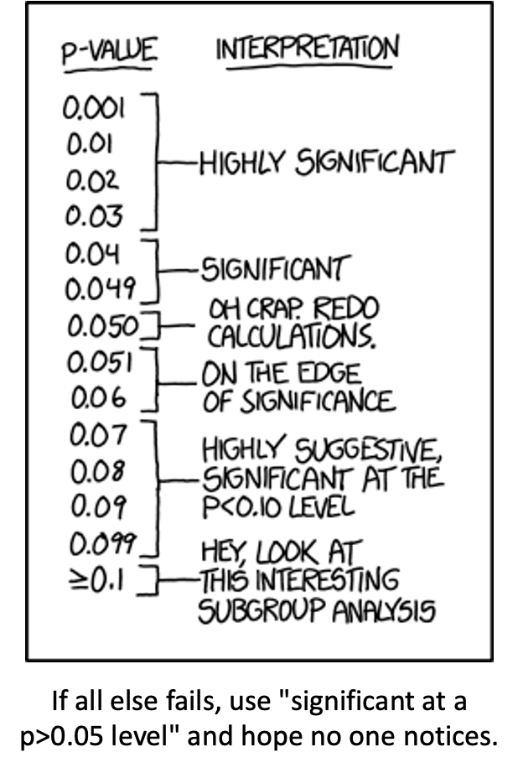
Where We Left Off
Covered last time — one-way ANOVA:
Analysis of variance: single and multi-factor designs
Examples: diatoms, circadian rhythms
Predictor variables: fixed vs. random
The ANOVA model
Analysis and partitioning of variance
Null hypothesis
Assumptions and diagnostics
Post-hoc F-tests — Tukey and others
Reporting the results
Note
✅ Key idea from last lecture
One-way ANOVA asks “do these groups differ?” for one factor. Today: what happens when two factors act together — separately, and possibly interacting?
XKCD comic listing p-value ranges with increasingly tongue-in-cheek interpretations, from ‘Highly Significant’ at p under 0.03 down through ‘On the edge of significance’ and ‘Hey, look at this interesting subgroup analysis’ at p >= 0.1, captioned ‘If all else fails, use significant at a p>0.05 level and hope no one notices’ — a joke about p-hacking and misusing significance thresholds.

Slide 3
Part 1 · Factorial ANOVA — the Concept

Slide 4
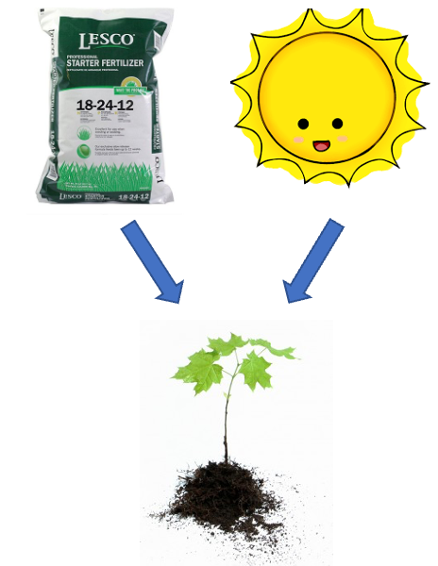

Two-Factor Designs (2-Way ANOVA)
Very common in ecology
Can have more factors (e.g., 3-way ANOVA), but interpretation gets very challenging
Most multifactor designs are factorial or nested
We’ll cover a 2-factor ANOVA — this could be fertilizer and sunlight for plant biomass produced:
  each can have an effect independently
  the effect of one factor may interact with the other factor
  example: a low- vs. high-light treatment might affect biomass; fertilizer might also affect biomass; but under higher light, the high-fertilizer treatment may grow better than expected
Note
📖 Reference
Gotelli & Ellison, A Primer of Ecological Statistics, Ch. 10 — The Analysis of Variance, extends to factorial designs like the one covered today.
Diagram of a fertilizer bag and a smiling sun icon, each with an arrow pointing down to a small green seedling, illustrating fertilizer and sunlight as two separate factors that can each affect plant biomass.
The palmerpenguins R package hex-sticker logo, showing simple cartoon illustrations of the three penguin species (Adelie, Chinstrap, Gentoo) used in this lecture’s dataset.

Slide 5
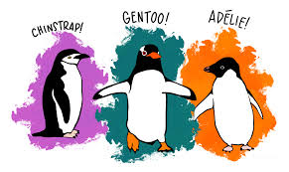
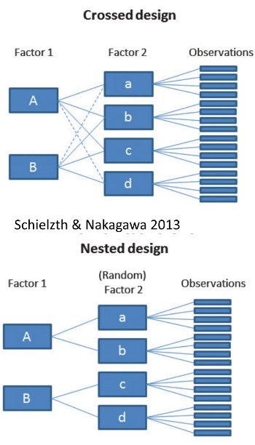
Factorial ANOVA: Design Structure
Consider two factors:
Factorial/crossed: every level of B in every level of A
Cartoon illustration of the three penguin species used in this lecture’s dataset, each labeled: Chinstrap, Gentoo, and Adelie.
Diagram contrasting a crossed design, where both levels of Factor 1 (A, B) connect to every level of Factor 2 (a, b, c, d), against a nested design below it, where each level of Factor 1 connects only to its own subset of (random) Factor 2 levels, both feeding into individual observations (Schielzth & Nakagawa 2013).

Slide 6
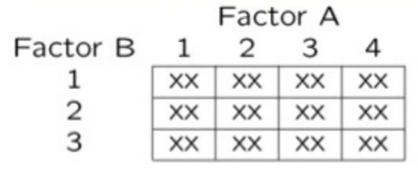
Factorial ANOVA: Effect Types
In factorial designs, we look at two types of factor effects:
Main effect of each factor (pooling across the other factor)
Interaction effects — is there a synergistic/antagonistic effect between factors?
Simple grid diagram of a factorial design with Factor A across the columns (levels 1-4) and Factor B down the rows (levels 1-3), with an ‘XX’ marking every cell, showing every combination of the two factors is represented.

Slide 7
Part 2 · Setting Up — the Penguin Data

Slide 8
Introduction to Two-Way ANOVA
Two-way ANOVA examines:
Main effect of Factor A (Species)
Main effect of Factor B (Sex)
Interaction between A × B
Balanced design: equal sample sizes in all cells
Type III sums of squares for unbiased estimates — if the design is balanced, the choice of SS type doesn’t matter
## # A tibble: 6 × 6
## species sex n mean_mass sd_mass se_mass
## <fct> <fct> <int> <dbl> <dbl> <dbl>
## 1 Adelie female 73 3369. 269. 31.5
## 2 Adelie male 73 4043. 347. 40.6
## 3 Chinstrap female 34 3527. 285. 48.9
## 4 Chinstrap male 34 3939. 362. 62.1
## 5 Gentoo female 58 4680. 282. 37.0
## 6 Gentoo male 61 5485. 313. 40.1

Slide 9
Data Preparation — Creating a Balanced Design
The penguin data frame is unbalanced — there are unequal samples per cell.
## # A tibble: 3 × 3
## species female male
## <fct> <int> <int>
## 1 Adelie 73 73
## 2 Chinstrap 34 34
## 3 Gentoo 58 61
## Minimum n = 34
## # A tibble: 3 × 3
## species female male
## <fct> <int> <int>
## 1 Adelie 34 34
## 2 Chinstrap 34 34
## 3 Gentoo 34 34
Statistical model:
$$Y_{ijk}=μ+α_{i}+β_{j}+(αβ)_{ij}+ε_{ijk}$$
μ = grand mean, α_i = effect of species i, β_j = effect of sex j, (αβ)_ij = interaction effect, ε_ijk = random error.

Slide 10
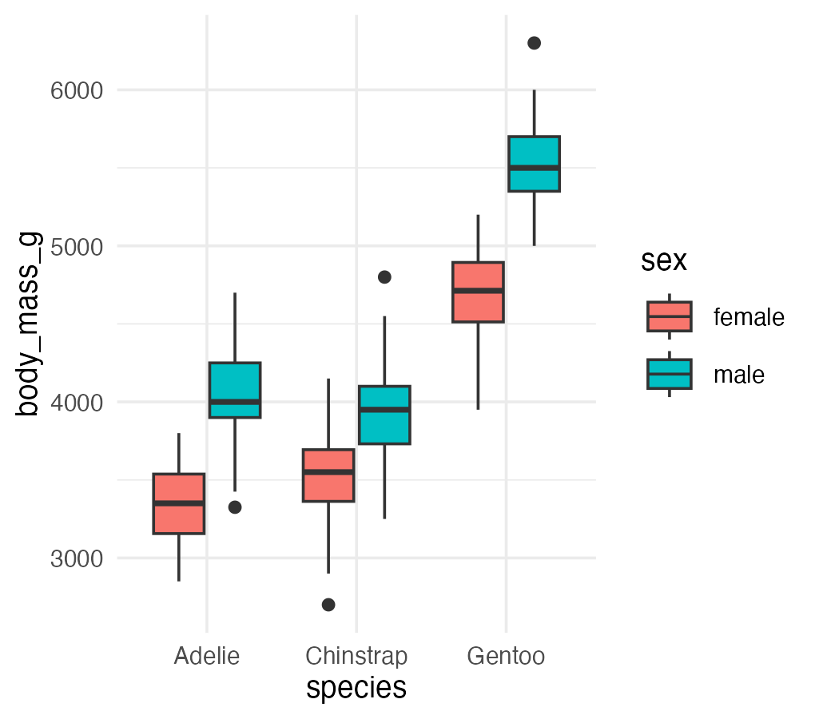
Descriptive Statistics
## # A tibble: 6 × 6
## species sex n mean_mass sd_mass se_mass
## <fct> <fct> <int> <dbl> <dbl> <dbl>
## 1 Adelie female 34 3335. 260. 44.5
## 2 Adelie male 34 4049. 318. 54.5
## 3 Chinstrap female 34 3527. 285. 48.9
## 4 Chinstrap male 34 3939. 362. 62.1
## 5 Gentoo female 34 4681. 309. 53.0
## 6 Gentoo male 34 5525 274. 47.0

Slide 11
Part 3 · The Factorial Model

Slide 12
Factorial ANOVA Models
Factorial designs can be of 3 types:
Model 1 — 2 fixed factors (the focus for today)
Model 2 — 2 random factors
Model 3 — 1 fixed, 1 random (mixed model) — often nested
Model 1 ANOVA:
$$y_{ijk}=μ+α_{i}+β_{j}+(αβ)_{ij}+ε_{ijk}$$
Tip
🖐 Notice
The formula looks identical to Model 2 and Model 3 — what changes between them is whether α, β are treated as fixed effects (specific groups you care about) or random effects (a sample from a larger population of possible groups).

Slide 13
Model Components — the Main Effects
$$y_{ijk}=μ+α_{i}+β_{j}+(αβ)_{ij}+ε_{ijk}$$
$y_{ijk}$: value of the k-th observation from the j-th and i-th combination of B and A (sex j of species i)
μ: overall mean (overall mass)
$α_{i}$: effect of the i-th level of A, pooling across all levels of B — $μ_{i}−μ$ (difference between the average mass of all “species i” penguins and the overall mean)
Tip
🖐 Notice
Every effect in this model is defined as a deviation from a mean — the grand mean, or a group mean. This is exactly the same logic as a t-test or one-way ANOVA, just with more terms.

Slide 14
Model Components — the Interaction
$$y_{ijk}=μ+α_{i}+β_{j}+(αβ)_{ij}+ε_{ijk}$$
$β_{j}$: effect of the j-th level of B, pooling across all levels of A — $μ_{j}−μ$ (difference between the average mass of all “sex j” penguins and the overall mean)
$(αβ)_{ij}$: effect of the interaction of level i of A and level j of B — $μ_{ij}−μ_{i}−μ_{j}+μ$. Does the effect of B depend on the level of A? (Is the effect of sex different across the 3 species?)
Note
✅ Key idea
The interaction term is what’s left over after you subtract out both main effects and the grand mean — it’s literally “the part the additive model can’t explain.”

Slide 15
Model Types and Interpretation
$$y_{ijk}=μ+α_{i}+β_{j}+(αβ)_{ij}+ε_{ijk}$$
Model 2 ANOVA is rare in ecology
Model 3 interpretation is different:
  $β_{j}$: random variable measuring variance in y across all possible levels of B, pooling across A
  $(αβ)_{ij}$ is a random variable measuring variance of the interaction between A and B across all possible levels of B (“is the effect of A consistent across all possible levels of B that could have been chosen?”)
Warning
⚠️ Watch out!
Fixed vs. random isn’t about the data — it’s about the question. Are you interested in these specific 3 species (fixed), or in “species” as a general source of variation (random)?

Slide 16
Part 4 · Estimated Marginal Means

Slide 17
Estimated Marginal Means — Species
Before we go further, we need to define estimated marginal means (EMMs)
Balanced data: it’s just the means of the groups — easy
Unbalanced data: it’s the mean of cell means, not a simple average of all raw observations
## Combined table with means and counts:
## # A tibble: 3 × 5
## species female_mean male_mean female_n male_n
## <fct> <dbl> <dbl> <int> <int>
## 1 Adelie 3369. 4043. 73 73
## 2 Chinstrap 3527. 3939. 34 34
## 3 Gentoo 4680. 5485. 58 61
##
##
## Regular means (WRONG for marginal means):
## # A tibble: 3 × 3
## species total_n regular_mean
## <fct> <int> <dbl>
## 1 Adelie 146 3706.
## 2 Chinstrap 68 3733.
## 3 Gentoo 119 5092.
## Estimated Marginal Means for Species (CORRECT):
## # A tibble: 3 × 3
## species emm_mean calculation
## <fct> <dbl> <chr>
## 1 Adelie 3706. (3368.8 + 4043.5) / 2 = 3706.2
## 2 Chinstrap 3733. (3527.2 + 3939) / 2 = 3733.1
## 3 Gentoo 5082. (4679.7 + 5484.8) / 2 = 5082.3
##
##
## Comparison showing EMM calculation:
## # A tibble: 3 × 6
## species cell_mean_female cell_mean_male species_emm regular_mean difference
## <fct> <dbl> <dbl> <dbl> <dbl> <dbl>
## 1 Adelie 3369. 4043. 3706. 3706. 4.55e-13
## 2 Chinstrap 3527. 3939. 3733. 3733. 0
## 3 Gentoo 4680. 5485. 5082. 5092. -1.01e+ 1

Slide 18
Estimated Marginal Means — Sex
Balanced data: just the means of the groups
Unbalanced data: mean of cell means
## Combined table with means and counts:
## # A tibble: 3 × 5
## species female_mean male_mean female_n male_n
## <fct> <dbl> <dbl> <int> <int>
## 1 Adelie 3369. 4043. 73 73
## 2 Chinstrap 3527. 3939. 34 34
## 3 Gentoo 4680. 5485. 58 61
##
## Regular means sex (WRONG for marginal means):
## # A tibble: 2 × 3
## sex total_n regular_mean
## <fct> <int> <dbl>
## 1 female 165 3862.
## 2 male 168 4546.
##
##
## Estimated Marginal Means for Sex (CORRECT):
## # A tibble: 2 × 3
## sex emm_mean calculation
## <fct> <dbl> <chr>
## 1 female 3859. (3368.8 + 3527.2 + 4679.7) / 3 = 3858.6
## 2 male 4489. (4043.5 + 3939 + 5484.8) / 3 = 4489.1
##
##
## Comparison showing difference between regular and marginal means:
## # A tibble: 2 × 5
## sex total_n regular_mean emm_mean difference
## <fct> <int> <dbl> <dbl> <dbl>
## 1 female 165 3862. 3859. -3.68
## 2 male 168 4546. 4489. -56.6

Slide 19
Part 5 · The Two-Way ANOVA Table

Slide 20
ANOVA Table Structure
$SS_{total}=SS_{A}+SS_{B}+SS_{AB}+SS_{residual}$
$SS_{total}=∑(Y−\overset{‾}{Y})^{2}$
$SS_{residual}$: the difference between each observation and its cell mean, summed over all observations
Source | df
A | p − 1
B | q − 1
AB | (p−1)(q−1)
Residual | pq(n−1)
Total | pqn − 1

Slide 21
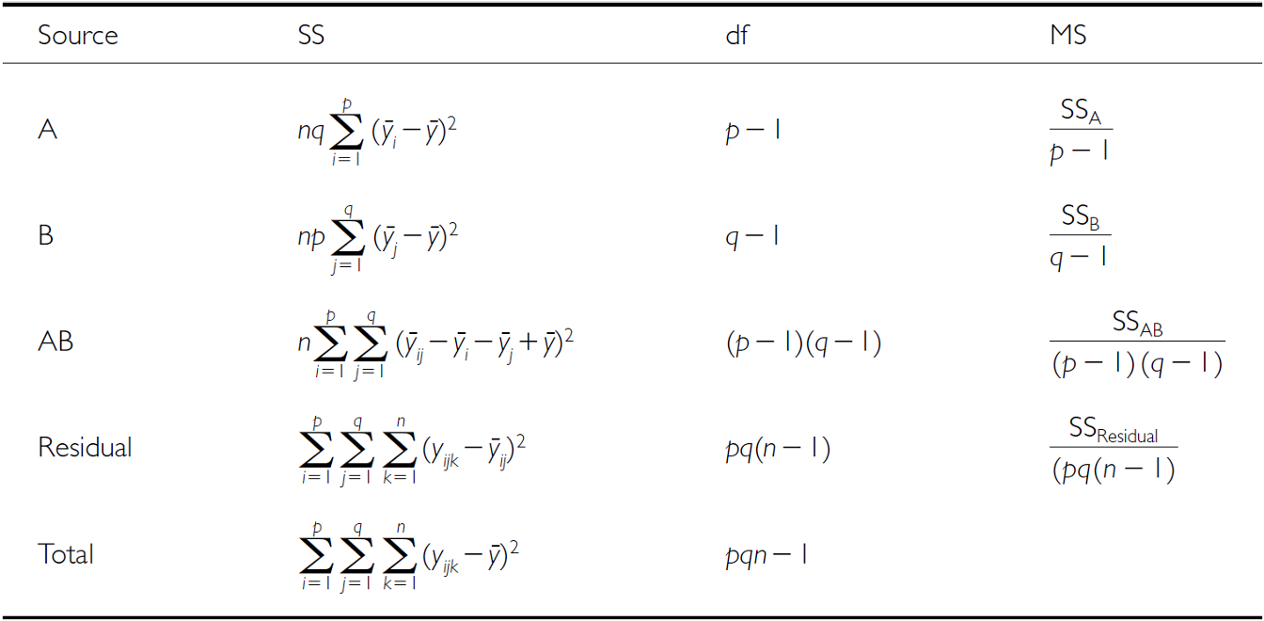
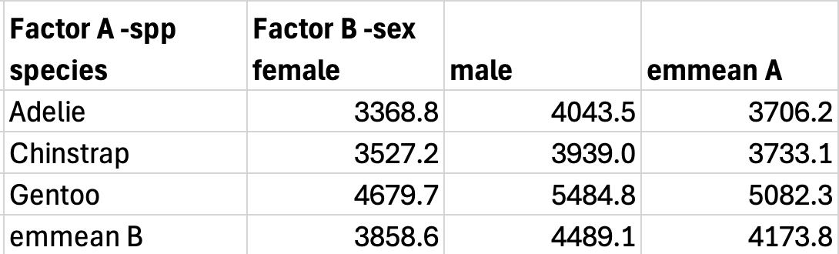
SSA: Factor A Effects
$SS_{A}$ is the SS of differences between each marginal mean of A and the overall mean
If A is species, take the EMMs for factor A and subtract from the overall mean
Full two-way ANOVA table listing Source (A, B, AB, Residual, Total), each with its sum-of-squares formula, degrees of freedom (p-1, q-1, (p-1)(q-1), pq(n-1), pqn-1), and mean-square formula.
Table of penguin body mass cell means and marginal (emmean) values by species (rows: Adelie, Chinstrap, Gentoo) and sex (columns: female, male), used to compute SS_A from the species row means.

Slide 22
SSB: Factor B Effects
$SS_{B}$ is the SS of differences between each marginal mean of B and the overall mean
If B is sex, take the EMMs for factor B and subtract from the overall mean
The same two-way ANOVA table (Source, SS, df, MS for A, B, AB, Residual, Total) repeated here for computing SS_B.
The same penguin body-mass cell-means and marginal-means table repeated here, used to compute SS_B from the sex column means.

Slide 23
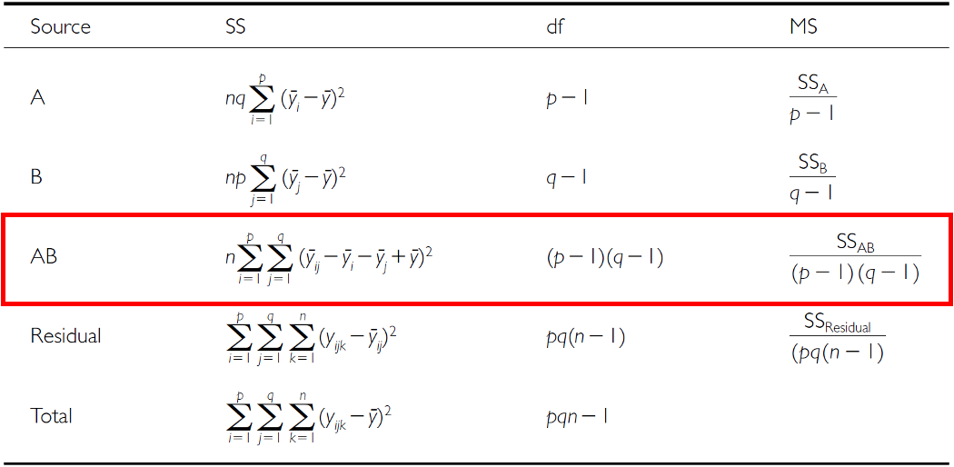
SSAB: Interaction Effects
$SS_{AB}$ is the SS of cell means minus marginal means plus the overall mean.
The same two-way ANOVA table with the AB (interaction) row outlined in red, highlighting its sum-of-squares, degrees of freedom (p-1)(q-1), and mean-square formulas.
The same penguin body-mass cell-means and marginal-means table repeated here, used to compute SS_AB from how each cell mean deviates from its row and column marginal means.

Slide 24
F-Ratio Calculations
SS converts to MS; F-ratio calculations differ depending on whether factors are fixed, random, or mixed.
Source | A, B fixed | A, B random | A fixed, B random
A | $MS_{A}/MS_{Res}$ | $MS_{A}/MS_{AB}$ | $MS_{A}/MS_{AB}$
B | $MS_{B}/MS_{Res}$ | $MS_{B}/MS_{AB}$ | $MS_{B}/MS_{AB}$
AB | $MS_{AB}/MS_{Res}$ | $MS_{AB}/MS_{Res}$ | $MS_{AB}/MS_{Res}$

Slide 25
Hypotheses — Both Factors Fixed
3 hypotheses are tested in a two-way factorial ANOVA: A, B, A×B. Both factors fixed:
$H_{0}(A)$: $μ_{1}=μ_{2}=...=μ_{p}$ (no difference in marginal means of A, pooling across B)
$H_{0}(B)$: $μ_{1}=μ_{2}=...=μ_{q}$ (no difference in marginal means of B, pooling across A)
$H_{0}(AB)$: $μ_{ij}−μ_{i}−μ_{j}+μ=0$ (no interaction effect)
Tip
🖐 Notice
These are exactly the two main-effect hypotheses from a one-way ANOVA, plus one new hypothesis just for the interaction.

Slide 26
Hypotheses — Mixed Model
3 hypotheses: A, B, A×B. One fixed, one random:
$H_{0}(A)$: $μ_{1}=μ_{2}=...=μ_{p}$ (no difference in marginal means of A, pooling across B)
$H_{0}(B)$: $σ_{B}^{2}=0$ (no added variance due to levels of B that could have been used)
$H_{0}(AB)$: $σ_{AB}^{2}=0$ (no added variance due to interaction between all levels of A and B that could have been used)
Warning
⚠️ Watch out!
Notice the switch from “means are equal” (fixed) to “variance is zero” (random) — that’s the fundamental difference in what a random-effect hypothesis is even asking.

Slide 27
Part 6 · Fitting the Balanced Model

Slide 28
Example Study Details
Let’s try the example with the palmerpenguins package data:
Effect of species and sex on body_mass_g
3 species (Factor A)
2 sexes (Factor B)
34 replicates in each cell
Cartoon illustration of the three penguin species used in this lecture’s dataset, each labeled: Chinstrap, Gentoo, and Adelie.

Slide 29
Two-Way ANOVA with Type III Sums of Squares
##
## Call:
## lm(formula = body_mass_g ~ species * sex, data = balanced_df)
##
## Residuals:
## Min 1Q Median 3Q Max
## -827.21 -178.13 6.25 175.00 861.03
##
## Coefficients:
## Estimate Std. Error t value Pr(>|t|)
## (Intercept) 4175.86 21.23 196.727 < 2e-16 ***
## species1 -484.31 30.02 -16.134 < 2e-16 ***
## species2 -442.77 30.02 -14.750 < 2e-16 ***
## sex1 -328.31 21.23 -15.467 < 2e-16 ***
## species1:sex1 -28.68 30.02 -0.955 0.341
## species2:sex1 122.43 30.02 4.078 6.57e-05 ***
## ---
## Signif. codes: 0 '***' 0.001 '**' 0.01 '*' 0.05 '.' 0.1 ' ' 1
##
## Residual standard error: 303.2 on 198 degrees of freedom
## Multiple R-squared: 0.8596, Adjusted R-squared: 0.856
## F-statistic: 242.4 on 5 and 198 DF, p-value: < 2.2e-16
## Type III Sums of Squares ANOVA:
## Anova Table (Type III tests)
##
## Response: body_mass_g
## Sum Sq Df F value Pr(>F)
## (Intercept) 3557308900 1 38701.5271 < 2.2e-16 ***
## species 87725999 2 477.2049 < 2.2e-16 ***
## sex 21988483 1 239.2224 < 2.2e-16 ***
## species:sex 1672776 2 9.0994 0.0001657 ***
## Residuals 18199467 198
## ---
## Signif. codes: 0 '***' 0.001 '**' 0.01 '*' 0.05 '.' 0.1 ' ' 1

Slide 30
Understanding Type III SS
Type III sums of squares test each effect after adjusting for all other effects in the model:
Species effect: tested after adjusting for sex and interaction
Sex effect: tested after adjusting for species and interaction
Interaction: tested after adjusting for both main effects
This is especially important for unbalanced designs, but we’re using it here for consistency with the next analysis.
## Effect Sizes (partial eta-squared):
## Effect Partial_Eta_Sq
## 1 Species 0.8282
## 2 Sex 0.5471
## 3 Interaction 0.0842
Note
📖 Which effect size, and why
$$η_{p}^{2}=\frac{SS_{effect}}{SS_{effect}+SS_{residual}}$$
Partial η² asks “of the variation this effect could explain, how much does it?” Plain η² divides by $SS_{total}$ instead.
They agree only when a design is balanced. Type III sums of squares do not add up to $SS_{total}$ in an unbalanced design — so dividing by their sum gives a number that is neither η² nor η²ₚ. Partial η² is well defined either way, which is why we use it throughout this lecture.

Slide 31
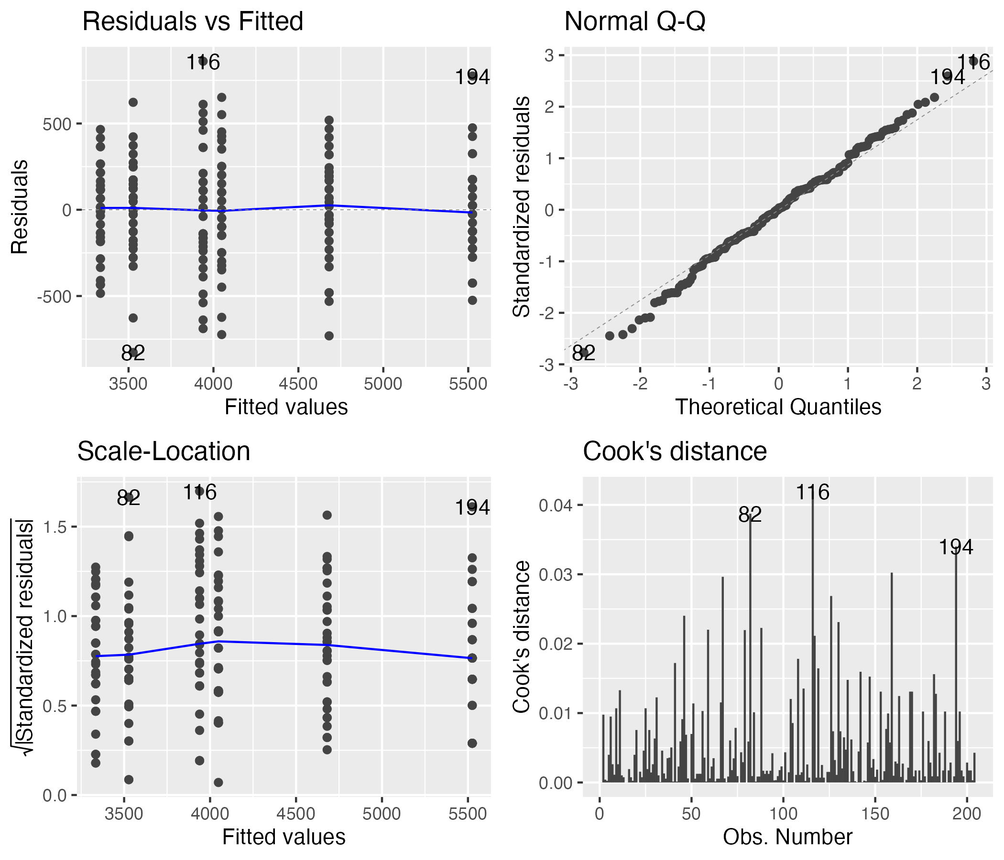
Checking Model Assumptions
The four standard diagnostic plots, built automatically with ggfortify::autoplot().
Four standard regression diagnostic plots for the two-way ANOVA model, arranged 2x2: residuals vs. fitted, normal Q-Q, scale-location, and residuals vs. leverage, generated automatically with ggfortify::autoplot().

Slide 32
Formal Tests — Normality and Homogeneity
The formal tests of normality of residuals and homogeneity of variances.
## Shapiro-Wilk Normality Test:
##
## Shapiro-Wilk normality test
##
## data: residuals(anova_model)
## W = 0.99612, p-value = 0.8886
## Levene's Test for Homogeneity:
## Levene's Test for Homogeneity of Variance (center = median)
## Df F value Pr(>F)
## group 5 0.7841 0.5622
## 198
## Number of outliers (|z| > 3): 0

Slide 33
Part 7 · EMMs and Post-Hoc for the Balanced Model

Slide 34
Computing EMMs
## Species EMMs:
## species emmean SE df lower.CL upper.CL
## Adelie 3692 36.8 198 3619 3764
## Chinstrap 3733 36.8 198 3661 3806
## Gentoo 5103 36.8 198 5030 5175
##
## Results are averaged over the levels of: sex
## Confidence level used: 0.95
## Sex EMMs:
## sex emmean SE df lower.CL upper.CL
## female 3848 30 198 3788 3907
## male 4504 30 198 4445 4563
##
## Results are averaged over the levels of: species
## Confidence level used: 0.95
## Species by Sex EMMs:
## species sex emmean SE df lower.CL upper.CL
## Adelie female 3335 52 198 3232 3437
## Chinstrap female 3527 52 198 3425 3630
## Gentoo female 4681 52 198 4578 4783
## Adelie male 4049 52 198 3946 4151
## Chinstrap male 3939 52 198 3836 4042
## Gentoo male 5525 52 198 5422 5628
##
## Confidence level used: 0.95
## [1] "Species pairwise comparisons:"
## contrast estimate SE df t.ratio p.value
## Adelie - Chinstrap -41.5 52 198 -0.799 0.7041
## Adelie - Gentoo -1411.4 52 198 -27.145 <0.0001
## Chinstrap - Gentoo -1369.9 52 198 -26.346 <0.0001
##
## Results are averaged over the levels of: sex
## P value adjustment: tukey method for comparing a family of 3 estimates
## [1] "Species comparisons within sex:"
## sex = female:
## contrast estimate SE df t.ratio p.value
## Adelie - Chinstrap -193 73.5 198 -2.620 0.0256
## Adelie - Gentoo -1346 73.5 198 -18.310 <0.0001
## Chinstrap - Gentoo -1154 73.5 198 -15.690 <0.0001
##
## sex = male:
## contrast estimate SE df t.ratio p.value
## Adelie - Chinstrap 110 73.5 198 1.490 0.2979
## Adelie - Gentoo -1476 73.5 198 -20.079 <0.0001
## Chinstrap - Gentoo -1586 73.5 198 -21.569 <0.0001
##
## P value adjustment: tukey method for comparing a family of 3 estimates

Slide 35
Post F-Test of the Interaction
When the interaction is significant, we test the overall interaction and ignore the main effects!
## species sex emmean SE df lower.CL upper.CL .group
## Adelie female 3334.559 51.99448 198 3196.378 3472.740 a
## Adelie male 4048.529 51.99448 198 3910.349 4186.710 b
## Chinstrap female 3527.206 51.99448 198 3389.025 3665.387 a
## Chinstrap male 3938.971 51.99448 198 3800.790 4077.151 b
## Gentoo female 4680.882 51.99448 198 4542.702 4819.063 c
## Gentoo male 5525.000 51.99448 198 5386.819 5663.181 d
##
## Confidence level used: 0.95
## Conf-level adjustment: sidak method for 6 estimates
## P value adjustment: sidak method for 15 tests
## significance level used: alpha = 0.05
## NOTE: If two or more means share the same grouping symbol,
## then we cannot show them to be different.
## But we also did not show them to be the same.

Slide 36
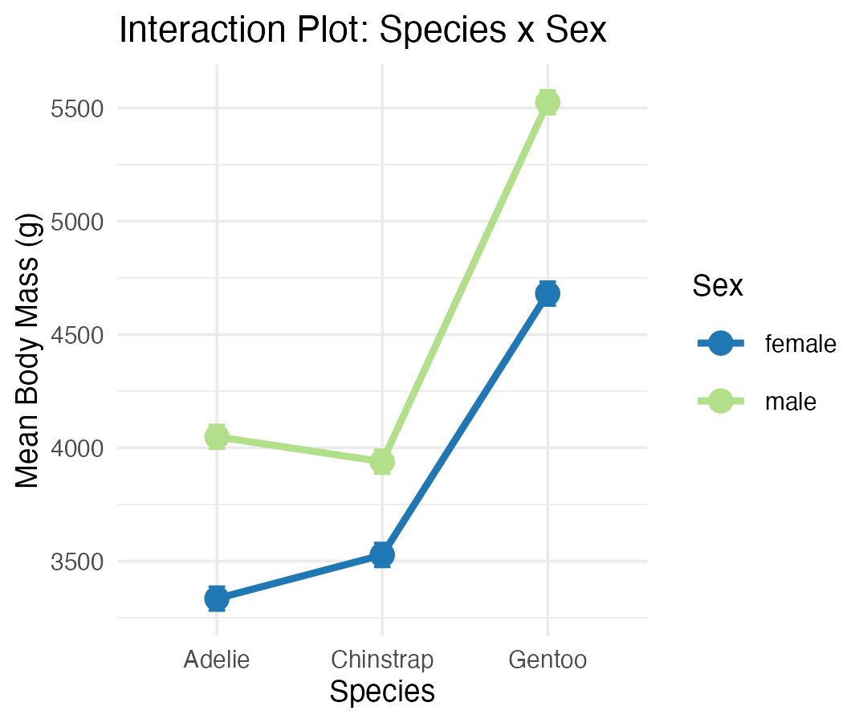
The Interaction Plot

Slide 37
Part 8 · Unbalanced Designs

Slide 38
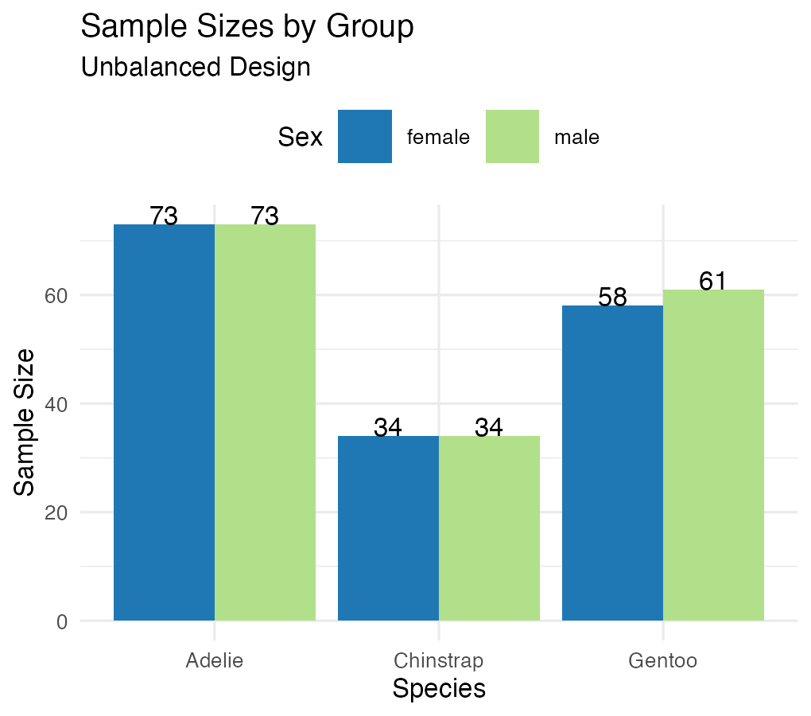
Introduction to Unbalanced Designs
The challenge of unbalanced data: real-world data is often unbalanced — unequal sample sizes across groups, missing data patterns, natural variation in sampling.
Key issues: Type I, II, and III SS give different results; order of terms matters for Type I SS; marginal means ≠ simple averages, so interpretation becomes complex.
Statistical model (same as balanced): $Y_{ijk}=μ+α_{i}+β_{j}+(αβ)_{ij}+ε_{ijk}$ — but parameter estimation differs!
## [1] "Unbalanced sample sizes:"
## # A tibble: 6 × 3
## species sex n
## <fct> <fct> <int>
## 1 Adelie female 73
## 2 Adelie male 73
## 3 Chinstrap female 34
## 4 Chinstrap male 34
## 5 Gentoo female 58
## 6 Gentoo male 61
## [1] "Total N = 333"
## [1] "Imbalance ratio = 2.15"

Slide 39
Type I (Sequential) SS
## Type I SS (Species -> Sex -> Interaction):
## Analysis of Variance Table
##
## Response: body_mass_g
## Df Sum Sq Mean Sq F value Pr(>F)
## species 2 145190219 72595110 758.358 < 2.2e-16 ***
## sex 1 37090262 37090262 387.460 < 2.2e-16 ***
## species:sex 2 1676557 838278 8.757 0.0001973 ***
## Residuals 327 31302628 95727
## ---
## Signif. codes: 0 '***' 0.001 '**' 0.01 '*' 0.05 '.' 0.1 ' ' 1
##
##
## Type I SS (Sex -> Species -> Interaction):
## Analysis of Variance Table
##
## Response: body_mass_g
## Df Sum Sq Mean Sq F value Pr(>F)
## sex 1 38878897 38878897 406.145 < 2.2e-16 ***
## species 2 143401584 71700792 749.016 < 2.2e-16 ***
## sex:species 2 1676557 838278 8.757 0.0001973 ***
## Residuals 327 31302628 95727
## ---
## Signif. codes: 0 '***' 0.001 '**' 0.01 '*' 0.05 '.' 0.1 ' ' 1
##
##
## Type I SS depends on order:
## Effect Order1_SS Order2_SS
## 1 Species 145190219 143401584
## 2 Sex 37090262 38878897
How Type I SS works — sequential decomposition:
First term gets all SS it can explain
Second term gets SS after removing the first
Third term gets SS after removing the first two
Problems with unbalanced data: order dependency, biased if factors are correlated, not invariant to coding.

Slide 40
Type III Sums of Squares
## [1] "Type III Sums of Squares:"
## Anova Table (Type III tests)
##
## Response: body_mass_g
## Sum Sq Df F value Pr(>F)
## (Intercept) 5232595969 1 54661.828 < 2.2e-16 ***
## species 143001222 2 746.924 < 2.2e-16 ***
## sex 29851220 1 311.838 < 2.2e-16 ***
## species:sex 1676557 2 8.757 0.0001973 ***
## Residuals 31302628 327
## ---
## Signif. codes: 0 '***' 0.001 '**' 0.01 '*' 0.05 '.' 0.1 ' ' 1
## [1] "Comparison of F-values:"
## Effect Type_I_F Type_III_F
## 1 Species 758.36 746.92
## 2 Sex 387.46 311.84
## 3 Interaction 8.76 8.76
How Type III SS works — marginal decomposition: each effect tested after adjusting for all others.
Advantages: order invariant, tests hypotheses about unweighted means, standard in most software.
Disadvantages: lower power with missing cells, tests may not be orthogonal, requires careful interpretation.
## [1] "Effect Sizes (partial eta-squared, Type III):"
## Effect Partial_Eta_Sq
## 1 Species 0.8204
## 2 Sex 0.4881
## 3 Interaction 0.0508

Slide 41
Manual SS Calculation, Step by Step
## [1] "Grand mean: 4207.1"
## [1] "Total SS: 215259666"
## [1] "Between-groups SS: 183957038"
## [1] "Within-groups SS: 31302628"
## [1] "Check: Between + Within = 215259666"
## SS(Species alone): 145190219
## SS(Sex alone): 38878897
##
## Sum of main effects: 184069116
## Actual between SS: 183957038
##
## Difference (design is not orthogonal): -112078
Note
✅ Key idea
Main effects don’t add up to the between-groups SS here because the effects aren’t orthogonal in an unbalanced design — proof that “unbalanced” really does change the arithmetic, not just the p-values.

Slide 42
Part 9 · EMMs and Diagnostics — the Unbalanced Model

Slide 43
Estimated Marginal Means — Unbalanced Data
## Species EMMs (model-based):
## species emmean SE df lower.CL upper.CL
## Adelie 3706 25.6 327 3656 3757
## Chinstrap 3733 37.5 327 3659 3807
## Gentoo 5082 28.4 327 5026 5138
##
## Results are averaged over the levels of: sex
## Confidence level used: 0.95
##
##
## Sex EMMs (model-based):
## sex emmean SE df lower.CL upper.CL
## female 3859 25.3 327 3809 3908
## male 4489 25.2 327 4440 4539
##
## Results are averaged over the levels of: species
## Confidence level used: 0.95
## contrast estimate SE df t.ratio p.value
## Adelie female - Chinstrap female -193 73.5 198 -2.620 0.0973
## Adelie female - Gentoo female -1346 73.5 198 -18.310 <0.0001
## Adelie female - Adelie male -714 73.5 198 -9.710 <0.0001
## Adelie female - Chinstrap male -604 73.5 198 -8.220 <0.0001
## Adelie female - Gentoo male -2190 73.5 198 -29.789 <0.0001
## Chinstrap female - Gentoo female -1154 73.5 198 -15.690 <0.0001
## Chinstrap female - Adelie male -521 73.5 198 -7.090 <0.0001
## Chinstrap female - Chinstrap male -412 73.5 198 -5.600 <0.0001
## Chinstrap female - Gentoo male -1998 73.5 198 -27.169 <0.0001
## Gentoo female - Adelie male 632 73.5 198 8.600 <0.0001
## Gentoo female - Chinstrap male 742 73.5 198 10.090 <0.0001
## Gentoo female - Gentoo male -844 73.5 198 -11.480 <0.0001
## Adelie male - Chinstrap male 110 73.5 198 1.490 0.6711
## Adelie male - Gentoo male -1476 73.5 198 -20.079 <0.0001
## Chinstrap male - Gentoo male -1586 73.5 198 -21.569 <0.0001
##
## P value adjustment: tukey method for comparing a family of 6 estimates
## species sex emmean SE df lower.CL upper.CL .group
## Adelie female 3368.836 36.21222 327 3272.980 3464.692 a
## Adelie male 4043.493 36.21222 327 3947.637 4139.349 b
## Chinstrap female 3527.206 53.06120 327 3386.749 3667.662 a
## Chinstrap male 3938.971 53.06120 327 3798.514 4079.427 b
## Gentoo female 4679.741 40.62586 327 4572.202 4787.281 c
## Gentoo male 5484.836 39.61427 327 5379.975 5589.698 d
##
## Confidence level used: 0.95
## Conf-level adjustment: sidak method for 6 estimates
## P value adjustment: sidak method for 15 tests
## significance level used: alpha = 0.05
## NOTE: If two or more means share the same grouping symbol,
## then we cannot show them to be different.
## But we also did not show them to be the same.

Slide 44
Pairwise Comparisons — Unbalanced Data
## Species pairwise comparisons (Tukey):
## contrast estimate SE df t.ratio p.value
## Adelie - Chinstrap -26.9 45.4 327 -0.593 0.8241
## Adelie - Gentoo -1376.1 38.2 327 -36.007 <0.0001
## Chinstrap - Gentoo -1349.2 47.0 327 -28.682 <0.0001
##
## Results are averaged over the levels of: sex
## P value adjustment: tukey method for comparing a family of 3 estimates
##
##
## Sex effect within each species:
## species = Adelie:
## contrast estimate SE df t.ratio p.value
## female - male -675 51.2 327 -13.174 <0.0001
##
## species = Chinstrap:
## contrast estimate SE df t.ratio p.value
## female - male -412 75.0 327 -5.487 <0.0001
##
## species = Gentoo:
## contrast estimate SE df t.ratio p.value
## female - male -805 56.7 327 -14.188 <0.0001
## Sex effect (female - male, grams) by species:
## Species Sex_Effect
## 1 Adelie -675
## 2 Chinstrap -412
## 3 Gentoo -805
##
##
## Interaction interpretation:
## [1] "Sex effects differ across species"

Slide 45
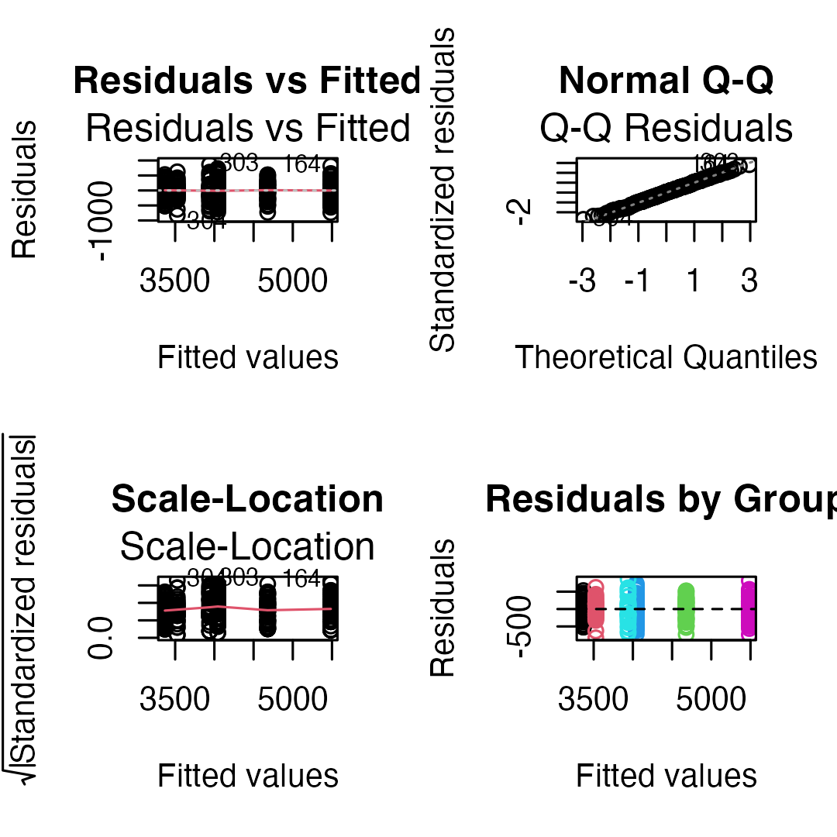
Diagnostic Plots — Unbalanced Design
## [1] "Shapiro-Wilk test:"
##
## Shapiro-Wilk normality test
##
## data: residuals(model_u)
## W = 0.99776, p-value = 0.9367
## [1] "Levene's test:"
## Levene's Test for Homogeneity of Variance (center = median)
## Df F value Pr(>F)
## group 5 1.3908 0.2272
## 327
## [1] "Residual SD by group:"
## # A tibble: 6 × 3
## species sex sd_resid
## <fct> <fct> <dbl>
## 1 Adelie female 269.
## 2 Adelie male 347.
## 3 Chinstrap female 285.
## 4 Chinstrap male 362.
## 5 Gentoo female 282.
## 6 Gentoo male 313.

Slide 46
Part 10 · Comparing Balanced vs. Unbalanced

Slide 47
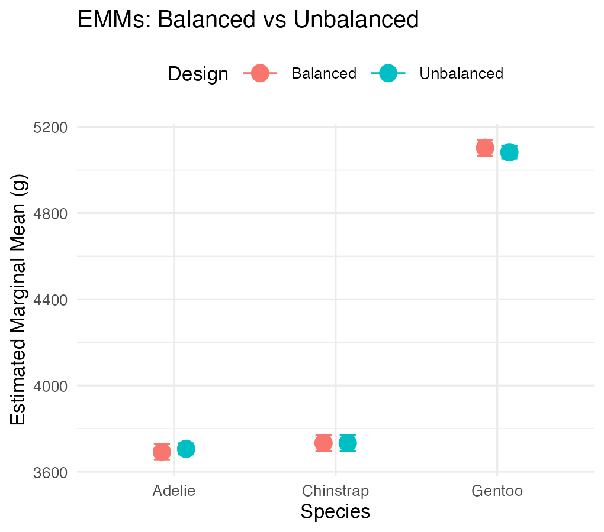
Side-by-Side Comparison
## Balanced vs Unbalanced Results:
## Effect Balanced_F Balanced_p Unbalanced_F Unbalanced_p
## 1 Species 477.20 0e+00 746.92 0e+00
## 2 Sex 239.22 0e+00 311.84 0e+00
## 3 Interaction 9.10 2e-04 8.76 2e-04
##
##
## Sample sizes:
## Balanced total N: 204
## Unbalanced total N: 333
## Data discarded: 129 observations

Slide 48
Part 11 · Summary and Best Practices

Slide 49
Summary — Unbalanced Designs
Challenges: Type I SS depends on order; simple means ≠ EMMs; reduced power for interactions; complex interpretation.
Solutions: use Type III SS for main effects; report EMMs, not simple means; check assumptions carefully; consider the impact of imbalance.
Recommendations:
Always report: sample sizes per cell, type of SS used, EMMs with CIs
Visualization: show actual data points, include error bars, note unequal sample sizes
Interpretation: focus on effect sizes, consider practical significance, acknowledge limitations

Slide 50
Final Recommendations
For experimental studies: design for balance when possible, randomize allocation, plan for attrition.
For observational studies: accept imbalance as reality, use Type III SS, report EMMs, consider covariates (ANCOVA).
Note
Statistical software defaults
R: Type I (sequential)
SAS: Type III (marginal)
SPSS: Type III (marginal)
Always specify which type you’re using!

Slide 51
Wrap-up
Today you:
Fitted a factorial model with two categorical predictors — body_mass_g ~ species * sex
Separated main effects from the interaction, and saw that an interaction means “the effect of one factor depends on the level of the other”
Used estimated marginal means instead of raw group averages, because with unequal cell sizes those are not the same thing
Met Type I, II and III sums of squares, and saw them give identical answers on a balanced design and different answers on an unbalanced one
Set contr.sum contrasts before asking for Type III — without that step R silently returns the wrong main-effect tests
Reported partial η² as the effect size that stays well defined either way
Important
⚠️ Read the interaction first
If the interaction is significant, a main effect is a average across conditions that behave differently — often not a meaningful quantity. Interpret the interaction, then use simple effects (emmeans(model, ~ sex | species)) rather than reporting the main effect as if it applied everywhere.
R even warns you: “Results may be misleading due to involvement in interactions.”
Note
✅ The one idea to keep
Balance is a property of your design, not your analysis. A balanced design makes the two factors orthogonal, so each one’s sum of squares is unambiguous. Imbalance makes them share variance — and then how you allocate that shared variance (Type I vs III) becomes a decision you have to make and defend.
Note
Up next — Nested ANOVA
When one factor is nested inside another rather than crossed with it
Subsamples, and the right error term to test against

Slide 52
Getting unstuck
When code breaks — and it will, that is normal:
Read the error message out loud; it usually names the line
Check the usual suspects: did you run options(contrasts = c("contr.sum", "contr.poly")) before fitting the model you pass to Anova(type = "III")? Are both predictors factors? Is it car::Anova() (capital A, Type II/III) rather than anova() (lower case, Type I)?
?function_name opens the help page
Bring the exact error (copy-paste it) to class or office hours
Note
✅ Key idea
Every working scientist googles error messages daily. Getting stuck is not failing — it is the job.

