Slide 1
Introduction — Start with R
Getting started in R

Slide 2
In class activity 1:

Slide 3
Objectives and goals
Can you identify inductive or deductive reasoning?
How do you formulate a question?
Can you develop a prediction?
What are hypotheses - Null and Alternate?
What are dependent and independent variables?
What is a replicate and how do we sample?
How do we organize data?
How do we graph the data we gather?

Slide 4
Schedule:
Head to the field outside of Swenson and go to pine stand
Discuss approaches to science and how to make observations
Point out the North versus South side of a pine tree and how weather might affect the needled dimensions
Return to laboratory and measure pine needles
Organize data
Make graphs to see what data looks like visually

Slide 5
Inductive reasoning approach
If you were a person that sees the world through an inductive reasoning approach what would you do right now with the conifers and the effect of sun?
Answer
start measuring needles around the tree
make a generalization about needles as affected by weather or wind or sun
make a generalization about the species of pine trees and needle lengths as a response to the treatment

Slide 6
Deductive reasoning approach
If you were a person that sees the world through a deductive reasoning approach what would you do right now?
Answer
note that there seems to be differences in pine needles on the different sides of trees
make generalization that weather or sun affects pine needle length
start measuring pine needles
test if the pattern exists or not
Then maybe test trees in sheltered versus sheltered areas or shaded and sunny areas

Slide 7
How does pine needle length vary
windward or sunny side of trees differ from the leeward or shady side of trees
what might we expect if there is and effect of the treatment
No effect of sun or wind
Then there would be no difference in needle length
This is called the Null Hypothesis and is denoted Ho
There is a difference in needle length
Could be shorter or longer - no specific pattern
Then we reject the idea above that there is no effect of the treatment
Accept the idea that there is a difference
This is called the Alternate Hypothesis or Ha
Note – we do not say if it is shorter or longer – this then becomes a prediction

Slide 8
How would we collect data to test this?
Can we collect needles from one tree tree and do the test?
NO – this is because this tree might have short needles — bad joke hidden…
This is called pseudoreplication see Hurlbert
We have to collect needles from many trees
The trees are the unit of replication here
We can collect needles from the same tree and take the average of them and use that as a single replicate for each side
We also need to be sure our sample is randomly selected
why do we need to randomize sampling?
how can we randomize our sampling?

Slide 9
What are the different variables?
We are working with variables
north south east or west
lee and windward sides
sunny or shady
species
pine needle length
what is a dependent variable?
what is an independent variable?

Slide 10
So each group go out and collect needles
1 branch or 20 needles from the sunny or windward side
1 branch or 20 needles from the shady or leeward side
Note that you need to collect them the same way and get the very base of the needle…
We will also use the inner 3 inches from the base of the branch
When done gather back here and we will head back to the laboratory.

Slide 11
Back in the laboratory
So before we begin – what are the steps we need to decide?
Note - setting up how you work with data and what you call each variable will save you TONS of time later on. This is called controlled vocabulary
How we measure these using calipers?
Are there any things we need to pay attention to?
What are the variables we have identified?
Note: is Date the same thing as date?
date
group
n_s – north or south or even the degrees
wind or sun - windward or leeward as it may change
tree_no – group # may work
Pine needle length – what do we call it?
What is the name we use?
What are the units?
Can we name the variable for both?
What is meta data?
List of variables, description, units, possible values
Saved as an associated text file
OK so take the measures and re-code in the shared Google spreadsheet

Slide 12
One last thing – Lets Estimate Error
Select 3 pine needles and number 1, 2, 3 and put at the front of the room
Each person needs to measure the 3 needles and record on paper
Enter name
Enter pine needle number
Enter the length as mm
When done each person can export the shared google drive as a CSV or comma delimited file and as an XLSX or excel file

Slide 13
Now Lets Open R Studio
Download the compressed file pine_needles.zip
Unzip this file in both windows and mac as it wont work
Open the folder and look at what is in there
Copy the files you have entered data into the data sub-directory with the same names as you see…
Then open RStudio
The window will look below – what is all this stuff…

Slide 14
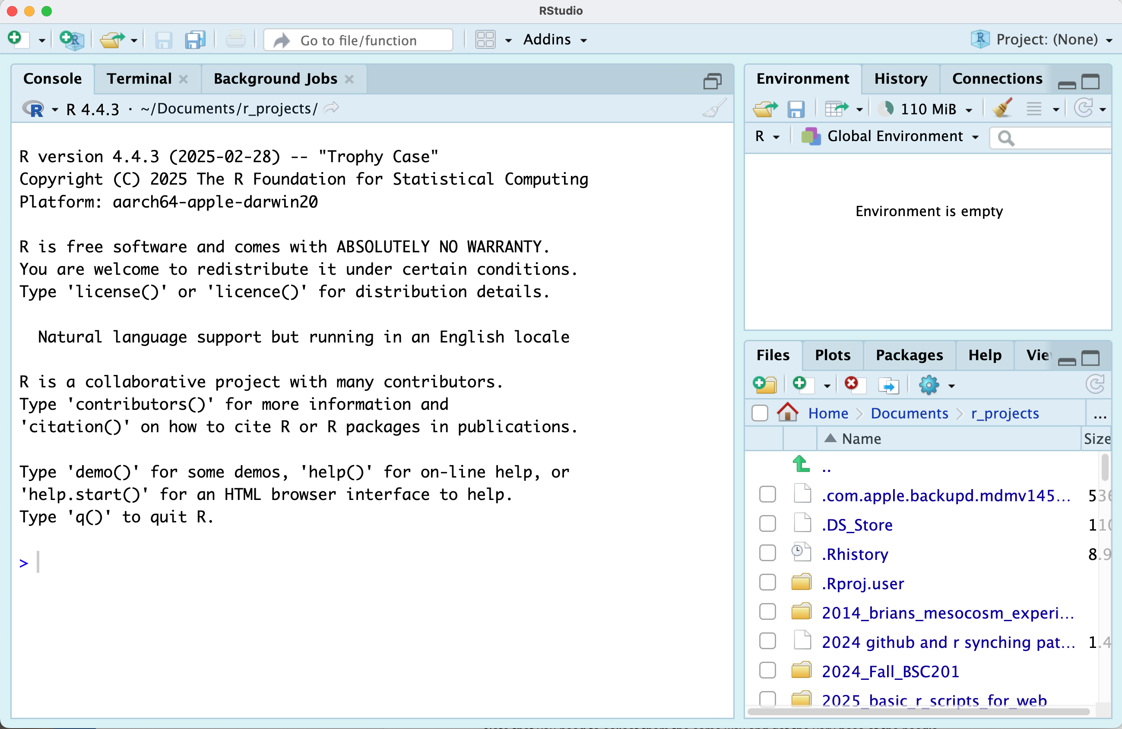
RStudio

Slide 15
Important parts of the screen
Console – this is really R running and R studio is the interface
Terminal – this is the back end of your computer without windows
Environment – this is where things in memory are stored like
Dataframes
Graphs Files – these are the files that are available… this now is your home directory Plots – the plots you create
Help – some form of help for you
More later - In the files you will see folders and you can click on them to see what is in there…
you can also click the dots next to the green arrow to go back up a level

Slide 16
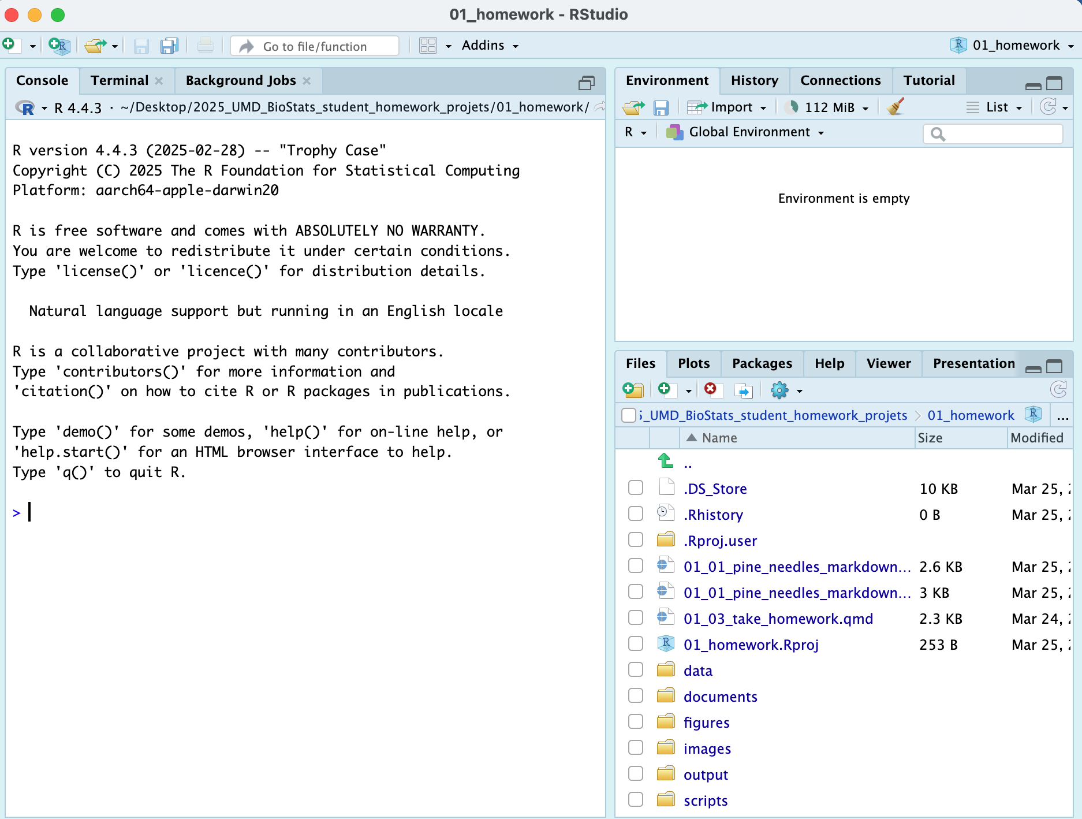
Now lets open the project that I created
click file - open project and select the 01_homework.Rproj file
your screen will now change as RStudio knows where home is

Slide 17
Note that in the upper right you will see 01_homework so you know you are in the right spot

Slide 18
How does RStudio work with R - <-
We need to cover a bit of syntax in R
in the console
r is case sensitive so X is different than x
the <- is the assignment operator
it stores whatever is on the right in a name that you have on the right
try typing x<-7 then return
this will store a new object in the environment that is an x and in that is 7
now type x and hit return and see what happens
a 7 will appear
now type y <- 2 and enter
now type x * y and return
you should see that it multiplied the x by the y variable and you get 14
THIS WILL GET SERIOUSLY OLD IF YOU HAVE TO RETYPE ALL THE TIME!!!
So we make command files or scripts
now in a r script file
lets click file and New File ... and R file
this will open a new script file that you can write code and run it with CTRL and return or on mac command + return
r is case sensitive so X is different than x
the <- is the assignment operator
it stores whatever is on the right in a name that you have on the right
try typing x<-7 then return
this will store a new object in the environment that is an x and in that is 7
now type x and hit command + return and see what happens in the console
a 7 will appear
now type y <- 2 and enter
now type x * y and command + return
you should see that it multiplied the x by the y variable and you get 14
This is one version - the other is a quarto markdown file we will see next
Quarto Files - how we will roll in the class
Now click the scripts folder where the scripts are stored
Open - 01_plain_r_script_for_pine_needles_blank.R by clicking on it
Then follow along…
one tricky note - when you open these they think this is home and all files are here or under them

Slide 19
How does RStudio work with R
we could do all of our work with R or base R
people have written a lot of helper functions called libraries stored in packages
we use these a lot of these
you install the package one time - a lot like buying a light bulb and screwing it in… you do that once
then you can load the libraries stored in the package each time you use a library
lets see how it works in a script I have made

Slide 20
Here is the script I provided to work on:
I have provided a lot of details here so you can see what is going on
You should have installed packages which is done below The # is a comment and allows you to write whatever you want and it won’ run
# install packages ----- # install.packages("quarto") # install.packages("readxl") # install.packages("tidyverse")
Each script you run from then on you will load the libraries from within the package.
# load this library one time only # library(quarto) # Load the libraries ---- library(readxl) # allows to read in excel files library(tidyverse) # provides utilities seen in console
── Attaching core tidyverse packages ──────────────────────── tidyverse 2.0.0 ── ✔ dplyr 1.2.1 ✔ readr 2.2.0 ✔ forcats 1.0.1 ✔ stringr 1.6.0 ✔ ggplot2 4.0.3 ✔ tibble 3.3.1 ✔ lubridate 1.9.5 ✔ tidyr 1.3.2 ✔ purrr 1.2.2 ── Conflicts ────────────────────────────────────────── tidyverse_conflicts() ── ✖ dplyr::filter() masks stats::filter() ✖ dplyr::lag() masks stats::lag() ℹ Use the conflicted package (<http://conflicted.r-lib.org/>) to force all conflicts to become errors

Slide 21
Loading files
Now like we did before with x and y we will do this with a spreadsheet from a CSV file or excel file
#| # load file ----- # this file is in the data sub directory # below put cursor between "" and click tab # allows to to select the directory # tab again and select the file p_df <- read_csv("data/pine_needles.csv")
Rows: 48 Columns: 6 ── Column specification ──────────────────────────────────────────────────────── Delimiter: "," chr (4): date, group, n_s, wind dbl (2): tree_no, length_mm ℹ Use `spec()` to retrieve the full column specification for this data. ℹ Specify the column types or set `show_col_types = FALSE` to quiet this message.
# dataframe stored by "<-" reading in csv file in quotes
This will import the excel file
# this will allow you to read in the excel file p_xl_df <- read_excel("data/pine_needles.xlsx")

Slide 22
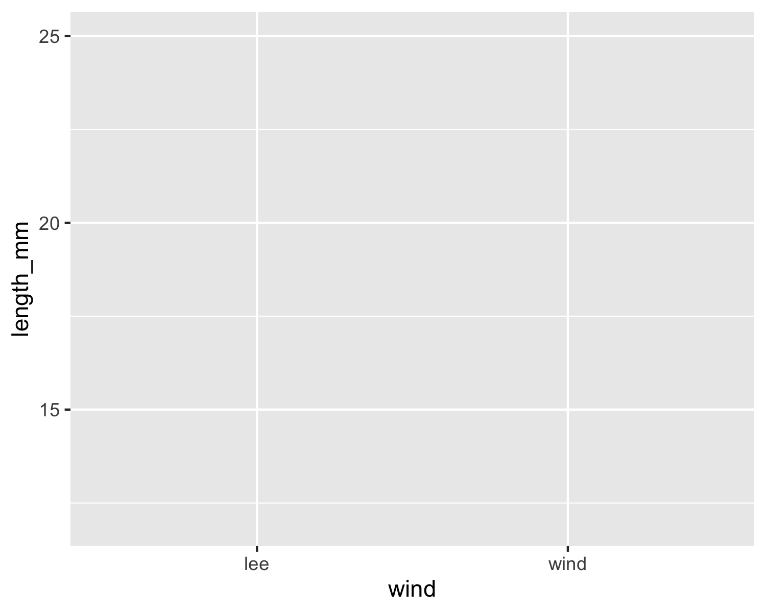
Visualize data
Use GGPlot to graph the data
the line below loads the dataframe and what the aesthetics are
it does not tell ggplot how to add a layer of the geometry to show the data
Tapestry Plot ——
ggplot(data = p_df, aes(x=wind, y=length_mm))

Slide 23
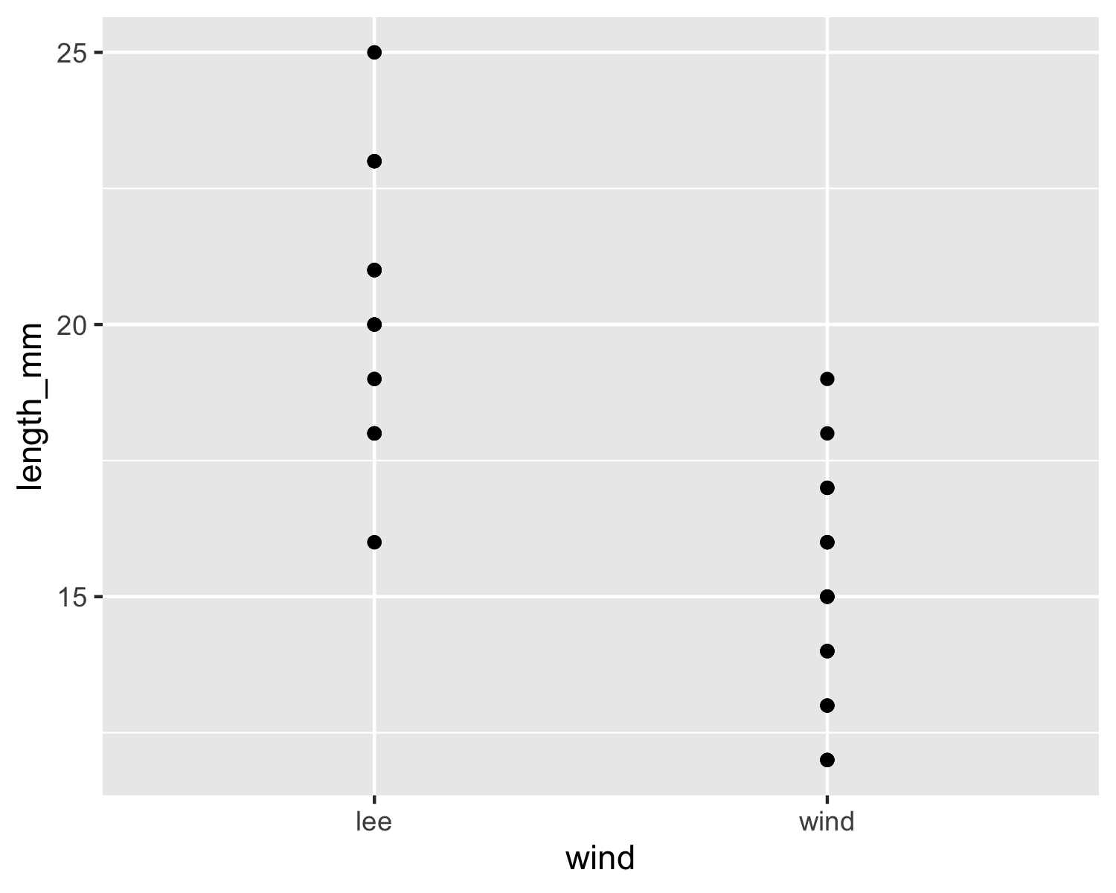
XY Plot —–
notice the points are layered on top but some overlap
ggplot(data = p_df, aes(x=wind, y=length_mm)) + geom_point()

Slide 24
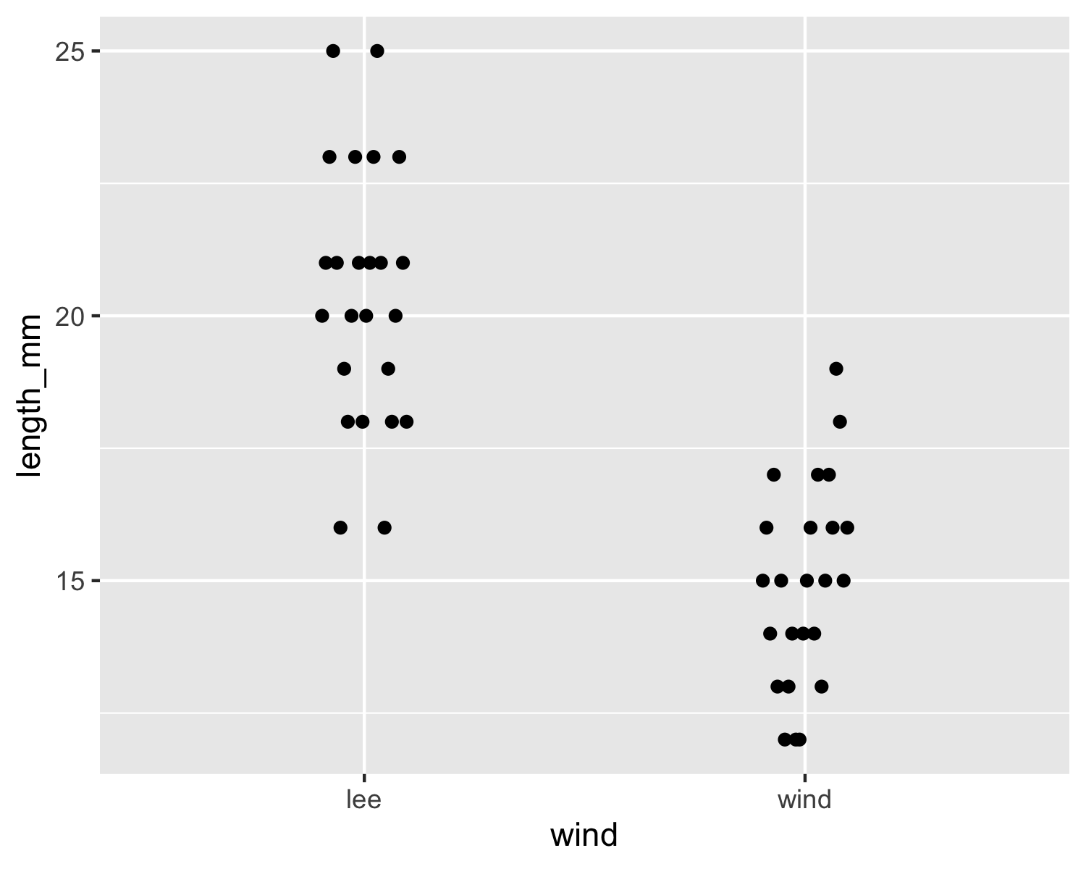
XY Plot with dodged points ——
ggplot(data = p_df, aes(x=wind, y=length_mm)) + geom_point(position = position_dodge2(width=0.2) )

Slide 25
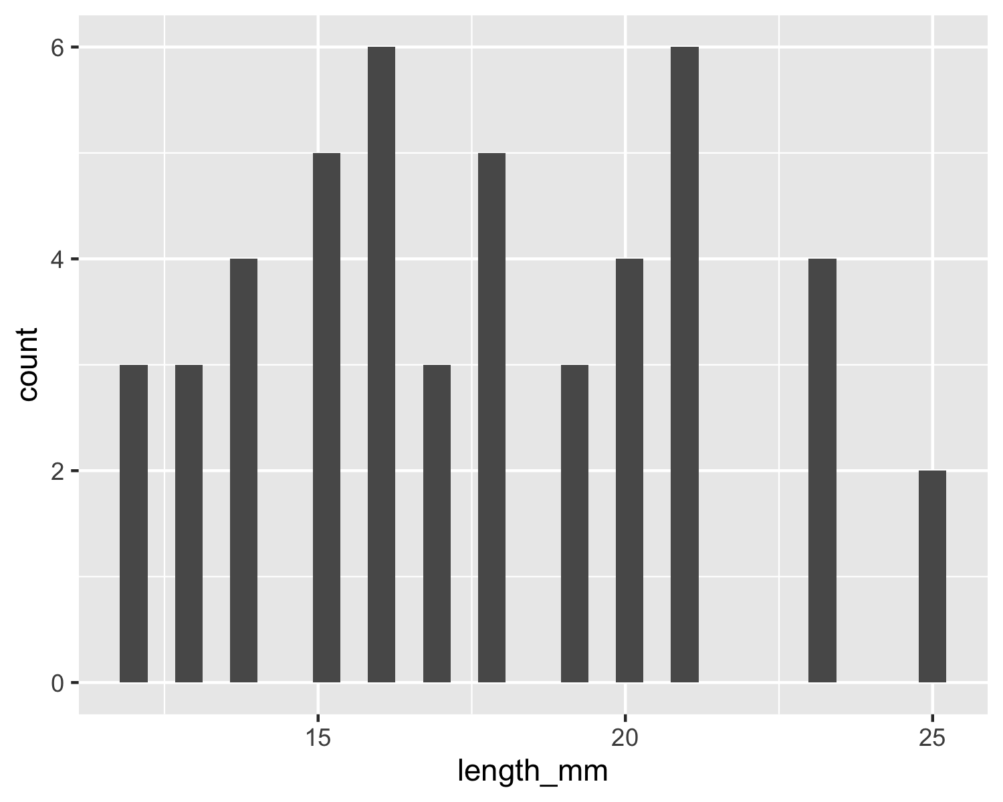
# this dodges the points # position_dodge2 or can use position_dodge depending on grouping
What are the other ways to display the data?
Histogram —–
ggplot(data = p_df, aes(x=length_mm)) + geom_histogram()
`stat_bin()` using `bins = 30`. Pick better value `binwidth`.

Slide 26
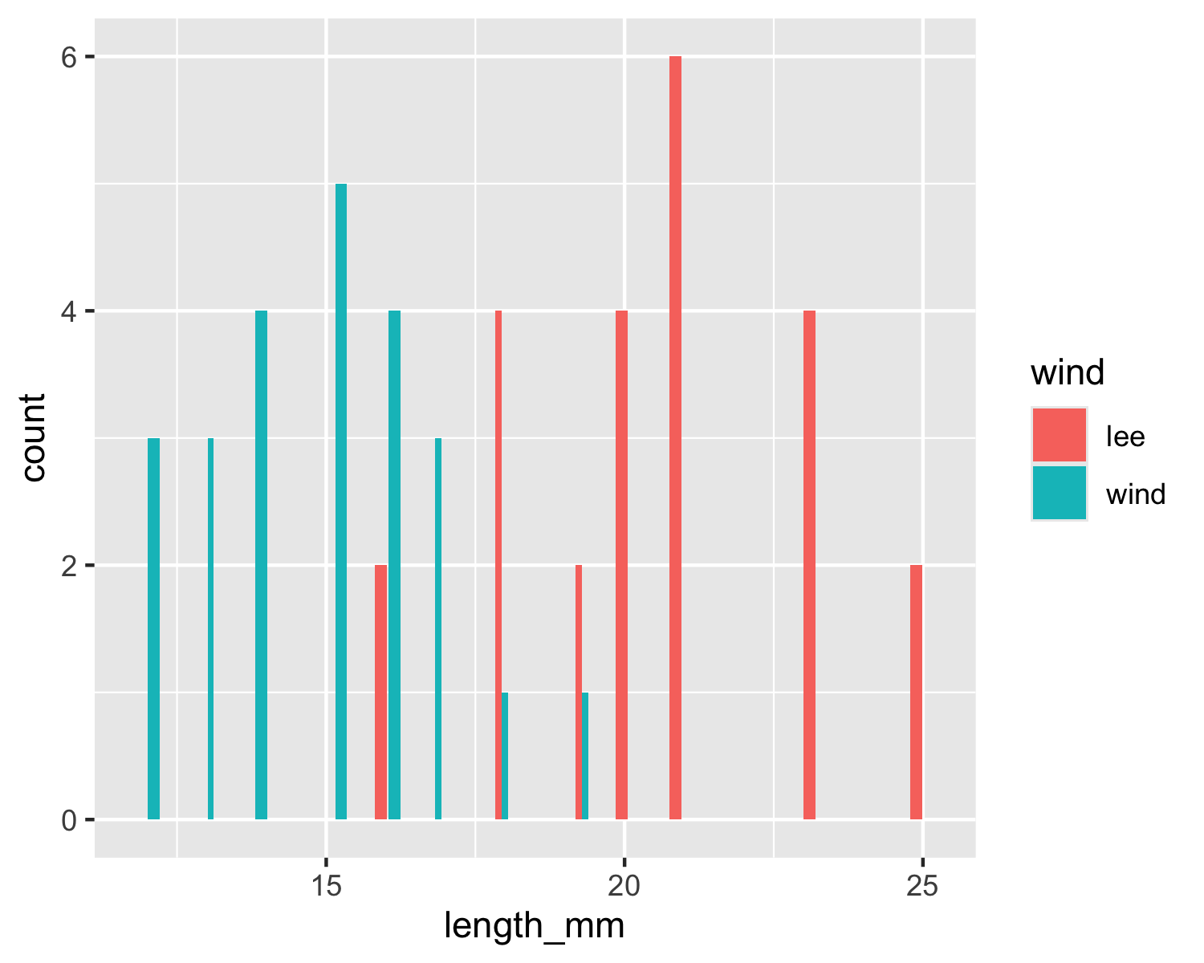
Note we really want to see the histograms colored by wind direction
We can map the wind aesthetic to a fill in the histogram
Histogram Colors —–
ggplot(data = p_df, aes(x=length_mm, fill = wind)) + geom_histogram( position = position_dodge2(width = 0.5))
`stat_bin()` using `bins = 30`. Pick better value `binwidth`.

Slide 27
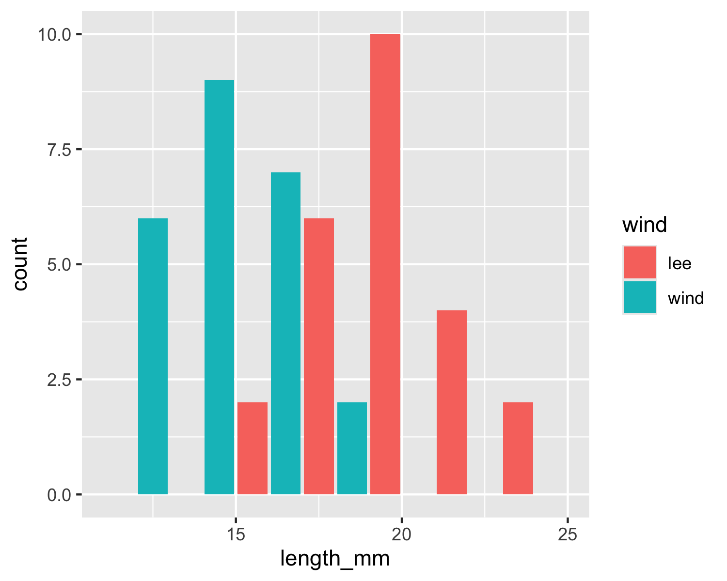
Histogram Bins —–
ggplot(data = p_df, aes(x=length_mm, fill = wind)) + geom_histogram( binwidth = 2, # sets the width in units of the bins - try different nubmers position = position_dodge2(width = 0.5))

Slide 28
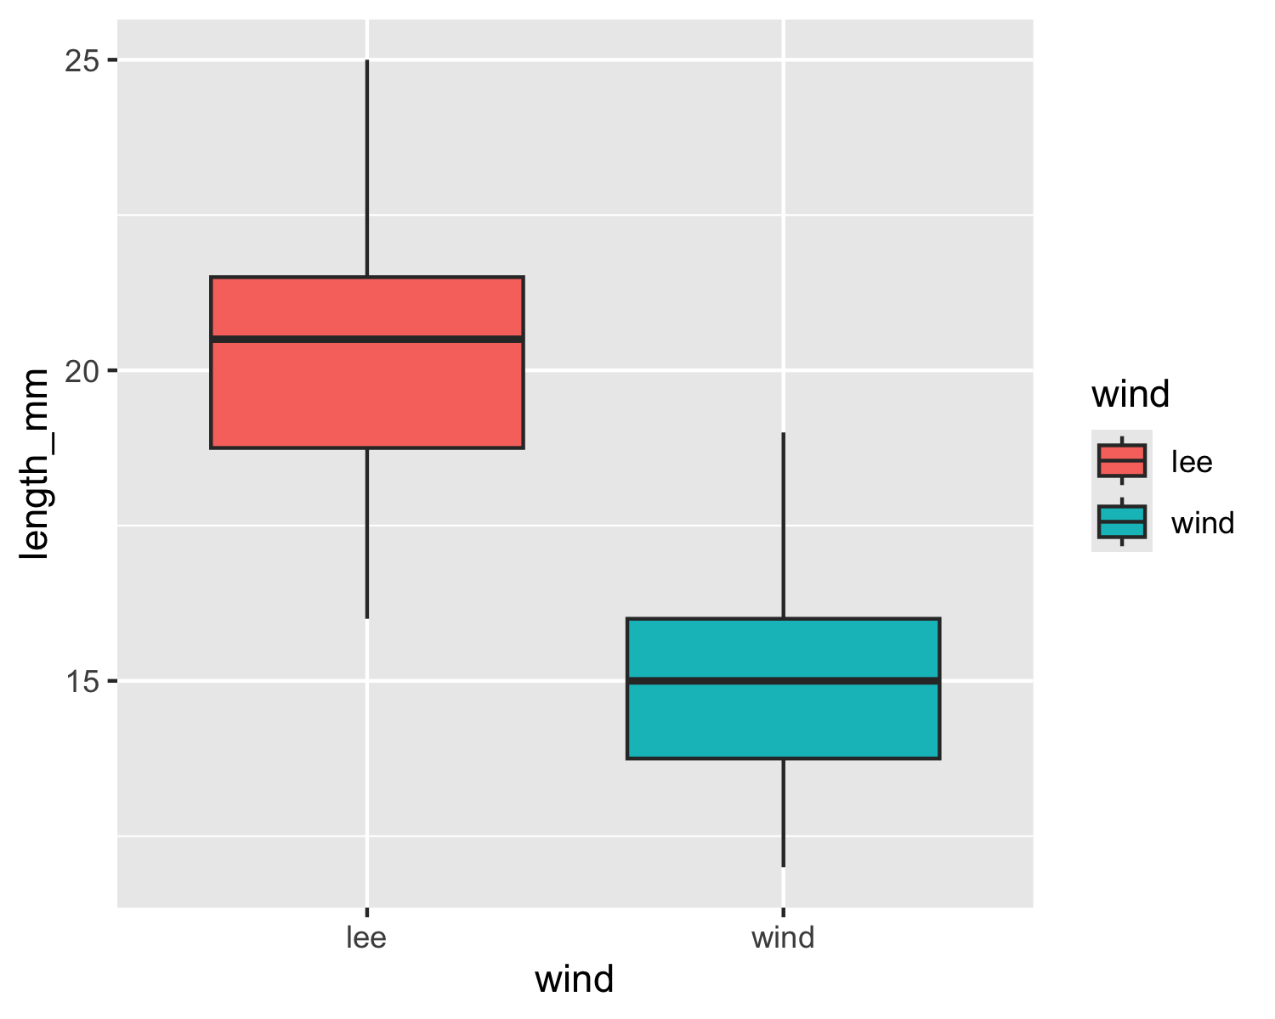
Other Plots if time in class
Box and Whisker Plots
ggplot(data = p_df, aes(x=wind, y=length_mm, fill = wind)) + geom_boxplot()

