Slide 1
Project Design & Graphing Data
Projects and ggplot Bill Perry

Slide 2
In-class Activity 2: Data Visualization
Recap from Activity 1
Collected pine needle samples from windward and leeward sides of trees
Identified independent variable (wind exposure) and dependent variable (needle length)
Measured needle lengths and recorded data
Created basic visualizations
Saved our data for further analysis
Today’s Objectives
Implement data pipeline best practices
Apply controlled vocabulary and naming conventions
Create effective tables and visualizations
Customize plots for publication quality
Combine multiple plots into composite figures

Slide 3
Part 1: Setting Up Your Environment
What data do we have
what is the controlled vocabulary?
are there units?
What is the directory structure?
Do we have a metadata file?
Is the data entered in a tidy format?
What are we missing?

Slide 4
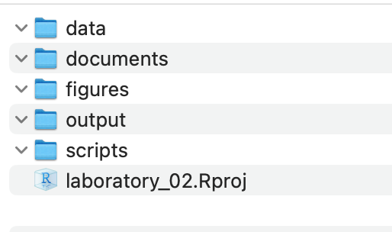
Now lets create a new quarto file
note I usually use this sort of system in an r_projects directory
I have redone it for the class to organize all of the terms data
you should try making some of your own projects

Slide 5
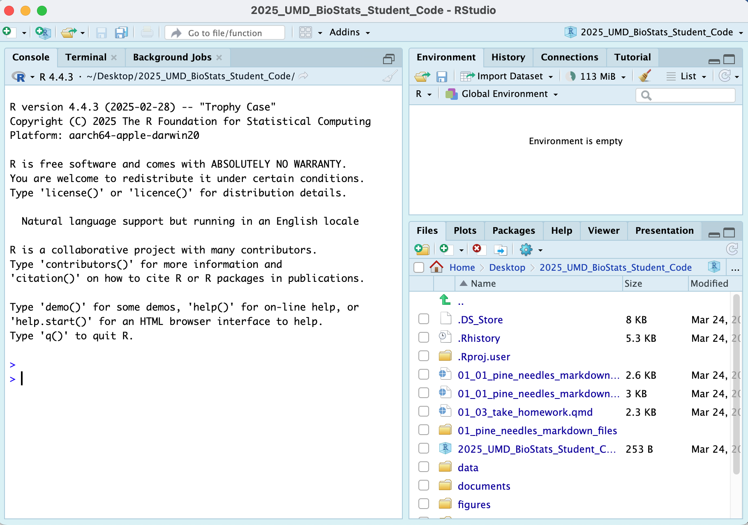
In RStudio:
click file - open project and select the 2025_UMD_BioStats_Student_Code.Rproj file or double click on it in the finder or data explorer.
your screen will now change as RStudio knows where home is

Slide 6
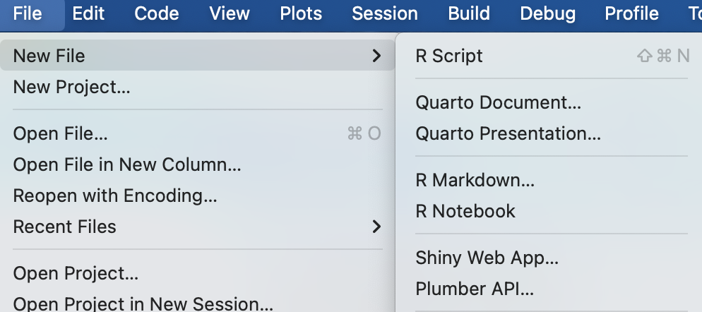
Note that in the upper right you will see 2025_UMD_BioStats_Student_Code so you know you are in the right spot
Now click File - New File - Quarto File

Slide 7
Create a file that starts with 02_ and then something that will help you know what is going on like 02_class_activity_in_class.qmd
Now this file thinks this is home.
So I usually copy stuff for the header from another file as its just too hard to remember all this…
--- title: "Title of your file" # Title of the file author: "Your Name" # who you are metadata-files: - ../../_templates/lectures.yml metadata-files: - _templates/activities.yml format: html: freeze: false toc: false default: true embed-resources: true self-contained: true default: true toc: false toc-depth: 3 number-sections: false highlight-style: github reference-doc: ms_templates/custom-reference.docx embed-resources: true ---
Exercise 1: Now to load the libraries
# install packages ----- # install.packages("readxl") # install.packages("tidyverse") # # we will install a few new libraries # install.packages("skimr")
Each script you run from then on you will load the libraries from within the package.
# Load the libraries ---- library(readxl) # allows to read in excel files library(tidyverse) # provides utilities seen in console
── Attaching core tidyverse packages ──────────────────────── tidyverse 2.0.0 ── ✔ dplyr 1.2.1 ✔ readr 2.2.0 ✔ forcats 1.0.1 ✔ stringr 1.6.0 ✔ ggplot2 4.0.3 ✔ tibble 3.3.1 ✔ lubridate 1.9.5 ✔ tidyr 1.3.2 ✔ purrr 1.2.2 ── Conflicts ────────────────────────────────────────── tidyverse_conflicts() ── ✖ dplyr::filter() masks stats::filter() ✖ dplyr::lag() masks stats::lag() ℹ Use the conflicted package (<http://conflicted.r-lib.org/>) to force all conflicts to become errors
library(skimr) # provide summary stats library(janitor) # it cleans ; )
Attaching package: 'janitor' The following objects are masked from 'package:stats': chisq.test, fisher.test
library(patchwork)
Exercise 2: Loading and Examining Data
Now like we did before with x and y we will do this with a spreadsheet from a CSV file or excel file
We are going to work with the same data we did in the last class.
# load file ----- # this file is in the data sub directory # below put cursor between "" and click tab # allows to to select the directory # tab again and select the file p_df <- read_csv("data/pine_needles.csv") # reads in csv file
Rows: 48 Columns: 6 ── Column specification ──────────────────────────────────────────────────────── Delimiter: "," chr (4): date, group, n_s, wind dbl (2): tree_no, length_mm ℹ Use `spec()` to retrieve the full column specification for this data. ℹ Specify the column types or set `show_col_types = FALSE` to quiet this message.
# dataframe stored by "<-" reading in csv file in quotes
Exercise 3: Examining Data
# Load the pine needle data p_df <- read_csv("data/pine_needles.csv", na = "NA")
Rows: 48 Columns: 6 ── Column specification ──────────────────────────────────────────────────────── Delimiter: "," chr (4): date, group, n_s, wind dbl (2): tree_no, length_mm ℹ Use `spec()` to retrieve the full column specification for this data. ℹ Specify the column types or set `show_col_types = FALSE` to quiet this message.
# Examine the data structure glimpse(p_df)
Rows: 48 Columns: 6 $ date <chr> "3/20/25", "3/20/25", "3/20/25", "3/20/25", "3/20/25", "3/20… $ group <chr> "cephalopods", "cephalopods", "cephalopods", "cephalopods", … $ n_s <chr> "n", "n", "n", "n", "n", "n", "s", "s", "s", "s", "s", "s", … $ wind <chr> "lee", "lee", "lee", "lee", "lee", "lee", "wind", "wind", "w… $ tree_no <dbl> 1, 1, 1, 1, 1, 1, 1, 1, 1, 1, 1, 1, 2, 2, 2, 2, 2, 2, 2, 2, … $ length_mm <dbl> 20, 21, 23, 25, 21, 16, 15, 16, 14, 17, 13, 15, 19, 18, 20, …
# View the first few rows head(p_df)
# A tibble: 6 × 6 date group n_s wind tree_no length_mm <chr> <chr> <chr> <chr> <dbl> <dbl> 1 3/20/25 cephalopods n lee 1 20 2 3/20/25 cephalopods n lee 1 21 3 3/20/25 cephalopods n lee 1 23 4 3/20/25 cephalopods n lee 1 25 5 3/20/25 cephalopods n lee 1 21 6 3/20/25 cephalopods n lee 1 16
# Get a statistical summary summary(p_df)
date group n_s wind tree_no Length :48 Length :48 Length :48 Length :48 Min. :1.00 N.unique : 1 N.unique : 4 N.unique : 2 N.unique : 2 1st Qu.:1.75 N.blank : 0 N.blank : 0 N.blank : 0 N.blank : 0 Median :2.50 Min.nchar: 7 Min.nchar: 5 Min.nchar: 1 Min.nchar: 3 Mean :2.50 Max.nchar: 7 Max.nchar:11 Max.nchar: 1 Max.nchar: 4 3rd Qu.:3.25 Max. :4.00 length_mm Min. :12.00 1st Qu.:15.00 Median :17.50 Mean :17.67 3rd Qu.:20.25 Max. :25.00
Questions to Consider:
What variables are in our dataset?
What are their data types?
Are there any missing values?
Do the variable names follow consistent conventions?
How might we improve the data organization?

Slide 8
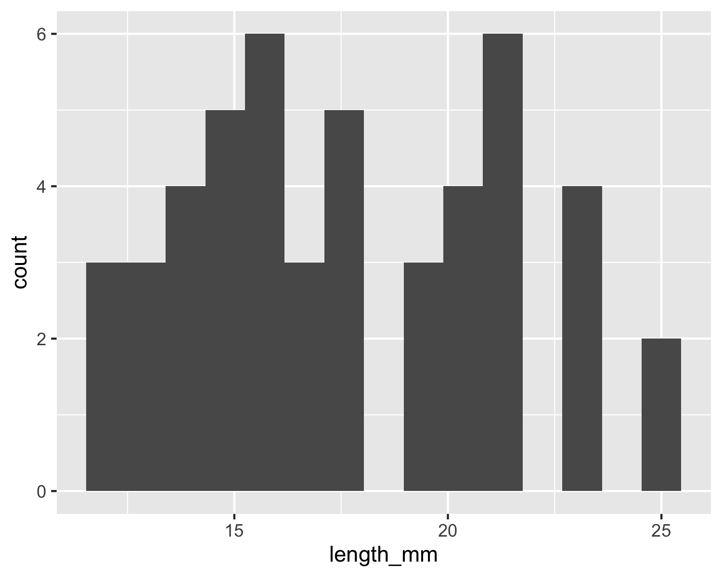
Part 2: Basic Data Visualization
Let’s create some simple visualizations to explore our data:
Exercise 2: Creating a Histogram
# Create a basic histogram p_df %>% ggplot(aes(x = length_mm)) + geom_histogram(bins = 15)

Slide 9
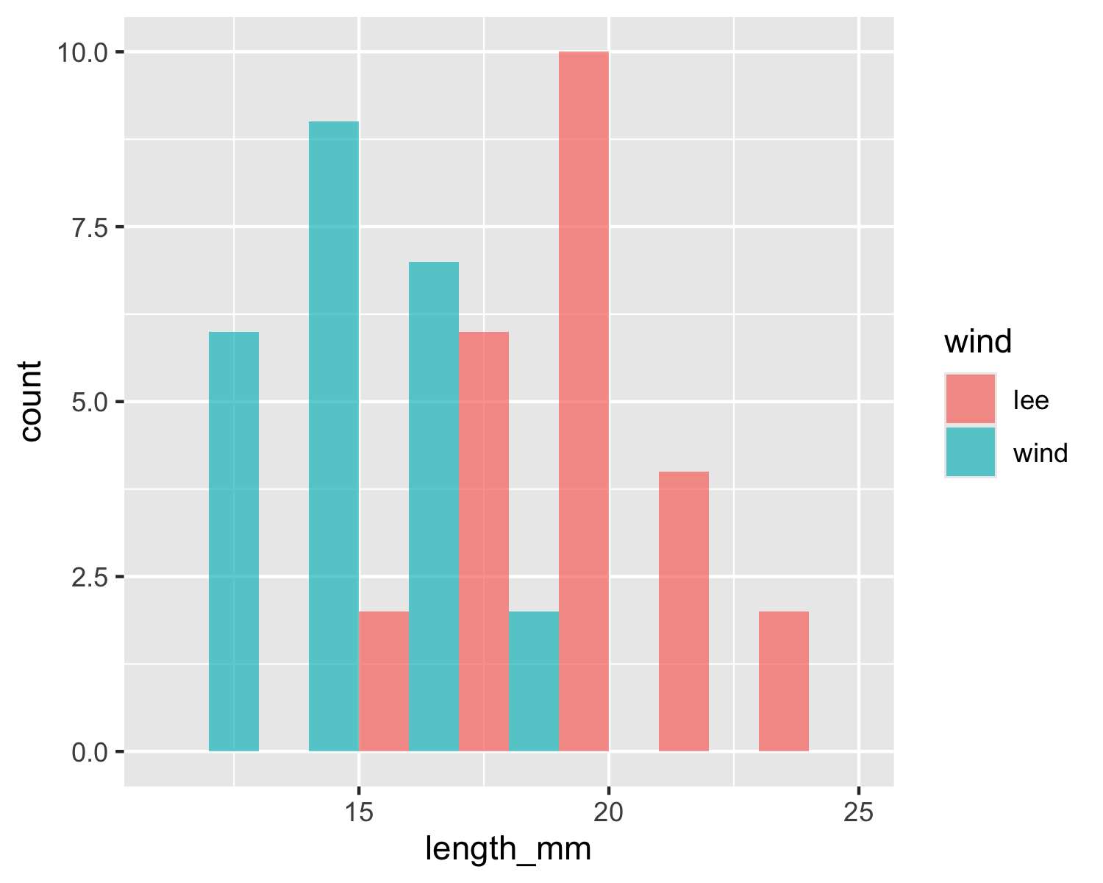
# Create a histogram with color grouping p_df %>% ggplot(aes(x = length_mm, fill = wind)) + geom_histogram(binwidth = 2, alpha = 0.7, position = "dodge")

Slide 10
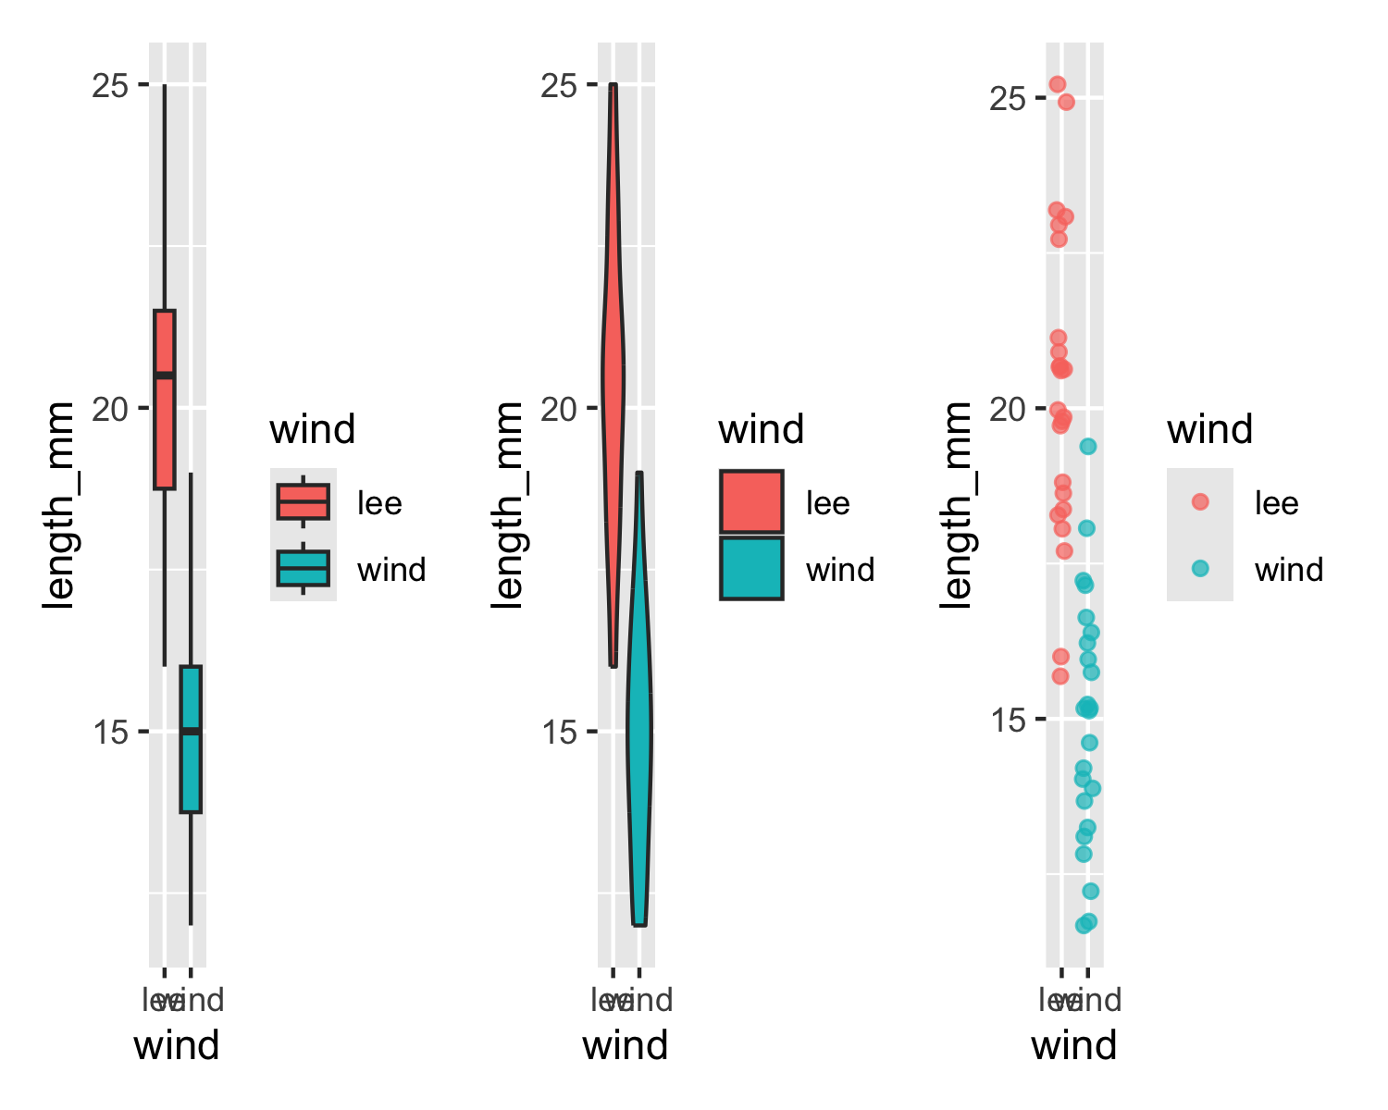
Key Insights from Histograms:
The histogram helps us understand: - The overall distribution of needle lengths - Potential differences between windward and leeward needles - Presence of any unusual values or outliers
Exercise 3: Creating Multiple Plot Types
Let’s explore different ways to visualize the same data:
# Box plot box_plot <- p_df %>% ggplot(aes(x = wind, y = length_mm, fill = wind)) + geom_boxplot() # Violin plot violin_plot <- p_df %>% ggplot(aes(x = wind, y = length_mm, fill = wind)) + geom_violin() # Dot plot dot_plot <- p_df %>% ggplot(aes(x = wind, y = length_mm, color = wind)) + geom_jitter(width = 0.2, alpha = 0.7) # Display all plots using patchwork box_plot + violin_plot + dot_plot

Slide 11
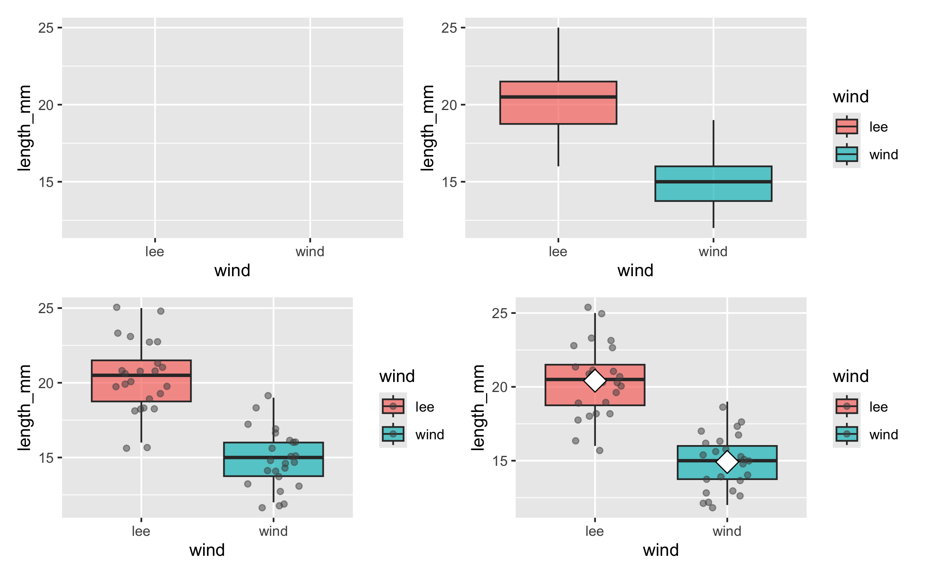
Questions to Consider:
Which plot type best reveals patterns in our data?
What are the advantages and disadvantages of each plot type?
How might we combine elements from different plot types?
Part 3: Building Complex Visualizations Layer by Layer
Now let’s build more sophisticated visualizations by adding layers one at a time:
Exercise 4: Building a Layered Plot
# Start with a basic plot p1 <- p_df %>% ggplot(aes(x = wind, y = length_mm, fill = wind)) # Add boxplot layer p2 <- p1 + geom_boxplot(alpha = 0.7) # Add individual data points p3 <- p2 + geom_jitter(width = 0.2, alpha = 0.5, color = "gray30") # Add mean indicators p4 <- p3 + stat_summary(fun = mean, geom = "point", shape = 23, size = 5, fill = "white") # Create a 2x2 grid of the progressive plot building (p1 | p2) / (p3 | p4)

Slide 12
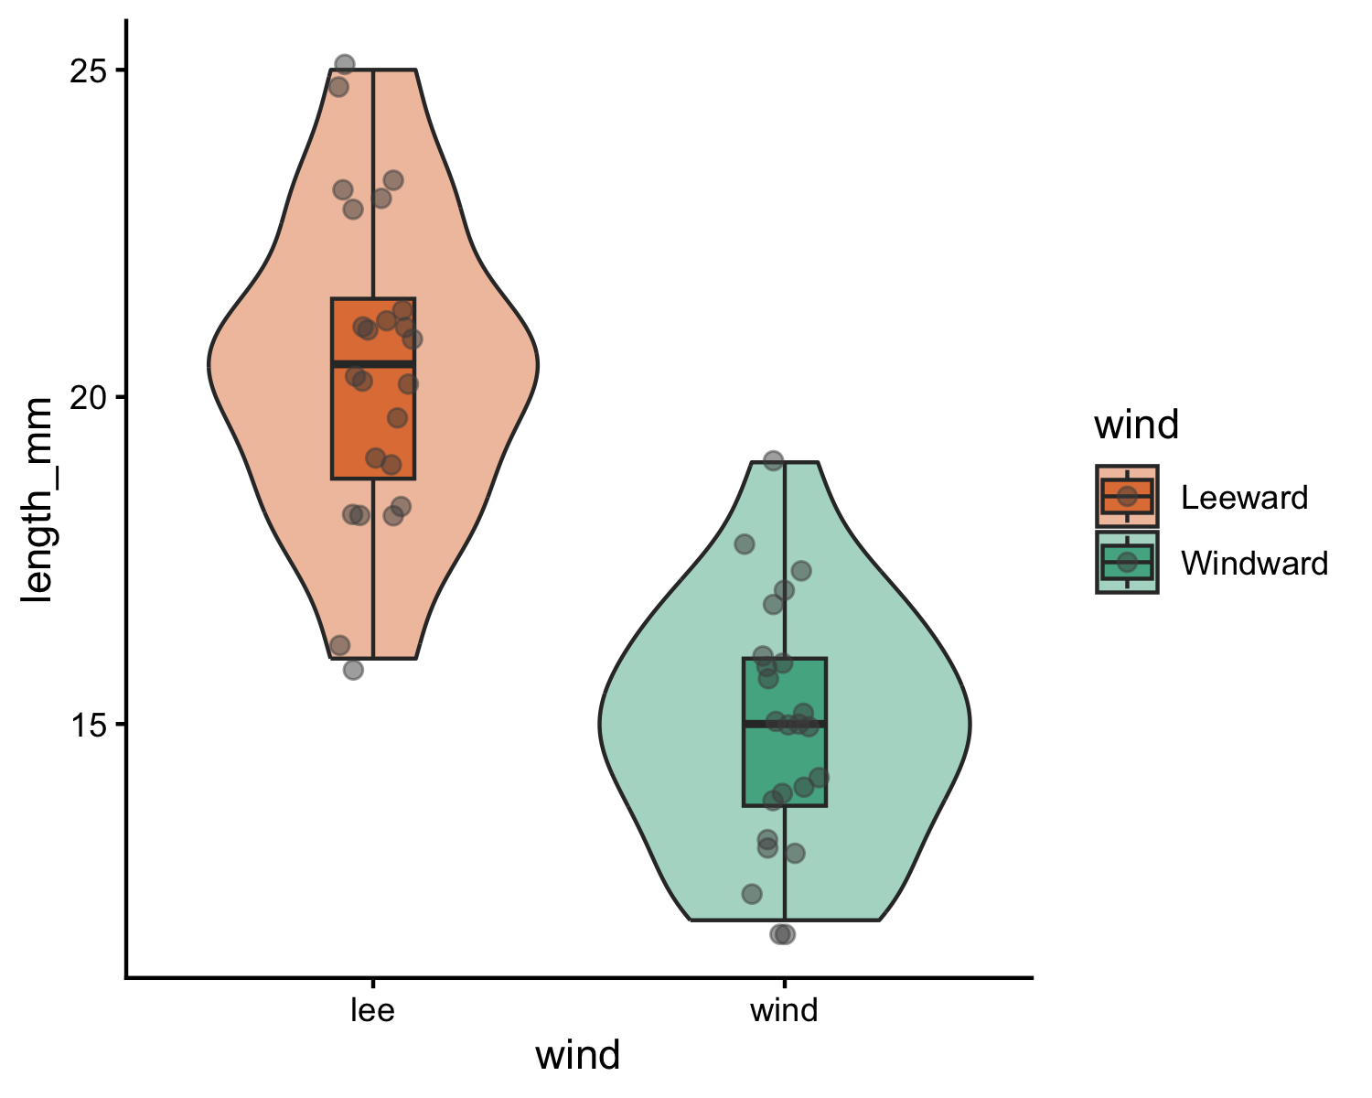
Discussion Points:
How does each layer contribute to the story our data is telling?
Why might we want to show individual data points alongside summary statistics?
How does transparency (alpha) help when overlaying multiple elements?
Part 4: Customizing Plots for Publication
Exercise 5: Adding customization
# Create a fully customized plot color_plot <- p_df %>% ggplot(aes(x = wind, y = length_mm, fill = wind)) + # Add violin plots for distribution geom_violin(alpha = 0.4) + # Add boxplots for key statistics geom_boxplot(width = 0.2, alpha = 0.7, outlier.shape = NA) + # Add individual data points geom_jitter(width = 0.1, alpha = 0.5, color = "gray30", size = 2) + # Add mean points # Customize colors with a colorblind-friendly palette scale_fill_manual( values = c( "wind" = "#1b9e77", "lee" = "#d95f02" ), labels = c( "wind" = "Windward", "lee" = "Leeward" )) + # Apply a clean theme theme_classic() # Display the publication-ready plot color_plot

Slide 13
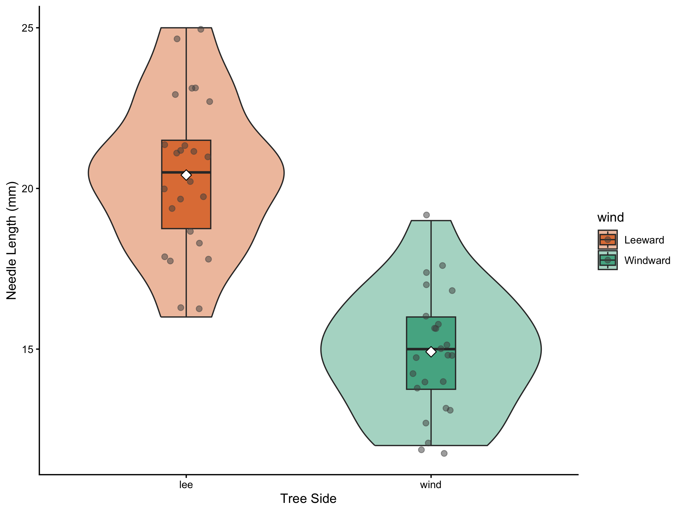
Let’s create a publication-quality figure by customizing colors, labels, and themes:
Exercise 6: Creating a Publication-Ready Plot
# Create a fully customized plot publication_plot <- p_df %>% ggplot(aes(x = wind, y = length_mm, fill = wind)) + # Add violin plots for distribution geom_violin(alpha = 0.4) + # Add boxplots for key statistics geom_boxplot(width = 0.2, alpha = 0.7, outlier.shape = NA) + # Add individual data points geom_jitter(width = 0.1, alpha = 0.5, color = "gray30", size = 2) + # Add mean points stat_summary(fun = mean, geom = "point", shape = 23, size = 3, fill = "white") + # Add informative labels labs( x = "Tree Side", y = "Needle Length (mm)" ) + # Customize colors with a colorblind-friendly palette scale_fill_manual( values = c("wind" = "#1b9e77", "lee" = "#d95f02"), labels = c("wind" = "Windward", "lee" = "Leeward") ) + # Apply a clean theme theme_classic() # Display the publication-ready plot publication_plot

Slide 14
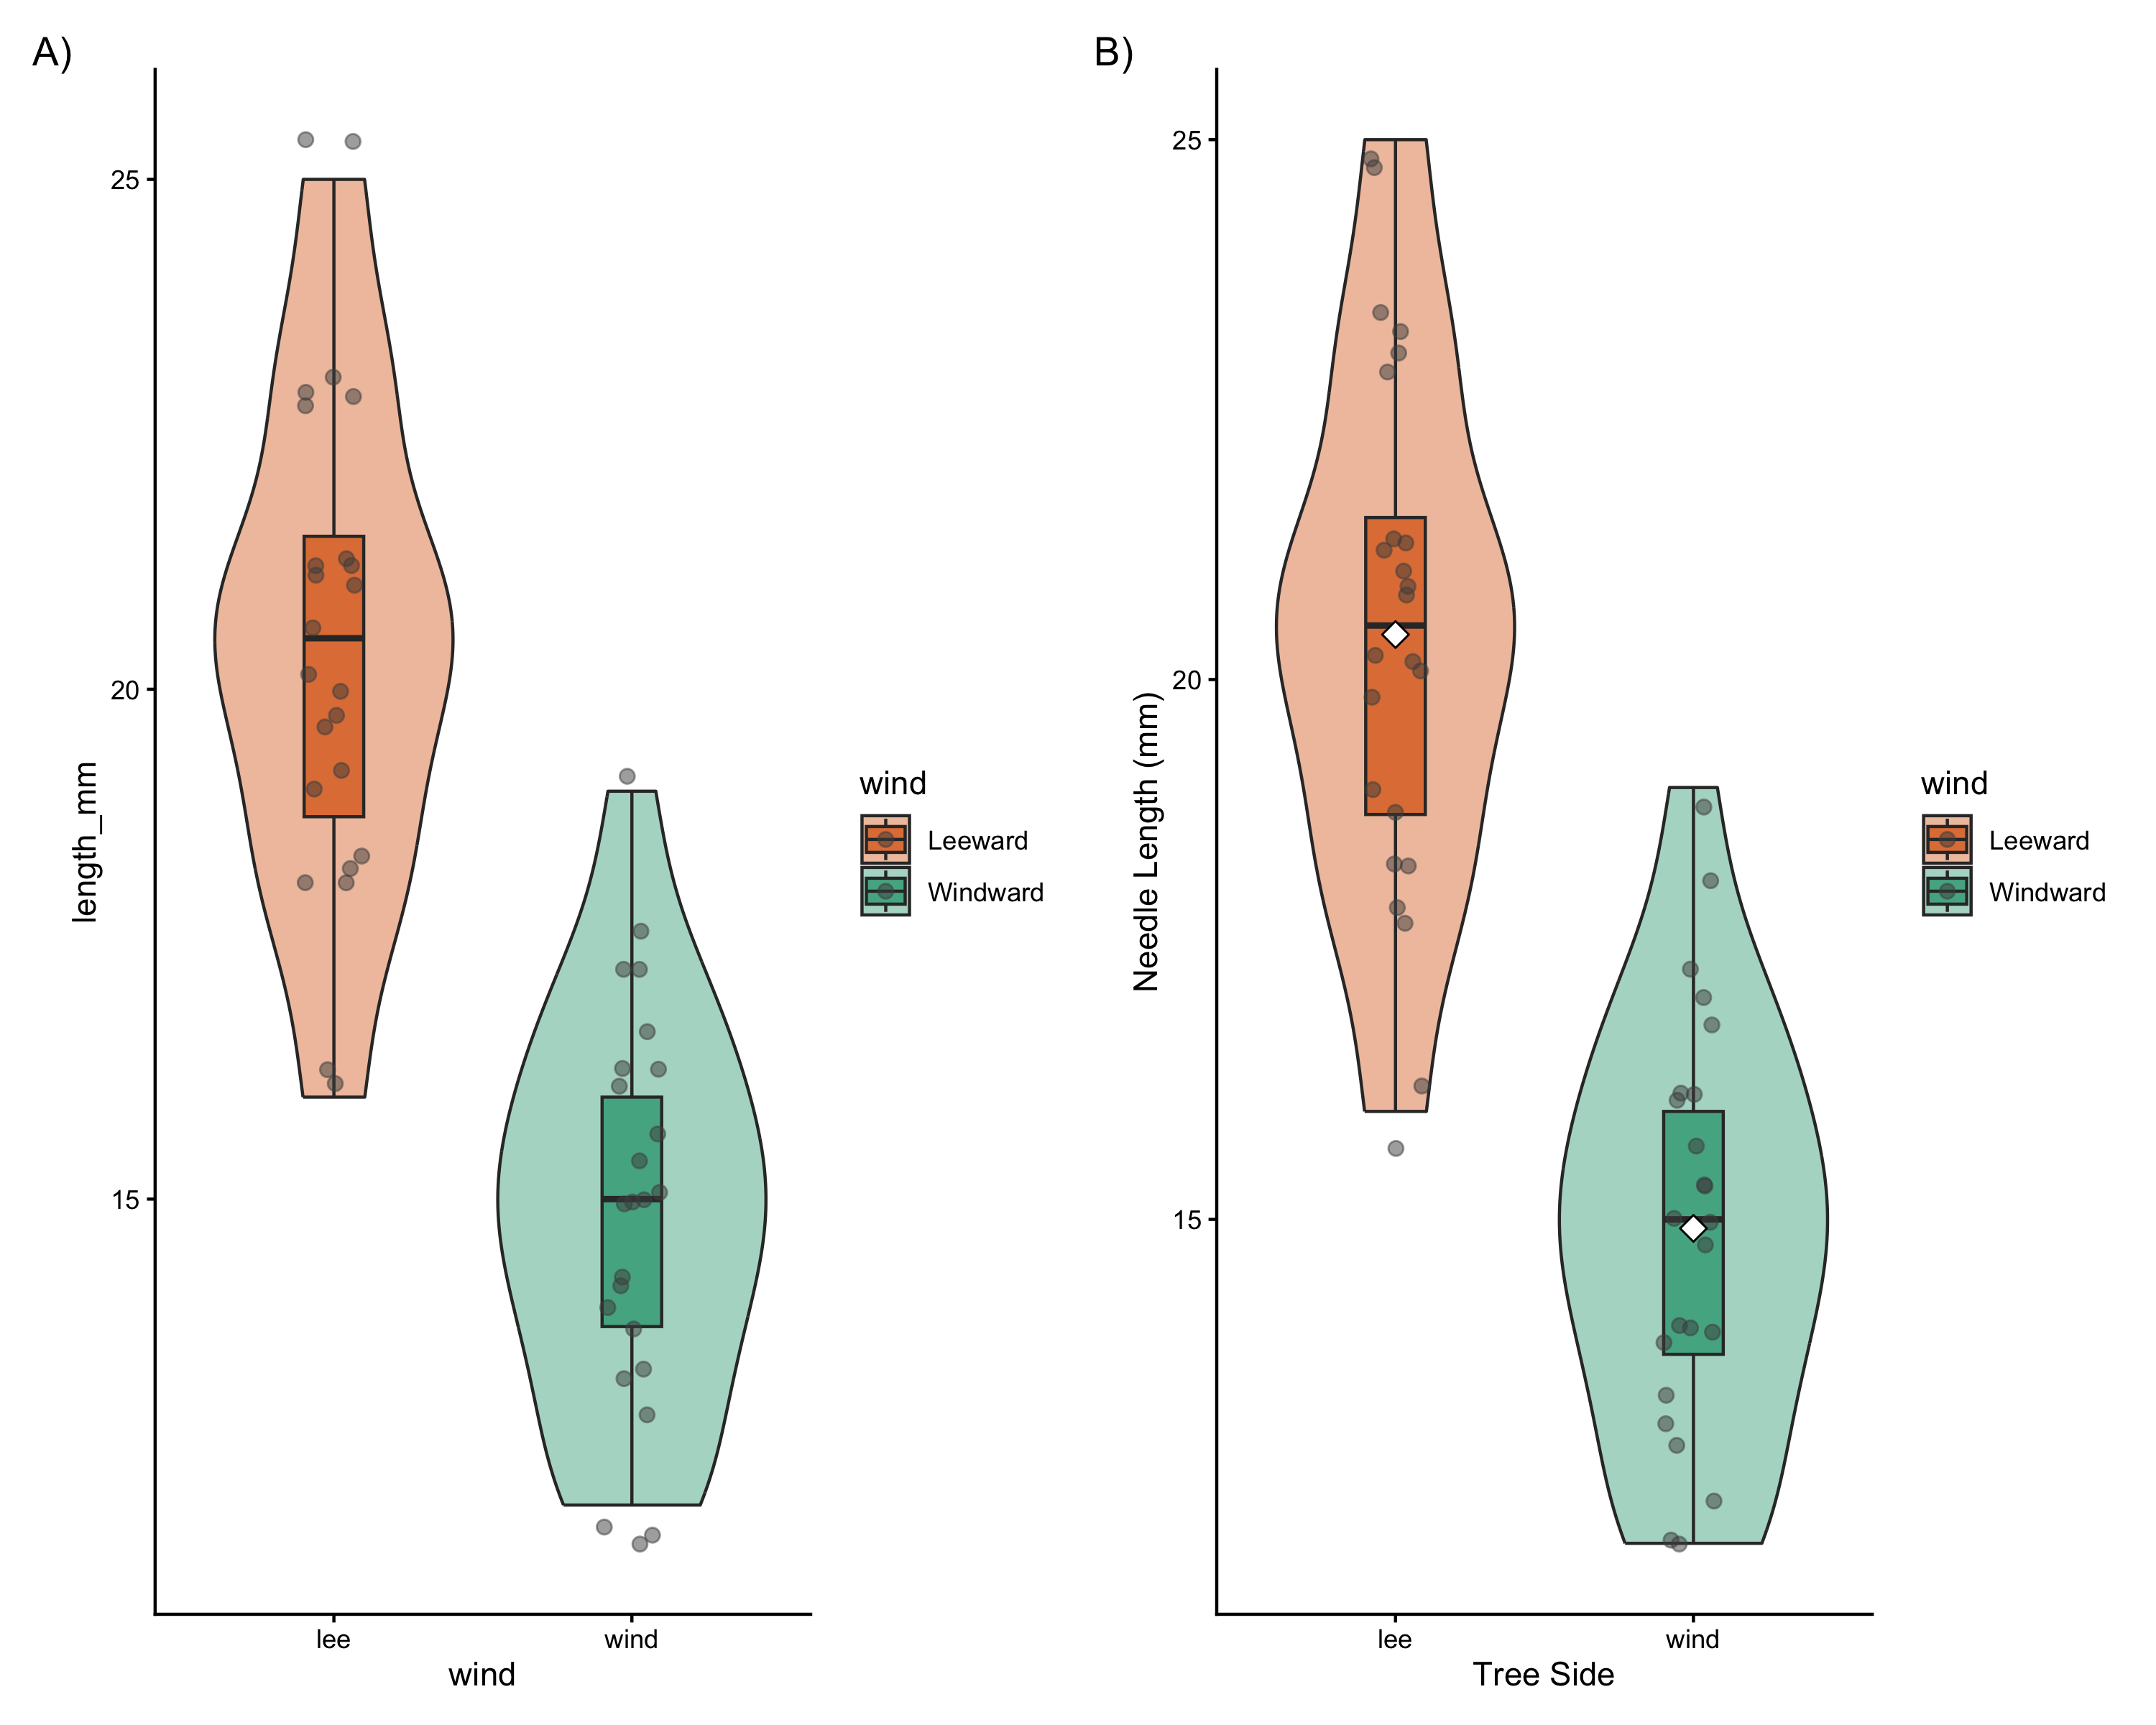
Customization Elements:
Plot Elements:
Violin plots to show distribution
Boxplots to show quartiles and median
Individual points for transparency
Mean indicators for central tendency
Visual Design:
Colorblind-friendly color palette
Thoughtful use of transparency
Clear, informative title and subtitle
Professional typography and spacing
Accessibility Considerations:
Sufficient contrast
Redundant encoding (position and color)
Clear labels with units
Part 5: Creating Complex Multi-Panel Figures
Finally, let’s create a publication-ready multi-panel figure:
color_plot + publication_plot + plot_layout(ncol = 2) + plot_annotation(tag_levels = "A", tag_suffix = ")")

Slide 15
# we can add this to remove things # why do this? # + theme( # axis.text.y = element_blank(), # Removes x-axis labels # axis.title.y = element_blank() # Removes x-axis title
Summary and Key Takeaways
In this activity, we’ve learned how to:
Load and examine data properly
Create basic visualizations to explore patterns
Build complex plots layer by layer using ggplot2’s grammar
Customize plots for clear communication and visual appeal
Add statistical information to support data interpretation
Combine multiple plots into publication-ready figures
Best Practices for Data Visualization:
Start simple, then add complexity as needed
Focus on the story your data is telling
Use appropriate plot types for your data structure
Minimize chart junk and maximize data-ink ratio
Create clear, informative labels
Use color purposefully and with accessibility in mind
Include both individual data points and summary statistics when possible
Consider your audience when designing visualizations

