Slide 1
Lecture: Nested ANOVA
Hierarchical designs
Bill Perry

Slide 2
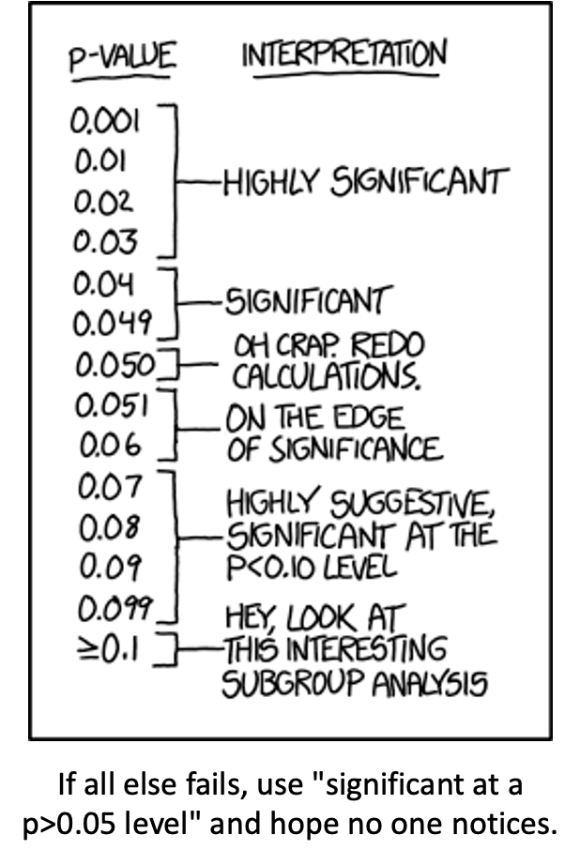
Where We Left Off
Covered last time — two-factor ANOVA:
Example, linear model, analysis of variance
Null hypotheses
Interactions and main effects
Unequal sample size
Assumptions
Note
✅ Key idea from last lecture
In a factorial design, every level of B appears under every level of A. Today: what happens when B is only ever nested inside one specific level of A?
XKCD comic listing p-value ranges with increasingly tongue-in-cheek interpretations, from ‘Highly Significant’ at p under 0.03 down through ‘On the edge of significance’ and ‘Hey, look at this interesting subgroup analysis’ at p >= 0.1, captioned ‘If all else fails, use significant at a p>0.05 level and hope no one notices’ — a joke about p-hacking and misusing significance thresholds.

Slide 3
Part 1 · Multifactor Designs

Slide 4
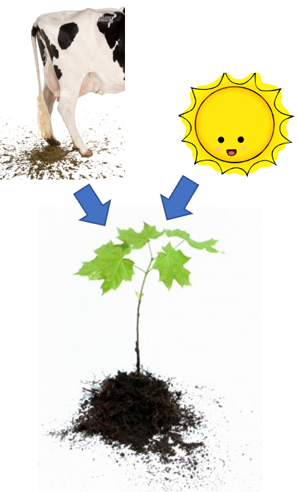
Two-Factor (2-Way) ANOVA, Recap
We often consider more than 1 factor (independent categorical variables) to reduce unexplained variance and look at interactions
2-factor designs (2-way ANOVA) are very common in ecology
Can have more factors (e.g., 3-way ANOVA) — interpretation gets tricky
Most multifactor designs are: factorial, nested, or mixed
Diagram of a cow (representing manure/fertilizer) and a smiling sun icon, each with an arrow pointing down to a small green seedling, illustrating two factors that can each affect plant growth.

Slide 5
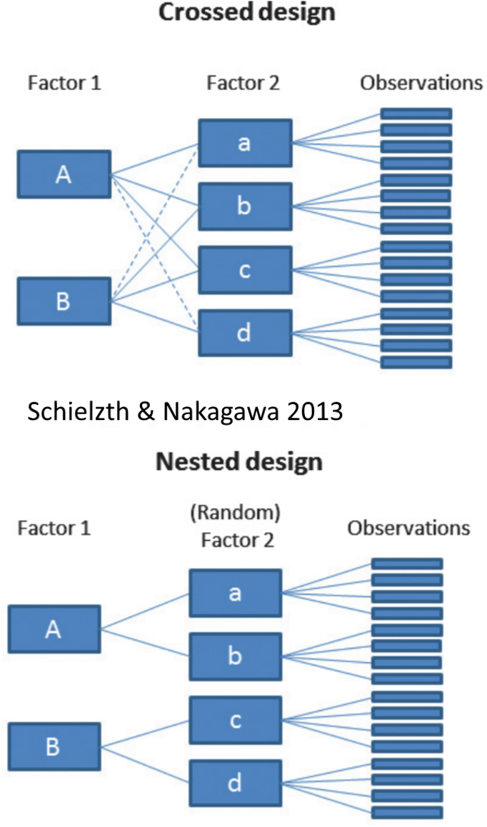
Factorial Versus Nested Designs
Consider two factors, A and B:
Factorial/crossed: every level of B in every level of A
Nested/hierarchical: levels of B occur only in 1 level of A
  both fixed — rare
  one fixed, one random
  both random — rare in ecology, common in genetics
Diagram contrasting a crossed design, where both levels of Factor 1 (A, B) connect to every level of Factor 2 (a, b, c, d), against a nested design below it, where each level of Factor 1 connects only to its own subset of (random) Factor 2 levels, both feeding into individual observations (Schielzth & Nakagawa 2013).

Slide 6
Part 2 · Factorial Designs — Examples

Slide 7
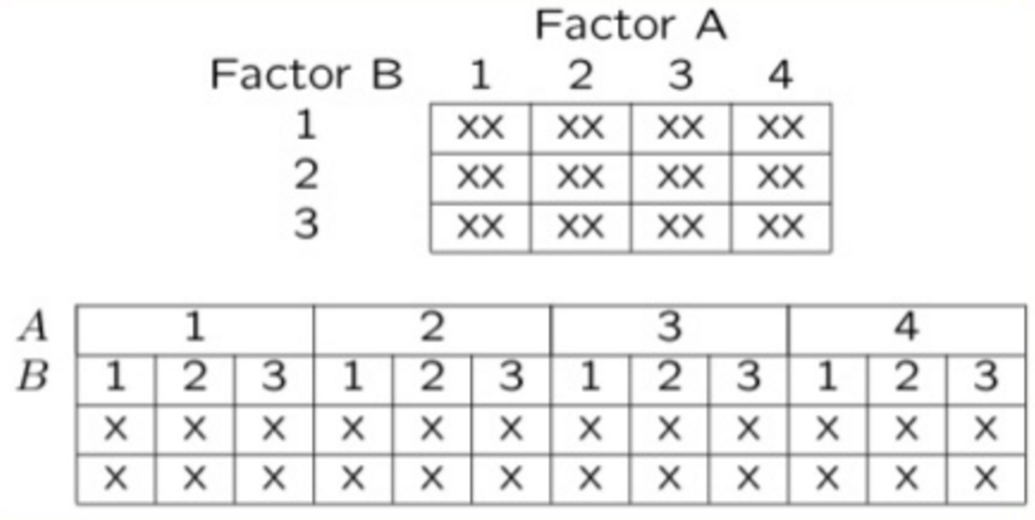
Factorial Designs Overview
Factorial designs: both factors are typically fixed (but not always).
Two grid diagrams of a factorial design with Factor A across the top (4 levels) and Factor B down the side (3 levels): a compact 4x3 grid marked ‘XX’ in every cell, and an expanded layout below showing each of the 12 A-by-B combinations as its own column with two replicate marks (X, X).

Slide 8
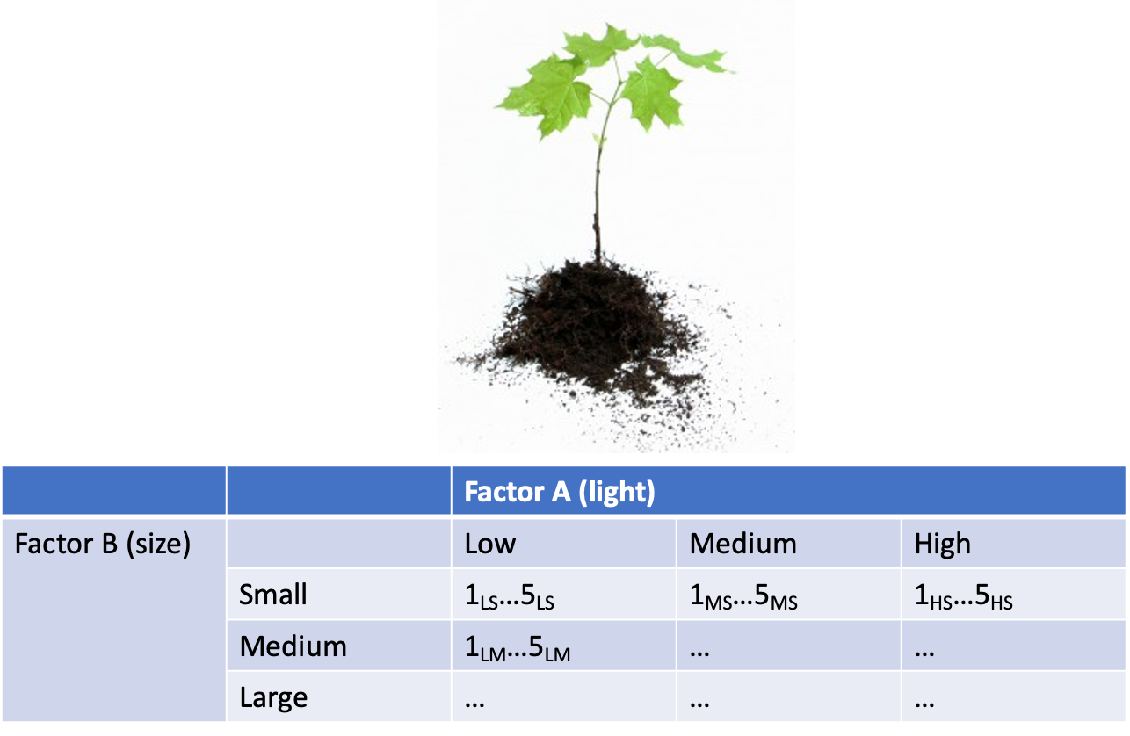
Factorial Design Example: Seedling Growth
Effects of light level on growth of seedlings of different size:
3 light levels (Factor A)
3 size classes (Factor B)
5 replicate seedlings in each cell
Photo of a small seedling above a table crossing Factor A (light: Low, Medium, High) with Factor B (size: Small, Medium, Large), with each cell showing 5 replicate seedling IDs (e.g., 1_LS…5_LS), illustrating the seedling-growth factorial design example.

Slide 9
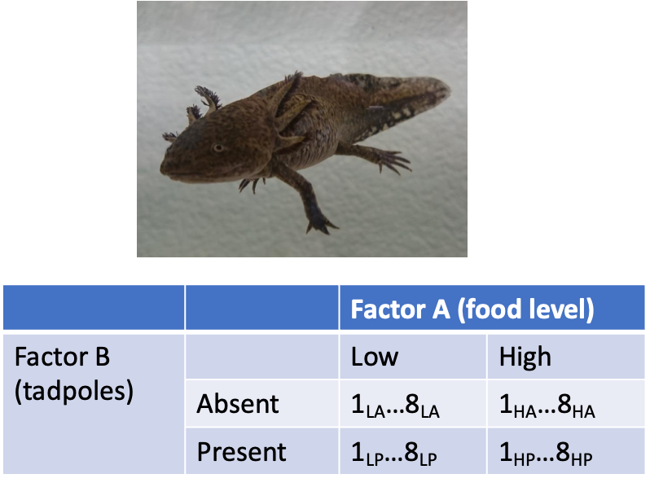
Factorial Design Example: Salamander Growth
Effects of food level and tadpole presence on larval salamander growth:
2 food levels (Factor A)
Presence/absence of tadpoles (Factor B)
8 replicates in each cell
Photo of a larval salamander above a table crossing Factor A (food level: Low, High) with Factor B (tadpoles: Absent, Present), with each cell showing 8 replicate IDs (e.g., 1_LA…8_LA), illustrating the salamander-growth factorial design example.

Slide 10
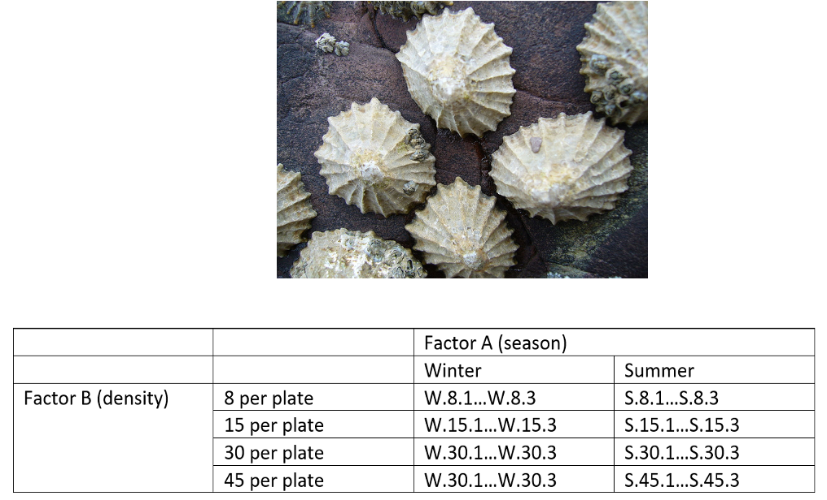
Factorial Design Example: Limpet Fecundity
Effect of season and density on limpet fecundity:
2 seasons (Factor A)
4 density treatments (Factor B)
3 replicates in each cell
Photo of limpets clustered on a rock above a table crossing Factor A (season: Winter, Summer) with Factor B (density: 8, 15, 30, 45 per plate), with each cell showing 3 replicate IDs (e.g., W.8.1…W.8.3), illustrating the limpet-fecundity factorial design example.

Slide 11
Part 3 · Nested Designs — Examples

Slide 12
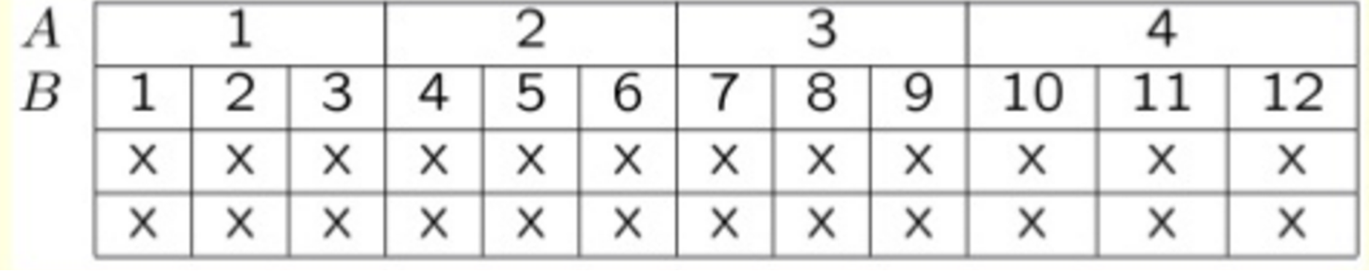
Nested Designs Overview
Nested designs cover: nested design examples, the linear model, analysis of variance, null hypotheses, unbalanced designs, assumptions, mixed-model ANOVA.
Nested designs: Factor A is usually fixed; Factor B is usually random.
Grid layout with Factor A across the top (4 levels) and Factor B down the side, each of the 4 levels of B uniquely numbered 1 through 12 nested within its own level of A, with two rows of X’s marking replicate observations under each B level.

Slide 13
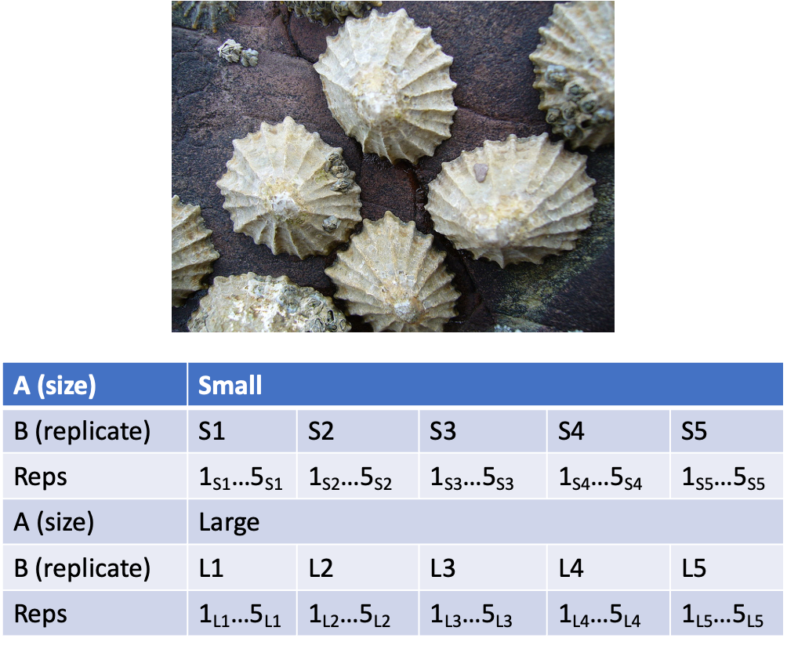
Nested Design Example: Limpet Growth
Study on effects of enclosure size on limpet growth:
2 enclosure sizes (Factor A)
5 replicate enclosures (Factor B)
5 replicate limpets per enclosure
Photo of limpets on a rock above a table for Factor A (enclosure size: Small, Large), each with 5 replicate enclosures (S1-S5 or L1-L5) and 5 replicate limpets per enclosure, illustrating the limpet-growth nested design example.

Slide 14
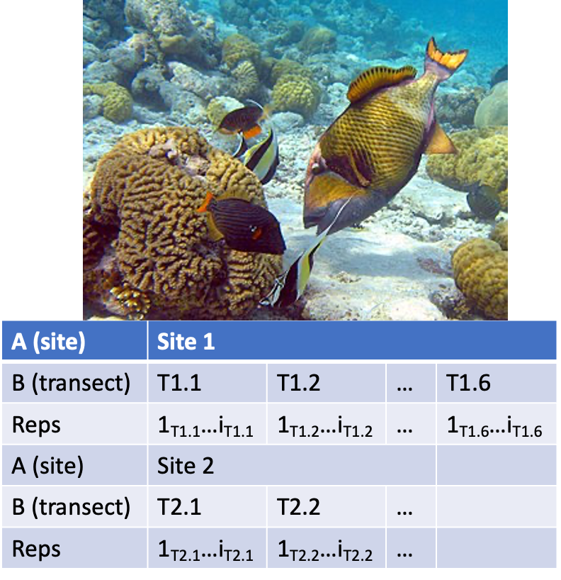
Nested Design Example: Reef Fish
Study on reef fish recruitment:
5 sites (Factor A)
6 transects at each site (Factor B)
Replicate observations along each transect
Underwater photo of reef fish above coral, above a table for Factor A (site: Site 1, Site 2), each with several transects (T1.1, T1.2, … T1.6) and replicate observations along each transect, illustrating the reef-fish recruitment nested design example.

Slide 15
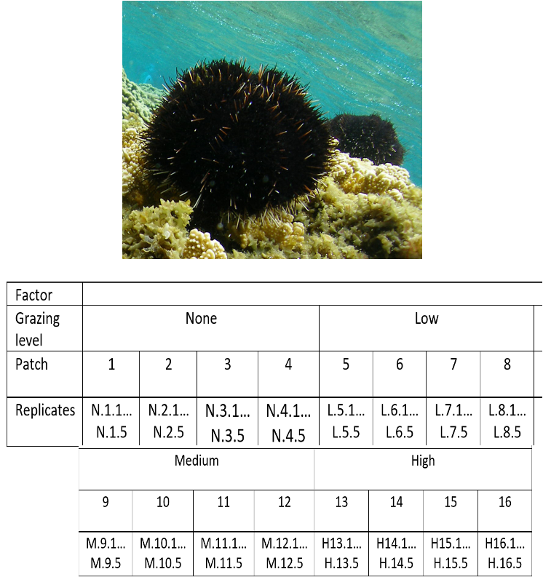
Nested Design Example: Sea Urchin Grazing
Effects of sea urchin grazing on biomass of filamentous algae:
4 urchin densities: 0%, 33%, 66%, 100% of natural density
4 patches of rocky bottom (3–4 m²) nested in each grazing level
5 replicate quadrats per patch
This is our worked example for the rest of the lecture.
Underwater photo of a black sea urchin on coral, above a table for grazing level (None, Low, Medium, High) each with 4 patches nested inside it and 5 replicate quadrats per patch, illustrating the sea urchin grazing worked example used for the rest of this lecture.

Slide 16
Part 4 · The Nested Design Model

Slide 17
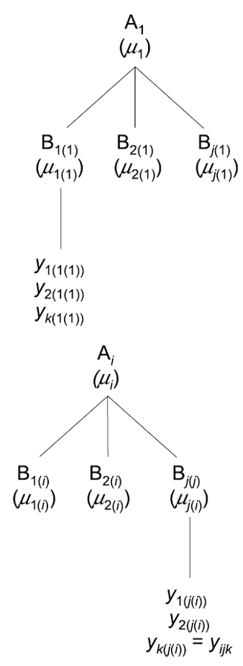
Nested Design: Linear Model Structure
Consider a nested design with:
p levels of factor A (i = 1…p) — e.g., 4 grazing levels
q levels of factor B (j = 1…q), nested within each level of A — e.g., 4 different patches per grazing level
n replicates (k = 1…n) in each combination of A and B — e.g., 5 replicate quadrats in each patch in each grazing level
Hierarchical tree diagram of the nested design structure: a top-level factor A_1 branching into several B levels nested within it, each branching further into individual replicate y observations, repeated for a general level A_i.

Slide 18
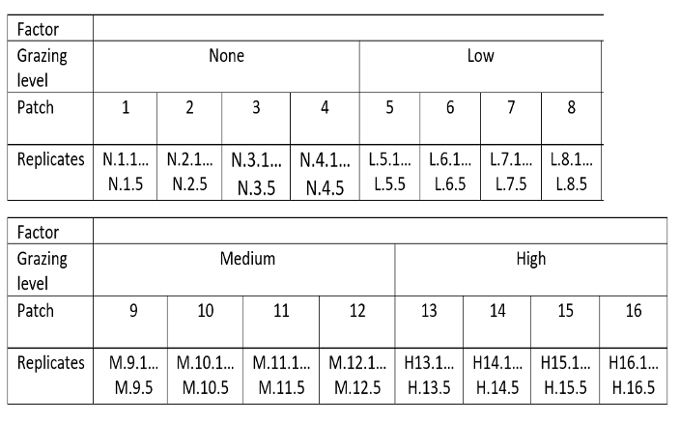
Calculating Means in a Nested Design
We can calculate several means:
Overall mean (across all levels of A and B) = $\overset{‾}{y}$
A mean for each level of A (across all levels of B in that A) = ${\overset{‾}{y}}_{i}$
A mean for each level of B within each A = ${\overset{‾}{y}}_{j(i)}$
Grazing-level-by-patch table (grazing level: None, Low, Medium, High, each with 4 patches numbered 1-16) with each patch cell listing 5 replicate quadrat IDs, the layout used to compute overall, A-level, and B-within-A means.

Slide 19
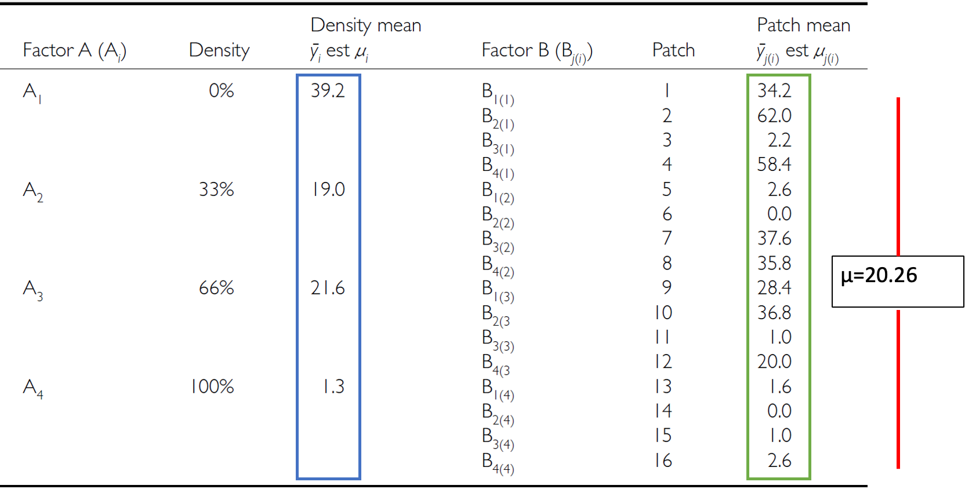
Nested Design Means, Visualized
Full worked data table for the sea urchin example: for each grazing level (A1-A4, 0-100%) the density mean is shown boxed in blue (e.g., 39.2 for 0%), and for each patch nested within it the patch mean is shown boxed in green, with the overall mean mu = 20.26 marked on the right by a red bar spanning all values.

Slide 20
The Nested Design Linear Model
$$y_{ijk}=μ+α_{i}+β_{j(i)}+ε_{ijk}$$
$y_{ijk}$ is the response variable — the value of the k-th replicate in the j-th level of B in the i-th level of A (e.g., algal biomass in the 3rd quadrat, in the 2nd patch, in the low-grazing treatment)
$μ$ is the overall mean (overall average algal biomass)
Tip
🖐 Notice
This looks almost identical to the two-way ANOVA model — the difference is entirely in the subscript: $β_{j(i)}$, not $β_{j}$. B only exists inside a specific A.

Slide 21
Fixed and Random Effects in the Nested Model
$$y_{ijk}=μ+α_{i}+β_{j(i)}+ε_{ijk}$$
$α_{i}$ is the fixed effect of factor A — the difference between the average biomass in all low-grazing-level quadrats and the overall mean
$β_{j(i)}$ is the random effect of factor B nested within factor A — usually a random variable measuring variance among all possible levels of B within each level of A (variance among all possible patches that could have been used in the low-grazing treatment)
Note
✅ Key idea
B being random is the whole point of nesting: you don’t care about these specific patches — you care about patch-to-patch variability in general.

Slide 22
The Error Term in the Nested Model
$$y_{ijk}=μ+α_{i}+β_{j(i)}+ε_{ijk}$$
$ε_{ijk}$ is the error term — the unexplained variance associated with the k-th replicate in the j-th level of B in the i-th level of A
$α_{i}$ is the effect of the i-th level of A: $μ_{i}−μ$
$ε_{ijk}$: the difference between the observed algal biomass in the 3rd quadrat in the 2nd patch in the low-grazing treatment, and the predicted biomass (the average biomass in that 2nd patch in the low-grazing treatment)
Tip
🖐 Notice
The residual is measured against the cell mean (this specific patch), not the treatment mean — that’s what makes it “nested,” arithmetically.

Slide 23
Part 5 · Partitioning Variance

Slide 24
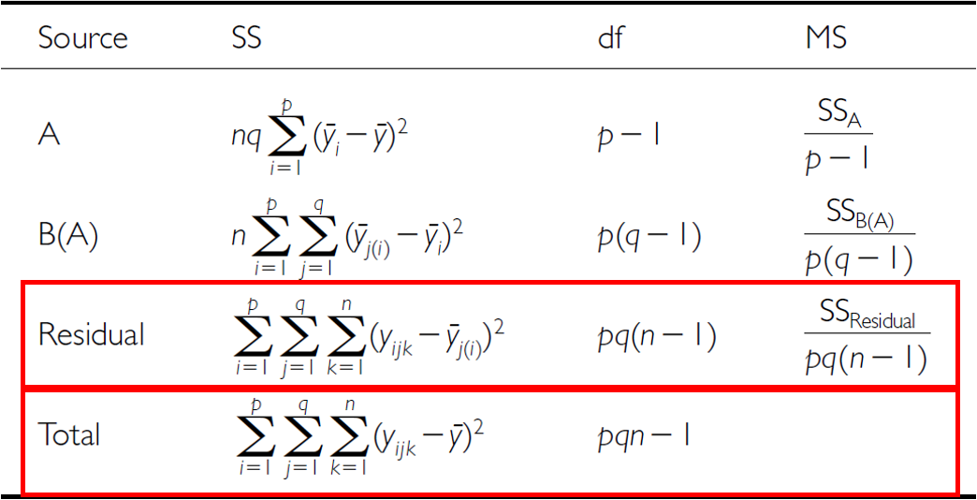
Analysis of Variance: Residual and Total
$SS_{resid}$ is the difference between each observation and the mean for its level of factor B, summed over all observations
$SS_{total}=SS_{A}+SS_{B}+SS_{resid}$
SS can be turned into MS by dividing by the appropriate df
Nested ANOVA table listing Source (A, B(A), Residual, Total), each with its sum-of-squares formula and degrees of freedom (p-1, p(q-1), pq(n-1), pqn-1), with the Residual and Total rows outlined in red to highlight how SS_residual is the deviation of each observation from its own B(A) cell mean.

Slide 25
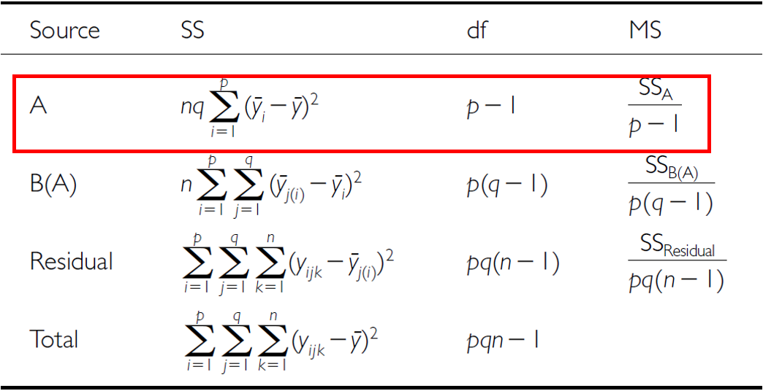
Analysis of Variance: SSA
As before, we partition the variance in the response variable using SS. $SS_{A}$ is the SS of differences between the mean in each level of A and the overall mean.
The same nested ANOVA table with the A row outlined in red, highlighting SS_A as the sum of squared deviations of each level-A mean from the overall mean.

Slide 26
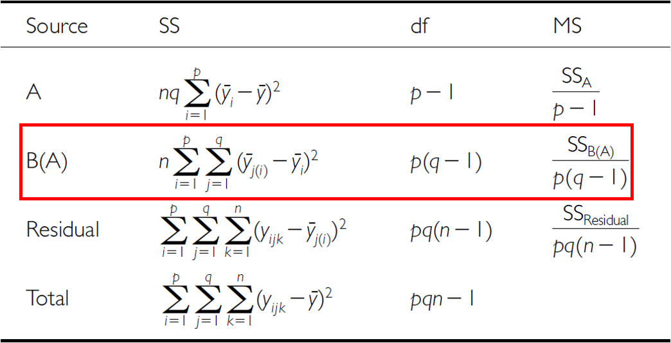
Analysis of Variance: SSB
$SS_{B}$ is the SS of the difference between the mean in each level of B and the mean of the corresponding level of A, summed across all levels of A.
The same nested ANOVA table with the B(A) row outlined in red, highlighting SS_B(A) as the sum of squared deviations of each level-B-within-A mean from its corresponding level-A mean.

Slide 27
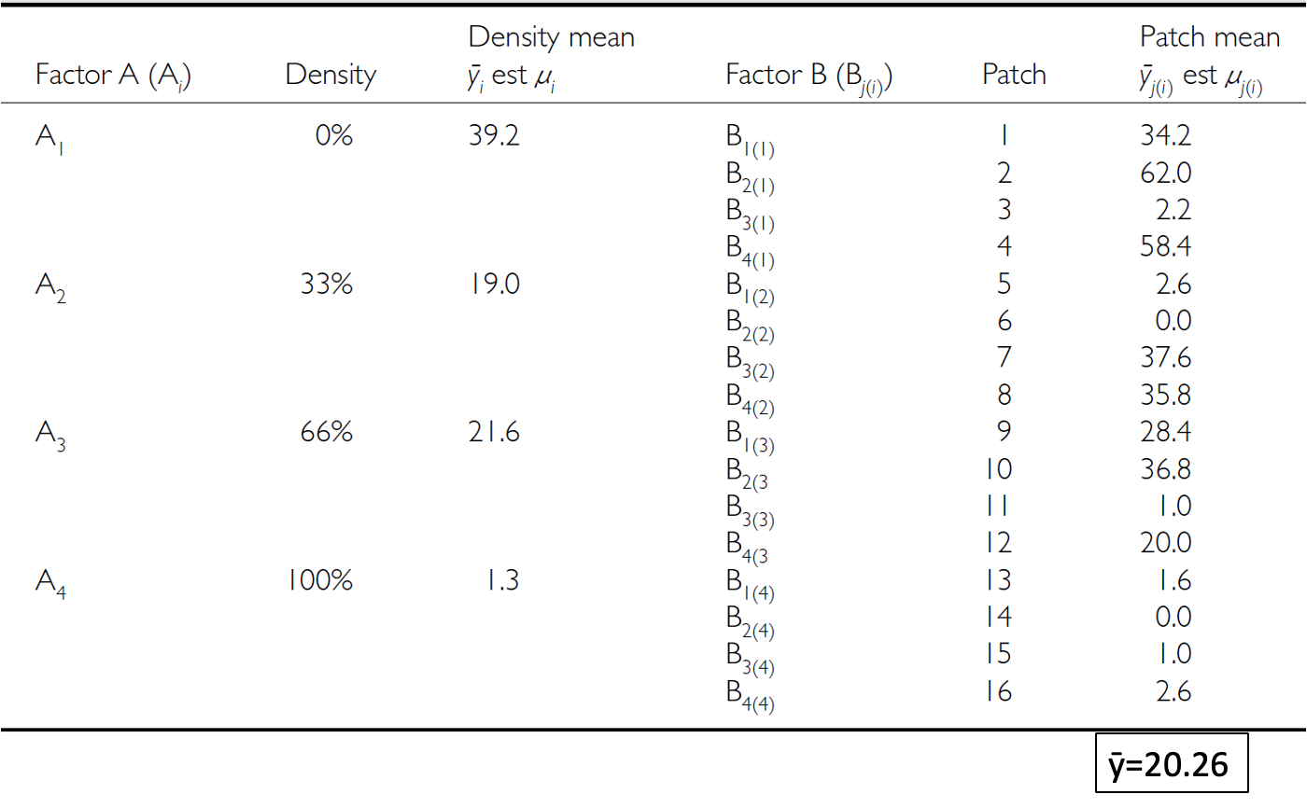
The Nested ANOVA Table
The full sea urchin data table repeated (density means per grazing level, patch means nested within each, overall mean y-bar = 20.26), shown here alongside the nested ANOVA table structure it feeds into.

Slide 28
Part 6 · Hypotheses and Assumptions

Slide 29
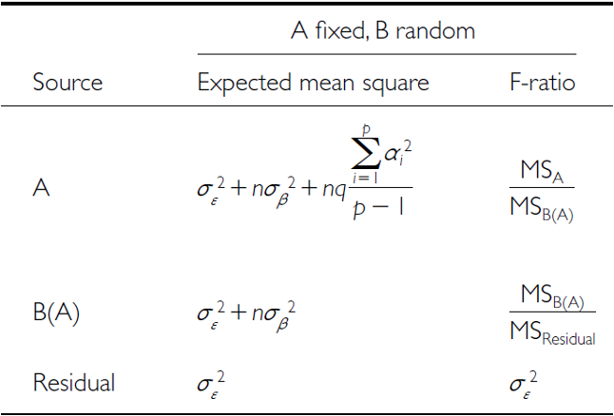
Null Hypotheses: Factor A
Two hypotheses are tested on values of MS. 1. No effects of factor A — assuming A is fixed:
$H_{0}(A)$: $μ_{1}=μ_{2}=...=μ_{i}=μ$
Same as in 1-factor ANOVA, using means from B factors nested within each level of A
(no difference in algal biomass across all grazing levels: $μ_{none}=μ_{low}=μ_{med}=μ_{high}$)
Table for the ‘A fixed, B random’ case listing the expected mean square and F-ratio formula for each source (A, B(A), Residual), showing that A is tested against MS_B(A) rather than MS_Residual because B is a random effect.

Slide 30
Null Hypotheses: Factor B
2. No effects of factor B nested in A — assuming B is random:
$H_{0}(B)$: $σ_{β}^{2}=0$ (no variance added due to differences between all possible levels of B)
(no variance added due to differences between patches)
Table for the ‘A fixed, B random’ case listing the expected mean square and F-ratio formula for each source (A, B(A), Residual), showing that A is tested against MS_B(A) rather than MS_Residual because B is a random effect.

Slide 31
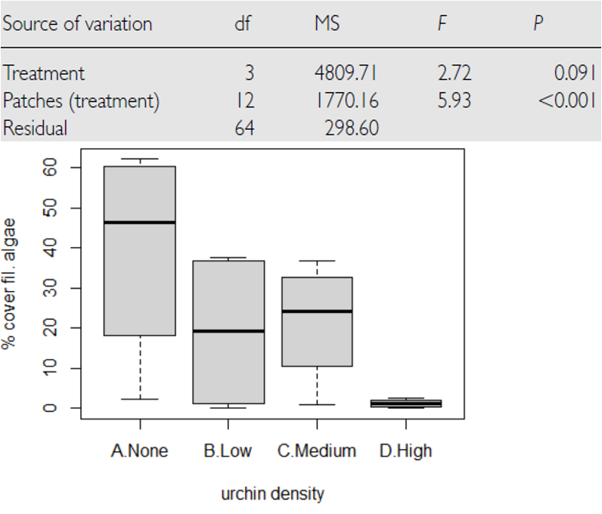
Conclusions from the Analysis
Conclusion:
“Significant variation between replicate patches within each treatment, but no significant difference in the amount of filamentous algae between treatments.”
Published nested ANOVA results table for the sea urchin study, showing Treatment not significant (F = 2.72, p = 0.091) but Patches(treatment) highly significant (F = 5.93, p < 0.001), with a boxplot below showing percent cover of filamentous algae declining from the None to High urchin-density treatments.

Slide 32
Unbalanced Nested Designs
Unequal sample sizes can arise from:
An uneven number of B levels within each A
An uneven number of replicates within each level of B
Not a problem unless you have unequal variance or a large deviation from normality.
The same grazing-level-by-patch layout table repeated, shown here in the context of unequal sample sizes in unbalanced nested designs.

Slide 33
Nested Design Assumptions
As usual, we assume: equal variance, normality, no outliers, independence of observations.
Equal variance + normality need to be assessed at both levels:
Since means for each level of B within each A are used for the H-test about A, need to assess whether those means meet normality and equal variance
Examine residuals for the H-test about B
Transformations can be used
Warning
⚠️ Watch out!
This is the part people most often get wrong: checking assumptions on the raw data isn’t enough for a nested design — you need to check them at the level each hypothesis test actually operates on.

Slide 34
Part 7 · The Sea Urchin Example — Data

Slide 35
The Nested Design, the Hard Way
This analysis examines the effects of varying sea urchin densities on the percentage cover of filamentous algae. The experiment was designed with:
Four random patches
Four urchin density treatments — 0% (urchins removed), 33%, 66%, and 100% of natural density (the unmanipulated control)
Five replicate quadrats measured within each treatment-patch combination
Note
📖 Reference
Quinn & Keough (2002), Experimental Design and Data Analysis for Biologists — this dataset and analysis follow their treatment of the sea urchin/algae example.

Slide 36
Data Overview
The data frame contains: patch (random patches 1–16 where treatments were applied), treat (urchin density treatment), quad (replicate quadrats within each treatment-patch combination), algae (percentage cover of filamentous algae — the response variable).
## Data
## # A tibble: 6 × 4
## treat patch quad algae
## <fct> <fct> <dbl> <dbl>
## 1 100% 1 1 0
## 2 100% 1 2 0
## 3 100% 1 3 0
## 4 100% 1 4 6
## 5 100% 1 5 2
## 6 100% 2 1 0
##
##
## Treatment levels:
## [1] "0%" "33%" "66%" "100%"
## Summary statistics by treatment:
## # A tibble: 4 × 7
## treat n mean sd se min max
## <fct> <int> <dbl> <dbl> <dbl> <dbl> <dbl>
## 1 0% 20 39.2 28.7 6.41 0 83
## 2 33% 20 19 25.7 5.74 0 71
## 3 66% 20 21.6 25.1 5.62 0 79
## 4 100% 20 1.3 3.18 0.711 0 13

Slide 37
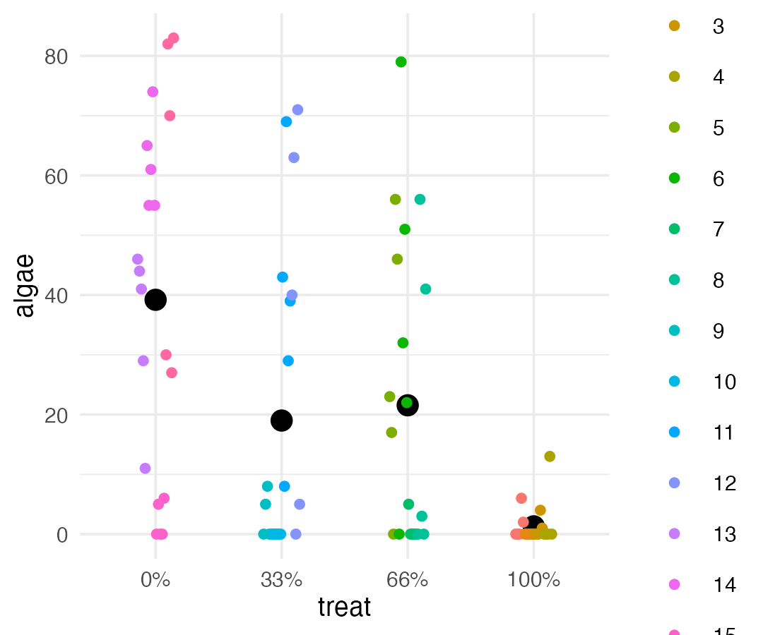
A First Look at the Data

Slide 38
Part 8 · The Wrong Way — Naive Factorial Model

Slide 39
Manual Nested ANOVA — Setting Up
In this experimental design, patch is nested within treat because each patch received only one treatment level — a hierarchical design where the effect of patches must be considered within each treatment (Quinn & Keough 2002).
We’ll use a traditional nested ANOVA. You could make this easy by averaging algae per patch and running a one-way ANOVA — but your power is significantly reduced, and you lose estimates of variability among patches.
This first attempt is really a regular factorial ANOVA — not appropriate, since it’s pseudoreplicated. Also, the F-value for Treat is using $MS_{resid}$ when it should use $MS_{treat:patch}$.
u_fact_model <- aov(algae ~ treat + treat:patch, data = u_df)
cat("Factorial model summary:\n\n")
## Factorial model summary:
summary(u_fact_model)
## Df Sum Sq Mean Sq F value Pr(>F)
## treat 3 14429 4810 16.108 0.0000000658 ***
## treat:patch 12 21242 1770 5.928 0.0000008323 ***
## Residuals 64 19110 299
## ---
## Signif. codes: 0 '***' 0.001 '**' 0.01 '*' 0.05 '.' 0.1 ' ' 1

Slide 40
Why the Factorial ANOVA Is Not Correct
We can correct this by specifying the error term
The MS needed for the F-value is really MS(patch nested in treatment), because those are the true replicates
We can specify that — the problem is this approach can’t really handle unbalanced designs
# Error(patch) -- not Error(treat:patch). Patch IDs are already unique
# (1-16) and each patch sits in exactly one treatment, so naming the patch
# alone is enough. Writing treat:patch asks for 4 x 16 = 64 combinations
# when only 16 exist, which makes R warn "Error() model is singular".
# Both give identical numbers; this one does it without the warning.
u_nested_model <- aov(algae ~ treat + Error(patch), data = u_df)
cat("Correctly specified nested ANOVA:\n\n")
## Correctly specified nested ANOVA:
summary(u_nested_model)
##
## Error: patch
## Df Sum Sq Mean Sq F value Pr(>F)
## treat 3 14429 4810 2.717 0.0913 .
## Residuals 12 21242 1770
## ---
## Signif. codes: 0 '***' 0.001 '**' 0.01 '*' 0.05 '.' 0.1 ' ' 1
##
## Error: Within
## Df Sum Sq Mean Sq F value Pr(>F)
## Residuals 64 19110 298.6

Slide 41
Same Numerator, Different Denominator
Both models used the same 80 quadrats and produced the same sums of squares. Only the F-test’s denominator changed:
Note
✅ How to find the right denominator
Ask: what did I randomly assign the treatment to?
That unit — patch here — supplies the error term. Everything measured inside it is a subsample, and subsamples tell you about measurement noise, not about treatment effects.
Tip
🖐 Notice MS(patch) is large
1770 vs 299 — patches genuinely differ from one another. That variability is real biology, and the nested model makes you pay for it. The naive model pretended it was not there.
 | MS treat | ÷ MS error | = F | p
Naive factorial | 4810 | ÷ 299 (quadrats) | 16.11 | 0.00000007
Nested | 4810 | ÷ 1770 (patches) | 2.72 | 0.091
Important
The p-value moved by six orders of magnitude.
The naive model tested the treatment against variation between quadrats within a patch — but quadrats are not what we assigned treatments to. Patches are.
There are 80 quadrats but only 16 patches, four per treatment. The honest test has 12 denominator degrees of freedom, not 64.

Slide 42
Where You Have Seen This Before
This is the pine needle problem again, one level up:
Warning
⚠️ The limit of aov(Error(...))
This syntax needs a (near-)balanced design. Ours is perfectly balanced — 4 patches per treatment, 5 quadrats per patch — so it works.
Real data usually is not. That is the problem mixed models solve, and it is where we go next.
Our pine study | This urchin study
8 needles per side | 5 quadrats per patch
within one tree | within one patch
4 trees are the replicates | 16 patches are the replicates
64 rows, n = 4 | 80 rows, n = 16
In Week 1 we solved it by averaging each tree to one number. That works, and it is honest.
A nested ANOVA does something better: it keeps every quadrat, estimates both levels of variability, and still tests the treatment against the right error term.
Note
✅ Key idea
Averaging throws the subsamples away. Nesting uses them — to estimate how noisy your measurements are — while still refusing to count them as replicates.

Slide 43
How Do I Know If My Design Is Nested?
Three questions, in order. Ask them of your own data before you fit anything.
1. What did I apply the treatment to? → Whole patches. Not quadrats.
2. Does every level of B appear under every level of A? → Patch 7 only ever received the 66% density. It cannot appear under 100%. → No ⇒ nested. (Yes ⇒ crossed/factorial.)
3. How many of those units do I have per treatment? → 4 patches, not 20 quadrats. That is your n.
Important
The answer to Q1 is your error term.
aov(algae ~ treat + Error(patch), data = u_df)
# ^^^^^^^^^^^^
# the thing treatments were assigned to
Tip
🖐 A quick tell
If two rows of your data share a value for the thing you randomized, they are not independent replicates of it.
Two quadrats in patch 3 share patch 3. Two needles on one tree share that tree.
Warning
⚠️ Nested factors are random
We are not asking “is patch 7 different from patch 12?” — those specific patches are of no interest. They are a sample of possible patches, so patch enters as a random effect.
The factor above it (treat) is fixed: those four densities are exactly the ones we care about.

Slide 44
Reporting a Nested ANOVA
Note
How to report this result
“Algal cover did not differ significantly among urchin density treatments (nested ANOVA, F₃,₁₂ = 2.72, p = 0.091), with patches treated as a random factor nested within treatment. Variation among patches within treatments was substantial, accounting for approximately 50% of the total variance (σ²_patch = 294, σ²_within = 299; n = 4 patches per treatment, 5 quadrats per patch).”
The three things people get wrong:
The degrees of freedom. It is F(3, 12) — the denominator df comes from the patch stratum, not the 64 on the “Within” line. Reporting F(3, 64) is reporting the wrong test.
Silence about the nesting. Say the word “nested” and name the random factor. A reader cannot tell from “F = 2.72” alone whether you did this correctly.
Throwing away the patch variance. It is a result, not a nuisance — here it is half the story.
# Variance components, straight from
# the two mean squares
MS_patch <- 1770.2 # Error: patch
MS_within <- 298.6 # Error: Within
n_quad <- 5 # quadrats per patch
var_patch <- (MS_patch - MS_within) / n_quad
var_within <- MS_within
cat("among patches:", round(var_patch, 1), "
")
## among patches: 294.3
cat("within patch: ", round(var_within, 1), "
")
## within patch: 298.6
cat("% among patches:",
round(100 * var_patch /
(var_patch + var_within), 1), "%
")
## % among patches: 49.6 %
Tip
🖐 Half the variance is between patches
Ignore that and you are pretending 80 quadrats are 80 independent observations. They are closer to 16.

Slide 45
Wrap-up
Today you:
Told a nested design from a crossed one, and learned the three questions that decide it
Found the right error term by asking what the treatment was applied to
Watched the same data give F = 16.11 (p < 0.0000001) the wrong way and F = 2.72 (p = 0.091) the right way
Estimated variance components, and found that half the variation lives between patches
Wrote it up with the correct degrees of freedom
Important
⚠️ The mistake this lecture exists to prevent
Using the residual mean square as your denominator when the treatment was applied to something coarser than a single measurement. It inflates F, shrinks p, and it is the most common error in ecological field experiments (Hurlbert 1984).
Note
✅ This has been the plan all along
Today it finally got its own name and its own model. Sums of squares were never the problem — the denominator was.
Tip
🖐 Before next class
Take a dataset you actually care about — yours, or one from a paper — and answer the three questions on the first slide of this section. Write down what your true n is. If it is smaller than the number of rows, you have found a nested design.

Slide 46
Getting unstuck
When code breaks — and it will, that is normal:
Read the error message out loud; it usually names the line
Check the usual suspects: are patch and treat factors? Are your nested unit IDs unique across the whole dataset (patch 1–16), or do they restart within each treatment (1–4, 1–4, …)? If they restart, R cannot tell nesting from crossing — renumber them, or write Error(treat:patch)
Seeing “Error() model is singular”? You asked for more error-term combinations than your design contains — usually Error(a:b) where Error(b) is enough
Bring the exact error (copy-paste it) to class or office hours
Note
✅ Key idea
Every working scientist googles error messages daily. Getting stuck is not failing — it is the job.

