Slide 1
Module 1 — Getting Started
Asking a question, meeting R, and making your first graph Bill Perry

Slide 2
Welcome to Biostatistics
This course teaches the whole pipeline: raw data → clean → summarize → visualize → test → report
You do not need prior coding experience — everyone starts exactly here
The only way to learn this is to type the code yourself and break it
Important
Getting stuck is not failing — it is the job. Every working scientist reads error messages and searches for answers every day.
Note
Today’s roadmap
Asking a good question
Organizing a project
Meeting R and Positron
Loading data and your first plot

Slide 3
Part 1 · Asking a Good Question
What makes something science?

Slide 4
Science makes predictions and tests them with a falsifiable approach — statistics
A claim that could never be shown wrong is not testable, and not science
Example:
“Needles on the sheltered side of a tree are longer” — testable ✅
“The forest decides needle length” — not testable ❌
Note
📖 New word
Falsifiable = a prediction that could, in principle, be proven wrong. A good hypothesis is one you could disprove.

Slide 5
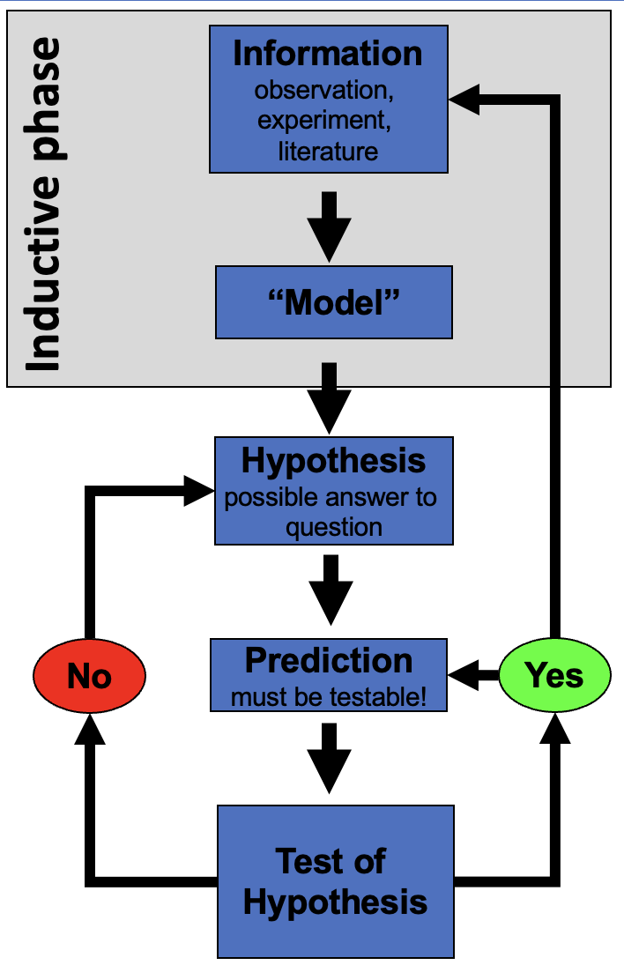
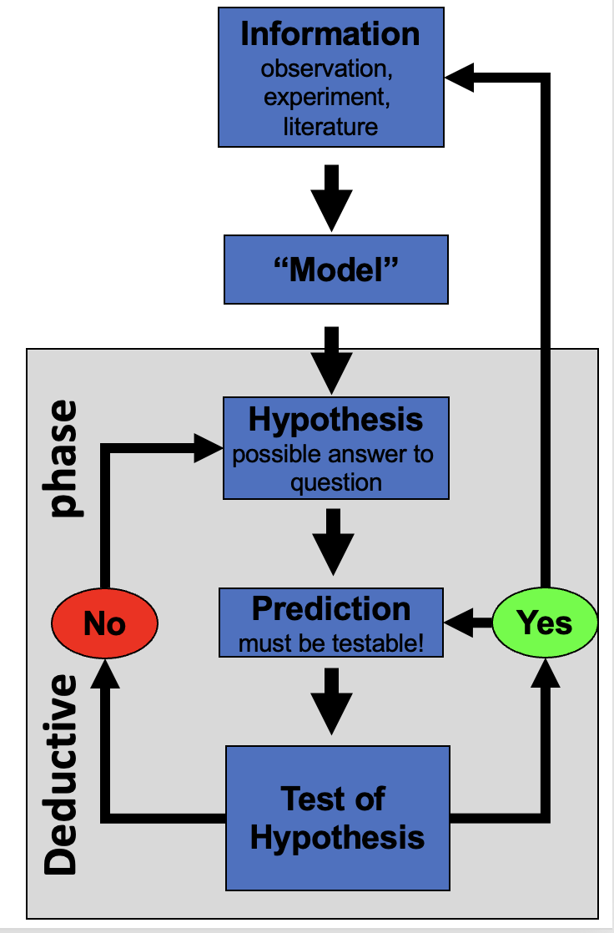
Two ways of reasoning toward that question
Inductive (specific → general)
Deductive (general → specific)
You measure needles on a few trees, notice a pattern, and generalize: “needle length seems to vary with side of tree.”
Note
Weakness: the pattern held in your sample — it is not guaranteed to hold everywhere.
You start from a general rule — “exposure affects needle length” — and predict what a new tree should show, then check.
Note
Weakness: only as strong as the general rule you started from.

Slide 6
Tip
In practice we do both, back and forth — notice a pattern (induction), propose a rule, then test it on new data (deduction).

Slide 7
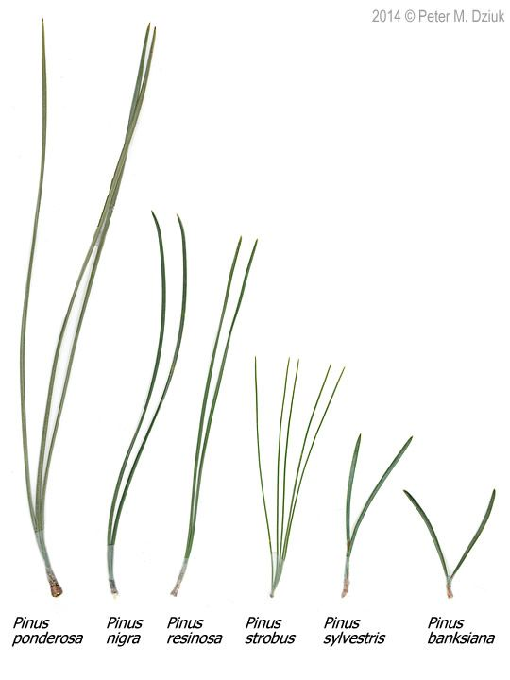
Our class question
Pine needles on the north/sheltered (lee) side of a tree vs. the south/exposed (windward) side:
H₀ (null): No difference in needle length between the two sides.
Hₐ (alternate): Needle length differs between the two sides.
Note
📖 New words
H₀ — the “nothing is happening” claim
Hₐ — the claim we suspect might be true
Note: Hₐ does not say which side is longer — that would be a prediction, a stronger, riskier claim

Slide 8
Designing a defensible sample
Can we test this with needles from one tree? No — that tree could just happen to have short needles. Treating many needles from one tree as if they were independent replicates is called pseudoreplication (Hurlbert 1984).
The tree — not the needle — is the unit of replication. We need needles from many trees, sampled the same way each time.
Randomize which trees and branches you sample, so your own bias doesn’t sneak into the data.
Important
Dependent vs. independent variable
Independent (X): side of tree — what we group by
Dependent (Y): needle length — what we measure
Tip
🖐 Today in the field
Each group collects needles from the lee side and the windward side of the same trees, using one agreed-on method — same height, same “mature needle” definition, same spot on the branch.

Slide 9
Part 2 · Organizing Your Project
Data is the raw material — treat it that way

Slide 10
Decide your variable names and units before you collect anything — this is a controlled vocabulary
Example: length_mm, not Length (mm) — no spaces, no units hidden in the header text, all lowercase
Plan where data goes the moment you collect it — do not let it pile up in email or texts
Note
✅ Key idea
A few minutes of naming discipline today saves hours of confusion in Module 2, when we clean messy data.
Tip
Controlled vocabulary example

Slide 11
One folder per project
pine_project/ ├── data/ ← raw files, never overwritten ├── scripts/ ← your .R code └── figures/ ← plots you save
Open this folder as your workspace in Positron (File → Open Folder…)
Every file path then becomes relative — no more C:/Users/.../Desktop/final_FINAL2.xlsx
Note
✅ Key idea
Keep raw data untouched. R writes new, processed files — so you can always trace your steps back to the original numbers.
Note
📖 New word
Metadata = data about your data: who collected it, when, how, with what instrument. Without it, data are nearly useless — even to future-you.

Slide 12
Tip
🖐 Preview
Tidy data — one row per observation, one column per variable — is the target we’re organizing toward. We’ll formalize this in Module 2.

Slide 13
Part 3 · Meet R and Positron
R is the engine, Positron is the dashboard

Slide 14
R — a free language for data and statistics
Positron — the editor (IDE) you drive it through
Four panes you’ll use constantly:
Note
📖 New word
IDE = Integrated Development Environment. R is the car engine; Positron is the seat, wheel, and dashboard.
Pane | Where | What it does
Editor | top-left | your scripts live here
Console | bottom | where code actually runs
Environment | right | everything you’ve stored
Plots / Files | right | figures and project files

Slide 15
R as a calculator, and storing values
Type math into the console and press Enter. To keep a value, give it a name with the assignment operator <-:
3 + 5 12 / 7 2 ^ 10 x <- 7 # store 7 under the name x x # read it back x * 2 # use it in math
Warning
⚠️ Watch out!
R is case-sensitive: x and X are different objects. Use <-, not =, to assign.
Note
📖 New word
Object = a named container holding a value. Look for it appear in the Environment pane the moment you create it.

Slide 16
Names, comments, and functions
Use lower_snake_case: needle_length, not x2 or NeedleLength
Anything after # is a comment — a note for humans, ignored by R
A function takes arguments in () and returns a result. Stuck? Ask for help with ?mean
# average of four needle lengths, in mm needle_length <- c(20, 21, 23, 25) mean(needle_length) # a function call ?mean args(mean)
Tip
🖐 Try it yourself
Predict what round(3.14159, 2) returns before you run it.
Note
📖 New words
Comment — ignored by R, read by humans
Argument — an input handed to a function
Function — a named, reusable operation

Slide 17
Vectors, data types, and scripts
A vector is a row of values made with c() — a spreadsheet column is really just a vector:
length_mm <- c(20, 21, 23, 25) # numeric side <- c("n", "s") # character — needs quotes
The console forgets. A script (.R file) remembers:
File → New File → R File, save it, run lines with Ctrl/Cmd+Enter
Warning
⚠️ Watch out!
Without quotes, s means “find an object called s,” not the text “s.” R will error if no such object exists.
Note
✅ Key idea
Console = scratch paper. Script = the lab notebook you keep and rerun.

Slide 18
Packages — extending what R can do
Install once, in the console. Load every session, at the top of every script:
install.packages("tidyverse") library(tidyverse) # wrangling + ggplot2
Warning
⚠️ Watch out!
“could not find function…” almost always means you forgot the library() line for that session.
Note
📖 New words
Package — the installed toolbox (once)
Library — loading it for today’s session (every time)

Slide 19
Part 4 · Load Data and Make Your First Plot
Bring the data in

Slide 20
Put the file in data/, then:
library(tidyverse) pine_df <- read_csv("data/pine_needles.csv")
Note
✅ Key idea
read_csv() comes free with library(tidyverse). Your file’s first row becomes the column names in R.
Note
Our columns
n_s — "n" (sheltered/lee) or "s" (exposed/windward)
wind — "lee" or "wind", same grouping said a different way
length_mm — needle length in millimeters

Slide 21
Look before you trust it
glimpse(pine_df)
Rows: 48 Columns: 6 $ date <chr> "3/20/25", "3/20/25", "3/20/25", "3/20/25", "3/20/25", "3/20… $ group <chr> "cephalopods", "cephalopods", "cephalopods", "cephalopods", … $ n_s <chr> "n", "n", "n", "n", "n", "n", "s", "s", "s", "s", "s", "s", … $ wind <chr> "lee", "lee", "lee", "lee", "lee", "lee", "wind", "wind", "w… $ tree_no <dbl> 1, 1, 1, 1, 1, 1, 1, 1, 1, 1, 1, 1, 2, 2, 2, 2, 2, 2, 2, 2, … $ length_mm <dbl> 20, 21, 23, 25, 21, 16, 15, 16, 14, 17, 13, 15, 19, 18, 20, …
dim(pine_df)
[1] 48 6
Tip
🖐 Notice
n_s and wind always travel together — n with lee, s with wind. Two columns encoding the same grouping. Useful redundancy, or something to simplify? We’ll revisit this in Module 2.
Warning
⚠️ Watch out!
If a number column shows as <chr> in glimpse(), a stray letter or comma is hiding in that column.

Slide 22
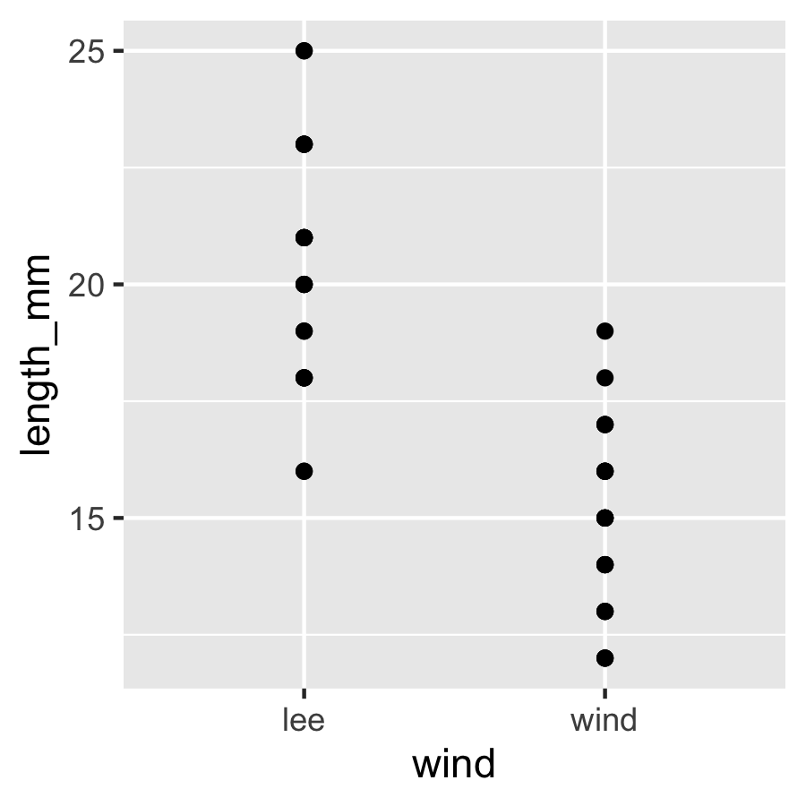
Your first plot: ggplot, built in layers
Every ggplot needs three things, joined with +:
data — which data frame
aes() — which columns map to x and y
geom — how to draw it
ggplot(pine_df, aes(x = wind, y = length_mm)) + geom_point()
Note
✅ Key idea
Seeing your data is the single most important habit in this course — before you summarize or test anything, plot it.
Warning
⚠️ Watch out!
+ sits at the end of a line, never the start.

Slide 23
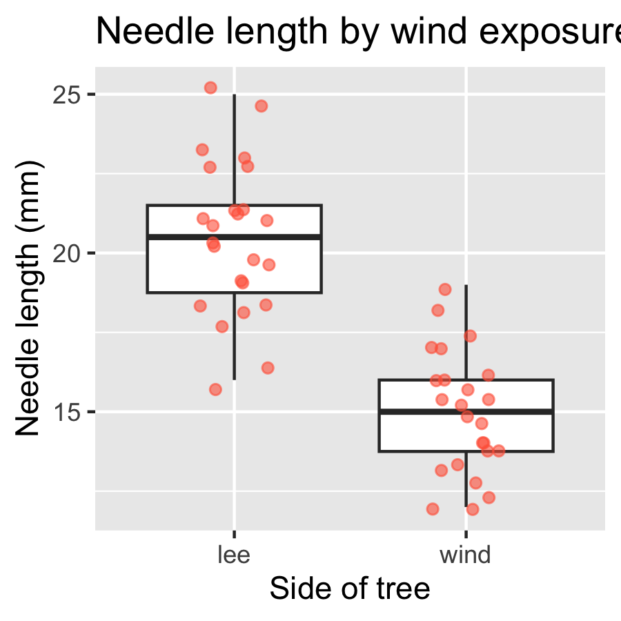
One layer at a time
ggplot(pine_df, aes(x = wind, y = length_mm)) + geom_boxplot() + geom_jitter(width = 0.15, alpha = 0.6, color = "tomato") + labs(x = "Side of tree", y = "Needle length (mm)", title = "Needle length by wind exposure")
Note
✅ Key idea
A boxplot shows the summary; the jittered points show every real value underneath it. Show both when you can.
Tip
🖐 Try it yourself
Swap wind for group. What does that plot tell you instead?

Slide 24
Save your plot
needle_plot <- ggplot(pine_df, aes(x = wind, y = length_mm)) + geom_boxplot() + geom_jitter(width = 0.15, alpha = 0.6, color = "tomato") + labs(x = "Side of tree", y = "Needle length (mm)") ggsave("figures/needle_length.png", plot = needle_plot, width = 3, height = 3, units = "in", dpi = 300)
Warning
⚠️ Watch out!
ggsave() wants the filename first, then plot =. Always use dpi = 300 — print/poster quality.
Note
📖 File format tip
Save figures as PNG for reports and submissions.

Slide 25
Wrap-up
Today you:
Turned a question into a testable H₀ / Hₐ
Organized a project folder with data/scripts/figures
Ran your first R code — objects, functions, vectors, packages
Loaded real data and made — and saved — your first ggplot
Tip
🖐 Before next class
Finish the worksheet: load pine_needles.csv, run glimpse(), and make one more plot — length_mm by n_s this time. Save it to figures/.
Note
Up next — Module 2
filter(), select(), mutate(), arrange()
Cleaning a genuinely messy version of this dataset
The pipe |> and building a pipeline

Slide 26
Getting unstuck
When code breaks — and it will, that is normal:
Read the error message out loud; it usually names the line
Check the usual suspects: library(tidyverse) loaded? Spelling? A missing ) or + at the start of a line?
?function_name opens the help page
Bring the exact error (copy-paste it) to class or office hours
Note
✅ Key idea
Every working scientist googles error messages daily. Getting stuck is not failing — it is the job.

