Slide 1
Module 4 — Graphing Effectively
Boxplots, group comparisons, and saving a publication-ready figure Bill Perry

Slide 2
Where We Left Off
Last time you:
Computed mean, median, SD, and SE — by hand and with summarize()
Fixed the length() trap with sum(!is.na())
Got tidy per-group tables with group_by() + summarize()
Note
✅ Key idea from Module 3
You now have real numbers describing lee vs. windward needles. Today we make those numbers visible — and save the result properly.
Note
Today’s roadmap
The ggplot grammar, recapped
Boxplots done right — with raw points
Plotting mean ± SE directly
Faceting and a quick theme tour
ggsave(), for real this time

Slide 3
Part 1 · The ggplot Grammar, Recapped
Every ggplot is three pieces joined with +:
data — which data frame
aes() — which columns map to x, y, color, fill…
geom — how to draw it
library(tidyverse) pine_df <- read_csv("data/pine_needles.csv")
Note
✅ Key idea
Everything today is the same three pieces — we’re just adding more layers and more polish on top of them.
Tip
🖐 Recap from Module 1
ggplot(pine_df, aes(x = n_s, y = length_mm)) + geom_point()

Slide 4
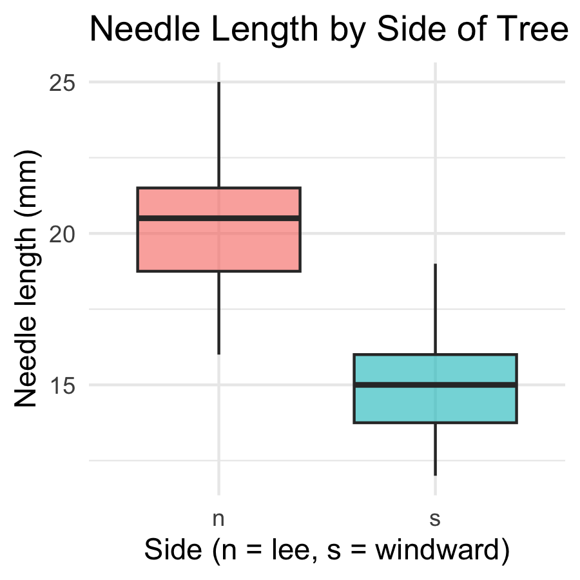
Part 2 · Boxplot Anatomy
pine_box_plot <- ggplot(pine_df, aes(x = n_s, y = length_mm, fill = n_s)) + geom_boxplot(alpha = 0.6, outlier.shape = NA) + labs( title = "Needle Length by Side of Tree", x = "Side (n = lee, s = windward)", y = "Needle length (mm)", fill = "Side" ) + theme_minimal() + theme(legend.position = "none") pine_box_plot
Boxplot anatomy:
Middle line = median
Box edges = 25th and 75th percentile (IQR)
Whiskers = 1.5 × IQR
Dots beyond whiskers = outliers
📖 R4DS §9 — Layers

Slide 5
Boxplot + Raw Points
Note
🔮 Predict first: With only 6 needles per side per tree, does a boxplot alone show you everything? What might it hide?

Slide 6
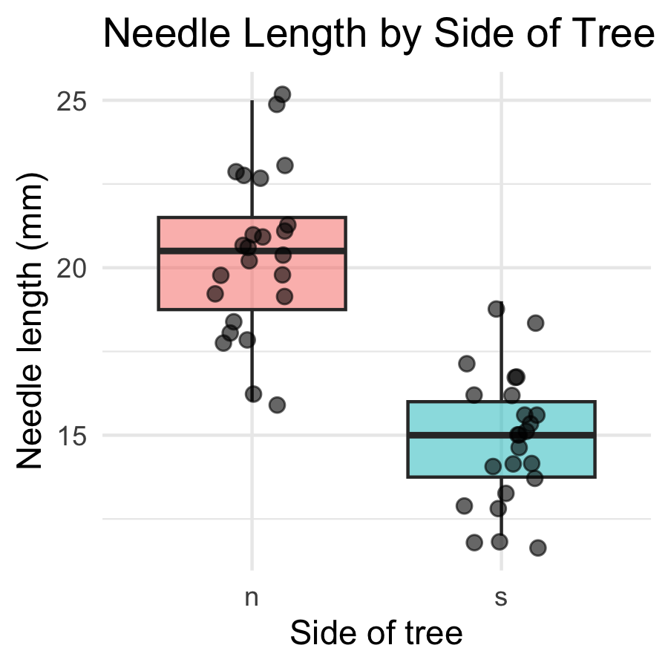
pine_jitter_plot <- ggplot(pine_df, aes(x = n_s, y = length_mm, fill = n_s)) + geom_boxplot(alpha = 0.5, outlier.shape = NA) + geom_point( position = position_jitter(width = 0.15, seed = 42), alpha = 0.6, size = 2 ) + labs( title = "Needle Length by Side of Tree", x = "Side of tree", y = "Needle length (mm)", fill = "Side" ) + theme_minimal() + theme(legend.position = "none") pine_jitter_plot
position_jitter(width = 0.15) spreads points sideways so they don’t overlap
seed = 42 — same jitter layout every time you render
alpha = 0.6 — semi-transparent, so overlapping points are still visible
Tip
Always show the raw points alongside a boxplot when n is small — every point matters, and a box alone can hide a bimodal or lopsided pattern.

Slide 7
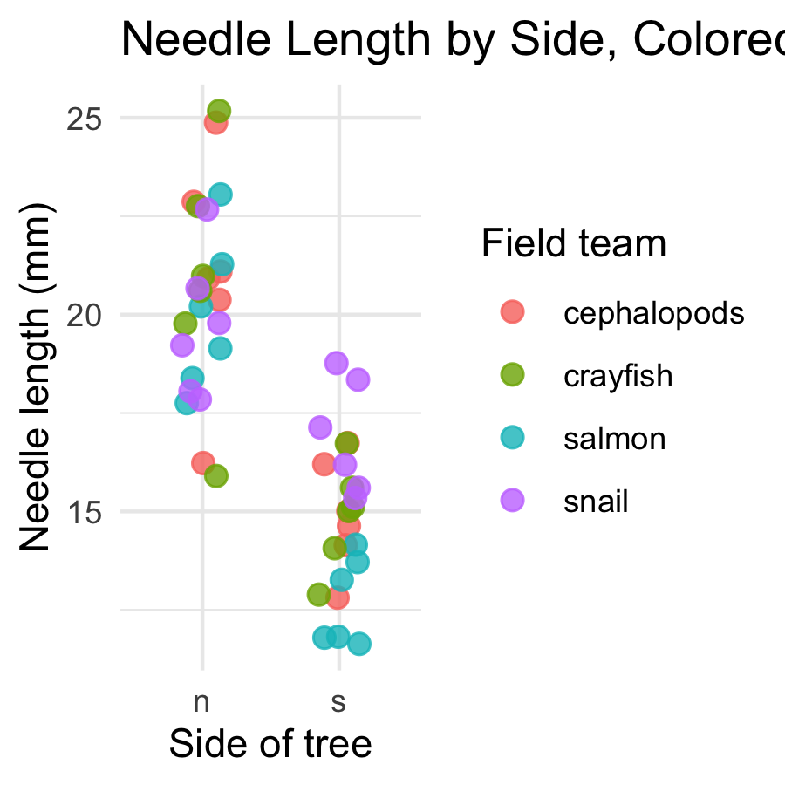
Part 3 · Mapping Color by Group
pine_team_plot <- ggplot(pine_df, aes(x = n_s, y = length_mm, color = group)) + geom_point( position = position_jitter(width = 0.15, seed = 42), size = 2.5, alpha = 0.8 ) + labs( title = "Needle Length by Side, Colored by Team", x = "Side of tree", y = "Needle length (mm)", color = "Field team" ) + theme_minimal() pine_team_plot
color = group maps a third variable onto the plot — no new geom needed
ggplot auto-builds the legend and picks colors for you
Mapping inside aes() always means “vary this by data” — not “make everything this color”
Warning
⚠️ Watch out!
color = "steelblue" outside aes() sets one fixed color. color = group inside aes() maps colors to a variable. Mixing these up is one of the most common ggplot mistakes.

Slide 8
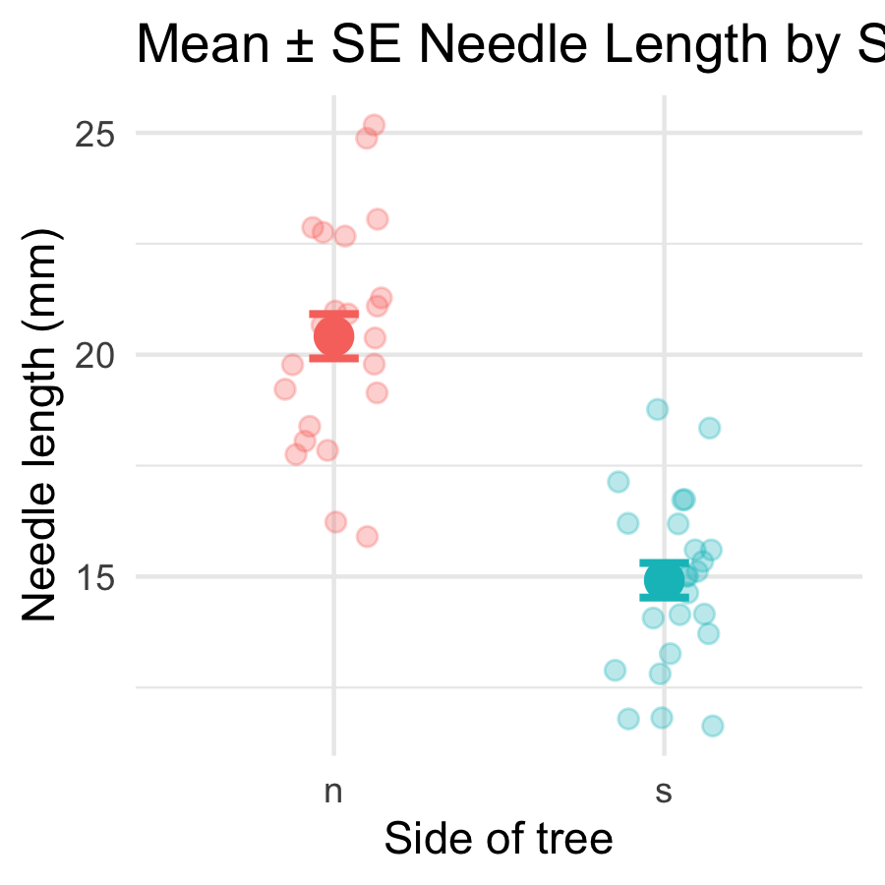
Part 4 · Mean ± SE — Plotted Directly
pine_mean_se_plot <- ggplot(pine_df, aes(x = n_s, y = length_mm, color = n_s)) + geom_point( position = position_jitter(width = 0.15, seed = 42), alpha = 0.3, size = 2 ) + stat_summary(fun = mean, geom = "point", size = 4) + stat_summary( fun.data = mean_se, geom = "errorbar", width = 0.15, linewidth = 0.9 ) + labs( title = "Mean ± SE Needle Length by Side", x = "Side of tree", y = "Needle length (mm)" ) + theme_minimal() + theme(legend.position = "none") pine_mean_se_plot
Two stat_summary() layers:
call | draws
fun = mean | one large point at the mean
fun.data = mean_se | error bars for ± 1 SE
stat_summary() computes the mean and SE for you, straight from the raw data — no summarize() step required first.
Note
✅ Key idea
This is the exact same mean and SE you calculated by hand in Module 3 — now you can see them.

Slide 9
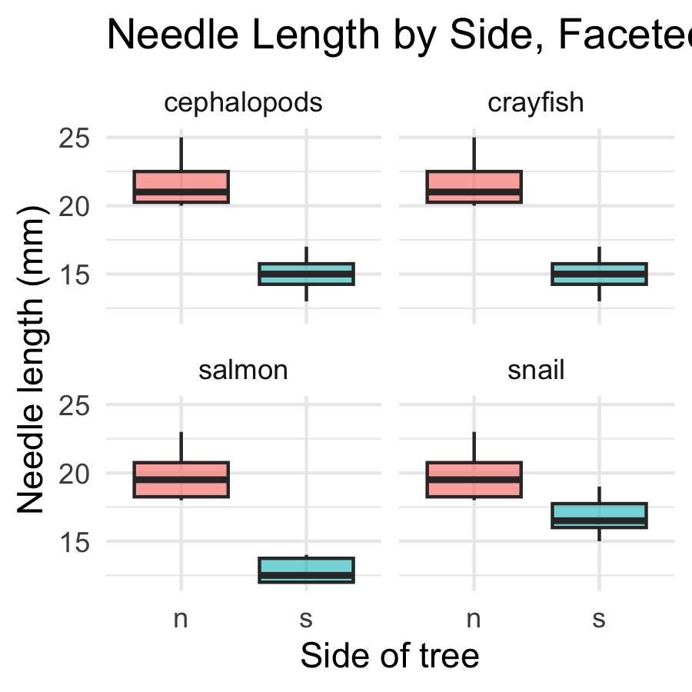
Part 5 · Faceting — One Panel Per Group
pine_facet_plot <- ggplot(pine_df, aes(x = n_s, y = length_mm, fill = n_s)) + geom_boxplot(alpha = 0.6, outlier.shape = NA) + facet_wrap(~group) + labs( title = "Needle Length by Side, Faceted by Team", x = "Side of tree", y = "Needle length (mm)" ) + theme_minimal() + theme(legend.position = "none") pine_facet_plot
facet_wrap(~group) gives each field team its own small panel
Same x/y scale across panels — easy to compare
Useful the moment “does every group show the same pattern?” is the real question
Tip
🖐 Notice
A faceted plot answers a different question than a single colored plot: not just “is there an overall pattern,” but “does the pattern hold for everyone?”

Slide 10
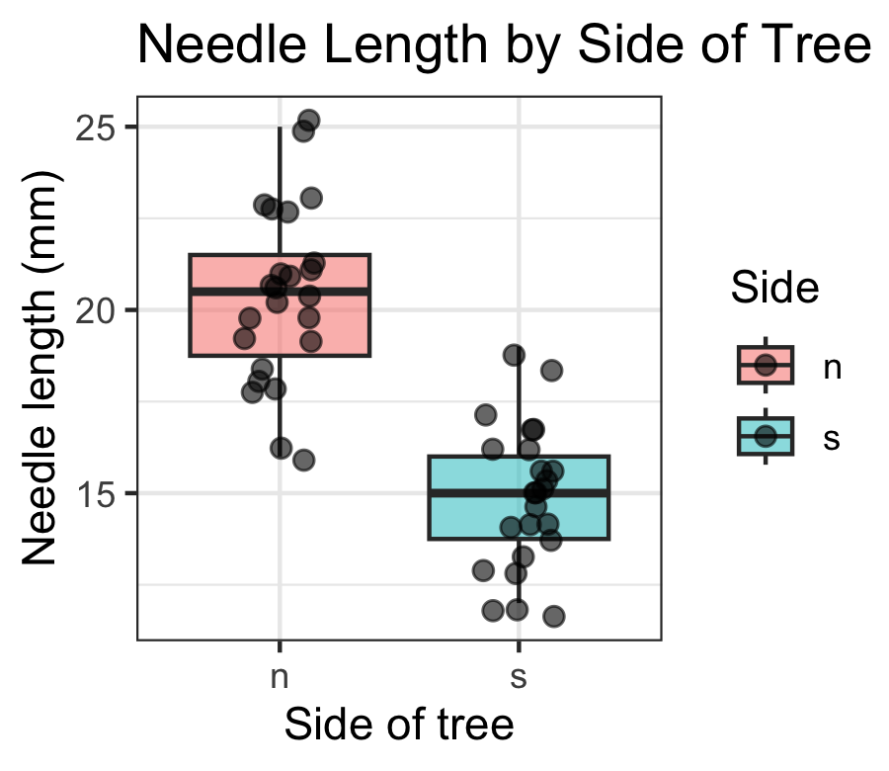
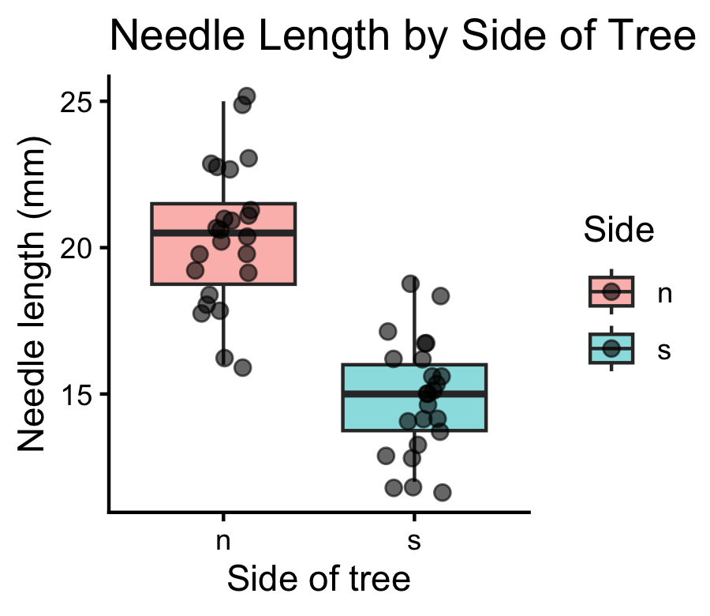
Part 6 · A Quick Theme Tour
pine_jitter_plot + theme_bw()
theme_minimal() — light, few gridlines (what we’ve used so far)
theme_bw() — white background, black-and-white frame
theme_classic() — just x/y axis lines, no gridlines at all
Note
✅ Key idea
A theme changes appearance only — never the data or the statistics underneath. Pick one and use it consistently across a report.
pine_jitter_plot + theme_classic()

Slide 11
Part 7 · Saving a Real Figure
ggsave( "figures/pine_needle_boxplot.png", plot = pine_jitter_plot, width = 3, height = 3, units = "in", dpi = 300 )
Warning
⚠️ Watch out!
ggsave() wants the filename first, then plot =. If you skip plot =, it saves whatever plot was drawn last — not necessarily the one you meant.
Note
✅ Key idea
Always set width, height, units, and dpi explicitly. Letting ggsave() guess gives you a plot sized for your screen, not for a report or a poster.

Slide 12
Wrap-up
Today you:
Built boxplots with raw points overlaid, not hidden
Mapped a third variable with color = / fill = inside aes()
Plotted mean ± SE directly with stat_summary() — no separate summary table needed
Faceted a plot with facet_wrap() to check every group at once
Compared themes, and saved a real, correctly-sized figure with ggsave()
Tip
🖐 Before next class
Finish the worksheet: build a mean ± SE plot faceted by group, pick a theme, and save it to figures/ at 3×3in, 300 dpi.
Note
Where this leads
You can now import, wrangle, describe, and visualize a dataset end to end. That full pipeline — raw data → clean → summarize → visualize — is the foundation every later statistical test builds on.

Slide 13
Getting unstuck
When code breaks — and it will, that is normal:
Read the error message out loud; it usually names the line
Check the usual suspects: library(tidyverse) loaded? Is color/fill inside aes() when it should be?
?function_name opens the help page
Bring the exact error (copy-paste it) to class or office hours
Note
✅ Key idea
Every working scientist googles error messages daily. Getting stuck is not failing — it is the job.

