Slide 1
Lecture 07
Bill Perry

Slide 2

Lecture 6 - A Brief review
Hypotheses
1- and 2-sided T tests
Assumptions of parametric tests

Slide 3

Lecture 7 overview
What we will cover today:
What are the assumptions again and how do you assess them
What to do when assumptions fail
Robust tests
Rank-based tests
Permutation tests
Lets work with the Lake Trout data as the weights are pretty cool and the assumptions may or may not hold
This is easily translated into any of the other dataframes you might want to use
lake trout

Slide 4
# Install packages if needed (uncomment if necessary) # install.packages("readr") # install.packages("tidyverse") # install.packages("car") # install.packages("here") # Load libraries library(car) # For diagnostic tests library(patchwork) library(tidyverse) # For data manipulation and visualization
# the stuff above controls the output and is also set at the top so dont need here # Load the pine needle data # Use here() function to specify the path lt_df <- read_csv("data/lake_trout.csv") # Examine the first few rows head(df)
1 function (x, df1, df2, ncp, log = FALSE) 2 { 3 if (missing(ncp)) 4 .Call(C_df, x, df1, df2, log) 5 else .Call(C_dnf, x, df1, df2, ncp, log) 6 }

Slide 5
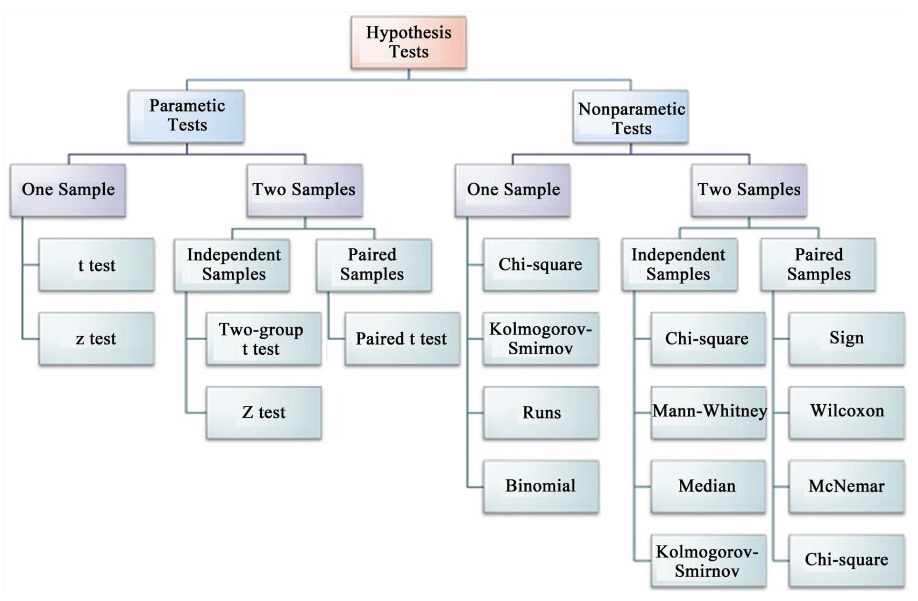
Parametric versus non-parametric tests
T-tests are parametric tests
Parametric tests:
specify/assume probability distribution from which parameters came
Basic assumptions of parametric t-tests:
Random sampling
Normality
Equal variance
No outliers
Non-parametric tests: no assumption about probability distribution
Mukasa et al 2021 DOI: 10.4236/ojbm.2021.93081

Slide 6
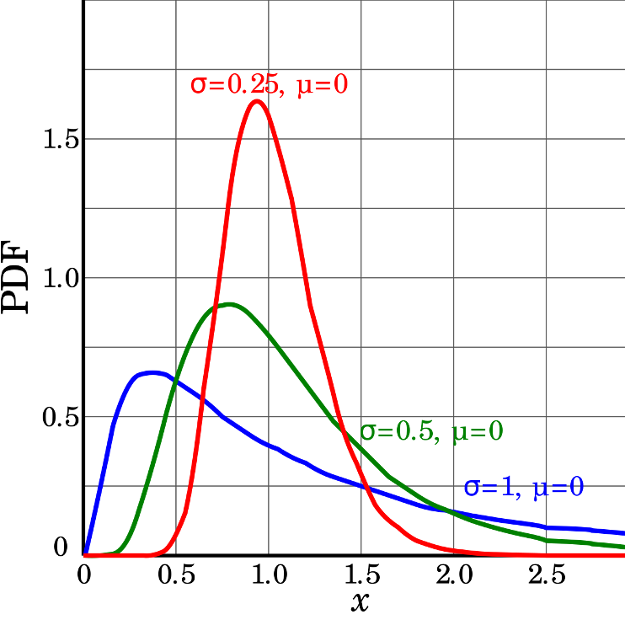
Assumptions of parametric tests
If assumptions of parametric test violated, test becomes unreliable
This is because test statistic may no longer follow distribution
Most parametric tests robust to mild/moderate violations of below assumptions

Slide 7
Assumptions of parametric tests
Basic assumptions of parametric t-tests:
Random sampling
Normality
Equal variance
No outliers
Random sampling:
samples are randomly collected from populations; part of experimental design
Necessary for sample -> population inference
<>

Slide 8
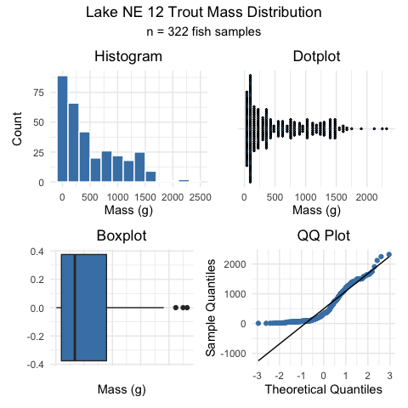
Assumptions of parametric tests
Basic assumptions of parametric t-tests:
Normality
equal variance
random sampling
no outliers
Lets do the above for one lake - NE 12 as if we were going to do a one sample T Test
we need to make a new dataframae with NE 12 data only called ne12_data
how do you do this?
Normality: Samples from normally distributed population
Graphical tests: histograms, dotplots, boxplots, qq-plots
“Formal” tests: Shapiro-Wilk test - sometimes not useful

Slide 9
Assumptions of parametric tests
Basic assumptions of parametric t-tests:
Normality
equal variance
random sampling
no outliers
Lets do the above for one lake - NE 12 as if we were going to do a one sample T Test
we need to make a new dataframae with NE 12 data only called ne12_data
how do you do this?
Normality: Samples from normally distributed population
Graphical tests: histograms, dotplots, boxplots, qq-plots
“Formal” tests: Shapiro-Wilk test - sometimes not useful
“Null hypothesis is that data is normally distributed”
[1] "Null hypothesis is that data is normally distributed"
Shapiro-Wilk normality test data: ne12_data$length_mm W = 0.94528, p-value = 1.56e-09

Slide 10
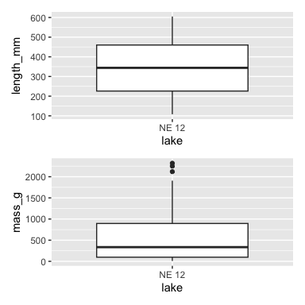
Assumptions of parametric tests
Basic assumptions of parametric t-tests:
Normality
equal variance
random sampling
no outliers
Equal variance: samples are from populations with similar degree of variability
Graphical tests: boxplots
“Formal” tests: F-ratio test
When samples sizes equal
Parametric tests most robust to violations of normality
Less so for equal variation assumptions

Slide 11
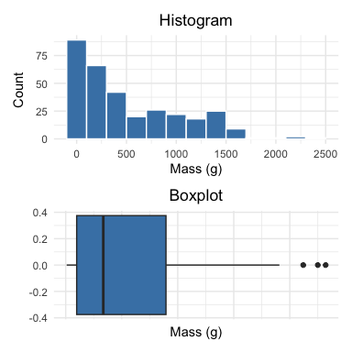
Assumptions of parametric tests
Basic assumptions of parametric t-tests: - Normality
- equal variance - random sampling - no outliers
No outliers: no “extreme” values that are very different from rest of sample
Graphical tests: boxplots, histograms
“Formal tests”: Grubb’s test - no one really does this
Note: outliers a problem for non-parametric tests as well

Slide 12
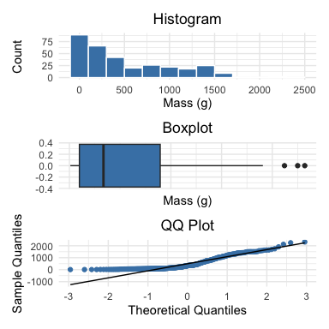
Nonparametric test
What if T Test assumptions fail?
Alternative tests, with more relaxed assumptions, are available
In which case would you use the following tests?
Welch’s t-test: when distribution normal but variance unequal
Mann-Whitney-Wilcoxon test: when distribution not normal and/or outliers are present (but both groups should still have similar distributions and ~equal variance)
Permutation test for two samples: when distribution not normal (but both groups should still have similar distributions and ~equal variance)
< –

Slide 13
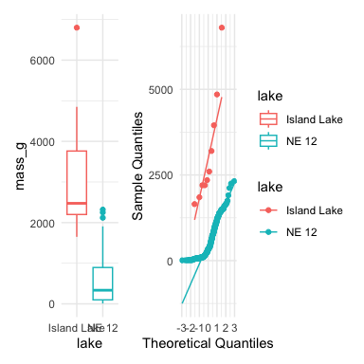
Assumptions of parametric tests
QQ-plots: tool for assessing normality
On x- theoretical quantiles from SND
On y- ordered sample values
Deviation from normal can be detected as deviation from straight line
isl_ne12_df <- lt_df %>% filter(lake %in% c("NE 12", "Island Lake")) ne12_island_box_plot <- isl_ne12_df %>% ggplot(aes(x=lake, y = mass_g, color=lake)) + geom_boxplot()+ theme_minimal() # ne12_island_box_plot ne12_island_qq_plot <- isl_ne12_df %>% # filter(lake =="NE 12") %>% ggplot(aes(sample = mass_g , color=lake)) + stat_qq() + stat_qq_line() + labs( x = "Theoretical Quantiles", y = "Sample Quantiles") + theme_minimal() ne12_island_box_plot +ne12_island_qq_plot+plot_layout(guides="collect")

Slide 14
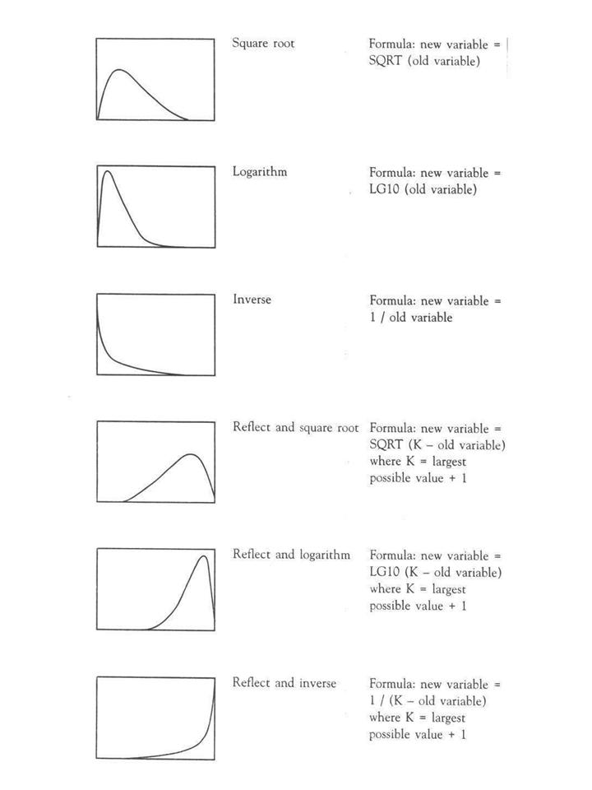
Assumptions of parametric tests
In some cases, data can be mathematically “transformed” to meet assumptions of parametric tests
this can be done in r and usually involves
log10 transformations
square root transformations
and many others… I will have a description soon

Slide 15
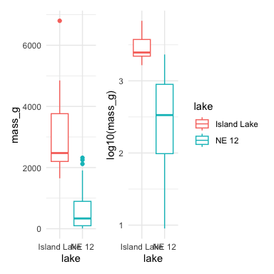
Robust tests
Welch’s t-test
common “robust” test for means of two populations
Robust to violation of equal variance assumption, deals better with unequal sample size
Parametric test (assumes normal distribution)
Calculates a t statistic but recalculates df based on samples sizes and s

Slide 16
Robust tests
Lets compare a parametric T-Test to a Welch’s t-test
T-Test is:
t.test(y1, y2, var.equal = TRUE, paired = FALSE)
Welch’s T-Test is:
t.test(y1, y2, var.equal = FALSE, paired = FALSE)
[1] "Standard t-test results for lenght_mm:"
Two Sample t-test data: mass_g by lake t = 14.181, df = 330, p-value < 2.2e-16 alternative hypothesis: true difference in means between group Island Lake and group NE 12 is not equal to 0 95 percent confidence interval: 2266.304 2996.360 sample estimates: mean in group Island Lake mean in group NE 12 3165.0000 533.6677
[1] "Welch's t-test results for lenght_mm:"
Welch Two Sample t-test data: mass_g by lake t = 5.1368, df = 9.0578, p-value = 0.0006016 alternative hypothesis: true difference in means between group Island Lake and group NE 12 is not equal to 0 95 percent confidence interval: 1473.676 3788.989 sample estimates: mean in group Island Lake mean in group NE 12 3165.0000 533.6677

Slide 17
Rank based tests
Rank-based tests: no assumptions about distribution (non-parametric)
Ranks of data: observations assigned ranks, sums (and signs for paired tests) of ranks for groups compared
Mann-Whitney U test common alternative to independent samples t-test
Wilcoxon signed-rank test is alternative to paired t-test
Assumptions: similar distributions for groups, equal variance
Less power than parametric tests
Best when normality assumption can not be met by transformation (weird distribution) or large outliers
[1] "Mann-Whitney U test results length:"
Wilcoxon rank sum test with continuity correction data: mass_g by lake W = 3205.5, p-value = 9.506e-08 alternative hypothesis: true location shift is not equal to 0

Slide 18
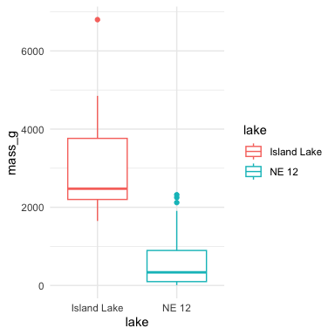
Permutation tests
Permutation tests based on resampling: reshuffling of original data
Resampling allows parameter estimation when distribution unknown, including SEs and CIs of statistics (means, medians)
Common approach is bootstrap: resample sample with replacement many times, recalculate sample stats
Use the perm package
Ho: µ_{A} = µ_{B}
Ha: µ_{A} ≠µ_{B}
Calculates the difference ∆ in means between two groups

Slide 19
Permutation tests
Randomly reshuffle observations between groups (keeping n_{NE 12}=323 and n_{Island}=10), calculate ∆
Repeat >1,000 times
Record proportion of the different means i
This is equivalent to p-value and can be used in “traditional” H test framework
For a graphical explanation:
Graphical Explanation

Slide 20
Permutation tests
In R (using ‘perm’ package):
Assumptions: both groups have similar distribution; equal variance
library(perm) # Prepare data for permutation test ne12_perm_data <- isl_ne12_df %>% filter(lake == "NE 12") %>% pull(length_mm) # Randomly sample exactly 25 observations from NE 12 (set seed for reproducibility) set.seed(123) ne12_perm_data <- sample(ne12_perm_data, size = 25, replace = FALSE) island_perm_data <- isl_ne12_df %>% filter(lake == "Island Lake") %>% pull(length_mm) # Calculate the observed difference in means observed_diff <- mean(ne12_perm_data, na.rm = TRUE) - mean(island_perm_data, na.rm = TRUE) # Perform permutation test for difference in means using perm package permTS(ne12_perm_data, island_perm_data, alternative = "two.sided", method = "exact.mc", control = permControl(nmc = 10000))
Exact Permutation Test Estimated by Monte Carlo data: GROUP 1 and GROUP 2 p-value = 2e-04 alternative hypothesis: true mean GROUP 1 - mean GROUP 2 is not equal to 0 sample estimates: mean GROUP 1 - mean GROUP 2 -333.08 p-value estimated from 10000 Monte Carlo replications 99 percent confidence interval on p-value: 0.000000000 0.001059383

Slide 21
Summary
Testing Assumptions of Parametric Tests
Key Assumptions
Random sampling: Samples are randomly collected from populations
Normality: Data follows a normal distribution
Equal variance: Samples come from populations with similar variability
No outliers: No extreme values that can skew results
Assessing Assumptions
Key to do every time
Should acknowledge in manuscript
Data Transformations
When assumptions aren’t met, transformations may help normalize data:
Log transformation: log10(x) - Useful for right-skewed data, multiplicative effects
Square root: sqrt(x) - Useful for count data, moderately right-skewed distributions
Box-Cox: More flexible family of power transformations
More specialized transformations especially for percentages o proportions
Statistical Test Options
1. Standard T-Test
Strengths: - High statistical power when assumptions are met - Well understood and widely accepted
Weaknesses: - Sensitive to violations of normality, equal variance - Heavily influenced by outliers
2. Welch’s T-Test
Strengths: - Robust to violations of equal variance assumption - Handles unequal sample sizes well - Still parametric (assumes normality)
Weaknesses: - Slightly less powerful than standard t-test when variances are equal - Still assumes normal distribution
3. Mann-Whitney-Wilcoxon Test
Strengths: - Non-parametric: doesn’t assume normal distribution - Robust against outliers - Works with ordinal data
Weaknesses: - Less statistical power than parametric tests - Still assumes similar distributions and approximate equal variance - Tests median differences rather than mean differences
4. Permutation Tests
Strengths: - Distribution-free: doesn’t assume a specific distribution - Can be applied to many types of test statistics - Handles small sample sizes well - Directly estimates p-values through resampling
Weaknesses: - Computationally intensive - Assumes exchangeability under the null hypothesis - Requires similar distributions and equal variance
Key Takeaway
Statistical tests have different strengths and assumptions. The choice should be guided by your data characteristics, not just convenience. Always visualize your data before deciding on the appropriate test.

