Slide 1
Lecture XX
Bill Perry

Slide 2
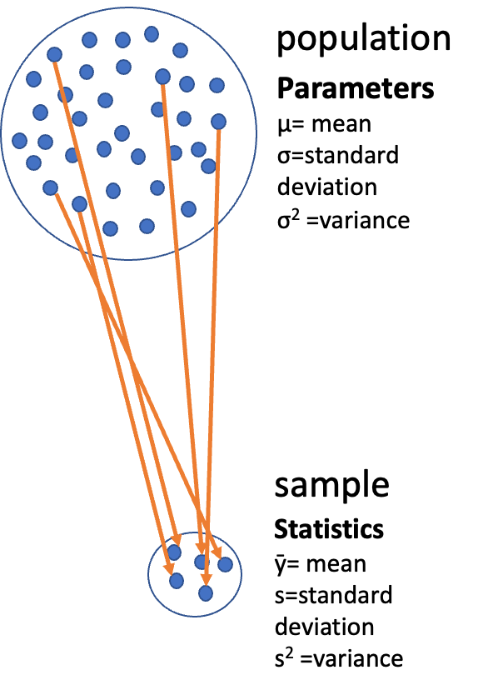
Lecture x: Review
Covered
Introduction to hypothesis testing
The standard normal distribution
Standard error
Confidence intervals
Student’s t-distribution
H testing
One and Two Sample T Test
p-values

Slide 3
Lecture y: Overview
The objectives:
p-values
Brief review
H test for a single population
1- and 2-sided tests
Hypothesis tests for two populations
Assumptions of parametric tests

Slide 4
Lecture y: first heading here
Major goal of statistics:

Slide 5
Extended Activity
This is an extension of the lecture and poses new ideas or extensions
We’d do x y z
Test if the ….
The xxx approach often has more statistical power

Slide 6
Final Activity: Take home messages
Common assumptions for tests:
Normality: Data comes from normally distributed populations
Equal variances (for two-sample tests)
Independence: Observations are independent
No outliers: Extreme values can influence results
What can we do if our data violates these assumptions?
Alternatives
Data transformation (log, square root, etc.)
Non-parametric tests
Bootstrapping approaches

Slide 7
Summary and Conclusions
In this activity, we’ve:
one
two
three
Key takeaways:
should know
and this
and this

Slide 8
What do you see as the key points?
Things that stood out
one
two

Slide 9
What are the muddy points?
What does not make sense or what questions do you have…
What makes you nervous?
one
two

