Slide 1
Lecture 11 - Multiple Regression
Bill Perry

Slide 2
Lecture 10: Review
Covered
Regression T-Test Anova
Regression Assumptions
Model II Regression

Slide 3
Lecture 11: Overview
Multiple Linear Regression model
Regression parameters
Analysis of variance
Null hypotheses
Explained variance
Assumptions and diagnostics
Collinearity
Interactions
Dummy variables
Model selection
Importance of predictors

Slide 4
Lecture 11: Analyses
What if more than one predictor (X) variable?
If predictors continuous
Mix between categorical and continuous
Can use multiple linear regression
 | Independent variable
Dependent variable | Continuous | Categorical
Continuous | Regression | ANOVA
Categorical | Logistic regression | Tabular

Slide 5
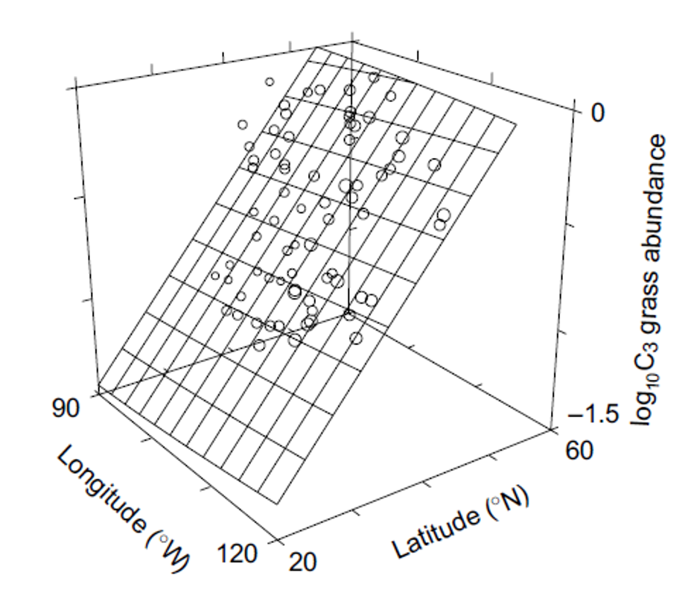
Lecture 11: Analyses
Abundance of C3 grasses can be modeled as function of
latitude
longitude
both
Instead of line, modeled with (hyper)plane

Slide 6
Lecture 11: Analyses
Used in similar way to simple linear regression:
Describe nature of relationship between Y and X’s
Determine explained / unexplained variation in Y
Predict new Ys from X
Find the “best” model
S

Slide 7

Lecture 11: Analyses
Crawley 2012: “Multiple regression models provide some of the most profound challenges faced by the analyst”:
Overfitting
Parameter proliferation
Multicollinearity
Model selection

Slide 8
Lecture 11: Analyses
Multiple Regression:
Set of i= 1 to n observations
fixed X-values for p predictor variables (X1, X2…Xp)
random Y-values:
$$y_{i}=β_{0}+β_{1}x_{i1}+β_{2}x_{i2}+...+β_{p}x_{ip}+ϵ_{i}$$
yi: value of Y for ith observation X1 = xi1, X2 = xi2,…, Xp = xip
β0: population intercept, the mean value of Y when X1 = 0, X2 = 0,…, Xp = 0

Slide 9
Lecture 11: Multiple linear regression model
Multiple Regression:
$$y_{i}=β_{0}+β_{1}x_{i1}+β_{2}x_{i2}+...+β_{p}x_{ip}+ϵ_{i}$$
β1: partial population slope, change in Y per unit change in X1 holding other X-vars constant
β2: partial population slope, change in Y per unit change in X2 holding other X-vars constant
βp: partial population slope, change in Y per unit change in Xp holding other X-vars constant

Slide 10
Lecture 11: Regression parameters
Multiple Regression:
$$y_{i}=β_{0}+β_{1}x_{i1}+β_{2}x_{i2}+...+β_{p}x_{ip}+ϵ_{i}$$
εi: unexplained error - difference bw yi and value predicted by model (ŷi)
NPP = β0 + β1(lat) + β2 (long) + β3 (soil fertility) + εi

Slide 11
Lecture 11: Regression parameters
Multiple Regression:
$$y_{i}=β_{0}+β_{1}x_{i1}+β_{2}x_{i2}+...+β_{p}x_{ip}+ϵ_{i}$$
Estimate multiple regression parameters (intercept, partial slopes) using OLS to fit the regression line
OLS minimize ∑(yi-ŷi)2, the SS (vertical distance) between observed yi and predicted ŷi for each xij
ε estimated as residuals: εi = yi-ŷi
Calculation solves set of simultaneous normal equations with matrix algebra

Slide 12
Lecture 11: Regression parameters
Regression equation can be used for prediction by subbing new values for predictor (X) variables
Confidence intervals calculated for parameters
Confidence and prediction intervals depend on number of observations and number of predictors
More observations decrease interval width
More predictors increase interval width
Prediction should be restricted to within range of X variables

Slide 13
Lecture 11: Analyses of variance
Variance - SStotal partitioned into SSregression and SSresidual
SSregression is variance in Y explained by model
SSresidual is variance not explained by model
Source of variation | SS | df | MS | Interpretation
Regression | $\sum_{i=1}^{n}{{\left(y_{i}−\overset{‾}{y}\right)}^{2}}$ | $p$ | $\frac{\sum_{i=1}^{n}{{\left(y_{i}−\overset{‾}{y}\right)}^{2}}}{p}$ | Difference between predicted observation and mean
Residual | $\sum_{i=1}^{n}{{\left(y_{i}−{\hat{y}}_{i}\right)}^{2}}$ | $n−p−1$ | $\frac{\sum_{i=1}^{n}{{\left(y_{i}−{\hat{y}}_{i}\right)}^{2}}}{n−p−1}$ | Difference between each observation and predicted
Total | $\sum_{i=1}^{n}{{\left(y_{i}−\overset{‾}{y}\right)}^{2}}$ | $n−1$ |  | Difference between each observation and mean

Slide 14
Lecture 11: Analyses
SS converted to non-additive MS (SS/df)
MSresidual: estimate population variance
MSregression: estimate population variance + variation due to strength of X-Y relationships
MS do not depend on sample size
Source of variation | SS | df | MS
Regression | $\sum_{i=1}^{n}{{\left(y_{i}−\overset{‾}{y}\right)}^{2}}$ | $p$ | $\frac{\sum_{i=1}^{n}{{\left(y_{i}−\overset{‾}{y}\right)}^{2}}}{p}$
Residual | $\sum_{i=1}^{n}{{\left(y_{i}−{\hat{y}}_{i}\right)}^{2}}$ | $n−p−1$ | $\frac{\sum_{i=1}^{n}{{\left(y_{i}−{\hat{y}}_{i}\right)}^{2}}}{n−p−1}$
Total | $\sum_{i=1}^{n}{{\left(y_{i}−\overset{‾}{y}\right)}^{2}}$ | $n−1$

Slide 15
Lecture 11: Hypotheses
Two Hos usually tested in MLR:
“Basic” Ho: all partial regression slopes equal 0; β1 = β2 = … = βp = 0
If “basic” Ho true, MSregression and MSresidual estimate variance and their ratio (F-ratio) = 1
If “basic” Ho false (at least one β ≠ 0) MSregression estimates variance + partial regression slope and their ratio (F-ratio)
will be > 1 - F-ratio compared to F-distribution for p-value

Slide 16
Lecture 11: Hypotheses
Also: is any specific β = 0 (explanatory role)?
E.g., does LAT have effect on NPP?
These Hs tested through model comparison
Model w 3 predictors X1, X2,X3 (model 1):
yi= β0 +β1xi1+β2xi2+β3xi3+ εi
To test Ho that β1 = 0 compare fit of model 1 to model 2:
yi= β0 +β2xi2+β3xi3+ εi

Slide 17
Lecture 11: Hypotheses
If SSregression of mod1=mod2, cannot reject Ho β1 = 0
If SSregression of mod1 > mod2, evidence to reject Ho β1 = 0
SS for β1 is SSextraβ1 = Full SSregression - Reduced SSregression
Use partial F-test to test Ho β1 = 0 :
$$F_{w,n−p}=\frac{MS_{Extra}}{FULL MS_{Residual}}$$
Can also use t-test (R provides this value)

Slide 18
Lecture 11: Explained variance
Explained variance (r2) is calculated the same way as for simple regression:
$$r^{2}=\frac{SS_{Regression}}{SS_{Total}}=1−\frac{SS_{Residual}}{SS_{Total}}$$
r2 values can not be used to directly compare models
r2 values will always increase as predictors added
r2 values with different transformation will differ

Slide 19
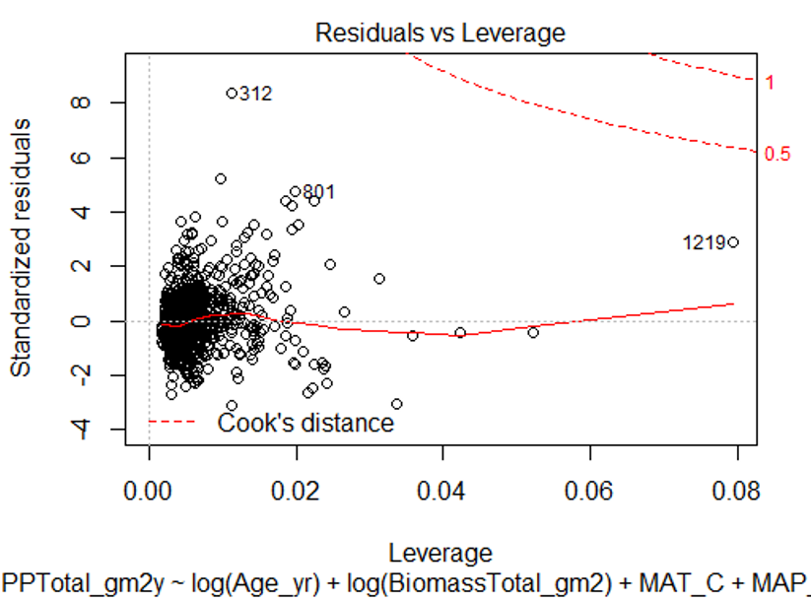
Lecture 11: Assumptions and diagnostics
Assume fixed Xs; unrealistic in most biological settings
No major (influential) outliers
Check leverage, influence- Cook’s Di

Slide 20
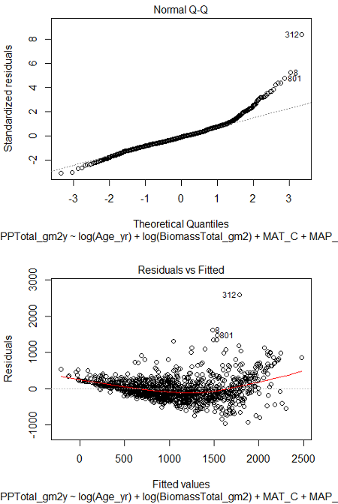
Lecture 11: Assumptions and diagnostics
Normality, equal variance, independence
Residual QQ-plots, residuals vs. predicted values plot
Distribution/variance often corrected by transforming Y

Slide 21
Lecture 11: Assumptions and diagnostics
More observations than predictor variables
Ideally at least 10x observations than predictors to avoid “overfitting”
Uncorrelated predictor variables (assessed using scatterplot matrix; VIFs)
Linear relationship between Y and each X, holding others constant (non-linearity assessed by AV plots)

Slide 22
Lecture 11: Analyses
Regression of Y vs. each X does not consider effect of other predictors:
want to know shape of relationship while holding other predictors constant

Slide 23
::::

Slide 24
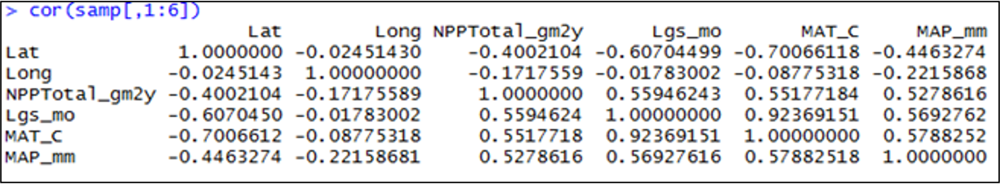
Lecture 11: Collinearity
Potential predictor variables are often correlated (e.g., morphometrics, nutrients, climatic parameters)
Multicollinearity (strong correlation between predictors) causes problems for parameter estimates
Severe collinearity causes unstable parameter estimates: small change in a single value can result in large changes in βp - estimates
Inflates partial slope error estimates, loss of power

Slide 25
Lecture 11: Collinearity
Collinearity can be detected by:
Variance inflation Factors:
VIF for Xj=1/ (1-r2 )
VIF > 10 = bad
Best/simplest solution:
exclude variables that are highly correlated with other variables
they are probably measuring similar
thing and are redundant

Slide 26
Lecture 11: Interactions
Predictors can be modeled as:
additive (effect of temp, plus precip, plus fertility) or
multiplicative (interactive)
Interaction: effect of Xi depends on levels of Xj
The partial slope of Y vs. X1 is different for different levels of X2 (and vice versa); measured by β3
$$y_{i}=β_{0}+β_{1}X_{i1}+β_{2}X_{i2}+ϵ_{i} \text{vs.} y_{i}=β_{0}+β_{1}X_{i1}+β_{2}X_{i2}++β_{3}X_{i3}ϵ_{i}$$
“Curvature” of the regression (hyper)plane

Slide 27
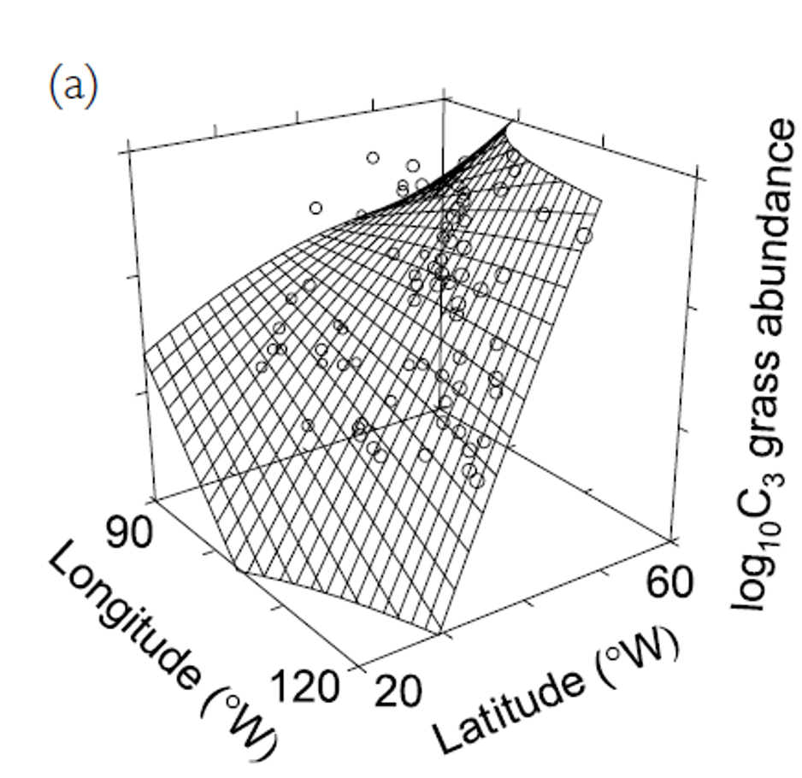
Lecture 11: Analyses

Slide 28
Lecture 11: Analyses
Adding interactions:
many more predictors (“parameter proliferation”):
2n; 6 params= 64 terms; 7 params= 128
interpretation more complex
When to include interactions? When they make biological sense

Slide 29
Lecture 11: Dummy variables
Multiple Linear Regression accommodates continuous and categorical variables (gender, vegetation type, etc.) Categorical vars as “dummy vars”, n of dummy variables = n-1 categories
Sex M/F:
Need 1 dummy var with two values (0, 1)
Fertility L/M/H:
Need 2 dummy var, each with two values (0, 1): fert1 (0 if L or H, 1 if M), fert2 (1 if H, 0 if L or M)
Fertility | fert1 | fert2
Low | 0 | 0
Med | 1 | 0
High | 0 | 1

Slide 30
Lecture 11: Analyses
Coefficients interpreted relative to reference condition
R codes dummy variables automatically
picks “reference” level alphabetically
Dummy variables with more than 2 levels add extra predictor variables to model
Fertility | fert1 | fert2
Low | 0 | 0
Med | 1 | 0
High | 0 | 1

Slide 31
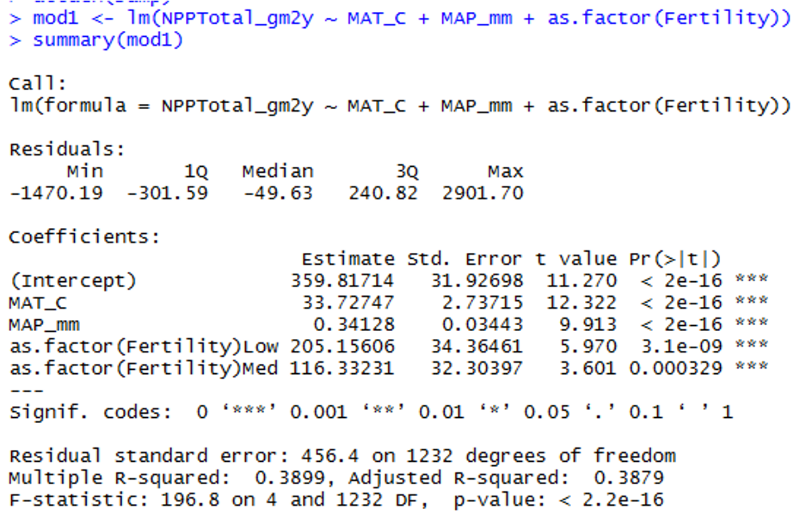
Lecture 11: Analyses
S

Slide 32
Lecture 11: Comparing models
When have multiple predictors (and interactions!)
how to choose “best” model?
Which predictors to include?
Occam’s razor: “best” model balances complexity with fit to data
To chose:
compare “nested” models
Overfitting
getting high r2 just by having more (useless predictors)
so r2 is not a good way of choosing between nested models

Slide 33
Lecture 11: Comparing models
Need to account for increase in fit with added predictors:
Adjusted r2
Akaike’s information criterion (AIC)
Both “penalize” models for extra predictors
Higher adjusted r2 and lower AIC are better when comparing models
$$\text{Adjusted }r^{2}=1−\frac{SS_{\text{Residual}}/\left(n−\left(p+1\right)\right)}{SS_{\text{Total}}/\left(n−1\right)}$$
$$\text{Akaike Information Criterion (AIC)}=n\left[ln\left(SS_{\text{Residual}}\right)\right]+2\left(p+1\right)−nln\left(n\right)$$

Slide 34
Lecture 11: Comparing models
But how to compare models?
Can fit all possible models
compare AICs or adj- r2,
tedious w lots of predictors
Automated forward (and backward) stepwise procedures: start w no terms (all terms), add (remove) terms w largest (smallest)
partial F statistic
We will use manual form of backward selection

Slide 35
Lecture 11: Analyses

Slide 36
Lecture 11: Predictors
Usually want to know relative importance of predictors to explaining Y
Three general approaches:
Using F-tests (or t-tests) on partial regression slopes
Using coefficient of partial determination
Using standardized partial regression slopes

Slide 37
Lecture 11: Predictors
Using F-tests (or t-tests) on partial regression slopes:
Conduct F tests of Ho that each partial regression slope = 0
If cannot reject Ho, discard predictor
Can get additional clues from relative size of F-values
Does not tell us absolute importance of predictor (usually can not directly compare slope parameters)

Slide 38
Lecture 11: Predictors
Using coefficient of partial determination:
the reduction in variation of Y due to addition of predictor (Xj)
$$r_{X_{j}}^{2}=\frac{SS_{\text{Extra}}}{\text{Reduced }SS_{\text{Residual}}}$$
SSextra
Increased in SSregression when Xj is added to model
Reduced SSresidual is the unexplained SS from model without Xj

Slide 39
Lecture 11: Predictors
Using standardized partial regression slopes:
predictors of predictor variables can not be directly compared
Why?
Standardize all vars (mean = 0, sd= 1)
Scales are identical and larger PRS mean more important variable

Slide 40
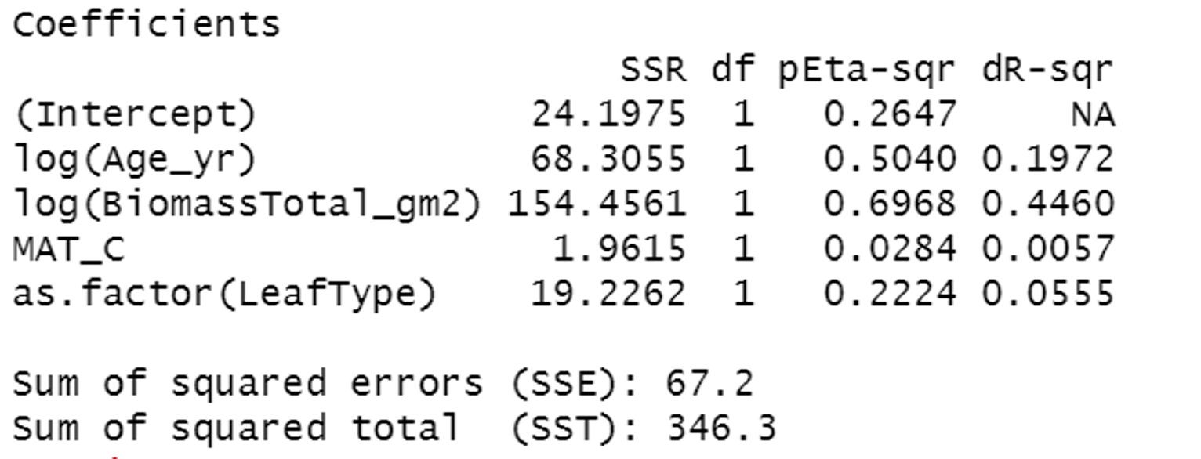
Lecture 11: Predictors
Using partial r2 values:

Slide 41
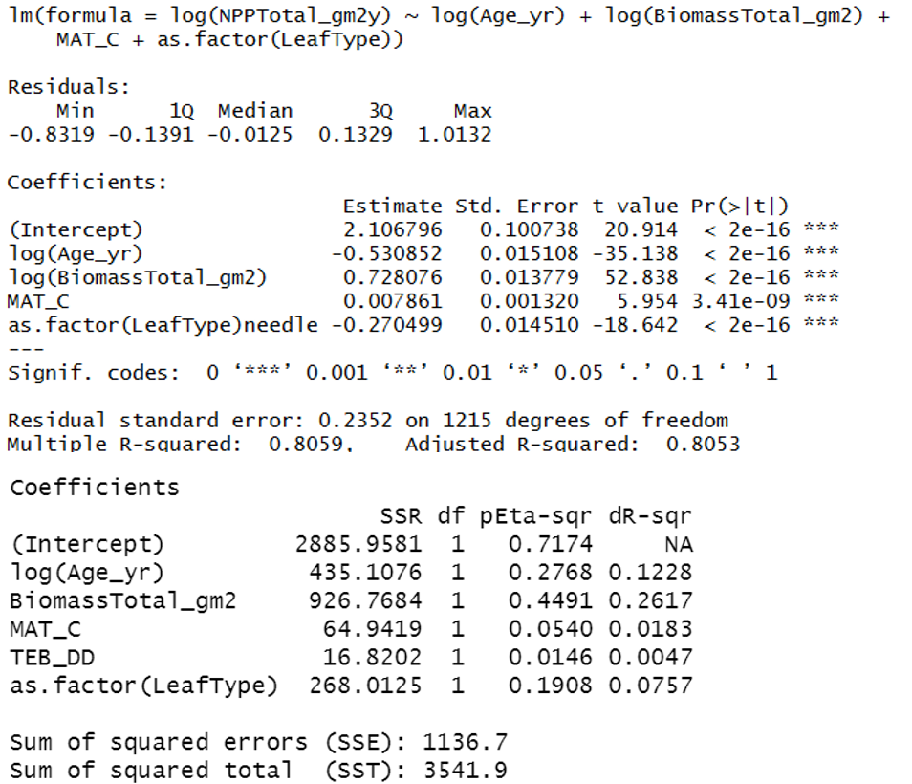
Lecture 11: Reporting results
Results are easiest to report in tabular format

Slide 42
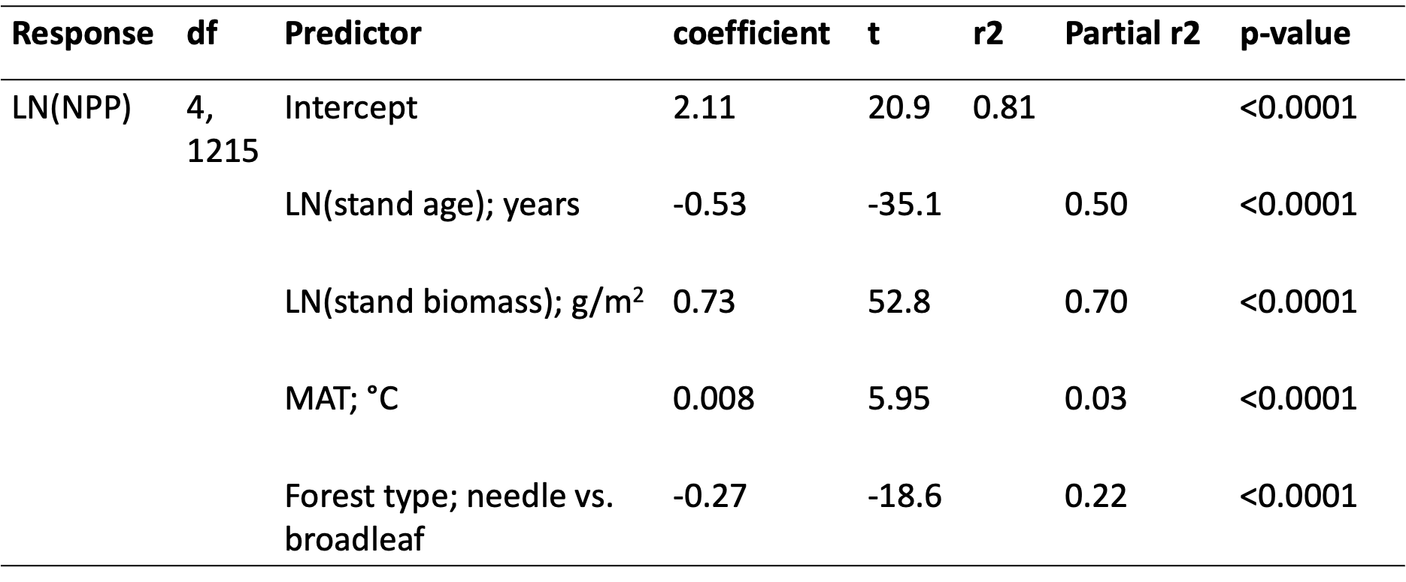
Lecture 11: Reporting results
Results are easiest to report in tabular format

