Slide 1
How an ANOVA IS A REGRESSION WIHT DUMMY VARIABLES
Bill Perry

Slide 2
Introduction
This document demonstrates how Analysis of Variance (ANOVA) is mathematically equivalent to a regression model with dummy variables using an example with R code and visualizations.

Slide 3
Setup and Data Creation
Let’s begin by loading necessary packages and creating a dataframe about plant heights with three different fertilizer treatments.
# install.packages("flextable") library(tidyverse) library(flextable) # Create the dataset fertilizer_data <- tibble( fertilizer = rep(c("A", "B", "C"), each = 3), height = c(10, 12, 8, # Fertilizer A 14, 16, 18, # Fertilizer B 20, 22, 24) # Fertilizer C ) # Display the dataset using flextable flextable(fertilizer_data) %>% set_caption("Plant Heights by Fertilizer Type") %>% theme_vanilla() %>% autofit()

Slide 4
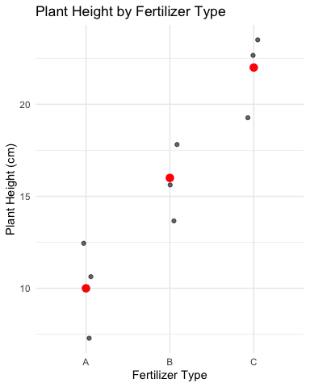
Calculating Group Means (ANOVA Approach)
In ANOVA, we calculate the mean of each group and compare variation between groups to variation within groups.
group_means <- fertilizer_data %>% group_by(fertilizer) %>% summarize(mean_height = mean(height)) flextable(group_means) %>% set_caption("Group Means (ANOVA Approach)") %>% theme_vanilla() %>% autofit()
Let’s visualize the raw data and group means:
ggplot(fertilizer_data, aes(x = fertilizer, y = height)) + geom_jitter(width = 0.1, alpha = 0.6) + geom_point(data = group_means, aes(y = mean_height), color = "red", size = 3) + labs(title = "Plant Height by Fertilizer Type", x = "Fertilizer Type", y = "Plant Height (cm)") + theme_minimal()
fertilizer | mean_height
A | 10
B | 16
C | 22

Slide 5
Running the ANOVA
# Run ANOVA anova_model <- aov(height ~ fertilizer, data = fertilizer_data) anova_summary <- summary(anova_model) anova_summary
Df Sum Sq Mean Sq F value Pr(>F) fertilizer 2 216 108 27 0.001 ** Residuals 6 24 4 --- Signif. codes: 0 '***' 0.001 '**' 0.01 '*' 0.05 '.' 0.1 ' ' 1

Slide 6
Regression with Dummy Variables
For the regression approach, we’ll create dummy variables for fertilizer types, using fertilizer A as the reference level.
# Set fertilizer A as the reference level fertilizer_data$fertilizer <- factor(fertilizer_data$fertilizer, levels = c("A", "B", "C")) # Run regression with dummy variables reg_model <- lm(height ~ fertilizer, data = fertilizer_data) reg_summary <- summary(reg_model) reg_summary
Call: lm(formula = height ~ fertilizer, data = fertilizer_data) Residuals: Min 1Q Median 3Q Max -2 -2 0 2 2 Coefficients: Estimate Std. Error t value Pr(>|t|) (Intercept) 10.000 1.155 8.660 0.000131 *** fertilizerB 6.000 1.633 3.674 0.010402 * fertilizerC 12.000 1.633 7.348 0.000325 *** --- Signif. codes: 0 '***' 0.001 '**' 0.01 '*' 0.05 '.' 0.1 ' ' 1 Residual standard error: 2 on 6 degrees of freedom Multiple R-squared: 0.9, Adjusted R-squared: 0.8667 F-statistic: 27 on 2 and 6 DF, p-value: 0.001

Slide 7
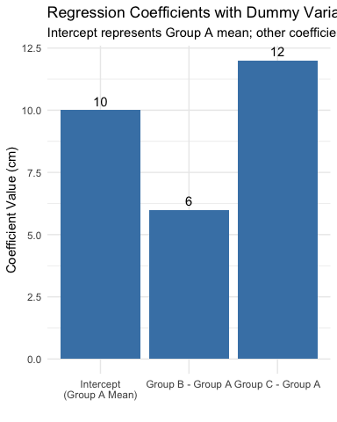
Understanding the Regression Coefficients
In our regression model:
The intercept (10) is equal to the mean of the reference group (A)
The coefficient for fertilizer B (6) is the difference between mean of group B and mean of group A
The coefficient for fertilizer C (12) is the difference between mean of group C and mean of group A
# Create a table showing the relationship between coefficients and means coefs <- coef(reg_model) coefficients_explained <- tibble( Term = c("Intercept", "fertilizerB", "fertilizerC"), Coefficient = coefs, Meaning = c( "Mean of Group A (reference group)", "Difference between Group B and Group A means", "Difference between Group C and Group A means" ), Mathematical_Expression = c( "β₀ = μA", "β₁ = μB - μA", "β₂ = μC - μA" ), Numeric_Value = c(coefs[1], paste0(round(group_means$mean_height[2], 1), " - ", round(group_means$mean_height[1], 1), " = ", round(coefs[2], 1)), paste0(round(group_means$mean_height[3], 1), " - ", round(group_means$mean_height[1], 1), " = ", round(coefs[3], 1)))) # Use flextable to format the table flextable(coefficients_explained) %>% set_caption("Regression Coefficients Explained") %>% theme_vanilla() %>% fit_to_width(max_width = 8, unit = "in") %>% bold(j = 1) %>% colformat_double(j = 2, digits = 2)
Let’s visualize these coefficients:
coef_data <- tibble( Term = factor(c("Intercept\n(Group A Mean)", "Group B - Group A", "Group C - Group A"), levels = c("Intercept\n(Group A Mean)", "Group B - Group A", "Group C - Group A")), Value = c(coefs[1], coefs[2], coefs[3]) ) ggplot(coef_data, aes(x = Term, y = Value)) + geom_col(fill = "steelblue") + geom_text(aes(label = round(Value, 1)), vjust = -0.5) + labs(title = "Regression Coefficients with Dummy Variables", subtitle = "Intercept represents Group A mean; other coefficients show differences from reference", x = "", y = "Coefficient Value (cm)") + theme_minimal()
Term | Coefficient | Meaning | Mathematical_Expression | Numeric_Value
Intercept | 10.00 | Mean of Group A (reference group) | β₀ = μA | 10
fertilizerB | 6.00 | Difference between Group B and Group A means | β₁ = μB - μA | 16 - 10 = 6
fertilizerC | 12.00 | Difference between Group C and Group A means | β₂ = μC - μA | 22 - 10 = 12

Slide 8
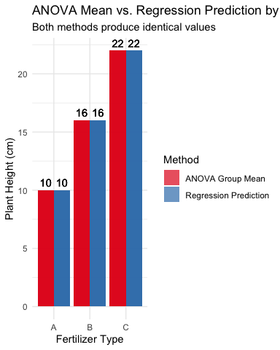
Demonstrating the Equivalence
Now, let’s prove that the regression model predictions are identical to the ANOVA group means:
# Get predictions from regression model predicted_values <- predict(reg_model, fertilizer_data) # Create a dataframe for comparison comparison_data <- fertilizer_data %>% mutate(predicted = predicted_values) %>% group_by(fertilizer) %>% mutate(group_mean = mean(height)) # Generate the predicted values for each group predicted_values_by_group <- comparison_data %>% group_by(fertilizer) %>% reframe( anova_mean = mean(height), regression_prediction = mean(predicted), formula = case_when( fertilizer == "A" ~ paste0(round(coefs[1], 1), " + 0 + 0 = ", round(coefs[1], 1)), fertilizer == "B" ~ paste0(round(coefs[1], 1), " + ", round(coefs[2], 1), " + 0 = ", round(coefs[1] + coefs[2], 1)), fertilizer == "C" ~ paste0(round(coefs[1], 1), " + 0 + ", round(coefs[3], 1), " = ", round(coefs[1] + coefs[3], 1)) ) )
Let’s visualize this equivalence:
# Create data for plotting the equivalence plot_data <- predicted_values_by_group %>% pivot_longer(cols = c(anova_mean, regression_prediction), names_to = "method", values_to = "value") %>% mutate(method = ifelse(method == "anova_mean", "ANOVA Group Mean", "Regression Prediction")) ggplot(plot_data, aes(x = fertilizer, y = value, fill = method)) + geom_bar(stat = "identity", position = position_dodge(), alpha = 0.7) + geom_text(aes(label = round(value, 1)), position = position_dodge(width = 0.9), vjust = -0.5) + labs(title = "ANOVA Mean vs. Regression Prediction by Fertilizer Type", subtitle = "Both methods produce identical values", x = "Fertilizer Type", y = "Plant Height (cm)", fill = "Method") + theme_minimal() + scale_fill_brewer(palette = "Set1")

Slide 9
Comparing Statistical Tests
Both ANOVA and regression provide an F-test. Let’s compare them:
# ANOVA: Extract F-value and p-value anova_f <- anova_summary[[1]]$`F value`[1] anova_p <- anova_summary[[1]]$`Pr(>F)`[1] # Regression: Extract F-value and p-value reg_f <- reg_summary$fstatistic[1] reg_p <- pf(reg_f, reg_summary$fstatistic[2], reg_summary$fstatistic[3], lower.tail = FALSE) # Compare them test_comparison <- tibble( Test = c("ANOVA F-test", "Regression F-test"), `F-value` = c(anova_f, reg_f), `p-value` = c(anova_p, reg_p) ) # Format with flextable flextable(test_comparison) %>% set_caption("Comparison of Statistical Tests") %>% theme_vanilla() %>% autofit() %>% colformat_double(j = 2:3, digits = 4)
Test | F-value | p-value
ANOVA F-test | 27.0000 | 0.0010
Regression F-test | 27.0000 | 0.0010

Slide 10
The Mathematical Relationship
For a one-way ANOVA with a categorical variable having k levels, we can express the relationship with regression as:
$$Y=β_{0}+β_{1}X_{1}+β_{2}X_{2}+...+β_{k−1}X_{k−1}+ϵ$$
Where: - $β_{0}$ is the mean of the reference group - $β_{1},β_{2},...,β_{k−1}$ are the differences between each group’s mean and the reference group mean - $X_{1},X_{2},...,X_{k−1}$ are dummy variables (0 or 1)
In our example: - $β_{0}=10$ (mean of group A) - $β_{1}=6$ (difference between B and A) - $β_{2}=12$ (difference between C and A)

Slide 11
Conclusion
This demonstration shows that one-way ANOVA is mathematically equivalent to regression with dummy variables. The key equivalences are:
ANOVA group means = Regression predictions for each group
F-statistic from ANOVA = F-statistic from regression
p-values are identical in both approaches
This confirms that both techniques are special cases of the General Linear Model, just expressed in different ways. For a categorical predictor with k levels, we need k-1 dummy variables in the regression approach, with one level serving as the reference category.

