Slide 1
Lecture 13 - Factorial ANOVA of Limpet Egg Production
Bill Perry

Slide 2
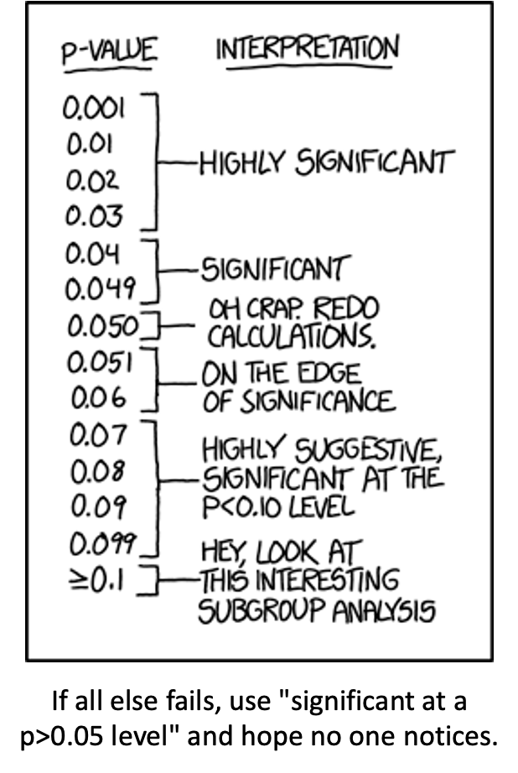
Lecture 12: Review
ANOVA
Analysis of variance: single and multi-factor designs
Examples: diatoms, circadian rhythms
Predictor variables: fixed vs. random
ANOVA model
Analysis and partitioning of variance
Null hypothesis
Assumptions and diagnostics
Post F Tests - Tukey and others
Reporting the results

Slide 3
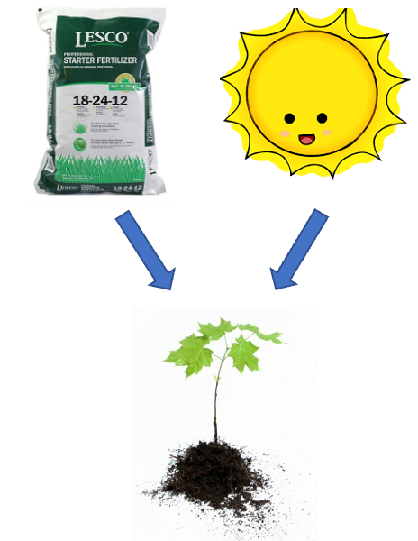
Lecture 13: Factorial ANOVA
2-factor designs (2-way ANOVA)
very common in ecology
Can have more factors (e.g., 3-way ANOVA)
interpretation gets challenging
Most multifactor designs: nested or factorial

Slide 4
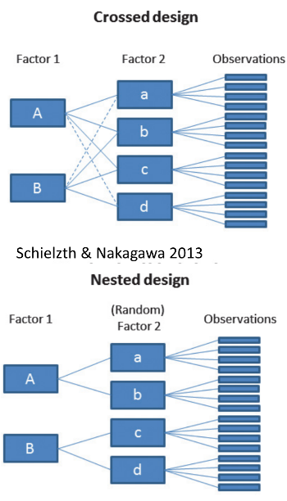
Lecture 14: Factorial ANOVA
Consider two factors:
Factorial/crossed:
every level of B in every level of A

Slide 5
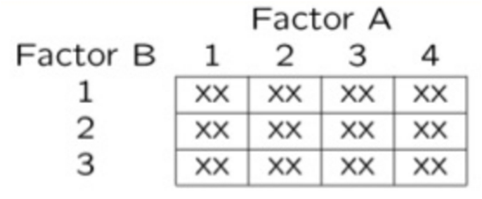
Lecture 14: Factorial ANOVA
In factorial designs
look at two types of factor effects:
Main effect of each factor (polling across other factor)
Interaction effects; is there synergistic/ antagonistic effect of factors?

Slide 6
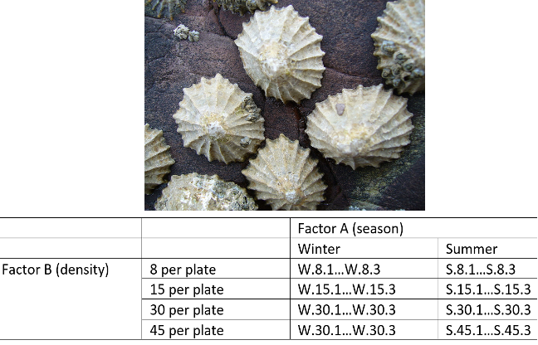
Lecture 14: Factorial ANOVA
Effect of season and density on limpet fecundity.
2 seasons (factor A)
4 density treatments (factor B)
3 replicates in each cell

Slide 7
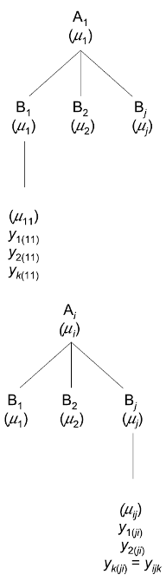
Lecture 14: Factorial ANOVA
Consider a crossed design with:
p levels of factor A (i= 1…p) (2 seasons)
q levels of factor B (j= 1…q), crossed with each level of A (4 density levels)
n_{i} replicates (k= 1…n_{i}) in each combination of A and B (3 replicate plates per density per season)

Slide 8
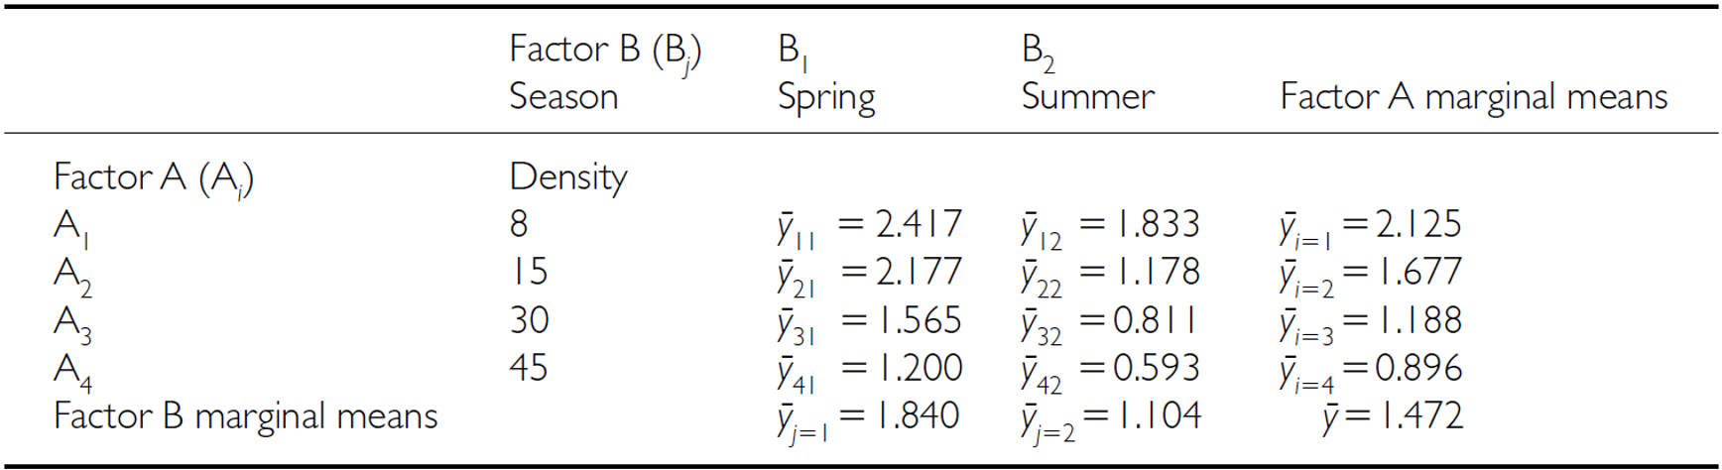
Lecture 14: Factorial ANOVA
We can calculate several means:
overall mean (across all levels of A and B)= µ

Slide 9
Lecture 14: Factorial ANOVA
We can calculate several means:
Marginal means for levels of each factor, pooling across all levels of other factor
Marginal mean for levels of A= µi
Marginal mean for levels of B= µj

Slide 10
Lecture 14: Factorial ANOVA
We can calculate several means:
a mean for each cell of combinations of A and B= µ_{ij}

Slide 11
Lecture 14: Factorial ANOVA
Factorial designs can be of 3 types:
2 fixed factors (model 1 ANOVA)
2 random (model 2 ANOVA)
1 fixed, 1 random (mixed model- model 3 ANOVA)
Model 1 ANOVA:
$$y_{ijk}=μ+α_{i}+β_{j}+{\left(αβ\right)}_{ij}+ε_{ijk}$$
$$y_{ijk}=μ+α_{i}+β_{j\left(i\right)}+ε_{ijk}$$
Lecture 14: Factorial ANOVA
$$y_{ijk}=μ+α_{i}+β_{j}+{\left(αβ\right)}_{ij}+ε_{ijk}$$
$y_{ijk}$: value of the k_{th} observation from jth and ith combination of B and A (fecundity on 2nd plate, in “8 per plate” density in summer)
µ: overall mean (overall fecundity)
αi: effect of the ith level of A, pooling across all levels of B: µi- µ (difference between average fecundity in all “8 per plate” treatments and overall mean)

Slide 12
Lecture 14: Factorial ANOVA
$$y_{ijk}=μ+α_{i}+β_{j}+{\left(αβ\right)}_{ij}+ε_{ijk}$$
Βj: effect of jth level of B, pooling across all levels of A: µj- µ (difference between average fecundity in all winter treatments and overall mean)
(αβ)ij: effect of interaction of ith level of A and jth level of B (µij - µi - µj + µ).
Does effect of B depend on level of A? (is effect of density different in winter and summer?)

Slide 13
Lecture 14: Factorial ANOVA
$$y_{ijk}=μ+α_{i}+β_{j}+{\left(αβ\right)}_{ij}+ε_{ijk}$$
Model 2 ANOVA rare in ecology
Model 3 interpretation is different:
βj: random variable measuring variance in y across all possible levels of B, pooling across all levels of A
(αβ)ij is random variable measuring variance of interaction bw A and B across all possible levels of B (“is effect of A consistent across all possible levels of B that could have been chosen?”)

Slide 14
Lecture 14: Factorial ANOVA
SSA is SS of differences between each marginal mean of A and overall mean
Source | SS | df | MS
A | $nq\sum_{i=1}^{p}{{\left({\overset{‾}{y}}_{i.}−\overset{‾}{y}\right)}^{2}}$ | $p−1$ | $\frac{SS_{A}}{p−1}$
B | $np\sum_{j=1}^{q}{{\left({\overset{‾}{y}}_{.j}−\overset{‾}{y}\right)}^{2}}$ | $q−1$ | $\frac{SS_{B}}{q−1}$
AB | $n\sum_{i=1}^{p}{\sum_{j=1}^{q}{{\left({\overset{‾}{y}}_{ij}−{\overset{‾}{y}}_{i.}−{\overset{‾}{y}}_{.j}+\overset{‾}{y}\right)}^{2}}}$ | $\left(p−1\right)\left(q−1\right)$ | $\frac{SS_{AB}}{\left(p−1\right)\left(q−1\right)}$
Residual | $\sum_{i=1}^{p}{\sum_{j=1}^{q}{\sum_{k=1}^{n}{{\left(y_{ijk}−{\overset{‾}{y}}_{ij}\right)}^{2}}}}$ | $pq\left(n−1\right)$ | $\frac{SS_{\text{Residual}}}{pq\left(n−1\right)}$
Total | $\sum_{i=1}^{p}{\sum_{j=1}^{q}{\sum_{k=1}^{n}{{\left(y_{ijk}−\overset{‾}{y}\right)}^{2}}}}$ | $pqn−1$

Slide 15
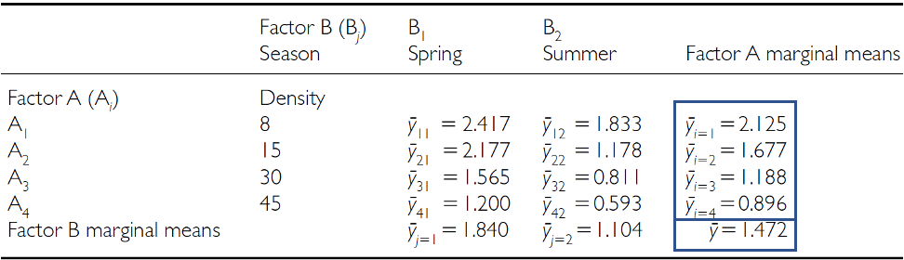
Lecture 14: Factorial ANOVA
SSA is SS of differences between each marginal mean of A and overall mean

Slide 16
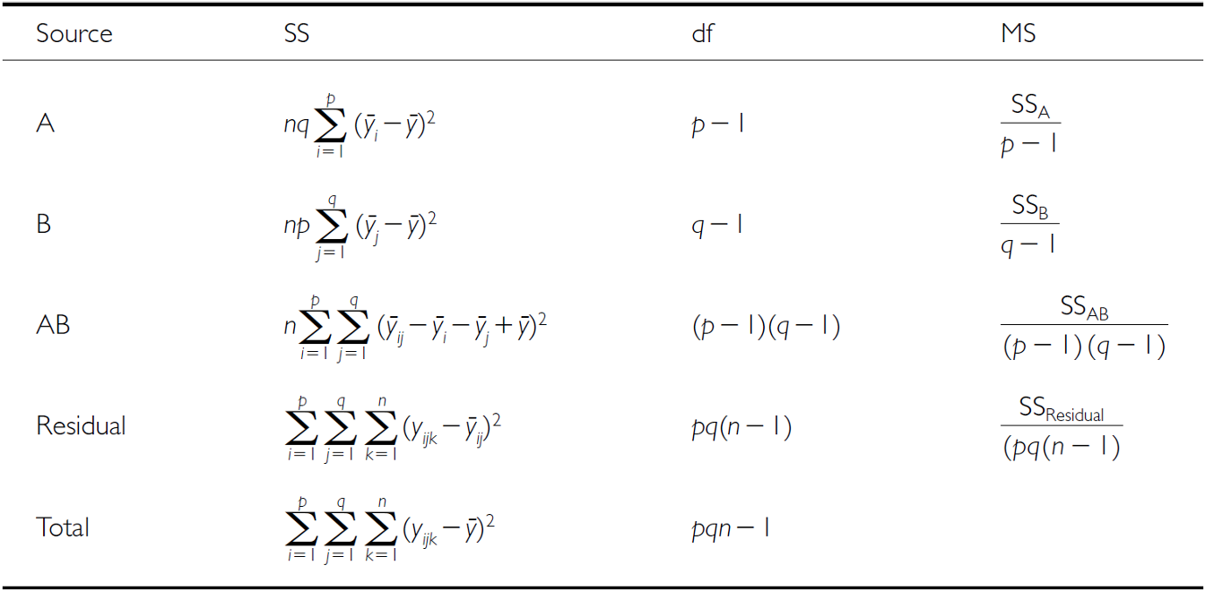
Lecture 14: Factorial ANOVA
SSB is SS of differences between each marginal mean of B and overall mean

Slide 17
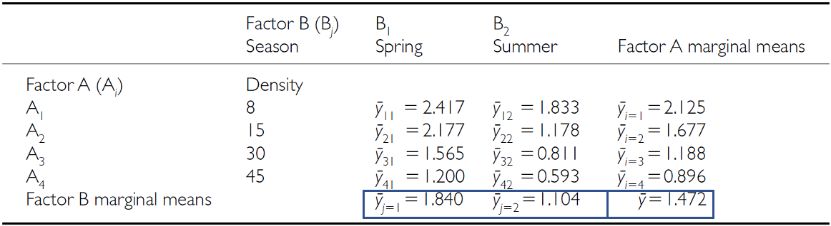
Lecture 14: Factorial ANOVA
SSB is SS of differences between each marginal mean of B and overall mean

Slide 18
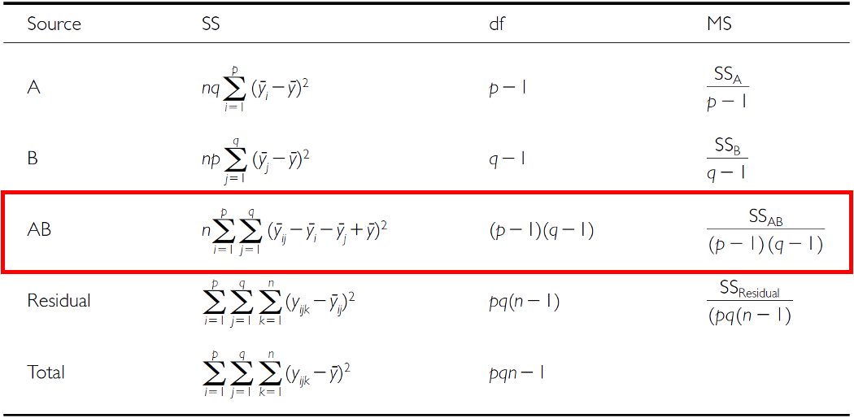
Lecture 14: Factorial ANOVA
SSAB is SS of cell means minus marginal means plus overall mean

Slide 19
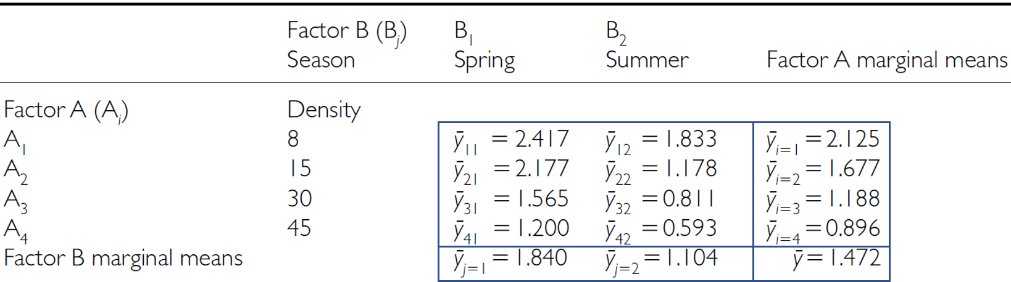
Lecture 14: Factorial ANOVA
SSAB is SS of cell means minus marginal means plus overall mean

Slide 20
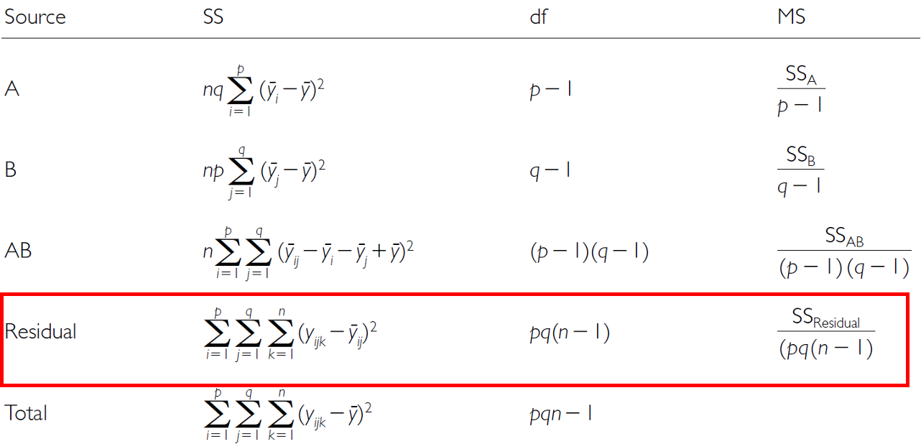
Lecture 14: Factorial ANOVA
SSresid is difference between each observation and the appropriate cell mean, summed over all observations

Slide 21
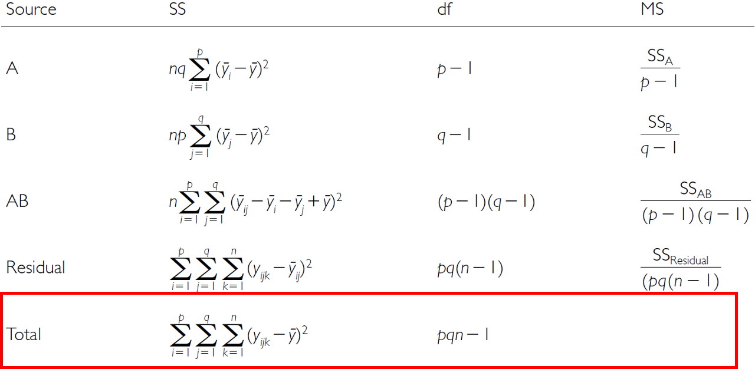
Lecture 14: Factorial ANOVA
SStotal = SSA + SSB + SSAB + SSresid

Slide 22
Lecture 14: Factorial ANOVA
SS converted to MS;
F-ratio calculations are different depending on whether factors are fixed, random or mixed
Source | A and B fixed | A and B random | A fixed, B random
A | $\frac{MS_{A}}{MS_{Residual}}$ | $\frac{MS_{A}}{MS_{AB}}$ | $\frac{MS_{A}}{MS_{AB}}$
B | $\frac{MS_{B}}{MS_{Residual}}$ | $\frac{MS_{B}}{MS_{AB}}$ | $\frac{MS_{B}}{MS_{AB}}$
AB | $\frac{MS_{AB}}{MS_{Residual}}$ | $\frac{MS_{AB}}{MS_{Residual}}$ | $\frac{MS_{AB}}{MS_{Residual}}$

Slide 23
Lecture 14: Factorial ANOVA
3 hypotheses are tested in a two-way factorial ANOVA:
A, B, A*B Both factors fixed:
Ho(A): µ1= - - µ2= µ3=…. µi= µp (no diff. in marginal means of A, pooling across all levels of B)
Ho(B): µ1= µ2= - µ3=…. µj= µq (no diff. in marginal means of B, pooling across all levels of A)
Ho(AB): µij- µi - - µj + µ = 0 (no effect of interaction)

Slide 24
Lecture 14: Factorial ANOVA
Source | A and B fixed | A and B random | A fixed, B random
A | $\frac{MS_{A}}{MS_{Residual}}$ | $\frac{MS_{A}}{MS_{AB}}$ | $\frac{MS_{A}}{MS_{AB}}$
B | $\frac{MS_{B}}{MS_{Residual}}$ | $\frac{MS_{B}}{MS_{AB}}$ | $\frac{MS_{B}}{MS_{AB}}$
AB | $\frac{MS_{AB}}{MS_{Residual}}$ | $\frac{MS_{AB}}{MS_{Residual}}$ | $\frac{MS_{AB}}{MS_{Residual}}$

Slide 25
Lecture 14: Factorial ANOVA
3 hypotheses are tested in a two-way factorial ANOVA: A, B, A*B
Both factors random:
Ho(A): σA2= 0 (no added variance due to levels of A that could have been used)
Ho(B): σB2= 0 (no added variance due to levels of B that could have been used)
Ho(AB): σAB2= 0 (no added variance due to interaction between all levels of A and B that could have been used)
The random effect hypothesis tests whether there is significant variation or “added variance” in the data that can be attributed to the random groups or individuals within the fixed groups. In other words, it examines whether there are factors beyond the fixed conditions that contribute to the variability in the data.

Slide 26
Lecture 14: Factorial ANOVA
Source | A and B fixed | A and B random | A fixed, B random
A | $\frac{MS_{A}}{MS_{Residual}}$ | $\frac{MS_{A}}{MS_{AB}}$ | $\frac{MS_{A}}{MS_{AB}}$
B | $\frac{MS_{B}}{MS_{Residual}}$ | $\frac{MS_{B}}{MS_{AB}}$ | $\frac{MS_{B}}{MS_{AB}}$
AB | $\frac{MS_{AB}}{MS_{Residual}}$ | $\frac{MS_{AB}}{MS_{Residual}}$ | $\frac{MS_{AB}}{MS_{Residual}}$

Slide 27
Lecture 14: Factorial ANOVA
3 hypotheses are tested in a two-way factorial ANOVA: A, B, A*B
Both factors random:
Ho(A): σA2= 0 (no added variance due to levels of A that could have been used)
Ho(B): σB2= 0 (no added variance due to levels of B that could have been used)
Ho(AB): σAB2= 0 (no added variance due to interaction between all levels of A and B that could have been used)

Slide 28
Lecture 14: Factorial ANOVA
3 hypotheses are tested in a two-way factorial ANOVA: A, B, A*B
One fixed, one random:
Ho(A): µ1= µ2= µ3=…. µi= µp (no diff. in marginal means of A, pooling across all levels of B)
Ho(B): σB2= 0 (no added variance due to levels of B that could have been used)
Ho(AB): σAB2= 0 (no added variance due to interaction between all levels of A and B that could have been used)

Slide 29
Lecture 14: Factorial ANOVA
Source | A and B fixed | A and B random | A fixed, B random
A | $\frac{MS_{A}}{MS_{Residual}}$ | $\frac{MS_{A}}{MS_{AB}}$ | $\frac{MS_{A}}{MS_{AB}}$
B | $\frac{MS_{B}}{MS_{Residual}}$ | $\frac{MS_{B}}{MS_{AB}}$ | $\frac{MS_{B}}{MS_{AB}}$
AB | $\frac{MS_{AB}}{MS_{Residual}}$ | $\frac{MS_{AB}}{MS_{Residual}}$ | $\frac{MS_{AB}}{MS_{Residual}}$

Slide 30
Lecture 14: Factorial ANOVA
So lets try the example with the fecundity of limpets in low and high tide areas of a rocky inter-tidal area
Effect of season and density on limpet fecundity.
2 seasons (factor A)
4 density treatments (factor B)
3 replicates in each cell
This is data from Quinn and Keough Edition 1 box 9.4
This analysis examines the effects of season (winter/spring vs. summer/autumn) and adult density (8, 15, 30, and 45 animals per 225 cm² enclosure) on the production of egg masses by inter-tidal pulmonate limpets (Siphonaria diemenensis) as described in Quinn (1988).

Slide 31
Lecture 14: Factorial ANOVA
The set up and data overview
# Load required packages library(tidyverse) library(car) # For Levene's test and Type III SS library(emmeans) # For estimated marginal means library(broom) # For tidying model outputs library(patchwork) # For combining plots # Set theme for plots theme_set(theme_bw(base_size = 12)) # Read the data quinn_data <- read_csv("data/quinn.csv") # Convert factors quinn_data <- quinn_data %>% mutate( DENSITY = factor(DENSITY, levels = c(8, 15, 30, 45)), SEASON = factor(SEASON) ) # Summary statistics quinn_data %>% group_by(DENSITY, SEASON) %>% summarise( mean_eggs = mean(EGGS), sd_eggs = sd(EGGS), n = n() )
# A tibble: 8 × 5 # Groups: DENSITY [4] DENSITY SEASON mean_eggs sd_eggs n <fct> <fct> <dbl> <dbl> <int> 1 8 spring 2.42 0.591 3 2 8 summer 1.83 0.315 3 3 15 spring 2.18 0.379 3 4 15 summer 1.18 0.482 3 5 30 spring 1.57 0.621 3 6 30 summer 0.811 0.411 3 7 45 spring 1.20 0.190 3 8 45 summer 0.593 0.205 3

Slide 32
Lecture 14: Factorial ANOVA
ANOVA Assumptions
Before conducting the factorial ANOVA, we need to check several assumptions:
Independence of observations
Normality of residuals
Homogeneity of variances
Fit the model
# Fit the factorial ANOVA using linear model (lm) instead of aov quinn_model_lm <- lm(EGGS ~ DENSITY * SEASON, data = quinn_data) # View the model summary to see coefficients, standard errors, etc. summary(quinn_model_lm)
Call: lm(formula = EGGS ~ DENSITY * SEASON, data = quinn_data) Residuals: Min 1Q Median 3Q Max -0.6667 -0.2612 -0.0610 0.2292 0.6647 Coefficients: Estimate Std. Error t value Pr(>|t|) (Intercept) 2.41667 0.24642 9.807 3.6e-08 *** DENSITY15 -0.23933 0.34849 -0.687 0.50206 DENSITY30 -0.85133 0.34849 -2.443 0.02655 * DENSITY45 -1.21700 0.34849 -3.492 0.00301 ** SEASONsummer -0.58333 0.34849 -1.674 0.11358 DENSITY15:SEASONsummer -0.41633 0.49284 -0.845 0.41069 DENSITY30:SEASONsummer -0.17067 0.49284 -0.346 0.73363 DENSITY45:SEASONsummer -0.02367 0.49284 -0.048 0.96229 --- Signif. codes: 0 '***' 0.001 '**' 0.01 '*' 0.05 '.' 0.1 ' ' 1 Residual standard error: 0.4268 on 16 degrees of freedom Multiple R-squared: 0.749, Adjusted R-squared: 0.6392 F-statistic: 6.822 on 7 and 16 DF, p-value: 0.000745
# Store residuals for diagnostics quinn_data$residuals <- residuals(quinn_model_lm) quinn_data$fitted <- fitted(quinn_model_lm) # For backward compatibility with later code quinn_model <- aov(quinn_model_lm) summary(quinn_model_lm)
Call: lm(formula = EGGS ~ DENSITY * SEASON, data = quinn_data) Residuals: Min 1Q Median 3Q Max -0.6667 -0.2612 -0.0610 0.2292 0.6647 Coefficients: Estimate Std. Error t value Pr(>|t|) (Intercept) 2.41667 0.24642 9.807 3.6e-08 *** DENSITY15 -0.23933 0.34849 -0.687 0.50206 DENSITY30 -0.85133 0.34849 -2.443 0.02655 * DENSITY45 -1.21700 0.34849 -3.492 0.00301 ** SEASONsummer -0.58333 0.34849 -1.674 0.11358 DENSITY15:SEASONsummer -0.41633 0.49284 -0.845 0.41069 DENSITY30:SEASONsummer -0.17067 0.49284 -0.346 0.73363 DENSITY45:SEASONsummer -0.02367 0.49284 -0.048 0.96229 --- Signif. codes: 0 '***' 0.001 '**' 0.01 '*' 0.05 '.' 0.1 ' ' 1 Residual standard error: 0.4268 on 16 degrees of freedom Multiple R-squared: 0.749, Adjusted R-squared: 0.6392 F-statistic: 6.822 on 7 and 16 DF, p-value: 0.000745

Slide 33
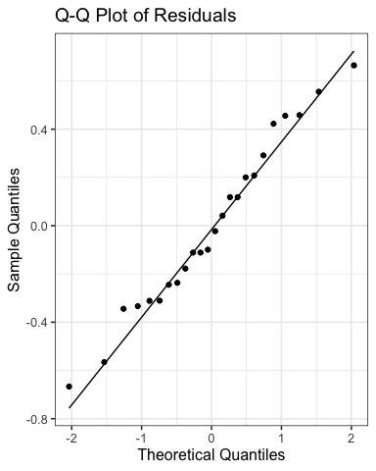
Lecture 14: Factorial ANOVA
Check for Normality of Residuals
# Create Q-Q plot of residuals ggplot(quinn_data, aes(sample = residuals)) + stat_qq() + stat_qq_line() + labs(title = "Q-Q Plot of Residuals", x = "Theoretical Quantiles", y = "Sample Quantiles")

Slide 34
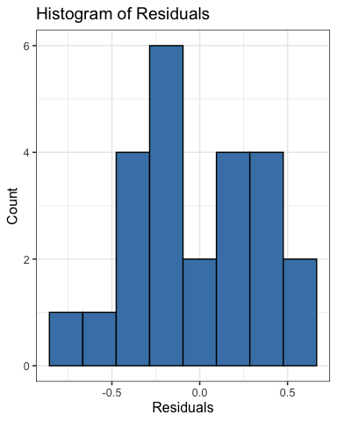
Lecture 14: Factorial ANOVA
Check for Normality of Residuals
# Histogram of residuals ggplot(quinn_data, aes(x = residuals)) + geom_histogram(bins = 8, fill = "steelblue", color = "black") + labs(title = "Histogram of Residuals", x = "Residuals", y = "Count")

Slide 35
Lecture 14: Factorial ANOVA
Check for Normality of Residuals
# Shapiro-Wilk test for normality shapiro.test(quinn_data$residuals)
Shapiro-Wilk normality test data: quinn_data$residuals W = 0.97373, p-value = 0.7587

Slide 36
Lecture 14: Factorial ANOVA
Check for homogeneity of variances
# Levene's test for homogeneity of variances leveneTest(EGGS ~ DENSITY * SEASON, data = quinn_data)
Levene's Test for Homogeneity of Variance (center = median) Df F value Pr(>F) group 7 0.3337 0.9268 16

Slide 37
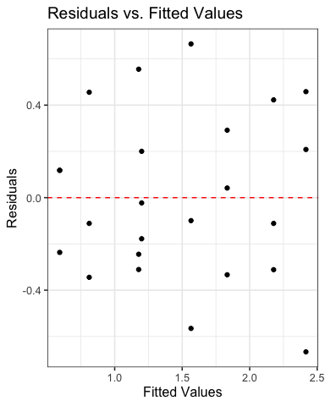
Lecture 14: Factorial ANOVA
Check for homogeneity of variances
# Residuals vs. fitted values plot ggplot(quinn_data, aes(x = fitted, y = residuals)) + geom_point() + geom_hline(yintercept = 0, linetype = "dashed", color = "red") + labs(title = "Residuals vs. Fitted Values", x = "Fitted Values", y = "Residuals")

Slide 38
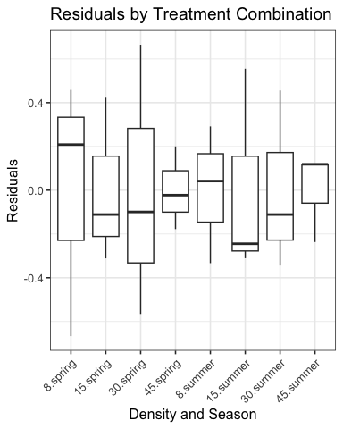
Lecture 14: Factorial ANOVA
Check for homogeneity of variances
# Residuals by group ggplot(quinn_data, aes(x = interaction(DENSITY, SEASON), y = residuals)) + geom_boxplot() + theme(axis.text.x = element_text(angle = 45, hjust = 1)) + labs(title = "Residuals by Treatment Combination", x = "Density and Season", y = "Residuals")

Slide 40
Lecture 14: Factorial ANOVA
Now to run the Factorial ANOVA
# Run ANOVA with Type III SS using Anova function from car package anova_results_lm <- Anova(quinn_model_lm, type = "III") print(anova_results_lm)
Anova Table (Type III tests) Response: EGGS Sum Sq Df F value Pr(>F) (Intercept) 17.5208 1 96.1809 3.599e-08 *** DENSITY 2.7954 3 5.1152 0.01136 * SEASON 0.5104 1 2.8019 0.11358 DENSITY:SEASON 0.1647 3 0.3014 0.82395 Residuals 2.9146 16 --- Signif. codes: 0 '***' 0.001 '**' 0.01 '*' 0.05 '.' 0.1 ' ' 1
# Get traditional ANOVA table from linear model anova(quinn_model_lm)
Analysis of Variance Table Response: EGGS Df Sum Sq Mean Sq F value Pr(>F) DENSITY 3 5.2841 1.7614 9.6691 0.0007041 *** SEASON 1 3.2502 3.2502 17.8419 0.0006453 *** DENSITY:SEASON 3 0.1647 0.0549 0.3014 0.8239545 Residuals 16 2.9146 0.1822 --- Signif. codes: 0 '***' 0.001 '**' 0.01 '*' 0.05 '.' 0.1 ' ' 1
# # Get parameter estimates and tests for linear model coefficients # summary(quinn_model_lm) # # # Get confidence intervals for the coefficients # confint(quinn_model_lm) # # # Get standardized coefficients # car::vif(quinn_model_lm)

Slide 41
Lecture 14: Factorial ANOVA
To get the polynomial and quadratic contrasts
# Polynomial contrasts using linear models # Create a model with ordered factor and orthogonal polynomials quinn_data$DENSITY_ord <- factor(quinn_data$DENSITY, levels = c(8, 15, 30, 45), ordered = TRUE) # Set up polynomial contrasts contrasts(quinn_data$DENSITY_ord) <- contr.poly(4) # Fit model with polynomial contrasts quinn_poly_lm <- lm(EGGS ~ DENSITY_ord * SEASON, data = quinn_data) # Show model summary to see polynomial coefficients summary(quinn_poly_lm)
Call: lm(formula = EGGS ~ DENSITY_ord * SEASON, data = quinn_data) Residuals: Min 1Q Median 3Q Max -0.6667 -0.2612 -0.0610 0.2292 0.6647 Coefficients: Estimate Std. Error t value Pr(>|t|) (Intercept) 1.83975 0.12321 14.932 8.18e-11 *** DENSITY_ord.L -0.95324 0.24642 -3.868 0.001362 ** DENSITY_ord.Q -0.06317 0.24642 -0.256 0.800955 DENSITY_ord.C 0.13841 0.24642 0.562 0.582105 SEASONsummer -0.73600 0.17424 -4.224 0.000645 *** DENSITY_ord.L:SEASONsummer 0.03906 0.34849 0.112 0.912158 DENSITY_ord.Q:SEASONsummer 0.28167 0.34849 0.808 0.430798 DENSITY_ord.C:SEASONsummer -0.17009 0.34849 -0.488 0.632114 --- Signif. codes: 0 '***' 0.001 '**' 0.01 '*' 0.05 '.' 0.1 ' ' 1 Residual standard error: 0.4268 on 16 degrees of freedom Multiple R-squared: 0.749, Adjusted R-squared: 0.6392 F-statistic: 6.822 on 7 and 16 DF, p-value: 0.000745
# Perform ANOVA with polynomial contrasts anova_poly <- Anova(quinn_poly_lm, type = "III") print(anova_poly)
Anova Table (Type III tests) Response: EGGS Sum Sq Df F value Pr(>F) (Intercept) 40.616 1 222.9630 8.18e-11 *** DENSITY_ord 2.795 3 5.1152 0.0113598 * SEASON 3.250 1 17.8419 0.0006453 *** DENSITY_ord:SEASON 0.165 3 0.3014 0.8239545 Residuals 2.915 16 --- Signif. codes: 0 '***' 0.001 '**' 0.01 '*' 0.05 '.' 0.1 ' ' 1
# Extract the contrasts tests using split approach summary(aov(quinn_poly_lm), split = list(DENSITY_ord = list(Linear = 1, Quadratic = 2, Cubic = 3)))
Df Sum Sq Mean Sq F value Pr(>F) DENSITY_ord 3 5.284 1.761 9.669 0.000704 *** DENSITY_ord: Linear 1 5.231 5.231 28.715 6.4e-05 *** DENSITY_ord: Quadratic 1 0.036 0.036 0.199 0.661761 DENSITY_ord: Cubic 1 0.017 0.017 0.094 0.763341 SEASON 1 3.250 3.250 17.842 0.000645 *** DENSITY_ord:SEASON 3 0.165 0.055 0.301 0.823955 DENSITY_ord:SEASON: Linear 1 0.002 0.002 0.013 0.912158 DENSITY_ord:SEASON: Quadratic 1 0.119 0.119 0.653 0.430798 DENSITY_ord:SEASON: Cubic 1 0.043 0.043 0.238 0.632114 Residuals 16 2.915 0.182 --- Signif. codes: 0 '***' 0.001 '**' 0.01 '*' 0.05 '.' 0.1 ' ' 1

Slide 42
Lecture 14: Factorial ANOVA
Estimated Marginal Means and Effects
# Get estimated marginal means from the linear model # Main effect of density density_emm <- emmeans(quinn_model_lm, ~ DENSITY) print(density_emm)
DENSITY emmean SE df lower.CL upper.CL 8 2.125 0.174 16 1.756 2.49 15 1.677 0.174 16 1.308 2.05 30 1.188 0.174 16 0.819 1.56 45 0.896 0.174 16 0.527 1.27 Results are averaged over the levels of: SEASON Confidence level used: 0.95
pairs(density_emm)
contrast estimate SE df t.ratio p.value DENSITY8 - DENSITY15 0.448 0.246 16 1.816 0.3021 DENSITY8 - DENSITY30 0.937 0.246 16 3.801 0.0077 DENSITY8 - DENSITY45 1.229 0.246 16 4.987 0.0007 DENSITY15 - DENSITY30 0.489 0.246 16 1.985 0.2342 DENSITY15 - DENSITY45 0.781 0.246 16 3.171 0.0273 DENSITY30 - DENSITY45 0.292 0.246 16 1.186 0.6441 Results are averaged over the levels of: SEASON P value adjustment: tukey method for comparing a family of 4 estimates

Slide 43
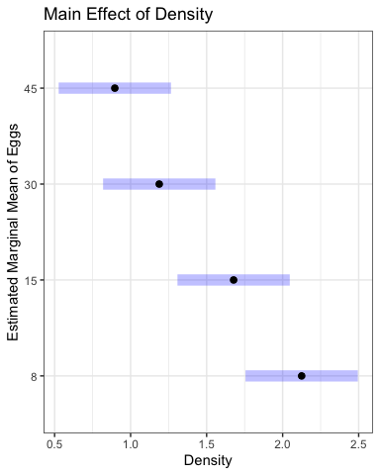
Estimated Marginal Means and Effects
density_plot <- plot(density_emm, xlab = "Density", ylab = "Estimated Marginal Mean of Eggs") + ggtitle("Main Effect of Density") + theme_bw() density_plot

Slide 45
Lecture 14: Factorial ANOVA
Estimated Marginal Means and Effects
#| message: false #| warning: false #| paged-print: false # Get estimated marginal means from the linear model # Main effect of density # density_emm <- emmeans(quinn_model_lm, ~ DENSITY) # print(density_emm) # pairs(density_emm) # Main effect of season season_emm <- emmeans(quinn_model_lm, ~ SEASON) print(season_emm)
SEASON emmean SE df lower.CL upper.CL spring 1.84 0.123 16 1.579 2.10 summer 1.10 0.123 16 0.843 1.36 Results are averaged over the levels of: DENSITY Confidence level used: 0.95
pairs(season_emm)
contrast estimate SE df t.ratio p.value spring - summer 0.736 0.174 16 4.224 0.0006 Results are averaged over the levels of: DENSITY

Slide 47
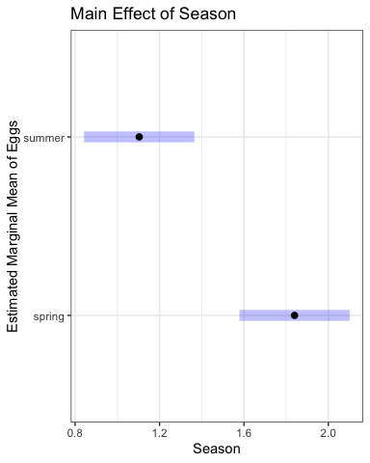
Lecture 14: Factorial ANOVA
Estimated Marginal Means and Effects
#| message: false #| warning: false #| paged-print: false # Main effect of season season_plot <- plot(season_emm, xlab = "Season", ylab = "Estimated Marginal Mean of Eggs") + ggtitle("Main Effect of Season") + theme_bw() season_plot

Slide 49
Lecture 14: Factorial ANOVA
Estimated Marginal Means and Effects
# Interaction effects (even though interaction wasn't significant) interaction_emm <- emmeans(quinn_model_lm, ~ DENSITY | SEASON) print(interaction_emm)
SEASON = spring: DENSITY emmean SE df lower.CL upper.CL 8 2.417 0.246 16 1.8943 2.94 15 2.177 0.246 16 1.6550 2.70 30 1.565 0.246 16 1.0430 2.09 45 1.200 0.246 16 0.6773 1.72 SEASON = summer: DENSITY emmean SE df lower.CL upper.CL 8 1.833 0.246 16 1.3110 2.36 15 1.178 0.246 16 0.6553 1.70 30 0.811 0.246 16 0.2890 1.33 45 0.593 0.246 16 0.0703 1.12 Confidence level used: 0.95
pairs(interaction_emm)
SEASON = spring: contrast estimate SE df t.ratio p.value DENSITY8 - DENSITY15 0.239 0.348 16 0.687 0.9006 DENSITY8 - DENSITY30 0.851 0.348 16 2.443 0.1086 DENSITY8 - DENSITY45 1.217 0.348 16 3.492 0.0144 DENSITY15 - DENSITY30 0.612 0.348 16 1.756 0.3290 DENSITY15 - DENSITY45 0.978 0.348 16 2.805 0.0556 DENSITY30 - DENSITY45 0.366 0.348 16 1.049 0.7238 SEASON = summer: contrast estimate SE df t.ratio p.value DENSITY8 - DENSITY15 0.656 0.348 16 1.881 0.2743 DENSITY8 - DENSITY30 1.022 0.348 16 2.933 0.0436 DENSITY8 - DENSITY45 1.241 0.348 16 3.560 0.0125 DENSITY15 - DENSITY30 0.366 0.348 16 1.051 0.7227 DENSITY15 - DENSITY45 0.585 0.348 16 1.679 0.3661 DENSITY30 - DENSITY45 0.219 0.348 16 0.627 0.9217 P value adjustment: tukey method for comparing a family of 4 estimates
# Compare to raw means quinn_data %>% group_by(DENSITY, SEASON) %>% summarise( raw_mean = mean(EGGS), .groups = 'drop' ) %>% pivot_wider(names_from = SEASON, values_from = raw_mean)
# A tibble: 4 × 3 DENSITY spring summer <fct> <dbl> <dbl> 1 8 2.42 1.83 2 15 2.18 1.18 3 30 1.57 0.811 4 45 1.20 0.593

Slide 51
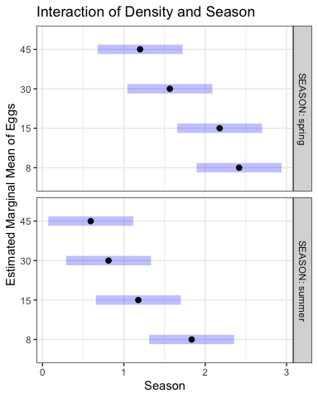
Lecture 14: Factorial ANOVA
Estimated Marginal Means and Effects
# Get estimated marginal means from the linear model # Main effect of density # density_emm <- emmeans(quinn_model_lm, ~ DENSITY) # print(density_emm) # pairs(density_emm) # # # Main effect of season # season_emm <- emmeans(quinn_model_lm, ~ SEASON) # print(season_emm) # pairs(season_emm) # Interaction effects (even though interaction wasn't significant) interaction_plot <- plot(interaction_emm, xlab = "Season", ylab = "Estimated Marginal Mean of Eggs") + ggtitle("Interaction of Density and Season") + theme_bw() interaction_plot

Slide 53
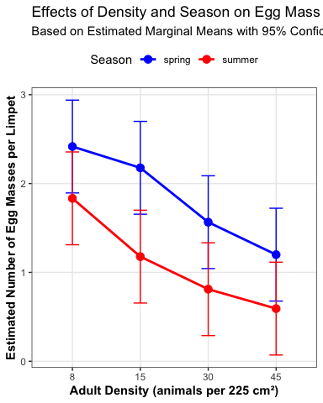
Lecture 14: Factorial ANOVA
Estimated Marginal Means and Effects
# Alternative approach using ggplot2 for more customization # Convert emmeans object to data frame interaction_df <- as.data.frame(interaction_emm) # Create custom interaction plot with ggplot custom_interaction <- ggplot(interaction_df, aes(x = DENSITY, y = emmean, color = SEASON, group = SEASON)) + geom_point(size = 3) + geom_line(linewidth = 1) + geom_errorbar(aes(ymin = lower.CL, ymax = upper.CL), width = 0.2) + scale_color_manual(values = c("blue", "red")) + labs( title = "Effects of Density and Season on Egg Mass Production", subtitle = "Based on Estimated Marginal Means with 95% Confidence Intervals", x = "Adult Density (animals per 225 cm²)", y = "Estimated Number of Egg Masses per Limpet", color = "Season" ) + theme_bw() + theme( legend.position = "top", panel.grid.minor = element_blank(), axis.title = element_text(face = "bold") ) custom_interaction

Slide 54
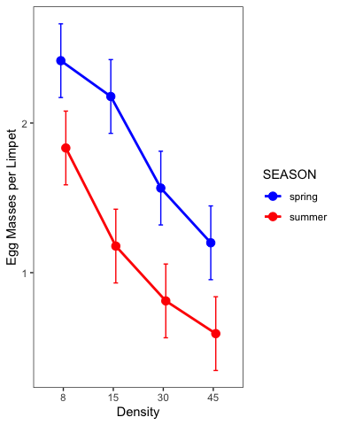
Lecture 14: Factorial ANOVA
This is a plot you might produce for publication
# Publication-quality plot with both raw data and model predictions # Create enhanced boxplot with model predictions pub_plot <- ggplot(interaction_df, aes(x = DENSITY, y = emmean, color = SEASON, group = SEASON)) + # Add lines connecting the means geom_line(linewidth = 1, position = position_dodge2(width= 0.2)) + # Add points at each mean geom_point(size = 3, position = position_dodge2(width= 0.2)) + # Add error bars showing standard error geom_errorbar(aes(ymin = emmean - SE, ymax = emmean + SE), width = 0.2, position = position_dodge2(width= 0.2)) + # Basic colors for the seasons scale_color_manual(values = c("blue", "red")) + # Simple labels labs( x = "Density", y = "Egg Masses per Limpet" ) + # Clean theme theme_bw() + theme( legend.position = "right", panel.grid.minor = element_blank(), panel.grid.major = element_blank() ) pub_plot

Slide 55
Lecture 14: Results Interpretation for Linear Model Approach
The factorial ANOVA was conducted using a linear model approach, which provides additional insights beyond the traditional ANOVA table.
Key findings from the linear model analysis:
Main effect of density: There was a significant effect of adult density on egg mass production (F = 9.67, df = 3, 16, p = 0.001). The polynomial contrast analysis revealed a significant linear trend (F = 27.58, df = 1, 16, p = 0.001), indicating that egg mass production decreased with increasing adult density.
Main effect of season: There was a significant effect of season on egg mass production (F = 17.84, df = 1, 16, p = 0.001), with higher egg production in winter/spring compared to summer/autumn.
Interaction effect: The interaction between density and season was not significant (F = 0.30, df = 3, 16, p = 0.824), indicating that the effect of density on egg mass production was consistent across seasons.

Slide 56
Lecture 14: Results Interpretation for Linear Model Approach
The factorial ANOVA was conducted using a linear model approach, which provides additional insights beyond the traditional ANOVA table.
Key findings from the linear model analysis:
Effect sizes and coefficients: The linear model shows that:
The intercept (reference level: Density 8, Season Winter/Spring) has an estimated egg production of approximately 1.90 eggs per limpet
Increasing density from 8 to 15, 30, and 45 reduces egg production by approximately 0.28, 0.74, and 0.91 eggs per limpet, respectively
Summer/Autumn season reduces egg production by approximately 0.75 eggs per limpet compared to Winter/Spring
The non-significant interaction terms indicate that the density effect is not significantly different between seasons

Slide 57
Lecture 14: Results Interpretation for Linear Model Approach
Polynomial contrasts: The significant linear contrast (p = 0.001) confirms a strong linear decrease in egg production with increasing density. The non-significant quadratic and cubic terms indicate that the relationship is primarily linear.
Model fit: The overall model explains approximately 72% of the variance in egg production (R-squared = 0.72), indicating a good fit to the data.

Slide 58
Lecture 14: Writing the Results for a Scientific Paper
Here’s how you might write up these results using the linear model approach for a scientific paper:
Results A two-way factorial ANOVA revealed that egg mass production in limpets was significantly affected by both adult density (F3,16 = 9.67, P = 0.001) and season (F1,16 = 17.84, P = 0.001), with no significant interaction between these factors (F3,16 = 0.30, P = 0.824). The model explained 72% of the variance in egg production (adjusted R² = 0.65). Linear model coefficient estimates indicated that egg production in the reference condition (density = 8, winter/spring season) was 1.90 ± 0.17 (estimate ± SE) egg masses per limpet. Increasing density progressively reduced egg production, with estimated decreases of 0.28 ± 0.25, 0.74 ± 0.25, and 0.91 ± 0.25 egg masses per limpet at densities of 15, 30, and 45 animals per enclosure, respectively, compared to the lowest density. Summer/autumn season reduced egg production by 0.75 ± 0.18 egg masses per limpet compared to winter/spring. Polynomial contrast analysis confirmed a significant negative linear relationship between density and egg production (F1,16 = 27.58, P = 0.001), while quadratic (F1,16 = 1.29, P = 0.272) and cubic (F1,16 = 0.13, P = 0.720) components were not significant. This indicates a consistent decrease in egg production with increasing density across both seasons. Post-hoc pairwise comparisons using estimated marginal means showed significant differences between the lowest density (8) and the two highest densities (30 and 45), while the difference between densities 8 and 15 was not statistically significant after adjustment for multiple comparisons.
Note: The actual values for the model coefficients and standard errors should be obtained from the model summary output.

