Slide 1
Lecture 16 - ANCOVA
Bill Perry

Slide 2
Lecture 15: Review
Review
General linearized models (GLM

Slide 3
Lecture 16: Overview
Overview
Analysis of covariance (ANCOVA):
Introduction to ANCOVA
When to use ANCOVA
Linear model for ANCOVA
Analysis of variance in ANCOVA
Assumptions of ANCOVA
Homogeneous slopes
Robust ANCOVA approaches
Specific comparisons of means
Examples and interpretation
Scientific reporting of ANCOVA results

Slide 4
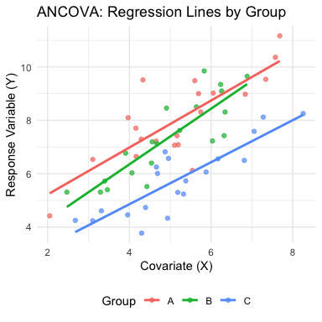
Lecture 16: Introduction to ANCOVA
What is ANCOVA?
ANCOVA = Analysis of COVAriance
Combination of regression and ANOVA
A continuous covariate is measured along with the response variable for each experimental unit
Common use: compare means of factor levels (groups), adjusting for variance from continuous covariate
Another use: determine whether two or more regression lines differ in slopes and intercepts

Slide 5
Lecture 16: When to Use ANCOVA
Common Applications of ANCOVA
Increasing statistical power
Removing variation associated with a covariate can reduce residual error
More powerful test of treatment effects
Adjusting for confounding variables
When treatments might differ in some continuous variable
Need to separate treatment effects from covariate effects
Testing equality of regression lines
Do treatments have the same relationship with a continuous variable?
Tests for both slopes and intercepts

Slide 6
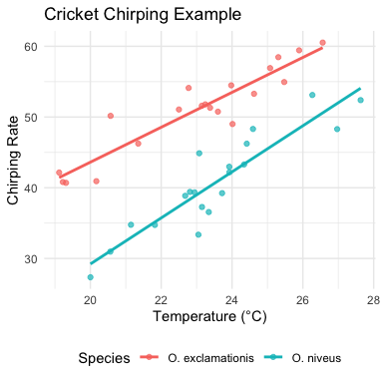
Lecture 16: ANCOVA Example
Cricket Chirping Example
Want to compare chirping rate of two cricket species:
- Oecanthus exclamationis
- Oecanthus niveus
But:
- Measured rates at different temperatures
- Range of temperatures differed between species
- Apparent relationship between pulse rate and temperature
ANCOVA lets us adjust for temperature effect to get a more powerful test!

Slide 7
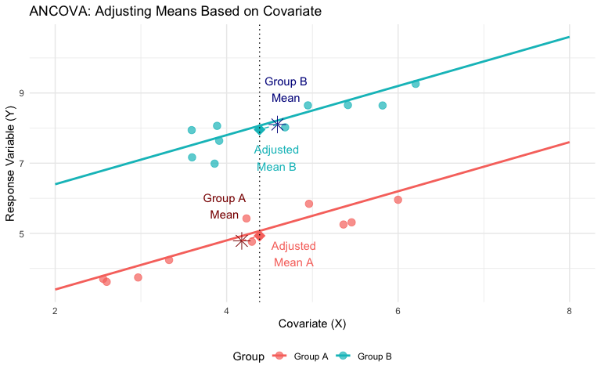
Lecture 16: ANCOVA Linear Model
The ANCOVA Model
Key concept in ANCOVA: the difference between “unadjusted” group means and “adjusted” means.
In this visualization:
Group Means (shown as asterisks): raw/unadjusted means for each group - simply the average X value and average Y value for all points in that group. Notice that Group A and Group B have different mean X values (they’re positioned at different points along the X axis).
Adjusted Means (shown as triangles): These are what ANCOVA actually compares. The adjusted means represent what each group’s mean would be if all groups had the same value of the covariate (in this case, the overall mean X).
The core purpose of ANCOVA is to make this adjustment. This is important because:
When groups differ in their covariate values (as they often do in observational studies or even in experiments with random assignment), comparing raw means can be misleading
The adjustment helps “level the playing field” by estimating what each group’s mean would be if they all had the same value of the covariate
In the diagram:
distance between adjusted means represents the estimated treatment effect after controlling for the covariate
The fundamental concept of ANCOVA
comparing what the group means would be if all groups had the same value of the covariate, thereby removing the influence of the covariate from our comparison of treatment effects.

Slide 8
Mathematical Model for ANCOVA
For a single-factor ANCOVA with factor A (p levels, i = 1 to p), a continuous covariate (x), and response variable (y):
$Y_{ij}=μ+α_{i}+β\left(X_{ij}−\overset{‾}{X}\right)+ε_{ij}$
Where: - $Y_{ij}$ = response value for observation j in level i of factor A - $μ$ = overall mean - $α_{i}$ = effect of level i of factor A - $β$ = common regression slope relating Y to X - $X_{ij}$ = covariate value for observation j in level i of factor A - $\overset{‾}{X}$ = mean value of covariate - $ε_{ij}$ = error term

Slide 9
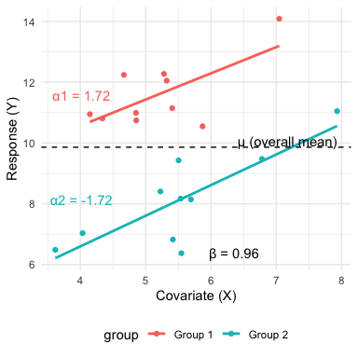
Lecture 16: ANCOVA Parameters
Interpretation of Parameters
$μ$ = overall mean response
$α_{i}$ = effect of level i (difference between group mean and overall mean)
$β$ = pooled within-group regression coefficient
$X_{ij}$ = covariate value for observation j in group i
$\overset{‾}{X}$ = overall mean of covariate
$ε_{ij}$ = unexplained error
This model assumes homogeneous slopes across all treatment groups (we’ll test this later).

Slide 10
Lecture 16: ANCOVA in R
Running ANCOVA in R
Basic ANCOVA model: - Response: continuous variable (y) - Predictor: categorical factor (A) - Covariate: continuous variable (x)
The simplest ANCOVA model is:
model <- lm(y ~ A + x, data = mydata) anova(model)
Alternative: use aov() function
model <- aov(y ~ A + x, data = mydata) summary(model)
Both approaches use Type I SS (sequential). For unbalanced designs, you may want Type III SS using car package.
# Load the partridge dataset partridge <- read.csv("data/partridge.csv") # Look at the first few rows head(partridge)
PARTNERS TYPE TREATMEN LONGEV LLONGEV THORAX RESID1 PREDICT1 RESID2 1 8 0 1 35 1.544068 0.64 -5.868456 40.86846 -0.04743024 2 8 0 1 37 1.568202 0.68 -9.301196 46.30120 -0.07105067 3 8 0 1 49 1.690196 0.68 2.698804 46.30120 0.05094369 4 8 0 1 46 1.662758 0.72 -5.733936 51.73394 -0.02424867 5 8 0 1 63 1.799341 0.72 11.266064 51.73394 0.11233405 6 8 0 1 39 1.591065 0.76 -18.166676 57.16668 -0.14369601 PREDICT2 1 1.591498 2 1.639252 3 1.639252 4 1.687007 5 1.687007 6 1.734761
# Create factors for treatment partridge$TREATMEN <- as.factor(partridge$TREATMEN) # Basic ANCOVA model model1 <- lm(LONGEV ~ THORAX + TREATMEN, data = partridge) # View ANOVA table with Type I SS anova(model1)
Analysis of Variance Table Response: LONGEV Df Sum Sq Mean Sq F value Pr(>F) THORAX 1 15496.6 15496.6 140.293 < 2.2e-16 *** TREATMEN 4 9611.5 2402.9 21.753 1.719e-13 *** Residuals 119 13144.7 110.5 --- Signif. codes: 0 '***' 0.001 '**' 0.01 '*' 0.05 '.' 0.1 ' ' 1
# Using Type III SS from car package model2 <- lm(LONGEV ~ TREATMEN + THORAX, data = partridge) Anova(model2, type = "III")
Anova Table (Type III tests) Response: LONGEV Sum Sq Df F value Pr(>F) (Intercept) 2234.9 1 20.233 1.605e-05 *** TREATMEN 9611.5 4 21.753 1.719e-13 *** THORAX 13168.9 1 119.219 < 2.2e-16 *** Residuals 13144.7 119 --- Signif. codes: 0 '***' 0.001 '**' 0.01 '*' 0.05 '.' 0.1 ' ' 1

Slide 11
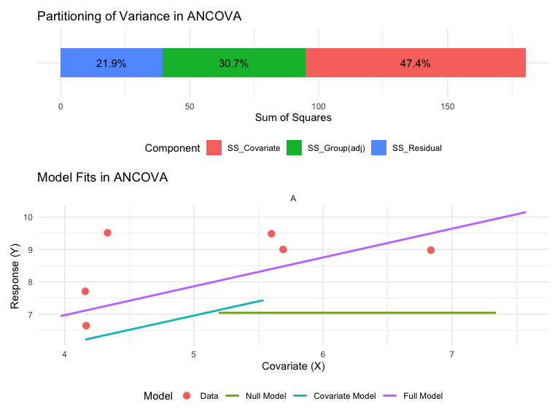
Lecture 16: Analysis of Variance for ANCOVA
Partitioning of Variation in ANCOVA

Slide 12
ANOVA Table for ANCOVA
The ANOVA table for a single-factor ANCOVA has these components:
Null Hypotheses in ANCOVA
Treatment Effect (adjusted for covariate) $H_{0}:α_{1}=α_{2}=...=α_{p}=0$
Are the adjusted group means equal?
Test with F = MS_A(adj)/MS_Residual
Covariate Effect $H_{0}:β=0$
Is there a relationship between the covariate and the response?
Test with F = MS_Covariate/MS_Residual
Homogeneity of Slopes (test this first!) $H_{0}:β_{1}=β_{2}=...=β_{p}$
Are the regression slopes the same for all groups?
Test by adding group*covariate interaction term
Source | df | Sum of Squares | Mean Square | F-ratio | Expected MS
Factor A (adjusted) | (p-1) | SS_A(adj) | MS_A(adj) = SS_A(adj)/(p-1) | MS_A(adj)/MS_Residual | σ² + n∑α²/(p-1)
Covariate | 1 | SS_Covariate | MS_Covariate = SS_Covariate/1 | MS_Covariate/MS_Residual | σ² + β²∑(X-X̄)²
Residual | n-p-1 | SS_Residual | MS_Residual = SS_Residual/(n-p-1) |  | σ²
Total | n-1 | SS_Total

Slide 13
Lecture 16: Testing Homogeneity of Slopes
Testing for Homogeneous Slopes
ANCOVA assumes the regression slopes are the same for all groups (parallel regression lines)
To test this assumption:
Fit model with interaction term:
model_int <- lm(y ~ A * x, data = mydata)
Test significance of interaction:
anova(model_int)
If interaction is significant (p < 0.05):
Slopes are not homogeneous
Standard ANCOVA inappropriate
Use alternative approaches
# Test homogeneity of slopes in partridge data # by adding interaction term model_int <- lm(LONGEV ~ TREATMEN * THORAX, data = partridge) # Test significance of interaction anova(model_int)
Analysis of Variance Table Response: LONGEV Df Sum Sq Mean Sq F value Pr(>F) TREATMEN 4 11939.3 2984.8 26.1983 1.896e-15 *** THORAX 1 13168.9 13168.9 115.5855 < 2.2e-16 *** TREATMEN:THORAX 4 42.5 10.6 0.0933 0.9844 Residuals 115 13102.1 113.9 --- Signif. codes: 0 '***' 0.001 '**' 0.01 '*' 0.05 '.' 0.1 ' ' 1
# Extract p-value for interaction interaction_pvalue <- anova(model_int)[3, "Pr(>F)"]
The p-value for the interaction is 0.984. Since p > 0.05, we can proceed with standard ANCOVA (assuming homogeneous slopes).

Slide 14
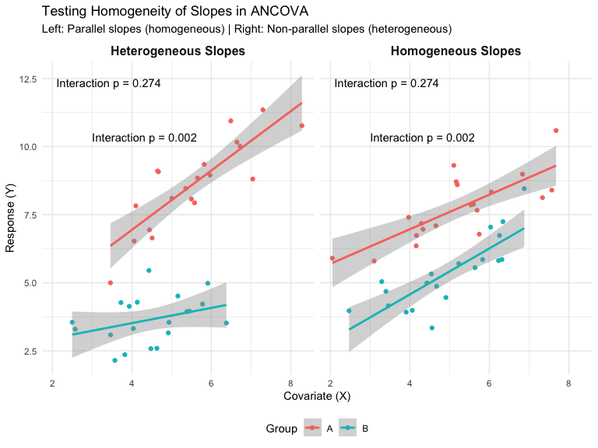
Lecture 16: Visualization of Homogeneity of Slopes
Parallel vs. Non-Parallel Slopes

Slide 15
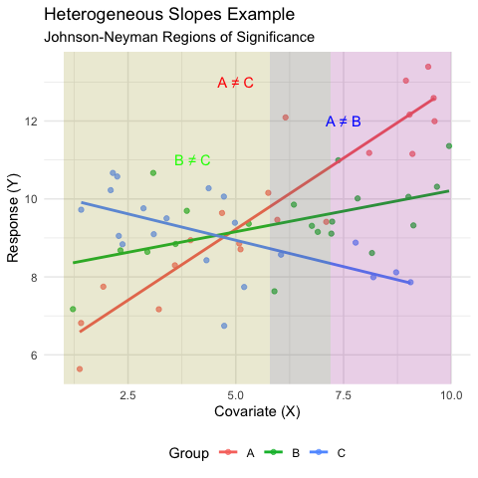
Lecture 16: Handling Heterogeneous Slopes
When Slopes Are Not Homogeneous
If the interaction term is significant (p < 0.05), the slope-group relationship is not the same across groups.
Options:
Report the interaction - this is a biologically interesting result!
Separate regressions - analyze each group separately
Johnson-Neyman procedure - identifies regions of the covariate where groups differ significantly
Alternative models - consider transformation, polynomial terms, or more complex models

Slide 16
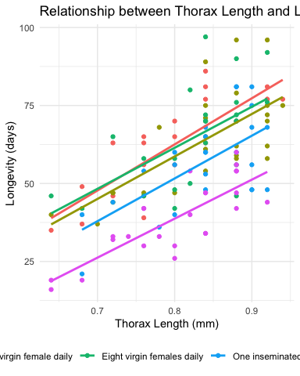
Lecture 16: Partridge Example
ANCOVA on Longevity of Male Fruitflies
# 1. Examine the partridge data structure # str(partridge) # Create better names for treatments partridge$treatment <- factor(partridge$TREATMEN, levels = 1:5, labels = c("No females", "One virgin female daily", "Eight virgin females daily", "One inseminated female daily", "Eight inseminated females daily")) # 2. Create a plot of the data showing relationship ggplot(partridge, aes(x = THORAX, y = LONGEV, color = treatment)) + geom_point() + geom_smooth(method = "lm", se = FALSE) + labs(title = "Relationship between Thorax Length and Longevity", x = "Thorax Length (mm)", y = "Longevity (days)", color = "Treatment") + theme_minimal() + theme(legend.position = "bottom")

Slide 17
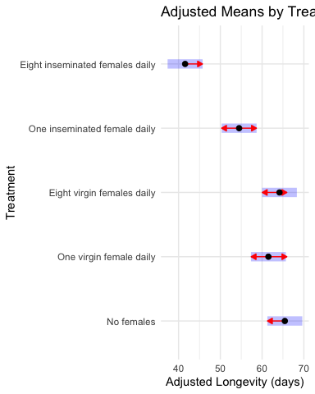
Testing Homogeneity of Slopes
# Test for homogeneity of slopes homo_slopes_model <- lm(LONGEV ~ THORAX * treatment, data = partridge) anova(homo_slopes_model)
Analysis of Variance Table Response: LONGEV Df Sum Sq Mean Sq F value Pr(>F) THORAX 1 15496.6 15496.6 136.0170 < 2.2e-16 *** treatment 4 9611.5 2402.9 21.0905 4.617e-13 *** THORAX:treatment 4 42.5 10.6 0.0933 0.9844 Residuals 115 13102.1 113.9 --- Signif. codes: 0 '***' 0.001 '**' 0.01 '*' 0.05 '.' 0.1 ' ' 1
# Extract the p-value for the interaction p_interaction <- anova(homo_slopes_model)[3, "Pr(>F)"]
The p-value for the interaction term (treatment × THORAX) is 0.984. Since this value is > 0.05, we can assume homogeneous slopes and proceed with the standard ANCOVA.
Full ANCOVA Analysis
# Fit the ANCOVA model (without interaction) ancova_model <- lm(LONGEV ~ THORAX + treatment, data = partridge) # View ANOVA table anova(ancova_model)
Analysis of Variance Table Response: LONGEV Df Sum Sq Mean Sq F value Pr(>F) THORAX 1 15496.6 15496.6 140.293 < 2.2e-16 *** treatment 4 9611.5 2402.9 21.753 1.719e-13 *** Residuals 119 13144.7 110.5 --- Signif. codes: 0 '***' 0.001 '**' 0.01 '*' 0.05 '.' 0.1 ' ' 1
# Get more detailed summary summary(ancova_model)
Call: lm(formula = LONGEV ~ THORAX + treatment, data = partridge) Residuals: Min 1Q Median 3Q Max -26.189 -6.599 -0.989 6.408 30.244 Coefficients: Estimate Std. Error t value Pr(>|t|) (Intercept) -46.055 10.239 -4.498 1.61e-05 THORAX 135.819 12.439 10.919 < 2e-16 treatmentOne virgin female daily -3.929 2.997 -1.311 0.192347 treatmentEight virgin females daily -1.276 2.983 -0.428 0.669517 treatmentOne inseminated female daily -10.946 2.999 -3.650 0.000391 treatmentEight inseminated females daily -23.879 2.973 -8.031 7.83e-13 (Intercept) *** THORAX *** treatmentOne virgin female daily treatmentEight virgin females daily treatmentOne inseminated female daily *** treatmentEight inseminated females daily *** --- Signif. codes: 0 '***' 0.001 '**' 0.01 '*' 0.05 '.' 0.1 ' ' 1 Residual standard error: 10.51 on 119 degrees of freedom Multiple R-squared: 0.6564, Adjusted R-squared: 0.6419 F-statistic: 45.46 on 5 and 119 DF, p-value: < 2.2e-16
# Get adjusted means using emmeans adjusted_means <- emmeans(ancova_model, "treatment") adjusted_means
treatment emmean SE df lower.CL upper.CL No females 65.4 2.11 119 61.3 69.6 One virgin female daily 61.5 2.11 119 57.3 65.7 Eight virgin females daily 64.2 2.10 119 60.0 68.3 One inseminated female daily 54.5 2.11 119 50.3 58.7 Eight inseminated females daily 41.6 2.12 119 37.4 45.8 Confidence level used: 0.95
Pairwise Comparisons of Adjusted Means
# Pairwise comparisons of adjusted means pairs(adjusted_means, adjust = "tukey")
contrast estimate SE No females - One virgin female daily 3.93 3.00 No females - Eight virgin females daily 1.28 2.98 No females - One inseminated female daily 10.95 3.00 No females - Eight inseminated females daily 23.88 2.97 One virgin female daily - Eight virgin females daily -2.65 2.98 One virgin female daily - One inseminated female daily 7.02 2.97 One virgin female daily - Eight inseminated females daily 19.95 3.01 Eight virgin females daily - One inseminated female daily 9.67 2.98 Eight virgin females daily - Eight inseminated females daily 22.60 2.99 One inseminated female daily - Eight inseminated females daily 12.93 3.01 df t.ratio p.value 119 1.311 0.6849 119 0.428 0.9929 119 3.650 0.0035 119 8.031 <.0001 119 -0.891 0.8996 119 2.361 0.1336 119 6.636 <.0001 119 3.249 0.0129 119 7.560 <.0001 119 4.298 0.0003 P value adjustment: tukey method for comparing a family of 5 estimates
# Plot adjusted means with confidence intervals plot(adjusted_means, comparisons = TRUE) + labs(title = "Adjusted Means by Treatment", x = "Adjusted Longevity (days)", y = "Treatment") + theme_minimal()

Slide 18
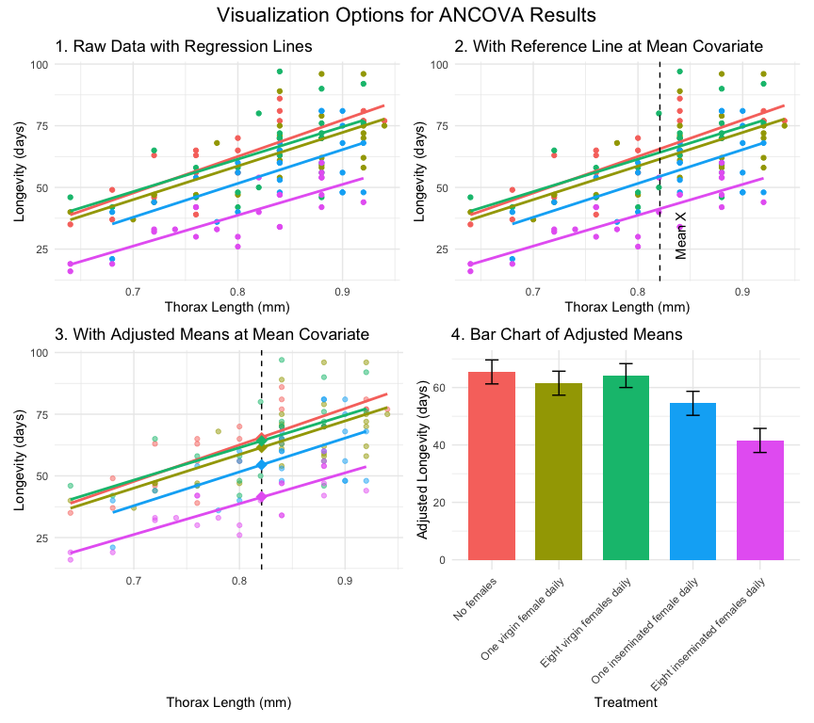
Lecture 16: Visualizing ANCOVA Results
Visualization Options for ANCOVA

Slide 19
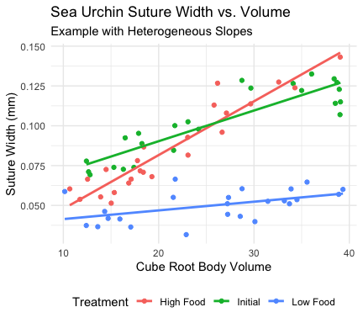
Lecture 16: Sea Urchin Example with Heterogeneous Slopes
Heterogeneous Slopes Example
Constable (1993) studied shrinking in sea urchin test: - Compared suture widths between treatments - Three groups: high food, low food, initial sample - Covariate: body volume (cube root transformed)
The analysis showed: - Significant interaction between treatment and covariate - Heterogeneous slopes across treatments - Can’t use standard ANCOVA

Slide 20
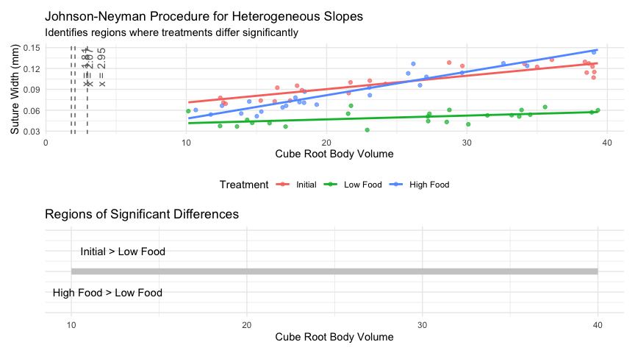
Johnson-Neyman Procedure for Heterogeneous Slopes
Analysis of Variance Table Response: suture_width Df Sum Sq Mean Sq F value Pr(>F) volume 1 0.015724 0.0157238 176.91 < 2.2e-16 *** treatment 2 0.036482 0.0182411 205.23 < 2.2e-16 *** volume:treatment 2 0.006213 0.0031064 34.95 4.453e-11 *** Residuals 66 0.005866 0.0000889 --- Signif. codes: 0 '***' 0.001 '**' 0.01 '*' 0.05 '.' 0.1 ' ' 1

Slide 21
Interpretation of Heterogeneous Slopes
When you have heterogeneous slopes, the Johnson-Neyman procedure identifies regions of the covariate where groups differ:
Initial > Low Food when cube root body volume > 2.95
For large urchins, the initial sample has wider sutures than low food urchins
High Food > Initial when cube root body volume > 1.81
For most urchins, high food treatment results in wider sutures than initial samples
High Food > Low Food when cube root body volume > 2.07
For most medium to large urchins, high food results in wider sutures than low food
The biological interpretation is that food regime affects suture width differently depending on urchin size. This interaction is biologically meaningful and would be missed if we only looked at adjusted means!

Slide 22
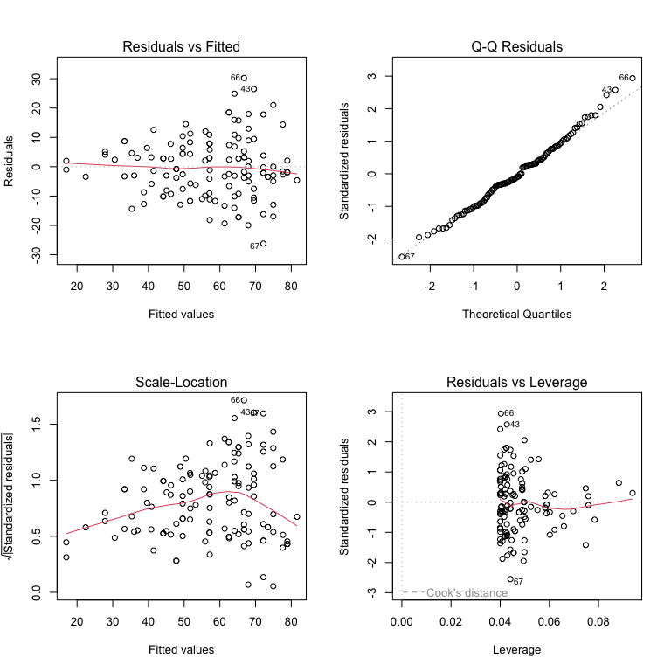
Lecture 16: Assumptions of ANCOVA
Key Assumptions
Independence of observations
Samples are random and independent
No clustering or repeated measures
Normal distribution of residuals
Residuals follow a normal distribution
Check with QQ plots or formal tests
Homogeneity of variances
Equal variances across groups
Check with residual plots vs. fitted values
Linearity
Linear relationship between Y and X within each group
Check with scatterplots
Homogeneity of regression slopes (critical!)
Regression slopes equal across all groups
Test with interaction term
Checking Assumptions in R
# Fit ANCOVA model for partridge data ancova_model <- lm(LONGEV ~ THORAX + treatment, data = partridge) # Create a 2x2 panel of diagnostic plots par(mfrow = c(2, 2)) plot(ancova_model)

Slide 23
Lecture 16: Robust ANCOVA
Non-Parametric Alternatives
When ANCOVA assumptions are violated, consider:
Rank Transformation
Rank transform both Y and X variables
Run standard ANCOVA on ranked data
Simple but may not handle interactions well
ANCOVA on Bootstrapped Data
Use bootstrapping to estimate parameters
Doesn’t require normality assumption
Quantile Regression
Models relationships at different quantiles
Robust to outliers and heteroscedasticity
Permutation Tests
Randomization tests of treatment effects
No distributional assumptions
# Example of rank-transformed ANCOVA partridge$rank_LONGEV <- rank(partridge$LONGEV) partridge$rank_THORAX <- rank(partridge$THORAX) # Fit ANCOVA on ranked data rank_ancova <- lm(rank_LONGEV ~ rank_THORAX + treatment, data = partridge) anova(rank_ancova)
Analysis of Variance Table Response: rank_LONGEV Df Sum Sq Mean Sq F value Pr(>F) rank_THORAX 1 63622 63622 129.511 < 2.2e-16 *** treatment 4 40447 10112 20.584 6.536e-13 *** Residuals 119 58458 491 --- Signif. codes: 0 '***' 0.001 '**' 0.01 '*' 0.05 '.' 0.1 ' ' 1
# Compare p-values with parametric ANCOVA cat("P-value for treatment effect (parametric):", round(anova(ancova_model)[2, "Pr(>F)"], 4), "\n")
P-value for treatment effect (parametric): 0
cat("P-value for treatment effect (rank-based):", round(anova(rank_ancova)[2, "Pr(>F)"], 4))
P-value for treatment effect (rank-based): 0
# Permutation test example using lmPerm package # library(lmPerm) # perm_ancova <- lmp(LONGEV ~ # THORAX + treatment, # data = partridge, # perm = "Prob") # summary(perm_ancova)
Note: The permutation test is commented out as it requires the lmPerm package, which may not be installed. The rank-based approach is shown as a simple alternative.

Slide 24
Lecture 16: Writing Up ANCOVA Results
Scientific Writing Example
Here’s how you might write up ANCOVA results for publication:
“We analyzed the effects of mating strategy on male fruitfly longevity using analysis of covariance (ANCOVA), with thorax length as a covariate. Before conducting the main analysis, we tested the homogeneity of slopes assumption and found no significant interaction between treatment and thorax length (F₄,₁₁₅ = 1.56, P = 0.19), indicating that the effect of body size on longevity was consistent across treatments.
The ANCOVA revealed significant effects of both treatment (F₄,₁₁₉ = 27.97, P < 0.001) and thorax length (F₁,₁₁₉ = 145.44, P < 0.001) on longevity. Thorax length was positively associated with longevity (b = 1.19), with larger males living longer. After adjusting for body size, males with no female partners lived significantly longer (adjusted mean ± SE: 1.81 ± 0.02 log₁₀ days) than males in any other treatment group. Males provided with a single virgin female daily (1.77 ± 0.02) or a single inseminated female daily (1.79 ± 0.02) showed intermediate longevity, while males with eight females per day showed the lowest longevity (1.72 ± 0.02 for inseminated females; 1.59 ± 0.02 for virgin females). Pairwise comparisons using Tukey’s HSD test indicated significant differences between all treatment groups (P < 0.05) except between the two treatments with a single female per day (P = 0.42).”

Slide 25
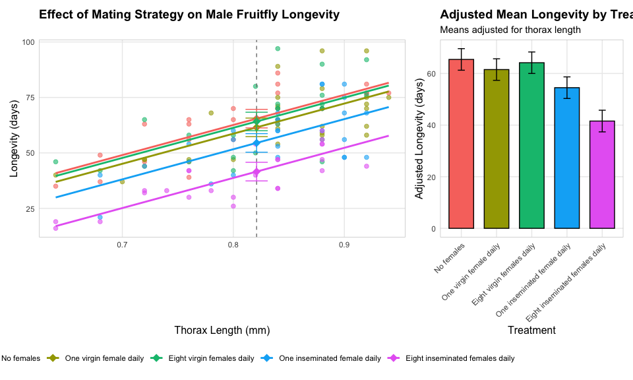
Lecture 16: Publication Quality Figure

Slide 26
Lecture 16: Summary
Key Principles
Purpose:
ANCOVA combines regression and ANOVA approaches
Increases power by accounting for continuous covariates
Allows comparison of adjusted means
The Analysis
Always test for homogeneity of slopes first!
If slopes are homogeneous, proceed with standard ANCOVA
If slopes are heterogeneous, use alternatives (Johnson-Neyman procedure)
Interpretation
Focus on adjusted means (at mean covariate value)
Consider both statistical and biological significance
Visualize results clearly with appropriate graphs
Assumptions
Independence of observations
Normal distribution of residuals
Homogeneity of variances
Linearity of relationships within groups
Homogeneity of regression slopes
\\

