Slide 1
Lecture 2: Project Design & Data Visualization
Bill Perry

Slide 2
Review of Lecture 1
Covered
Inductive vs deductive reasoning
Formulating research questions
Accuracy vs precision
Data types and classifications
Setting up R projects
Installing and loading libraries
Reading files into R
Creating basic graphs

Slide 3
Lecture 2: Project Design & Data Visualization
The objectives:
Design a well-organized project
Implement good naming conventions
Controlled vocabulary
Including units in names
Create and use metadata effectively
Build tidy, well-structured spreadsheets
Understand data repositories
Create effective visualizations with ggplot2
<>

Slide 4
Project Design: Step 1
Data: the raw material of science
Wide variety of formats, sizes, complexity
Data management and curation often under emphasized
Good data management: owe it to our funding agencies, colleagues, supervisors, and study systems
<>

Slide 5
Lecture 2: Project Design: Step 1
Determine data types you’ll collect
Establish controlled vocabulary
Example: do_mgl for dissolved oxygen in mg/L
Example: drp_ugl for dissolved reactive phosphorus in μg/L
Plan your data flow from collection to analysis
Organize your project structure (folders, files)
Enter data promptly after collection
Save in multiple formats (Excel and CSV)
Ensure tidy data principles from the start
Note
See Hadley Wickham’s Tidy Data principles for best practices
<>

Slide 6
Project Design: Step 2

Slide 7
Create a Metadata Sheet that includes:
Variable descriptions
Units of measurement
Collection methods
Instrument details
Dates and locations
Any other relevant contextual information
<>

Slide 8
Practice Exercise 1: Pine Data Organization
Let’s examine our pine needle data: - What naming conventions did you choose? - How did you organize the data? - How can you verify data formats (numeric vs categorical)? - What’s your plan for organizing outputs and figures?
# Code to read and examine data library(tidyverse) library(patchwork) library(kableExtra) pine_df <- read_csv("data/pine_needles.csv") glimpse(pine_df)
Rows: 48 Columns: 6 $ date <chr> "3/20/25", "3/20/25", "3/20/25", "3/20/25", "3/20/25", "3/20/2… $ group <chr> "cephalopods", "cephalopods", "cephalopods", "cephalopods", "c… $ n_s <chr> "n", "n", "n", "n", "n", "n", "s", "s", "s", "s", "s", "s", "n… $ wind <chr> "lee", "lee", "lee", "lee", "lee", "lee", "wind", "wind", "win… $ tree_no <dbl> 1, 1, 1, 1, 1, 1, 1, 1, 1, 1, 1, 1, 2, 2, 2, 2, 2, 2, 2, 2, 2,… $ len_mm <dbl> 20, 21, 23, 25, 21, 16, 15, 16, 14, 17, 13, 15, 19, 18, 20, 23…

Slide 9
Lecture 2: Data Management: Step 3
Storage and Backup Strategy:
Store raw data and metadata securely
Save in both Excel and CSV formats
Consider write-protecting raw data files
Implement the 3-2-1 backup rule:
3 total copies of data
2 different storage media
1 offsite location (cloud storage)
Establish a regular backup schedule
<

Slide 10
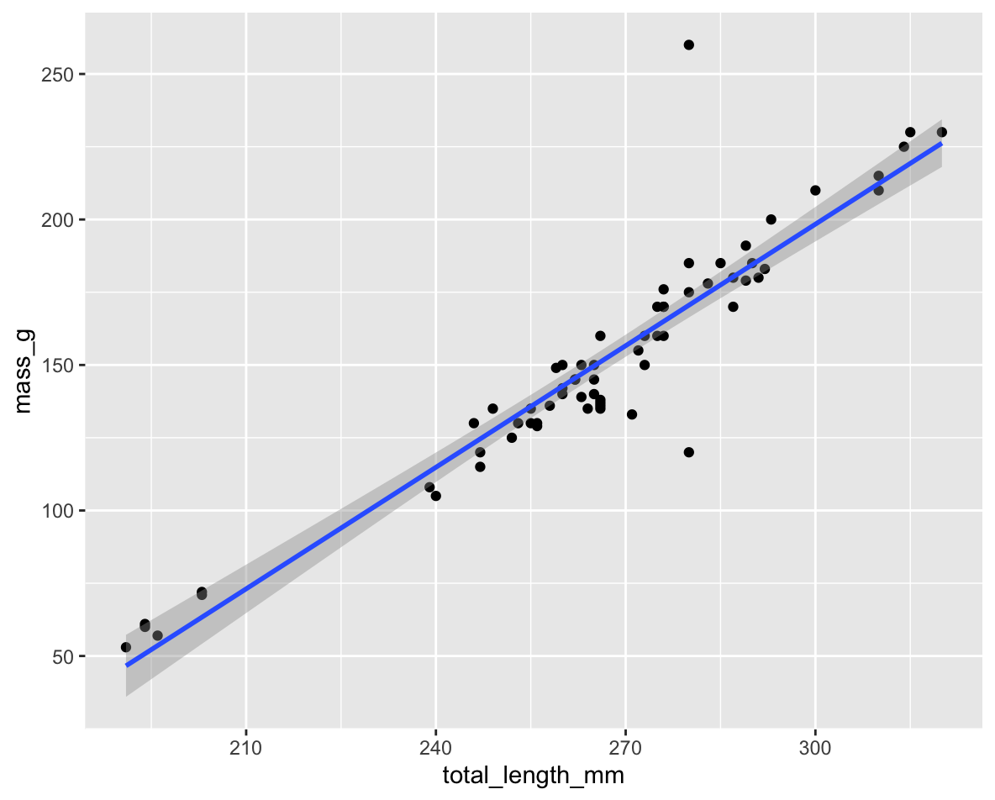
Lecture 2: Data Management: Step 4
Initial Data Inspection:
Examine data in the Environment tab
Run summary() and glimpse() functions
Create exploratory visualizations
Check for outliers, errors, and missing data
# Specify how to handle missing values during import pine_df <- read_csv("data/pine_needles.csv", na = c("", "NA", "N/A", "missing", "null")) # Get a quick summary summary(pine_df)

Slide 11
Practice Exercise 2: Try plotting a histogram of your data
Create a histogram of pine needle lengths to check the distribution:
# Write your code here to make a plot # How do you examine the data - what are the ways you think and lets try it!

Slide 12
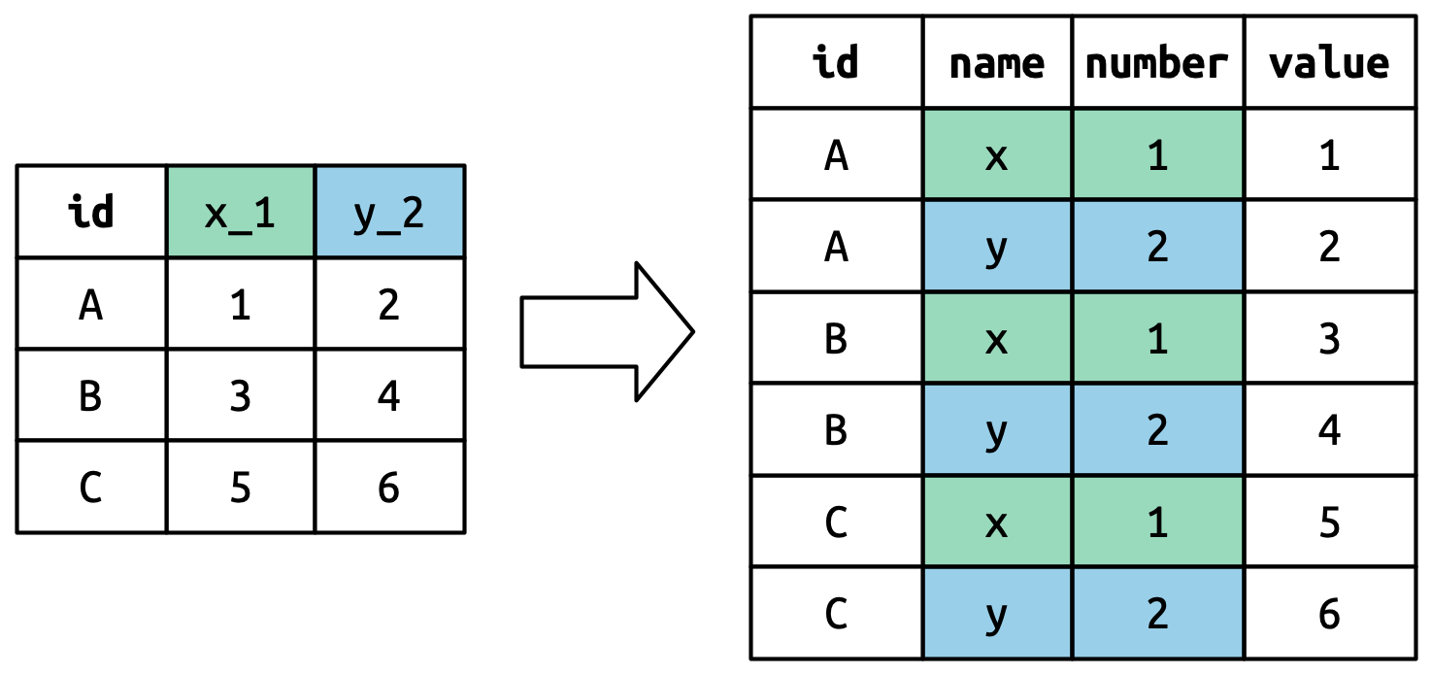
Lecture 2: Data Management: Step 5
Data Cleaning:
Correct errors and inconsistencies
Replace missing values with proper NA codes
Document all changes made to raw data
Save a clean, master version (consider making read-only)
Keep notes on data cleaning procedures

Slide 13
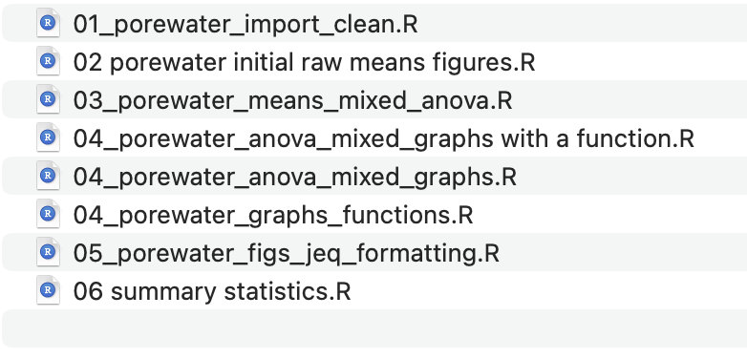
Lecture 2: Data Management: Step 6
Analysis and Visualization Workflow:
Create exploratory visualizations
Summarize and transform data as needed
Document all analysis steps
Save outputs systematically
A good way to organize script files is number them in the order they get run.

Slide 14
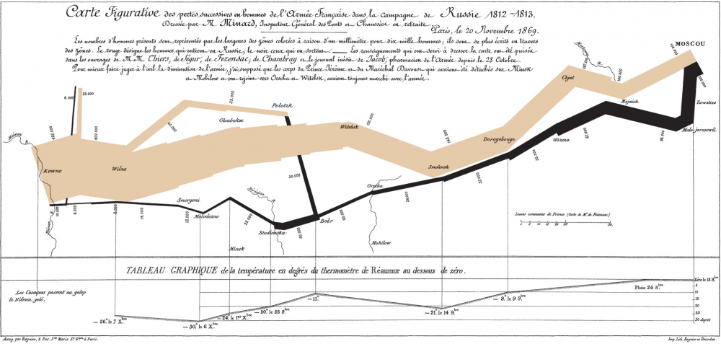
Lecture 2: Effective Data Visualization
Why make plots?
Get in a group and discuss
What is the purpose of a data visualization?
What elements are essential in an effective plot?
What characteristics define a “good” plot?
What common mistakes make plots ineffective?
Napoleon’s Disastrous Invasion of Russia Detailed in an 1869 Data Visualization: It’s Been Called “the Best Statistical Graphic Ever Drawn”

Slide 15
Lecture 2: Tables vs. Visualizations
How readable are tables?
We will get to what these number mean and how to make them in the next lecture.
Tables
are they useful in a presentation?
wind | n | mean_len_mm | sd_len_mm | min_len_mms | max_len_mm
lee | 24 | 20 | 2.45 | 16 | 25
wind | 24 | 15 | 1.91 | 12 | 19

Slide 16
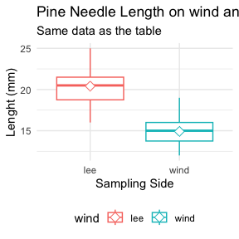
Lecture 2: Displaying data
how does a table compare to a plot?
Does this help?
What is this plot?
if you don’t explain does the audience know?
<

Slide 17
Lecture 2: Principles of Effective Graphics
According to Tufte (2001), good scientific graphics:
Show the data without distortion
Maximize data-ink ratio (minimize non-data elements)
Make large datasets coherent and understandable
Encourage comparison between elements
Reveal multiple layers of information
Serve a clear purpose in telling your story
Integrate with statistical methods appropriately
group | mean_length | sd_length | n | se_length | conf_low | conf_high
cephalopods | 18.00000 | 3.861229 | 12 | 1.1146409 | 15.54669 | 20.45331
crayfish | 18.00000 | 3.861229 | 12 | 1.1146409 | 15.54669 | 20.45331
salmon | 16.33333 | 3.938928 | 12 | 1.1370705 | 13.83066 | 18.83601
snail | 18.33333 | 2.269695 | 12 | 0.6552045 | 16.89124 | 19.77543

Slide 18
Lecture 2: Creating Effective Graphics
According to Tufte (2001), good scientific graphics:
To implement these principles:
Focus on the data, not decorative elements
Ensure proportional representation of numbers
Provide clear and informative labels
Remove unnecessary elements (“chart junk”)
Revise and refine visualizations iteratively

Slide 19
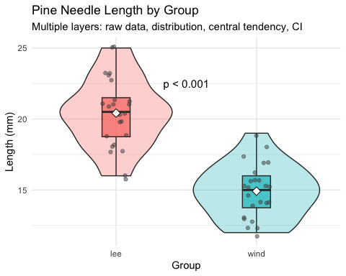
Lecture 2: Displaying data
To make good graphics:
Above all, focus on data
Do not distort data
Graphical representation of numbers → directly proportional to numbers
Strive for clarity through labeling
Maximize data-ink ratio
Remove non-data ink
Reduce redundant data ink
Revise and redraw

Slide 20
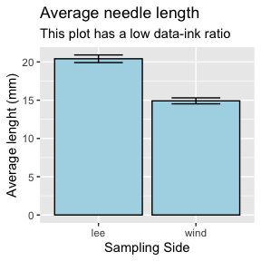
Lecture 2: Displaying data
What do you think?
Does this -
Focus on data
Distort data
Is it directly proportional to numbers
Is labeling clear
Maximize data-ink ratio
Remove non-data ink
Reduce redundant data ink
Revise and redraw
<
# Let's create two versions of the same plot # First, a "poor" version with low data-ink ratio library(ggthemes) poor_plot <- ggplot(pine_df, aes(x = wind, y = len_mm)) + geom_bar(stat = "summary", fun = "mean", fill = "lightblue", color = "black") + geom_errorbar(stat = "summary", fun.data = "mean_se", width = 0.5) + # theme_excel() + labs(title = "Average needle length", subtitle = "This plot has a low data-ink ratio", x = "Sampling Side", y = "Average lenght (mm)") poor_plot

Slide 21
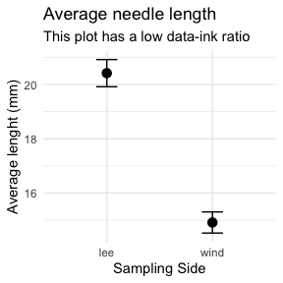
Lecture 2: Displaying data
What do you think?
Does this -
Focus on data
Distort data
Is it directly proportional to numbers
Is labeling clear
Maximize data-ink ratio
Remove non-data ink
Reduce redundant data ink
Revise and redraw
What is one of the most common plots you make all the time?
# "Better" version with higher data-ink ratio better_plot <- ggplot(pine_df, aes(x = wind, y = len_mm)) + stat_summary(fun = "mean", geom = "point", size = 3) + stat_summary(fun.data = "mean_se", geom = "errorbar", width = 0.2) + theme_minimal() + labs(title = "Average needle length", subtitle = "This plot has a low data-ink ratio", x = "Sampling Side", y = "Average lenght (mm)") better_plot

Slide 22
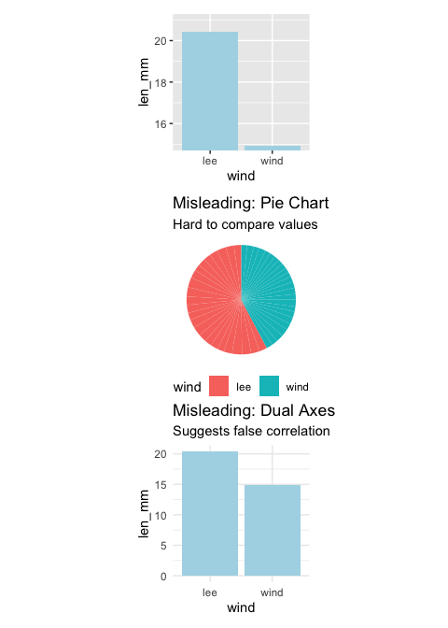
Lecture 2: Displaying data -the bad
Common Visualization Problems
Data distortion:
Non-zero baselines on bar charts
3D effects that skew perspective
Inappropriate scales
Excessive “chart junk”:
Too many gridlines
Unnecessary decorative elements
Redundant information
Poor color choices:
Too many colors
Non-colorblind-friendly palettes
Colors that don’t print well in grayscale
Misleading representations:
Pie charts with too many categories
Dual y-axes with different scales
Truncated axes without clear indication
<
NULL

Slide 23
Practice Exercise 3: Lets try some plots with pine data first
Lets try to make some basic plots
# Write your code here to make a dot plot or X y plot # How do you examine the data - what are the ways you think and lets try it! # what is missing - hwo do you tell the effect of wind?

Slide 24
Practice Exercise 4: OK we are closer but what about colors or shape or fills
Lets try to make some more basic plots
This is free time - we will free code this….
Below are some examples of code you will need for the future
# Write your code here to make a dot plot or X y plot # How do you examine the data - what are the ways you think and lets try it! # what is missing - hwo do you tell the effect of wind?

Slide 25
Lecture 2: Introduction to the Grammar of Graphics - ggPLOT
We will learn the anatomy of a GGplot is layers
ggplot2 uses a layered grammar of graphics approach:
Data: The dataset you’re visualizing
Aesthetics: Mapping variables to visual properties
Geometries: The visual elements representing data
Facets: Splitting visualization into subplots
Statistics: Statistical transformations of the data
Coordinates: The space in which data is plotted
Themes: Overall visual style of the plotWe have aesthetics

Slide 26
Lecture 2: Building a ggplot Visualization
Key Components:
Aesthetics (aes) map variables to visual properties:
x and y positions
color, fill, shape, size, alpha
group, linetype
**Geometries (geom_*)** determine how data is displayed:
geom_point(): Scatter plots
geom_line(): Line graphs
geom_boxplot(): Box-and-whisker plots
geom_violin(): Violin plots
geom_histogram(): Histograms
geom_bar(): Bar charts
Position adjustments control how elements are arranged:
position_dodge(): Side-by-side elements
position_jitter(): Add random noise to points
position_stack(): Stack elements on top of each other
Labels and annotations provide context:
labs(): Title, subtitle, caption, axis labels
annotate(): Add text, shapes, etc.

Slide 27
Lecture 2: Fine-tuning your visualizations:
Colors, fills, and shapes:
scale_color_manual( values = c("wind" = "darkblue", "lee" = "darkred"), labels = c("wind" = "Windward", "lee" = "Leeward") )
Coordinate systems:
coord_cartesian(ylim = c(10, 30)) # Zoom in without dropping data
Themes:
theme_minimal() + theme( axis.title = element_text(size = 14), legend.position = "bottom" )
Combining plots with patchwork:
plot1 + plot2 + plot_layout(ncol = 2)
Practice Exercise 4: Creating a Publication-Quality Plot
Create a fully customized plot that would be suitable for publication:
# Create a publication-quality plot pine_df %>% ggplot(aes(x = wind, y = len_mm, fill = wind)) + geom_violin(alpha = 0.4) + geom_boxplot(width = 0.2, alpha = 0.7, outlier.shape = NA) + geom_jitter(width = 0.1, alpha = 0.5, color = "gray30", size = 2) + stat_summary(fun = mean, geom = "point", shape = 23, size = 3, fill = "white") + labs( title = "Pine Needle Length Varies with Wind Exposure", subtitle = "Needles on the leeward side tend to be longer", x = "Tree Side", y = "Needle Length (mm)", caption = "Data collected Spring 2023" ) + scale_fill_manual( values = c("wind" = "#1b9e77", "lee" = "#d95f02"), labels = c("wind" = "Windward", "lee" = "Leeward") ) + theme_minimal() + theme( plot.title = element_text(face = "bold", size = 16), plot.subtitle = element_text(size = 12, color = "gray30"), axis.title = element_text(face = "bold"), legend.title = element_blank(), legend.position = "bottom" )
Key Takeaways
Plan your data management from the beginning
Consistent naming conventions
Good organization
Regular backups
Make your data tidy from the start
One observation per row
One variable per column
One value per cell
Create effective visualizations by:
Focusing on data, not decoration
Using appropriate plot types
Following good design principles
Customizing for clear communication
Master the grammar of graphics to:
Build plots layer by layer
Communicate patterns clearly
Tell compelling stories with data
Next Steps
Practice creating different types of plots
Learn to combine multiple plots effectively
Explore statistical transformations in ggplot2
Develop a consistent visualization style

