Slide 1
Lecture 8
Bill Perry

Slide 2

Lecture 7: Review
Covered
Assumption tests for parametric tests
Statistical vs Biological significance
Nonparametric tests
Welch’s t-test: when distribution normal but variance unequal
Permutation test for two samples: when distribution not normal (but both groups should still have similar distributions and ~equal variance)
Mann-Whitney-Wilcoxon test: when distribution not normal and/or outliers are present (but both groups should still have similar distributions and ~equal variance)

Slide 3
Decision errors
Even good studies can reach incorrect conclusions
“Decision errors”
Two types of decision errors
Want to know probability of making these errors
<

Slide 4
Type I and Type II Errors
Type I error rate
α: wrongly reject H₀ when it’s true
α = 0.05 means a type I error rate of 5%
Type II error rate, β
wrongly fail to reject H₀ when it’s false
Power = 1-β: probability of correctly rejecting H₀ when H₁ is true
Inverse relationship between type I and type II error - but not straightforward
Result of chance - sample not representative of population
Which type of error is more dangerous?
<
the dotted line is also the alpha = 0.05

Slide 5
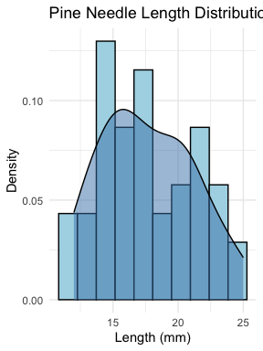
Exploratory graphical data analysis
Graphical exploration is one of first steps in data analysis:
Detect data entry errors
Pattern exploration
Assess assumptions of tests
Detect outliers
Most important Q: shape of distribution?
Determined by density plots: “density of different values”
# Let's examine our pine needle data pine_data %>% group_by(wind) %>% summarize( n = n(), mean = mean(len_mm), sd = sd(len_mm), min = min(len_mm), max = max(len_mm) )
# A tibble: 2 × 6 wind n mean sd min max <chr> <int> <dbl> <dbl> <dbl> <dbl> 1 lee 24 20.4 2.45 16 25 2 wind 24 14.9 1.91 12 19
# Histogram with density ggplot(pine_data, aes(x = len_mm)) + geom_histogram(aes(y = ..density..), fill = "lightblue", color = "black", bins = 10) + geom_density(alpha = 0.5, fill = "steelblue") + labs(title = "Pine Needle Length Distribution", x = "Length (mm)", y = "Density") + theme_minimal()

Slide 6
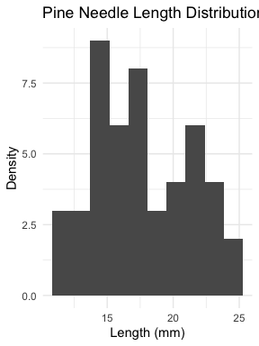
Types of Exploratory Plots
Histograms: data broken into intervals, number of observations in each interval plotted on y-axis
Not great for small samples
# Histogram with density ggplot(pine_data, aes(x = len_mm)) + geom_histogram(bins = 10) + labs(title = "Pine Needle Length Distribution", x = "Length (mm)", y = "Density") + theme_minimal()

Slide 7
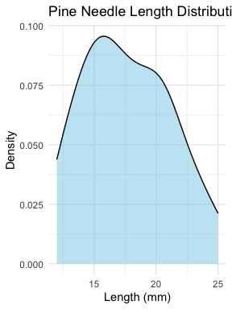
Types of Exploratory Plots
Kernel density plot: data broken into intervals, normal distribution assumed within each interval, sum of density functions plotted
# Kernel density plot ggplot(pine_data, aes(x = len_mm)) + geom_density(fill = "skyblue", alpha = 0.5) + labs(title = "Pine Needle Length Distribution", x = "Length (mm)", y = "Density") + theme_minimal()

Slide 8
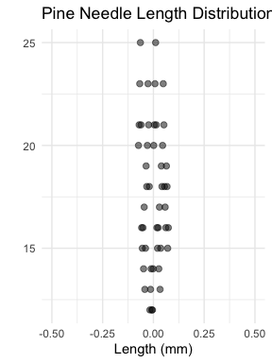
Types of Exploratory Plots
Dotplots: each value represented as a dot along the measurement scale
# Dot plot of pine needle lengths ggplot(pine_data, aes(x = 0, y = len_mm)) + geom_point(size = 2, alpha = 0.5, position = position_dodge2(width=.15)) + # geom_jitter(width = 0.1, height = .05, size = 2, alpha = 0.5) + labs(title = "Pine Needle Length Distribution", x = "Length (mm)", y = "") + scale_x_continuous(limits = c(-.5, .5))+ theme_minimal()

Slide 9
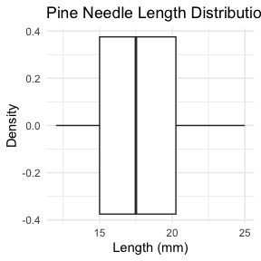
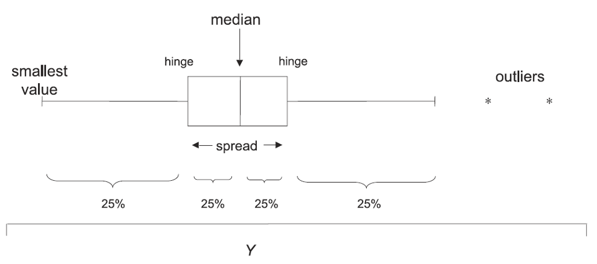
Types of Exploratory Plots
Boxplot: displays median, quartiles, range, outliers
Good when n > ~10
# Kernel density plot #| message: false #| warning: false #| fig-height: 4 #| fig-width: 3 #| include: true #| paged-print: false #| ggplot(pine_data, aes(x = len_mm)) + geom_boxplot()+ labs(title = "Pine Needle Length Distribution", x = "Length (mm)", y = "Density") + theme_minimal()

Slide 10
Types of Exploratory Plots
Scatter plot: display of bivariate data
Shows distribution, outliers, non-linearity
Scatter matrix: like scatterplot, but for multiple variables -will show later
<

Slide 11
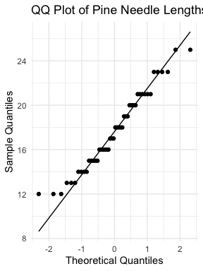
Types of Exploratory Plots
QQ plots: compare quantiles of distribution against theoretical distribution (e.g. normal)
# qqplot # QQ plot for pine needle lengths ggplot(pine_data, aes(sample = len_mm)) + stat_qq() + stat_qq_line() + labs(title = "QQ Plot of Pine Needle Lengths", x = "Theoretical Quantiles", y = "Sample Quantiles") + theme_minimal()
# ggplot(pine_data, aes(sample = len_mm)) + # stat_qq(color = "darkgreen", size = 2, alpha = 0.6) + # stat_qq_line(color = "blue", linewidth = 1, linetype = "dashed") + # labs(title = "QQ Plot of Pine Needle Lengths", # x = "Theoretical Quantiles", # y = "Sample Quantiles") + # theme_minimal()

Slide 12
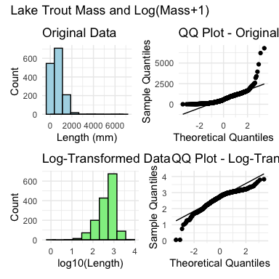
Data transformation and standardization
If data don’t meet distributional assumptions can try transforming:
Approximate a normal distribution of data and errors
Improve homogeneity of variance
Reduce effect of outliers
Improve linearity for regression analysis
Reduce interactions between variables
Data transformation changes the scale on which data are measured
Common transformations:
Right-skewed data: power (root) transformations, log10 transformation
Left-skewed data: power transformations, log10 of (constant - x)
Percentages/proportions (bounded): Arcsine transformation
Rank transformation: most extreme, leads to loss of information
# Let's apply a log transformation to our pine needle data lt_df <- read_csv("data/lake_trout.csv") # Let's apply a log transformation to our pine needle data lt_df <- lt_df %>% mutate(log_mass = log10(mass_g +1)) # Create before and after plots to show transformation effect lt_hist_1_plot <- ggplot(lt_df, aes(x = mass_g)) + geom_histogram(bins = 10, fill = "lightblue", color = "black") + geom_density(alpha = 0.5) + labs(title = "Original Data", x = "Length (mm)", y = "Count") + theme_minimal() lt_qq_1_plot <- ggplot(lt_df, aes(sample = mass_g)) + geom_qq() + geom_qq_line() + labs(title = "QQ Plot - Original", x = "Theoretical Quantiles", y = "Sample Quantiles") + theme_minimal() lt_hist_2_log_plot <- ggplot(lt_df, aes(x = log_mass)) + geom_histogram(bins = 10, fill = "lightgreen", color = "black") + geom_density(alpha = 0.5) + labs(title = "Log-Transformed Data", x = "log10(Length)", y = "Count") + theme_minimal() lt_qq_2_log_plot <- ggplot(lt_df, aes(sample = log_mass)) + geom_qq() + geom_qq_line() + labs(title = "QQ Plot - Log-Transformed", x = "Theoretical Quantiles", y = "Sample Quantiles") + theme_minimal() # Combine plots (lt_hist_1_plot + lt_qq_1_plot) / (lt_hist_2_log_plot + lt_qq_2_log_plot)+ plot_annotation( title = "Lake Trout Mass and Log(Mass+1)" )

Slide 13
Data transformation and standardization
Common transformations:
Right-skewed data: power (root) transformations, log10 transformation
Left-skewed data: power transformations, log10 of (constant - x)
Percentages/proportions (bounded): Arcsine transformation
Rank transformation: most extreme, leads to loss of information
<

Slide 15
Outliers
Outliers: unusual values that are outside the range of most other observations
Can significantly affect results of analysis
Outliers identified using:
Formal tests (Dixon’s Q, Cook’s D)
Graphically, using boxplots or QQ plots
What to do with outliers? Depends why they happened:
If obvious data entry error, can be removed
If part of the data:
Rerun analysis with and without outliers, report both results
Use tests robust to outliers or transform data
Unethical to remove inconvenient outliers
<

Slide 16
Final Activity: Take home messages
Common assumptions for tests:
Normality: Data comes from normally distributed populations
Equal variances (for two-sample tests)
Independence: Observations are independent
No outliers: Extreme values can influence results
What can we do if our data violates these assumptions?
Alternatives
Data transformation (log, square root, etc.)
Non-parametric tests
Bootstrapping approaches

Slide 17
Summary and Conclusions
In this activity, we’ve:
Explored decision errors (Type I and Type II) and their implications
Learned various methods for exploratory data analysis
Discussed data transformations to meet statistical assumptions
Examined approaches for handling outliers
Key takeaways:
Always explore your data visually before formal analysis
Consider the assumptions of statistical tests and check if they are met
Choose appropriate transformations or alternative tests when assumptions are violated
Be transparent about handling outliers and report all analytical decisions

Slide 18
What do you see as the key points?
Things that stood out

Slide 19
What are the muddy points?
What does not make sense or what questions do you have…
What makes you nervous?

