Slide 1
Lecture 05
Bill Perry

Slide 2
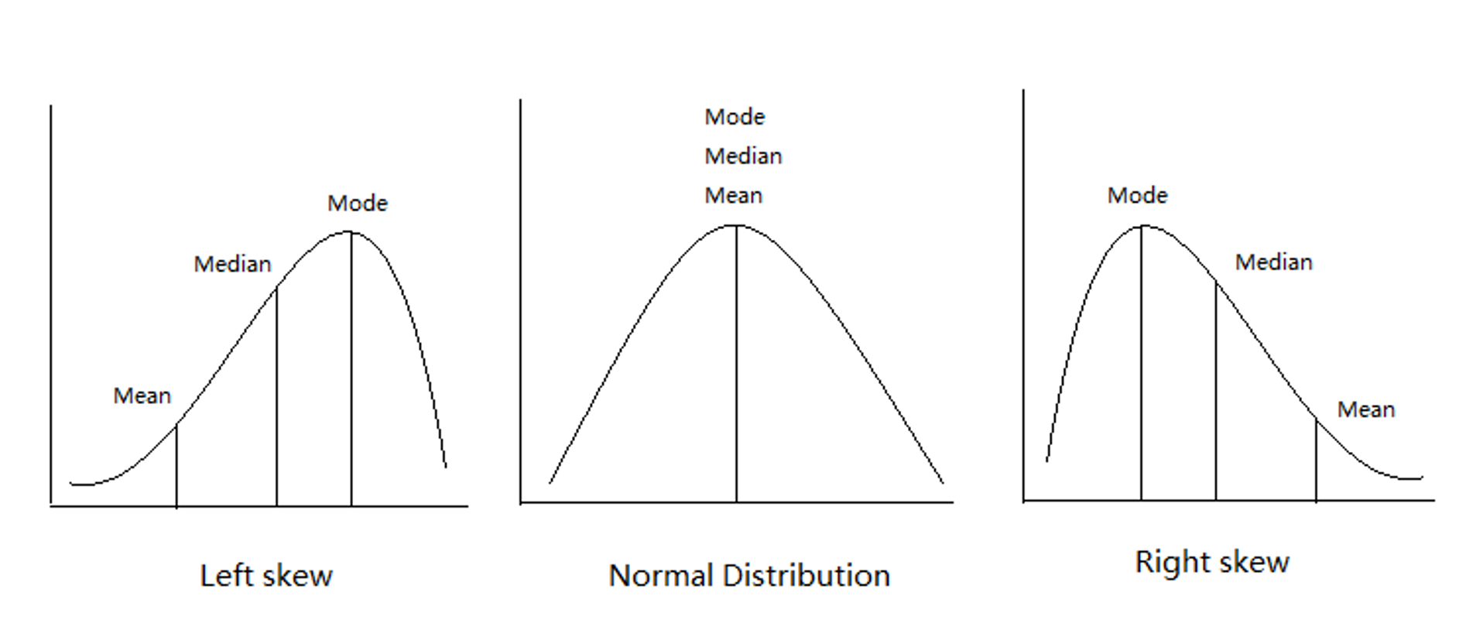
Lecture 4: Review
Introduction to hypothesis testing
The standard normal distribution
Standard error
Confidence intervals
Student’s t-distribution
H testing sequence
p-values
Our last graphs

Slide 3
Lecture 5: Overview
The objectives:
p-values
Brief review
H test for a single population
1- and 2-sided tests
Hypothesis tests for two populations
Assumptions of parametric tests
asdfasfasd

Slide 4
Lecture 5: Statistical hypothesis testing
Major goal of statistics:
inferences about populations from samples…
assign degree of confidence to inferences
Statistical hypothesis testing:
formalized approach to inference
Hypotheses ask whether samples come from populations with certain properties
Often interested in quewstions about population means
but other questions are of interst
asdfasfasd

Slide 5
Lecture 5: Statistical hypothesis testing
Useful hypotheses: - Rely on specifying - null hypothesis (Ho) - alternate hypothesis (Ha)
Ho is the hypothesis of “no effect”
two samples from population with same mean
sample is from population of mean = 0
Ha (research hypothesis)
is the opposite of the Ho
or predicts that there is an effect of x on y
but does NOT suggest a direction
asdfasfasd

Slide 6
Lecture 5: Statistical hypothesis testing
Together Ho and Ha encompass all possible outcomes: - For Example: - Ho: µ=0, Ha: µ ≠ 0 - mean equals 0 or mean does not equal 0 - Ho: µ=3700, Ha: µ ≠ 3700 - mean equals 3700 or mean does not equal 3700 - Ho: µ1 = µ2, Ha: µ1 ≠ µ2 - mean of population 1 equals mean of population 2 or it does not - Ho: µ > 0, Ha: µ ≤ 0 - can be directional mean is greater than 0 or mean is not equal or less than 0
asdfasfasd

Slide 7
Lecture 5: Statistical hypothesis testing
Tests assess likelihood of the null hypothesis being true
If the Ho is likely false, then Ha assumed to be correct
More precisely:
the long run probability of obtaining sample value (or more extreme one) if the null hypothesis is true
p(data|Ho) - the probability of observing the data given that the null hypothesis Ho is true
asdfasfasd

Slide 8
Lecture 5: Statistical hypothesis testing
Hypothesis tests
Expressed as p-value (0 to 1)
Interpret p-value as:
probability of obtaining sample value of statistic (or more extreme one) if Ho is true
High p-value:
high probability of obtaining sample statistic under Ho
if the null hypothesis (Ho) were true, you would frequently observe data similar to or more extreme than your sample statistic
your observed results are quite compatible with what the null hypothesis predicts
low p-value: low probability of obtaining sample statistic under Ho
if the null hypothesis (Ho) were true, you would rarely observe data similar to or more extreme than your sample statistic
Your results are unusual under the null hypothesis, suggesting that either you’ve witnessed a rare event or the null hypothesis may be incorrect
asdfasfasd

Slide 9
Lecture 5: Statistical hypothesis testing
Statistical test results: - p = 0.3 means that if I repeated the study 100 times, I would get this (or more extreme) result due to chance 30 times - p = 0.03 means that if I repeated the study 100 times, I would get this (or more extreme) result due to chance 3 times
Which p-value suggests Ho likely false?
asdfasfasd

Slide 10
Lecture 5: Statistical hypothesis testing
Statistical test results:
At what point reject Ho? - p < 0.05 conventional “significance threshold” (α = alpha or p value) - p < 0.05 means: - if Ho is true and we repeated the study 100 times - we would get this (or more extreme) result less than 5 times due to chance
asdfasfasd

Slide 11
Lecture 5: Statistical hypothesis testing
Statistical test results: - α is the rate at which we will reject a true null hypothesis (Type I error rate) - Lowering α will lower likelihood of incorrectly rejecting a true null hypothesis (e.g., 0.01, 0.001)
*Both Hs and α are specified **BEFORE collection of data and analysis*
asdfasfasd

Slide 12
Lecture 5: Statistical hypothesis testing
Traditionally α=0.05 is used as a cut off for rejecting null hypothesis
There is nothing magical about 0.05 - actual p-values need to be reported - also need to decide prior to study
p-value range | Interpretation
P > 0.10 | No evidence against Ho - data appear consistent with Ho
0.05 < P < 0.10 | Weak evidence against the Ho in favor of Ha
0.01 < P < 0.05 | Moderate evidence against Ho in favor of Ha
0.001 < P < 0.01 | Strong evidence against Ho in favor of Ha
P < 0.001 | Very strong evidence against Ho in favor of Ha

Slide 13

Lecture 5: Statistical hypothesis testing

Slide 14

Lecture 5: Statistical hypothesis testing
Fisher:
p-value as informal measure of discrepancy betwen data and Ho
“If p is between 0.1 and 0.9 there is certainly no reason to suspect the hypothesis tested. If it is below 0.02 it is strongly indicated that the hypothesis fails to account for the whole of the facts. We shall not often be astray if we draw a conventional line at .05 …”

Slide 15
Lecture 5: Statistical hypothesis testing
General procedure for H testing:
Specify Null (Ho) and alternate (Ha)
Determine test (and test statistic) to be used
Test statistic is used to compare your data to expectation under Ho (null hypothesis)
Specify significance (α or p value) level below which Ho will be rejected
asdfasfasd

Slide 16
Lecture 5: Statistical hypothesis testing
General procedure for H testing: - Collect data - Perform test - If p-value < α, conclude Ho is likely false and reject it - If p-value > α, conclude no evidence Ho is false and retain it
asdfasfasd

Slide 17
Lecture 5: Brief review
Recall… - Major goal of statistics: inferences about populations from samples… and assign degree of confidence to inferences - Statistical H-testing: formalized approach to inference - Relies on specifying null hypothesis (Ho) and alternate hypothesis (Ha) - Tests assess likelihood of the null hypothesis being true - Expressed as p-value: probability of obtaining sample value of statistic (or more extreme one) if Ho is true
asdfasfasd

Slide 18
Lecture 5: Brief review
Recall hospital example - Probability of getting sample like A (with ȳ at least as far away from 3700 as 3500)? - p(ȳ ≤ 3500 or ȳ ≥ 3900)
What about - 1-tailed or 2-tailed test?
Can solve using SND and z-scores
asdfasfasd

Slide 19
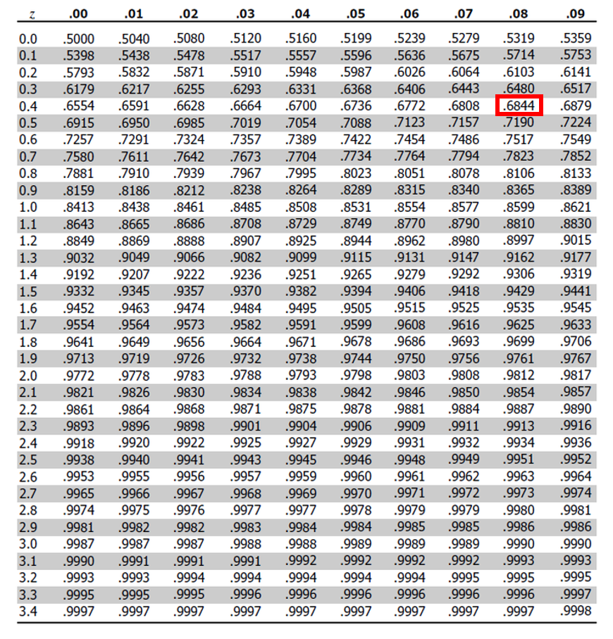
Lecture 5: Brief review
z= (3500-3700)/410 = -0.48
From z table: p= 0.3156 X 2
p of getting sample as far away from µ as A is = 0.6312 (63.1%)
But- usually can’t use z!
Can use t-distribution instead…

Slide 20
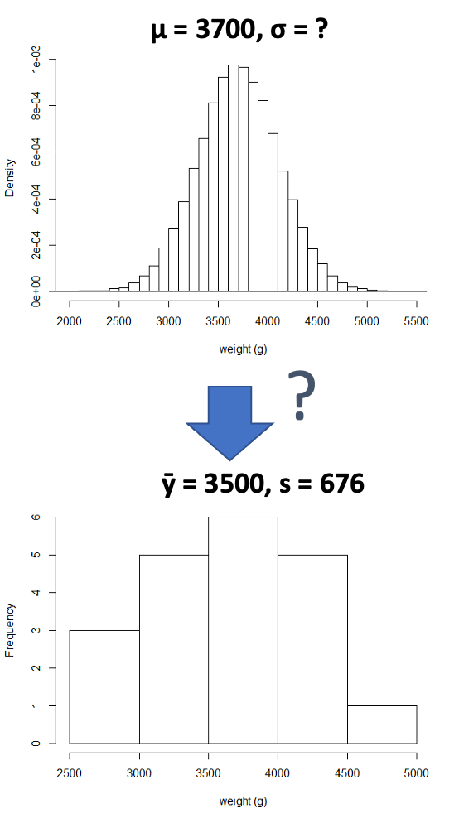
Lecture 5: H test for a single population
Let’s rephrase the question somewhat: What is probability that sample A (ȳ=3500, s=676) is from population with µ = 3700 (and σ = ?)?

Slide 21
Lecture 5: H test for a single population
This is a 1-sample test - 1-sample tests ask whether - µ is different than some number (e.g., 0 or 3700 or whatever) - based on sample - Another way: - probability this sample came from population with certain µ (mean) (e.g., 3700)

Slide 22
Lecture 5: H test for a single population
Common approach is one-sample t-test, which uses t statistic: - St is value of statistic of interest from sample (e.g., ȳ) - θ is population value if Ho is true (e.g., µ=0) - SSt is standard error of the mean (s/√n)
What does equation tell us about relationships between variables?
$t_{s}=\frac{St−θ}{S_{St}}$
test statistic (ts) is calculated by taking difference between observed statistic and value you’d expect under Ho then dividing by the standard error.
This standardization allows you to measure how many “standard errors away” your result is from what would be expected if the null hypothesis were true.

Slide 23
Lecture 5: H test for a single population
Process:
Specify Ho (e.g., µ = 0) and HA (e.g., µ ≠ 0)
Specify significance level (e.g., α = 0.05)
Take sample from population
Calculate:
$t=\frac{\overset{‾}{y}−0}{s/\sqrt{n}}$

Slide 24
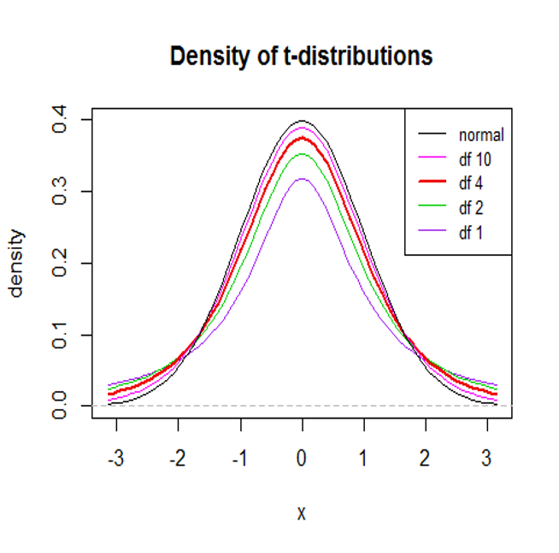
Lecture 5: H test for a single population
If sample from pop with mean or µ = 0 then t will be close to 0
|Large| t values are more likely if Ho false
Compare t with t-distribution: - if t is further than t at specified significance level (p = 0.05) (σ) - t has less than 5% chance of coming from null distribution
$t_{s}=\frac{St−θ}{S_{St}}$

Slide 25
Lecture 5: H test for a single population
Is birth weight in population significantly different than 3700 g? - Specify Ho: µ = 3700 and Ha: µ ≠ 3700 - Specify significance level (α = 0.05) - Take sample from population: ȳ = 3500, s = 676
“What is probability of getting sample at least as far from µ as 3500?”
asdfasfasd

Slide 26
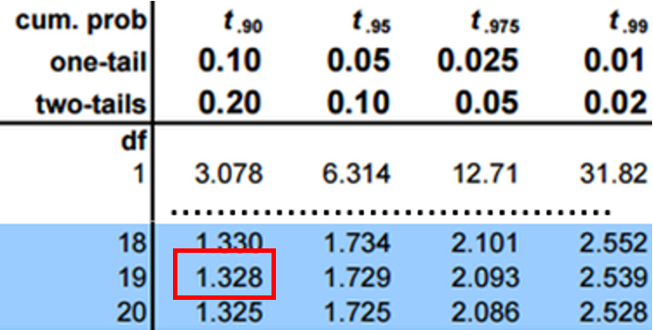
Lecture 5: H test for a single population
Is this one-tailed or two-tailed question?
Calculate t = (3500 – 3700) / (676/ √ 20)
t = -1.32
Compare with t-distribution for df=19

Slide 27
Lecture 5: H test for a single population
~0.10 of t distribution left of t=-1.32 and ~0.1 right of 1.32 (~0.2 overall)
Probability of getting a sample as extreme (or more) as this is ~0.2

Slide 28
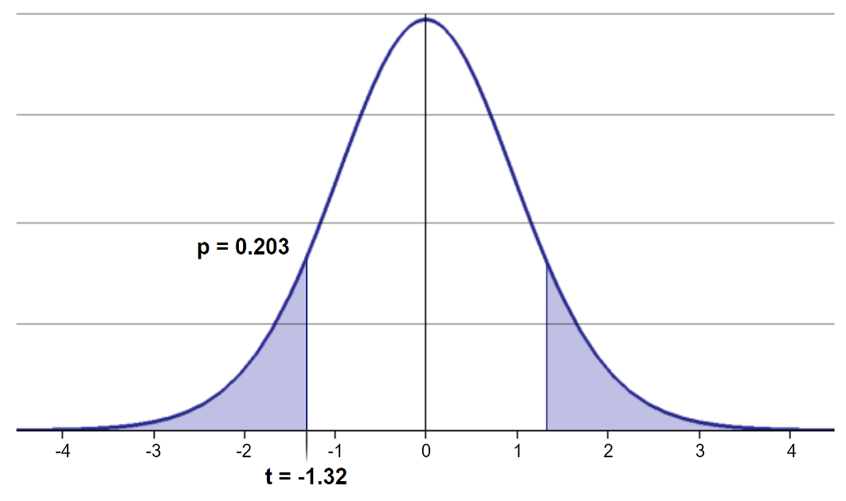
Lecture 5: H test for a single population
(p=0.203 to be exact)
No sufficient evidence to reject Ho

Slide 29
Lecture 5: H test for a single population
asdfa
asdfasfasd

Slide 30
Lecture 5: H test for a single population
asdfa
asdfasfasd

Slide 31
Lecture 5: H test for a single population
asdfa
asdfasfasd

Slide 32
Lecture 5: H test for a single population
asdfa
asdfasfasd

Slide 33
Lecture 5: H test for a single population
asdfa
asdfasfasd

Slide 34
Lecture 5: H test for a single population
asdfa
asdfasfasd

Slide 35
Lecture 5: H test for a single population
asdfa
asdfasfasd

Slide 36
Lecture 5: H test for a single population
asdfa
asdfasfasd

Slide 37
Lecture 5: H test for a single population
asdfa
asdfasfasd

Slide 38
Lecture 5: H test for a single population
asdfa
asdfasfasd

Slide 39
Lecture 5: H test for a single population
asdfa
asdfasfasd

Slide 40
Lecture 5: H test for a single population
asdfa
asdfasfasd

Slide 41
Lecture 5: H test for a single population
asdfa
asdfasfasd

Slide 42
Lecture 5: H test for a single population
asdfa
asdfasfasd

Slide 43
Lecture 5: H test for a single population
asdfa
asdfasfasd

Slide 44
Lecture 5: H test for a single population
asdfa
asdfasfasd

