Slide 1
Lecture 05: Probability and Statistical Inference
Bill Perry

Slide 2
Lecture 4: Review
Introduction to histograms or frequency distributions
Probability Distribution Functions (PDF)
Descriptive Statistics
Center - mean, median, mode
Spread - range, variance, standard deviation

Slide 3
Lecture 4: Review

Slide 4
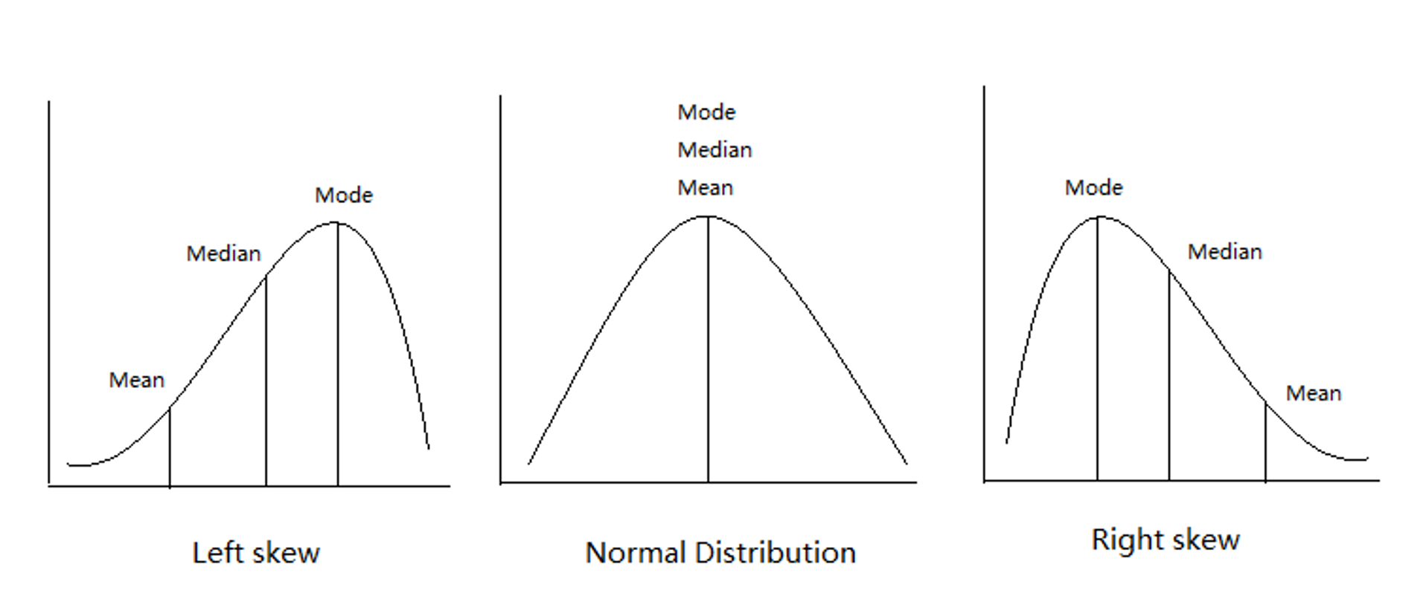
Introduction to histograms or frequency distributions
Probability Distribution Functions (PDF)
Descriptive Statistics
Center - mean, median, mode
Spread - range, variance, standard deviation

Slide 5
Lecture 4: Review
Introduction to histograms or frequency distributions
Probability Distribution Functions (PDF)
Descriptive Statistics
Center - mean, median, mode
Spread - range, variance, standard deviation
Lecture 5: Probability and Statistical Inference
lake | mean_length | sd_length | se_length | count
I3 | 265.6061 | 28.30378 | 3.483954 | 66
I8 | 362.5980 | 52.33901 | 5.182334 | 102

Slide 6
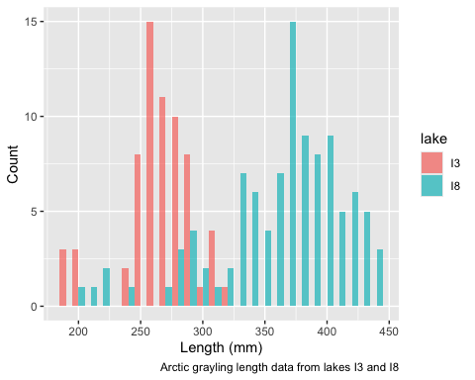
The goals for today
Statistical inference fundamentals
Hypothesis testing principles
T Distributions
One sample T Tests
Two sample T Test

Slide 7
Lecture 5: Confidence intervals
In the more typical case DON’T know the population σ or standard deviation
estimate it from the samples
and when sample size is <~30)
can’t use the standard normal (z) distribution
Instead, we use Student’s t distribution

Slide 8
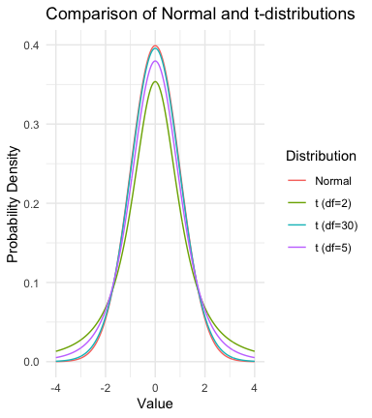
Lecture 5: Understanding t-distribution
When sample sizes are small, the t-distribution is more appropriate than the normal distribution.
Similar to normal distribution but with heavier tails
Shape depends on degrees of freedom (df = n-1)
With large df (>30), approaches the normal distribution
Used for:
Small sample sizes
When population standard deviation is unknown
Calculating confidence intervals
Conducting t-tests

Slide 9
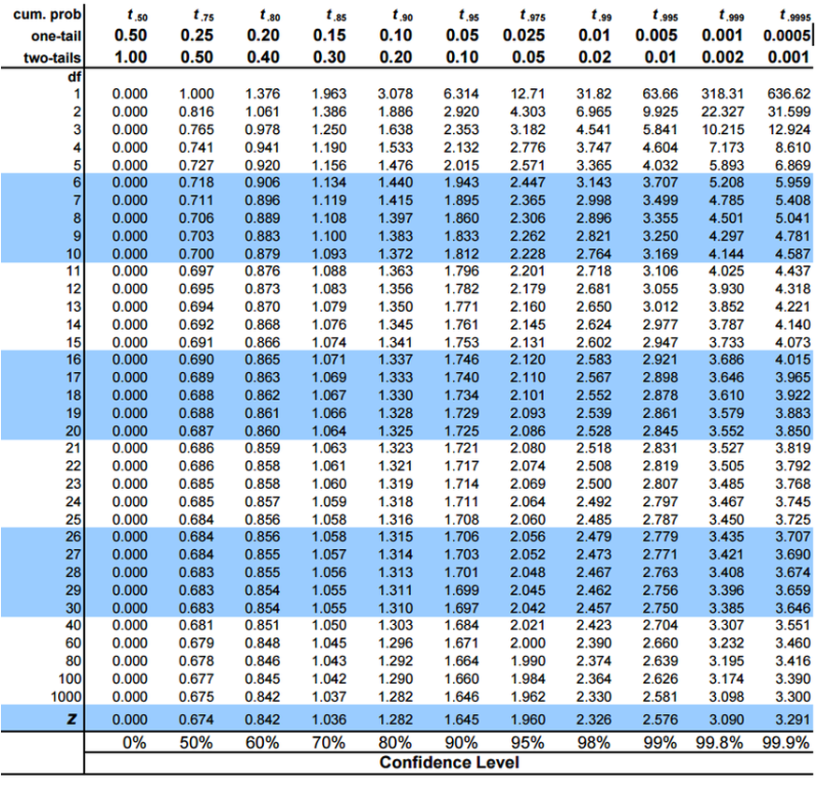
Lecture 5: Understanding t-distribution
When sample sizes are small, the t-distribution is more appropriate than the normal distribution.
Similar to normal distribution (1.96 = 2.5% tails) but with heavier tails
Shape depends on degrees of freedom (df = n-1)
With large df (>30), approaches the normal distribution
Used for:
Small sample sizes
When population standard deviation is unknown
Calculating confidence intervals
Conducting t-tests

Slide 10
Practice Exercise 4: Using the t-distribution
Let’s compare confidence intervals using the normal approximation (z) versus the t-distribution for our fish data.
Mean: 257.4 mm
Standard deviation: 26.44 mm
Standard error: 8.36 mm
95% CI using z: 241 to 273.8 mm
95% CI using t: 238.5 to 276.3 mm
t critical value: 2.262 vs z critical value: 1.96

Slide 11
Student’s t-distribution
To calculate CI for sample from “unknown” population:
$\text{CI}=\overset{‾}{y}±t⋅\frac{s}{\sqrt{n}}$
Where:
ȳ is sample mean
𝑛 is sample size
s is sample standard deviation
t t-value corresponding the probability of the CI
t in t-table for different degrees of freedom (n-1)

Slide 12
Lecture 5: Student’s t-distribution
Here is a t-table
Values of t that correspond to probabilities
Probabilities listed along top
Sample dfs are listed in the left-most column
Probabilities are given for one-tailed and two-tailed “questions”

Slide 13
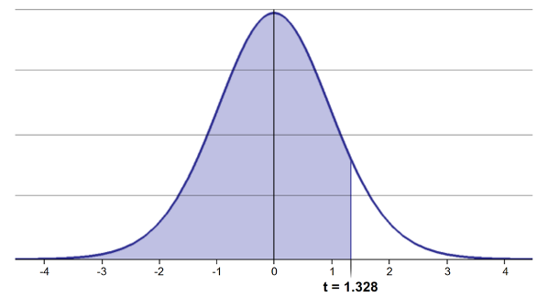
Lecture 5: Student’s t-distribution
One-tailed questions: area of distribution left or (right) of a certain value
n=20 (df=19) - 90% of the observations found left
t= 1.328 (10% are outside)

Slide 14
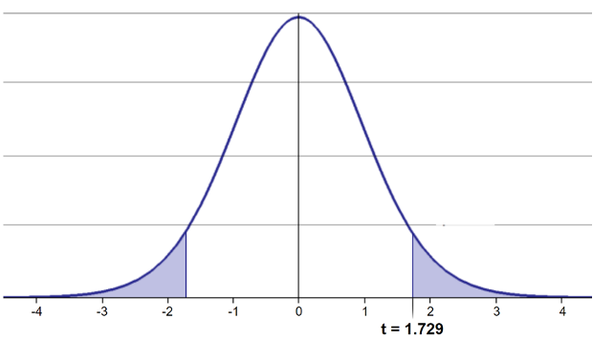
Lecture 5: Student’s t-distribution
Two-tailed questions refer to area between certain values
n= 20 (df=19), 90% of the observations are between
t=-1.729 and t=1.729 (10% are outside)

Slide 15
Lecture 5: Student’s t-distribution
Let’s calculate CIs again:
Use two-sided test
$\text{CI}=\overset{‾}{y}±t⋅\frac{s}{\sqrt{n}}$
95% CI Sample A: = 272.8 ± 2.262 * (37.81/(9^0.5)) = 1.650788
The 95% CI is between 244.3 and 301.3
“The 95% CI for the population mean from sample A is 272.8 ± 28.5”

Slide 16
Lecture 5: Student’s t-distribution
So:
Can assess confidence that population mean is within a certain range
Can use t distribution to ask questions like:
“What is probability of getting sample with mean = ȳ from population with mean = µ?” (1 sample t-test)
“What is the probability that two samples came from same population?” (2 sample t-test)

Slide 17
Lecture 5: Single Sample T-Test
We want to test if the mean fish length in I3 differs from 240mm.
Activity: Define hypotheses and identify assumptions
H₀: μ = 240 (The mean fish length in I3 is 240mm)
H₁: μ ≠ 240 (The mean fish length in I3 is not 55mm)
Assumptions for t-test:
Data is normally distributed
Observations are independent
No significant outliers

Slide 18
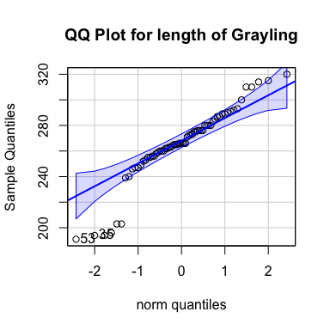
Assumptions in R - qqplots from car

Slide 19
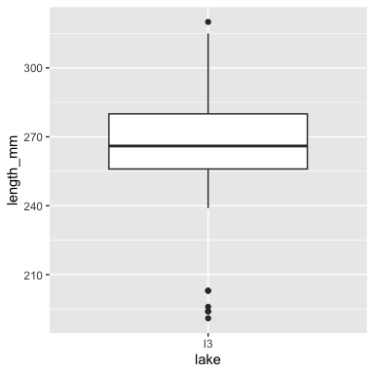
[1] 53 35
Statistical Test of Normality - Shapiro-Wilk test
Shapiro-Wilk normality test data: i3_df$length_mm W = 0.91051, p-value = 0.0001623

Slide 20
Now for Practice
Practice Exercise 1: One-Sample t-Test
Let’s perform a one-sample t-test to determine if the mean fish length in I3 Lake differs from 240 mm:
Mean: 265.6 mm
One Sample t-test data: i3_df$length_mm t = 7.3497, df = 65, p-value = 4.17e-10 alternative hypothesis: true mean is not equal to 240 95 percent confidence interval: 258.6481 272.5640 sample estimates: mean of x 265.6061
Interpret this test result by answering these questions:
What was the null hypothesis?
What was the alternative hypothesis?
What does the p-value tell us?
Should we reject or fail to reject the null hypothesis at α = 0.05?
What is the practical interpretation of this result for fish biologists?

Slide 21
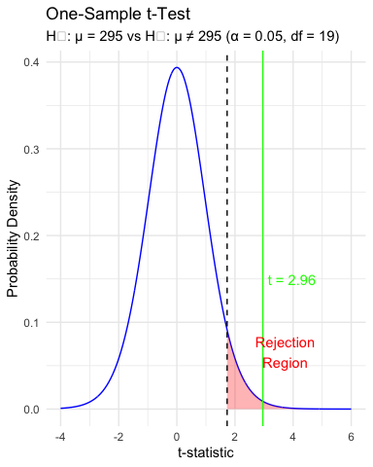
Lecture 5: Intro to Hypothesis Testing
Hypothesis testing is a systematic way to evaluate research questions using data.
Key components:
Null hypothesis (Ho): Typically assumes “no effect” or “no difference”
Alternative hypothesis (Ha): The claim we’re trying to support
Statistical test: Method for evaluating evidence against H₀
P-value: Probability of observing our results (or more extreme) if H₀ is true
Significance level (α): Threshold for rejecting H₀, typically 0.05
Decision rule: Reject Ho if p-value < α == p < 0.05

Slide 22
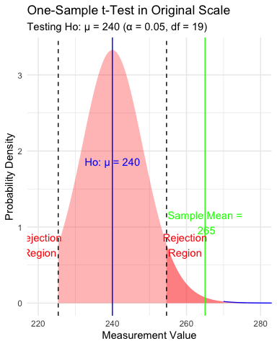
Lecture 5: Intro to Hypothesis Testing
Hypothesis testing is a systematic way to evaluate research questions using data.
Key components:
Null hypothesis (H₀): Typically assumes “no effect” or “no difference”
Alternative hypothesis (Hₐ): The claim we’re trying to support
Statistical test: Method for evaluating evidence against H₀
P-value: Probability of observing our results (or more extreme) if H₀ is true
Significance level (α): Threshold for rejecting H₀, typically 0.05
Decision rule: Reject H₀ if p-value < α

Slide 23
Lecture 5: Interpreting and Reporting Results of a 1 sample T Test
Activity: Interpret the t-test results
What does the p-value tell us?
Should we reject or fail to reject the null hypothesis?
How to report this result in a scientific paper:
“A two-tailed, one-sample t-test at α=0.05 showed that the mean pine needle length on the windward side (… mm, SD = …) [was/was not] significantly different from the expected 55 mm, t(…) = …, p = …”

Slide 24
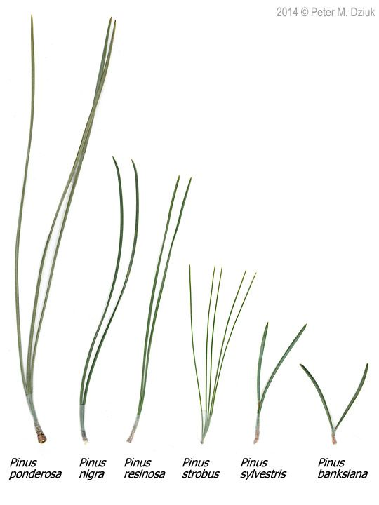
Lecture 5: Next steps - two sample T Tests
For example
what is probability that population X is the same as population Y?
How would you assess this question using what we learned?
This is what we will do with the pine needles…

Slide 25
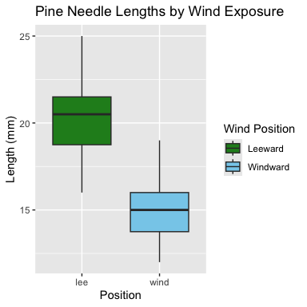
Lecture 5: Next steps - two samples
For example
what is probability that population X is the same as population Y?
How would you assess this question using what we learned?

Slide 26
Practice Exercise 2: Formulating Hypotheses
For the following research questions about pine needles write the null and alternative hypotheses:
Are needles on the lee side longer than the needles on the windy side?
What are the hypotheses?
Ho =
Ha =

Slide 27
Lecture 5: Next steps - two samples
Now, let’s compare pine needle lengths between windward and leeward sides of trees.
Question: Is there a significant difference in needle length between the windward and leeward sides?
This requires a two-sample t-test.
Two-sample t-test compares means from two independent groups.
$t=\frac{{\overset{‾}{x}}_{1}−{\overset{‾}{x}}_{2}}{S_{p}\sqrt{\frac{1}{n_{1}}+\frac{1}{n_{2}}}}$
where:
x̄₁ and x̄₂: These represent the sample means of the two groups you’re comparing
s²ₚ: This is the pooled variance, calculated as: s²ₚ = [(n₁ - 1)s₁² + (n₂ - 1)s₂²] / (n₁ + n₂ - 2), where s₁² and s₂² are the sample variances of the two groups.
n₁ and n₂: These are the sample sizes of the two groups.
√(1/n₁ + 1/n₂): This represents the pooled standard error.
$t=\frac{SIGNAL}{NOISE}$
Practice Exercise 3: Calculate summary statistics grouped by wind exposure
Before conducting the test, we need to understand the data for each group.
You need this and the graph to see what is goin on ….
# A tibble: 2 × 5 wind mean_length sd_length n se_length <chr> <dbl> <dbl> <int> <dbl> 1 lee 20.4 2.45 24 0.500 2 wind 14.9 1.91 24 0.390

Slide 28
Practice Exercise 4: Effect size
We could also look at the difference in means… some cool code here
# A tibble: 1 × 1 difference <dbl> 1 -5.5
Practice Exercise 5: Using GGPLOT to get summary stats
GGplot also has code to make the mean and standard error plots we are interested in along whit a lot of others

Slide 29
Lecture 5: Testing Assumptions for Two-Sample T-Test
For a two-sample t-test, we need to check:
Normality within each group
Equal variances between groups (for standard t-test)
Independent observations
If assumptions are violated:
Welch’s t-test (unequal variances)
Non-parametric alternatives (Mann-Whitney U test)
Practice Exercise 6: Test normality of windward pine needle lengths
qqplots
Note you need to test each groups separately…
Practice Exercise 7: Test normality of windward pine needle lengths
qqplots
Note you need to test each groups separately…
# A tibble: 6 × 6 date group n_s wind tree_no length_mm <chr> <chr> <chr> <chr> <dbl> <dbl> 1 3/20/25 cephalopods n lee 1 20 2 3/20/25 cephalopods n lee 1 21 3 3/20/25 cephalopods n lee 1 23 4 3/20/25 cephalopods n lee 1 25 5 3/20/25 cephalopods n lee 1 21 6 3/20/25 cephalopods n lee 1 16
Practice Exercise 8: Test normality of windward pine needle lengths
qqplots
Note you need to test each groups separately…
[1] 21 22
Practice Exercise 9: Test normality of windward pine needle lengths
Shapiro-Wilk test
Note you need to test each groups separately…
[1] "Shapiro-Wilk test for windward data:"
Shapiro-Wilk normality test data: windward_data$length_mm W = 0.96062, p-value = 0.451
Practice Exercise 10: Test normality of windward pine needle lengths
qqplots
Note you need to test each groups separately…
[1] 4 16
Practice Exercise 11: Test normality of windward pine needle lengths
Shapiro-Wilk test
Note you need to test each groups separately…
[1] "Shapiro-Wilk test for leeward data:"
Shapiro-Wilk normality test data: leeward_data$length_mm W = 0.95477, p-value = 0.3425
Practice Exercise 12: Test Normality at one time
There are always a lot of ways to do this in R
# A tibble: 2 × 4 wind shapiro_stat shapiro_p_value normal_distribution <chr> <dbl> <dbl> <chr> 1 lee 0.955 0.343 Normal 2 wind 0.961 0.451 Normal
Practice Exercise 13: Test equal variances
Levenes test can be done on the original dataframe
[1] "Levene's Test for Homogeneity of Variance:"
Levene's Test for Homogeneity of Variance (center = median) Df F value Pr(>F) group 1 1.2004 0.2789 46

Slide 30
Lecture 5: Conducting the Two-Sample T-Test
Now we can compare the mean pine needle lengths between windward and leeward sides.
Ho: μ₁ = μ₂ (The mean needle lengths are equal)
Ha: μ₁ ≠ μ₂ (The mean needle lengths are different)
Deciding between:
Standard t-test (equal variances)
Welch’s t-test (unequal variances)
Note the Levenes Test should be NOT SIGNIFICANT - What is the null hypothesis
Levene's Test for Homogeneity of Variance (center = median) Df F value Pr(>F) group 1 1.2004 0.2789 46

Slide 31
Lecture 5: Conducting the Two-Sample T-Test
Now we can do a two sample TTEST
Calculate t-statistic manually (optional)
YOUR CODE HERE:
t = (mean1 - mean2) / sqrt((s1^2/n1) + (s2^2/n2))
Tip
[1] "Standard two-sample t-test:"
Two Sample t-test data: length_mm by wind t = 8.6792, df = 46, p-value = 3.01e-11 alternative hypothesis: true difference in means between group lee and group wind is not equal to 0 95 percent confidence interval: 4.224437 6.775563 sample estimates: mean in group lee mean in group wind 20.41667 14.91667

Slide 32
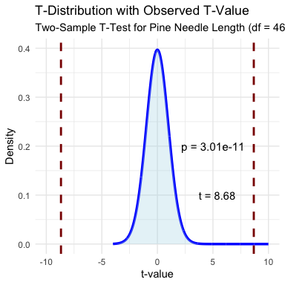
Lecture 5: Interpreting and Reporting Two-Sample T-Test Results
Interpret the results of the two-sample t-test
What can we conclude about the needle lengths on windward vs. leeward sides?
How to report this result in a scientific paper:
“A two-tailed, two-sample t-test at α=0.05 showed [a significant/no significant] difference in needle length between windward (M = …, SD = …) and leeward (M = …, SD = …) sides of pine trees, t(…) = …, p = ….”

Slide 33
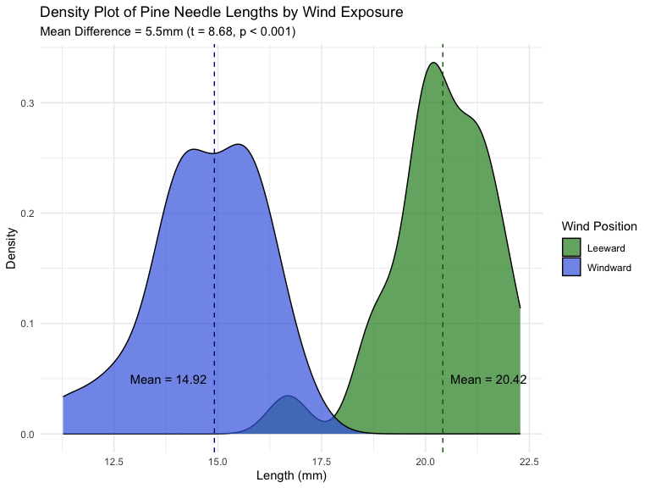
Lecture 5: Interpreting and Reporting Two-Sample T-Test Results
Interpret the results of the two-sample t-test
What can we conclude about the needle lengths on windward vs. leeward sides?
How to report this result in a scientific paper:
“A two-tailed, two-sample t-test at α=0.05 showed [a significant/no significant] difference in needle length between windward (M = …, SD = …) and leeward (M = …, SD = …) sides of pine trees, t(…) = …, p = ….”

Slide 34
Final Activity: Assumptions of Parametric Tests
Common assumptions for t-tests:
Normality: Data comes from normally distributed populations
Equal variances (for two-sample tests)
Independence: Observations are independent
No outliers: Extreme values can influence results
What can we do if our data violates these assumptions?
Alternatives when assumptions are violated:
Data transformation (log, square root, etc.)
Non-parametric tests

Slide 35
Summary and Conclusions
In this activity, we’ve:
Formulated hypotheses about pine needle length
Tested assumptions for parametric tests
Conducted one-sample and two-sample t-tests
Visualized data using appropriate methods
Learned how to interpret and report t-test results
Key takeaways:
Always check assumptions before conducting tests
Visualize your data to understand patterns
Report results comprehensively
Consider alternatives when assumptions are violated

