Slide 1
01_Homework
Bill Perry

Slide 2
Homework for Week 1:
This is an assignment for you to practice the code and all the work we do in class on a different dataframe. We will assign one of these each week for you to do that encompasses all fo the work we do. We give it out on Monday so you can start early and see how this work.

Slide 3
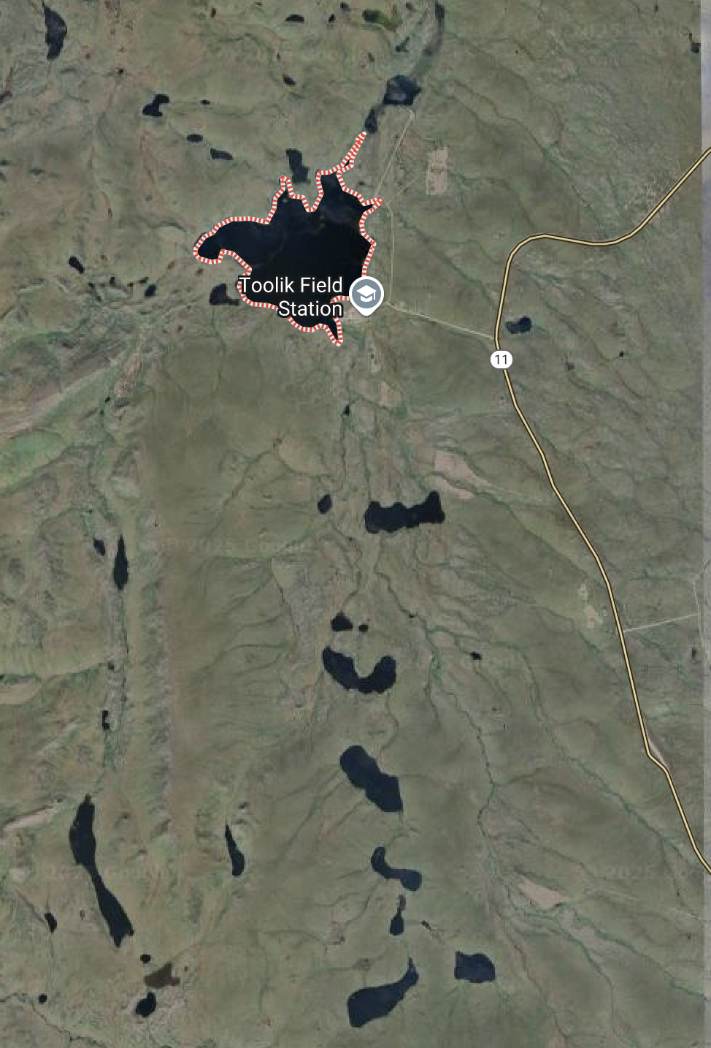

Slide 4
Objectives and goals
Make a new Project in RStudio.
Create directories
data, scripts, output, figures, documents
Create a quarto markdown file and open it
Put this in the top in place of what is there and add your info
--- title: "Grayling in Lake I-8" # Title of the file author: "YOUR NAME" # who you are format: # this is the formats that it will render to html: default: true embed-resources: true # makes everything go into the html file editor: visual # type of editing project: execute-dir: project # where it will look for files execute: keep-md: true # retains the images when you start again cache: true echo: true ---

Slide 5
Load the libraries
# Load the libraries ---- library(readxl) # allows to read in excel files library(tidyverse) # provides utilities seen in console
Read in the file grayling_lakes_I3_I8.csv as a dataframe
Read in the file grayling_lakes_I3_I8.xlsx as a separate dataframe
Annotate your code in the code block as what what is going on and why
Annotate the HTML code as you see fit.
Visualize the data as the lengths of fish in lakes I_3 and I_8 as points
remember position = position_dodge2(width=0.2)
Visualize the data as box and whisker plots
Provide summary statistics grouped by lake
n, mean, standard deviation, standard error
Visualize the data as mean plus or minus error in ggplot
be sure to have proper axis labels and units where necessary
What to turn in -
a zipped or compressed folder of the entire project folder
a self-contained html file showing the output
annotations in the quarto file that shows or tells what is being done like in the class activities

