Slide 1
Lecture 04: Probability and Inference
Bill Perry

Slide 2
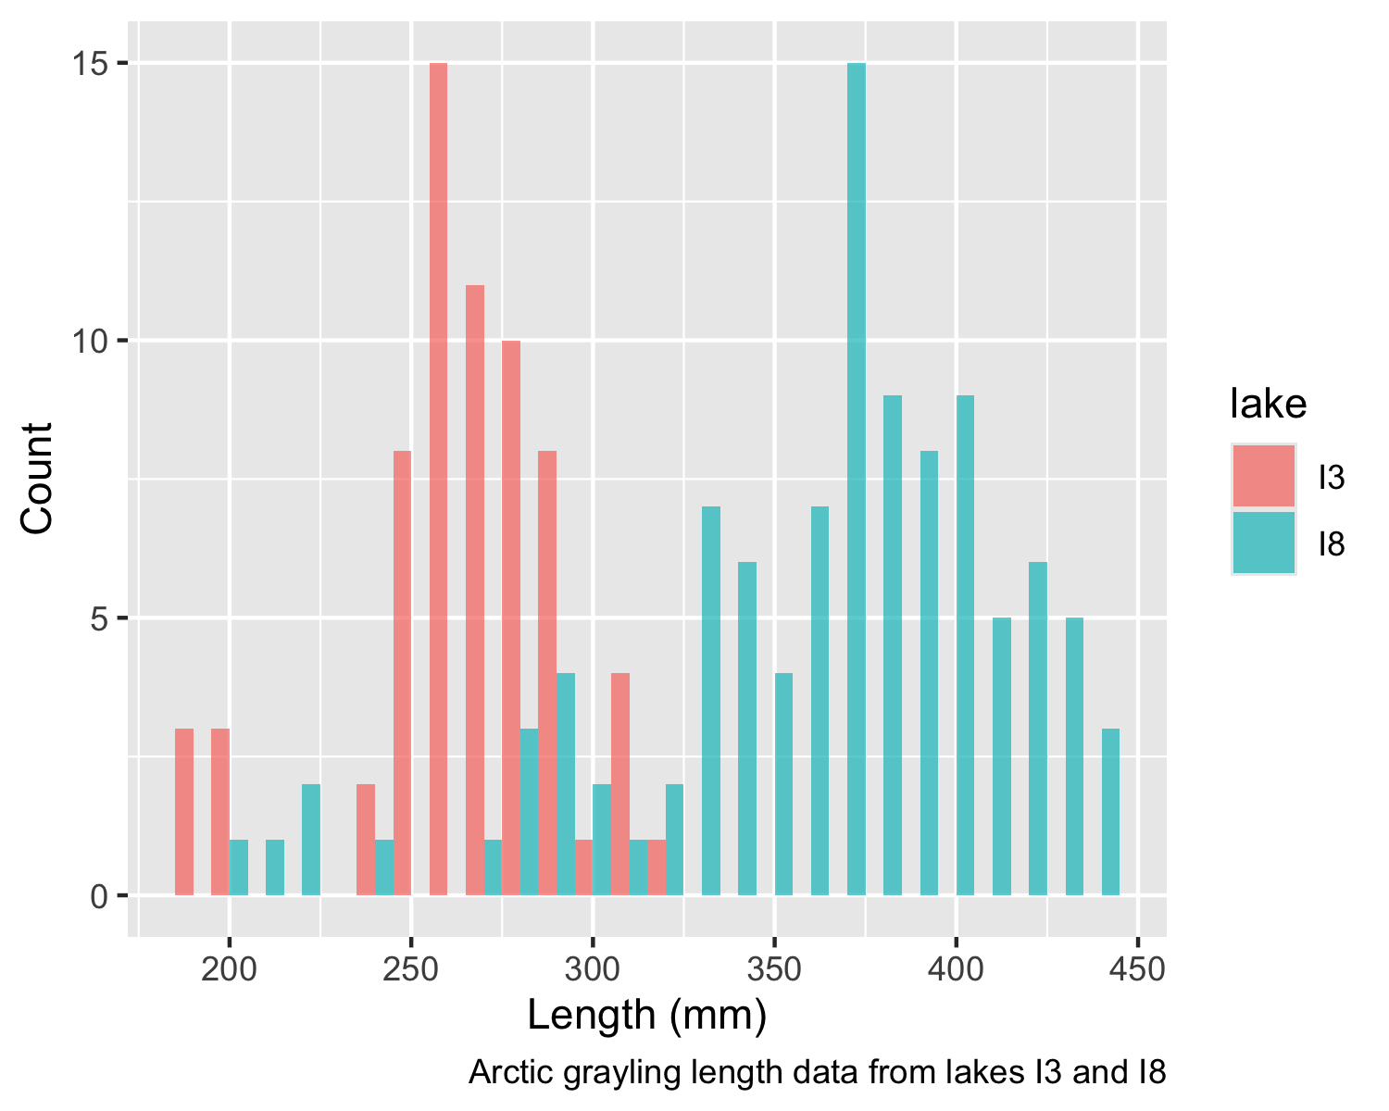
Lecture 4: Probability and Statistical Inference
Review of probability distributions
Standard normal distribution and Z-scores
Standard error and confidence intervals
Statistical inference fundamentals
Hypothesis testing principles

Slide 3
Practice Exercise 1: Exploring the Grayling Dataset
Practice Exercise 1: Exploring the Grayling Dataset
Let’s explore the Arctic grayling data from lakes I3 and I8. Use the grayling_df data frame to create basic summary statistics.
# Write your code here to explore the basic structure of the data # also note plottig a box plot is really useful # Calculate summary statistics grayling_summary <- grayling_df %>% group_by(lake) %>% summarize( mean_length = mean(length_mm, na.rm = TRUE), sd_length = sd(length_mm, na.rm = TRUE), se_length = sd_length/sqrt(sum(!is.na(length_mm))), count = sum(!is.na(length_mm)), .groups = "drop") grayling_summary
# A tibble: 2 × 5 lake mean_length sd_length se_length count <chr> <dbl> <dbl> <dbl> <int> 1 I3 266. 28.3 3.48 66 2 I8 363. 52.3 5.18 102

Slide 4
Lecture 4: Probability Distributions
Probability Distribution Functions
A probability distribution describes the probability of different outcomes in an experiment
We’ve seen histograms of observed data
Theoretical distributions help us model and understand real-world data
We will focus on a standard normal distribution and a students t distribution

Slide 5
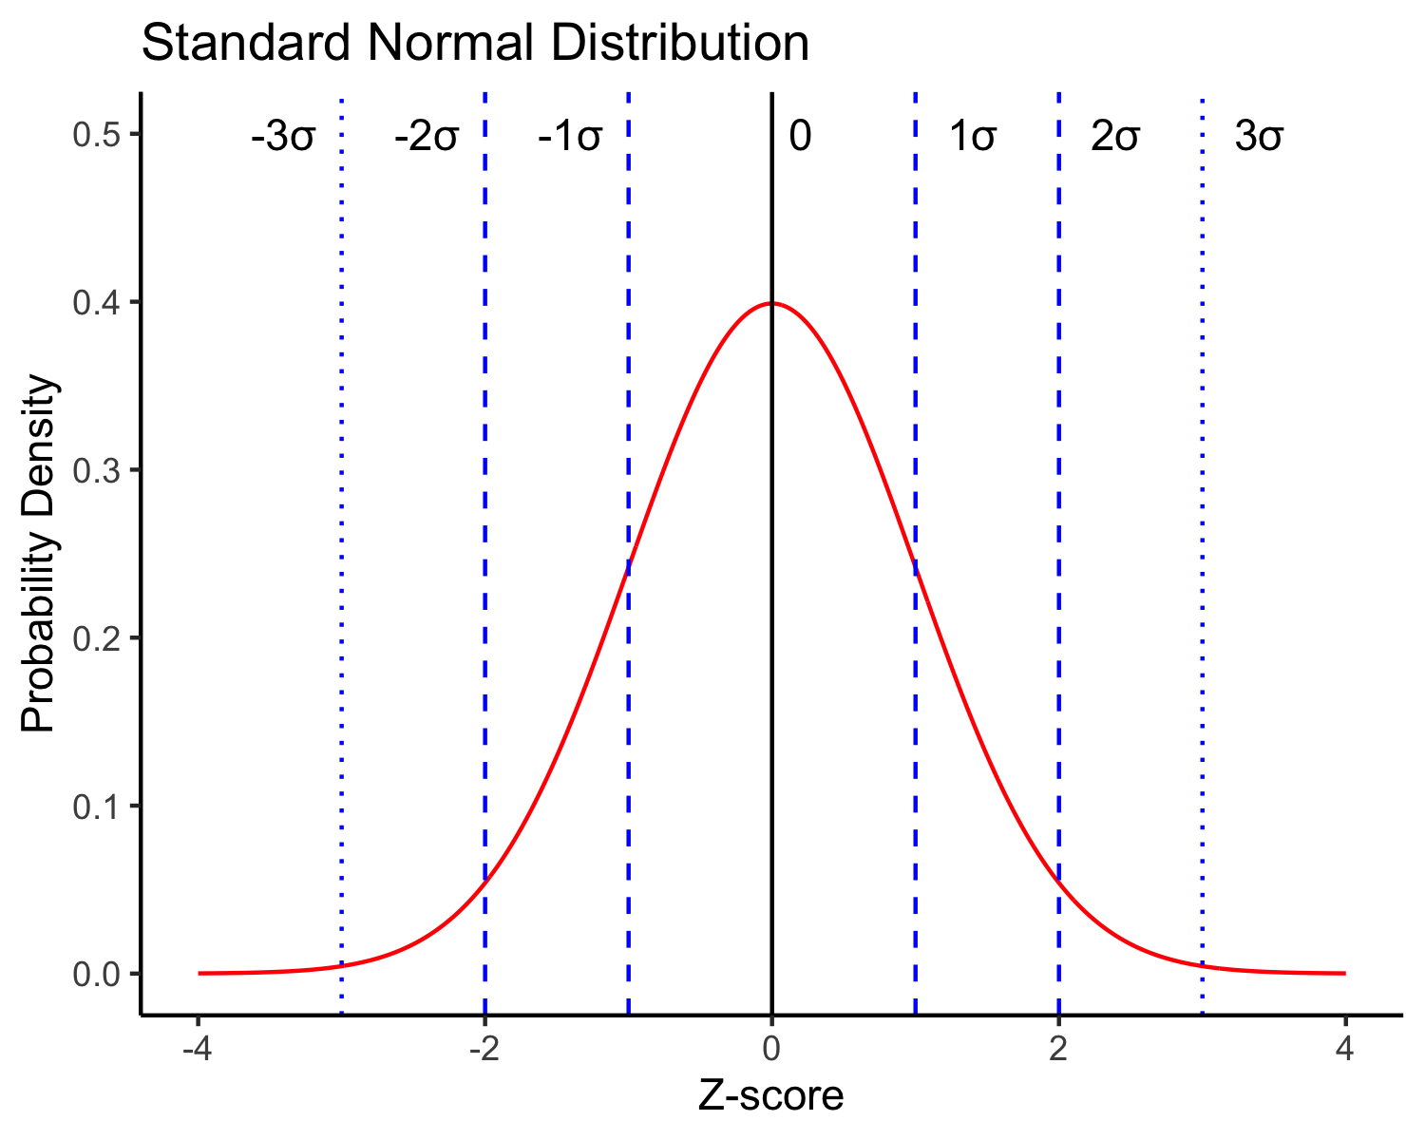
Lecture 4: The Standard Normal Distribution
The standard normal distribution is crucial for understanding statistical inference:
Has mean (μ) = 0 and standard deviation (σ) = 1
Symmetrical bell-shaped curve
Area under the curve = 1 (total probability)
Approximately:
68% of data within ±1σ of the mean
95% of data within ±2σ of the mean - really 1.96σ
99.7% of data within ±3σ of the mean
Z-scores allow us to convert any normal distribution to the standard normal distribution.

Slide 6
Practice Exercise 2: Calculating Z-scores of lake I3
Practice Exercise 2: Calculating Z-scores
Let’s practice converting raw values to Z-scores using the Arctic grayling data.
Z Score = (length - mean) / standard deviation
# Calculate the mean and standard deviation of fish lengths mean_length <- mean(i3_df$length_mm, na.rm = TRUE) sd_length <- sd(i3_df$length_mm, na.rm = TRUE) # Calculate Z-scores for fish lengths i3_df <- i3_df %>% mutate(z_score = (length_mm - mean_length) / sd_length) # View the first few rows with Z-scores head(i3_df)
# A tibble: 6 × 6 site lake species length_mm mass_g z_score <dbl> <chr> <chr> <dbl> <dbl> <dbl> 1 113 I3 arctic grayling 266 135 0.0139 2 113 I3 arctic grayling 290 185 0.862 3 113 I3 arctic grayling 262 145 -0.127 4 113 I3 arctic grayling 275 160 0.332 5 113 I3 arctic grayling 240 105 -0.905 6 113 I3 arctic grayling 265 145 -0.0214

Slide 7
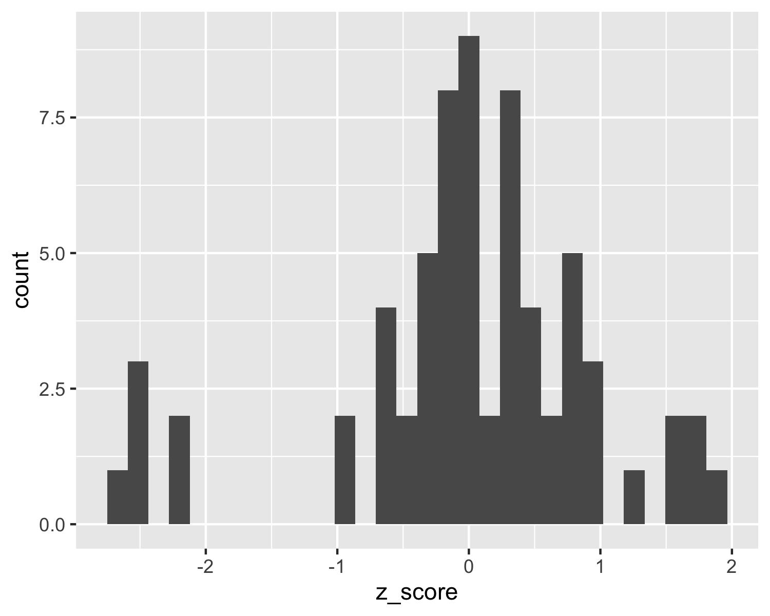
Lecture 4: The fish data as a z score
So if we plot this data what does it look like in a standard normal distributon?

Slide 8
Z-score Results
How to get area under 1 STD DEV?
Proportion within 1 standard deviation = sum of absolute values of Z Scores that are less than or equal to 1 divided by the number in the sample…
Remember in a true normal distribution it is 68% within 1 std dev.
should be approximately (varies if distribution is not normal):
68% of data within ±1σ of the mean
95% of data within ±2σ of the mean - really 1.96σ
99.7% of data within ±3σ of the mean
# What proportion of fish are within 1 standard deviation of the mean? within_1sd <- sum(abs(i3_df$z_score) <= 1, na.rm = TRUE) / sum(!is.na(i3_df$z_score)) cat("Proportion within 1 SD:", round(within_1sd * 100, 1), "%\n")
Proportion within 1 SD: 81.8 %

Slide 9
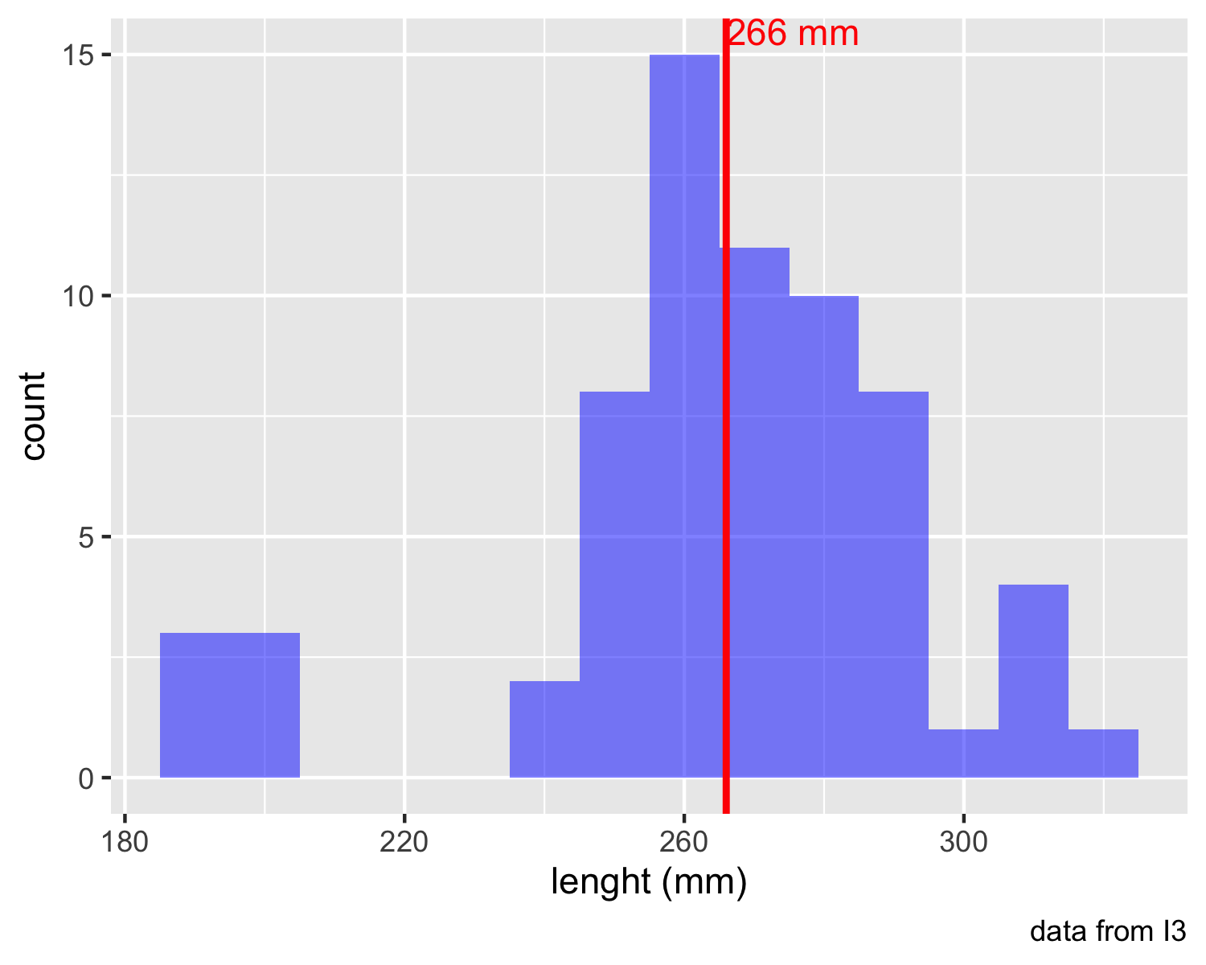
Lecture 4: Standard normal distribution - Fish Data
You want to know things about this population like
probability of a fish having a certain length (e.g., > 300 mm)
Can solve this by integrating the area under curve
But it is tedious to do every time
Instead
we can use the standard normal distribution (SND)
and can use the proportions from the density curve
# A tibble: 1 × 1 mean_length <dbl> 1 266.

Slide 10
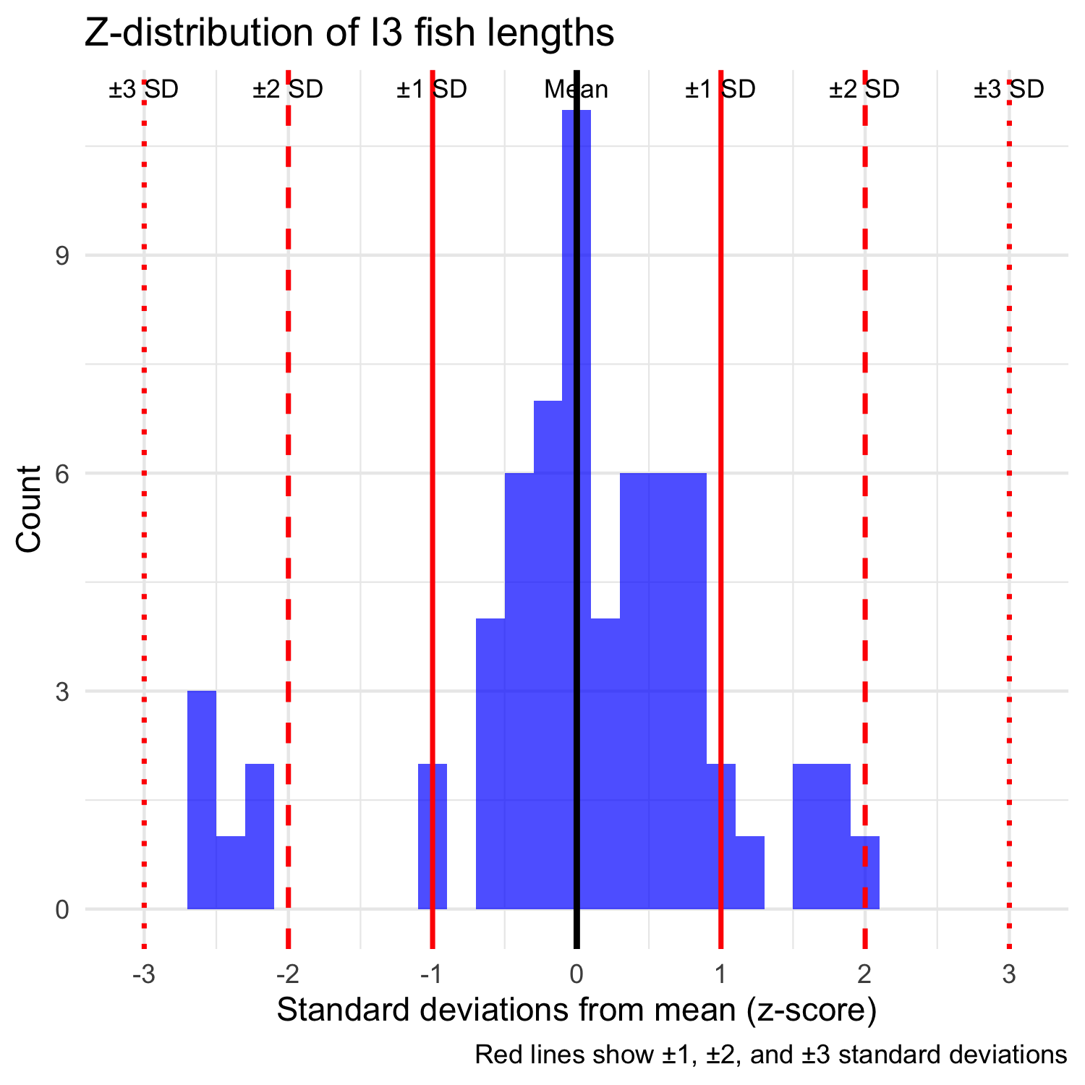
Lecture 4: Standard normal distribution properties
Standard Normal Distribution
“benchmark” normal distribution with µ = 0, σ = 1
The Standard Normal Distribution is defined so that:
~68% of the curve area within +/- 1 σ of the mean,
~95% within +/- 2 σ of the mean,
~99.7% within +/- 3 σ of the mean
*remember σ = standard deviation

Slide 11
Lecture 4: Using Z-tables
Areas under curve of Standard Normal Distribution
Have been calculated for a range of sample sizes
Can be looked up in z-table
No need to integrate
Any normally distributed data can be standardized
transformed into the standard normal distribution
a value can be looked up in a table

Slide 12
Lecture 4: Z-score Formula
Done by converting original data points to z-scores
Z-scores calculated as:
$\text{Z = }\frac{x_{i}−μ}{σ}$
z = z-score for observation
xi = original observation
µ = mean of data distribution
σ = SD of data distribution
So lets do this for a fish that is 300mm long and guess the probability of catching something larger
z = (300 - 265.61)/28.3 = 1.215194

Slide 13
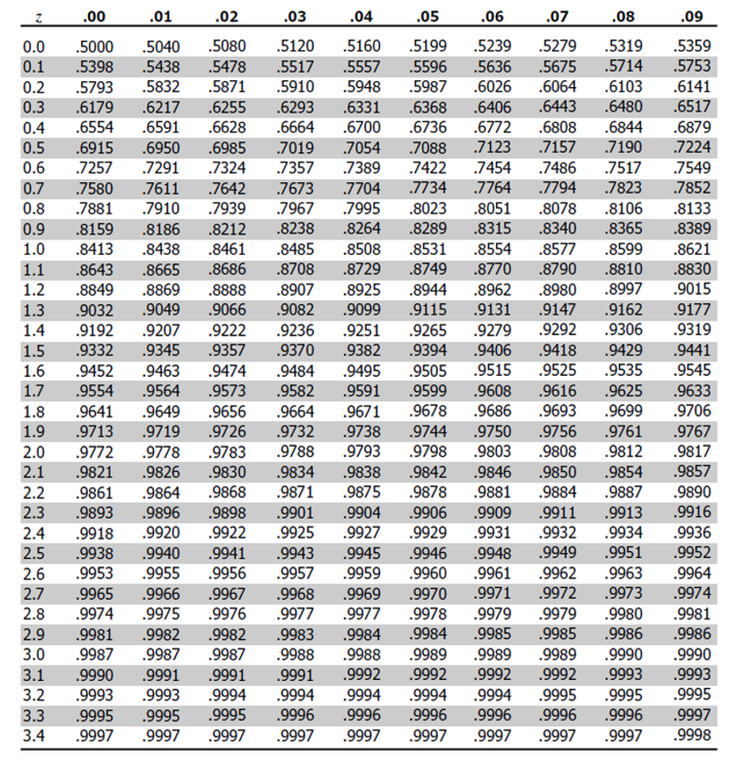
Lecture 4: Z-score example from table
Done by converting original data points to z-scores
Z-scores calculated as:
$\text{Z = }\frac{X_{i}−μ}{σ}$
z = z-score for observation
xi = original observation
µ = mean of data distribution
σ = SD of data distribution
So lets do this for a fish that is 300mm long and guess the probability of catching something larger
z = (300 - 265.61)/28.3 = 1.22
look up 1.2 on left and 0.02 on top to get 0.8888 in table
Means 88.9% is the area left of the curve and
100 - 88.9 = 11.27% of fish are expected to be longer
At what point do you think its not likely to catch a larger fish - what percentage?
do this the other way using that percent and why?

Slide 14
Lecture 4: Z-score example calculation in r
We can use R to get these values easier…
# For standard normal distribution (mean=0, sd=1):
pnorm(z) # gives cumulative probability (area to the left)
qnorm(p) # gives z-value for a given probability
dnorm(z) # gives probability density
# Examples: z_value <- 1.22 prob_left <- pnorm(z_value) # 0.975 (97.5% to the left) prob_right <- 1 - pnorm(z_value) # 0.025 (2.5% to the right) prob_between <- pnorm(2) - pnorm(-2) # 0.95 (95% between ±1.96) # To find z-value for a given probability: z_for_95_percent <- qnorm(0.888) # 1.96 print(prob_left)
[1] 0.8887676
print(prob_right)
[1] 0.1112324
print(prob_between)
[1] 0.9544997
print(z_for_95_percent)
[1] 1.21596

Slide 15
Lecture 4: We can now use this for fun in the fish
Lets say we are interested in knowing at what point from I3 it is not likely to catch a larger fish?
Maybe we expect 95% of the time to catch a fish that is “common” but the 5% is the unlikely portion….
# Examples: # What fish length corresponds to the top 5% (unlikely)? top_5_percent_z <- qnorm(0.95) # z-score for 95th percentile unlikely_length <- mean_length + (top_5_percent_z * sd_length) cat("Only 5% of fish are longer than:", round(unlikely_length, 1), "mm\n")
Only 5% of fish are longer than: 312.2 mm
cat("This corresponds to z-score:", round(top_5_percent_z, 3), "\n")
This corresponds to z-score: 1.645

Slide 16
Lecture 4: What this means
Given that we can: transform data to z-scores from standard normal distribution…
…figure out area under the curve (probability) associated with range of z-scores…
…can therefore figure out probability associated with a range of original data

Slide 17
Lecture 4: So what is next…
We can look at Standard normal distributions and know probability of a value being in a range under the standard normal curve…
Previously we had calculated Standard Error and Confidence Intervals -
Now can assess our confidence that the population mean is within a certain range
Can use t distribution to ask questions like:
“What is probability of getting sample with mean = ȳ from population with mean = µ?“ (1 sample t-test)
“What is the probability that two samples came from same population?” (2 sample t-test)

Slide 18
Lecture 4: When Population σ is Unknown
When calculating confidence intervals we usually DON’T know the population σ (standard deviation) or 𝝁 population mean
estimate it from the samples when don’t know the population σ or 𝝁
and when sample size is small < ~30
can’t use the standard normal (z) distribution
Instead, we use Student’s t distribution

Slide 19
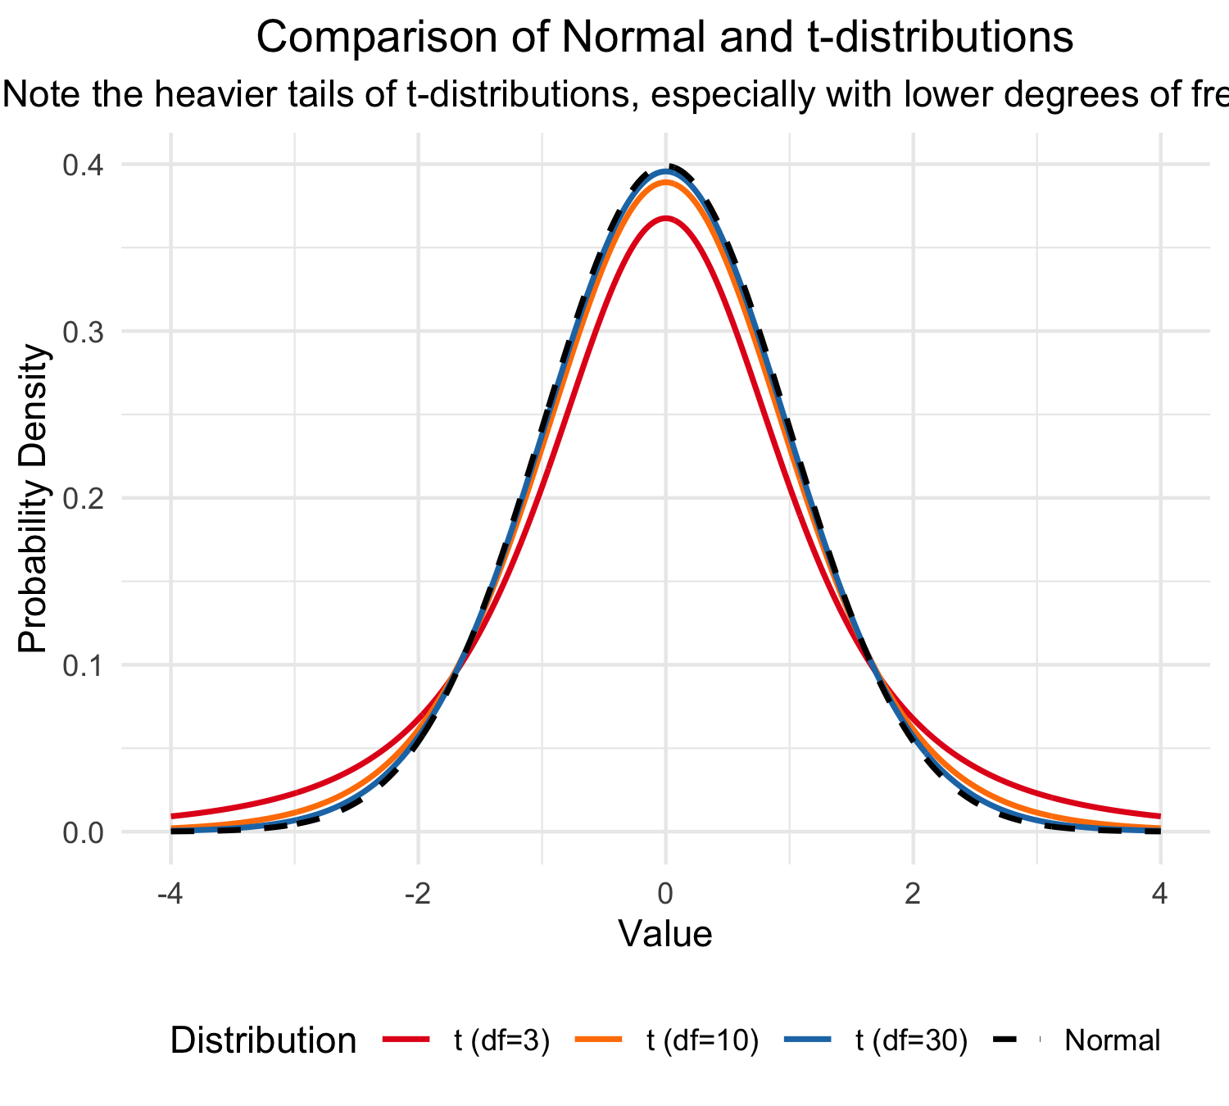
Lecture 4: Understanding t-distribution
When sample sizes are small, the t-distribution is more appropriate than the normal distribution.
Similar to normal distribution but with heavier tails
Shape depends on degrees of freedom (df = n-1)
With large df (>30), approaches the normal distribution
Used for:
Small sample sizes
When population standard deviation is unknown
Calculating confidence intervals
Conducting t-tests

Slide 20
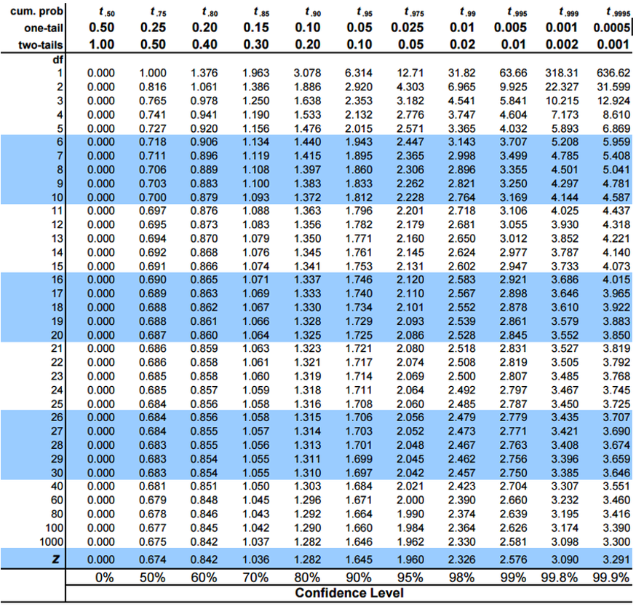
Student’s t-distribution Formula
To calculate CI for sample from “unknown” population:
$\text{CI}=\overset{‾}{y}±t⋅\frac{s}{\sqrt{n}}$
Where:
ȳ is sample mean
𝑛 is sample size
s is sample standard deviation
t t-value corresponding the probability of the CI
t in t-table for different degrees of freedom (n-1)

Slide 21
Lecture 4: Student’s t-distribution Table
Here is a t-table
Values of t that correspond to probabilities
Probabilities listed along top
Sample dfs are listed in the left-most column
Probabilities are given for one-tailed and two-tailed “questions”

Slide 22
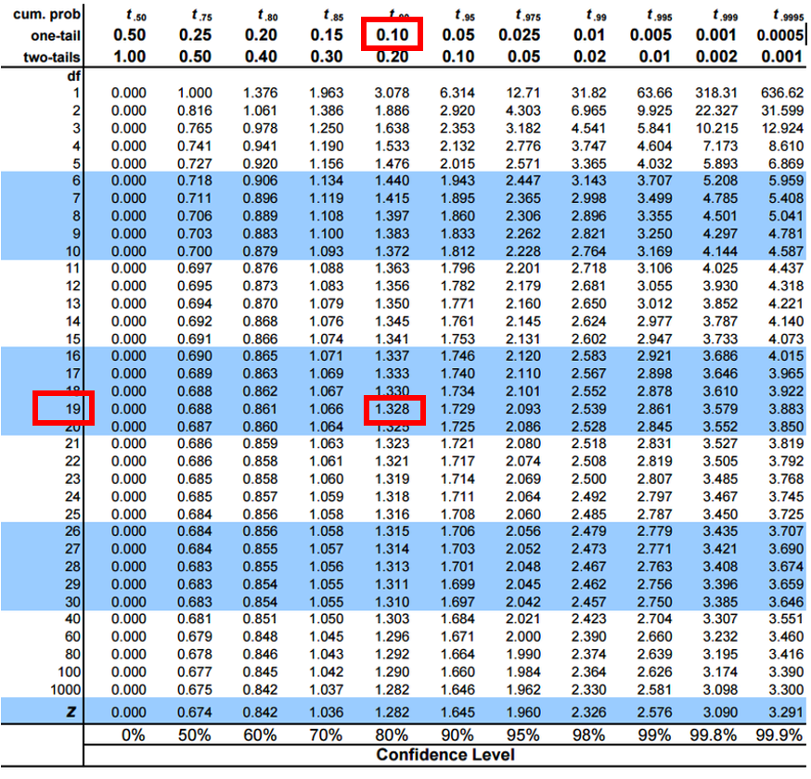
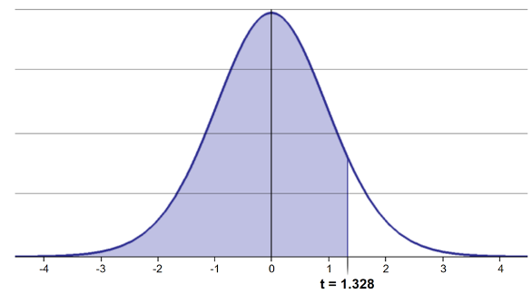
Lecture 4: One-tailed Questions
One-tailed questions: area of distribution left or (right) of a certain value
n=20 (df=19) - 90% of the observations found left
t= 1.328 (10% are outside)

Slide 23
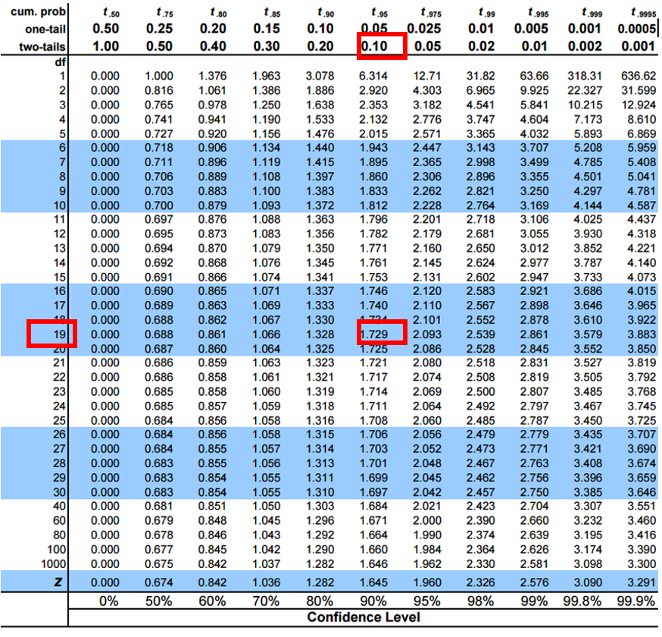
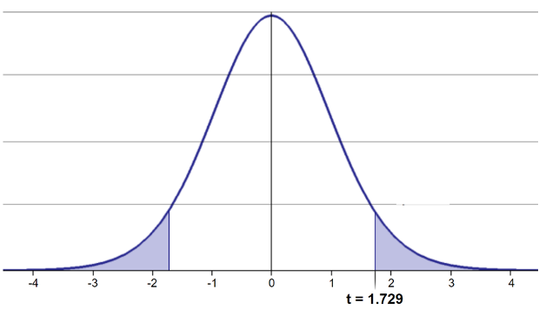
Lecture 4: Two-tailed Questions
Two-tailed questions refer to area between certain values
n= 20 (df=19), 90% of the observations are between
t=-1.729 and t=1.729 (10% are outside)

Slide 24
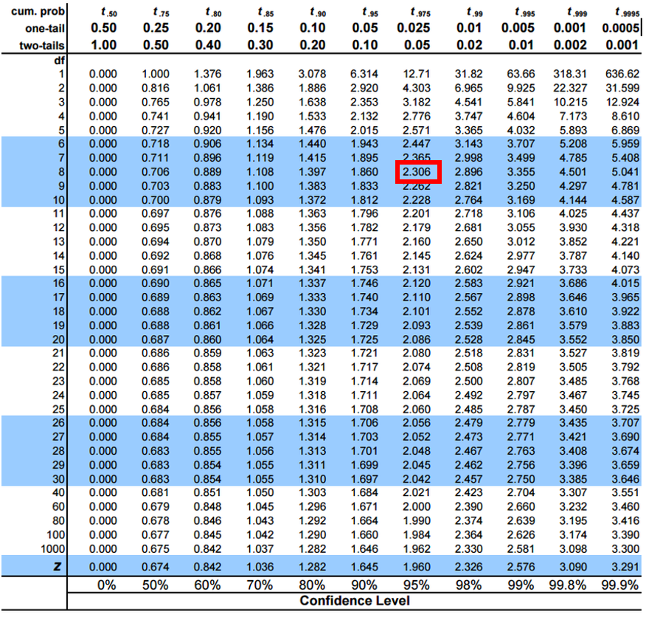
Lecture 4: t-distribution CI Example
Let’s calculate CIs again:
Use two-sided test
$\text{CI}=\overset{‾}{y}±t⋅\frac{s}{\sqrt{n}}$
95% CI Sample A: = 272.8 ± 2.306 * (37.81/(9^0.5))
mean = 272.8, N = 20, and s = 37.81 - t is ?
CI = 29.06
The 95% CI is between 243.7 and 301.9
“The 95% CI for the population mean from sample A is 272.8 ± 29.06

Slide 25
Practice Exercise 4: Using the t-distribution
Practice Exercise 4: Using the t-distribution
Let’s compare confidence intervals using the normal approximation (z) versus the t-distribution for our fish data. I3 data and 10 fish Mean is 266.7 - sd is 17.12 - se is 5.41
## $\text{CI}=\overset{‾}{y}±t⋅\frac{s}{\sqrt{n}}$
Practice Exercise 4: Using the t-distribution
Let’s compare confidence intervals using the normal approximation (z) versus the t-distribution for our fish data. I3 data and 10 fish Mean is 266.7 - sd is 17.12 - se is 5.41
## $\text{CI}=\overset{‾}{y}±t⋅\frac{s}{\sqrt{n}}$
# Display results cat("Mean:", round(sample_mean, 1), "mm\n")
Mean: 251.2 mm
cat("Standard deviation:", round(sample_sd, 2), "mm\n")
Standard deviation: 41.47 mm
cat("Standard error:", round(sample_se, 2), "mm\n")
Standard error: 13.11 mm
cat("95% CI using z:", round(z_ci_lower, 1), "to", round(z_ci_upper, 1), "mm\n")
95% CI using z: 225.5 to 276.9 mm
cat("95% CI using t:", round(t_ci_lower, 1), "to", round(t_ci_upper, 1), "mm\n")
95% CI using t: 221.5 to 280.9 mm
cat("t critical value:", round(t_crit, 3), "vs z critical value: 1.96\n")
t critical value: 2.262 vs z critical value: 1.96

Slide 26
Lecture 4: Intro to Hypothesis Testing one tailed
Hypothesis testing is a systematic way to evaluate research questions using data.
Key components:
Null hypothesis (H₀): Typically assumes “no effect” or “no difference”
Alternative hypothesis (Hₐ): The claim we’re trying to support
Statistical test: Method for evaluating evidence against H₀
P-value: Probability of observing our results (or more extreme) if H₀ is true
Significance level (α): Threshold for rejecting H₀, typically 0.05
Decision rule: Reject H₀ if p-value < α lets test if our sample mean of 320 is larger than 270 or not? Essentially we are looking at the confidence intervals!!! But we are only interested if it is larger
Summary of One-Tailed Hypothesis Test:
Sample mean: 320
Hypothesized mean: 285
Sample size: 12
Standard deviation: 42.15
Standard error: 12.168
t-statistic: 2.876
Critical t-value (one-tailed): 1.796
Critical value: 306.85
Decision: Reject Ho (sample mean falls in upper rejection region)

Slide 27
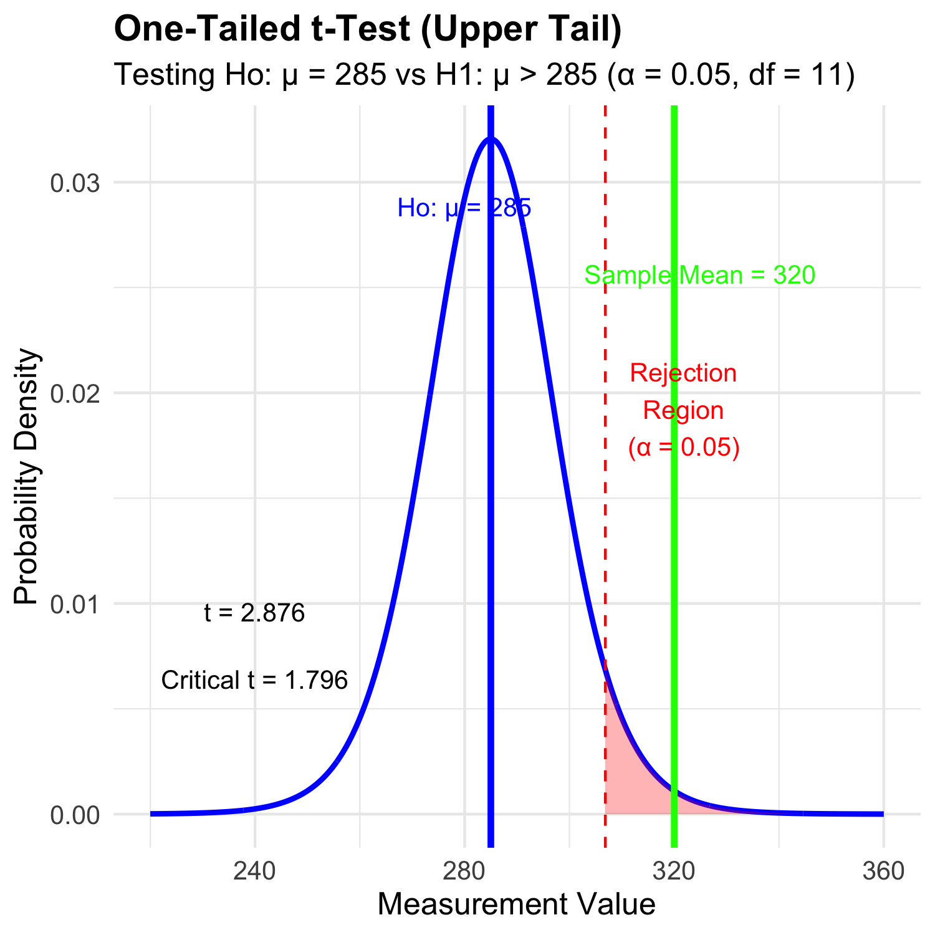
Lecture 4: Intro to Hypothesis Testing one tailed
Hypothesis testing is a systematic way to evaluate research questions using data.
Key components:
Null hypothesis (H₀): Typically assumes “no effect” or “no difference”
Alternative hypothesis (Hₐ): The claim we’re trying to support
Statistical test: Method for evaluating evidence against H₀
P-value: Probability of observing our results (or more extreme) if H₀ is true
Significance level (α): Threshold for rejecting H₀, typically 0.05
Decision rule: Reject H₀ if p-value < α lets test if our sample mean of 320 is larger than 270 or not? Essentially we are looking at the confidence intervals!!! But we are only interested if it is larger

Slide 29
Lecture 4: Hypothesis Testing two tailed
Hypothesis testing is a systematic way to evaluate research questions using data.
Key components:
Null hypothesis (H₀): Typically assumes “no effect” or “no difference”
Alternative hypothesis (Hₐ): The claim we’re trying to support
Statistical test: Method for evaluating evidence against H₀
P-value: Probability of observing our results (or more extreme) if H₀ is true
Significance level (α): Threshold for rejecting H₀, typically 0.05
Decision rule: Reject H₀ if p-value < α
lets test if our sample mean of 320 is equal to 270 or not? Essentially we are looking at the confidence intervals!!!
Summary of Hypothesis Test:
Sample mean: 320
Hypothesized mean: 270
Standard error: 12.603
t-statistic: 3.967
Critical t-value (±): 2.306
Critical values: 240.94 to 299.06
Decision: Reject Ho (sample mean falls in rejection region)

Slide 30
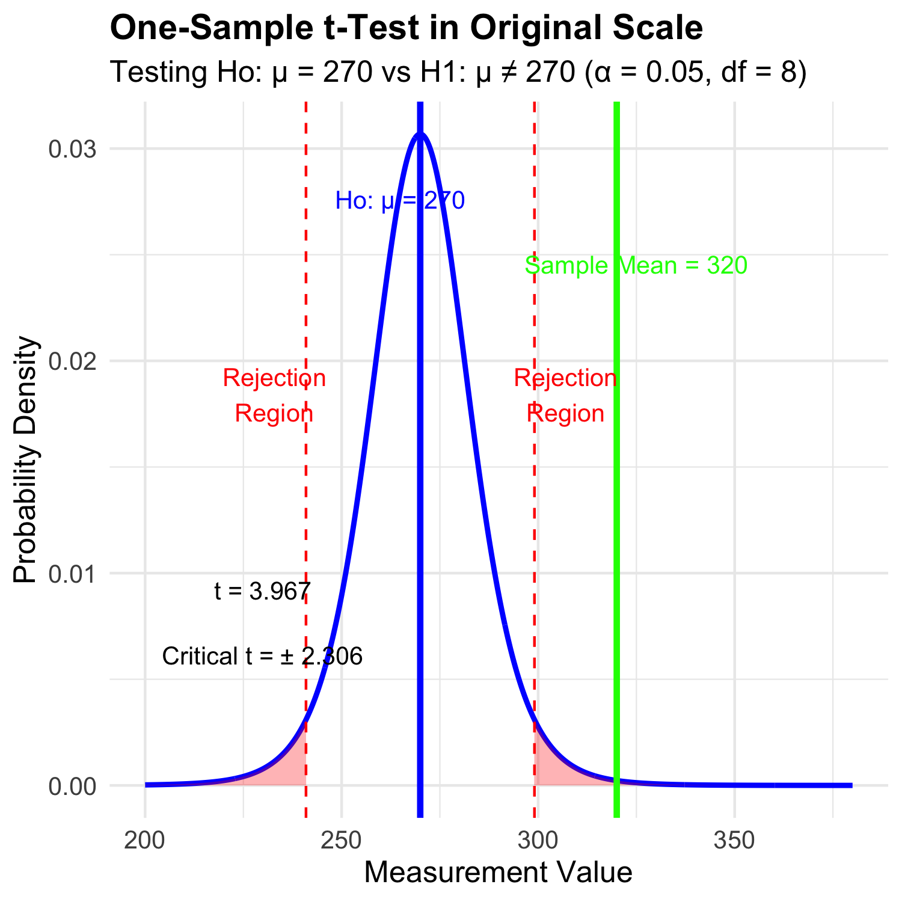
Lecture 4: Hypothesis Testing two tailed
Hypothesis testing is a systematic way to evaluate research questions using data.
Key components:
Null hypothesis (H₀): Typically assumes “no effect” or “no difference”
Alternative hypothesis (Hₐ): The claim we’re trying to support
Statistical test: Method for evaluating evidence against H₀
P-value: Probability of observing our results (or more extreme) if H₀ is true
Significance level (α): Threshold for rejecting H₀, typically 0.05
Decision rule: Reject H₀ if p-value < α
lets test if our sample mean of 320 is equal to 270 or not? Essentially we are looking at the confidence intervals!!!

Slide 31
Practice Exercise 5: One-Sample t-Test
Practice Exercise 5: Lets practice a One-Sample t-Test
Let’s perform a one-sample t-test to determine if the mean fish length in Lake I3 differs from 260 mm:
# get only lake I3 i3_df <- grayling_df %>% filter(lake=="I3") # what is the mean i3_mean <- mean(i3_df$length_mm, na.rm=TRUE) cat("Mean:", round(i3_mean, 1), "mm\n")
Mean: 265.6 mm
# Perform a one-sample t-test t_test_result <- t.test(i3_df$length_mm, mu = 260) # View the test results t_test_result
One Sample t-test data: i3_df$length_mm t = 1.6091, df = 65, p-value = 0.1124 alternative hypothesis: true mean is not equal to 260 95 percent confidence interval: 258.6481 272.5640 sample estimates: mean of x 265.6061
Interpret this test result by answering these questions:
What was the null hypothesis?
What was the alternative hypothesis?
What does the p-value tell us?
Should we reject or fail to reject the null hypothesis at α = 0.05?
What is the practical interpretation of this result for fish biologists?

Slide 32
Practice Exercise 6: Formulating Hypotheses
Practice Exercise 6: Formulating Hypotheses
For the following research questions about Arctic grayling, write the null and alternative hypotheses:
Are fish in Lake I8 longer than fish in Lake I3?
# Let's test one of these hypotheses: Are fish in Lake I8 longer than fish in Lake I3? # Perform an independent t-test t_test_result <- t.test(length_mm ~ lake, data = grayling_df, alternative = "less") # H₀: μ_I3 ≥ μ_I8, H₁: μ_I3 < μ_I8 # Display the results t_test_result
Welch Two Sample t-test data: length_mm by lake t = -15.532, df = 161.63, p-value < 2.2e-16 alternative hypothesis: true difference in means between group I3 and group I8 is less than 0 95 percent confidence interval: -Inf -86.66138 sample estimates: mean in group I3 mean in group I8 265.6061 362.5980
Based on this t-test, what can we conclude about the difference in fish length between the two lakes?

Slide 33
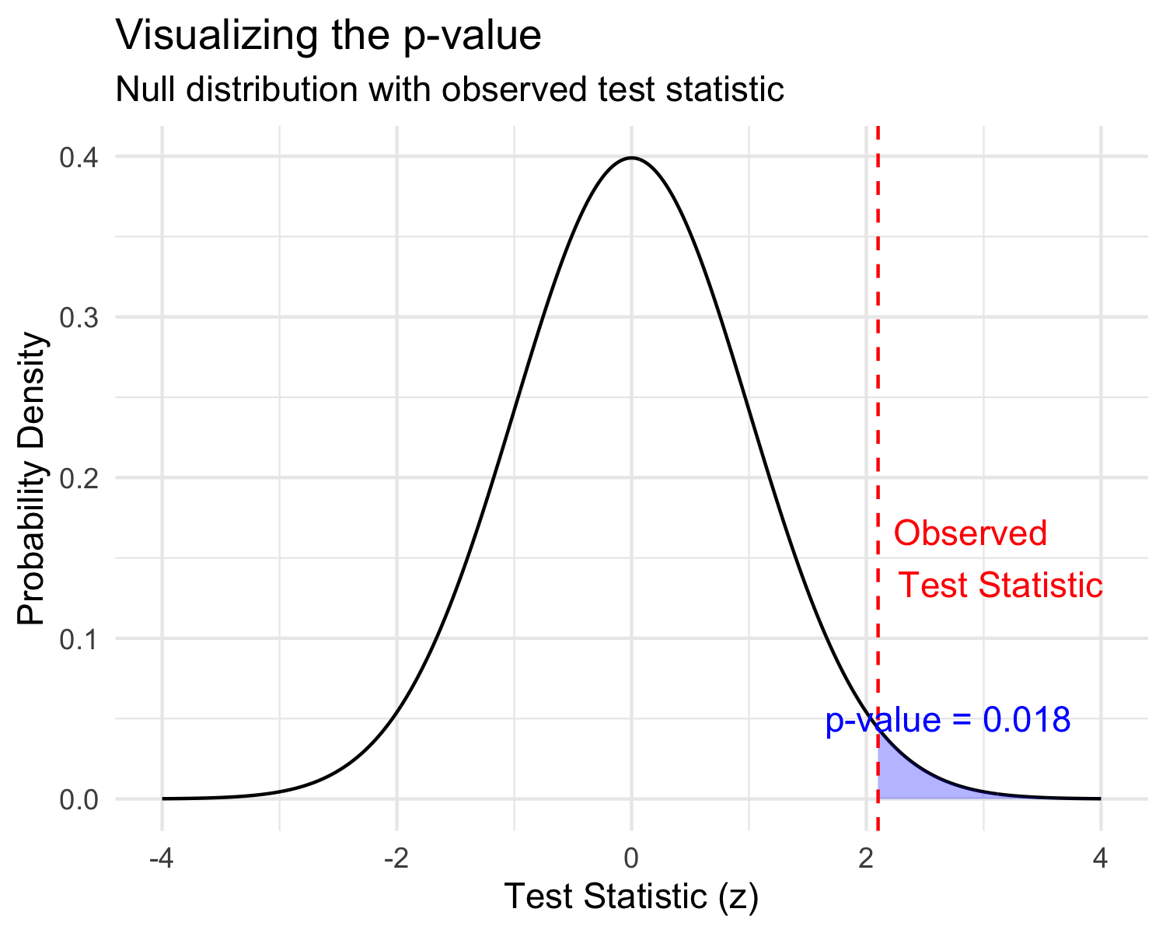
Lecture 4: Understanding P-values
A p-value is the probability of observing the sample result (or something more extreme) if the null hypothesis is true.
Common interpretations:
- p < 0.05: Strong evidence against H₀
- 0.05 ≤ p < 0.10: Moderate evidence against H₀
- p ≥ 0.10: Insufficient evidence against H₀
Common misinterpretations:
- p-value is NOT the probability that H₀ is true
- p-value is NOT the probability that results occurred by chance
- Statistical significance ≠ practical significance
the smaller the p value does not necessarily mean much… use < 0.05 even if is is 10^-16

Slide 34
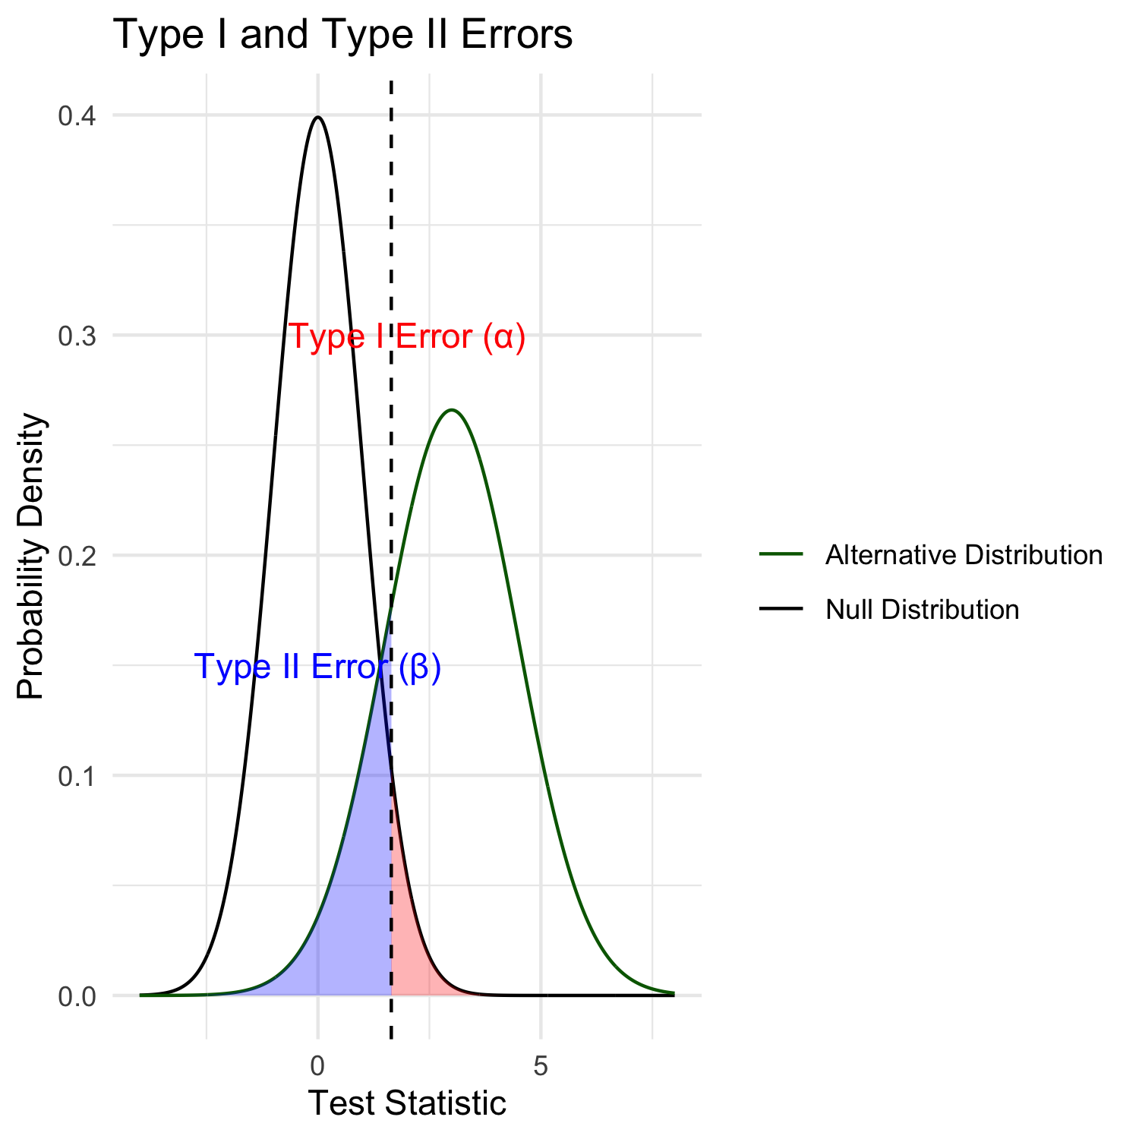
Lecture 4: Type I and Type II Errors
When making decisions based on hypothesis tests, two types of errors can occur:
Type I Error (False Positive)
- Rejecting H₀ when it’s actually true
- Probability = α (significance level)
- “Finding an effect that isn’t real”
Type II Error (False Negative)
- Failing to reject H₀ when it’s actually false
- Probability = β - “Missing an effect that is real”
Statistical Power = 1 - β
- Probability of correctly rejecting a false H₀
- Increases with:
- Larger sample size
- Larger effect size
- Lower variability
- Higher α level

Slide 35
Lecture 4: Type I and Type II Errors
What does it mean…
Black curve (Null Distribution): distribution of test statistics when Ho is true
Green curve (Alternative Distribution): distribution when Ha is true (is an effect)
Red shaded area (Type I Error): probability of rejecting Ho when it’s actually tru
area under the null distribution (black curve) to the right α (p=0.05)
Blue shaded area (Type II Error): probability of failing to reject Ho when alternative is actually true
area under alternative distribution (green curve) left of α (depends on effect size, sample size, etc.)
The Key Insight fundamental trade-off in hypothesis testing:
as α value moves left or right, change balance between Type I and Type II errors
Moving left reduces Type II errors increases Type I errors, and vice versa
power (1 - β) area under the green curve RIGHT of dashed line
the probability of correctly detecting a real effect.

Slide 37
Practice Exercise 7: Interpreting Errors and Power
Practice Exercise 6: Interpreting P-values and Errors
Given the following scenarios, identify whether a Type I or Type II error might have occurred:
A researcher concludes that a new fishing regulation increased grayling size, when in fact it had no effect.
A study fails to detect a real decline in grayling population due to warming water, concluding there was no effect.
Let’s calculate the power of our t-test to detect a 30 mm difference in length between lakes:
# Calculate power for detecting a 30 mm difference # First determine parameters lake_I3 <- grayling_df %>% filter(lake == "I3") lake_I8 <- grayling_df %>% filter(lake == "I8") n1 <- nrow(lake_I3) n2 <- nrow(lake_I8) sd_pooled <- sqrt((var(lake_I3$length_mm) * (n1-1) + var(lake_I8$length_mm) * (n2-1)) / (n1 + n2 - 2)) # Calculate power effect_size <- 30 / sd_pooled # Cohen's d df <- n1 + n2 - 2 alpha <- 0.05 power <- power.t.test(n = min(n1, n2), delta = effect_size, sd = 1, # Using standardized effect size sig.level = alpha, type = "two.sample", alternative = "two.sided") # Display results power
Two-sample t test power calculation n = 66 delta = 0.6741298 sd = 1 sig.level = 0.05 power = 0.9702076 alternative = two.sided NOTE: n is number in *each* group

Slide 38
Lecture 4: Summary
Key concepts covered:
Probability distributions model random phenomena
Normal distribution is especially important
Z-scores standardize measurements
Standard error measures precision of estimates
Decreases with larger sample sizes
Used to construct confidence intervals
Confidence intervals express uncertainty
Provide plausible range for parameters
95% CI: mean ± 1.96 × SE
Hypothesis testing evaluates claims
Null vs. alternative hypotheses
P-values quantify evidence against H₀
Consider both statistical and practical significance

