Slide 1
Lecture 10 - Multiple Regression
Bill Perry

Slide 2
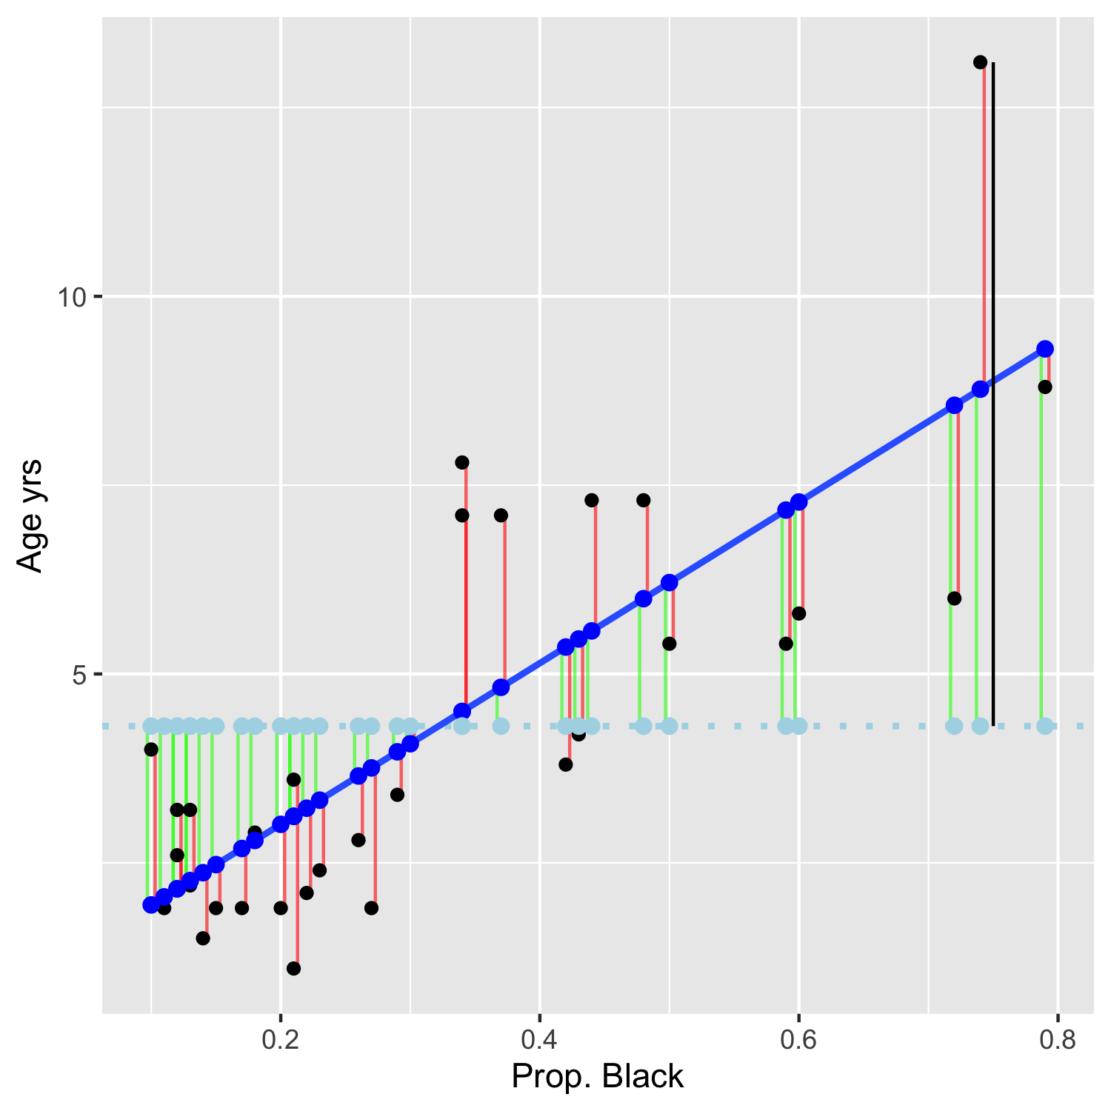
Lecture 09: Review
Covered
Regression T-Test Anova
Regression Assumptions
sum of squared allocation and subdivision from total sums of squares

Slide 3
Lecture 10: Overview
Multiple Linear Regression model
Regression parameters
Analysis of variance
Null hypotheses
Explained variance
Assumptions and diagnostics
Collinearity
Interactions
Dummy variables
Model selection
Importance of predictors

Slide 4
Lecture 10: Analyses
What if more than one predictor (X) variable?
If predictors continuous
Mix between categorical and continuous
Can use multiple linear regression
 | Independent variable
Dependent variable | Continuous | Categorical
Continuous | Regression | ANOVA
Categorical | Logistic regression

Slide 5
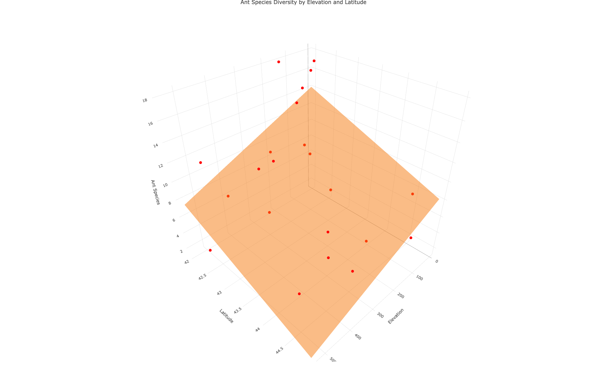
Lecture 10: Analyses
Abundance of ants can be modeled as function of
latitude
longitude
both
Instead of line, modeled with (hyper)plane

Slide 6
Lecture 10: Analyses
Used in similar way to simple linear regression:
Describe nature of relationship between Y and X’s
Determine explained / unexplained variation in Y
Predict new Ys from X
Find the “best” model

Slide 7

Lecture 10: Analyses
Crawley 2012: “Multiple regression models provide some of the most profound challenges faced by the analyst”:
Overfitting
Parameter proliferation
Multicollinearity
Model selection

Slide 8
Lecture 10: Analyses
Multiple Regression:
Set of i= 1 to n observations
fixed X-values for p predictor variables (X1, X2…Xp)
random Y-values:
$$y_{i}=β_{0}+β_{1}x_{i1}+β_{2}x_{i2}+...+β_{p}x_{ip}+ϵ_{i}$$
y_{i}: value of Y for i^{th} observation X₁ = x_{i1}, X₂ = x_{i2},…, x_{p} = x_{ip}
β₀: population intercept, the mean value of Y when X₁= 0, X₂ = 0,…, X_{p} = 0

Slide 9
Lecture 10: Multiple linear regression model
Multiple Regression:
$$y_{i}=β_{0}+β_{1}x_{i1}+β_{2}x_{i2}+...+β_{p}x_{ip}+ϵ_{i}$$
β₁: partial regression slope, change in Y per unit change in X₁ holding other X-vars constant
β₂: partial regression slope, change in Y per unit change in X₂ holding other X-vars constant
β_{p}: partial regression slope, change in Y per unit change in X_{p} holding other X-vars constant
What is partial - the relationship between a predictor variable and the response variable while holding all other predictor variables constant. It tells you the isolated effect of one variable, controlling for the influence of others.

Slide 10
Lecture 10: Partial regression slopes
model: ant_spp ~ elevation + latitude
The partial slope for elevation tells you how ant species richness changes with elevation when latitude is held constant
1-m increase in elevation - ant spp decrease by 0.012 spp, holding latitude constant
Or 100-meter increase in elevation, lose 1.2 spp
The partial slope for latitude tells you how ant species richness changes with latitude when elevation is held constant
1-degree increase in latitude, ant spp decrease by 2 species, holding elevation constant
Moving north = fewer ant spp, even when comparing sites at same elevation
model <- lm(ant_spp ~ elevation + latitude, data = ant_df) summary(model)
Call: lm(formula = ant_spp ~ elevation + latitude, data = ant_df) Residuals: Min 1Q Median 3Q Max -6.1180 -2.3759 0.3218 1.9070 5.8369 Coefficients: Estimate Std. Error t value Pr(>|t|) (Intercept) 98.49651 26.50701 3.716 0.00147 ** elevation -0.01226 0.00411 -2.983 0.00765 ** latitude -2.00981 0.61956 -3.244 0.00427 ** --- Signif. codes: 0 '***' 0.001 '**' 0.01 '*' 0.05 '.' 0.1 ' ' 1 Residual standard error: 3.022 on 19 degrees of freedom Multiple R-squared: 0.5543, Adjusted R-squared: 0.5074 F-statistic: 11.82 on 2 and 19 DF, p-value: 0.000463

Slide 11
Lecture 10: Regression parameters
Multiple Regression:
$$y_{i}=β_{0}+β_{1}x_{i1}+β_{2}x_{i2}+...+β_{p}x_{ip}+ϵ_{i}$$
ε_{i}: unexplained error - difference between y_{i} and value predicted by model (ŷ_{i})
ant_spp = β₀ + β₁(lat) + β₂(elevation) + ε_{i}

Slide 12
Lecture 10: Regression parameters
Multiple Regression:
$$y_{i}=β_{0}+β_{1}x_{i1}+β_{2}x_{i2}+...+β_{p}x_{ip}+ϵ_{i}$$
Estimate multiple regression parameters (intercept, partial slopes) using OLS to fit the regression line
OLS minimize ∑(y_{i}-ŷ_{i})², the SS (vertical distance) between observed y_{i} and predicted ŷ_{i} for each x_{ij}
ε estimated as residuals: ε_{i} = y_{i}-ŷ_{i}
Calculation solves set of simultaneous normal equations with matrix algebra

Slide 13
Lecture 10: Regression parameters
Regression equation can be used for prediction by subbing new values for predictor (X) variables
Confidence intervals calculated for parameters
Confidence and prediction intervals depend on number of observations and number of predictors
More observations decrease interval width
More predictors increase interval width
Prediction should be restricted to within range of X variables

Slide 14
Lecture 10: Analyses of variance or sums of squares
Variance - SS_{total} partitioned into SS_{regression} and SS_{residual}
SS_{regression} is variance in Y explained by model
SS_{residual} is variance not explained by model
Source of variation | SS | df | MS | Interpretation
Regression | $\sum_{i=1}^{n}{{\left(y_{i}−\overset{‾}{y}\right)}^{2}}$ | $p$ | $\frac{\sum_{i=1}^{n}{{\left(y_{i}−\overset{‾}{y}\right)}^{2}}}{p}$ | Difference between predicted observation and mean
Residual | $\sum_{i=1}^{n}{{\left(y_{i}−{\hat{y}}_{i}\right)}^{2}}$ | $n−p−1$ | $\frac{\sum_{i=1}^{n}{{\left(y_{i}−{\hat{y}}_{i}\right)}^{2}}}{n−p−1}$ | Difference between each observation and predicted
Total | $\sum_{i=1}^{n}{{\left(y_{i}−\overset{‾}{y}\right)}^{2}}$ | $n−1$ |  | Difference between each observation and mean

Slide 15
Lecture 10: Analyses
SS converted to non-additive MS=(SS/df)
MS_{residual}: estimate population variance
MS_{regression}: estimate population variance + variation due to strength of X-Y relationships
MS is an estimate of variance that doesn’t increase with sample size the way Sum of Squares (SS) does
Source of variation | SS | df | MS
Regression | $\sum_{i=1}^{n}{{\left(y_{i}−\overset{‾}{y}\right)}^{2}}$ | $p$ | $\frac{\sum_{i=1}^{n}{{\left(y_{i}−\overset{‾}{y}\right)}^{2}}}{p}$
Residual | $\sum_{i=1}^{n}{{\left(y_{i}−{\hat{y}}_{i}\right)}^{2}}$ | $n−p−1$ | $\frac{\sum_{i=1}^{n}{{\left(y_{i}−{\hat{y}}_{i}\right)}^{2}}}{n−p−1}$
Total | $\sum_{i=1}^{n}{{\left(y_{i}−\overset{‾}{y}\right)}^{2}}$ | $n−1$

Slide 16
Lecture 10: Hypotheses
Two Null Hypotheses usually tested in MLR:
“Basic” H_{o}: all partial regression slopes equal 0; β₁ = β₂ = … = β_{p} = 0
If “basic” H_{o} true, MS_{regression} and MS_{residual} estimate variance and their ratio (F-ratio) = 1
If “basic” H_{o} false (at least one β ≠ 0) MS_{regression} estimates variance + partial regression slope and their ratio (F-ratio) will be > 1 - F-ratio compared to F-distribution for p-value

Slide 17
Lecture 10: Hypotheses
Also: is any specific β = 0 (explanatory role)?
E.g., does LAT have effect on Ant species?
These H’s tested through model comparison
Model 1 - model with 2 predictors X₁, X₂:
yi= β₀ +β₁x_{i1}+β₂x_{i2}+ ε_{i}
Model 2 - To test H_{o} that β₂ = 0 compare fit of model 1 to model 2 with 1 predictor:
y_{i}= β₀ +β₁x_{i1}+ ε_{i}

Slide 18
Lecture 10: Hypotheses
If SS_{regression} of model₁=model₂, cannot reject H_{o} β₁ = 0
adding X₂ did not explain any additional variance
If SS_{regression} of mod1 > mod2, evidence to reject H_{o} β₁ = 0
adding X2 explains more variance
evidence to reject H0: β₂ = 2
SS for β₁ is SS_{extra}β₁ = Full SS_{regression} - Reduced SS_{regression}
This quantifies how much additional variance X₂ explains
Use partial F-test to test Ho β₁ = 0 :
$$F_{w,n−p}=\frac{MS_{Extra}}{FULL MS_{Residual}}$$
Can also use t-test (R provides this value)

Slide 19
Lecture 10: Explained variance
Explained variance (r²) is calculated the same way as for simple regression:
$$r^{2}=\frac{SS_{Regression}}{SS_{Total}}=1−\frac{SS_{Residual}}{SS_{Total}}$$
r² values can not be used to directly compare models
r² values will always increase as predictors added
r² values with different transformation will differ

Slide 20
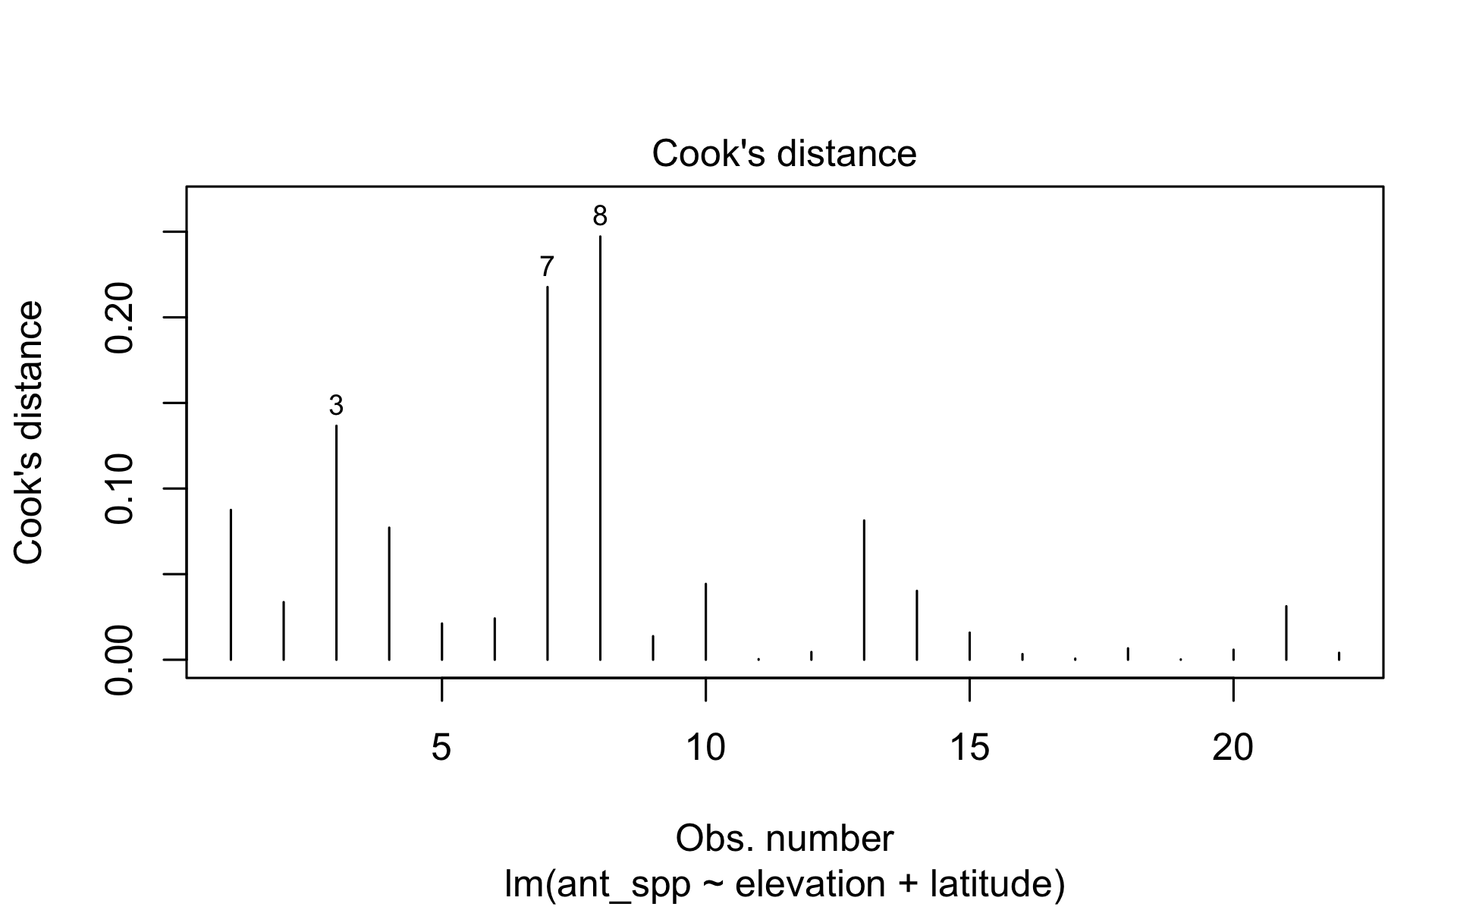
Lecture 10: Assumptions and diagnostics
Assume fixed Xs; unrealistic in most biological settings
No major (influential) outliers
Check leverage, influence- Cook’s Di
# Plot Cook's distance plot(model, which = 4)

Slide 21
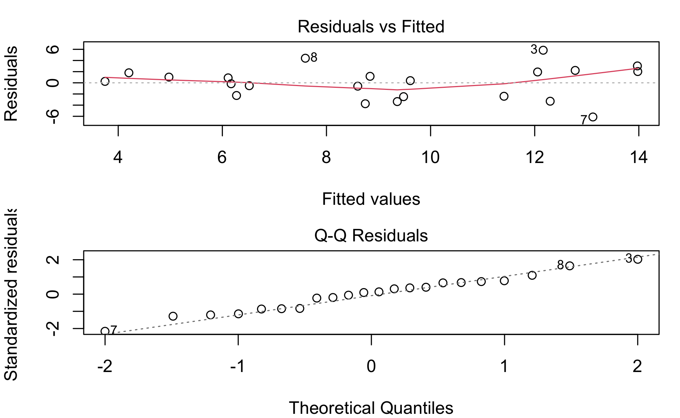
Lecture 10: Assumptions and diagnostics
Normality, equal variance, independence
Residual QQ-plots, residuals vs. predicted values plot
Distribution/variance often corrected by transforming Y

Slide 22
Lecture 10: Assumptions and diagnostics
More observations than predictor variables
Ideally at least 10x observations than predictors to avoid “overfitting” 10:1
2 predictors = 20 observations!!!
No colinearity
Need Uncorrelated predictor variables (assessed using scatterplot matrix; VIFs)
Each X has linear relationship with Y after accounting for other predictors
Added Variable (AV) plots (also called partial regression plots)
These show the relationship between Y and X₁ after removing the linear effects of all other predictors
Create AV plots for all predictors - avPlots(model)
Or for just one predictor - avPlot(model, variable = "proportion_black")

Slide 23
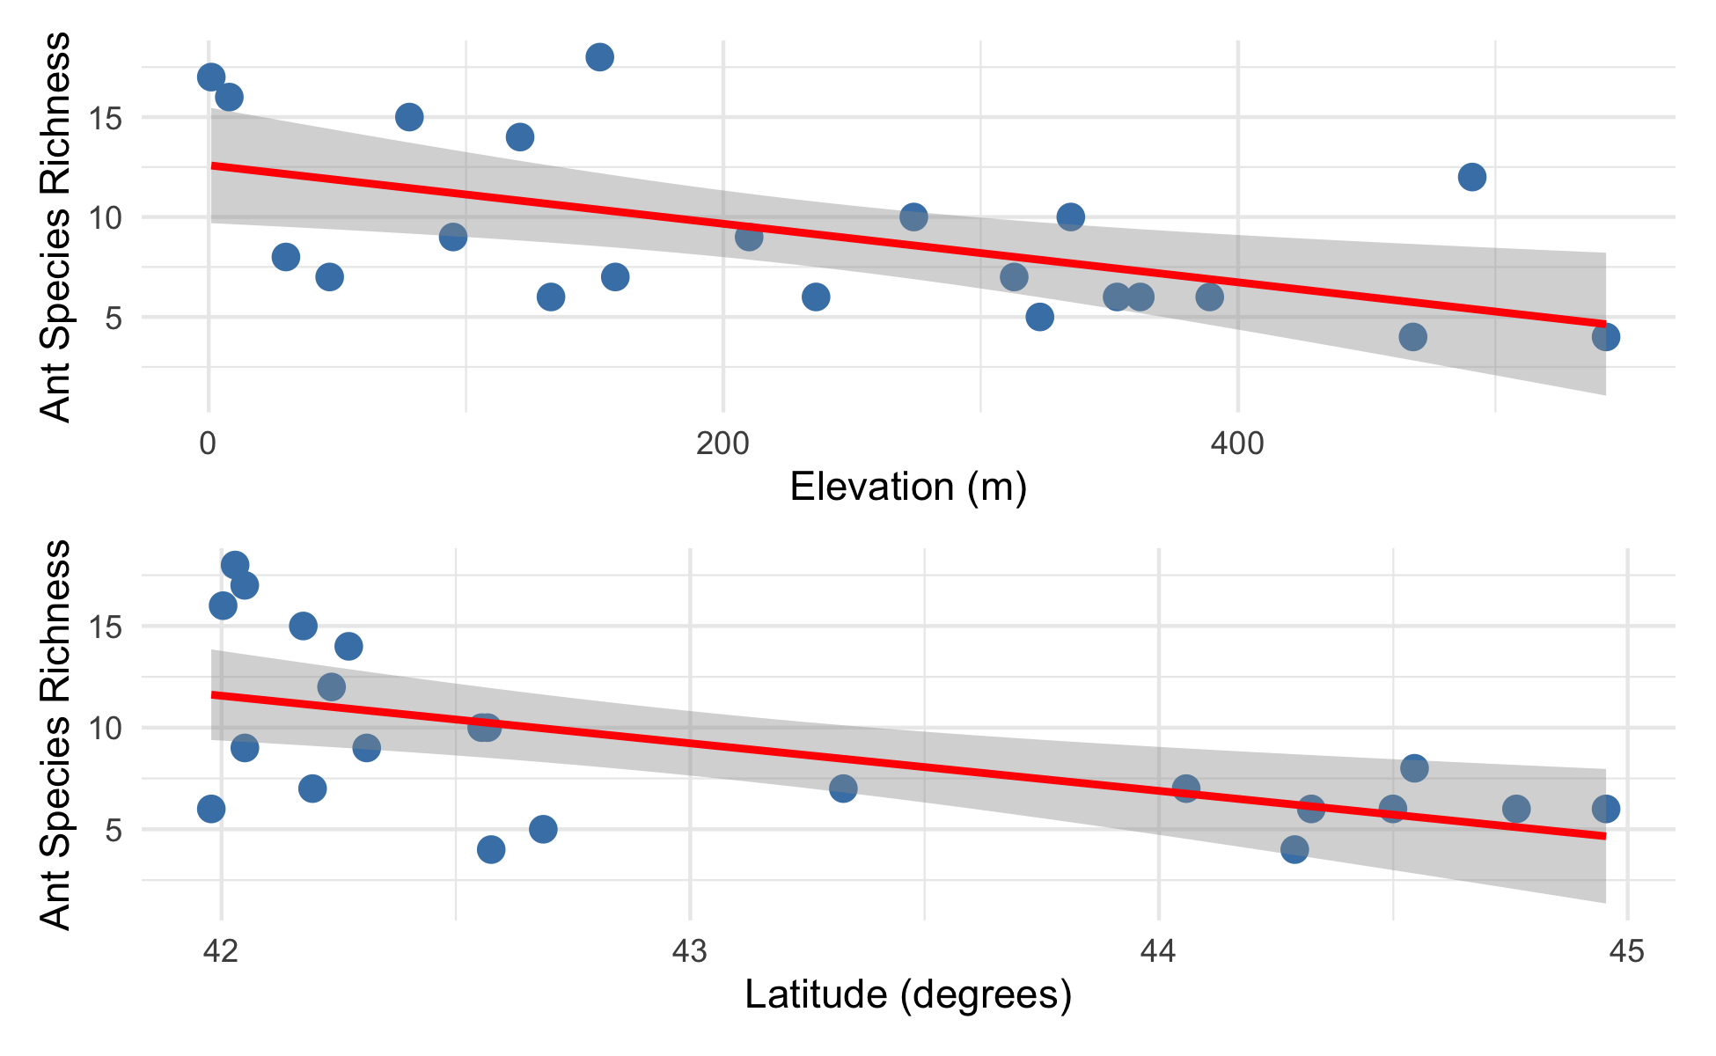
Lecture 10: Analyses
Regression of Y vs. each X does not consider effect of other predictors:
want to know shape of relationship while holding other predictors constant

Slide 24
Lecture 10: Collinearity
Potential predictor variables are often correlated (e.g., morphometrics, nutrients, climatic parameters)
Multicollinearity (strong correlation between predictors) causes problems for parameter estimates
Severe collinearity causes unstable parameter estimates: small change in a single value can result in large changes in βp - estimates
Inflates partial slope error estimates, loss of power
elevation latitude ant_spp elevation 1.0000000 0.1787454 -0.5545244 latitude 0.1787454 1.0000000 -0.5879407 ant_spp -0.5545244 -0.5879407 1.0000000

Slide 25
Lecture 10: Collinearity
Collinearity can be detected by:
Variance inflation Factors (VIF):
VIF for X_{j}=1/ (1-r² )
VIF > 10 = bad
Best/simplest solution:
exclude variables that are highly correlated with other variables
they are probably measuring similar things and are redundant

Slide 26
Lecture 10: Interactions
Predictors can be modeled as:
additive (effect of temp, plus precip, plus fertility) or
multiplicative (interactive)
Interaction: effect of Xi depends on levels of Xj
The partial slope of Y vs. X₁ is different for different levels of X₂ (and vice versa); measured by β₃
$$y_{i}=β_{0}+β_{1}X_{i1}+β_{2}X_{i2}+ϵ_{i} \text{vs.} y_{i}=β_{0}+β_{1}X_{i1}+β_{2}X_{i2}+β_{3}X_{i1}*X_{i2}ϵ_{i}$$
This leads to “Curvature” of the regression (hyper)plane

Slide 27
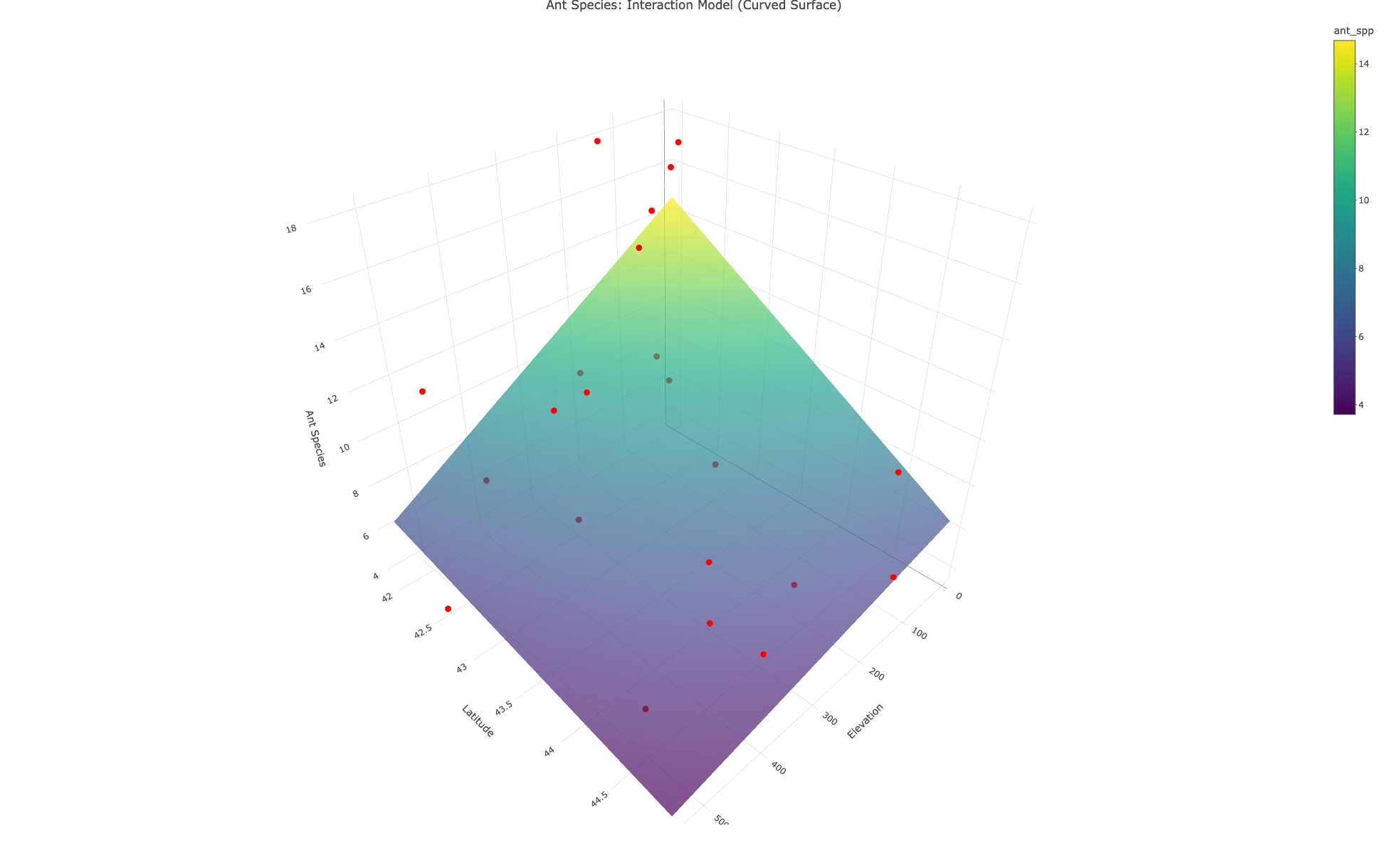
Lecture 10: Analyses
Interaction terms lead to “Curvature” of the regression (hyper)plane

Slide 28
Lecture 10: Analyses
Adding interactions:
many more predictors (“parameter proliferation”):
2^{n} is required; 6 parameters = 64 terms; 7 parameters= 128
interpretation more complex
When to include interactions? When they make biological sense!!!

Slide 29
Lecture 10: Dummy variables
Multiple Linear Regression accommodates continuous and categorical variables (gender, vegetation type, etc.) Categorical vars as “dummy vars”, n of dummy variables = n-1 categories
Sex M/F:
Need 1 dummy var with two values (0, 1)
Fertility L/M/H:
Need 2 dummy var, each with two values (0, 1): fert1 (0 if L or H, 1 if M), fert2 (1 if H, 0 if L or M)
Fertility | fert1 | fert2
Low | 0 | 0
Med | 1 | 0
High | 0 | 1

Slide 30
Lecture 10: Analyses
Coefficients interpreted relative to reference condition
R codes dummy variables automatically
picks “reference” level alphabetically
Dummy variables with more than 2 levels add extra predictor variables to model
Fertility | fert1 | fert2
Low | 0 | 0
Med | 1 | 0
High | 0 | 1

Slide 31
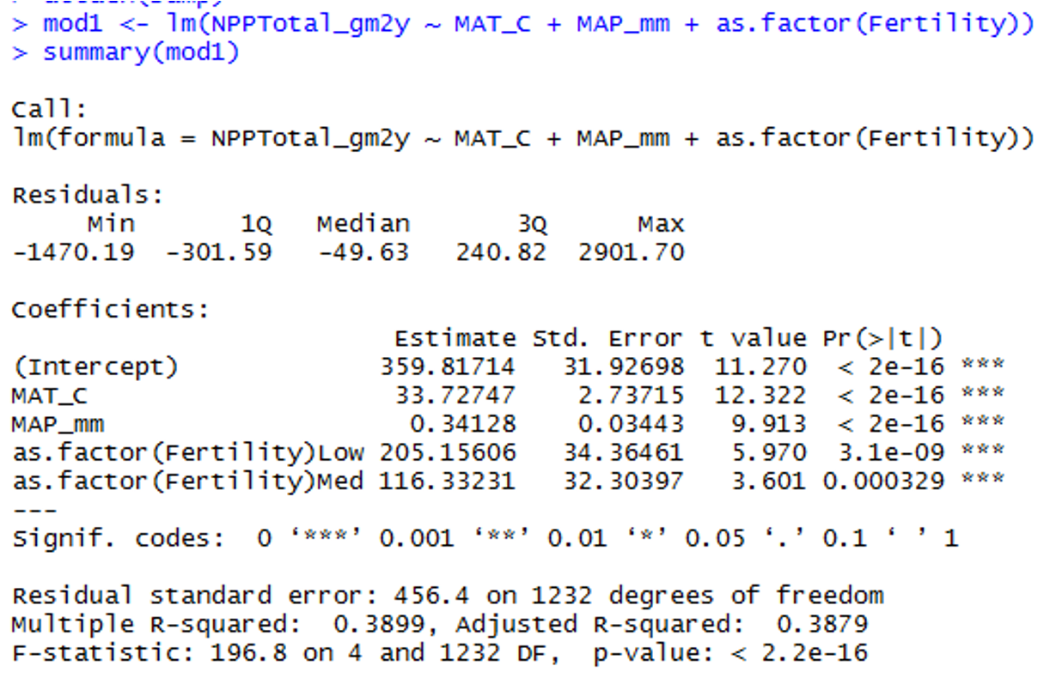
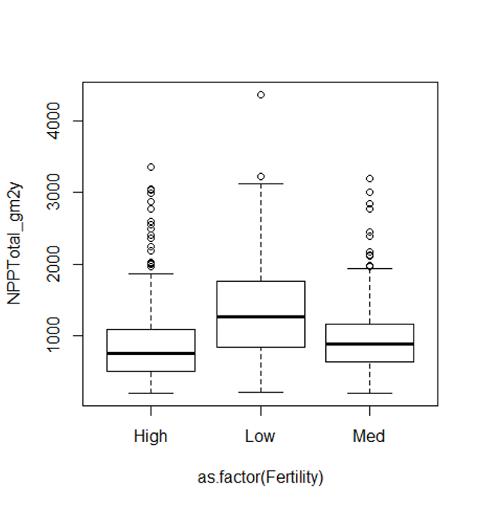
Lecture 10: Analyses

Slide 32
Lecture 10: Comparing models
When have multiple predictors (and interactions!)
how to choose “best” model?
Which predictors to include?
Occam’s razor: “best” model balances complexity with fit to data
To chose:
compare “nested” models
Overfitting
getting high r2 just by having more (useless predictors)
so r2 is not a good way of choosing between nested models

Slide 33
Lecture 10: Comparing models
Need to account for increase in fit with added predictors:
Adjusted r2
Akaike’s information criterion (AIC)
Both “penalize” models for extra predictors
Higher adjusted r2 and lower AIC are better when comparing models
p = predictors
n = #
$$\text{Adjusted }r^{2}=1−\frac{SS_{\text{Residual}}/\left(n−\left(p+1\right)\right)}{SS_{\text{Total}}/\left(n−1\right)}$$
$$\text{Akaike Information Criterion (AIC)}=n\left[ln\left(SS_{\text{Residual}}\right)\right]+2\left(p+1\right)−nln\left(n\right)$$

Slide 34
Lecture 10: Comparing models
But how to compare models?
Can fit all possible models
compare AICs or adj- r2,
tedious w lots of predictors
Automated forward (and backward) stepwise procedures: start w no terms (all terms), add (remove) terms w largest (smallest)
partial F statistic
We will use manual form of backward selection

Slide 35
Lecture 10: Analyses
========== FULL MODEL (Both Variables) ==========
Call: lm(formula = ant_spp ~ elevation + latitude, data = ant_df) Residuals: Min 1Q Median 3Q Max -6.1180 -2.3759 0.3218 1.9070 5.8369 Coefficients: Estimate Std. Error t value Pr(>|t|) (Intercept) 98.49651 26.50701 3.716 0.00147 ** elevation -0.01226 0.00411 -2.983 0.00765 ** latitude -2.00981 0.61956 -3.244 0.00427 ** --- Signif. codes: 0 '***' 0.001 '**' 0.01 '*' 0.05 '.' 0.1 ' ' 1 Residual standard error: 3.022 on 19 degrees of freedom Multiple R-squared: 0.5543, Adjusted R-squared: 0.5074 F-statistic: 11.82 on 2 and 19 DF, p-value: 0.000463

Slide 36
Lecture 10: Analyses
========== ELEVATION ONLY MODEL ==========
Call: lm(formula = ant_spp ~ elevation, data = ant_df) Residuals: Min 1Q Median 3Q Max -4.9010 -2.6947 -0.9502 2.9657 7.6363 Coefficients: Estimate Std. Error t value Pr(>|t|) (Intercept) 12.589088 1.385615 9.086 1.55e-08 *** elevation -0.014641 0.004913 -2.980 0.0074 ** --- Signif. codes: 0 '***' 0.001 '**' 0.01 '*' 0.05 '.' 0.1 ' ' 1 Residual standard error: 3.671 on 20 degrees of freedom Multiple R-squared: 0.3075, Adjusted R-squared: 0.2729 F-statistic: 8.881 on 1 and 20 DF, p-value: 0.0074

Slide 37
Lecture 10: Analyses
========== LATITUDE ONLY MODEL ==========
Call: lm(formula = ant_spp ~ latitude, data = ant_df) Residuals: Min 1Q Median 3Q Max -6.2223 -2.1188 0.0599 2.1267 6.4990 Coefficients: Estimate Std. Error t value Pr(>|t|) (Intercept) 109.8532 30.9803 3.546 0.00203 ** latitude -2.3401 0.7199 -3.251 0.00401 ** --- Signif. codes: 0 '***' 0.001 '**' 0.01 '*' 0.05 '.' 0.1 ' ' 1 Residual standard error: 3.569 on 20 degrees of freedom Multiple R-squared: 0.3457, Adjusted R-squared: 0.313 F-statistic: 10.57 on 1 and 20 DF, p-value: 0.004006

Slide 38
Lecture 10: Analyses
========== MODEL COMPARISON TABLE ==========
Model Adjusted_R2 AIC R2_vs_Full AIC_vs_Full 1 Both Variables 0.5074180 115.8646 0.0000000 0.000000 2 Elevation Only 0.2728722 123.5608 -0.2345459 7.696164 3 Latitude Only 0.3129580 122.3132 -0.1944600 6.448613
========== KEY FINDINGS ==========
Full Model AIC: 115.86 (Adjusted R²: 0.5074)
Elevation Only AIC: 123.56 (Adjusted R²: 0.2729)
Latitude Only AIC: 122.31 (Adjusted R²: 0.3130)
--- Differences from Full Model ---
Removing latitude: AIC increases by 7.70, Adj R² decreases by -0.2345
Removing elevation: AIC increases by 6.45, Adj R² decreases by -0.1945
========== CONCLUSION ==========
✓ Full model has LOWEST AIC (best fit)
✓ Full model has HIGHEST Adjusted R² (explains most variance)
✗ Removing either variable worsens model performance
Both elevation and latitude are important predictors of ant species diversity!

Slide 39
Lecture 10: Predictors
Usually want to know relative importance of predictors to explaining Y
Three general approaches:
Using F-tests (or t-tests) on partial regression slopes
Using coefficient of partial determination
Using standardized partial regression slopes

Slide 40
Lecture 10: Predictors
Using F-tests (or t-tests) on partial regression slopes:
Conduct F tests of Ho that each partial regression slope = 0
If cannot reject Ho, discard predictor
Can get additional clues from relative size of F-values
Does not tell us absolute importance of predictor (usually can not directly compare slope parameters)

Slide 41
Lecture 10: Predictors
Using coefficient of partial determination:
the reduction in variation of Y due to addition of predictor (Xj)
$$r_{X_{j}}^{2}=\frac{SS_{\text{Extra}}}{\text{Reduced }SS_{\text{Residual}}}$$
SSextra
Increased in SSregression when Xj is added to model
Reduced SSresidual is the unexplained SS from model without Xj

Slide 42
Lecture 10: Predictors
Using standardized partial regression slopes:
predictors of predictor variables can not be directly compared
Why?
Standardize all vars (mean = 0, sd= 1)
Scales are identical and larger PRS mean more important variable

Slide 43
Lecture 10: Predictors
Using partial r² values
pEta_sqr (Partial Eta Squared):
Elevation: 0.3189 (31.9%) - Elevation explains 31.9% of the variance after controlling for latitude
Latitude: 0.3564 (35.6%) - Latitude explains 35.6% of the variance after controlling for elevation
Both are important predictors! Latitude is slightly stronger
dR_sqr (Delta R Squared / Semi-partial R²):
Elevation: 0.2087 (20.9%)
If you removed elevation from the model, R² would drop by 20.9%
Latitude: 0.2468 (24.7%)
If you removed latitude from the model, R² would drop by 24.7%
Shows the unique contribution of each predictor to the total variance explained
== Method 2: Type II ANOVA (car package) ==
Anova Table (Type II tests) Response: ant_spp Sum Sq Df F value Pr(>F) elevation 81.224 1 8.8955 0.007652 ** latitude 96.085 1 10.5231 0.004272 ** Residuals 173.487 19 --- Signif. codes: 0 '***' 0.001 '**' 0.01 '*' 0.05 '.' 0.1 ' ' 1
== Coefficients Table ==
Coefficients SSR df pEta_sqr dR_sqr elevation 81.22 1 0.3189 0.2087 latitude 96.09 1 0.3564 0.2468 Residuals 173.49 19 0.5000 0.4457
== Summary Statistics ==
Sum of squared errors (SSE): 173.5
Sum of squared total (SST): 389.3
Model R²: 0.5543

