Slide 1
Lecture 13 - Nested ANOVA
Bill Perry

Slide 2
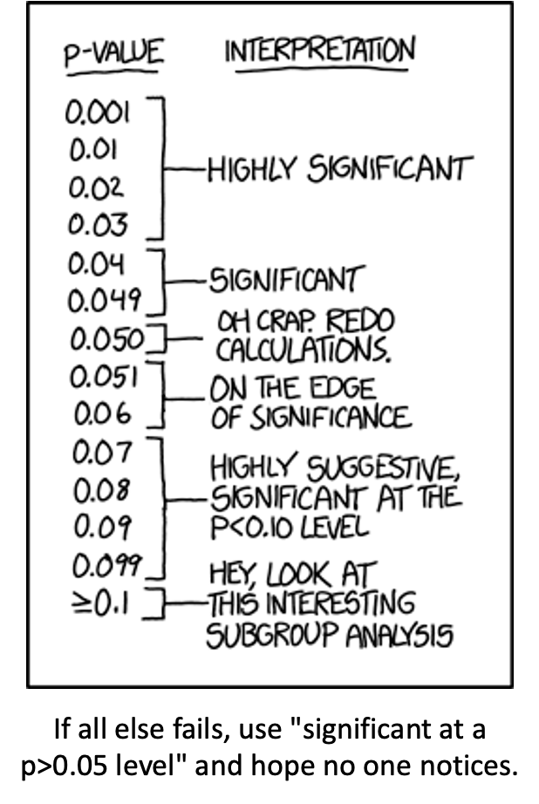
Lecture 12: Review
Two Factor ANOVA
Example
Linear model
Analysis of variance
Null hypotheses
Interactions and main effects
Unequal sample size
Assumptions

Slide 3
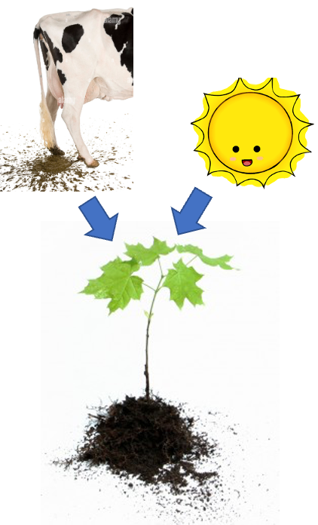
Lecture 12: 2 Factor or 2 Way ANOVA
Often consider more than 1 factor (independent categorical variables):
reduce unexplained variance
look at interactions
2-factor designs (2-way ANOVA) very common in ecology
Can have more factors (e.g., 3-way ANOVA)
interpretation tricky…
Most tests are multifactor designs:
factorial
nested
mixed

Slide 4
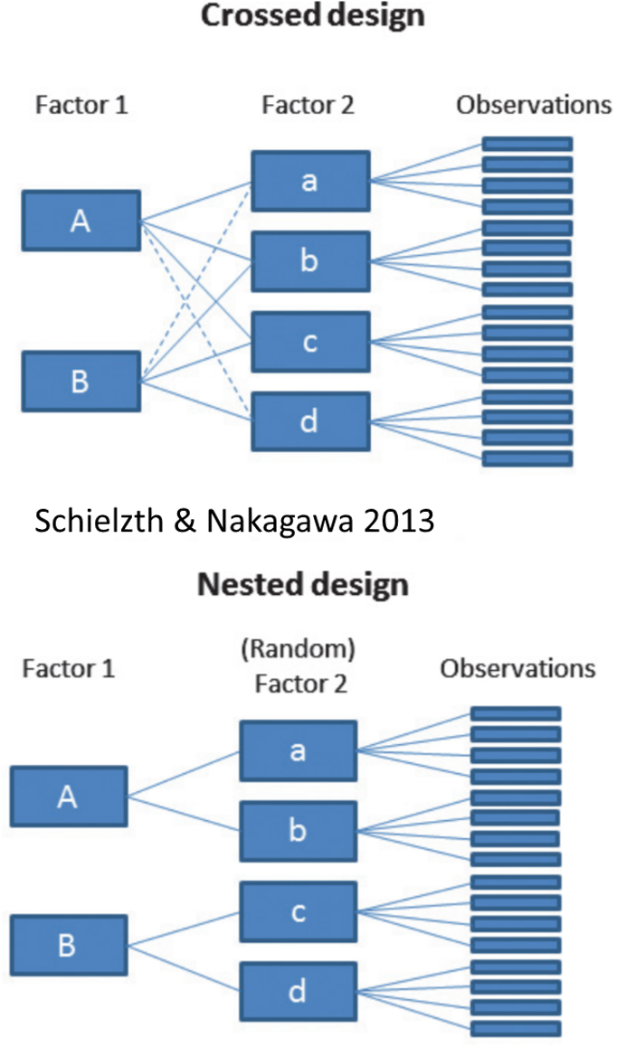
Factorial Versus Nested Designs
Consider two factors: A and B
Factorial/crossed: every level of B in every level of A
Nested/hierarchical: levels of B occur only in 1 level of A
both can be fixed - rare
one fixed one random
both random - rare in ecology common in genetics

Slide 5
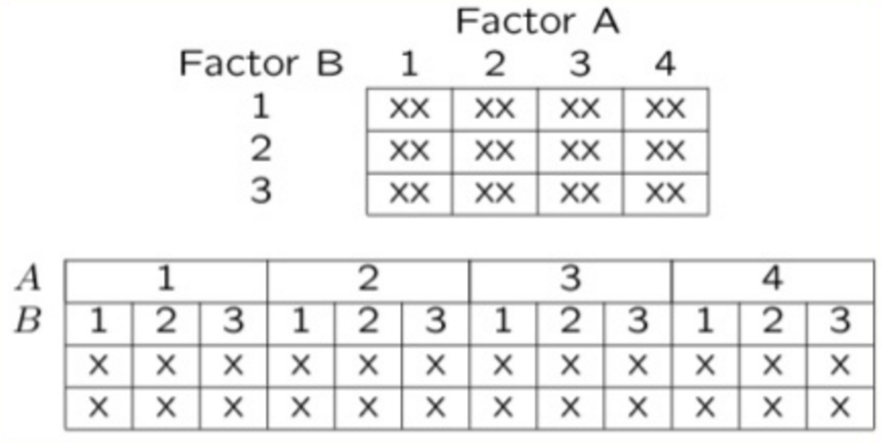
Factorial Designs Overview
Factorial Designs:
Both factors typically fixed (but not always)

Slide 6
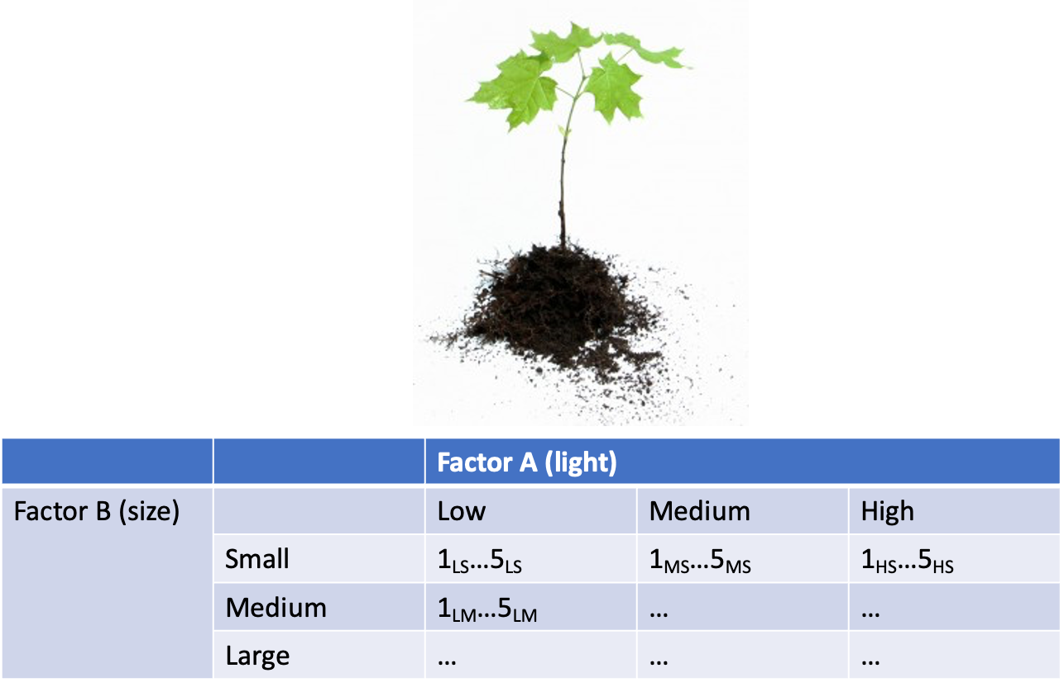
Factorial Design Example: Seedling Growth
Effects of light level on growth of seedlings of different size:
3 light levels (factor A)
3 size classes (factor B)
5 replicate seeding in each cell

Slide 7
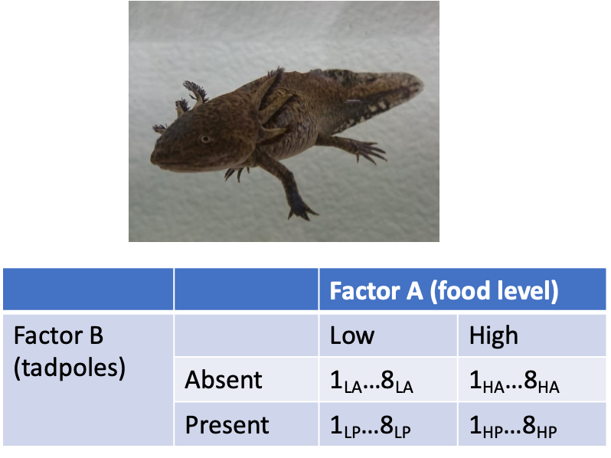
Factorial Design Example: Salamander Growth
Effects of food level and tadpole presence on larval salamander growth
2 food levels (factor A)
presence/absence of tadpoles (factor B)
8 replicates in each cell

Slide 8
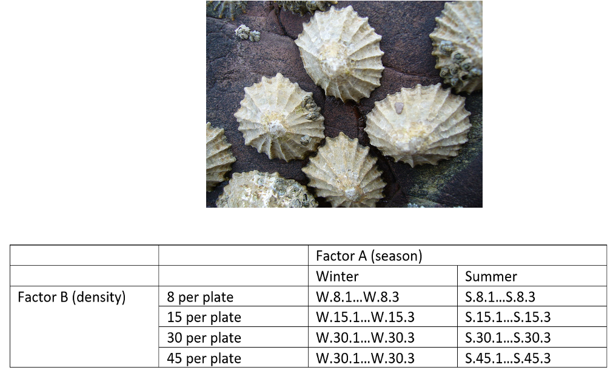
Factorial Design Example: Limpet Fecundity
Effect of season and density on limpet fecundity.
2 seasons (factor A)
4 density treatments (factor B)
3 replicates in each cell

Slide 9
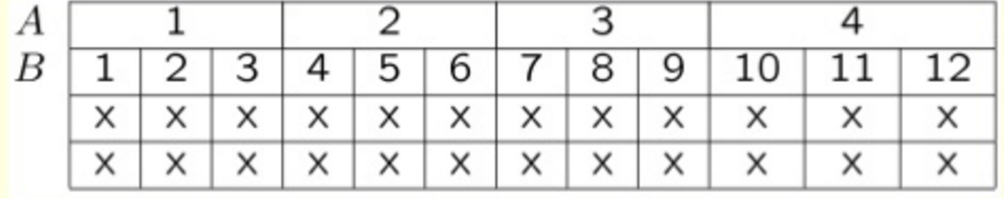
Nested Designs Overview
Nested design examples
Nested designs
Linear model
Analysis of variance
Null hypotheses
Unbalanced designs
Assumptions
mixed model ANOVA
Nested Designs:
Factor A usually fixed
Factor B usually random

Slide 10
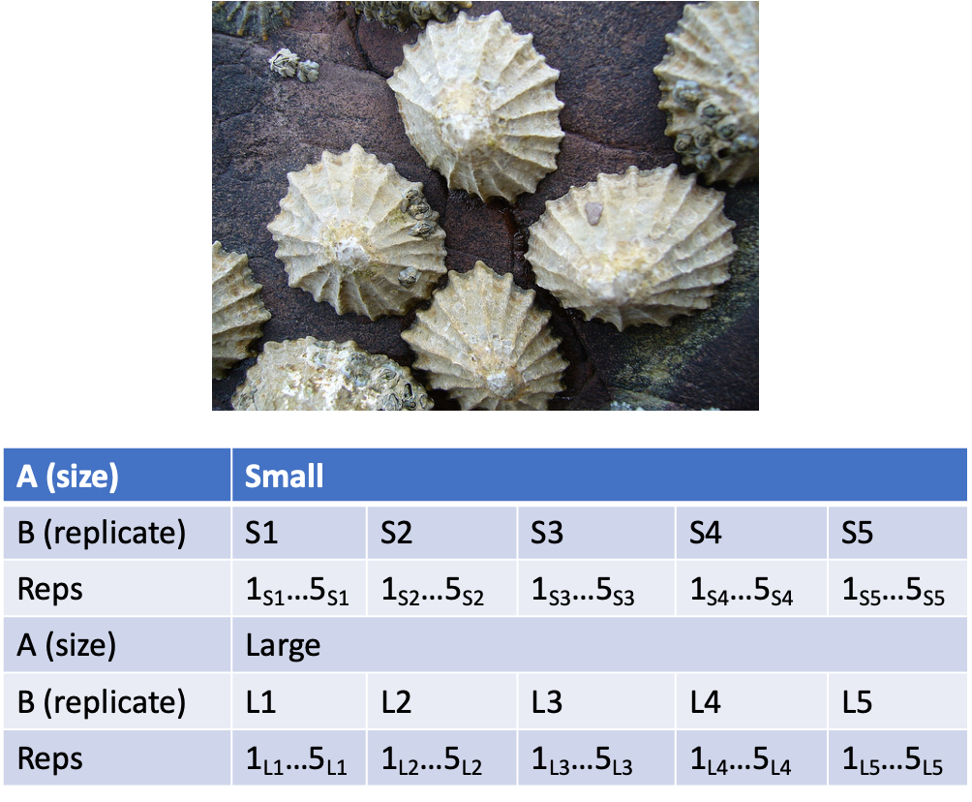
Nested Design Example: Limpet Growth
Study on effects of enclosure size on limpet growth:
2 enclosure sizes (factor A)
5 replicate enclosures (factor B)
5 replicate limpets per enclosure

Slide 11
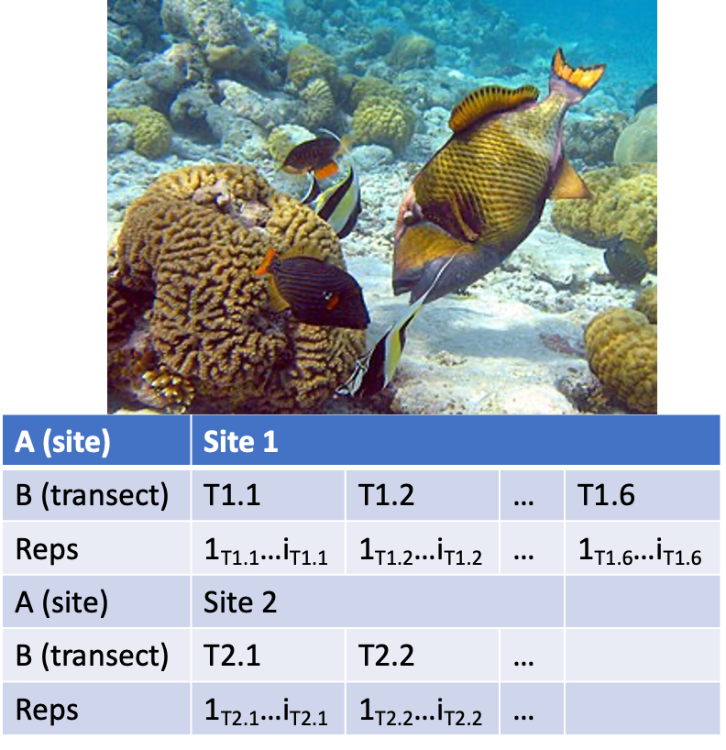
Nested Design Example: Reef Fish
Study on reef fish recruitment:
5 sites (factor A)
6 transects at each site (factor B)
replicate observations along each transect

Slide 12
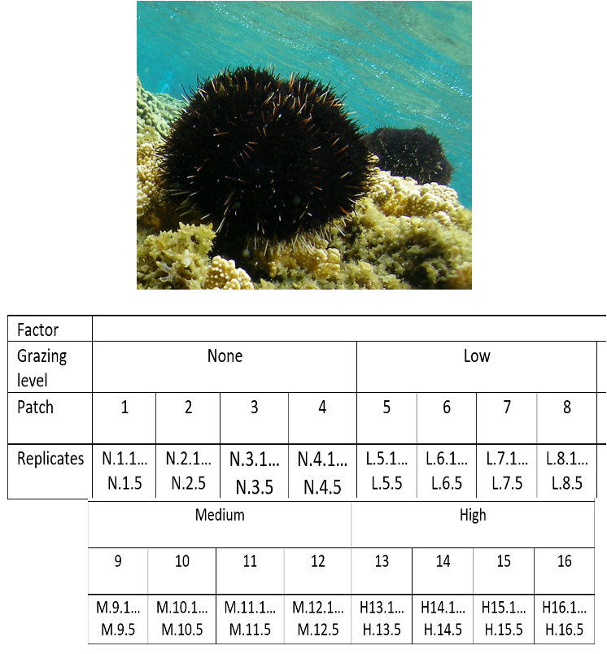
Nested Design Example: Sea Urchin Grazing
Effects of sea urchin grazing on biomass of filamentous algae:
4 levels of urchin grazing: none, L, M, H
4 patches of rocky bottom (3-4 m2) nested in each level of grazing
5 replicate quadrats per patch

Slide 13
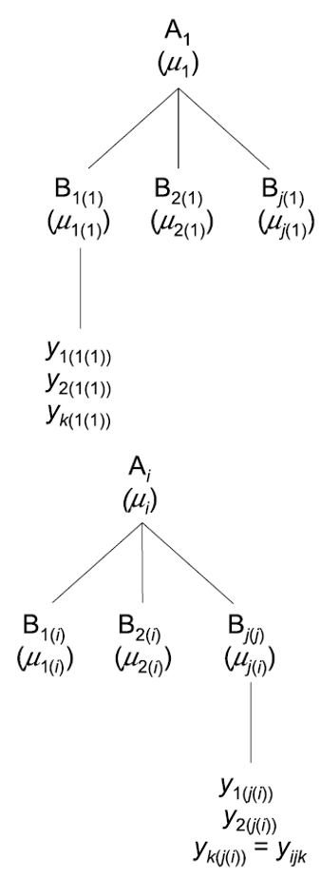
Nested Design: Linear Model Structure
Consider a nested design with:
p levels of factor A (i= 1…p) (e.g., 4 grazing levels)
q levels of factor B (j= 1…q), nested within each level of A (e.g., 4 - diff. patches per grazing level)
n replicates (k= 1…n) in each combination of A and B (5 replicate - quadrats in each patch in each grazing level)

Slide 14
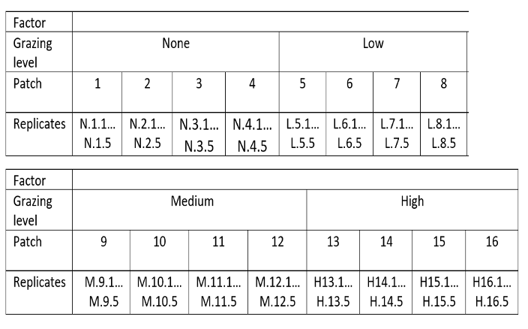
Calculating Means in Nested Design
Can calculate several means:
overall mean (across all levels of A and B)= ȳ;
a mean for each level of A (across all levels of B in that A)= ȳi;
a mean for each level of B within each A= ȳj(i)

Slide 15
Nested Design Means Visualization

Slide 16
Nested Design Linear Model
The linear model for a nested design is:
$$y_{ijk}=μ+α_{i}+β_{j\left(i\right)}+ε_{ijk}$$
Where:
$y_{ijk}$ is the response variable
value of the k-th replicate in j-th level of B in the i-th level of A
(algal biomass in 3rd quadrat, in 2nd patch in low grazing treatment)
$μ$ is the overall mean
(overall average algal biomass)

Slide 17
Fixed Effects in Nested Model
The linear model for a nested design is:
$$y_{ijk}=μ+α_{i}+β_{j\left(i\right)}+ε_{ijk}$$
$α_{i}$ is the fixed effect of factor $i$
(difference between average biomass in all low grazing level quadrats and overall mean)
$β_{j\left(i\right)}$ is the random effect of factor $j$ nested within factor $i$
usually random variable, measuring variance among all possible levels of B within each level of A
(variance among all possible patches that may have been used in the low grazing treatment)

Slide 18
Error Term in Nested Model
The linear model for a nested design is:
$y_{ijk}=μ+α_{i}+β_{j\left(i\right)}+ε_{ijk}$
where:
$ε_{ijk}$ is the error term
αi: is the effect of the ith level of A: µi- µ
unexplained variance associated with the kth replicate in jth level of B in the ith level of A
(difference bw observed algal biomass in 3rd quadrat in 2nd patch in low grazing treatment and predicted biomass - average biomass in 2nd patch in low grazing treatment)

Slide 19
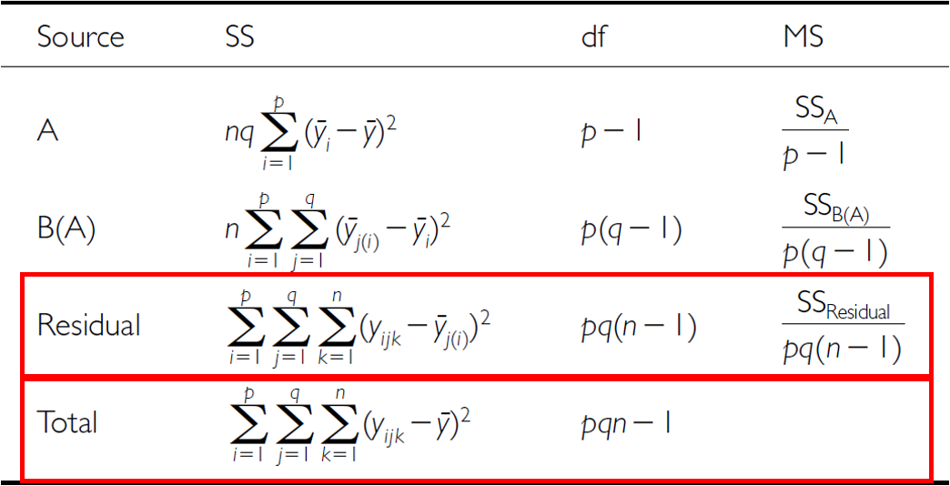
Analysis of Variance: Residual and Total
SSresid is difference bw each observation and mean for its level of factor B, summed over all observations
SStotal = SSA + SSB + SSresid
SS can be turned into MS by dividing by appropriate df

Slide 20
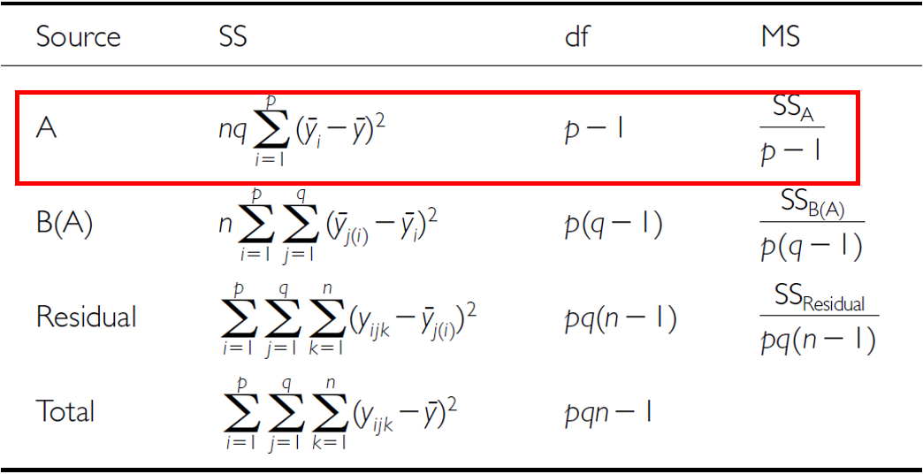
Analysis of Variance: SSA
As before, partition the variance in the response variable using SS SSA is SS of differences between means in each level of A and overall mean

Slide 21
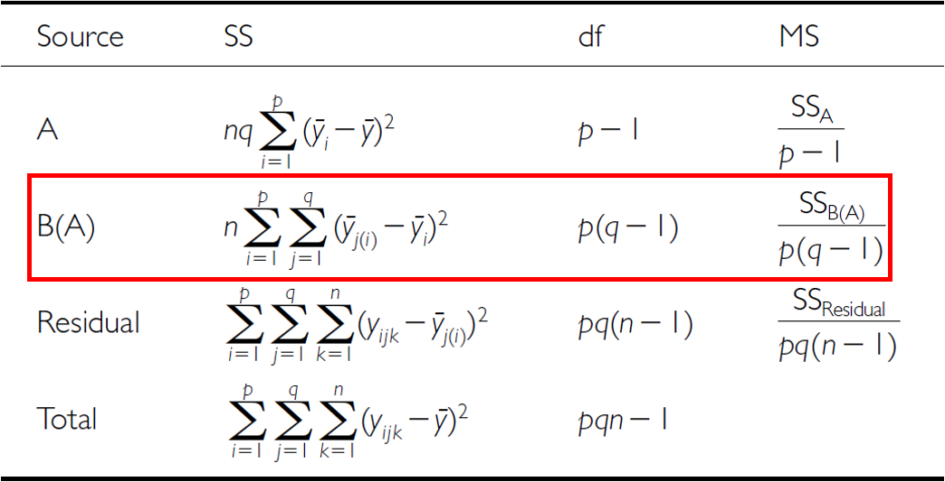
Analysis of Variance: SSB
SSB is SS of difference between means in each level of B and the mean of corresponding level of A summed across levels of A

Slide 22
Analysis of Variance Table

Slide 23
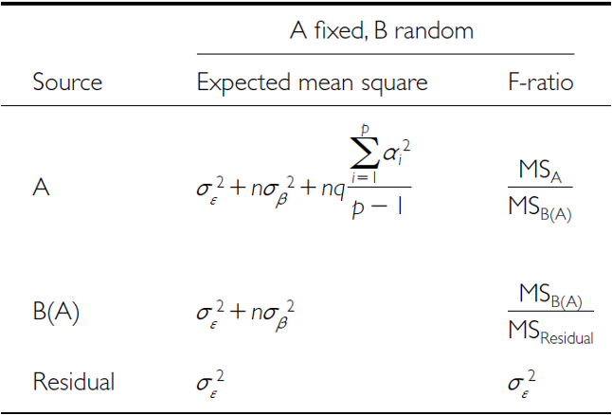
Null Hypotheses: Factor A
Two hypotheses tested on values of MS:
no effects of factor A
Assuming A is fixed:
Ho(A): µ1= µ2= µ3=…. µi= µ
Same as in 1-factor ANOVA, using means from B factors nested within each - level of A
(no difference in algal biomass across all levels of grazing: µnone= - µlow= µmed= µhigh)

Slide 24
Null Hypotheses: Factor B
Two hypotheses tested on values of MS:
No effects of factor B nested in A
Assuming B is random:
Ho(B): σβ2= 0 (no variance added due to differences between all possible - levels of B)
(no variance added due to differences between patches)

Slide 25
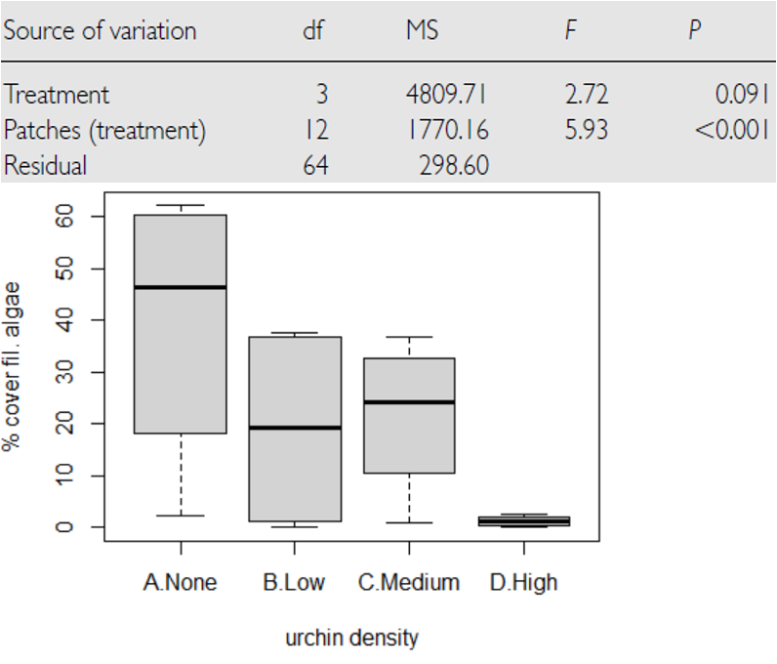
Conclusions from Analysis
Conclusions?
“significant variation between replicate patches within each treatment, but no significant difference in amount of filamentous algae between treatments”

Slide 26
Unbalanced Nested Designs
Unequal sample sizes can be because of:
uneven number of B levels within each A
uneven number of replicates within each level of B
Not a problem, unless have unequal variance or large deviation from - normality

Slide 27
Nested Design Assumptions
As usual, we assume
equal variance
normality
no outliers
independence of observations
Equal variance + normality need to be assessed at both levels:
Since means for each level of B within each A are used for the H-test about A, need to assess whether those means meet normality and equal variance
Examine residuals for H-test about B
Transformations can be used

Slide 28
Lecture 13: The nested design the hard way
This analysis examines the effects of varying sea urchin densities on the percentage cover of filamentous algae. The experiment was designed with:
four random patches
four urchin density treatments (
none = removed
low = control
medium = 33% of original density
high = 66% of original density)
Five replicate quadrats were measured within each treatment-patch combination.

Slide 29
Lecture 13: Data Overview
The dataframe contains the following variables:
patch: Random patches (1-16) where treatments were applied
treat: Urchin density treatment (None/Removed, Low/Control, Medium/33% Density, High/66% Density)
quad: Replicate quadrats within each treatment-patch combination
algae: Percentage cover of filamentous algae (response variable)
Read data and make factors
## Data ## # A tibble: 6 × 4 ## treat patch quad algae ## <fct> <fct> <dbl> <dbl> ## 1 high 1 1 0 ## 2 high 1 2 0 ## 3 high 1 3 0 ## 4 high 1 4 6 ## 5 high 1 5 2 ## 6 high 2 1 0 ## ## ## Treatment levels: ## [1] "none" "low" "medium" "high"
Summary statistics
## Summary statistics by treatment: ## # A tibble: 4 × 7 ## treat n mean sd se min max ## <fct> <int> <dbl> <dbl> <dbl> <dbl> <dbl> ## 1 none 20 39.2 28.7 6.41 0 83 ## 2 low 20 1.3 3.18 0.711 0 13 ## 3 medium 20 21.6 25.1 5.62 0 79 ## 4 high 20 19 25.7 5.74 0 71

Slide 30
Plots
u_df %>% ggplot(aes(treat, algae)) + stat_summary(aes(treat, algae),fun = "mean", geom="point", size = 3) + geom_point(aes(color=as.factor(patch)), position = position_dodge2(width=0.3))

Slide 31
Manual nested ANOVA
In this experimental design,
patch is nested within treat because each patch received only one treatment level.
a hierarchical design where the effect of patches must be considered within each treatment.
in Quinn & Keough (2002)
we’ll use a traditional nested ANOVA
you could make this easy and take the averages of the response variable algae
do a one way anova
your power is significantly reduced
you don’t get estimates of variability of patches
This is really a regular factorial anova
really not appropriate as it is pseudoreplicated
also the F value for Treat is using the MSresid
should use MStreat:patch
# Full model for patch effect and residual - proper nesting notation # First, get the standard ANOVA table to extract MS values u_fact_model <- aov(algae ~ treat + treat:patch, data = u_df) cat("Factorial model summary:\n\n") ## Factorial model summary: summary(u_fact_model) ## Df Sum Sq Mean Sq F value Pr(>F) ## treat 3 14429 4810 16.108 0.0000000658 *** ## treat:patch 12 21242 1770 5.928 0.0000008323 *** ## Residuals 64 19110 299 ## --- ## Signif. codes: 0 '***' 0.001 '**' 0.01 '*' 0.05 '.' 0.1 ' ' 1

Slide 32
The factorial anova is not correct
We can correct this by specifying the error term
The MS needed for the F value is really MS patch nested in treatments as those are the replicates
we can specify that
problem is that we can’t really handle unbalanced designs.
# Explicitly specify the nesting # This will give you the correct F-test using patch within treat as error term u_nested_model <- aov(algae ~ treat + Error(treat:patch), data = u_df) cat("Correctly specified nested ANOVA:\n\n") ## Correctly specified nested ANOVA: summary(u_nested_model) ## ## Error: treat:patch ## Df Sum Sq Mean Sq F value Pr(>F) ## treat 3 14429 4810 2.717 0.0913 . ## Residuals 12 21242 1770 ## --- ## Signif. codes: 0 '***' 0.001 '**' 0.01 '*' 0.05 '.' 0.1 ' ' 1 ## ## Error: Within ## Df Sum Sq Mean Sq F value Pr(>F) ## Residuals 64 19110 298.6

Slide 33


What to do if it is unbalanced design
And you are from the 80’s and had big hair
# Using afex package (recommended for unbalanced designs) # The afex package is specifically designed for ANOVA with # Type III SS and handles nested designs pretty well: options(contrasts = c("contr.sum", "contr.poly")) # This works and gives you the correct answer u_afex_model <- aov_car(algae ~ treat + Error(patch), data = u_df, fun_aggregate = mean) cat("AFEX nested ANOVA results:\n\n") ## AFEX nested ANOVA results: summary(u_afex_model) ## Anova Table (Type 3 tests) ## ## Response: algae ## num Df den Df MSE F ges Pr(>F) ## treat 3 12 354.03 2.7171 0.40451 0.09126 . ## --- ## Signif. codes: 0 '***' 0.001 '**' 0.01 '*' 0.05 '.' 0.1 ' ' 1
Bon Jovi
David Bowie

Slide 34
The modern way - mixed model ANOVA
Fit the model with treatment as fixed effect and patch nested within treatment as random lmer(algae ~ treat + (1|treat:patch), data = u_df, control = lmerControl(optimizer = “bobyqa”, optCtrl = list(maxfun = 2e5)))
BOBYQA (Bound Optimization BY Quadratic Approximation)
optimization algorithm in mixed-effects modeling to find the best parameter values maximizing the likelihood function
Useful when fitting complex models like the ones you’re working with in your nested ANOVA analysis
Notation we will get into later
random intercept - fixed slope - (1|patch)
random intercept - random slope - (1|treat:patch)
# Fit the model with treatment as fixed effect and patch nested within treatment as random u_lmer_model <- lmer(algae ~ treat + (1|treat:patch), data = u_df, control = lmerControl(optimizer = "bobyqa", optCtrl = list(maxfun = 2e5))) # BOBYQA (Bound Optimization BY Quadratic Approximation) is an optimization algorithm used in mixed-effects modeling to find the best parameter values that maximize the likelihood function. It's especially useful when fitting complex models like the ones you're working with in your nested ANOVA analysis. cat("Mixed model summary:\n\n") ## Mixed model summary: summary(u_lmer_model) ## Linear mixed model fit by REML. t-tests use Satterthwaite's method [ ## lmerModLmerTest] ## Formula: algae ~ treat + (1 | treat:patch) ## Data: u_df ## Control: lmerControl(optimizer = "bobyqa", optCtrl = list(maxfun = 200000)) ## ## REML criterion at convergence: 684.9 ## ## Scaled residuals: ## Min 1Q Median 3Q Max ## -1.9808 -0.3106 -0.1093 0.2831 2.5910 ## ## Random effects: ## Groups Name Variance Std.Dev. ## treat:patch (Intercept) 294.3 17.16 ## Residual 298.6 17.28 ## Number of obs: 80, groups: treat:patch, 16 ## ## Fixed effects: ## Estimate Std. Error df t value Pr(>|t|) ## (Intercept) 20.262 4.704 12.000 4.308 0.00102 ** ## treat1 18.937 8.147 12.000 2.324 0.03846 * ## treat2 -18.962 8.147 12.000 -2.327 0.03825 * ## treat3 1.287 8.147 12.000 0.158 0.87707 ## --- ## Signif. codes: 0 '***' 0.001 '**' 0.01 '*' 0.05 '.' 0.1 ' ' 1 ## ## Correlation of Fixed Effects: ## (Intr) treat1 treat2 ## treat1 0.000 ## treat2 0.000 -0.333 ## treat3 0.000 -0.333 -0.333

Slide 35
The modern way - mixed model ANOVA
METHOD 1 - the F-distribution with estimated degrees of freedom
Accounts for the uncertainty in variance component estimation
More conservative (higher p-values)
Better for small samples
# Type III ANOVA with F-statistics (not chi-square) using Satterthwaite's method u_anova_result <- Anova(u_lmer_model, type = 3, ddf = "Satterthwaite", test.statistic = "F") cat("Type III ANOVA with F test:\n\n") ## Type III ANOVA with F test: u_anova_result ## Analysis of Deviance Table (Type III Wald F tests with Kenward-Roger df) ## ## Response: algae ## F Df Df.res Pr(>F) ## (Intercept) 18.5551 1 12 0.001018 ** ## treat 2.7171 3 12 0.091262 . ## --- ## Signif. codes: 0 '***' 0.001 '**' 0.01 '*' 0.05 '.' 0.1 ' ' 1

Slide 36
The modern way - mixed model ANOVA
METHOD 2 - the Chi Square
Assumes variance components are known (not estimated)
More liberal (lower p-values)
Assumes large samples
Why Different Results?
relationship between these tests is:
Chi-square = F × numerator df
The p-values differ because:
F-test accounts for denominator df (12 in your case) - reflects sample size
Chi-square assumes infinite denominator df - assumes large samples
Rule of Thumb
under 100 observations or < 20 random effect levels: Use F-test
over 500 observations and > 50 random effect levels: Chi-square is okay
In between: F-test is safer
# Alternative using car package with F-statistic u_anova_f <- Anova(u_lmer_model, type = 3, test.statistic = "Chisq") cat("Type III ANOVA with F test:\n\n") ## Type III ANOVA with F test: u_anova_f ## Analysis of Deviance Table (Type III Wald chisquare tests) ## ## Response: algae ## Chisq Df Pr(>Chisq) ## (Intercept) 18.5551 1 0.00001651 *** ## treat 8.1513 3 0.04299 * ## --- ## Signif. codes: 0 '***' 0.001 '**' 0.01 '*' 0.05 '.' 0.1 ' ' 1

Slide 37
The modern way - mixed model ANOVA
The nested ANOVA model is specified as:
$algae_{ijk}=μ+α_{i}+β_{j\left(i\right)}+ϵ_{ijk}$
Where:
$μ$ is the overall mean
$α_{i}$ is the fixed effect of treatment $i$
$β_{j\left(i\right)}$ is the random effect of patch $j$ nested within treatment $i$
$ϵ_{ijk}$ is the residual error for quadrat $k$ in patch $j$ within treatment $i$
## Final ANOVA results: ## Analysis of Deviance Table (Type III Wald F tests with Kenward-Roger df) ## ## Response: algae ## F Df Df.res Pr(>F) ## (Intercept) 18.5551 1 12 0.001018 ** ## treat 2.7171 3 12 0.091262 . ## --- ## Signif. codes: 0 '***' 0.001 '**' 0.01 '*' 0.05 '.' 0.1 ' ' 1

Slide 38
Lecture 13: Variance Components
Important
Interpretation of ANOVA Results The nested ANOVA reveals that there was no significant effect of urchin density treatment on algae cover (χ² = 8.1513, df = 3, p = 0.04306). The variance component for patches nested within treatments (294.3) indicates substantial spatial heterogeneity in algae cover, highlighting the importance of accounting for this spatial variation in the analysis.

Slide 39
Lecture 13: Post-hoc Comparisons
Although the main effect of treatment was marginally significant in the nested ANOVA (p = 0.04306), we can examine the mean differences between treatments to understand patterns in the data.
# Calculate estimated marginal means u_emm <- emmeans(u_lmer_model, ~ treat) cat("Estimated marginal means:\n\n") ## Estimated marginal means: u_emm ## treat emmean SE df lower.CL upper.CL ## none 39.2 9.41 12 18.70 59.7 ## low 1.3 9.41 12 -19.20 21.8 ## medium 21.6 9.41 12 1.05 42.0 ## high 19.0 9.41 12 -1.50 39.5 ## ## Degrees-of-freedom method: kenward-roger ## Confidence level used: 0.95

Slide 40
Lecture 13: Tukey Pairwise Comparisons
# Pairwise comparisons with Sidak adjustment u_pairs <- pairs(u_emm, adjust = "sidak") cat("Pairwise comparisons (Sidak adjusted):\n\n") ## Pairwise comparisons (Sidak adjusted): u_pairs ## contrast estimate SE df t.ratio p.value ## none - low 37.90 13.3 12 2.849 0.0848 ## none - medium 17.65 13.3 12 1.327 0.7557 ## none - high 20.20 13.3 12 1.518 0.6356 ## low - medium -20.25 13.3 12 -1.522 0.6331 ## low - high -17.70 13.3 12 -1.330 0.7534 ## medium - high 2.55 13.3 12 0.192 1.0000 ## ## Degrees-of-freedom method: kenward-roger ## P value adjustment: sidak method for 6 tests

Slide 41
Lecture 13: Letter Display
# Extract compact letter display for plotting u_cld <- multcomp::cld(u_emm, alpha = 0.05, Letters = letters) cat("Compact letter display:\n\n") ## Compact letter display: u_cld ## treat emmean SE df lower.CL upper.CL .group ## low 1.3 9.41 12 -19.20 21.8 a ## high 19.0 9.41 12 -1.50 39.5 a ## medium 21.6 9.41 12 1.05 42.0 a ## none 39.2 9.41 12 18.70 59.7 a ## ## Degrees-of-freedom method: kenward-roger ## Confidence level used: 0.95 ## P value adjustment: tukey method for comparing a family of 4 estimates ## significance level used: alpha = 0.05 ## NOTE: If two or more means share the same grouping symbol, ## then we cannot show them to be different. ## But we also did not show them to be the same.
Important
Interpretation of Treatment Comparisons The mean algae cover shows a clear pattern with increasing urchin density: None/Removed (39.20%) > Medium/33% Density (19.00%) > High/66% Density (21.55%) > Low/Control (1.30%). The pattern suggests an inverse relationship between urchin density and algae cover, with complete removal showing the highest algae cover. The high variability among patches within treatments contributed to the marginal statistical significance for the treatment effect.

Slide 42
Lecture 13: ANOVA Assumptions Testing
For valid inference from ANOVA, several assumptions must be met. We test these assumptions below.
Base R approach
Note that it does not work that well

Slide 43
Lecture 13: Levenes Test for Homogeneity of Variance
Levenes test
# Homogeneity of Variance # Levene's test for homogeneity of variance u_levene <- leveneTest(algae ~ treat, data = u_df) cat("Levene's test for homogeneity of variance:\n\n") ## Levene's test for homogeneity of variance: u_levene ## Levene's Test for Homogeneity of Variance (center = median) ## Df F value Pr(>F) ## group 3 8.1694 0.00008785 *** ## 76 ## --- ## Signif. codes: 0 '***' 0.001 '**' 0.01 '*' 0.05 '.' 0.1 ' ' 1
Interpretation of Assumption Tests The Q-Q plot shows some deviation from normality, particularly in the tails, and Levene’s test indicates significant heterogeneity of variances across treatments (p = 0.00008785). As noted by Quinn & Keough (2002), there were “large differences in within-cell variances” in this dataset, and transformations (including arcsin) did not improve variance homogeneity. However, ANOVA is generally robust to heteroscedasticity with balanced designs, which is why they chose to analyze untransformed data. The Residuals vs. fitted plot also shows a pattern of increasing variance with increasing fitted values, confirming the heteroscedasticity.

Slide 44
Lecture 13: Visualization

Slide 45
Lecture 13: Means Plot

Slide 46
Lecture 13: Discussion
Important
Scientific Interpretation Our nested ANOVA analysis revealed substantial spatial heterogeneity in algae cover, with significant variation among patches within each treatment. The effect of urchin density treatments on filamentous algae cover was marginally significant at the α = 0.05 level (p = 0.043). The descriptive statistics show a clear pattern where algae cover increases as urchin density decreases, with None/Removed showing the highest cover (39.20%), followed by Medium/33% Density (19.00%), High/66% Density (21.55%), and Low/Control showing minimal algae cover (1.30%). This pattern demonstrates a density-dependent relationship between urchin grazing and algal abundance. The substantial variance component associated with patches nested within treatments (294.31, approximately 39.5% of total variance) underscores the importance of spatial heterogeneity in structuring algal communities. This finding highlights the necessity of accounting for spatial variability when designing and analyzing ecological field experiments. From an ecological perspective, these results suggest that sea urchins significantly influence algal communities through grazing, though local environmental factors and patch-specific conditions also play an important role in determining algae cover. This has important implications for ecosystem management, as it indicates that the effects of urchin density manipulations are context-dependent and influenced by local environmental conditions.

Slide 47
We can do this manually
But UGGGG who would EVER do this
# Method 1: Convert to dataframe with Source as a proper variable u_man_model <- aov(algae ~ treat + treat:patch, data = u_df) u_anova_summary <- summary(u_man_model)[[1]] cat("Standard ANOVA table:\n\n") ## Standard ANOVA table: u_anova_summary ## Df Sum Sq Mean Sq F value Pr(>F) ## treat 3 14429 4809.7 16.1075 0.00000006579 *** ## treat:patch 12 21242 1770.2 5.9282 0.00000083226 *** ## Residuals 64 19110 298.6 ## --- ## Signif. codes: 0 '***' 0.001 '**' 0.01 '*' 0.05 '.' 0.1 ' ' 1
# Extract values by position (much simpler!) # Row 1 = treat, Row 2 = treat:patch, Row 3 = Residuals u_MS_treat <- u_anova_summary[1, "Mean Sq"] # Row 1, Mean Sq column u_MS_patch <- u_anova_summary[2, "Mean Sq"] # Row 2, Mean Sq column u_MS_residual <- u_anova_summary[3, "Mean Sq"] # Row 3, Mean Sq column u_df_treat <- u_anova_summary[1, "Df"] u_df_patch <- u_anova_summary[2, "Df"] u_df_residual <- u_anova_summary[3, "Df"] cat("Extracted mean squares:\n\n") ## Extracted mean squares: cat("MS Treatment:", u_MS_treat, "\n") ## MS Treatment: 4809.713 cat("MS Patch(Treatment):", u_MS_patch, "\n") ## MS Patch(Treatment): 1770.162 cat("MS Residual:", u_MS_residual, "\n\n") ## MS Residual: 298.6
# Calculate CORRECT F-ratios for nested design u_F_treat_correct <- u_MS_treat / u_MS_patch # Treatment tested against patches u_F_patch <- u_MS_patch / u_MS_residual # Patches tested against residual cat("Corrected F-ratios:\n\n") ## Corrected F-ratios: cat("F Treatment:", u_F_treat_correct, "\n") ## F Treatment: 2.717102 cat("F Patch(Treatment):", u_F_patch, "\n\n") ## F Patch(Treatment): 5.928207
# Calculate correct p-values u_p_treat_correct <- pf(u_F_treat_correct, u_df_treat, u_df_patch, lower.tail = FALSE) u_p_patch <- pf(u_F_patch, u_df_patch, u_df_residual, lower.tail = FALSE) cat("Corrected p-values:\n\n") ## Corrected p-values: cat("p Treatment:", u_p_treat_correct, "\n") ## p Treatment: 0.091262 cat("p Patch(Treatment):", u_p_patch, "\n\n") ## p Patch(Treatment): 0.0000008322613
# Create simple corrected table u_corrected_table <- data.frame( Source = c("Treatment", "Patches(Treatment)", "Residual"), Df = c(u_df_treat, u_df_patch, u_df_residual), MS = round(c(u_MS_treat, u_MS_patch, u_MS_residual), 1), F = c(round(u_F_treat_correct, 2), round(u_F_patch, 2), NA), p = c(ifelse(u_p_treat_correct < 0.001, "<0.001", round(u_p_treat_correct, 3)), ifelse(u_p_patch < 0.001, "<0.001", round(u_p_patch, 3)), NA) ) cat("Corrected ANOVA table:\n\n") ## Corrected ANOVA table: u_corrected_table ## Source Df MS F p ## 1 Treatment 3 4809.7 2.72 0.091 ## 2 Patches(Treatment) 12 1770.2 5.93 <0.001 ## 3 Residual 64 298.6 NA <NA>

