Slide 1
Principal Component Analysis (PCA)
Understanding Multivariate Data with Darlingtonia californica Bill Perry

Slide 2
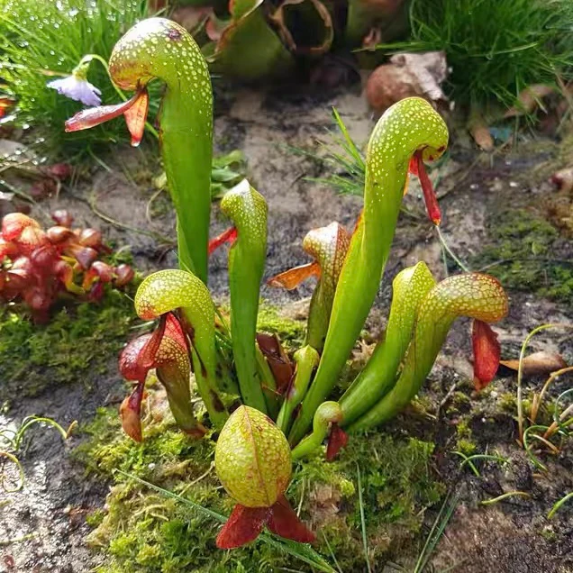
Introduction to Multivariate Analysis
Why Study Multivariate Data?
In ecology, often measure many variables on the same organisms:
Plant morphology: height, width, leaf size, flower size
Environmental conditions: temperature, pH, nutrients
Species composition: presence/absence, abundance
Challenge: How do we make sense of all these variables at once?
PCA helps by:
Reducing many correlated variables to a few key dimensions
Visualizing patterns in high-dimensional data
Identifying the most important sources of variation
Darlingtonia californica (Cobra Lily)
image of a cobra lily Darlingtonia californica

Slide 3
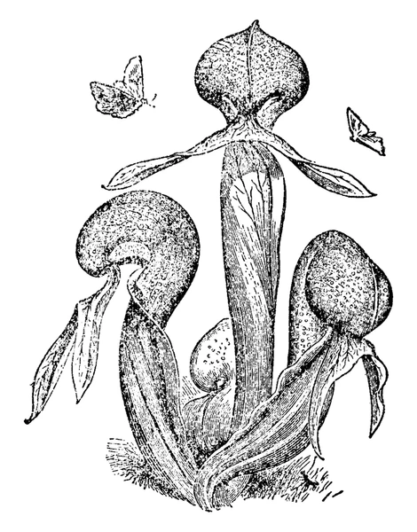
Our Study System: Darlingtonia
The Cobra Lily Dataset
Analyze morphological measurements from 89 individual Darlingtonia californica plants collected from 4 sites in the Siskiyou Mountains of Oregon.
Variables measured (10 total):
Morphological measurements (mm):
height - Height of pitcher
mouth_diam - Mouth diameter
tube_diam - Tube diameter
keel_diam - Keel diameter
wing1_length, wing2_length
Wing lengths (2 measurements)
wingsprea - Wing spread
Biomass measurements (g):
hoodmass_g - Hood mass
tubemass_g - Tube mass
wingmass_g - Wing mass
![Darlingtonia pitcher structure showing measured features\]
**Sites**:
TJH: T.J. Howell’s Fen
DG: Day’s Gulch
LEH: L.E. Hunter’s Fen
HD: High Divide

Slide 4
Loading the Data
Step 1: Import and Prepare the Data
# Load the data darlingtonia <- read_csv("darlingtonia.csv") # View the structure head(darlingtonia) ## # A tibble: 6 × 11 ## site height mouth_diam tube_diam keel_diam wing1_length wing2_length ## <chr> <dbl> <dbl> <dbl> <dbl> <dbl> <dbl> ## 1 TJH 654 38.4 16.6 6.4 85 76 ## 2 TJH 413 22.2 17.2 5.9 55 26 ## 3 TJH 610 31.2 19.9 6.7 62 60 ## 4 TJH 546 34.4 20.8 6.3 84 79 ## 5 TJH 665 30.5 20.4 6.6 60 51 ## 6 TJH 665 33.6 19.5 6.6 84 66 ## # ℹ 4 more variables: wingsprea <dbl>, hoodmass_g <dbl>, tubemass_g <dbl>, ## # wingmass_g <dbl> darlingtonia %>% count(site, name = "n_plants") ## # A tibble: 4 × 2 ## site n_plants ## <chr> <int> ## 1 DG 25 ## 2 HD 12 ## 3 LEH 25 ## 4 TJH 25

Slide 5
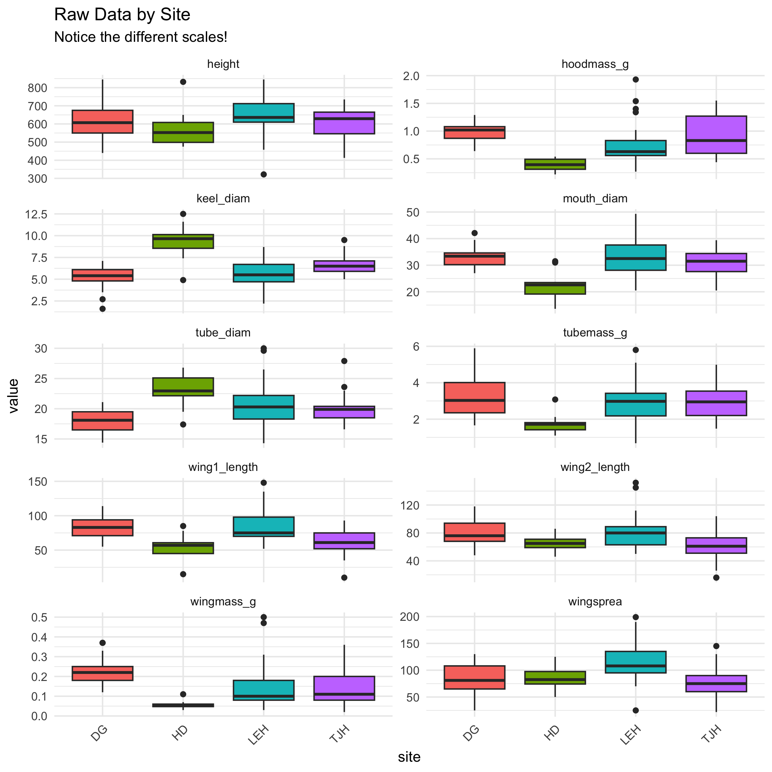
Exploring the Raw Data
Initial Data Exploration
Before any analysis, we should always look at our data:
Check for outliers
Examine distributions
Look for patterns by site
Understand variable scales
Key observations:
Variables measured in different units (mm vs. g)
Different ranges: height (hundreds) vs. biomass (fractions)
Need to standardize before PCA!

Slide 6
The Problem of Different Scales
Why Standardization Matters
Without standardization:
Variables with larger values (like height in mm) would dominate the analysis over variables with smaller values (like biomass in g).
Example from data:
Height: mean ≈ 600 mm, range 322-845 mm -
Wing mass: mean ≈ 0.16 g, range 0.02-5.00 g
calculated distances without standardizing, height would have 1000× more influence than wing mass!
Solution: Z-score standardization
$Z=\frac{\left(Y_{i}−\overset{‾}{Y}\right)}{s}$
transforms each variable to:
Mean = 0
Standard deviation = 1
Units: “standard deviations from the mean”
Before standardization: - Height dominates (larger scale)
After standardization:
All variables contribute equally
Measured in “standard deviations”
# Example: standardize height darlingtonia %>% summarize( mean_height = mean(height), sd_height = sd(height), mean_wingmass = mean(wingmass_g), sd_wingmass = sd(wingmass_g) ) ## # A tibble: 1 × 4 ## mean_height sd_height mean_wingmass sd_wingmass ## <dbl> <dbl> <dbl> <dbl> ## 1 616. 101. 0.154 0.102 # After standardization, both will have: # mean = 0, sd = 1

Slide 7
Measuring Multivariate Distance
Euclidean Distance Between Individuals
How different are two plants?
For two plants measured on multiple variables, calculate Euclidean distance:
For 2 variables (height and spread):
$d_{i,j}=\sqrt{{\left(y_{i,1}−y_{j,1}\right)}^{2}+{\left(y_{i,2}−y_{j,2}\right)}^{2}}$
For n variables:
$d_{i,j}=\sqrt{\sum_{k=1}^{n}{{\left(y_{i,k}−y_{j,k}\right)}^{2}}}$
Pythagorean theorem extended to many dimensions!
Key point: Distance should use standardized values so all variables contribute equally
## ## Distance between plants 1 and 2 (standardized): ## 3.53 standard deviations ## ## ## Note: Standardization uses mean and SD from ALL plants, ## not just these two plants!

Slide 8
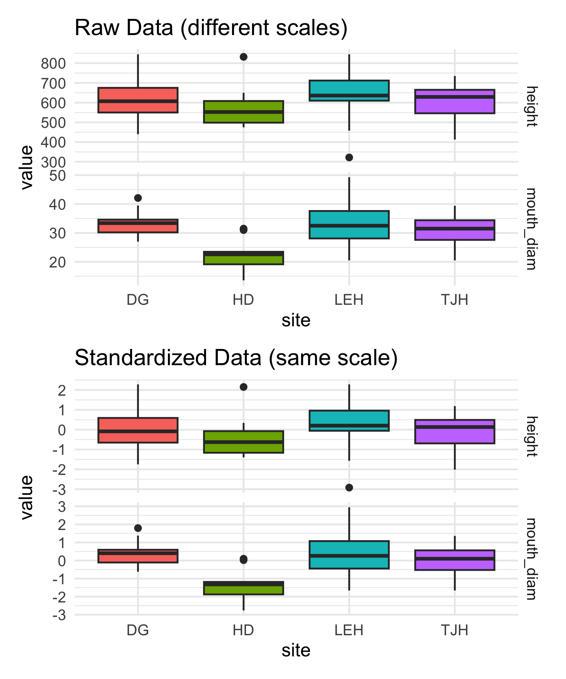
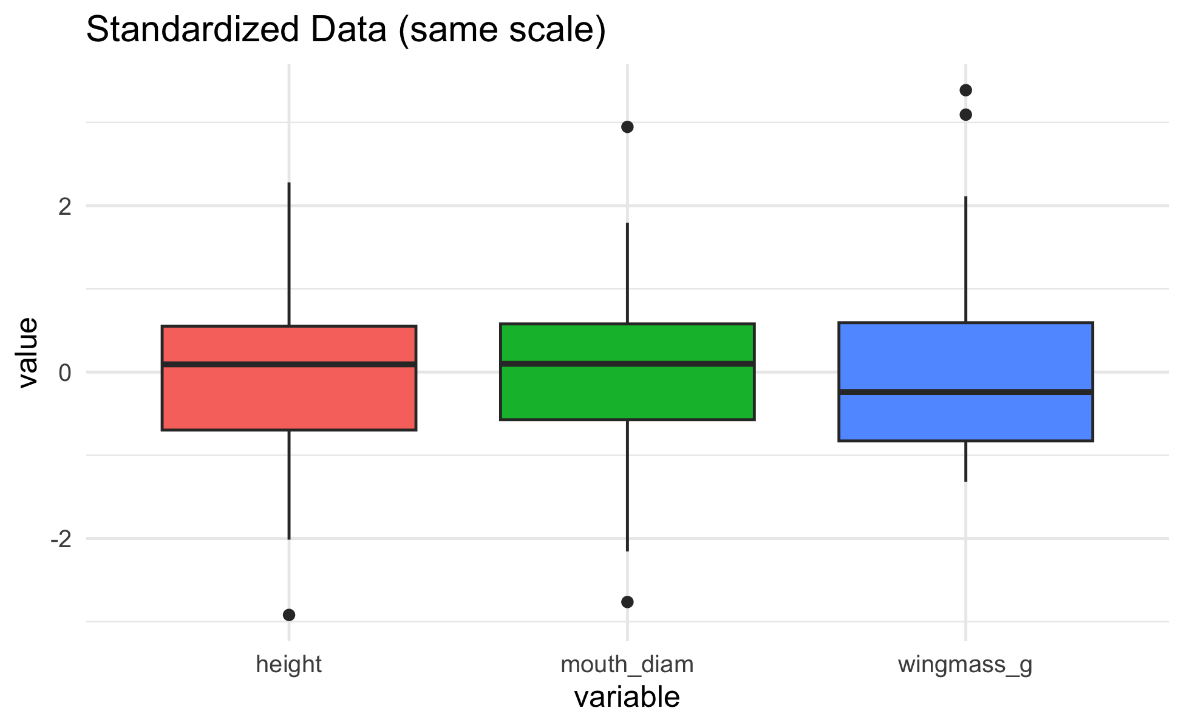
Standardizing the Data
Step 2: Z-score Transformation
Visualizing Standardized Data

Slide 9
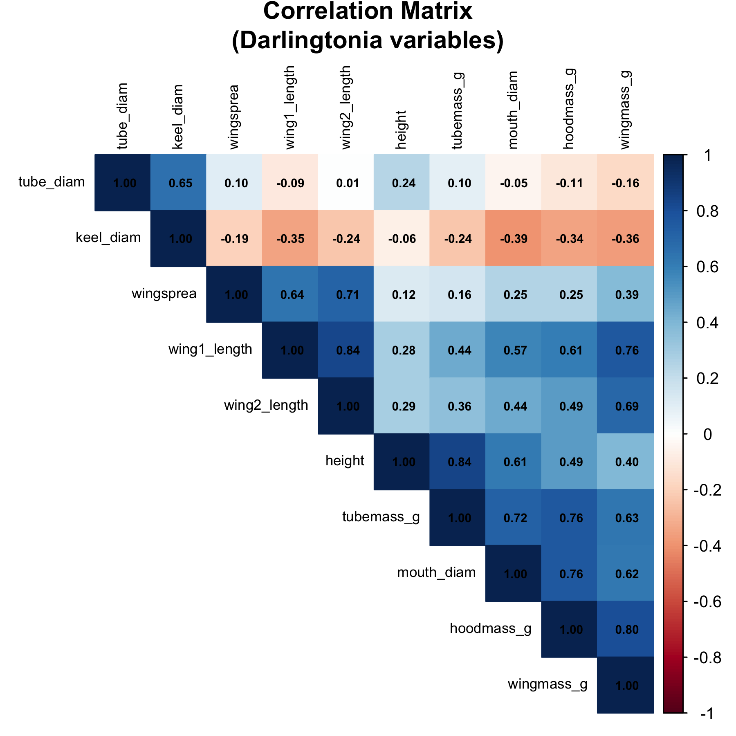
Understanding Correlations
Why Correlations Matter for PCA
PCA works best when variables are correlated:
If variables are uncorrelated → PCA provides no benefit
If variables are highly correlated → PCA can reduce dimensions effectively
In data, expect correlations because:
Larger plants have larger measurements overall
Wing dimensions likely correlate with each other
Mass measurements correlate with size measurements
The correlation matrix shows relationships between all pairs of variables.
Strong correlations (positive or negative) suggest PCA will be useful!
Strong positive correlations (dark blue) suggest variables measure similar aspects of plant size/shape.

Slide 10
Correlation Matrix Details
Examining Variable Relationships
## height mouth_diam tube_diam keel_diam wing1_length wing2_length ## height 1.00 0.61 0.24 -0.06 0.28 0.29 ## mouth_diam 0.61 1.00 -0.05 -0.39 0.57 0.44 ## tube_diam 0.24 -0.05 1.00 0.65 -0.09 0.01 ## keel_diam -0.06 -0.39 0.65 1.00 -0.35 -0.24 ## wing1_length 0.28 0.57 -0.09 -0.35 1.00 0.84 ## wing2_length 0.29 0.44 0.01 -0.24 0.84 1.00 ## wingsprea 0.12 0.25 0.10 -0.19 0.64 0.71 ## hoodmass_g 0.49 0.76 -0.11 -0.34 0.61 0.49 ## tubemass_g 0.84 0.72 0.10 -0.24 0.44 0.36 ## wingmass_g 0.40 0.62 -0.16 -0.36 0.76 0.69 ## wingsprea hoodmass_g tubemass_g wingmass_g ## height 0.12 0.49 0.84 0.40 ## mouth_diam 0.25 0.76 0.72 0.62 ## tube_diam 0.10 -0.11 0.10 -0.16 ## keel_diam -0.19 -0.34 -0.24 -0.36 ## wing1_length 0.64 0.61 0.44 0.76 ## wing2_length 0.71 0.49 0.36 0.69 ## wingsprea 1.00 0.25 0.16 0.39 ## hoodmass_g 0.25 1.00 0.76 0.80 ## tubemass_g 0.16 0.76 1.00 0.63 ## wingmass_g 0.39 0.80 0.63 1.00

Slide 11
Key Observations
Highly correlated variables:
Height with tube area (r=0.89)
Wing lengths with each other (r=0.80)
Wing area with wing spread (r=0.81)
These correlations indicate redundancy
multiple variables measuring similar things.
Moderate correlations:
Most morphological variables
Mass measurements with size
Lower correlations:
Some specific features like keel diameter
PCA will help by combining correlated variables into fewer components!

Slide 12
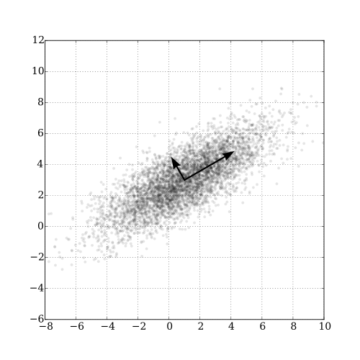
What is Principal Component Analysis?
The Concept of PCA
PCA creates new variables (components) that are:
Linear combinations of original variables
Uncorrelated with each other
Ordered by importance (amount of variance explained)
The mathematical idea:
For each plant i and component k:
$Z_{ik}=a_{i1}Y_{1}+a_{i2}Y_{2}+...+a_{in}Y_{n}$
Where:
$Z_{ik}$ = score on principal component k
$Y_{j}$ = standardized value of original variable j
$a_{ij}$ = loading (weight) of variable j on component i
Goal: Find loadings that maximize variance in first component, then second, etc.
https://upload.wikimedia.org/wikipedia/commons/thumb/f/f5/GaussianScatterPCA.svg/500px-GaussianScatterPCA.svg.png

Slide 13
Principal Components: Properties
Understanding Components are:
1. Orthogonal (perpendicular)
Components are uncorrelated
Each captures independent information
2. Ordered by variance
PC1 explains the most variance
PC2 explains second most (of remaining variance)
And so on…
3. Linear combinations
Each component is a weighted sum of original variables
Weights (loadings) show variable importance
Why this matters:
Dimension reduction:
Start with 10 correlated variables
End with 2-3 uncorrelated components
Retain most information with fewer dimensions
Easier interpretation:
PC1 might represent “overall size”
PC2 might represent “shape”
Components often have biological meaning
Better for analysis:
Can use in regression, ANOVA
No multicollinearity problems
Variables are standardized

Slide 14
Performing PCA in R
Step 3: Run the Analysis
# Perform PCA using prcomp() # center = TRUE: center variables (mean = 0) # scale. = TRUE: scale variables (sd = 1) pca_result <- prcomp(darl_numeric, center = TRUE, scale = TRUE) # What's in the result? names(pca_result) ## [1] "sdev" "rotation" "center" "scale" "x"

Slide 15
Understanding the Output
## Importance of components: ## PC1 PC2 PC3 PC4 PC5 PC6 PC7 ## Standard deviation 2.2332 1.3288 1.2354 0.75701 0.59301 0.51062 0.46177 ## Proportion of Variance 0.4987 0.1766 0.1526 0.05731 0.03517 0.02607 0.02132 ## Cumulative Proportion 0.4987 0.6753 0.8279 0.88521 0.92038 0.94645 0.96777 ## PC8 PC9 PC10 ## Standard deviation 0.3768 0.33982 0.25457 ## Proportion of Variance 0.0142 0.01155 0.00648 ## Cumulative Proportion 0.9820 0.99352 1.00000
Output components:
sdev: standard deviations of each PC (square root of eigenvalues)
rotation: loadings matrix (how variables load on PCs)
x: PC scores for each observation
center: variable means
scale: variable standard deviations

Slide 16
Eigenvalues and Variance Explained
How Much Variance Does Each PC Explain?
Eigenvalues ($λ$) measure variance explained by each component.
The proportion of variance for PC j is:
${\text{Proportion}}_{j}=\frac{λ_{j}}{\sum_{k=1}^{n}{λ_{k}}}$
In practice:
PC1 always explains the most variance
We want the first few PCs to explain most (>70%) of total variance
allows dimension reduction
## # A tibble: 10 × 4 ## PC Eigenvalue Proportion Cumulative ## <chr> <dbl> <dbl> <dbl> ## 1 PC1 4.99 0.499 0.499 ## 2 PC2 1.77 0.177 0.675 ## 3 PC3 1.53 0.153 0.828 ## 4 PC4 0.573 0.057 0.885 ## 5 PC5 0.352 0.035 0.92 ## 6 PC6 0.261 0.026 0.946 ## 7 PC7 0.213 0.021 0.968 ## 8 PC8 0.142 0.014 0.982 ## 9 PC9 0.115 0.012 0.994 ## 10 PC10 0.065 0.006 1

Slide 17
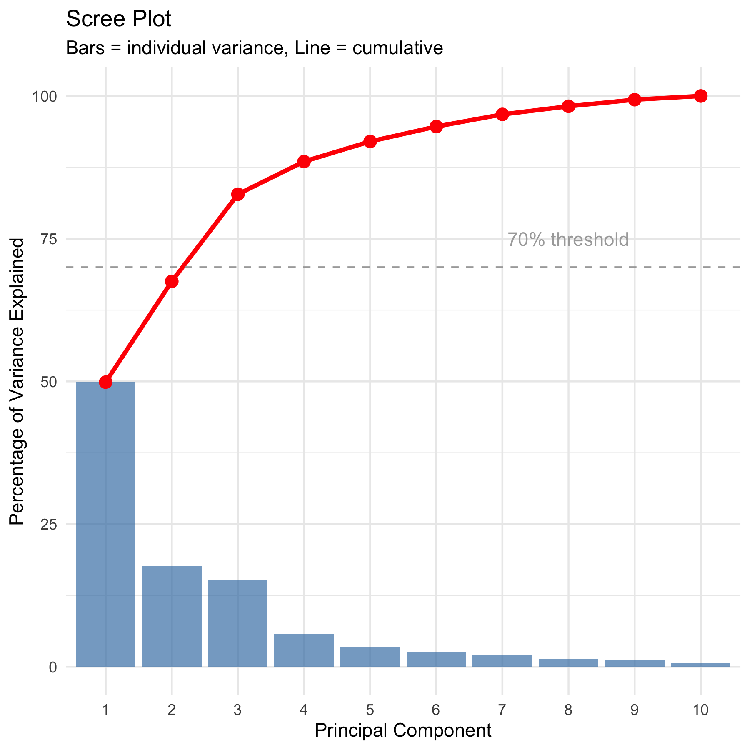
Scree Plot: Choosing Components
How Many Components to Use?
A scree plot shows variance explained by each component.
How to read it:
Look for an “elbow” - sharp change in slope
Keep components before the elbow
Discard components in the “scree” (rubble)
In this data:
PC1 explains 49.9% of variance
PC2 explains 17.7%
PC3 explains 15.3%
First 3 PCs explain 77.3% of variance
Decision: Use PC1, PC2, and PC3 for interpretation.
remaining 7 components explain 17.1% (mostly noise).

Slide 18
Understanding Loadings
What are Loadings?
Loadings are the weights ($a_{ij}$) that show how each original variable contributes to each principal component.
For PC1:
$Z_{1}=a_{11}Y_{1}+a_{12}Y_{2}+...+a_{1p}Y_{p}$
Interpreting loadings:
Large positive loading: variable increases with PC
Large negative loading: variable decreases with PC
Near-zero loading: variable unimportant for PC
Guidelines:
Loadings > 0.3 or < -0.3 are worth considering
Loadings > 0.5 or < -0.5 are important
Sign (+ or -) can flip; patterns matter more
PC1 loadings:
Most variables have similar positive values
All ~0.31 to 0.40 except keel (-0.18) and tube (-0.002)
Suggests PC1 measures “overall size”
## PC1 PC2 PC3 ## height -0.278 -0.449 0.198 ## mouth_diam -0.369 -0.110 0.214 ## tube_diam 0.040 -0.602 -0.390 ## keel_diam 0.202 -0.491 -0.328 ## wing1_length -0.375 0.171 -0.280 ## wing2_length -0.342 0.131 -0.415 ## wingsprea -0.239 0.156 -0.549 ## hoodmass_g -0.385 -0.057 0.185 ## tubemass_g -0.355 -0.320 0.263 ## wingmass_g -0.393 0.080 -0.007

Slide 19
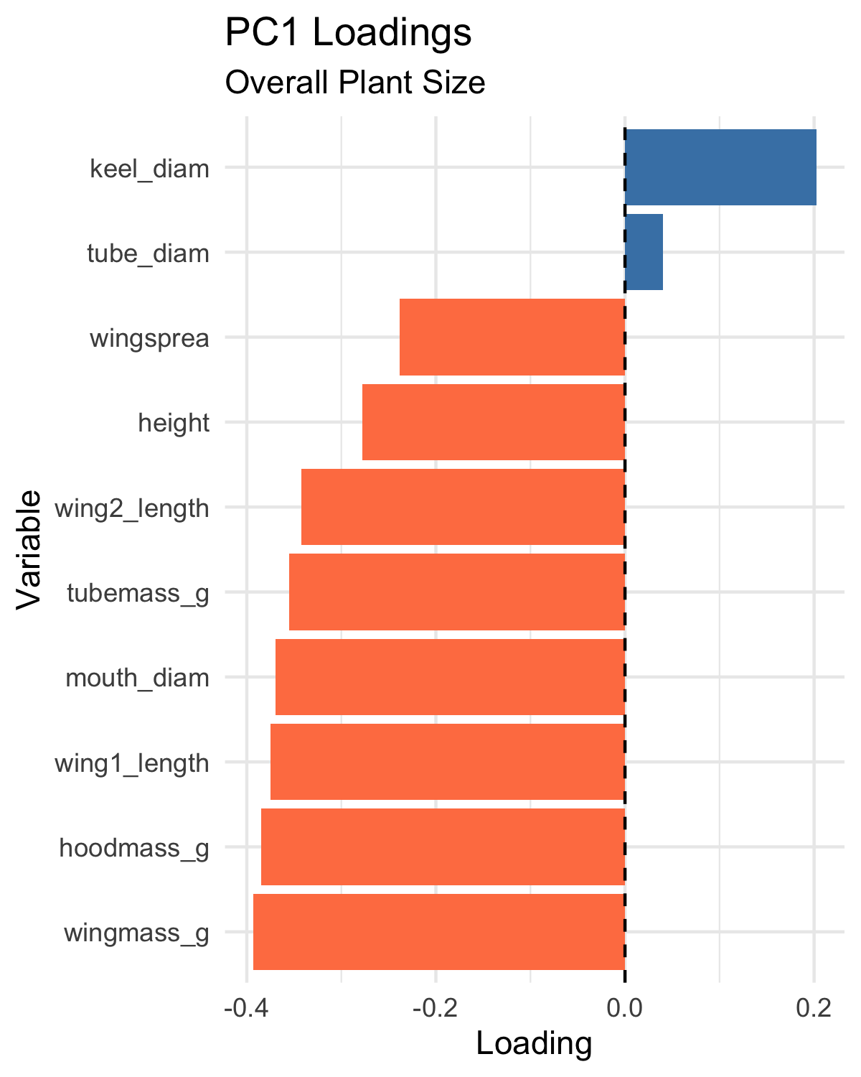
Interpreting PC1: Overall Size
PC1 Interpretation - Looking at PC1 loadings:
Key patterns:
Most variables load positively and similarly: - Height: 0.310 - Mouth diameter: 0.400
Wing lengths: 0.386, 0.372
Wing spread: 0.256
Biomass: 0.397, 0.380, 0.230
Exception: Keel diameter (-0.177) and tube diameter (~0)
Biological meaning: PC1 represents overall plant size
most measurements scale together (bigger plants have bigger everything).
## # A tibble: 10 × 2 ## Variable Loading ## <chr> <dbl> ## 1 wingmass_g -0.393 ## 2 hoodmass_g -0.385 ## 3 wing1_length -0.375 ## 4 mouth_diam -0.369 ## 5 tubemass_g -0.355 ## 6 wing2_length -0.342 ## 7 height -0.278 ## 8 wingsprea -0.239 ## 9 keel_diam 0.202 ## 10 tube_diam 0.0402
High PC1 → large plants
Low PC1 → small plants

Slide 20
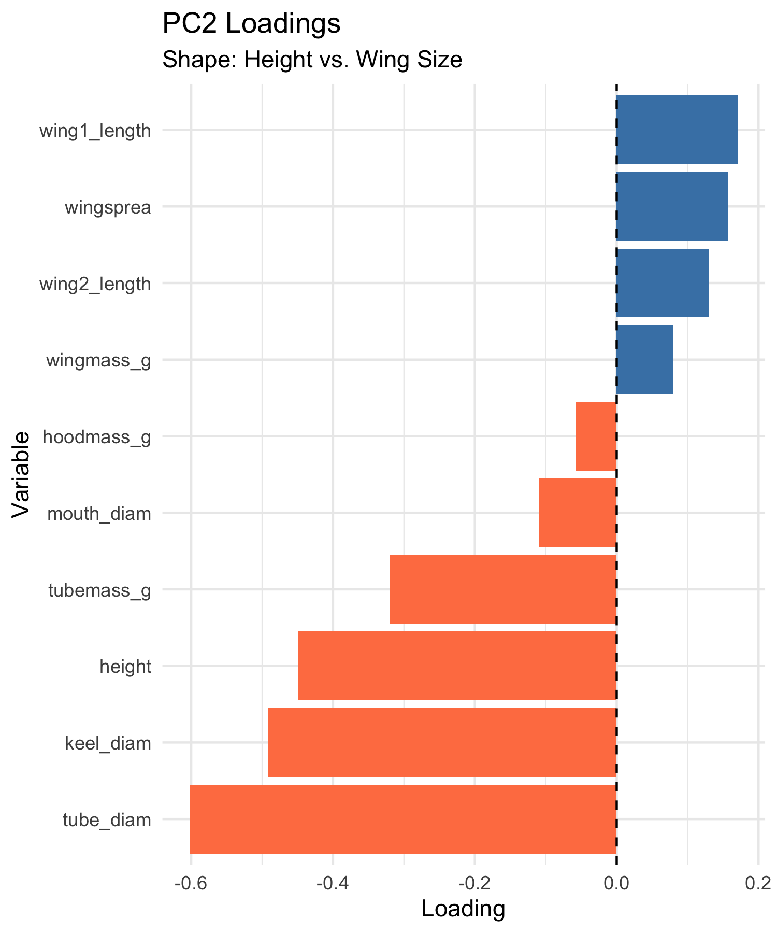
Interpreting PC2: Shape Contrast
PC2 Interpretation
Looking at PC2 loadings:
Key patterns:
Height: -0.419 (negative, moderate)
Mouth: -0.250 (negative, moderate)
Wing measurements: positive (0.275-0.434)
Wing spread: 0.434 (positive, strong)
Biomass: mostly negative
Biological meaning: PC2 represents shape trade-offs
tall narrow pitchers vs. short wide pitchers with large wings.
## # A tibble: 10 × 2 ## Variable Loading ## <chr> <dbl> ## 1 tube_diam -0.602 ## 2 keel_diam -0.491 ## 3 height -0.449 ## 4 tubemass_g -0.320 ## 5 wing1_length 0.171 ## 6 wingsprea 0.156 ## 7 wing2_length 0.131 ## 8 mouth_diam -0.110 ## 9 wingmass_g 0.0800 ## 10 hoodmass_g -0.0575
High PC2 → short plants with large wings
Low PC2 → tall narrow plants

Slide 21
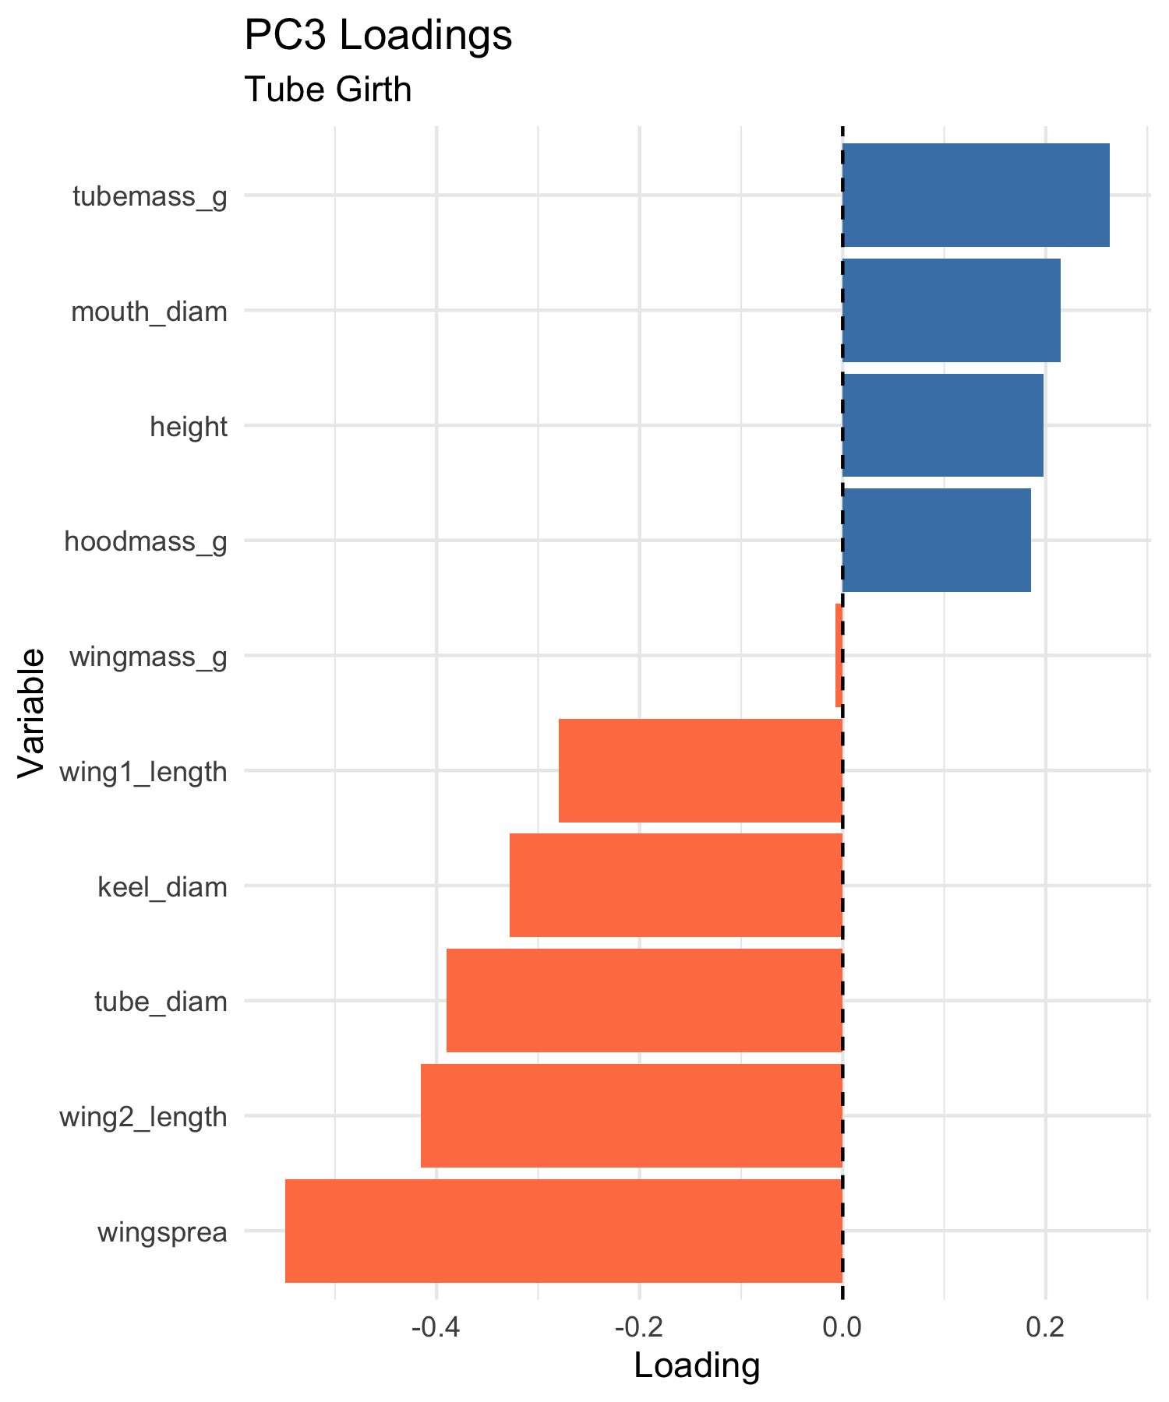
Interpreting PC3
PC3 Interpretation
Looking at PC3 loadings:
Key patterns:
Dominated by:
Tube diameter: 0.743 (very strong positive)
Keel diameter: 0.576 (strong positive)
Most other variables near zero
Biological meaning: PC3 represents tube girth
width/diameter of tube structure independent of height or wing size.
Plants with high PC3 scores = fat tubes, allowing to trap larger prey?
## # A tibble: 10 × 2 ## Variable Loading ## <chr> <dbl> ## 1 wingsprea -0.549 ## 2 wing2_length -0.415 ## 3 tube_diam -0.390 ## 4 keel_diam -0.328 ## 5 wing1_length -0.280 ## 6 tubemass_g 0.263 ## 7 mouth_diam 0.214 ## 8 height 0.198 ## 9 hoodmass_g 0.185 ## 10 wingmass_g -0.00743
High PC3 → fat tubes
Low PC3 → skinny tubes

Slide 22
Principal Component Scores
What are PC Scores?
PC scores are values of each principal component for each obs./plant
Each plant gets a score on each PC:
PC1 score = measure of size
PC2 score = measure of shape
PC3 score = measure of tube girth
How they’re calculated:
For plant i on PC1:
${\text{PC1}}_{i}=0.31×height_{i}+0.40×mouth_{i}+...$
Using the standardized values and loadings we saw earlier.
## # A tibble: 10 × 5 ## plant_id site PC1 PC2 PC3 ## <int> <chr> <dbl> <dbl> <dbl> ## 1 1 TJH -1.92 0.0772 1.53 ## 2 2 TJH 3.35 1.53 0.755 ## 3 3 TJH 0.918 -0.0320 0.248 ## 4 4 TJH -0.983 0.236 -0.242 ## 5 5 TJH 1.15 -1.02 1.54 ## 6 6 TJH -1.37 -0.613 0.847 ## 7 7 TJH -1.50 -1.63 0.693 ## 8 8 TJH -0.651 0.121 -0.412 ## 9 9 TJH 2.48 -0.0786 -0.260 ## 10 10 TJH -1.11 -1.27 2.27

Slide 23
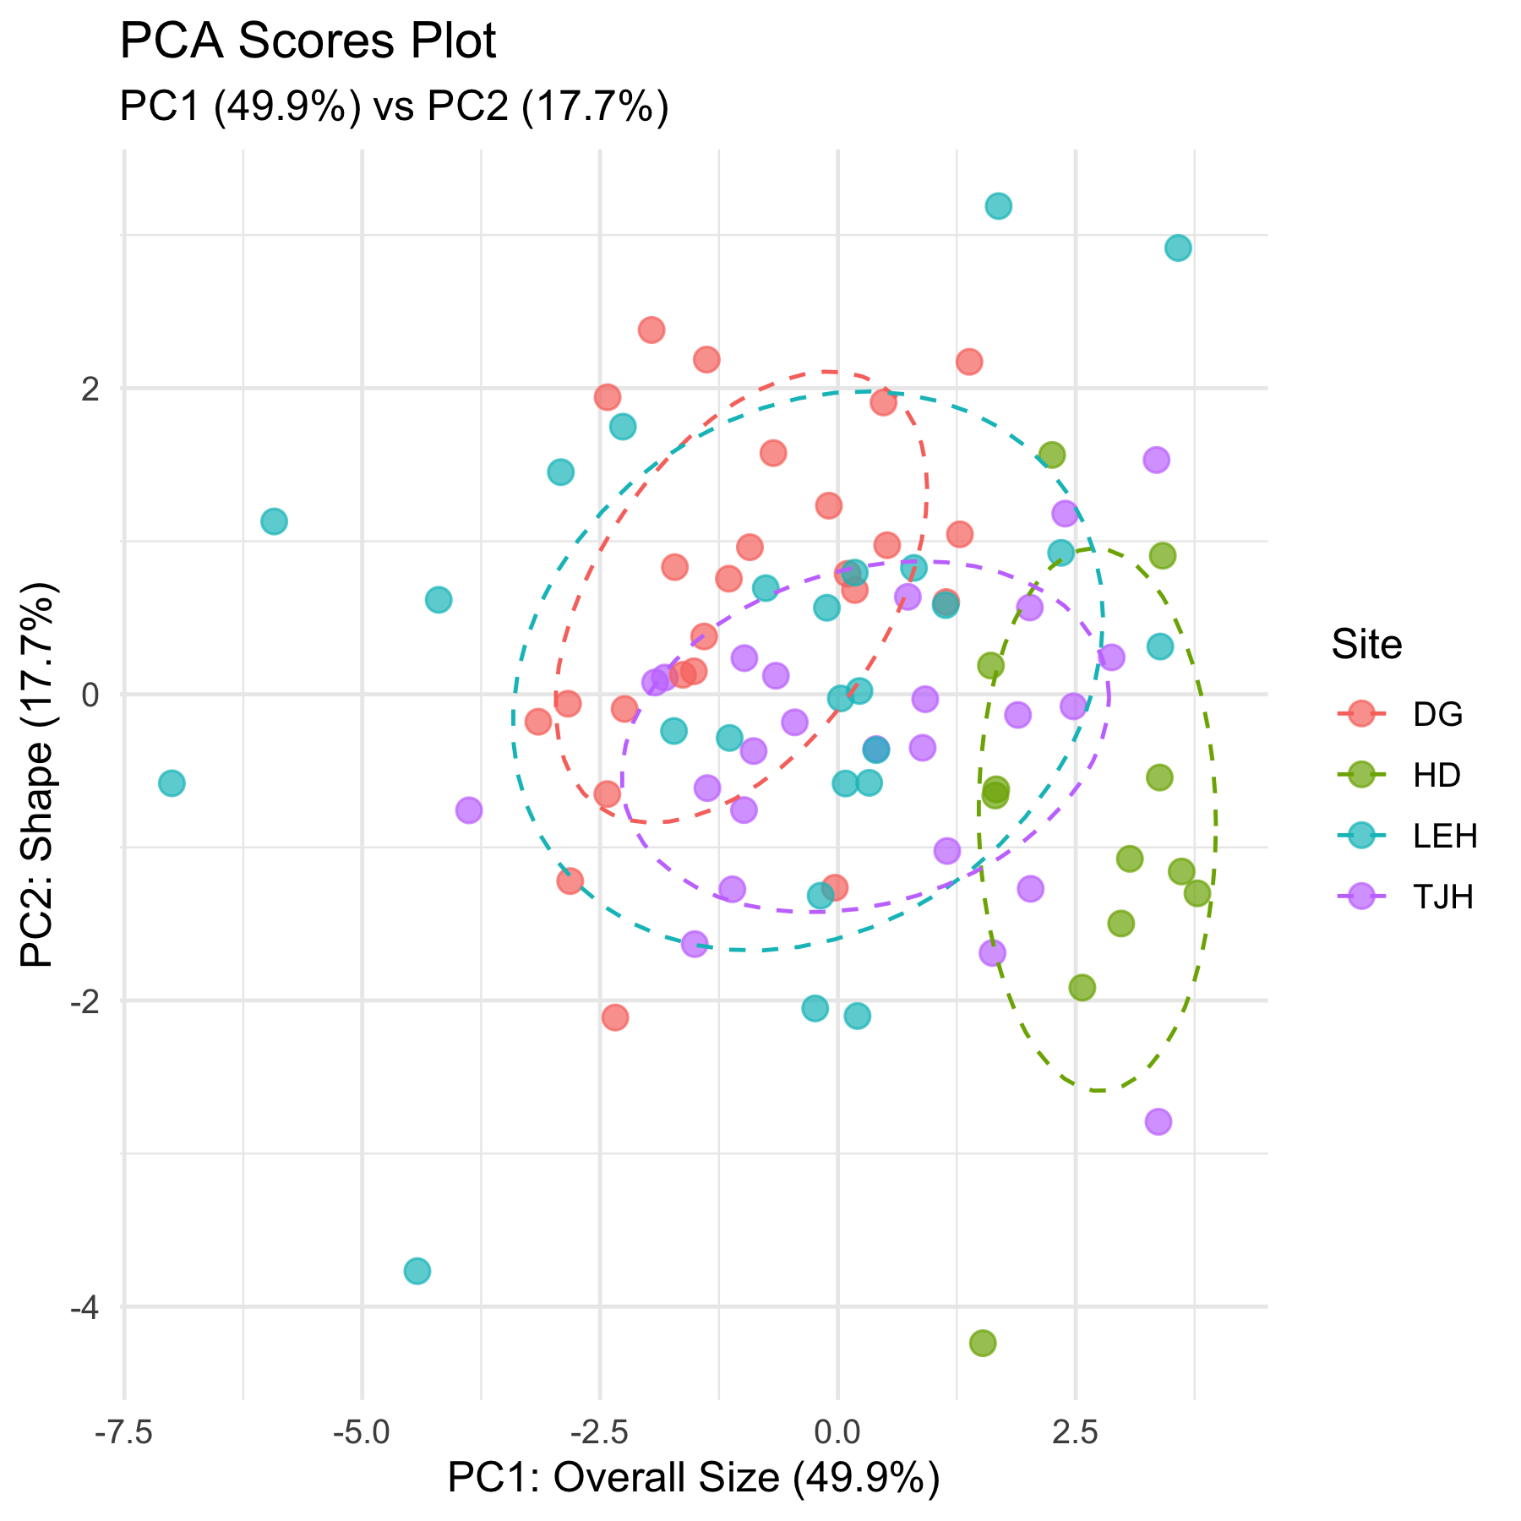
Visualizing PCA Results: Scores Plot
Ordination of Sites
We can plot PC scores to visualize:
How plants are distributed in PC space
Whether sites differ in morphology
Patterns and groupings
In this plot:
Each point = one plant
Position determined by PC1 and PC2 scores
Colors indicate collection site
Observations:
Sites show some separation
HD (orange) plants have lower PC1 (smaller)
TJH (pink) plants variable but lower PC2
Some overlap among sites
This is called ordination - ordering objects along axes.
The ordination

Slide 24
Different visualization of PCA Scores

Slide 25
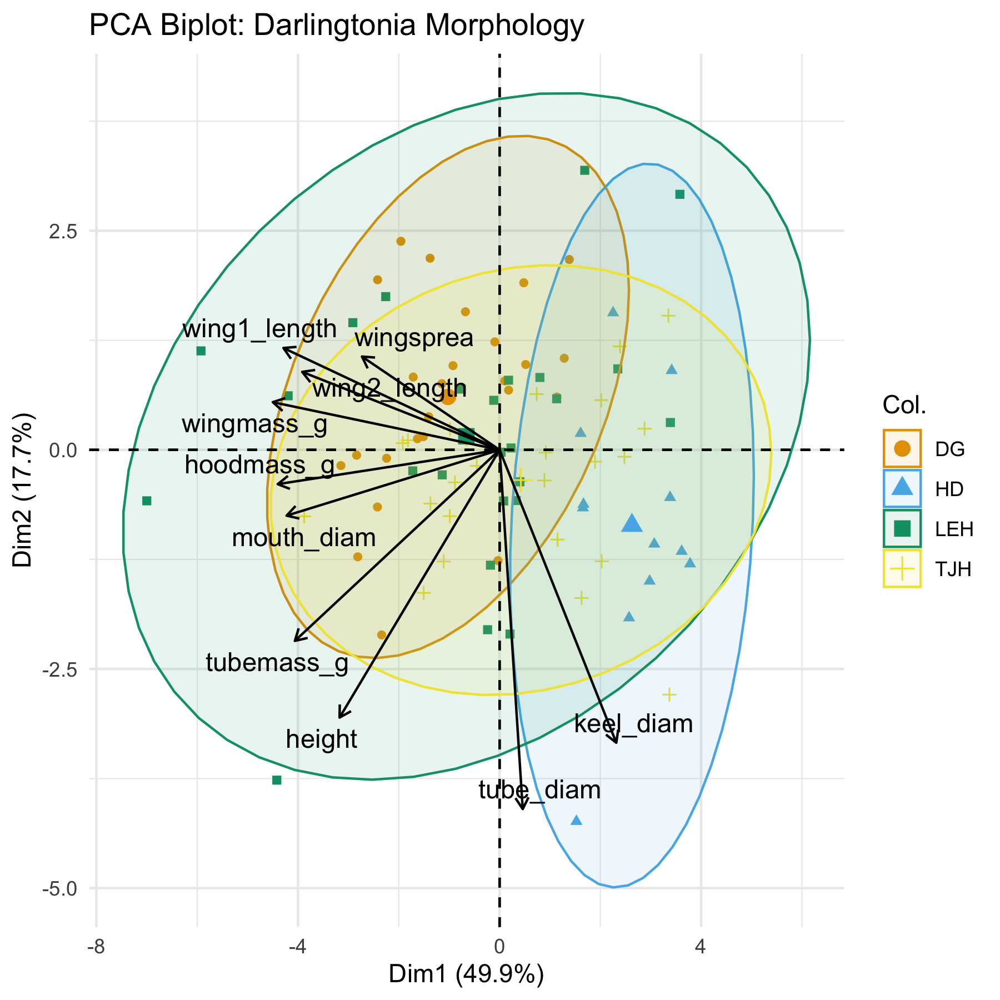
PCA Biplot: Combining Scores and Loadings
Reading a Biplot
A biplot shows both:
Points = plants (PC scores)
Arrows = original variables (loadings)
How to interpret arrows:
Length = how important the variable is
Direction = how the variable relates to PCs
Angle between arrows = correlation
Small angle = positively correlated
90° = uncorrelated
180° = negatively correlated
How to interpret points:
Plants in the direction of an arrow are high in that variable
Plants opposite an arrow are low in that variable
The plot

Slide 26
Biplot Interpretation
Key Patterns in the Biplot
Variable relationships:
Most morphological and biomass variables point together (right and slightly down):
Height, mouth, masses - These are highly correlated
All contribute to PC1 (size)
Wing variables (wing1_length, wing2_length, wingspread) point more upward:
Contribute positively to PC2
Represent the “wing dimension” of shape
Site separation:
HD (blue): Lower PC1, plants are smaller overall
DG (orange): Higher PC1, plants are larger
TJH (yellow) and LEH (green): Intermediate and variable
Biological Interpretation
What determines plant morphology?
Size (PC1, 45.8% variance)
Primary source of variation
Most measurements scale together
May reflect resource availability or age
Shape trade-offs (PC2, 16.7% variance)
Tall narrow vs. short wide with large wings
May reflect different trapping strategies
Or developmental/environmental constraints
Tube dimensions (PC3, 14.8% variance)
Independent aspect of morphology
May affect prey capture efficiency
Sites differ primarily in overall size, with some shape variation.

Slide 27
Testing Site Differences with ANOVA
Step 4: Statistical Analysis
Now that we have PC scores, we can test if sites differ:
Result: Sites differ significantly in PC1 (F = 9.26, P < 0.001)
# Test for site differences on PC1 (size) anova_pc1 <- aov(PC1 ~ site, data = pc_scores) summary(anova_pc1) ## Df Sum Sq Mean Sq F value Pr(>F) ## site 3 124.3 41.44 11.29 2.75e-06 *** ## Residuals 83 304.6 3.67 ## --- ## Signif. codes: 0 '***' 0.001 '**' 0.01 '*' 0.05 '.' 0.1 ' ' 1 # Calculate means by site pc_scores %>% group_by(site) %>% summarize( mean_PC1 = mean(PC1), sd_PC1 = sd(PC1), n = n() ) ## # A tibble: 4 × 4 ## site mean_PC1 sd_PC1 n ## <chr> <dbl> <dbl> <int> ## 1 DG -1.02 1.38 25 ## 2 HD 2.63 0.857 12 ## 3 LEH -0.659 2.61 25 ## 4 TJH 0.423 1.90 25

Slide 28
ANOVA for PC2 and PC3
Testing Shape and Tube Differences
Results:
PC2 (shape): F = 5.36, P = 0.002 (significant)
PC3 (tube girth): F = 1.45, P = 0.234 (not significant)
# Test for site differences on PC2 (shape) anova_pc2 <- aov(PC2 ~ site, data = pc_scores) summary(anova_pc2) ## Df Sum Sq Mean Sq F value Pr(>F) ## site 3 21.63 7.209 4.595 0.00502 ** ## Residuals 83 130.22 1.569 ## --- ## Signif. codes: 0 '***' 0.001 '**' 0.01 '*' 0.05 '.' 0.1 ' ' 1 # Test for site differences on PC3 (tube girth) anova_pc3 <- aov(PC3 ~ site, data = pc_scores) summary(anova_pc3) ## Df Sum Sq Mean Sq F value Pr(>F) ## site 3 43.68 14.561 13.8 2.2e-07 *** ## Residuals 83 87.58 1.055 ## --- ## Signif. codes: 0 '***' 0.001 '**' 0.01 '*' 0.05 '.' 0.1 ' ' 1 # Summary statistics pc_scores %>% group_by(site) %>% summarize(mean_PC2 = mean(PC2),mean_PC3 = mean(PC3)) ## # A tibble: 4 × 3 ## site mean_PC2 mean_PC3 ## <chr> <dbl> <dbl> ## 1 DG 0.604 0.542 ## 2 HD -0.863 -1.26 ## 3 LEH 0.155 -0.555 ## 4 TJH -0.345 0.618

Slide 29
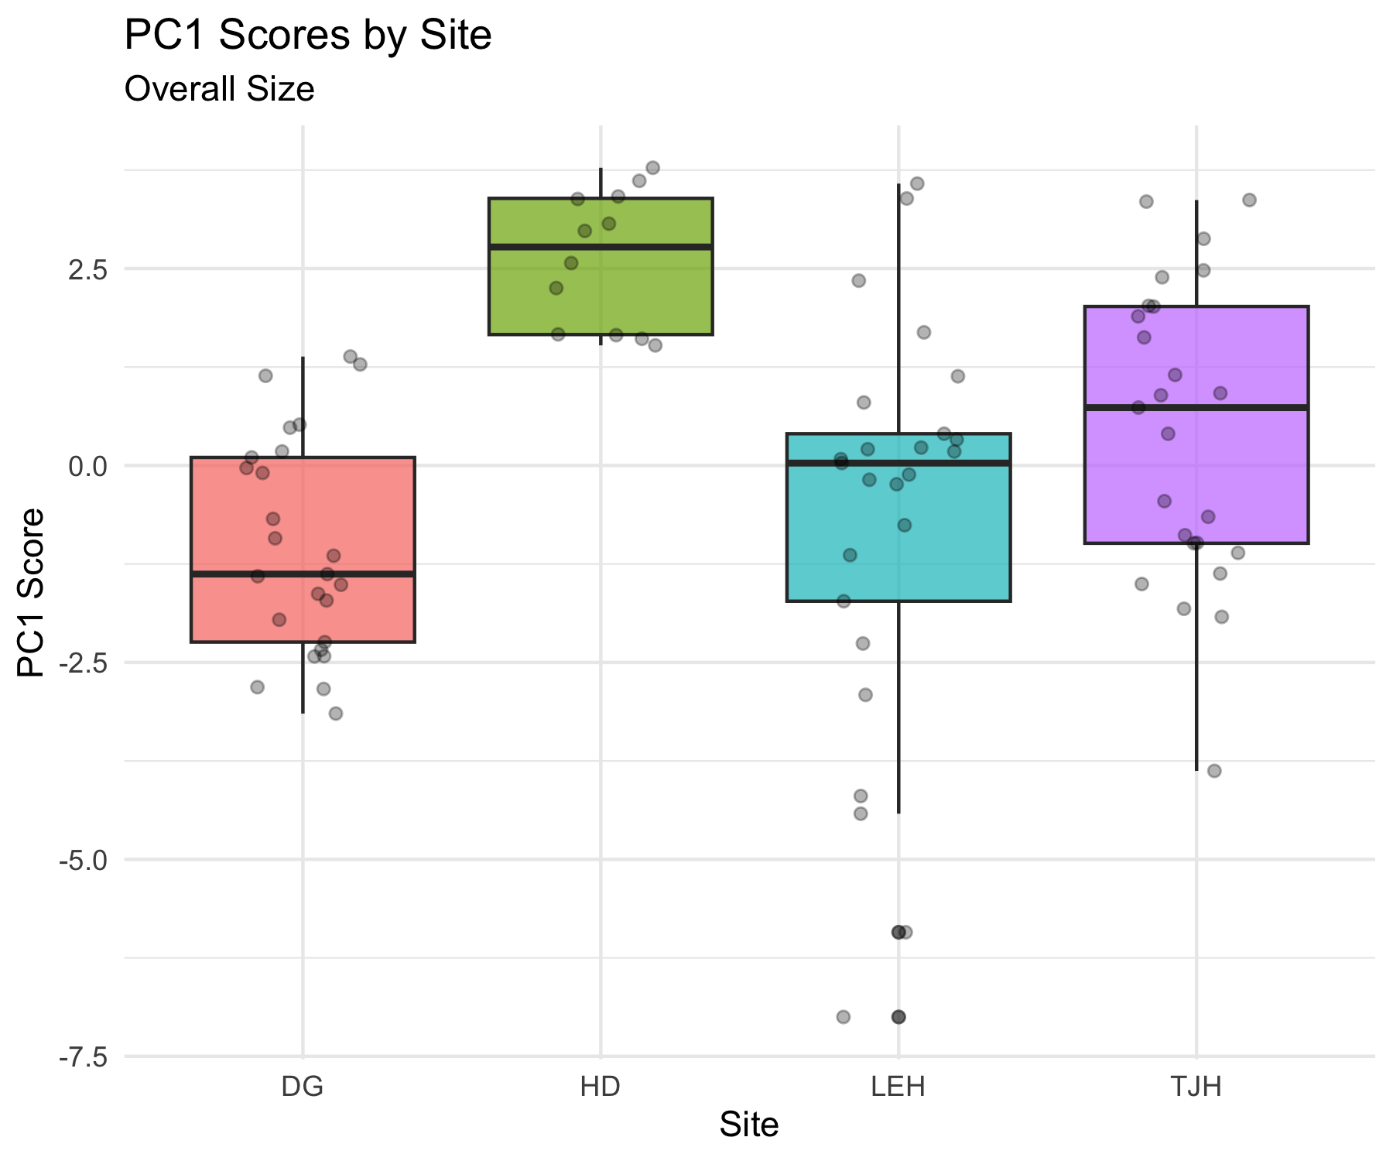
Visualizing Site Differences
Box Plots of PC Scores
HD plants are significantly smaller than plants at other sites.
TJH plants have different shapes
taller and narrower with smaller wings.

Slide 30
Post-hoc Comparisons
Which Sites Differ?
## contrast estimate SE df t.ratio p.value ## DG - HD -3.651 0.673 83 -5.427 <.0001 ## DG - LEH -0.366 0.542 83 -0.675 0.9064 ## DG - TJH -1.447 0.542 83 -2.671 0.0442 ## HD - LEH 3.285 0.673 83 4.883 <.0001 ## HD - TJH 2.204 0.673 83 3.276 0.0082 ## LEH - TJH -1.082 0.542 83 -1.996 0.1977 ## ## P value adjustment: tukey method for comparing a family of 4 estimates ## site emmean SE df lower.CL upper.CL .group ## DG -1.024 0.383 83 -1.786 -0.262 a ## LEH -0.659 0.383 83 -1.421 0.103 ab ## TJH 0.423 0.383 83 -0.339 1.185 b ## HD 2.626 0.553 83 1.526 3.726 c ## ## Confidence level used: 0.95 ## P value adjustment: tukey method for comparing a family of 4 estimates ## significance level used: alpha = 0.05 ## NOTE: If two or more means share the same grouping symbol, ## then we cannot show them to be different. ## But we also did not show them to be the same.

Slide 31
Distance Between Sites
Calculating Euclidean Distance Between Groups
Calculate the distance between site centroids (mean PC scores):
$d_{k,j}=\sqrt{\sum_{i=1}^{p}{{\left({\overset{‾}{Z}}_{i,k}−{\overset{‾}{Z}}_{i,j}\right)}^{2}}}$
Where ${\overset{‾}{Z}}_{i,k}$ is the mean of PC i for site k.
Using all PCs preserves the true Euclidean distance from the original data.
Using just PC1-PC3 (77% of variance) gives approximate distances.
HD is most different from other sites (smallest plants).
# Calculate site centroids (means) site_means <- pc_scores %>% group_by(site) %>% summarize(across(PC1:PC3, mean)) site_means ## # A tibble: 4 × 4 ## site PC1 PC2 PC3 ## <chr> <dbl> <dbl> <dbl> ## 1 DG -1.02 0.604 0.542 ## 2 HD 2.63 -0.863 -1.26 ## 3 LEH -0.659 0.155 -0.555 ## 4 TJH 0.423 -0.345 0.618 # Calculate distance matrix site_dist <- site_means %>% dplyr::select(PC1, PC2, PC3) %>% dist() %>% round(3) site_dist ## 1 2 3 ## 2 4.328 ## 3 1.241 3.511 ## 4 1.732 2.942 1.672

Slide 32
Visualization of the distances
# 1. Prepare PC Scores with Site pc_scores_for_dist <- as.data.frame(pca_result$x) %>% mutate(site = darlingtonia$site) # 2. Calculate the mean PC scores for each site (the site "centroids") site_centroids <- pc_scores_for_dist %>% group_by(site) %>% summarise(across(starts_with("PC"), mean)) %>% ungroup() # 3. Set site names as row names BEFORE calculating distances site_centroids_matrix <- site_centroids %>% column_to_rownames("site") # This keeps site names as row names # 4. Calculate the Euclidean distance matrix between site centroids dist_matrix <- dist(site_centroids_matrix, method = "euclidean") # Display the distance matrix dist_matrix ## DG HD LEH ## HD 4.346434 ## LEH 1.621198 3.659711 ## TJH 1.843120 3.021386 1.960547 # Visualize the distance matrix fviz_dist(dist_matrix, gradient = list(low = "#00AFBB", high = "#FC4E07"))

Slide 33
Summary: PCA Results for Darlingtonia
What We Learned
Dimension Reduction Success
☒ Started with: 10 correlated variables
☒ Reduced to: 3 principal components
☒ Retained: 77.3% of variance
This makes data easier to visualize, interpret, and analyze.
Biological Insights - Three major axes of morphological variation: - PC1 (45.8%): Overall size
Larger vs. smaller plants
HD site has smallest plants - PC2 (16.7%): Shape contrast
Tall/narrow vs. short/wide with large wings
TJH site has taller, narrower plants - PC3 (14.8%): Tube girth
Fat vs. skinny tubes
No significant site differences
Statistical Findings
Sites differ significantly in size (PC1)
Sites differ significantly in shape (PC2)
Sites do not differ in tube girth (PC3)
PCA Advantages
☒ Reduced 10 dimensions to 3
☒ Created uncorrelated variables
☒ Revealed biological patterns
☒ Enabled statistical testing
☒ Simplified visualization
Key Take-Home Messages
PCA good for exploratory analysis of multivariate data
Always standardize when different units/scales
Loadings reveal variables contributions to each component
Scores used in subsequent analyses (ANOVA, regression)
Biplots visualize both samples and variables simultaneously

Slide 34
When to Use PCA
PCA is Appropriate When:
☒ Variables are continuous (not categorical)
☒ Variables are correlated (redundancy exists) + Linear relationships
☒ Goal is dimension reduction or data exploration
☒ Sample size adequate (at least 3× number of variables)
PCA Assumptions:
Linearity: relationships between variables are linear
Adequate correlation: variables must be correlated
No severe outliers: can distort results
Sample size: need enough observations
Always Check:
Correlation matrix (are variables correlated?)
Scree plot (how many components needed?)
Loadings (biological interpretation makes sense?)
Outliers (check scores plots)

Slide 35
When to Consider Alternatives:
Different data types:
Categorical variables → MCA (Multiple
Correspondence Analysis) - Species composition data → CA (Correspondence Analysis)
Distance/dissimilarity matrices → PCoA (Principal Coordinates Analysis)
Different goals: - Classification → Discriminant Analysis
Non-linear patterns → NMDS (Non-metric Multidimensional Scaling)
Hypothesis testing → MANOVA
Problems with PCA:
Strong outliers present
Non-linear relationships
Variables are uncorrelated
Many zeros in data
PCA works best for morphological, physiological, and environmental variables!

Slide 36
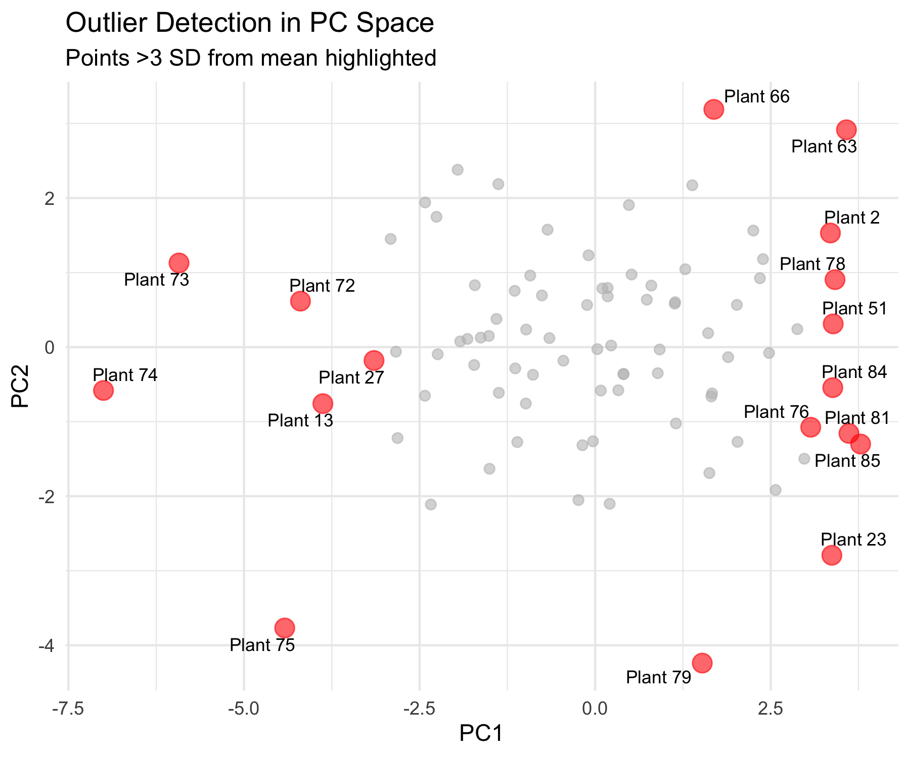
Additional PCA Diagnostics
Checking Assumptions and Quality
Sampling Adequacy
Kaiser-Meyer-Olkin (KMO) Test:
Measures sampling adequacy
Values > 0.6 = acceptable
Values > 0.8 = good
Our overall KMO = 0.80 (good!)
# KMO test requires psych package KMO(cor(darl_numeric)) ## Kaiser-Meyer-Olkin factor adequacy ## Call: KMO(r = cor(darl_numeric)) ## Overall MSA = 0.76 ## MSA for each item = ## height mouth_diam tube_diam keel_diam wing1_length wing2_length ## 0.64 0.84 0.47 0.61 0.85 0.80 ## wingsprea hoodmass_g tubemass_g wingmass_g ## 0.76 0.78 0.72 0.86
2. Outlier Detection
Check for influential observations:

Slide 37
PCA vs. Other Ordination Methods
Comparison Table
Method | Data Type | Distance/Similarity | Linear? | Eigenanalysis?
PCA | Continuous, correlated | Euclidean (correlation) | Yes | Yes
CA | Count data, species | Chi-square | No | Yes
PCoA | Any (via distance matrix) | Any distance metric | N/A | Yes
NMDS | Any (via distance matrix) | Any distance metric | No | No
DCA | Species abundance | Weighted averaging | No | Yes

Slide 38
Advanced Topics in PCA
Topics We Haven’t Covered
Factor Analysis: - Similar to PCA but with different goals - Assumes latent “factors” cause observed variables - Uses rotation to improve interpretation - More common in social sciences
Robust PCA: - Less sensitive to outliers - Uses robust covariance estimators - Useful with messy ecological data
Sparse PCA: - Forces many loadings to exactly zero - Easier to interpret - Better for very high-dimensional data
Functional PCA: - For time series or spatial data - Treats curves as observations - Common in physiology
Probabilistic PCA: - Includes uncertainty estimation - Can handle missing data - Maximum likelihood framework
Kernel PCA: - Handles non-linear relationships - Uses kernel trick from machine learning - More flexible but harder to interpret
These are beyond our scope but worth knowing exist!

Slide 39
Practical Tips for PCA
Best Practices

Slide 40
Before PCA:
Explore your data
Check distributions
Identify outliers
Understand variable scales
Check correlations
Make correlation plot
Ensure variables are correlated
Consider removing redundant variables
Standardize appropriately
Use scale = TRUE for different units
Consider centering only for same units
Check sample size
Need at least 3× variables
More is better (50+ ideal)
During PCA:
Examine scree plot
Look for elbow
Consider cumulative variance
Usually keep 2-5 components
Interpret loadings
Look for patterns
Consider biological meaning
Ignore very small loadings
Check scores plots
Look for outliers
Identify patterns/groups
Consider site/treatment effects
After PCA:
Report clearly
State why you used PCA
Report variance explained
Describe component interpretation
Use results appropriately
PC scores can go into other analyses
Don’t over-interpret small components
Remember: exploratory tool!

Slide 41
Reporting PCA Results
What to Include in Papers/Theses

Slide 42
Methods Section:
“We performed principal component analysis (PCA) on 10 morphological and biomass variables measured on 89 Darlingtonia californica plants from four sites. Variables were standardized (mean = 0, SD = 1) prior to analysis to account for different measurement scales. PCA was conducted using the prcomp() function in R. We retained principal components with eigenvalues > 1 and that cumulatively explained >70% of variance.”
Results Section:
“The first three principal components explained 77.3% of variance (PC1: 45.8%, PC2: 16.7%, PC3: 14.8%). PC1 represented overall plant size, with high positive loadings for most morphological and biomass variables…”
Essential Figures:
Scree plot - shows variance explained
Loadings plot - shows variable contributions
Scores plot or biplot - shows samples in PC space
Essential Tables:
Variance explained by each PC
Loadings for retained PCs (usually PC1-PC3)
ANOVA results if testing groups
Don’t Report:
All 10 PCs if only 3 are meaningful
Tiny loadings (< 0.3)
Every individual PC score
Raw eigenvalues (report % variance instead)

Slide 43
Common PCA Mistakes to Avoid
Mistakes Students Make:
❌ Not standardizing data with different units → ✓ Always use scale = TRUE for different units
❌ Forgetting to check correlations → ✓ Make correlation plot first
❌ Using too many components → ✓ Use scree plot, keep components above elbow
❌ Over-interpreting small loadings → ✓ Focus on loadings > |0.3|
❌ Ignoring signs on loadings → ✓ Sign can flip; look at patterns
❌ Treating PC scores as original data → ✓ Remember PCs are derived variables
❌ Using PCA on categorical data → ✓ Use appropriate method (CA, MCA)
❌ Not checking for outliers → ✓ Plot scores, check for extreme values
❌ Assuming PCs have biological meaning → ✓ Interpret carefully, components are mathematical
❌ Using PCA with too few samples → ✓ Need n > 3p (preferably n > 50)
❌ Not reporting variance explained → ✓ Always report % variance for each PC
❌ Forgetting that PCA is exploratory → ✓ Use for patterns, not hypothesis testing

Slide 44
Practice Exercise
Exercise 1: Subset Analysis
Try running PCA on just the morphological variables (exclude biomass):
# Select only morphological variables darl_morph <- darlingtonia %>% select(height, mouth_diam, tube_diam, keel_diam, wing1_length, wing2_length, wingsprea) # Run PCA pca_morph <- prcomp(darl_morph, scale. = TRUE) # Examine results summary(pca_morph) # How do results differ from full PCA?
Exercise 2: Site-Specific PCA
Run PCA on just one site (e.g., DG):
# Filter to one site darl_dg <- darlingtonia %>% filter(site == "DG") %>% select(-site) # Run PCA pca_dg <- prcomp(darl_dg, scale. = TRUE) # Compare to overall PCA summary(pca_dg) # Do the same patterns emerge?
Exercise 3: Interpretation
What does PC1 represent in each analysis?
How much variance is explained?
Do you see the same patterns?

Slide 45
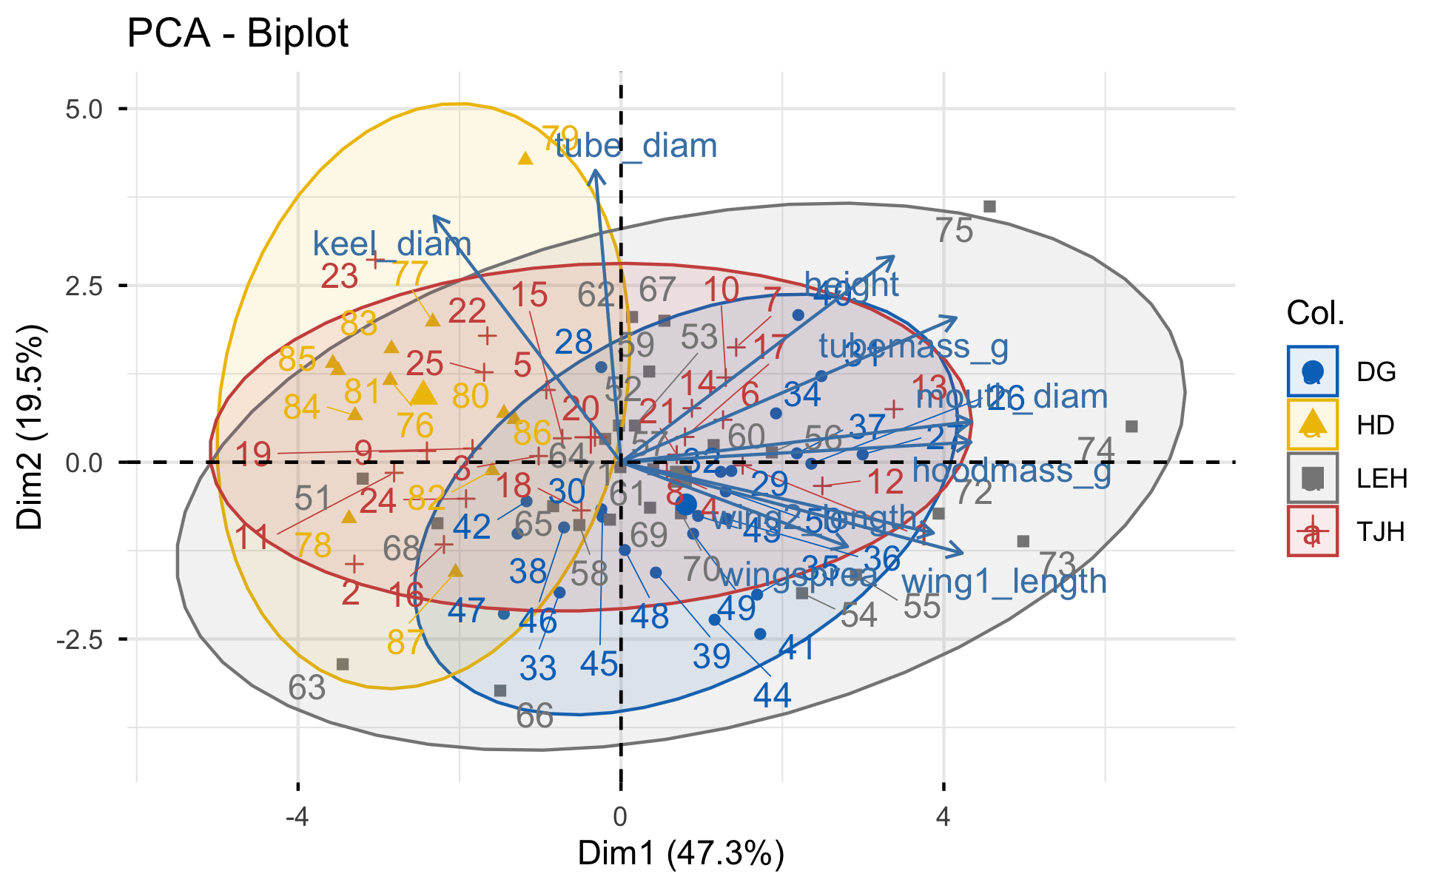
Some other ways
# Create dataset with row names darl_pca_data <- darlingtonia %>% select(height, mouth_diam, tube_diam, keel_diam, wing1_length, wing2_length, wingsprea, hoodmass_g, tubemass_g) # PCA pca_facto <- PCA(darl_pca_data, graph = FALSE, scale.unit = TRUE) # Create grouping factor with same length site_groups <- factor(darlingtonia$site) # Plot with grouping fviz_pca_biplot(pca_facto, col.ind = site_groups, # Use col.ind instead palette = "jco", addEllipses = TRUE, ellipse.level = 0.95, repel = TRUE)

Slide 46
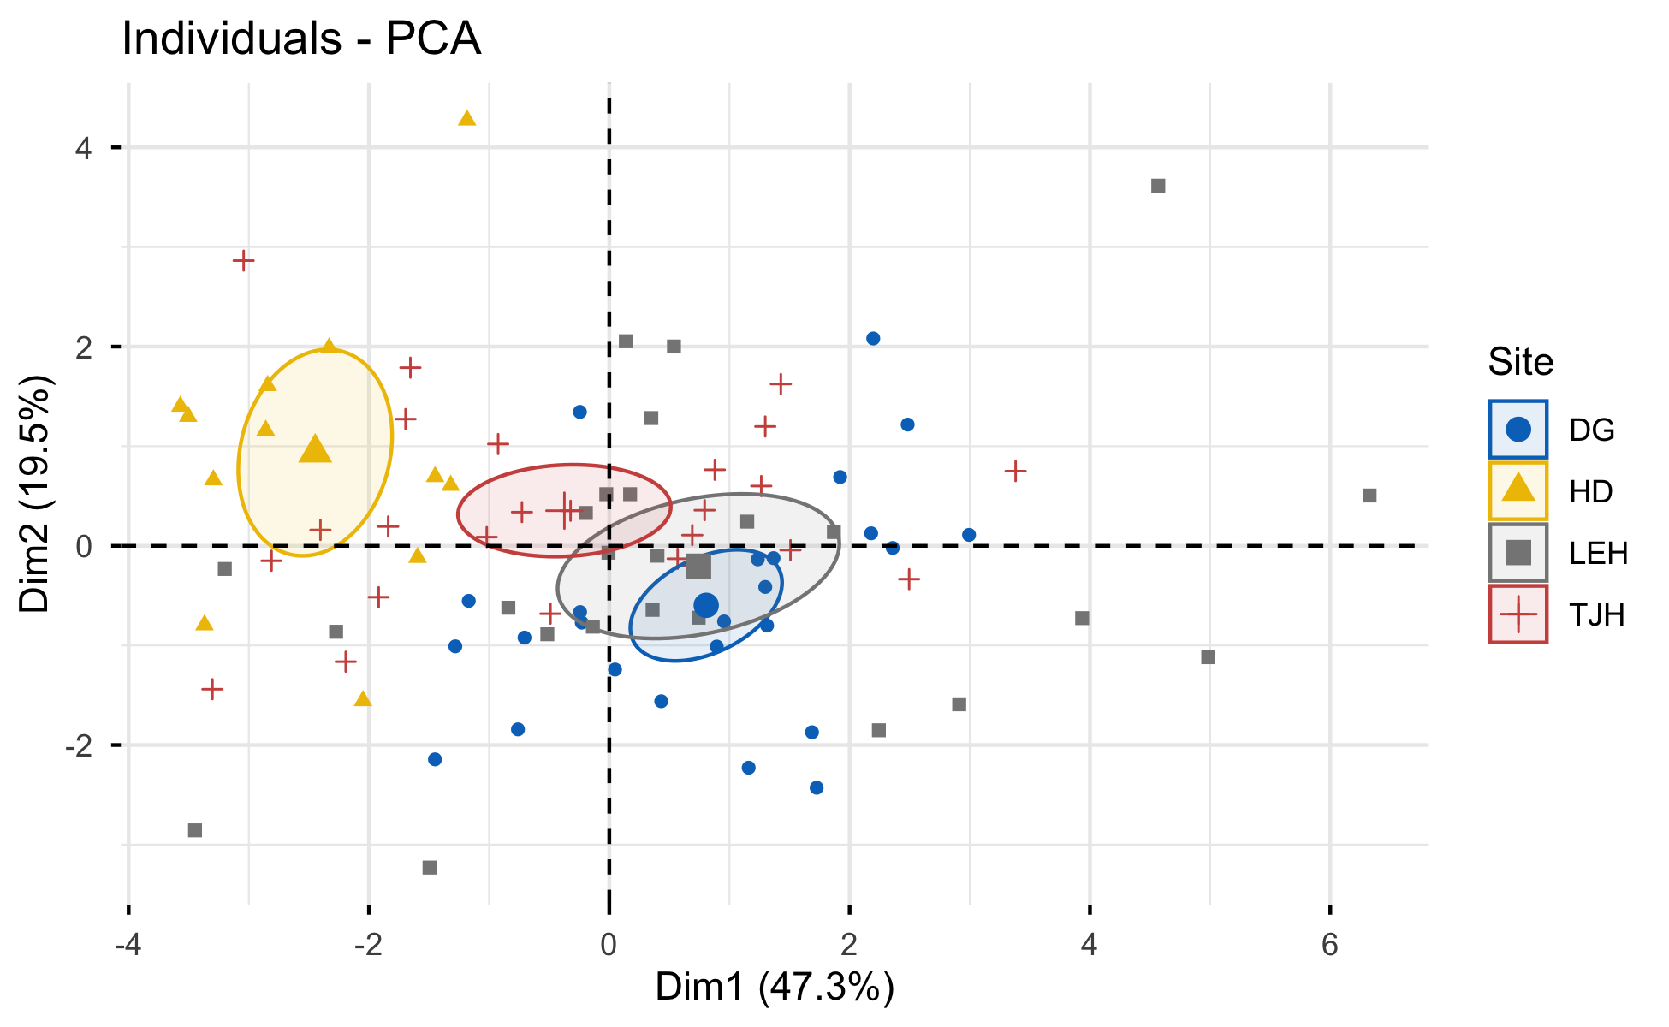
# Individual plot with better options fviz_pca_ind(pca_facto, geom.ind = "point", col.ind = darlingtonia$site, palette = "jco", addEllipses = TRUE, ellipse.type = "confidence", legend.title = "Site", repel = TRUE)

Slide 47
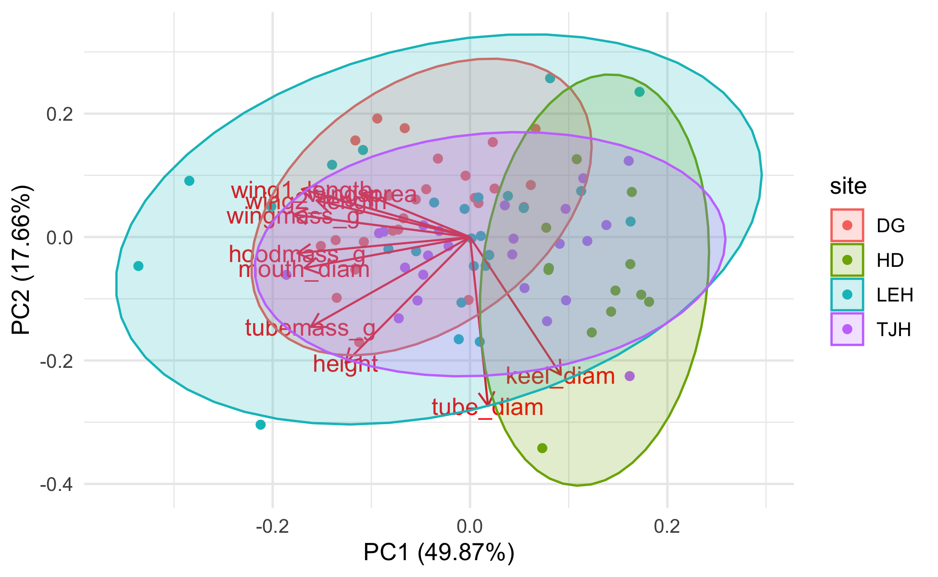
# Quick PCA plot with ggplot2 autoplot(pca_result, data = darlingtonia, colour = 'site', loadings = TRUE, loadings.label = TRUE, frame = TRUE, # Adds ellipses frame.type = 'norm') # or 't' for confidence

Slide 48
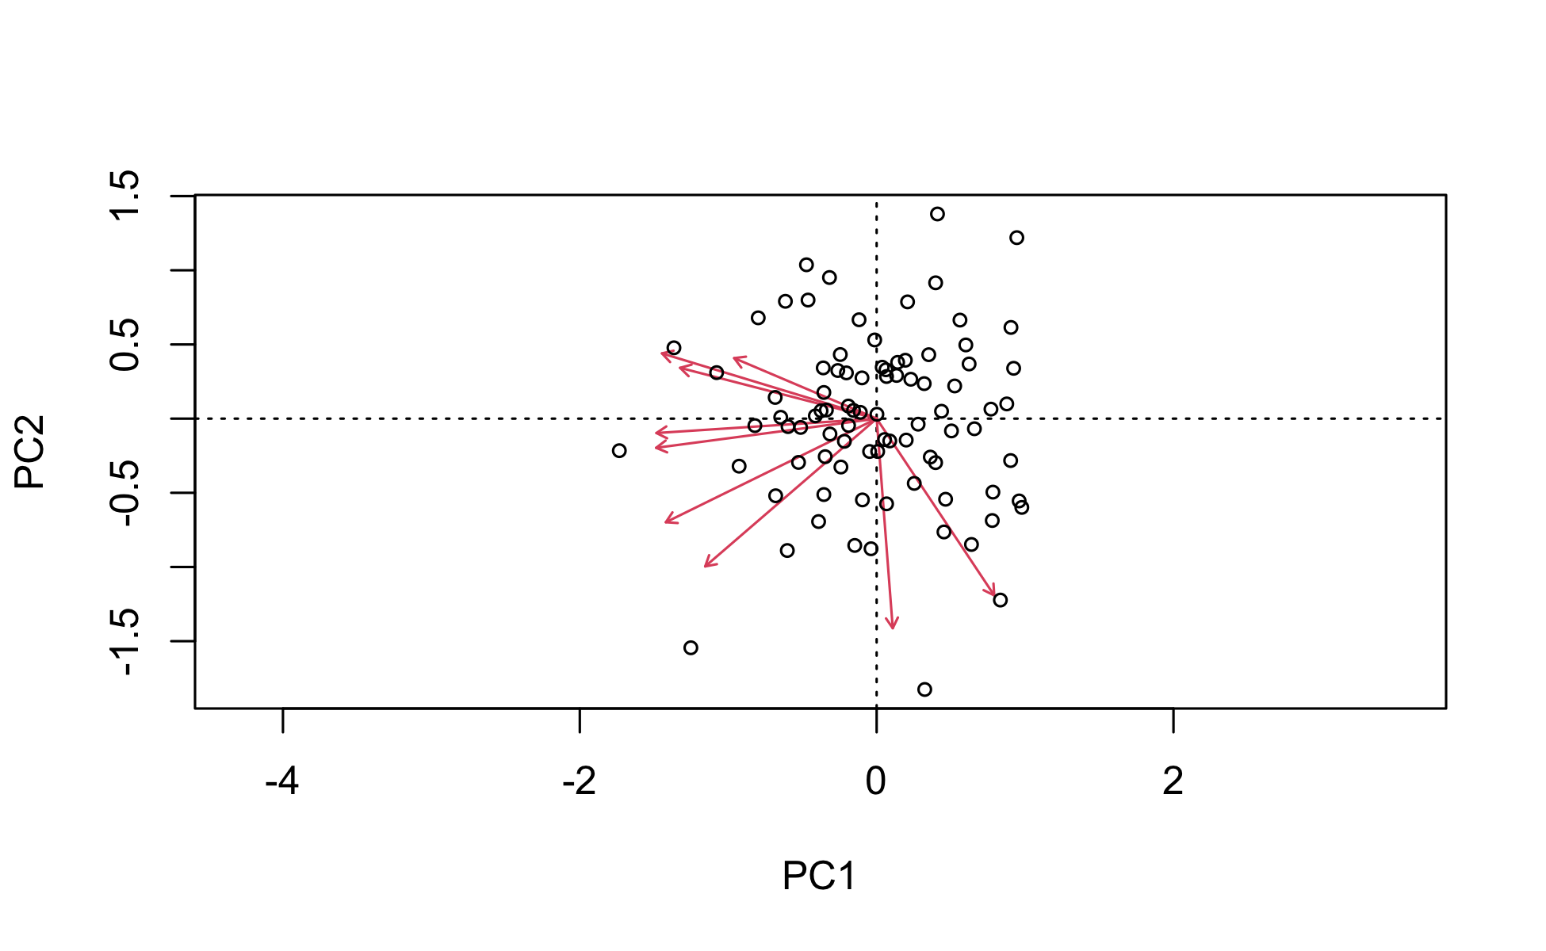
# Prepare data matrix (samples × variables) darl_matrix <- darlingtonia %>% select(height, mouth_diam, tube_diam, keel_diam, wing1_length, wing2_length, wingsprea, hoodmass_g, tubemass_g) %>% scale() # PCA with vegan (uses SVD, similar to prcomp) pca_vegan <- rda(darl_matrix) # Quick plot biplot(pca_vegan, scaling = 2)

Slide 49
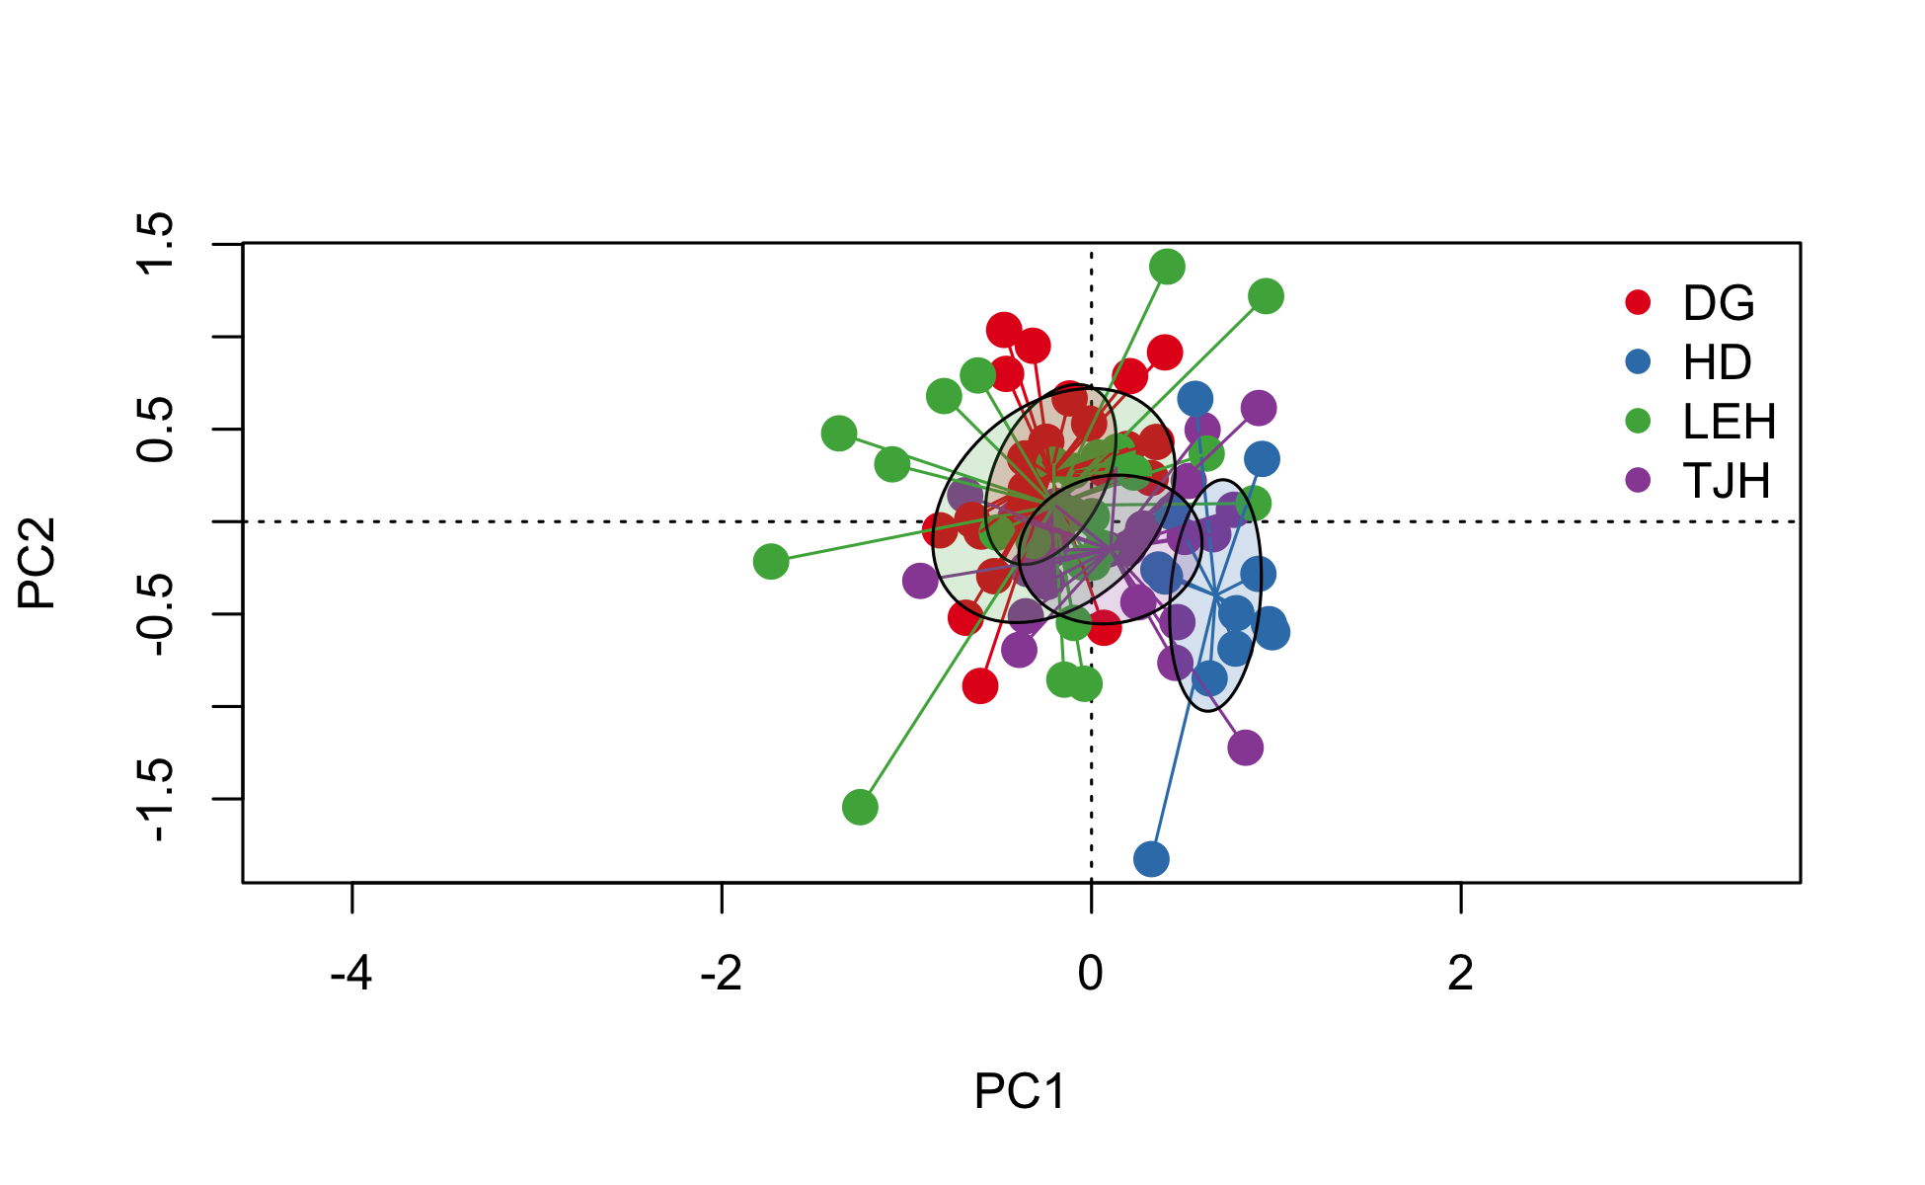
# Calculate distances between sites site_matrix <- darlingtonia %>% select(height, mouth_diam, wingmass_g) %>% mutate(site = darlingtonia$site) %>% group_by(site) %>% summarise(across(everything(), mean)) %>% column_to_rownames("site") # Euclidean distance (many distance metrics available!) dist_euclidean <- vegdist(site_matrix, method = "euclidean") dist_bray <- vegdist(site_matrix, method = "bray") # Bray-Curtis dist_manhattan <- vegdist(site_matrix, method = "manhattan") # Create a nice color palette site_factor <- factor(darlingtonia$site) n_sites <- length(levels(site_factor)) colors <- brewer.pal(min(n_sites, 8), "Set1") # Use Set1 palette site_colors <- colors[as.numeric(site_factor)] # Ordination plot with sites ordiplot(pca_vegan, type = "none") points(pca_vegan, display = "sites", col = site_colors, pch = 19, cex = 1.5) ordispider(pca_vegan, groups = darlingtonia$site, col = colors) ordiellipse(pca_vegan, groups = darlingtonia$site, draw = "polygon", col = colors, alpha = 0.2) # Add legend legend("topright", legend = levels(site_factor), col = colors, pch = 19, bty = "n")

Slide 50
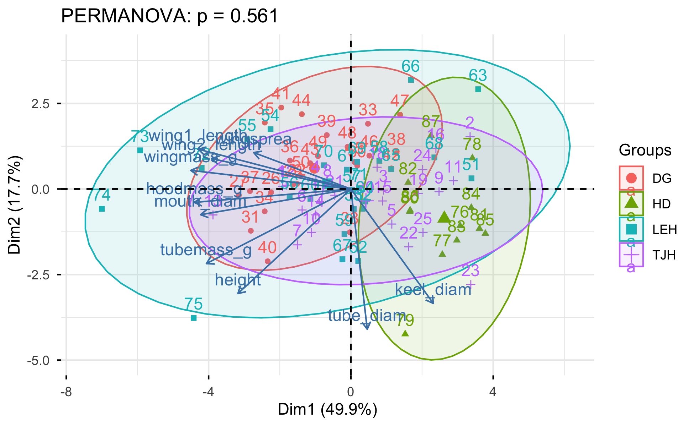
# Analysis pca_vegan <- rda(darl_matrix) permanova <- adonis2(darl_matrix ~ site, data = darlingtonia) # Visualization fviz_pca_biplot(pca_result, habillage = darlingtonia$site, addEllipses = TRUE) + labs(title = paste0("PERMANOVA: p = ", round(permanova$`Pr(>F)`[1], 3)))

Slide 51
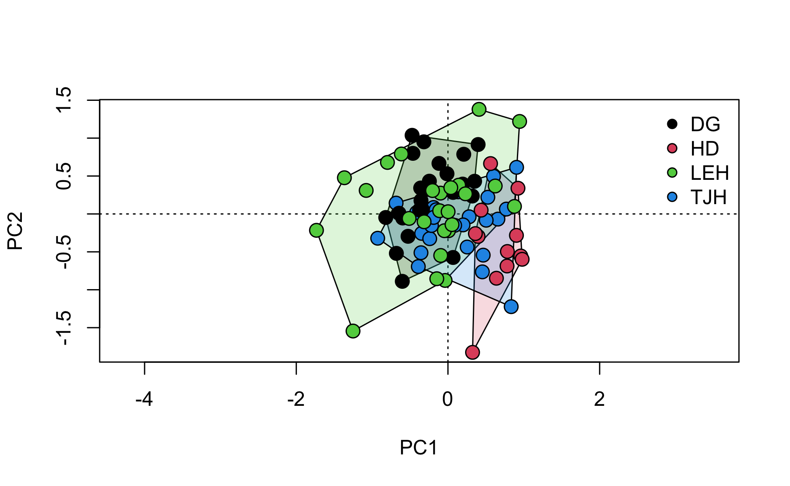
# Scale the data properly darl_scaled <- darlingtonia %>% select(height, mouth_diam, tube_diam, keel_diam, wing1_length, wing2_length, wingsprea, hoodmass_g, tubemass_g) %>% scale() %>% as.data.frame() # Convert back to data frame # PERMANOVA permanova_scaled <- adonis2(darl_scaled ~ site, data = darlingtonia, method = "euclidean", permutations = 999) permanova_scaled ## Permutation test for adonis under reduced model ## Permutation: free ## Number of permutations: 999 ## ## adonis2(formula = darl_scaled ~ site, data = darlingtonia, permutations = 999, method = "euclidean") ## Df SumOfSqs R2 F Pr(>F) ## Model 3 189.72 0.24512 8.9836 0.001 *** ## Residual 83 584.28 0.75488 ## Total 86 774.00 1.00000 ## --- ## Signif. codes: 0 '***' 0.001 '**' 0.01 '*' 0.05 '.' 0.1 ' ' 1
# Ordination plot with convex hulls (simpler) ordiplot(pca_vegan, type = "none") ordihull(pca_vegan, groups = darlingtonia$site, draw = "polygon", col = 1:n_sites, alpha = 50) points(pca_vegan, display = "sites", pch = 21, bg = as.numeric(factor(darlingtonia$site)), cex = 1.5) legend("topright", legend = levels(factor(darlingtonia$site)), pt.bg = 1:n_sites, pch = 21, bty = "n")

Slide 52
# Pairwise comparisons between sites pairwise_result <- pairwise.adonis2(darl_scaled ~ site, data = darlingtonia, method = "euclidean", # Add this! p.adjust.m = "bonferroni") pairwise_result ## $parent_call ## [1] "darl_scaled ~ site , strata = Null , permutations 999" ## ## $TJH_vs_DG ## Df SumOfSqs R2 F Pr(>F) ## Model 1 32.602 0.10636 5.7128 0.001 *** ## Residual 48 273.930 0.89364 ## Total 49 306.532 1.00000 ## --- ## Signif. codes: 0 '***' 0.001 '**' 0.01 '*' 0.05 '.' 0.1 ' ' 1 ## ## $TJH_vs_LEH ## Df SumOfSqs R2 F Pr(>F) ## Model 1 47.72 0.10517 5.6414 0.004 ** ## Residual 48 406.06 0.89483 ## Total 49 453.78 1.00000 ## --- ## Signif. codes: 0 '***' 0.001 '**' 0.01 '*' 0.05 '.' 0.1 ' ' 1 ## ## $TJH_vs_HD ## Df SumOfSqs R2 F Pr(>F) ## Model 1 69.308 0.25135 11.751 0.001 *** ## Residual 35 206.432 0.74865 ## Total 36 275.740 1.00000 ## --- ## Signif. codes: 0 '***' 0.001 '**' 0.01 '*' 0.05 '.' 0.1 ' ' 1 ## ## $DG_vs_LEH ## Df SumOfSqs R2 F Pr(>F) ## Model 1 26.24 0.06493 3.3333 0.02 * ## Residual 48 377.85 0.93507 ## Total 49 404.09 1.00000 ## --- ## Signif. codes: 0 '***' 0.001 '**' 0.01 '*' 0.05 '.' 0.1 ' ' 1 ## ## $DG_vs_HD ## Df SumOfSqs R2 F Pr(>F) ## Model 1 131.09 0.42382 25.745 0.001 *** ## Residual 35 178.22 0.57618 ## Total 36 309.31 1.00000 ## --- ## Signif. codes: 0 '***' 0.001 '**' 0.01 '*' 0.05 '.' 0.1 ' ' 1 ## ## $LEH_vs_HD ## Df SumOfSqs R2 F Pr(>F) ## Model 1 101.69 0.2468 11.468 0.001 *** ## Residual 35 310.35 0.7532 ## Total 36 412.04 1.0000 ## --- ## Signif. codes: 0 '***' 0.001 '**' 0.01 '*' 0.05 '.' 0.1 ' ' 1 ## ## attr(,"class") ## [1] "pwadstrata" "list"
# install.packages("RVAideMemoire") library(RVAideMemoire) # Pairwise PERMANOVA pairwise.perm.manova(vegdist(darl_scaled, method = "euclidean"), darlingtonia$site, test = "Wilks", nperm = 999, p.method = "bonferroni") ## ## Pairwise comparisons using permutation MANOVAs on a distance matrix ## ## data: vegdist(darl_scaled, method = "euclidean") by darlingtonia$site ## 999 permutations ## ## DG HD LEH ## HD 0.006 - - ## LEH 0.102 0.006 - ## TJH 0.012 0.006 0.030 ## ## P value adjustment method: bonferroni
results come from different statistical tests being used. Let me break down what each is doing: 1. pairwise.adonis2() - PERMANOVA on subsets What it does: For each pair, it subsets the data to just those 2 sites and runs a separate PERMANOVA Results: All p-values ≤ 0.016 (5 of 6 are p = 0.001) Interpretation: Tests if centroids (mean positions) differ between site pairs 2. pairwise.perm.manova() - Different test entirely What it does: Uses a MANOVA-based approach with permutations on the full distance matrix Results: More conservative - DG vs LEH now p = 0.078 (not significant) Interpretation: Also tests centroid differences but uses a different statistical framework
Why the differences matter: Location (Centroid) Tests:
pairwise.adonis2() and pairwise.perm.manova() both test if site means differ They give slightly different p-values due to different algorithms, but similar conclusions Use these to answer: “Are sites morphologically different?”

