Slide 1
Lecture 02
Bill Perry

Slide 2
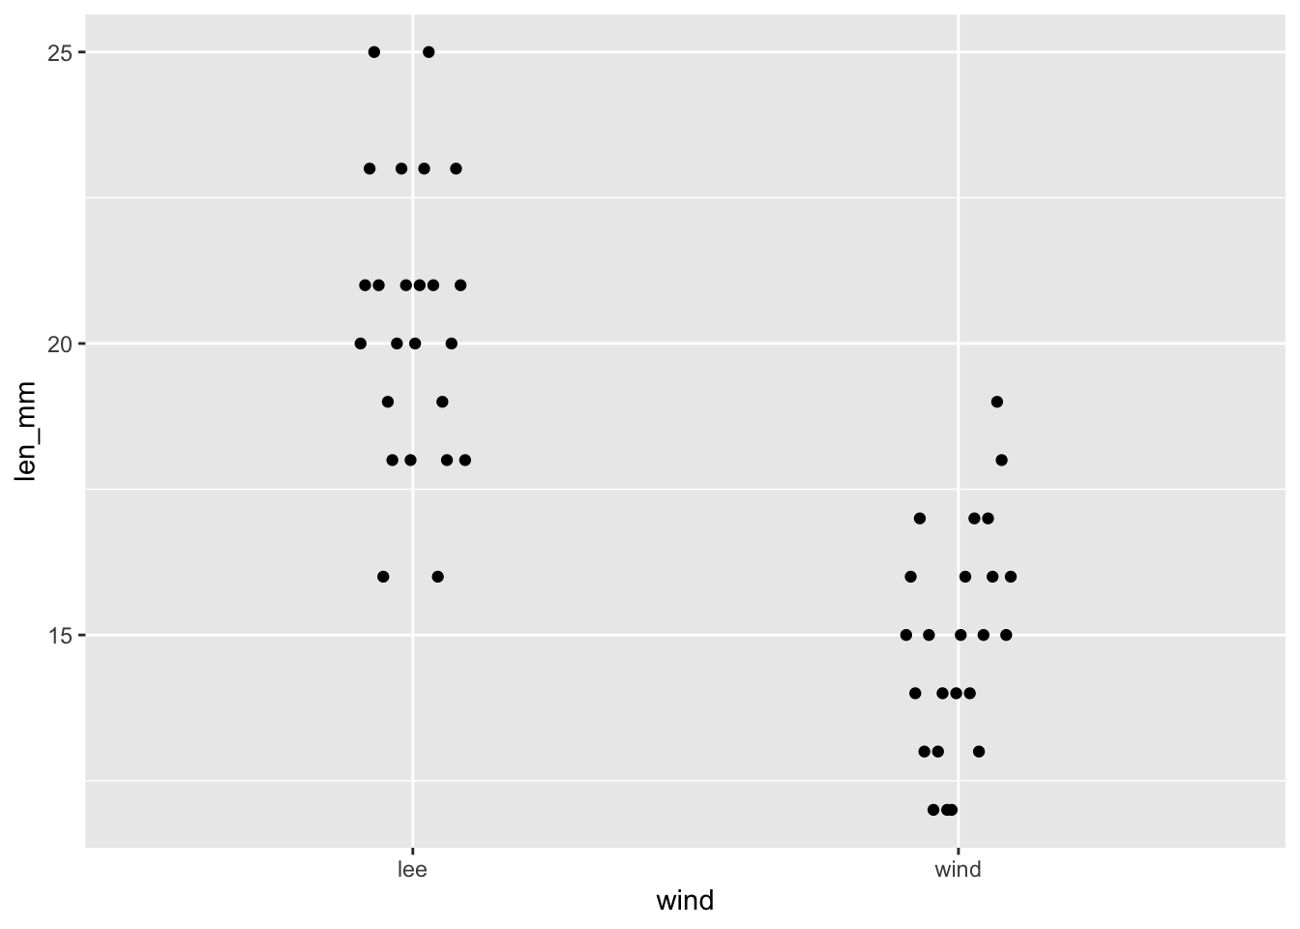
Lecture 2: Review
We covered inductive vs deductive reasoning
How to begin to ask questions
Accuracy and precision
What are general types of data
How to set up an R project in Rstudio
How to install and load libraries
How to read a file into R
How to make a graph
Our first graph

Slide 3
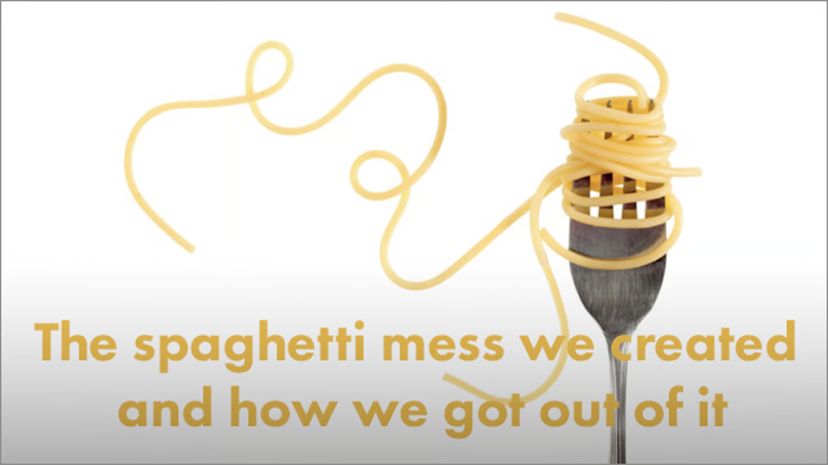
Lecture 2: How to deal with data wrangling
Data management overview
How to make a tidy spreadsheet
Metadata - why you really should use it
Data repositories
R in practice

Slide 4
Lecture 2: Data management overview
Data: the raw material of science
Wide variety of formats, sizes, complexity
Data management and curation often under emphasized
Good data management: owe it to our funding agencies, colleagues, supervisors, and study systems

Slide 5
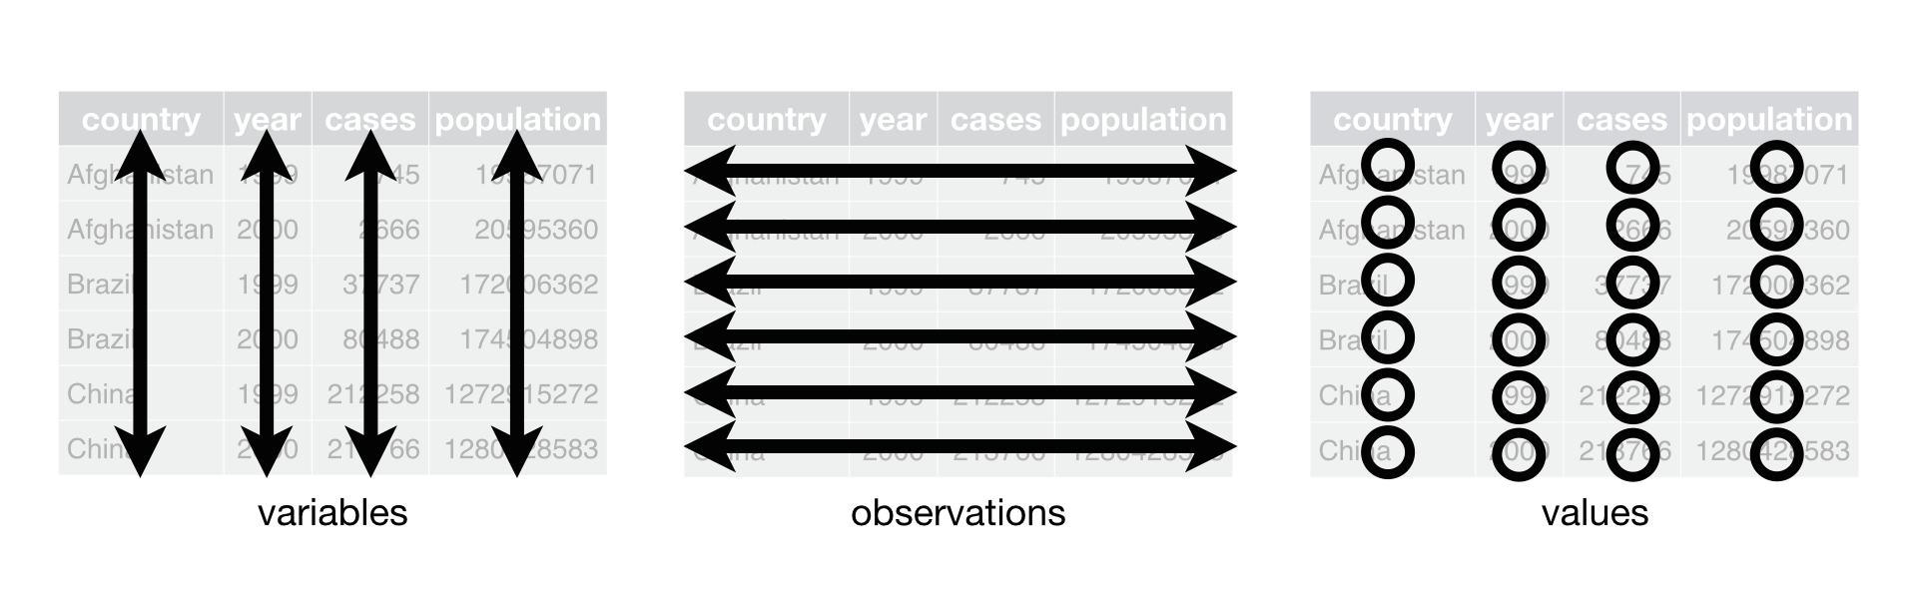
Lecture 2: Data gathering - managing
Step 1
Decide on what type of data you are collecting
Decide on controlled vocabulary - odo_mgl, drp_ugl
Decide on what has to happen to the data flow
Organize your project -
Enter the data as soon as you can
in a spreadsheet as excel and csv
you really need to be sure it is tidy
Tidy data by Whickham
Step 2:
Make a MetaData sheet a. data about data b. descriptions, units, etc.

Slide 6
Practice Exercise 1: Can you do this for the pine data we have collected?
Let’s recreate the basic histogram of fish lengths from our last class. Use the sculpin_df data frame that’s already loaded.
# Write your code here to read in the file # How do you examine the data - what are the ways you think and lets try it!

Slide 7

Lecture 2: Data gathering - managing
Step 3
Store your raw data and metadata
Electronic dataframes should be stored in ≥3 copies:
Your computer (onsite)
External storage (onsite)
Offsite storage (e.g., cloud storage)
Have regular backup strategy

Slide 8
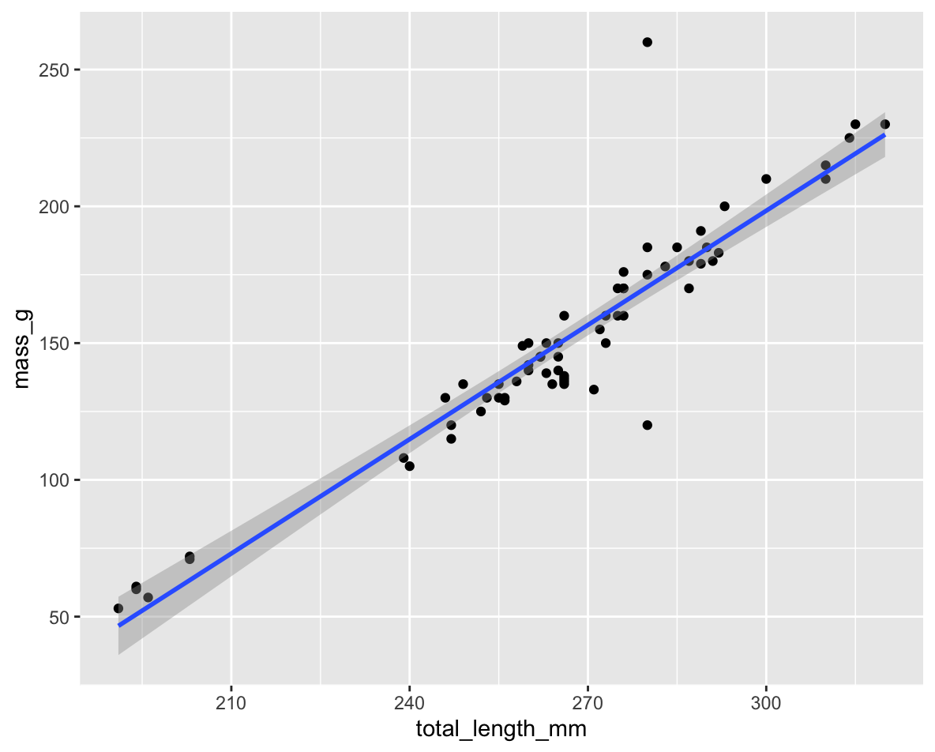
Lecture 2: Data gathering - managing
Step 4
Graph your data and check outliers, errors, missing data
You can choose a NA or space… opinions differ
you can set this when you import data
# Specifying NA values explicitly data <- read_csv("your_file.csv", na = c("", "NA", "N/A", "missing", "null"))

Slide 9
Practice Exercise 2: Lets plot our data again
Let’s recreate the basic plots you might use to visualize the data and lets see what it looks like.
# Lets practice making a plot! # What are the ways you want to see data and lets try them!

Slide 10
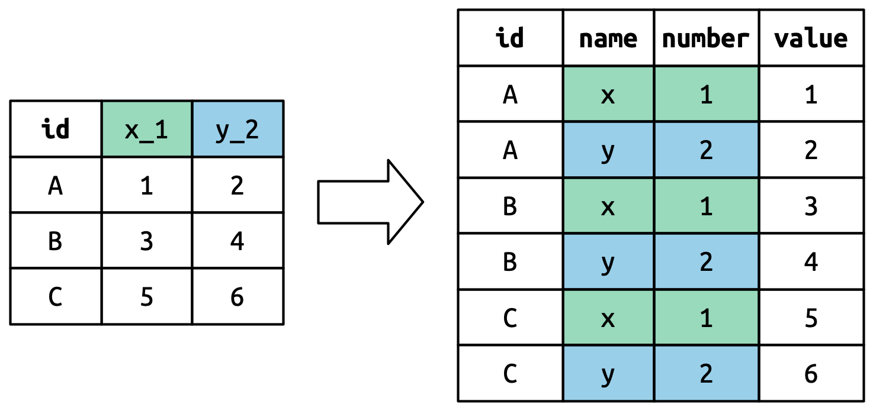
Lecture 2: Data gathering - managing
Step 5
Cleaning Data -
Correct errors, fill missing data with “NA”, resolve outliers
save a clean data file as the master file - often good to make read only
Add information in a notes column or text file about what was done and why.

Slide 11
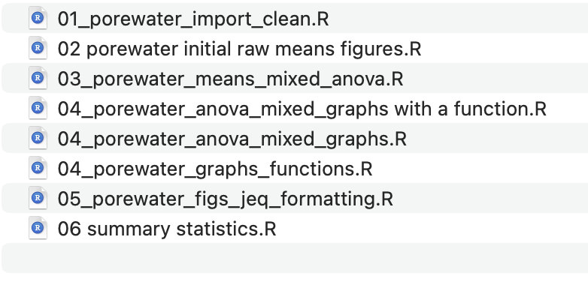
Lecture 2: Data gathering - managing
Step 6
Time to graph the data and explore, summarize, and transform data
If there are a lot of steps in cleaning and doing transfomations and calculations save them to new output file.
A good way to organize script files is number them in the order they get run.

Slide 12
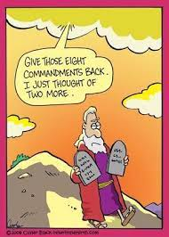
Lecture 2: Data gathering - managing
The important considerations in data
enter field/ lab data into electronic format as soon as possible and back it up in at least one location (e.g., cloud storage)
do not modify raw data in any way following entry into electronic format
store all data in an open-access format (e.g., .csv)
thoroughly check and clean your raw data, saving it as a separate file (e.g., “output/cleaned_raw_data.csv”)
accompany raw field/lab data with meta-data that is unambiguously linked to the raw data file
carry out all analyses, calculations and visualization on a separate file from the “raw“ or “clean” data: the “analysis” data
perform all data transformation, analysis and visualization by reproducible code and code shall be stored together with data
arrange all raw and analysis data in “instance-row, variable-column” or tidy format: one column per variable

Slide 13
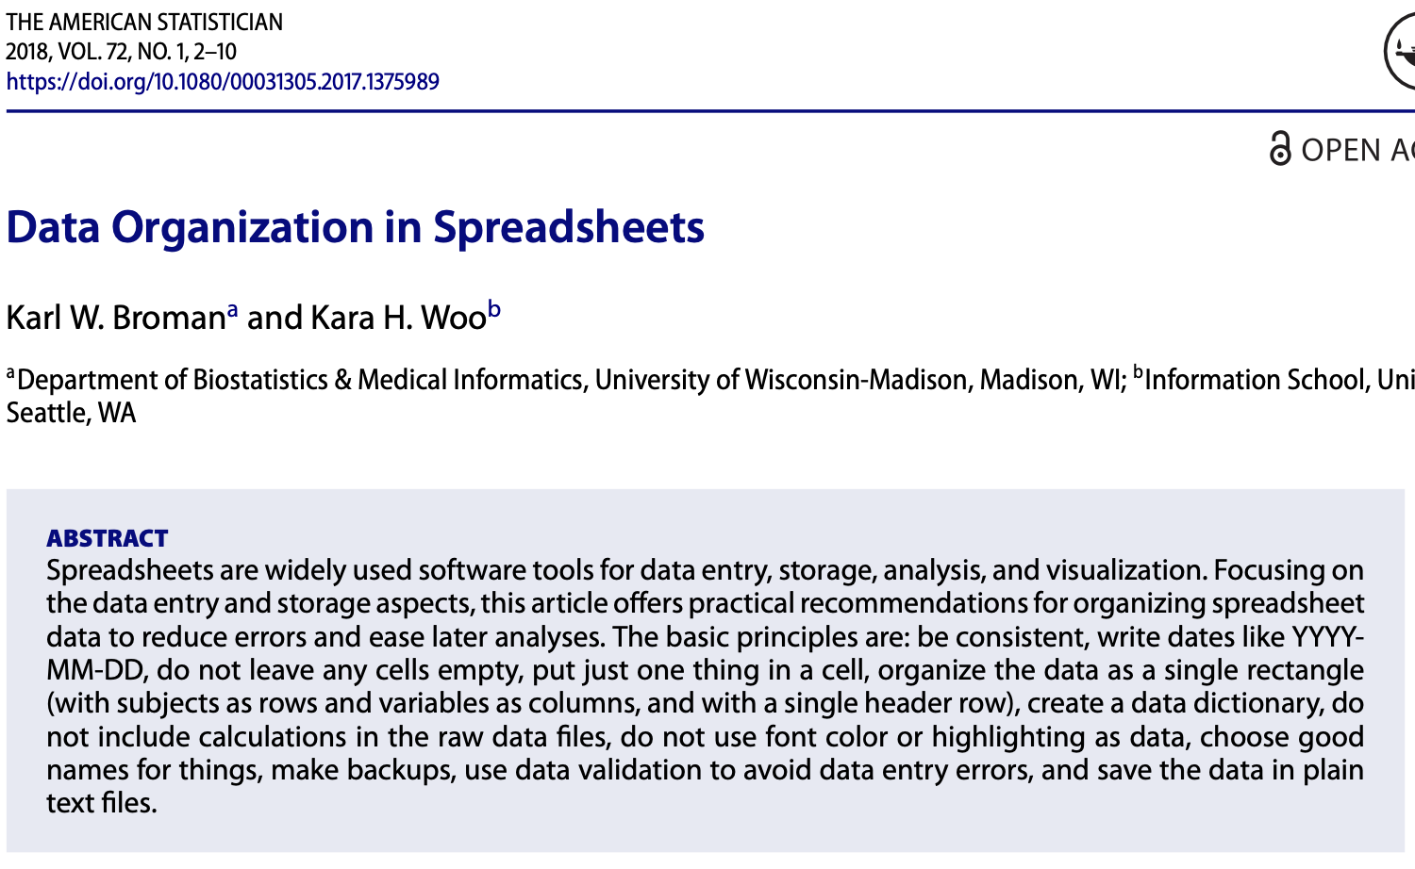
Lecture 2: Data gathering - managing
Broman KW, & Woo KH. 2018. Data organization in spreadsheets. The American Statistician 72: 2-10 (HERE)
Spreadsheets break data - use with extreme caution
Spreadsheets: data entry and storage
R: visualization and analysis
Goal: organize data so readable by humans and computers

Slide 14
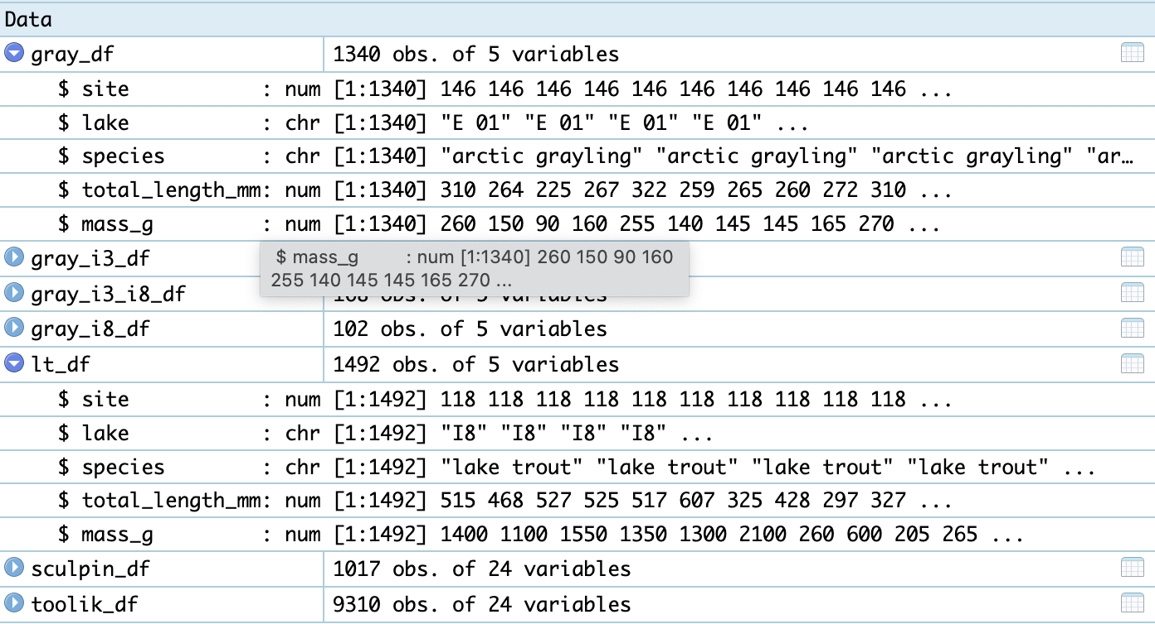
Lecture 2: Data gathering - managing
Be consistent!
Variable names
Codes for categorical variables
Variable names
use snake case and lower case - nitrate_n_mgl
always use the same name
Codes for missing values - NA or 9999 or a space - I know but I do it
Date formats -
YYYY-MM-DD HH:MM:SS
Time begins in 1970-01-01
names of objects
dataframes after import data_df
plots - len_wt_plot
models - anova_wt_model
File names
use separators - 2025_02_01_lake_x_inflow.csv
Note format Requires considerable foresight and organization
example of fish data

Slide 15
Practice Exercise 3: How do we fix variable names?
So there are two issues
what can you do when reading in file?
what can you do when the file is in and need to fix things
# lets do # 2 first - no pun intended # if you wanted to rename variables what would would you do? # now time for #1 - there are tools to make your life easier # install.packages("janitor") # what does a janitor or BSW do? # library(janitor) # lets read in a messy file... junk.csv # first look at the file # df <- read_csv("data/junk.csv) # df_excel <- read_excel("data/junk.csv")

Slide 17
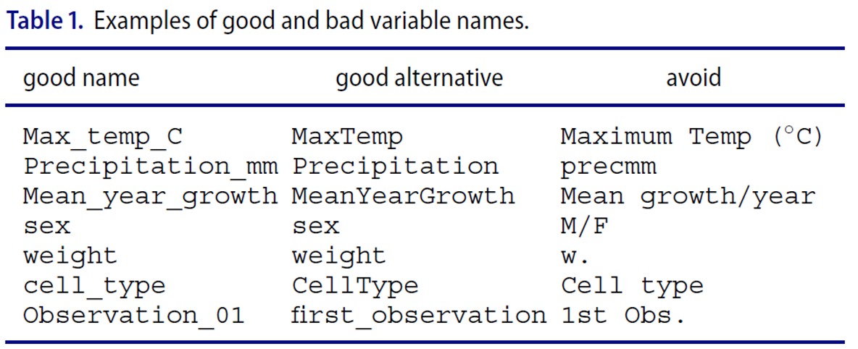
Lecture 2: Data gathering - managing
Variable and file names can be a problem
Avoid spaces but use underscore _
Avoid special characters @#$%^@#
Be sure to also use a variety of separators so you can separate later
or use the same number of characters across a variable name
2025_03_04_file-site

Slide 18

Lecture 2: Data gathering - managing
Excel will drive you mad
it will mess up your dates
store data in separate columns - year - month - day
or use a string 20250401
always use unambiguous format of larges to smallest - why?
is 01 04 2025 the same as 04 01 2025
what are the dates in english?
or European

Slide 19
Practice Exercise 3: Are there ways to deal with excel and why is it a problem
Let’s look at junk.xlsx
# Write your code here to create a histogram of fish lengths from Toolik Lake # Remember to use the pipe operator %>% and ggplot with geom_histogram() # copy the date to a new cell and make a number!

Slide 20
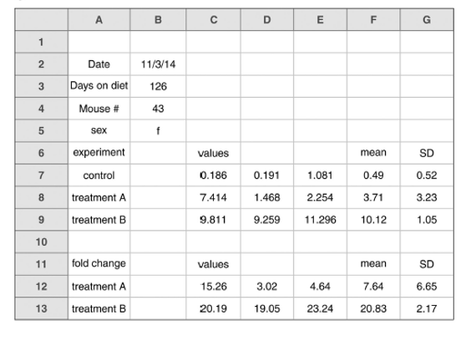
Lecture 2: Data gathering - managing
Never do Calculations in Excel
always do calculations in R - reproducible
never merge cells
can use highlighting but it will disappear
a nice rectangular dataframe will make you happy
tears will flow if not

Slide 21

Lecture 2: Data gathering - managing
Meta Data
This data will love beyond you
Someone will need to interpret it - what do they need
What is data about
Who collected it
When
Where
Funding agency
Methods used to collect
Variable names
description
units
abbreviations
CALCULATIONS AND WHY?

