Slide 1
Lecture 17 - Multivariate STATS
Bill Perry

Slide 3
Introduction to Multivariate Statistics
Overview
Multivariate data: multiple variables per object
Types of multivariate analyses
Functional vs. structural methods
R-mode vs. Q-mode analyses
Eigenvectors, eigenvalues, and components
Distance and dissimilarity measures
Data transformations and standardization
Screening multivariate data
MANOVA

Slide 4
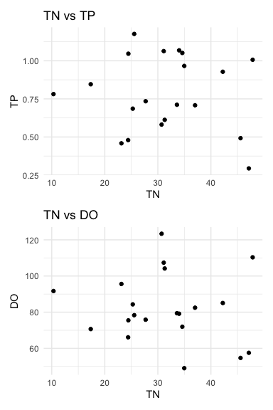
Multivariate Data
Multiple variables recorded about each object (individual, quadrat, site, etc.)
Objects: rows (i = 1 to n)
Variables: columns (j = 1 to p)
Examples:
Stream sites with multiple chemical parameters
Species with multiple morphological traits
Sample units with multiple species abundances

Slide 5
Multivariate data vs. multivariate analysis
We’ve already seen multivariate data in multiple regression and multi-factor ANOVA, but now we’ll look at cases with multiple response variables.

Slide 6
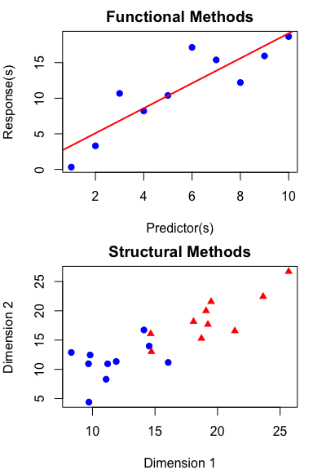
Multivariate Statistics in Ecology
Functional vs. Structural Methods
Functional methods: - Clear response and predictor variables - Goal: relate Y’s to X’s - Examples: MANOVA, PERMANOVA
Structural methods: - Find patterns/structure in data - Often no clear predictors - Examples: PCA, NMDS, Cluster Analysis

Slide 7
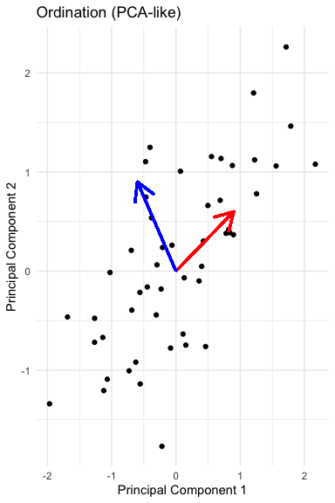
Structural Methods in Multivariate Analysis
Two Main Approaches
Scaling/Ordination Methods: - Reduce dimensions with new derived variables - Summarize patterns in data - Examples: PCA, CCA
Dissimilarity-Based Methods: - Measure dissimilarity between objects - Visualize relationships between objects - Examples: NMDS, Cluster Analysis

Slide 8
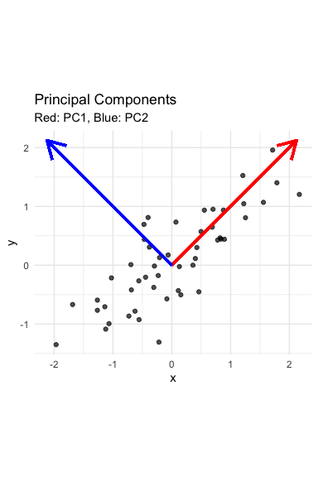
Eigenvectors, Eigenvalues, and Components
Goal: derive new variables (principal components) that explain variation in data
Components are linear combinations of original variables:
zik = c1yi1 + c2yi2 + … + cpyip
Properties of derived variables:
First component explains most variation
Second explains most remaining variation
Components are uncorrelated with each other
As many components as original variables

Slide 9
Key concept
Eigenvalues (λ) represent the amount of variation explained by each new derived variable, while eigenvectors contain the coefficients showing how original variables contribute to each component.

Slide 10
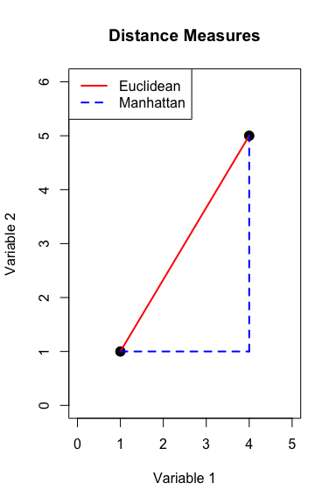
Distance and Dissimilarity Measures
Measure how different objects are in multivariate space
Common measures:
Euclidean distance: direct geometric distance
Manhattan distance: sum of absolute differences
Bray-Curtis: good for species abundance data
Kulczynski: for abundance data with zeros
Used in cluster analysis, MDS, and other techniques
Create dissimilarity matrices for analysis

Slide 11
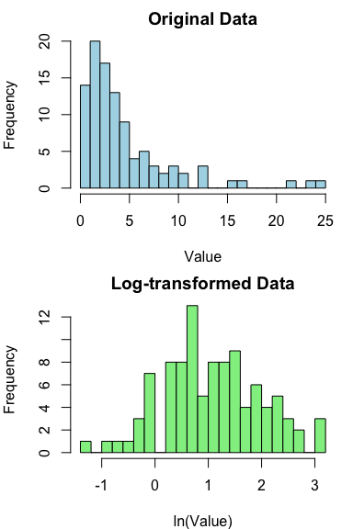
Data Transformations & Standardization
Common Approaches
Transformations: - Log transformation for skewed data - Root transformations for count data - Fourth-root for species abundance data
Standardization: - Centering: subtract mean (mean = 0) - Standardization: divide by SD (SD = 1) - Crucial for variables with different units - May not be appropriate for species data

Slide 12
Why standardize?
Standardization ensures all variables contribute equally to the analysis regardless of their original units or scales of measurement. Without it, variables with larger values or variances would dominate the results.

Slide 13
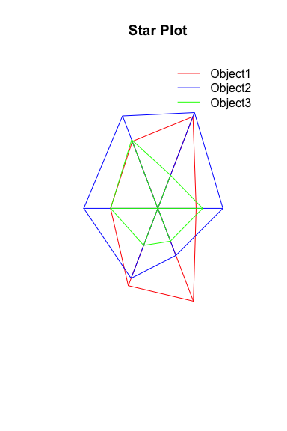
Multivariate Graphics
Visual Representation Methods
SPLOMS/Scatterplot Matrices: show bivariate relationships
Star plots: display multiple variables per object
Chernoff faces: represent variables as facial features
Heatmaps: visualize data matrices with color
Biplots: show objects and variables together
Ordination plots: visualize relationships in reduced dimensions

Slide 14
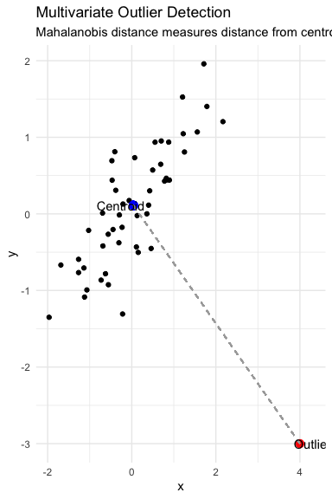
Screening Multivariate Data
Key Issues to Check
Multivariate Outliers: - Objects with unusual patterns across variables - Detected with Mahalanobis distance (d²) - Test against χ² distribution with p df
Missing Observations: - Common approaches: - Deletion: remove affected object or variable - Imputation: estimate missing values - Maximum likelihood methods - Multiple imputation

Slide 15
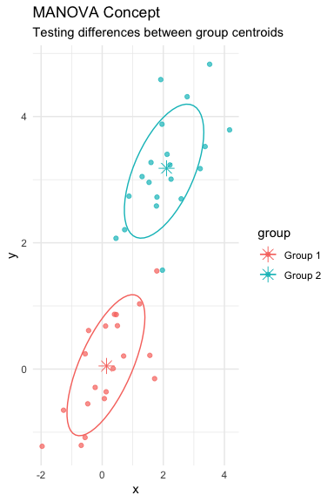
MANOVA (Multivariate Analysis of Variance)
Multivariate extension of ANOVA
Tests for differences in group centroids based on multiple response variables
Advantages over multiple ANOVAs:
Controls family-wise error rate
Accounts for correlations between variables
More powerful when variables are correlated
Common test statistics:
Wilk’s lambda (λ)
Pillai’s trace
Hotelling-Lawley trace

Slide 16
MANOVA Assumptions
Multivariate normality
Homogeneity of variance-covariance matrices
No extreme multivariate outliers
Independence of observations

Slide 17
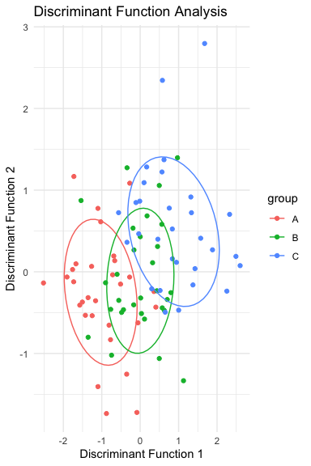
Discriminant Function Analysis
Mathematically similar to MANOVA
Used for:
Testing differences between groups (like MANOVA)
Identifying variables that separate groups
Classifying observations into groups
Creates linear combinations (discriminant functions) that maximize between-group differences
Can assess how well classification performs
Jackknifed classification provides more realistic success rates

Slide 18
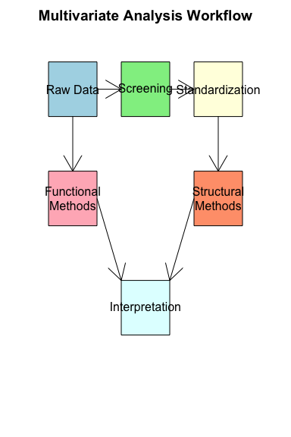
Summary
Key Concepts
Multivariate data requires special techniques to account for correlations between variables
Functional methods (MANOVA) test hypotheses about group differences
Structural methods (PCA, NMDS) find patterns in data
Distance measures quantify similarities between objects
Data standardization is crucial for variables with different units
Multivariate graphics help visualize complex relationships

