Slide 1
Lecture 06 H testing and simple tests II
Bill Perry

Slide 2

Brief review
H test for a single population
1- and 2-sided tests
H test for two populations
Assumptions of parametric tests

Slide 3


Lecture 5 overview
Assumptions of parametric tests
Statistical vs. biological significance
Robust tests
Rank-based tests
Permutation tests
Assignment 1
Lake Trout
source
Grayling

Slide 4
Assumptions of parametric tests
T-tests are parametric tests
Parametric tests: specify/assume probability distribution from which parameters came
Non-parametric tests: no assumption about probability distribution
Mukasa et al 2021 DOI: 10.4236/ojbm.2021.93081

Slide 5
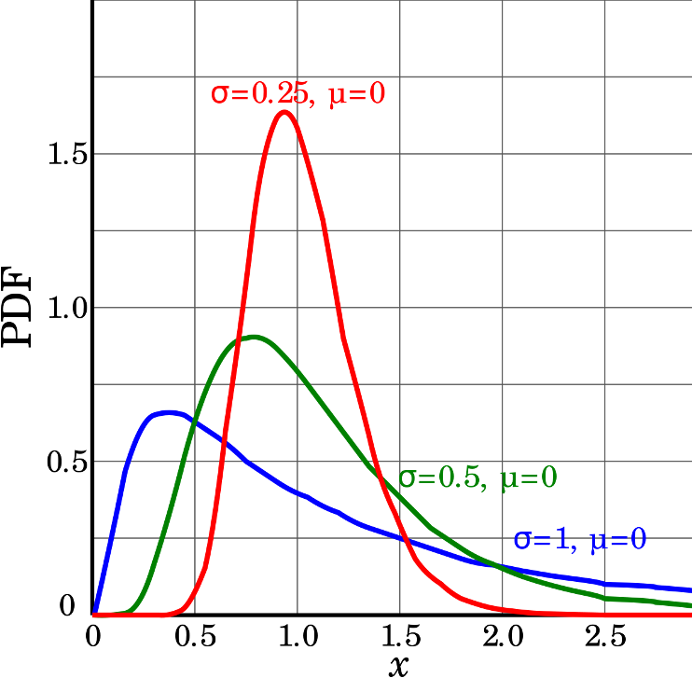
Assumptions of parametric tests
If assumptions of parametric test violated, test becomes unreliable
This is because test statistic may no longer follow distribution
Most parametric tests robust to mild/moderate violations of below assumptions

Slide 6
Assumptions of parametric tests
Basic assumptions of parametric t-tests:
Normality, equal variance, random sampling, no outliers
Normality: Samples from normally distributed population
Graphical tests: histograms, dotplots, boxplots, qq-plots
“Formal” tests: Shapiro-Wilk test
<

Slide 7
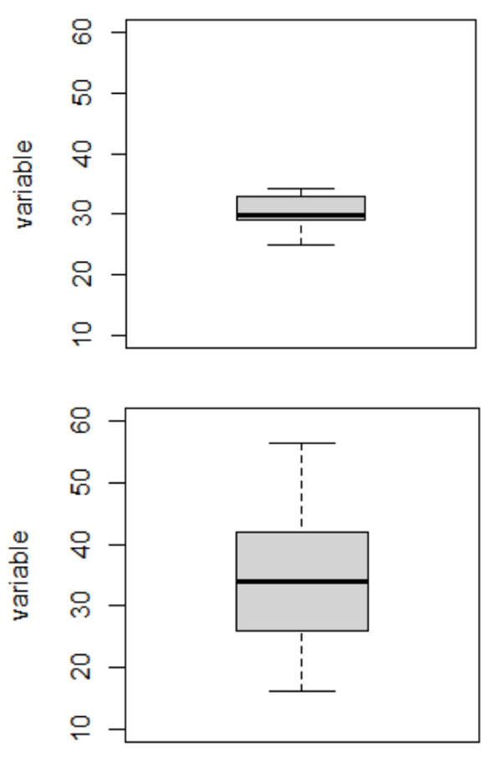
Assumptions of parametric tests
Equal variance: samples are from populations with similar degree of variability
Graphical tests: boxplots
“Formal” tests: F-ratio test
Parametric tests most robust to violations of normality and equal var. assumptions when samples sizes equal

Slide 8
Assumptions of parametric tests
Normality, equal variance, random sampling, no outliers
Random sampling: samples are randomly collected from populations; part of experimental design
Necessary for sample -> population inference
<>

Slide 9
Assumptions of parametric tests
Normality, equal variance, random sampling, no outliers
No outliers: no “extreme” values that are very different from rest of sample
Graphical tests: boxplots, histograms
“Formal tests”: Grubb’s test
Note: outliers also problem for non-parametric tests
<>

Slide 10
Statistical vs. biological significance
Statistical significance: difference unlikely due to chance
Says nothing about biological significance of difference!
With large sample size can detect very small differences between populations
E.g.: consider 2 snail populations,
A and B:
Ho: µ~size A~ = µ~size B~
Ha: µ~size A~ ≠ µ~size B~
<!– –>

Slide 11
Statistical vs. biological significance
Size of A: 5.05 (± 2.00 SD)mm, size of B: 5.00 (± 2.00 SD)mm
Sample 50, 200, 30,000 individuals from each pop:
n = 50: t = 0.32, df = 98, p-value = 0.75
n = 200: t = 0.058, df = 398, p-value = 0.95
n = 30,000: t = -4.47, df = 59998, p-value = 7.996*10⁻⁶

Slide 12
Statistical vs. biological significance
Finally, statistically significant difference…
Meaningful? Ecologically significant? Statistics can’t answer this question
IMPORTANT to report info that can assess biological significance
“A two-tailed, two-sample independent t-test showed significant difference in size between pop. A (4.99 mm ± 1.99 SD) and pop. B (5.06 mm ± 1.99 SD) at á=0.05 (t = -4.47, df = 59998, p-value < 0.0001).”
<!– –>

Slide 13
Assumptions of parametric tests
Basic assumptions of parametric t-tests:
Normality, equal variance, random sampling, no outliers
What to do if assumptions are violated?
<>

Slide 14
Homework take-up
t-tests have several assumptions. Alternative tests, with more relaxed assumptions, are available to statisticians. In which case would you use the following tests?
Welch’s t-test: when distribution normal but variance unequal
Permutation test for two samples: when distribution not normal (but both groups should still have similar distributions and ~equal variance)
Mann-Whitney-Wilcoxon test: when distribution not normal and/or outliers are present (but both groups should still have similar distributions and ~equal variance)
< –>

Slide 15
Assumptions of parametric tests
QQ-plots: tool for assessing normality
On x- theoretical quantiles from SND
On y- ordered sample values
Deviation from normal can be detected as deviation from straight line
<!– –>

Slide 16
Assumptions of parametric tests
In some cases, data can be mathematically “transformed” to meet assumptions of parametric tests

Slide 17
Robust tests
Welch’s t-test: common “robust” test for means of two populations
Robust to violation of equal variance assumption, deals better with unequal sample size
Parametric test (assumes normal distribution)
Calculates a t statistic but recalculates df based on samples sizes and s
<!– –>

Slide 18
Robust tests
In R:
t.test(y1, y2, var.equal = FALSE, paired = FALSE)
will use the Welch approach
T-test AvB df= 38 t= -3.62 p= 0.0009
AvC df= 38 t= -2.91 p= 0.005
Welch’s
AvB df= 37.9 t= -3.62 p= 0.0009
AvC df= 26.1 t= -2.91 p= 0.007
<!– –>

Slide 19
Rank based tests
Rank-based tests: no assumptions about distribution (non-parametric)
Ranks of data: observations assigned ranks, sums (and signs for paired tests) of ranks for groups compared
Mann-Whitney U test common alternative to independent samples t-test
Wilcoxon signed-rank test is alternative to paired t-test

Slide 20
Rank based tests
Assumptions: similar distributions for groups, equal variance
Less power than parametric tests
Best when normality assumption can not be met by transformation (weird distribution) or large outliers
A: n= 15, y= 8, s= 4 B : n= 15, y= 10, s= 5
Approach A vs. B
T-test df= 28 t= -3.53 p= 0.0014 M-W U (Wilcoxon’s) W= 41 p= 0.002

Slide 21
Permutation tests
Permutation tests based on resampling: reshuffling of original data
Resampling allows parameter estimation when distribution unknown, including SEs and CIs of statistics (means, medians)
Common approach is bootstrap: resample sample with replacement many times, recalculate sample stats

Slide 22
Permutation tests
Sample A: n = 40, ȳ= 1.72, s = 4.17
Sample B: n = 35, ȳ= 4.50, s = 4.83
Ho: µ_{A} = µ_{B}, Ha: µ_{A} ≠µ_{B}
Calculate ∆ in means between two groups (2.78)
<!– –>

Slide 23
Permutation tests
Randomly reshuffle observations between groups (keeping n_{A}=40 and n_{B}=35), calculate ∆
Repeat >1,000 times
Record proportion of the ∆means is ≥2.94 µmol
This is equivalent to p-value and can be used in “traditional” H test framework
For a graphical explanation:
Graphical Explanation

Slide 24
Permutation tests
In R (using ‘perm’ package):
permTS(y1, y2, alternative = “two.sided”, method = “exact.mc”, control = permControl(nmc = 10000))
Assumptions: both groups have similar distribution; equal variance

Slide 25
R practice
Get practice doing basic t-tests
Alternatives in next lecture
Dataset (squirrel_data.csv) and lab instructions on Canvas
Answer questions in bold
Due end of Thursday

