Slide 1
Lecture 06 H testing and simple tests II
Bill Perry

Slide 2

Brief review
H test for a single population
1- and 2-sided tests
H test for two populations
Assumptions of parametric tests

Slide 3


Lecture 5 overview
Assumptions of parametric tests
Statistical vs. biological significance
Robust tests
Rank-based tests
Permutation tests
Assignment 1
Lake Trout
source
Grayling

Slide 4
Assumptions of parametric tests
T-tests are parametric tests
Parametric tests: specify/assume probability distribution from which parameters came
Non-parametric tests: no assumption about probability distribution
Mukasa et al 2021 DOI: 10.4236/ojbm.2021.93081

Slide 5
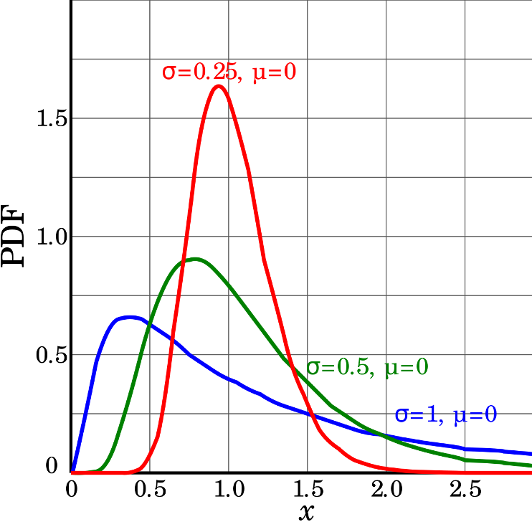
Assumptions of parametric tests
If assumptions of parametric test violated, test becomes unreliable
This is because test statistic may no longer follow distribution
Most parametric tests robust to mild/moderate violations of below assumptions

Slide 6
Assumptions of parametric tests
Basic assumptions of parametric t-tests:
Normality, equal variance, random sampling, no outliers
Normality: Samples from normally distributed population
Graphical tests: histograms, dotplots, boxplots, qq-plots
“Formal” tests: Shapiro-Wilk test
<

Slide 7
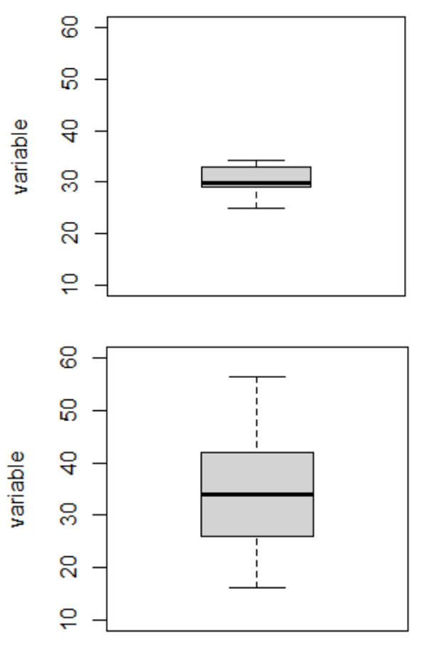
Assumptions of parametric tests
Equal variance: samples are from populations with similar degree of variability
Graphical tests: boxplots
“Formal” tests: F-ratio test
Parametric tests most robust to violations of normality and equal var. assumptions when samples sizes equal

Slide 8
Assumptions of parametric tests
Normality, equal variance, random sampling, no outliers
Random sampling: samples are randomly collected from populations; part of experimental design
Necessary for sample -> population inference
<>

Slide 9
Assumptions of parametric tests
Normality, equal variance, random sampling, no outliers
No outliers: no “extreme” values that are very different from rest of sample
Graphical tests: boxplots, histograms
“Formal tests”: Grubb’s test
Note: outliers also problem for non-parametric tests
<>

Slide 10
Homework take-up
Perform 2-sample t-test:
pop A: 5.3, 5.6, 4.3, 4.9, 5.3, 4.1, 5.2, 5.0 cm
pop B: 6.1, 4.7, 5.9, 4.7, 6.2, 6.0, 5.4, 4.9 cm
ȳ_{popA} - ȳ_{popB} = -0.53
s_{ȳopA-ȳopB} = 0.29
t = -1.80
df = 14
p (estimated from t-table) = 0.05 < p < 0.1
Writeup: “a 2-tailed, independent 2-sampe t-test showed no significant difference bw beak length of pop A (4.96 cm ± 0.52 SD) and pop B (5.49 ± 0.64) at á=0.05: t(14) =-1.80, p = 0.094”

Slide 11
Homework take-up
Look through the ecological literature and find an example of a published manuscript that uses either a t-test of one of the tests mentioned in Q2. Provide the following information:
Reference for paper
Scientific question being addressed
Specific hypothesis tested (in mathematical notation)
The results of the t test (t, df, p) and the author’s conclusions

Slide 12
Statistical vs. biological significance
Statistical significance: difference unlikely due to chance
Says nothing about biological significance of difference!
With large sample size can detect very small differences between populations
E.g.: consider 2 snail populations, A and B: Ho: µ~size A~ = µ~size B~; Ha: µ~size A~ ≠ µ~size B~

Slide 13
Statistical vs. biological significance
Size of A: 5.05 (± 2.00 SD)mm, size of B: 5.00 (± 2.00 SD)mm
Sample 50, 200, 30,000 individuals from each pop:
n = 50: t = 0.32, df = 98, p-value = 0.75
n = 200: t = 0.058, df = 398, p-value = 0.95
n = 30,000: t = -4.47, df = 59998, p-value = 7.996*10⁻⁶

Slide 14
Statistical vs. biological significance
Finally, statistically significant difference…
Meaningful? Ecologically significant? Statistics can’t answer this question
IMPORTANT to report info that can assess biological significance
“A two-tailed, two-sample independent t-test showed significant difference in size between pop. A (4.99 mm ± 1.99 SD) and pop. B (5.06 mm ± 1.99 SD) at á=0.05 (t = -4.47, df = 59998, p-value < 0.0001).”

Slide 15
Assumptions of parametric tests
Basic assumptions of parametric t-tests:
Normality, equal variance, random sampling, no outliers
What to do if assumptions are violated?

Slide 16
Homework take-up
t-tests have several assumptions. Alternative tests, with more relaxed assumptions, are available to statisticians. In which case would you use the following tests?
Welch’s t-test: when distribution normal but variance unequal
Permutation test for two samples: when distribution not normal (but both groups should still have similar distributions and ~equal variance)
Mann-Whitney-Wilcoxon test: when distribution not normal and/or outliers are present (but both groups should still have similar distributions and ~equal variance)

Slide 17
Assumptions of parametric tests
QQ-plots: tool for assessing normality
On x- theoretical quantiles from SND
On y- ordered sample values
Deviation from normal can be detected as deviation from straight line

Slide 18
Assumptions of parametric tests
In some cases, data can be mathematically “transformed” to meet assumptions of parametric tests

Slide 19
Robust tests
Welch’s t-test: common “robust” test for means of two populations
Robust to violation of equal variance assumption, deals better with unequal sample size
Parametric test (assumes normal distribution)
Calculates a t statistic but recalculates df based on samples sizes and s

Slide 20
Robust tests
In R: t.test(y1, y2, var.equal = FALSE, paired = FALSE) will use the Welch approach

Slide 21
Rank based tests
Rank-based tests: no assumptions about distribution (non-parametric)
Ranks of data: observations assigned ranks, sums (and signs for paired tests) of ranks for groups comparted
Mann-Whitney U test common alternative to independent samples t-test
Wilcoxon signed-rank test is alternative to paired t-test

Slide 22
Rank based tests
Assumptions: similar distributions for groups, equal variance
Less power than parametric tests
Best when normality assumption can not be met by transformation (weird distribution) or large outliers

Slide 23
Permutation tests
Permutation tests based on resampling: reshuffling of original data
Resampling allows parameter estimation when distribution unknown, including SEs and CIs of statistics (means, medians)
Common approach is bootstrap: resample sample with replacement many times, recalculate sample stats

Slide 24
Permutation tests
Sample A: n = 40, ȳ= 1.72, s = 4.17
Sample B: n = 35, ȳ= 4.50, s = 4.83
Ho: µ_{A} = µ_{B}, Ha: µ_{A} ≠µ_{B}
Calculate ∆ in means bw two groups (2.78)

Slide 25
Permutation tests
Randomly reshuffle observations bw groups (keeping n_{A}=40 and n_{B}=35), calculate ∆
Repeat >1,000 times
Record proportion of the ∆means is ≥2.94 µmol
This is equivalent to p-value and can be used in “traditional” H test framework
For a graphical explanation: https://www.jwilber.me/permutationtest/

Slide 26
Permutation tests
In R (using ‘perm’ package):
permTS(y1, y2, alternative = “two.sided”, method = “exact.mc”, control = permControl(nmc = 10000))
Assumptions: both groups have similar distribution; equal variance

Slide 27
R practice
Get practice doing basic t-tests
Alternatives in next lecture
Dataset (squirrel_data.csv) and lab instructions on Canvas
Answer questions in bold
Due end of Thursday

