Slide 1
Lecture 9
Bill Perry

Slide 2
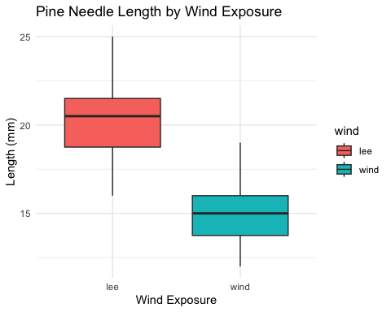
Lecture 8: Review
Covered
Decision errors
Data exploration and transformation
Exploratory graphical data analysis
Graphical testing of assumptions
Data transformation and standardization
Outliers
R practice: robust tests, basic graphics

Slide 3
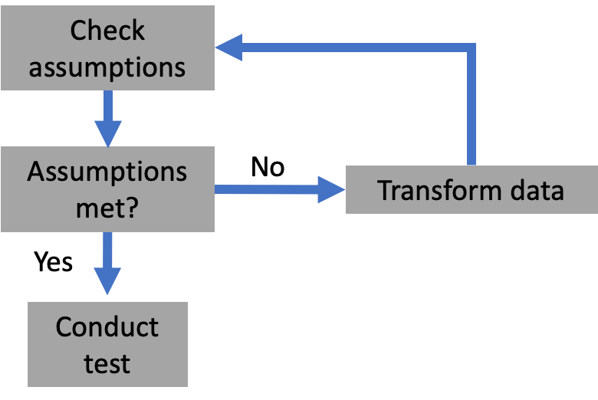
Lecture 9: Overview
The objectives:
Note on test assumptions
Multiple testing
Graphics:
Why graphics?
Rules of good graphics
Some bad graphics

Slide 4
Lecture 9: Overview
Assumption testing: iterative process
If unable to transform: non-parametric approach
When assumptions are violated, we can:
1. Transform data
2. Use robust methods
3. Use non-parametric tests

Slide 6
Lecture 9: Overview
Assumption testing: iterative process
If unable to transform: non-parametric approach
When assumptions are violated, we can:
1. Transform data
2. Use robust methods
3. Use non-parametric tests

Slide 7
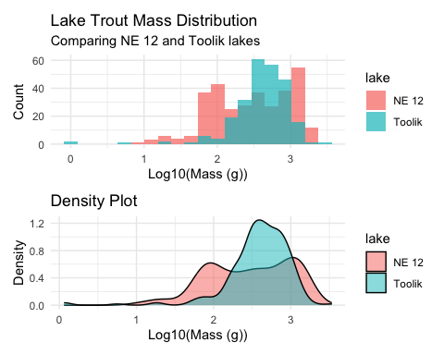
Testing assumptions
Assumption testing: iterative process
If unable to transform: non-parametric approach
When assumptions are violated, we can:
1. Transform data
2. Use robust methods
3. Use non-parametric tests

Slide 9
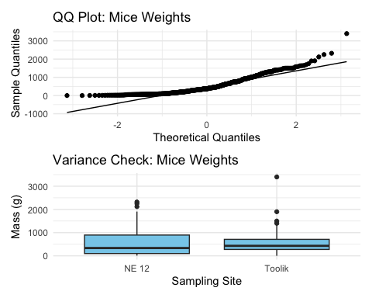
Testing assumptions
Assumption testing: iterative process
If unable to transform: non-parametric approach
# Testing normality assumption on mice weights shapiro.test(trout_data$mass_g)
Shapiro-Wilk normality test data: trout_data$mass_g W = 0.87436, p-value < 2.2e-16
# Testing equality of variances across sampling sites # First create a model mice_model <- lm(mass_g ~ sampling_site, data = trout_data) # Then test for homogeneity of variances car::leveneTest(mice_model)
Levene's Test for Homogeneity of Variance (center = median) Df F value Pr(>F) group 1 26.352 3.911e-07 *** 569 --- Signif. codes: 0 '***' 0.001 '**' 0.01 '*' 0.05 '.' 0.1 ' ' 1
When assumptions are violated, we can:
1. Transform data
2. Use robust methods
3. Use non-parametric tests

Slide 10
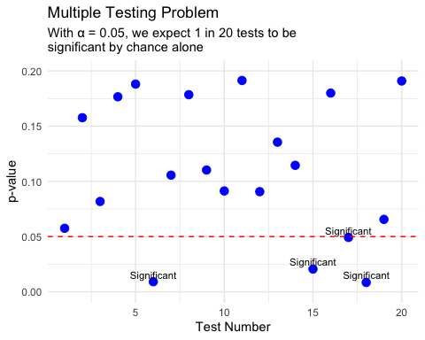
Lecture 9: Overview
The objectives:
Note on test assumptions
Multiple testing
Graphics:
Why graphics?
Rules of good graphics
Some bad graphics

Slide 11
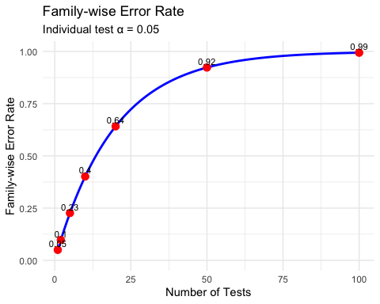
Multiple testing
Multiple tests: simultaneous tests of related hypotheses on single dataset
e.g., 5 pops of snails, are mean sizes different among all groups (1-2, 1-3, 1-5, 2-3, 2-4…)?
Multiple testing increases possibility of type I error
If 5% chance of falsely rejecting Ho in 1 test, with each additional test your “family-wise” type I error rate increases:
1 test = 0.05
2 tests = 0.098
5 tests = 0.23
20 tests = 0.64
# Function to calculate family-wise error rate family_wise_error <- function(alpha_per_test, num_tests) { 1 - (1 - alpha_per_test)^num_tests } # Create a data frame of family-wise error rates error_rates <- tibble( num_tests = c(1, 2, 5, 10, 20, 50, 100), error_rate = family_wise_error(0.05, num_tests) ) error_rates
# A tibble: 7 × 2 num_tests error_rate <dbl> <dbl> 1 1 0.0500 2 2 0.0975 3 5 0.226 4 10 0.401 5 20 0.642 6 50 0.923 7 100 0.994

Slide 12
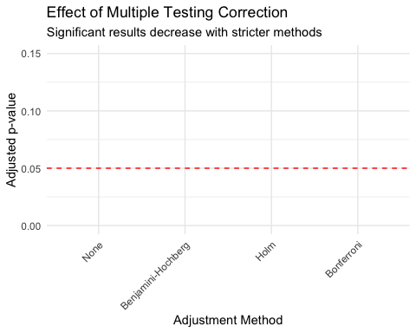
Multiple testing adjustments
Adjust family-wise rate using lower pair-wise rate (α=0.01), but increase type II error rate…
Common correction methods:
Bonferroni correction: pairwise α₍ₚₑₚ = α₍fwₑₚ/c
For 20 tests, desired α₍fwₑₚ=0.05, α₍ₚₑₚ = 0.0025
Holm-Sidak: 1 - (1 - α₍fwₑₚ)^{1/c}
For 20 tests α₍ₚₑₚ = 0.0026
Sequential Holm: p-values ranked, smallest tested at α₍fwₑₚ/c (0.005), second at α₍fwₑₚ/(c-1) (0.0055), etc.
# Let's perform multiple t-tests on our mice data # Compare mass between each pair of sampling sites # Get unique sampling sites sites <- unique(trout_data$lake) num_sites <- length(sites) num_comparisons <- num_sites * (num_sites - 1) / 2 # Matrix to store results results <- data.frame( comparison = character(num_comparisons), p_value = numeric(num_comparisons), stringsAsFactors = FALSE ) # Perform pairwise t-tests counter <- 1 for (i in 1:(num_sites-1)) { for (j in (i+1):num_sites) { site_i_data <- trout_data$mass_g[trout_data$lake == sites[i]] site_j_data <- trout_data$mass_g[trout_data$lake == sites[j]] test_result <- t.test(site_i_data, site_j_data) results$comparison[counter] <- paste(sites[i], "vs", sites[j]) results$p_value[counter] <- test_result$p.value counter <- counter + 1 } } # Apply different p-value adjustments results$bonferroni <- p.adjust(results$p_value, method = "bonferroni") results$holm <- p.adjust(results$p_value, method = "holm") results$BH <- p.adjust(results$p_value, method = "BH") # Benjamini-Hochberg # Display results results %>% arrange(p_value) %>% mutate(across(where(is.numeric), round, 4))
comparison p_value bonferroni holm BH 1 NE 12 vs Toolik 0.6718 0.6718 0.6718 0.6718

Slide 13
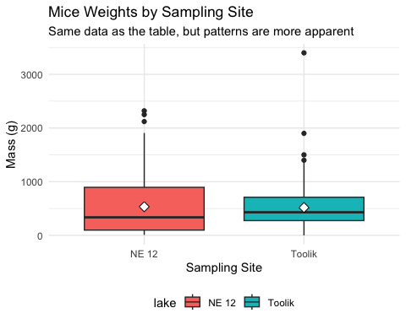
Graphics: Why use them?
Graphics are visual metaphors for data
Closest to actual data: table
But graphics can:
Summarize data (means, CVs, R²)
Make patterns more apparent
Communicate results efficiently
Tell a story with the data
# First, let's look at the data as a table mice_summary <- trout_data %>% group_by(lake) %>% summarize( n = n(), mean_mass = mean(mass_g), sd_mass = sd(mass_g), min_mass = min(mass_g), max_mass = max(mass_g) ) mice_summary
# A tibble: 2 × 6 lake n mean_mass sd_mass min_mass max_mass <chr> <int> <dbl> <dbl> <dbl> <dbl> 1 NE 12 322 534. 520. 9 2320 2 Toolik 249 518. 373. 0.15 3400

Slide 14
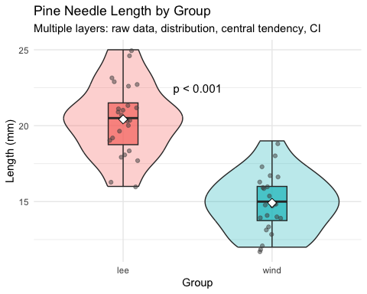
Good scientific graphics
According to Tufte (2001), good scientific graphics:
Show the data
Are efficient: show many numbers in small space
Make large datasets coherent by using appropriate graphic methods
Encourage comparison
Reveal several layers of information (e.g., averages, relationships, variability)
Serve clear purpose: important to telling the main story
Integrated with statistical methods (e.g., boxplots with t-tests, scatter plots with regression)
# Let's create a plot showing several layers of information pine_summary <- pine_data %>% group_by(group) %>% summarize( mean_length = mean(length_mm), sd_length = sd(length_mm), n = n() ) %>% mutate(se_length = sd_length / sqrt(n), conf_low = mean_length - qt(0.975, n-1) * se_length, conf_high = mean_length + qt(0.975, n-1) * se_length) pine_summary
# A tibble: 4 × 7 group mean_length sd_length n se_length conf_low conf_high <chr> <dbl> <dbl> <int> <dbl> <dbl> <dbl> 1 cephalopods 18 3.86 12 1.11 15.5 20.5 2 crayfish 18 3.86 12 1.11 15.5 20.5 3 salmon 16.3 3.94 12 1.14 13.8 18.8 4 snail 18.3 2.27 12 0.655 16.9 19.8

Slide 15
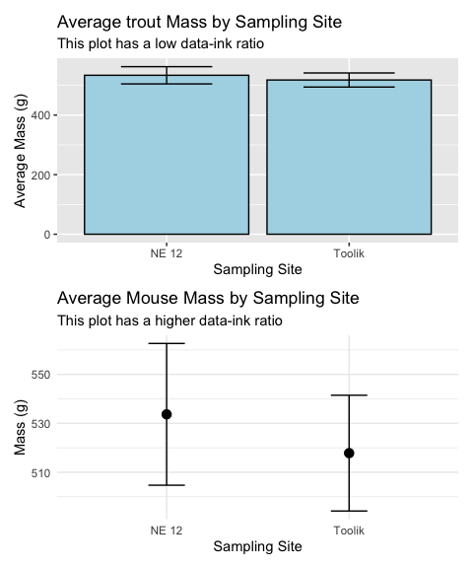
Principles of good graphics
To make good graphics:
Above all, focus on data
Do not distort data
Graphical representation of numbers → directly proportional to numbers
Strive for clarity through labelling
Maximize data-ink ratio
Remove non-data ink
Reduce redundant data ink
Revise and redraw
# Let's create two versions of the same plot # First, a "poor" version with low data-ink ratio library(ggthemes) p1 <- ggplot(trout_data, aes(x = lake, y = mass_g)) + geom_bar(stat = "summary", fun = "mean", fill = "lightblue", color = "black") + geom_errorbar(stat = "summary", fun.data = "mean_se", width = 0.5) + # theme_excel() + labs(title = "Average trout Mass by Sampling Site", subtitle = "This plot has a low data-ink ratio", x = "Sampling Site", y = "Average Mass (g)")

Slide 16
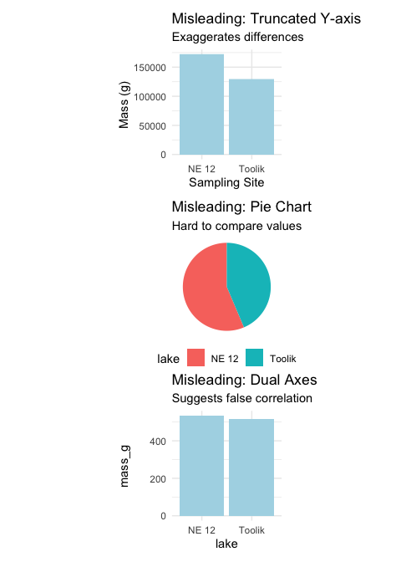
Bad graphics examples
Common problems in graphics:
Distorting the data:
Using non-zero baselines for bar charts
Using 3D effects that distort perspective
Using inappropriate scales
Chart junk:
Excessive gridlines
Unnecessary legends
Decorative elements that don’t add information
Poor color choices:
Too many colors
Non-color-blind friendly palettes
Colors that don’t print well in grayscale
Misleading representations:
Pie charts for many categories
Dual y-axes with different scales
Truncated axes without clear indication

Slide 17
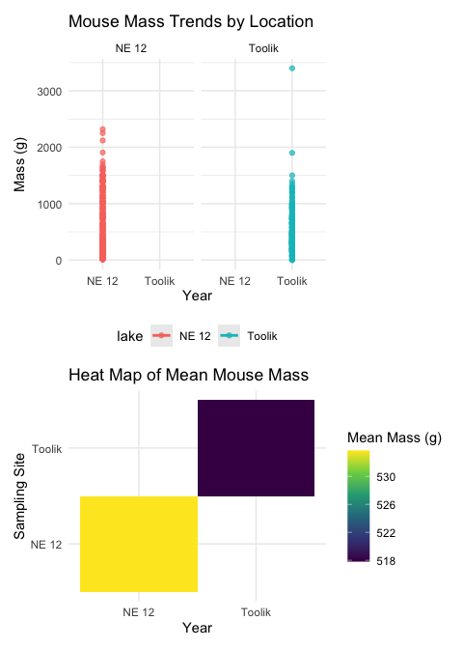
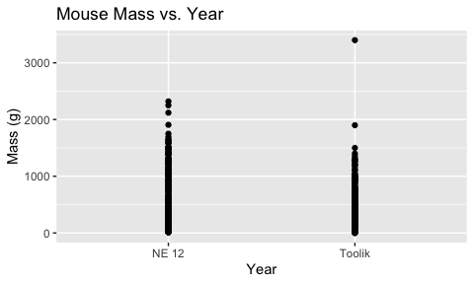
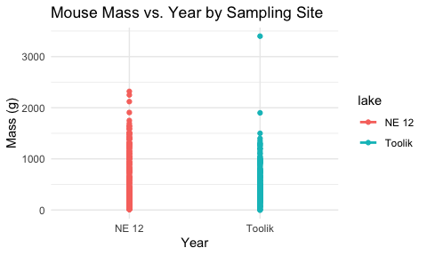
R practice: ggplot2
Let’s create some plots with ggplot2 using the mice data:
# Basic scatter plot ggplot(trout_data, aes(x = lake, y = mass_g)) + geom_point() + labs(title = "Mouse Mass vs. Year", x = "Year", y = "Mass (g)")
# Scatter plot with grouping and trend line ggplot(trout_data, aes(x = lake, y = mass_g, color = lake)) + geom_point() + geom_smooth(method = "lm", se = FALSE) + labs(title = "Mouse Mass vs. Year by Sampling Site", x = "Year", y = "Mass (g)") + theme_minimal()

Slide 18
Final Activity: Take home messages
Key points about multiple testing:
Running multiple tests increases the family-wise error rate
Various correction methods exist (Bonferroni, Holm, Benjamini-Hochberg)
Choose the appropriate correction based on your research question
Report both uncorrected and corrected p-values for transparency
Principles of good graphics:
Focus on the data, not decoration
Maximize data-ink ratio
Ensure proportional representation
Clear labeling and annotation
Choose appropriate visualization for your data type
When applying multiple testing corrections:
Bonferroni: Most conservative, controls family-wise error rate
Holm: Less conservative than Bonferroni, still controls FWER
Benjamini-Hochberg: Controls false discovery rate instead of FWER
No correction: Highest power, but highest type I error rate
Alternative to multiple pairwise tests: - ANOVA with post-hoc tests - Planned comparisons - Multilevel models

Slide 19
Summary and Conclusions
In this lecture, we’ve:
Explored the problem of multiple testing and why it increases type I error rates
Learned various methods for correcting p-values in multiple test scenarios
Discussed principles of good scientific graphics based on Tufte’s work
Identified common pitfalls in data visualization
Practiced creating effective visualizations using ggplot2
Key takeaways:
Be cautious when conducting multiple tests on the same dataset
Apply appropriate corrections to control error rates
Focus on clear, efficient data visualization that emphasizes the data
Remove chart junk and maximize the data-ink ratio
Choose visualization methods that match your research question and data type
Consider both statistical significance and visual presentation when communicating results

Slide 20
What do you see as the key points?
Things that stood out
The dramatic increase in type I error rate with multiple testing
The trade-off between type I error control and statistical power
The importance of choosing appropriate graphics to communicate your findings
How poor visualization choices can mislead readers even when the statistics are correct

Slide 21
What are the muddy points?
What does not make sense or what questions do you have…
What makes you nervous?
When to choose which multiple testing correction method
How to balance aesthetic appeal with statistical accuracy in graphics
Deciding between different visualization types for the same data

