Slide 1
Lecture 03
Bill Perry

Slide 2

Lecture 2: Review of data and graphing
We covered
How to design a well-organized project
How to implement good naming conventions
Controlled vocabulary
Including units in names
Create and use metadata effectively
Build tidy, well-structured spreadsheets
Understand data repositories
Create effective visualizations with ggplot2
These are variables - do you know what they mean?
TGW - yep its a thing
ODO - what do you think it is?
NO3 - what is it? Are you sure? Why might you get in legal trouble if you used this?

Slide 3
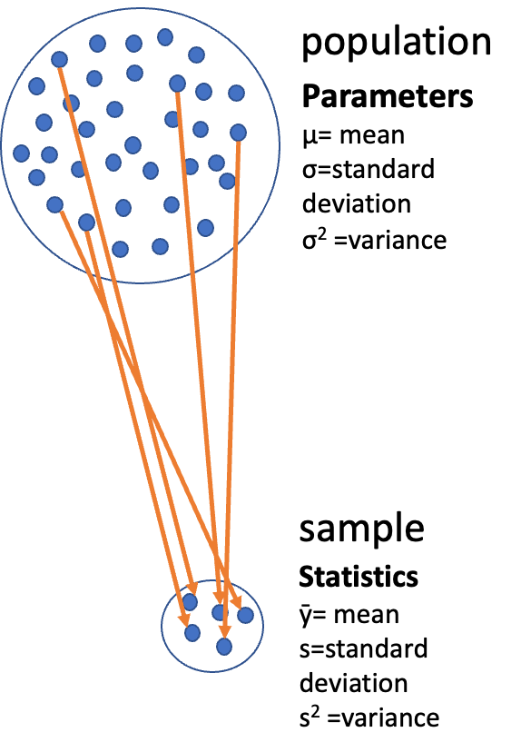
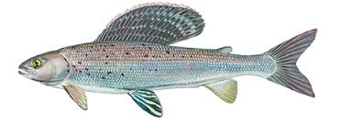
Lecture 3: Descriptive Statistics and Uncerrtainty in R and Tidyverse
The objectives:
Understand why statistics is vital in biology
Distinguish between different types of biological variables
Learn about accuracy, precision, and bias in measurements
Calculate and interpret measures of central tendency (mean, median, geometric mean)
Calculate and interpret measures of spread (standard deviation, variance, IQR)
Understand data transformations for skewed distributions
Visualize descriptive statistics for our data
Learn how to handle uncertainty in our data
We’ll use a dataset on grayling fish from two different lakes to explore these concepts..

Slide 4
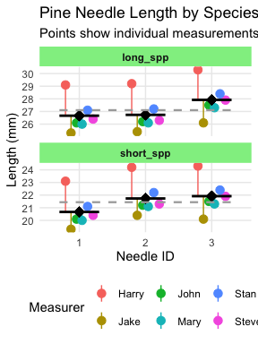
Lecture 3: Why Statistics is Vital in Biology
Biology is fundamentally different from fields like physics in that:
Most biological phenomena are probabilistic rather than deterministic
Responses occur with some characteristic probability, not with certainty
All biological material varies, which is essential for evolution (recall Darwin’s postulates):
Variation exists within populations
Some variation is heritable
Some heritable variation affects survival/reproduction
Environmental conditions (in nature, lab, or greenhouse) always vary
Measurements include error
Multiple unmeasured causal factors influence nearly all biological systems
Statistics helps us understand biological processes in this variable world by:
Condensing variation into summary form (Descriptive statistics)
Testing whether observations are consistent with predictions (Inferential statistics)

Slide 5
Practice Exercise 1: Can you do this for the pine data we have collected?
Let’s recreate the basic histogram of fish lengths from our last class. Use the sculpin_df data frame that’s already loaded.
# Write your code here to read in the file # How do you examine the data - what are the ways you think and lets try it!

Slide 6
Lecture 3: Populations and Samples
Before we dive into descriptive statistics, let’s clarify some fundamental concepts:
Population: The entire group of things under consideration; the group for which answers obtained from measurements and statistical analysis are pertinent.
Sample: A subset of the population that is actually measured.
Sample unit: The individual thing drawn from the population.
Types of populations: -
Observational population: Usually finite but may be very large (e.g., head width of all corn earworms in a field) -
Experimental population: Often conceptually infinite (e.g., all possible goldenrod plants that could receive a specific fertilizer treatment)
Sampling involves
inference - generalizing from what is observed in the sample to what is present in the population.
Valid inference requires random sampling.

Slide 7
Lecture 3: Parameters vs. Statistics
It’s important to distinguish between:
Parameters: True numerical values for a population (usually denoted by Greek letters)
Statistics: Estimates of parameters based on samples (usually denoted by Roman letters)
For example:
Population mean (μ) is estimated by sample mean (Y̅)
Population standard deviation (σ) is estimated by sample standard deviation (s)
The standard deviation formula above includes n-1 in the denominator (rather than n) to provide an unbiased estimate of the population parameter.

Slide 9
Lecture 3: Kinds of Biological Variables
Understanding the type of variable you’re working with is essential for selecting appropriate statistics:
Measurement or Quantitative Variables
Continuous: Any value between extremes of scale is possible (e.g., mass, length)
Discrete (meristic): Only fixed values (usually integers) between extremes are possible (e.g., bristle number, egg count)
Rank Variables (Ordinal)
Assign only order, not quantity
Nothing implied about relative distance between values
Categorical Variables (Qualitative)
No quantitative information (e.g., male/female, living/dead)
Some are simplifications of quantitative variables (e.g., color instead of wavelength)
asdfsd

Slide 10
Lecture 3: Kinds of Biological Variables
Derived Variables
Percentages, Proportions: Ratio of some component to total
Ratios: Relation of two variables
Rates: Quantity per unit (time, mass, etc.)
Indices: More complex derived variables (e.g., condition index)
Let’s explore our grayling fish dataset and identify the types of variables it contains.
asf

Slide 11
Practice Exercise 2: Can you do this for the pine data we have collected?
Let’s examine the different data and determine what they are?
# Write your code here to read in the file # How do you examine the data - what are the ways you think and lets try it! # Load the grayling data grayling_df <- read_csv("data/gray_I3_I8.csv") # Take a look at the first few rows head(grayling_df)
# A tibble: 6 × 5 site lake species total_length_mm mass_g <dbl> <chr> <chr> <dbl> <dbl> 1 113 I3 arctic grayling 266 135 2 113 I3 arctic grayling 290 185 3 113 I3 arctic grayling 262 145 4 113 I3 arctic grayling 275 160 5 113 I3 arctic grayling 240 105 6 113 I3 arctic grayling 265 145
# Get a summary of the dataset glimpse(grayling_df)
Rows: 168 Columns: 5 $ site <dbl> 113, 113, 113, 113, 113, 113, 113, 113, 113, 113, 113,… $ lake <chr> "I3", "I3", "I3", "I3", "I3", "I3", "I3", "I3", "I3", … $ species <chr> "arctic grayling", "arctic grayling", "arctic grayling… $ total_length_mm <dbl> 266, 290, 262, 275, 240, 265, 265, 253, 246, 203, 289,… $ mass_g <dbl> 135, 185, 145, 160, 105, 145, 150, 130, 130, 71, 179, …

Slide 12
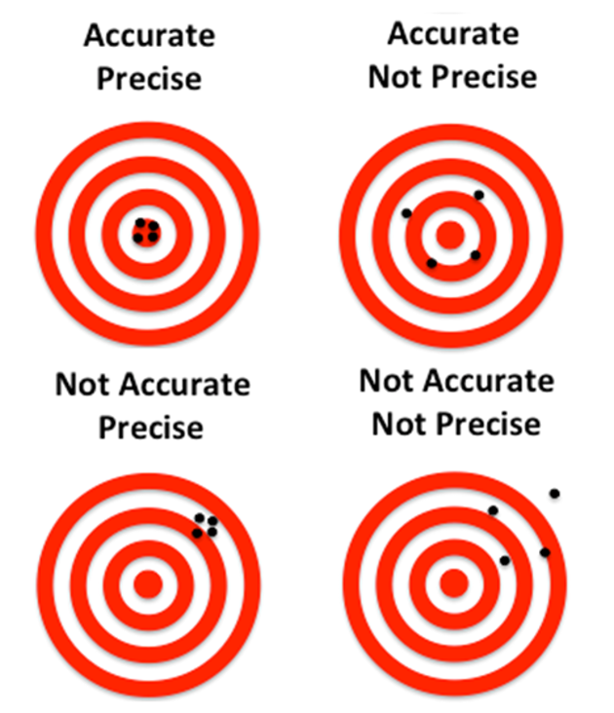
Lecture 3: Accuracy, Precision, and Bias
When taking biological measurements, understanding measurement quality is essential:
Accuracy: Closeness of measured value to true value
Precision: Closeness of repeated measurements to each other (repeatability)
Bias: Systematic departure from the true value
Accuracy is a function of both precision and bias. For statisticians, bias is usually a more serious problem than low precision because:
It’s harder to detect (true value usually unknown)
Low precision can be compensated for by increased sample size

Slide 13
Practice Exercise 1: What are potential sources of error in pine needles or fish?
For our grayling data, potential sources of measurement error might include:
Precision issues:
Variations in how fish are measured (e.g., slightly bent fish)
Bias issues:
Systematic underestimation of length if measurements aren’t taken from the true tip of the snout to the end of the tail
Accuracy issues? what could they be?

Slide 14
Lecture 3: Measures of Central Tendency
The two most common measures of central tendency are the mean and the median.
The Arithmetic Mean The arithmetic mean is the average of a set of measurements:
$$\overset{‾}{Y}=\frac{\sum_{i=1}^{n}{Y_{i}}}{n}$$
Where:
$Y_{i}$ represents each individual measurement
$n$ is the total number of observations
stuff
# Calculate mean length of all fish mean_length <- mean(grayling_df$total_length_mm) cat("Mean length of all fish:", round(mean_length, 1), "mm\n")
Mean length of all fish: 324.5 mm
# Calculate mean by lake grayling_df %>% group_by(lake) %>% summarise(mean_length = mean(total_length_mm, na.rm=TRUE)) %>% kable(caption = "Mean length by lake", digits = 1)
lake | mean_length
I3 | 265.6
I8 | 362.6
Mean length by lake

Slide 15
Lecture 3: Measures of Central Tendency
The Median
The median is the middle value of a sorted dataset.
If there is an even number of observations, it’s the average of the two middle values.
# Calculate median length of all fish median_length <- median(grayling_df$total_length_mm) cat("Median length of all fish:", median_length, "mm\n")
Median length of all fish: 324.5 mm
# Calculate median by lake grayling_df %>% group_by(lake) %>% summarise(median_length = median(total_length_mm)) %>% kable(caption = "Median length by lake", digits = 1)
lake | median_length
I3 | 266
I8 | 373
Median length by lake

Slide 16
Lecture 3: Measures of Spread
The spread of a distribution tells us how variable the measurements are.
Variance and Standard Deviation
The variance is
$$s=\frac{\sum_{i=1}^{n}{{\left(Y_{i}−\overset{‾}{Y}\right)}^{2}}}{n−1}$$
The standard deviation is the square root of variance
measures how far observations typically are from the mean and are in the units of the mean:
$$s=\sqrt{\frac{\sum_{i=1}^{n}{{\left(Y_{i}−\overset{‾}{Y}\right)}^{2}}}{n−1}}$$
# Calculate standard deviation of fish length var_length <- var(grayling_df$total_length_mm) sd_length <- sd(grayling_df$total_length_mm) cat("Variance of length:", round(var_length, 1), "mm²\n")
Variance of length: 4225.9 mm²
cat("Standard deviation of length:", round(sd_length, 1), "mm\n")
Standard deviation of length: 65 mm
# Calculate by lake grayling_df %>% group_by(lake) %>% summarise( var_length = var(total_length_mm), sd_length = sd(total_length_mm) ) %>% kable(caption = "Standard deviation and variance by lake", digits = 1)
lake | var_length | sd_length
I3 | 801.1 | 28.3
I8 | 2739.4 | 52.3
Standard deviation and variance by lake

Slide 17
Lecture 3: Measures of Spread

Slide 18
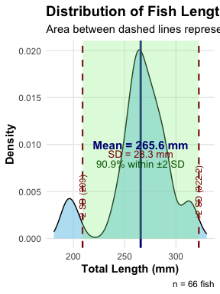
The area under the curve of a bell shaped curve within + and - 2 Standard deviations on each side includes about 95% of the data
# Read the data fish_data <- read.csv("data/gray_I3_I8.csv") # Filter data for I8 lake i3_data <- fish_data %>% filter(lake == "I3") # Calculate statistics mean_length <- mean(i3_data$total_length_mm) sd_length <- sd(i3_data$total_length_mm) # Calculate the bounds for standard deviations minus_2sd <- mean_length - (2 * sd_length) plus_2sd <- mean_length + (2 * sd_length) # Calculate percentage of data within 2 SD percent_within_2sd <- 100 * mean( i3_data$total_length_mm >= minus_2sd & i3_data$total_length_mm <= plus_2sd ) # Create the plot ggplot(i3_data, aes(x = total_length_mm)) + # Add density curve geom_density(fill = "skyblue", alpha = 0.6) + # Add vertical line for mean geom_vline(xintercept = mean_length, color = "navy", linewidth = 1) + # Add vertical lines for +/- 2 SD geom_vline(xintercept = minus_2sd, color = "darkred", linewidth = 0.8, linetype = "dashed") + geom_vline(xintercept = plus_2sd, color = "darkred", linewidth = 0.8, linetype = "dashed") + # Highlight area within 2 SD annotate("rect", xmin = minus_2sd, xmax = plus_2sd, ymin = 0, ymax = Inf, fill = "lightgreen", alpha = 0.3) + # Add annotations annotate("text", x = mean_length, y = 0.010, label = paste0("Mean = ", round(mean_length, 1), " mm"), color = "navy", fontface = "bold", size = 4) + annotate("text", x = mean_length, y = 0.009, label = paste0("SD = ", round(sd_length, 1), " mm"), color = "darkred", size = 3.5) + annotate("text", x = mean_length, y = 0.008, label = paste0(round(percent_within_2sd, 1), "% within ±2 SD"), color = "darkgreen", size = 3.5) + # Add labels for SD boundaries annotate("text", x = minus_2sd, y = 0.002, label = paste0("-2 SD (", round(minus_2sd, 1), ")"), color = "darkred", angle = 90, hjust = 0, size = 3) + annotate("text", x = plus_2sd, y = 0.002, label = paste0("+2 SD (", round(plus_2sd, 1), ")"), color = "darkred", angle = 90, hjust = 0, size = 3) + # Add title and labels labs( title = "Distribution of Fish Lengths in i3 Lake", subtitle = "Area between dashed lines represents ±2 standard deviations from the mean", x = "Total Length (mm)", y = "Density", caption = paste0("n = ", nrow(i3_data), " fish") ) + theme_minimal() + theme( plot.title = element_text(face = "bold", size = 14), plot.subtitle = element_text(size = 11), axis.title = element_text(face = "bold"), panel.grid.minor = element_blank() ) + # Set x-axis limits to show the full range plus a bit of padding xlim(min(i3_data$total_length_mm) - 10, max(i3_data$total_length_mm) + 10)
# Print statistics to console cat("i3 Lake Fish Length Summary:\n")
i3 Lake Fish Length Summary:
cat("Number of fish:", nrow(i3_data), "\n")
Number of fish: 66
cat("Mean length:", round(mean_length, 2), "mm\n")
Mean length: 265.61 mm
cat("Standard Deviation:", round(sd_length, 2), "mm\n")
Standard Deviation: 28.3 mm
cat("Range for ±2 SD:", round(minus_2sd, 2), "to", round(plus_2sd, 2), "mm\n")
Range for ±2 SD: 209 to 322.21 mm
cat("Percentage within ±2 SD:", round(percent_within_2sd, 2), "%\n")
Percentage within ±2 SD: 90.91 %

Slide 19
Lecture 3: Coefficient of Variation
The coefficient of variation (CV) expresses the standard deviation as a percentage of the mean:
$$CV=\frac{s}{\overset{‾}{Y}}×100\%$$
This is useful for comparing the variability of measurements with different units or vastly different scales.
stuff
# Calculate coefficient of variation cv_length <- sd_length / mean_length * 100 cat("Coefficient of variation:", round(cv_length, 1), "%\n")
Coefficient of variation: 10.7 %
# Calculate by lake grayling_df %>% group_by(lake) %>% summarise( cv_length = sd(total_length_mm) / mean(total_length_mm) * 100 ) %>% kable(caption = "Coefficient of variation by lake", digits = 1)
lake | cv_length
I3 | 10.7
I8 | 14.4
Coefficient of variation by lake

Slide 20
Lecture 3: Interquartile Range
The interquartile range (IQR) is the range of the middle 50% of the data:
$$IQR=Q_{3}−Q_{1}$$
Where $Q_{1}$ is the first quartile (25th percentile) and $Q_{3}$ is the third quartile (75th percentile).
stuff
# Calculate quartiles and IQR q1_length <- quantile(grayling_df$total_length_mm, 0.25) q3_length <- quantile(grayling_df$total_length_mm, 0.75) iqr_length <- IQR(grayling_df$total_length_mm) cat("First quartile:", q1_length, "mm\n")
First quartile: 270.75 mm
cat("Third quartile:", q3_length, "mm\n")
Third quartile: 377 mm
cat("Interquartile range:", iqr_length, "mm\n")
Interquartile range: 106.25 mm
# Calculate by lake grayling_df %>% group_by(lake) %>% summarise( q1 = quantile(total_length_mm, 0.25), q3 = quantile(total_length_mm, 0.75), iqr = IQR(total_length_mm) ) %>% kable(caption = "Quartiles and IQR by lake", digits = 1)
lake | q1 | q3 | iqr
I3 | 256 | 280 | 24
I8 | 340 | 401 | 61
Quartiles and IQR by lake

Slide 21
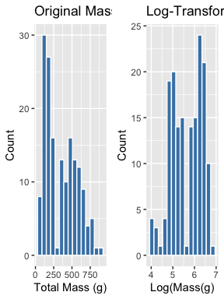
Lecture 3: Data Transformations for Skewed Distributions
Biological data are often skewed (asymmetrical), which can make the arithmetic mean less representative of central tendency. Data transformations can help address this issue.
Logarithmic Transformation
The logarithmic transformation is one of the most common for right-skewed biological data:
When data are log-normally distributed, the geometric mean often provides a better measure of central tendency than the arithmetic mean.
# Add log-transformed length to our dataset grayling_df <- grayling_df %>% mutate(log_mass = log(mass_g)) # Compare original and log-transformed distributions p1 <- ggplot(grayling_df, aes(x = mass_g)) + geom_histogram(bins = 15, fill = "steelblue", color = "white") + labs( title = "Original Mass Distribution", x = "Total Mass (g)", y = "Count" ) p2 <- ggplot(grayling_df, aes(x = log_mass)) + geom_histogram(bins = 15, fill = "steelblue", color = "white") + labs( title = "Log-Transformed Mass Distribution", x = "Log(Mass(g)", y = "Count" ) # Display side by side gridExtra::grid.arrange(p1, p2, ncol = 2)
# Compare means on original and transformed scales mean_log_mass <- mean(grayling_df$log_mass) back_transformed_mean <- exp(mean_log_mass) cat("Arithmetic mean of original data:", round(mean_length, 1), "mm\n")
Arithmetic mean of original data: 265.6 mm
cat("Geometric mean (back-transformed mean of logs):", round(back_transformed_mean, 1), "mm\n")
Geometric mean (back-transformed mean of logs): NA mm

Slide 22
Lecture 3: When to Use Transformations
Log transformation: When data are right-skewed or follow multiplicative rather than additive processes
Square root transformation: For count data or data where variance increases with the mean
Inverse transformation: For strongly right-skewed data
Arcsine square root transformation: For proportions or percentages (though logistic regression is often preferred now)
s

Slide 23
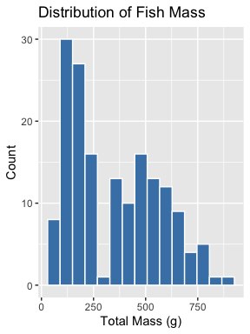
Lecture 3: Visualizing Distributions
Histograms
Histograms show the frequency distribution of our data.
# Create a histogram ggplot(grayling_df, aes(x = mass_g)) + geom_histogram(bins = 15, fill = "steelblue", color = "white") + labs( title = "Distribution of Fish Mass", x = "Total Mass (g)", y = "Count" )

Slide 24
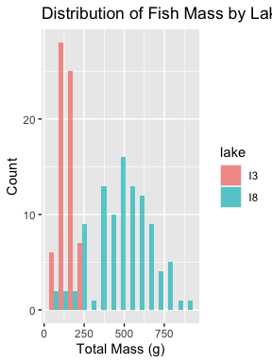
# Histograms by lake ggplot(grayling_df, aes(x = mass_g, fill = lake)) + geom_histogram(bins = 15, position = "dodge", alpha = 0.7) + labs( title = "Distribution of Fish Mass by Lake", x = "Total Mass (g)", y = "Count" )

Slide 25
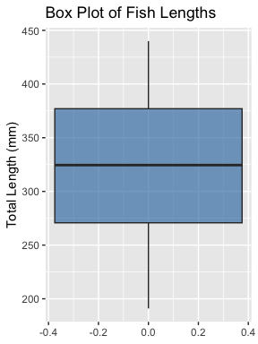
Lecture 3: Visualizing Distributions
Box Plots
Box plots show the median, quartiles, and potential outliers.
# Create a box plot ggplot(grayling_df, aes(y = total_length_mm)) + geom_boxplot(fill = "steelblue", alpha = 0.7) + labs( title = "Box Plot of Fish Lengths", y = "Total Length (mm)" )

Slide 26
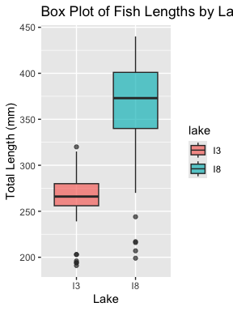
# Box plot by lake ggplot(grayling_df, aes(x = lake, y = total_length_mm, fill = lake)) + geom_boxplot(alpha = 0.7) + labs( title = "Box Plot of Fish Lengths by Lake", x = "Lake", y = "Total Length (mm)" )

Slide 27
Lecture 3: Comparing Mean vs. Median
The mean and median measure different aspects of a distribution:
Mean: Center of gravity of the distribution
Median: Middle value of the data
When a distribution is symmetric, the mean and median are similar. When it’s skewed or has outliers, they can differ significantly.
stuff
# Calculate summary statistics by lake stats_by_lake <- grayling_df %>% group_by(lake) %>% summarise( mean = mean(total_length_mm), median = median(total_length_mm), sd = sd(total_length_mm), iqr = IQR(total_length_mm), skewness = moments::skewness(total_length_mm) ) # Display the results kable(stats_by_lake, caption = "Comparison of Mean and Median by Lake", digits = 1)
lake | mean | median | sd | iqr | skewness
I3 | 265.6 | 266 | 28.3 | 24 | -0.9
I8 | 362.6 | 373 | 52.3 | 61 | -1.1
Comparison of Mean and Median by Lake

Slide 28
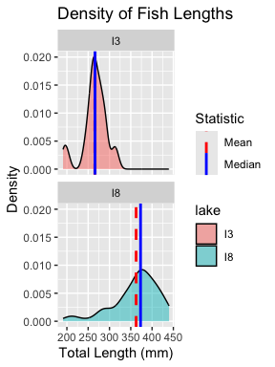
Lecture 3: Comparing Mean vs. Mediany
The mean and median measure different aspects of a distribution:
Mean: Center of gravity of the distribution
Median: Middle value of the data
When a distribution is symmetric, the mean and median are similar. When it’s skewed or has outliers, they can differ significantly.
stuff
# Create a density plot with vertical lines for mean and median ggplot(grayling_df, aes(x = total_length_mm, fill = lake)) + geom_density(alpha = 0.5) + geom_vline(data = stats_by_lake, aes(xintercept = mean, color = "Mean"), linetype = "dashed", linewidth = 1) + geom_vline(data = stats_by_lake, aes(xintercept = median, color = "Median"), linetype = "solid", linewidth = 1) + scale_color_manual(values = c("Mean" = "red", "Median" = "blue")) + facet_wrap(~ lake, ncol = 1) + labs( title = "Density of Fish Lengths", x = "Total Length (mm)", y = "Density", color = "Statistic" )

Slide 29
Lecture 3: Standard Deviation vs. Interquartile Range
The standard deviation and interquartile range both measure spread, but:
Standard deviation: Sensitive to outliers
Interquartile range: Robust against outliers
When the data is approximately normal, the IQR ≈ 1.35 × standard deviation.
# Calculate the ratio of IQR to SD for our data grayling_df %>% group_by(lake) %>% summarise( sd = sd(total_length_mm), iqr = IQR(total_length_mm), ratio_iqr_sd = IQR(total_length_mm) / sd(total_length_mm) ) %>% kable(caption = "Comparison of SD and IQR by Lake", digits = 2)
lake | sd | iqr | ratio_iqr_sd
I3 | 28.30 | 24 | 0.85
I8 | 52.34 | 61 | 1.17
Comparison of SD and IQR by Lake

Slide 30
Lecture 3: Standard Deviation vs. Interquartile Range
Percentiles are values that divide a dataset into 100 equal parts.
The 25th percentile is the first quartile (Q1)
The 50th percentile is the median
The 75th percentile is the third quartile (Q3)
The IQR is the difference between Q3 and Q1.
stuff
# Calculate percentiles percentiles <- quantile(grayling_df$total_length_mm, probs = c(0.1, 0.25, 0.5, 0.75, 0.9)) # Display the percentiles kable( data.frame( Percentile = c("10th", "25th (Q1)", "50th (Median)", "75th (Q3)", "90th"), Value = percentiles ), caption = "Key Percentiles of Fish Length (mm)", digits = 1 )
 | Percentile | Value
10% | 10th | 251.1
25% | 25th (Q1) | 270.8
50% | 50th (Median) | 324.5
75% | 75th (Q3) | 377.0
90% | 90th | 408.6
Key Percentiles of Fish Length (mm)

Slide 31
Lecture 3: Handling Missing Values
Let’s examine how missing values affect our descriptive statistics by looking at the mass variable, which has some missing data.
# Check for missing values in mass sum(is.na(grayling_df$mass_g))
[1] 2
# Calculate descriptive statistics with and without handling missing values # Without handling (will produce NA results) cat("Mean mass without handling NAs:", mean(grayling_df$mass_g), "g\n")
Mean mass without handling NAs: NA g
# With handling missing values cat("Mean mass with na.rm=TRUE:", mean(grayling_df$mass_g, na.rm = TRUE), "g\n")
Mean mass with na.rm=TRUE: 351.2289 g
# Calculate descriptive statistics by lake, properly handling NAs grayling_df %>% group_by(lake) %>% summarise( mean_mass = mean(mass_g, na.rm = TRUE), median_mass = median(mass_g, na.rm = TRUE), sd_mass = sd(mass_g, na.rm = TRUE), n_missing = sum(is.na(mass_g)) ) %>% kable(caption = "Mass Statistics by Lake (Handling Missing Values)", digits = 1)
lake | mean_mass | median_mass | sd_mass | n_missing
I3 | 150.5 | 147 | 42.2 | 0
I8 | 483.7 | 490 | 176.5 | 2
Mass Statistics by Lake (Handling Missing Values)

Slide 32
Lecture 3: Best Practices for Handling Missing Values:
Always check for missing values in your data before calculating statistics.
Use na.rm = TRUE when calculating summary statistics to handle missing values.
Report the number of missing values along with your statistics.
Consider whether the missing values are random or might introduce bias.

Slide 33
Sampling from a Population
Now that we have estimates of the sample we need to relate that to the population

Slide 34
In reality, we rarely know the true population parameters. When studying fish in lakes I3 and I8:
The population includes all grayling fish in each lake
The true population mean (μ) and standard deviation (σ) are unknown
Our dataset is a sample from this population
We use the sample mean (x̄) to estimate μ
Sampling introduces random variation in our estimates
Let’s demonstrate how different samples from the same population can give different estimates.
If we could sample all fish in the lake, we would know the true mean length. But that’s usually impossible in ecology!

Slide 35
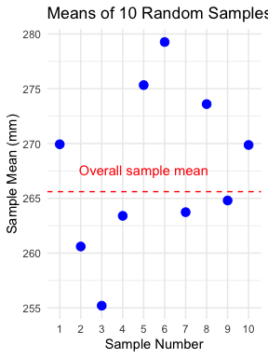
Demonstrating Sampling Variation
Let’s take several random samples from Lake I3 and see how the sample means vary:
# Filter for Lake I3 i3_data <- grayling_df %>% filter(lake == "I3") # Function to take a random sample and calculate the mean sample_mean <- function(data, sample_size) { sample_data <- sample_n(data, sample_size) return(mean(sample_data$total_length_mm)) } # Take 10 different samples of size 15 from Lake I3 set.seed(123) # For reproducibility sample_size <- 15 sample_means <- replicate(10, sample_mean(i3_data, sample_size)) # Create a data frame with sample numbers and means samples_df <- data.frame( sample_number = 1:10, sample_mean = sample_means ) # Display the sample means samples_df
sample_number sample_mean 1 1 269.9333 2 2 260.6000 3 3 255.2000 4 4 263.4000 5 5 275.3333 6 6 279.2667 7 7 263.7333 8 8 273.6000 9 9 264.8000 10 10 269.8667
# Calculate the mean and standard deviation of the sample means mean(sample_means)
[1] 267.5733
sd(sample_means)
[1] 7.346063
# Plot the different sample means ggplot(samples_df, aes(x = factor(sample_number), y = sample_mean)) + geom_point(size = 3, color = "blue") + geom_hline(yintercept = mean(i3_data$total_length_mm), linetype = "dashed", color = "red") + annotate("text", x = 5, y = mean(i3_data$total_length_mm) + 2, label = "Overall sample mean", color = "red") + labs(title = "Means of 10 Random Samples from Lake I3", x = "Sample Number", y = "Sample Mean (mm)") + theme_minimal()

Slide 36
Notice how each sample’s mean differs from the overall mean. This demonstrates sampling variation.

Slide 37
Standard Error: Quantifying Uncertainty
The standard error of the mean (SEM) measures the precision of a sample mean as an estimate of the population mean.
Formula: $SE_{\overset{‾}{x}}=\frac{s}{\sqrt{n}}$
Where: - s is the sample standard deviation - n is the sample size
The standard error tells us: - How much uncertainty is in our estimate - How much sample means are expected to vary - How close our sample mean is likely to be to the true population mean
Remember: - Standard deviation (s) describes the variability in the individual data points - Standard error (SE) describes the variability in the sample mean itself - As sample size increases, SE decreases (more precise estimate)

Slide 38
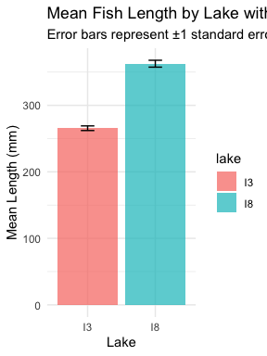
Standard Error for Our Grayling Data
Let’s calculate and visualize the standard error for both lakes:
# Calculate mean, SD, and SE for each lake grayling_stats <- grayling_df %>% group_by(lake) %>% summarize( mean_length = mean(total_length_mm), sd_length = sd(total_length_mm), n = n(), se_length = sd_length / sqrt(n) ) # Display the statistics grayling_stats
# A tibble: 2 × 5 lake mean_length sd_length n se_length <chr> <dbl> <dbl> <int> <dbl> 1 I3 266. 28.3 66 3.48 2 I8 363. 52.3 102 5.18
# Create a bar plot with error bars representing ±1 SE ggplot(grayling_stats, aes(x = lake, y = mean_length, fill = lake)) + geom_bar(stat = "identity", alpha = 0.7) + geom_errorbar(aes(ymin = mean_length - se_length, ymax = mean_length + se_length), width = 0.2) + labs(title = "Mean Fish Length by Lake with Standard Error", subtitle = "Error bars represent ±1 standard error", x = "Lake", y = "Mean Length (mm)") + theme_minimal()

Slide 39
Sampling Distribution of the Mean
The sampling distribution of the mean is the theoretical distribution of all possible sample means of a given sample size from a population.
Important properties: 1. It is centered at the population mean (μ) 2. Its standard deviation is the standard error (σ/√n) 3. For large sample sizes, it approaches a normal distribution (Central Limit Theorem)
The larger the sample size: - The narrower the sampling distribution - The smaller the standard error - The more precise our estimate of the population mean
Let’s simulate the sampling distribution for Lake I3 fish data.

Slide 40
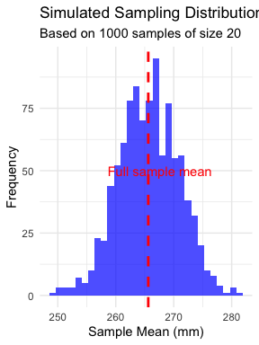
Simulating the Sampling Distribution
Let’s simulate taking many samples from Lake I3 to visualize the sampling distribution:
# Filter for Lake I3 i3_data <- grayling_df %>% filter(lake == "I3") # Number of samples to simulate num_simulations <- 1000 sample_size <- 20 # Simulate many samples and calculate means set.seed(456) # For reproducibility simulated_means <- replicate(num_simulations, sample_mean(i3_data, sample_size)) # Calculate the mean and standard deviation of the simulated means mean_of_means <- mean(simulated_means) sd_of_means <- sd(simulated_means) # Create a data frame with the simulated means simulated_df <- data.frame(sample_mean = simulated_means) # Plot the sampling distribution ggplot(simulated_df, aes(x = sample_mean)) + geom_histogram(bins = 30, fill = "blue", alpha = 0.7) + geom_vline(xintercept = mean(i3_data$total_length_mm), linetype = "dashed", color = "red", size = 1) + annotate("text", x = mean(i3_data$total_length_mm) + 2, y = 50, label = "Full sample mean", color = "red") + labs(title = "Simulated Sampling Distribution of the Mean", subtitle = paste("Based on", num_simulations, "samples of size", sample_size), x = "Sample Mean (mm)", y = "Frequency") + theme_minimal()

Slide 41
Notice that the simulated sampling distribution:
Is approximately normally distributed
Is centered around the overall sample mean
Has a spread that is related to the standard error

Slide 42
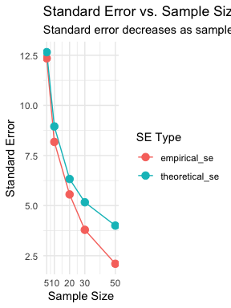
Standard Error and Sample Size
Let’s see how the standard error changes with different sample sizes:
# Define a range of sample sizes to test sample_sizes <- c(5, 10, 20, 30, 50) # For each sample size, simulate the sampling distribution and calculate SE results <- data.frame() for (size in sample_sizes) { # Simulate many sample means for this sample size simulated_means <- replicate(500, sample_mean(i3_data, size)) # Calculate the standard deviation of the sampling distribution (empirical SE) empirical_se <- sd(simulated_means) # Calculate the theoretical SE theoretical_se <- sd(i3_data$total_length_mm) / sqrt(size) # Add to results results <- rbind(results, data.frame( sample_size = size, empirical_se = empirical_se, theoretical_se = theoretical_se )) } # Display the results results
sample_size empirical_se theoretical_se 1 5 12.349407 12.657835 2 10 8.178270 8.950441 3 20 5.558957 6.328918 4 30 3.792177 5.167540 5 50 2.099744 4.002759
# Plot how SE changes with sample size results_long <- pivot_longer(results, cols = c(empirical_se, theoretical_se), names_to = "se_type", values_to = "standard_error") ggplot(results_long, aes(x = sample_size, y = standard_error, color = se_type)) + geom_line() + geom_point(size = 3) + scale_x_continuous(breaks = sample_sizes) + labs(title = "Standard Error vs. Sample Size", subtitle = "Standard error decreases as sample size increases", x = "Sample Size", y = "Standard Error", color = "SE Type") + theme_minimal()

Slide 43
Confidence Intervals
A confidence interval is a range of values that is likely to contain the true population parameter.
The 95% confidence interval for the mean is approximately:
$\overset{‾}{x}±2×SE_{\overset{‾}{x}}$
This “2 SE rule of thumb” means: - The interval extends 2 standard errors below and above the sample mean - About 95% of such intervals constructed from different samples would contain the true population mean
Confidence intervals provide a way to express the precision of our estimates.

Slide 44
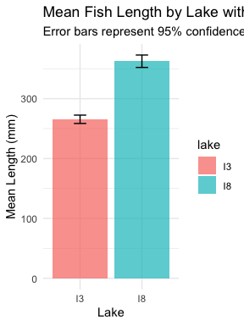
Calculating Confidence Intervals for Grayling Data
Let’s calculate and visualize the 95% confidence intervals for the mean fish length in each lake:
# Calculate 95% confidence intervals grayling_ci <- grayling_df %>% group_by(lake) %>% summarize( mean_length = mean(total_length_mm), sd_length = sd(total_length_mm), n = n(), se_length = sd_length / sqrt(n), ci_lower = mean_length - 2 * se_length, ci_upper = mean_length + 2 * se_length ) # Display the confidence intervals grayling_ci
# A tibble: 2 × 7 lake mean_length sd_length n se_length ci_lower ci_upper <chr> <dbl> <dbl> <int> <dbl> <dbl> <dbl> 1 I3 266. 28.3 66 3.48 259. 273. 2 I8 363. 52.3 102 5.18 352. 373.
# Plot with confidence intervals ggplot(grayling_ci, aes(x = lake, y = mean_length, fill = lake)) + geom_bar(stat = "identity", alpha = 0.7) + geom_errorbar(aes(ymin = ci_lower, ymax = ci_upper), width = 0.2) + labs(title = "Mean Fish Length by Lake with 95% Confidence Intervals", subtitle = "Error bars represent 95% confidence intervals", x = "Lake", y = "Mean Length (mm)") + theme_minimal()

Slide 45
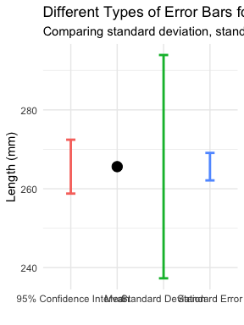
Different Types of Error Bars
Let’s compare different ways of displaying uncertainty in our estimates:
# Calculate statistics for different types of error bars grayling_error_bars <- grayling_df %>% group_by(lake) %>% summarize( mean_length = mean(total_length_mm), sd_length = sd(total_length_mm), n = n(), se_length = sd_length / sqrt(n), ci_lower = mean_length - 1.96 * se_length, ci_upper = mean_length + 1.96 * se_length, one_sd_lower = mean_length - sd_length, one_sd_upper = mean_length + sd_length ) # Create a data frame for plotting different error types lake_i3 <- grayling_error_bars %>% filter(lake == "I3") error_types <- data.frame( error_type = c("Standard Deviation", "Standard Error", "95% Confidence Interval"), lower = c(lake_i3$one_sd_lower, lake_i3$mean_length - lake_i3$se_length, lake_i3$ci_lower), upper = c(lake_i3$one_sd_upper, lake_i3$mean_length + lake_i3$se_length, lake_i3$ci_upper) ) # Plot the comparison ggplot() + geom_point(data = lake_i3, aes(x = "Mean", y = mean_length), size = 4) + geom_errorbar(data = error_types, aes(x = error_type, ymin = lower, ymax = upper, color = error_type), width = 0.2, size = 1) + labs(title = "Different Types of Error Bars for Lake I3", subtitle = "Comparing standard deviation, standard error, and 95% confidence interval", x = "", y = "Length (mm)", color = "Error Bar Type") + theme_minimal() + theme(legend.position = "none")

Slide 46
Key Takeaways
The standard error measures the precision of a sample statistic as an estimate of a population parameter
The standard error of the mean decreases as sample size increases: $SE_{\overset{‾}{x}}=\frac{s}{\sqrt{n}}$
The sampling distribution shows the variation in sample statistics that would be expected due to random sampling
Confidence intervals provide a range of plausible values for the population parameter
Larger sample sizes provide more precise estimates (narrower confidence intervals)
When reporting results, always include a measure of precision (SE or

Slide 47
For Further Practice
Try calculating the standard error and confidence intervals for other variables in the dataset
Experiment with different sample sizes to see how they affect the precision of estimates
Compare the means of the two lakes using confidence intervals - do they overlap?
Consider how these concepts extend to other statistics beyond the mean

Slide 48
Lecture 3: Conclusion
In this lecture, we’ve explored:
Why statistics is essential in biology
Types of biological variables and their properties
Accuracy, precision, and bias in measurements
Measures of central tendency (mean, median, geometric mean)
Measures of spread (standard deviation, variance, and interquartile range)
Data transformations for skewed distributions
Visualization techniques for understanding distributions
Handling missing values
These tools form the foundation of statistical analysis and will be essential as we move forward to more complex statistical methods.

