Slide 1
Lecture 04: Probability and Inference
Bill Perry

Slide 2
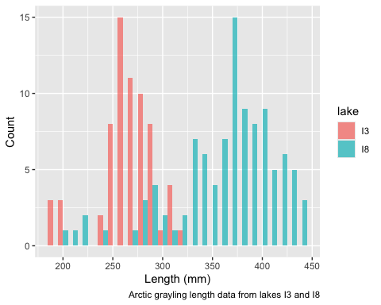
Lecture 4: Probability and Statistical Inference
Review of probability distributions
Standard normal distribution and Z-scores
Standard error and confidence intervals
Statistical inference fundamentals
Hypothesis testing principles

Slide 3
Practice Exercise 1: Exploring the Grayling Dataset
Let’s explore the Arctic grayling data from lakes I3 and I8. Use the grayling_df data frame to create basic summary statistics.
# Write your code here to explore the basic structure of the data # also note plottig a box plot is really useful str(grayling_df)
spc_tbl_ [168 × 5] (S3: spec_tbl_df/tbl_df/tbl/data.frame) $ site : num [1:168] 113 113 113 113 113 113 113 113 113 113 ... $ lake : chr [1:168] "I3" "I3" "I3" "I3" ... $ species : chr [1:168] "arctic grayling" "arctic grayling" "arctic grayling" "arctic grayling" ... $ total_length_mm: num [1:168] 266 290 262 275 240 265 265 253 246 203 ... $ mass_g : num [1:168] 135 185 145 160 105 145 150 130 130 71 ... - attr(*, "spec")= .. cols( .. site = col_double(), .. lake = col_character(), .. species = col_character(), .. total_length_mm = col_double(), .. mass_g = col_double() .. ) - attr(*, "problems")=<externalptr>
summary(grayling_df)
site lake species total_length_mm Min. :113 Length:168 Length:168 Min. :191.0 1st Qu.:113 Class :character Class :character 1st Qu.:270.8 Median :118 Mode :character Mode :character Median :324.5 Mean :116 Mean :324.5 3rd Qu.:118 3rd Qu.:377.0 Max. :118 Max. :440.0 mass_g Min. : 53.0 1st Qu.:151.2 Median :340.0 Mean :351.2 3rd Qu.:519.5 Max. :889.0 NA's :2

Slide 4
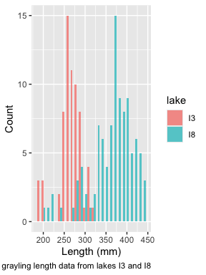
Lecture 4: Probability Distributions
Probability Distribution Functions
A probability distribution describes the probability of different outcomes in an experiment
We’ve seen histograms of observed data
Theoretical distributions help us model and understand real-world data
We will focus on a standard normal distribution and a t distribution

Slide 5
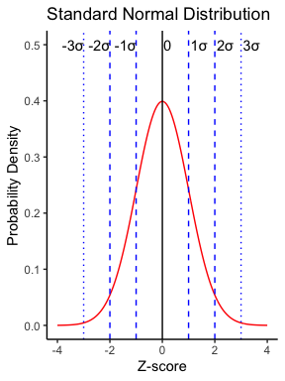
Lecture 4: The Standard Normal Distribution
The standard normal distribution is crucial for understanding statistical inference:
Has mean (μ) = 0 and standard deviation (σ) = 1
Symmetrical bell-shaped curve
Area under the curve = 1 (total probability)
Approximately:
68% of data within ±1σ of the mean
95% of data within ±2σ of the mean - really 1.96σ
99.7% of data within ±3σ of the mean
Z-scores allow us to convert any normal distribution to the standard normal distribution.

Slide 6
Practice Exercise 2: Calculating Z-scores
Let’s practice converting raw values to Z-scores using the Arctic grayling data.
# Calculate the mean and standard deviation of fish lengths mean_length <- mean(grayling_df$total_length_mm, na.rm = TRUE) sd_length <- sd(grayling_df$total_length_mm, na.rm = TRUE) # Calculate Z-scores for fish lengths grayling_df <- grayling_df %>% mutate(z_score = (total_length_mm - mean_length) / sd_length) # View the first few rows with Z-scores head(grayling_df)
# A tibble: 6 × 6 site lake species total_length_mm mass_g z_score <dbl> <chr> <chr> <dbl> <dbl> <dbl> 1 113 I3 arctic grayling 266 135 -0.900 2 113 I3 arctic grayling 290 185 -0.531 3 113 I3 arctic grayling 262 145 -0.961 4 113 I3 arctic grayling 275 160 -0.761 5 113 I3 arctic grayling 240 105 -1.30 6 113 I3 arctic grayling 265 145 -0.915
# What proportion of fish are within 1 standard deviation of the mean? within_1sd <- sum(abs(grayling_df$z_score) <= 1, na.rm = TRUE) / sum(!is.na(grayling_df$z_score)) cat("Proportion within 1 SD:", round(within_1sd * 100, 1), "%\n")
Proportion within 1 SD: 64.3 %

Slide 7
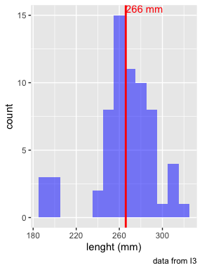
Lecuture 4: Standard normal distribution
You want to know things about this population like
probability of afish having a certain length (e.g., > 300 mm)
Can solve this by integrating under curve
But it is tedious to do every time
Instead
we can use the standard normal distribution (SND)
# A tibble: 1 × 1 mean_length <dbl> 1 266.

Slide 9
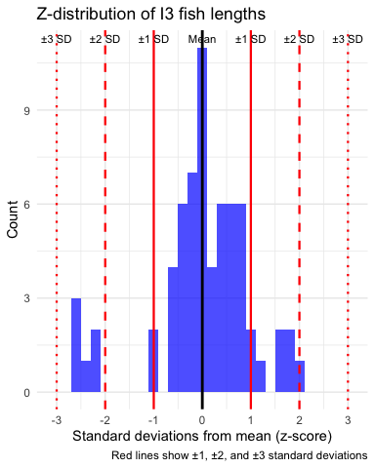
Lecture 4: Standard normal distribution
Standard Normal Distribution
“benchmark” normal distribution with µ = 0, σ = 1
The Standard Normal Distribution is defined so that:
~68% of the curve area within +/- 1 σ of the mean,
~95% within +/- 2 σ of the mean,
~99.7% within +/- 3 σ of the mean
*remember σ = standard deviation

Slide 10
Lecture 4: Standard normal distribution
Areas under curve of Standard Normal Distribution
Have been calculated for a range of sample sizes
Can be looked up in z-table
No need to integrate
Any normally distributed data can be standardized
transformed into the standard normal distribution
a value can ber looked up in a table

Slide 12
Lecture 4: Standard normal distribution
Done by converting original data points to z-scores
Z-scores calculated as:
$\text{Z = }\frac{X_{i}−μ}{σ}$
z = z-score for observation
xi = original observation
µ = mean of data distribution
σ = SD of data distribution
So lets do this for a fish that is 300mm long and guess the probability of catching something larger
z = (300 - 265.61)/28.3 = 1.215194
i3_stats <- gray_i3_df %>% summarize( mean_length = round(mean(total_length_mm, na.rm = TRUE), 2), sd_length = sd(total_length_mm, na.rm = TRUE), n = sum(!is.na(total_length_mm)), se_length = round(sd_length / sqrt(sum(!is.na(total_length_mm))), 2), .groups = "drop" ) # Display the results i3_stats
# A tibble: 1 × 4 mean_length sd_length n se_length <dbl> <dbl> <int> <dbl> 1 266. 28.3 66 3.48

Slide 13
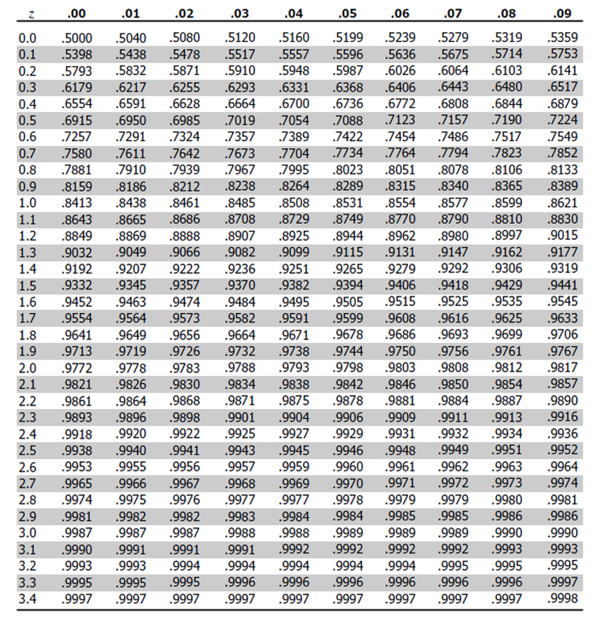
Lecture 4: Standard normal distribution
Done by converting original data points to z-scores
Z-scores calculated as:
$\text{Z = }\frac{X_{i}−μ}{σ}$
z = z-score for observation
xi = original observation
µ = mean of data distribution
σ = SD of data distribution
So lets do this for a fish that is 320mm long and guess the probability of catching something larger
z = (320 - 265.61)/28.3 = 1.92
or .9726 in table or 97.3% is the area left of the curve and
100 - 97.3 = 2.7% or 2.7% of fish are expected to be longer

Slide 15
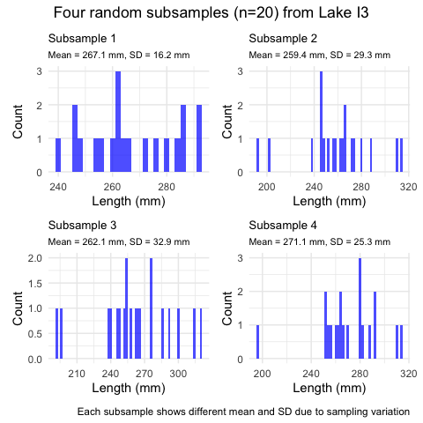
Lecture 4: Sampling a population - Std Error
The standard error of the mean (SEM) tells us how precise our sample mean is as an estimate of the population mean.
Standard Error Formula:
$$SE_{\overset{‾}{Y}}=\frac{s}{\sqrt{n}}$$
Where:
$s$ is the sample standard deviation
$n$ is the sample size
Key properties:
SEM decreases as sample size increases
SEM is used to construct confidence intervals
SEM measures the precision of the sample mean

Slide 16
Practice Exercise 5: Sampling Distributions
Let’s explore how sample size affects our estimates by taking samples of different sizes:
# Set seed for reproducibility set.seed(456) # Create samples of different sizes small_sample <- grayling_df %>% sample_n(5) medium_sample <- grayling_df %>% sample_n(30) large_sample <- grayling_df %>% sample_n(125) # Calculate mean and standard error for each sample small_mean <- mean(small_sample$total_length_mm, na.rm = TRUE) small_se <- sd(small_sample$total_length_mm, na.rm = TRUE) / sqrt(10) medium_mean <- mean(medium_sample$total_length_mm, na.rm = TRUE) medium_se <- sd(medium_sample$total_length_mm, na.rm = TRUE) / sqrt(30) large_mean <- mean(large_sample$total_length_mm, na.rm = TRUE) large_se <- sd(large_sample$total_length_mm, na.rm = TRUE) / sqrt(100) # Create a data frame with the results results <- data.frame( Sample_Size = c(10, 30, 100), Mean = c(small_mean, medium_mean, large_mean), SE = c(small_se, medium_se, large_se) ) # Display the results results
Sample_Size Mean SE 1 10 302.000 26.607330 2 30 319.200 12.082989 3 100 323.328 6.478149
What do you observe about the standard error as sample size increases? Why does this happen?

Slide 17
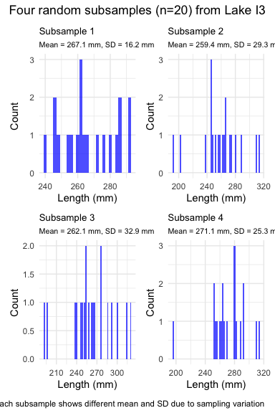
Lecture 4: Estimating µ - population mean
Every sample gives slightly different estimate of µ
Can take many samples and calculate means
Plot the frequency distribution of means
Get the “sampling distribution of means”
3 important properties:
Sampling distribution of means (SDM) from normal population will be normal
Large Sampling distribution of means from any population will be normal (Central Limit Theorem)
The mean of Sampling distribution of means will equal µ or the mean

Slide 18
Lecture 4: Estimating µ - population mean
Given above
can estimate the standard deviation of sample means
“Standard error of sample mean”
How good is your estimate of population mean? (based on the sample collected)
quantifies how much the sample means are expected to vary from samples
gives an estimate of the error associated with using $\overset{‾}{y}$ to estimate $μ$…

Slide 19
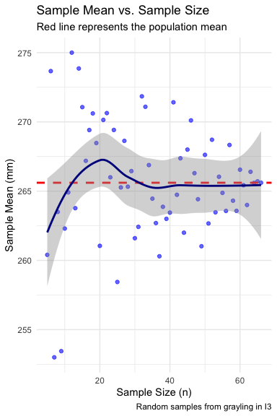
Lecture 4: Estimating µ - population mean
Notice: - $s_{\overset{‾}{y}}$ depends on - sample s (standard deviation) - sample n - ($s_{\overset{‾}{y}}=\frac{s}{\sqrt{n}}$)
How and why? - Decreases with sample n - number - increases with sample s - standard deviation
Large sample, low s = greater confidence in estimate of $μ$

Slide 21
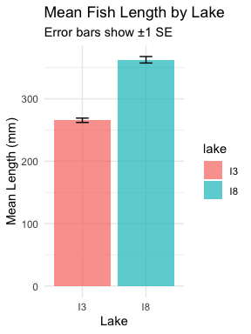
Lecture 4: Standard Error of the Mean
The standard error of the mean (SEM) tells us how precise our sample mean is as an estimate of the population mean.
Standard Error Formula:
$$SE_{\overset{‾}{Y}}=\frac{s}{\sqrt{n}}$$
Where:
$s$ is the sample standard deviation
$n$ is the sample size
Key properties:
SEM decreases as sample size increases
SEM is used to construct confidence intervals
SEM measures the precision of the sample mean

Slide 22
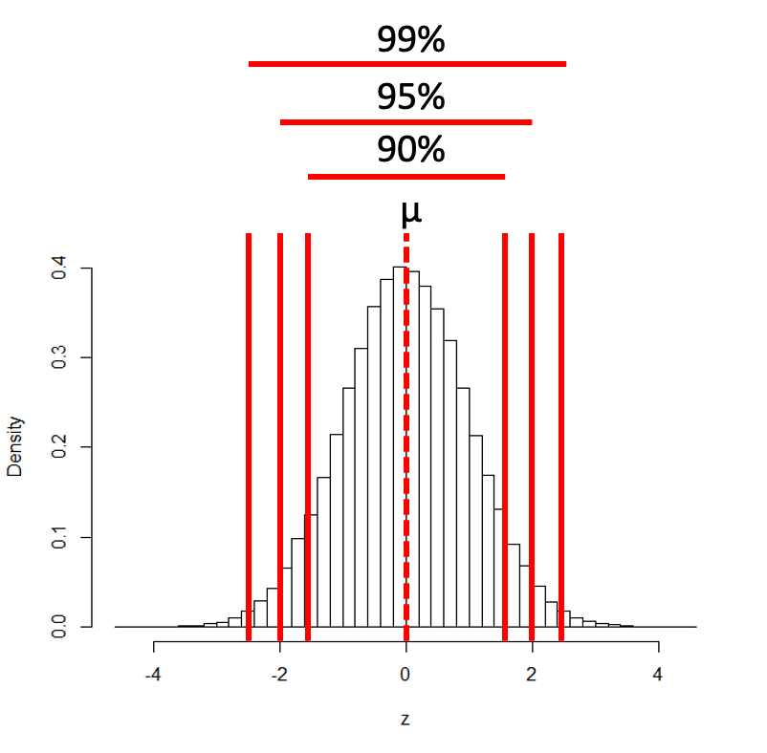
Lecture 4: Confidence Intervals
A confidence interval is a range of values that is likely to contain the true population parameter.
95% Confidence Interval Formula:
$$\text{95\% CI}=\overset{‾}{y}±z⋅\frac{σ}{\sqrt{n}}$$
Where:
ȳ is the sample mean
𝑛 is the sample size
σ is the population standard deviation
z is the z-value corresponding the probability of the CI

Slide 23
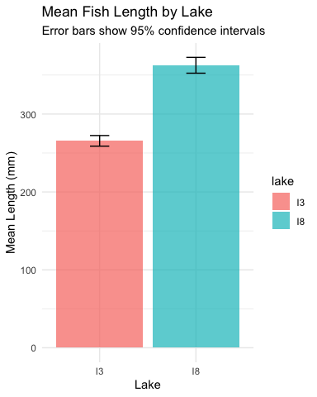
Lecture 4: Confidence Intervals
A confidence interval is a range of values that is likely to contain the true population parameter.
Interpretation: If we were to take many samples and calculate the 95% CI for each, about 95% of these intervals would contain the true population mean.
Common misinterpretation: “There is a 95% probability that the true mean is in this interval.”
Interpret 95% CI to mean:
Range of values that contains µ (population mean) with 95% probability
More correctly:
If we took 100 samples from population
calculate a CI from each
95 of the 100 CIs will contain the true population mean - µ

Slide 25
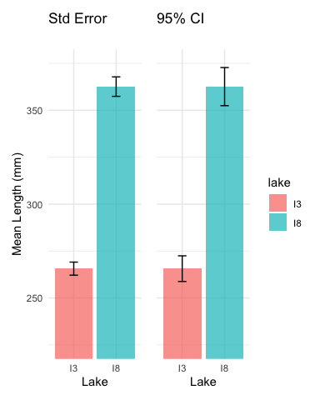
Lecture 4: Compare the SE and CI plots
Lets compare what the two plots look like near each other

Slide 26
Practice Exercise 3: Calculating Standard Error and Confidence Intervals
Calculate the standard error and 95% confidence interval for the mean length of Arctic grayling in each lake.
# Calculate the standard error and confidence intervals by lake ci_results <- grayling_df %>% group_by(lake) %>% summarize( mean_length = round(mean(total_length_mm, na.rm = TRUE), 2), sd_length = sd(total_length_mm, na.rm = TRUE), n = sum(!is.na(total_length_mm)), se_length = round(sd_length / sqrt(n), 2), ci = round(1.96 * se_length, 2), ci_lower = round(mean_length - 1.96 * se_length, 2), ci_upper = round(mean_length + 1.96 * se_length, 2), .groups = "drop" ) # Display the results ci_results
# A tibble: 2 × 8 lake mean_length sd_length n se_length ci ci_lower ci_upper <chr> <dbl> <dbl> <int> <dbl> <dbl> <dbl> <dbl> 1 I3 266. 28.3 66 3.48 6.82 259. 272. 2 I8 363. 52.3 102 5.18 10.2 352. 373.
What do these confidence intervals tell us about the difference between lakes?

Slide 27
Lecture 4: Confidence intervals
In the more typical case DON’T know the population σ
estimate it from the samples when don’t know the population σ
and when sample size is <~30)
can’t use the standard normal (z) distribution
Instead, we use Student’s t distribution

Slide 29
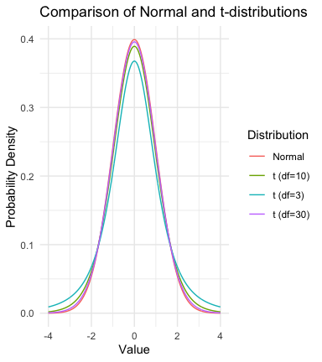
Lecture 4: Understanding t-distribution
When sample sizes are small, the t-distribution is more appropriate than the normal distribution.
Similar to normal distribution but with heavier tails
Shape depends on degrees of freedom (df = n-1)
With large df (>30), approaches the normal distribution
Used for:
Small sample sizes
When population standard deviation is unknown
Calculating confidence intervals
Conducting t-tests

Slide 30
Practice Exercise 4: Using the t-distribution
Let’s compare confidence intervals using the normal approximation (z) versus the t-distribution for our fish data.
# Calculate CI using both z and t distributions for a smaller subset small_sample <- grayling_df %>% filter(lake == "I3") %>% slice_sample(n = 10) # Calculate statistics sample_mean <- mean(small_sample$total_length_mm) sample_sd <- sd(small_sample$total_length_mm) sample_n <- nrow(small_sample) sample_se <- sample_sd / sqrt(sample_n) # Calculate confidence intervals z_ci_lower <- sample_mean - 1.96 * sample_se z_ci_upper <- sample_mean + 1.96 * sample_se # For t-distribution, get critical value for 95% CI with df = n-1 t_crit <- qt(0.975, df = sample_n - 1) t_ci_lower <- sample_mean - t_crit * sample_se t_ci_upper <- sample_mean + t_crit * sample_se # Display results cat("Mean:", round(sample_mean, 1), "mm\n")
Mean: 255.3 mm
cat("Standard deviation:", round(sample_sd, 2), "mm\n")
Standard deviation: 26.26 mm
cat("Standard error:", round(sample_se, 2), "mm\n")
Standard error: 8.31 mm
cat("95% CI using z:", round(z_ci_lower, 1), "to", round(z_ci_upper, 1), "mm\n")
95% CI using z: 239 to 271.6 mm
cat("95% CI using t:", round(t_ci_lower, 1), "to", round(t_ci_upper, 1), "mm\n")
95% CI using t: 236.5 to 274.1 mm
cat("t critical value:", round(t_crit, 3), "vs z critical value: 1.96\n")
t critical value: 2.262 vs z critical value: 1.96

Slide 31
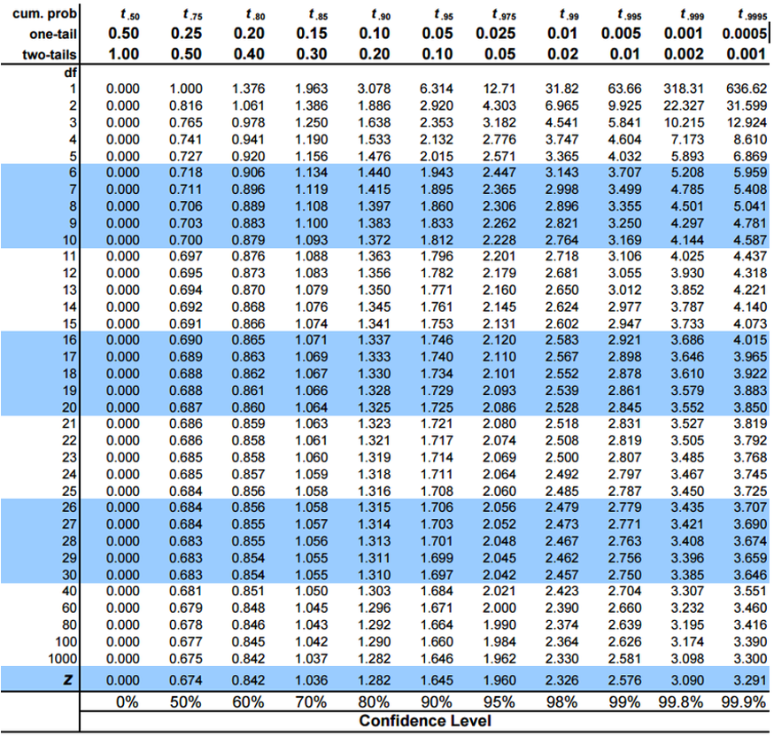
Student’s t-distribution
To calculate CI for sample from “unknown” population:
$\text{CI}=\overset{‾}{y}±t⋅\frac{s}{\sqrt{n}}$
Where:
ȳ is sample mean
𝑛 is sample size
s is sample standard deviation
t t-value corresponding the probability of the CI
t in t-table for different degrees of freedom (n-1)

Slide 32
Lecture 5: Student’s t-distribution
Here is a t-table
Values of t that correspond to probabilities
Probabilities listed along top
Sample dfs are listed in the left-most column
Probabilities are given for one-tailed and two-tailed “questions”

Slide 33
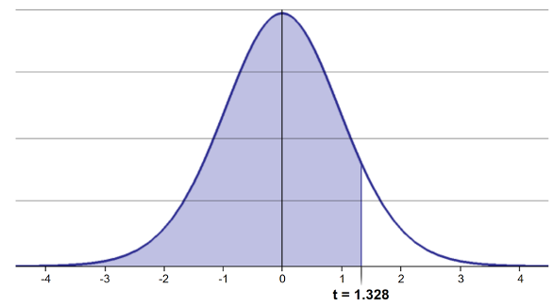
Lecture 5: Student’s t-distribution
One-tailed questions: area of distribution left or (right) of a certain value
n=20 (df=19) - 90% of the observations found left
t= 1.328 (10% are outside)

Slide 34
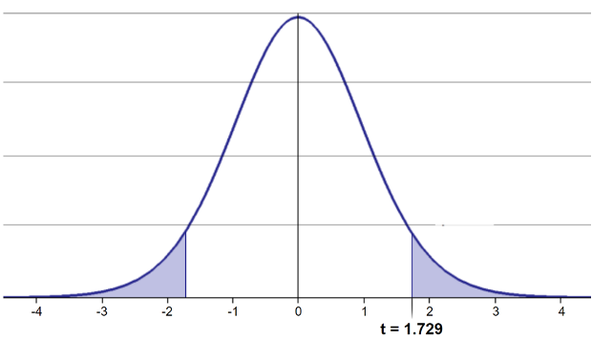
Lecture 5: Student’s t-distribution
Two-tailed questions refer to area between certain values
n= 20 (df=19), 90% of the observations are between
t=-1.729 and t=1.729 (10% are outside)

Slide 35
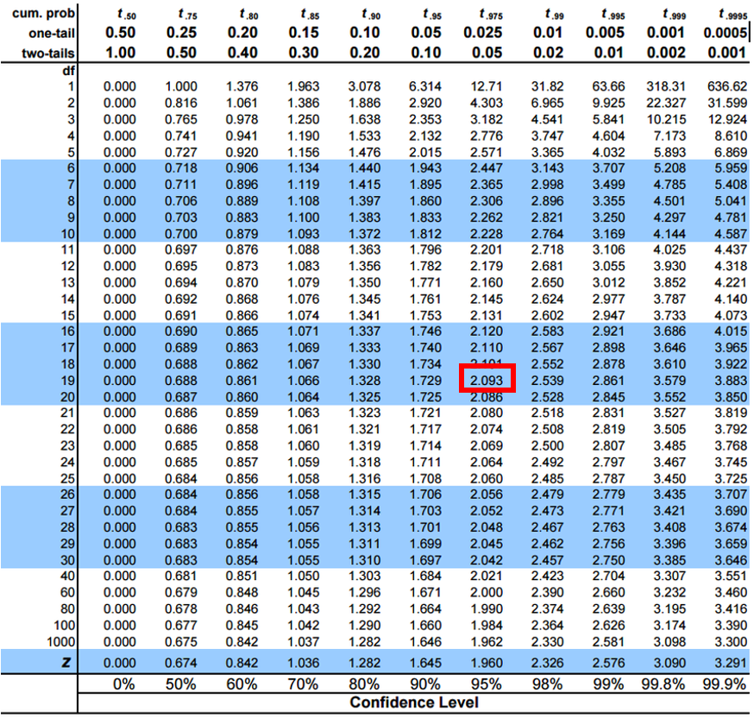
Lecture 5: Student’s t-distribution
Let’s calculate CIs again:
Use two-sided test
95% CI Sample A: = 272.8 ± 2.262 * (37.81/(9^0.5)) = 1.650788
The 95% CI is between 244.3 and 301.3
“The 95% CI for the population mean from sample A is 272.8 ± 28.5”

Slide 37
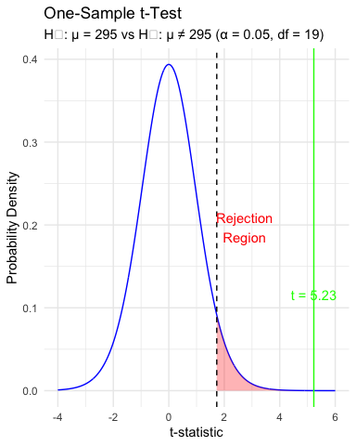
Lecture 4: Intro to Hypothesis Testing
Hypothesis testing is a systematic way to evaluate research questions using data.
Key components:
Null hypothesis (H₀): Typically assumes “no effect” or “no difference”
Alternative hypothesis (Hₐ): The claim we’re trying to support
Statistical test: Method for evaluating evidence against H₀
P-value: Probability of observing our results (or more extreme) if H₀ is true
Significance level (α): Threshold for rejecting H₀, typically 0.05
Decision rule: Reject H₀ if p-value < α

Slide 38
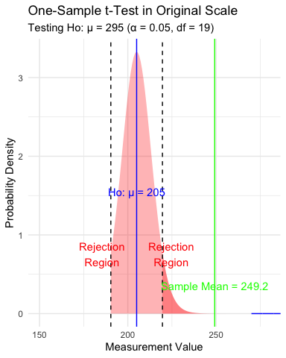
Lecture 4: Intro to Hypothesis Testing
Hypothesis testing is a systematic way to evaluate research questions using data.
Key components:
Null hypothesis (H₀): Typically assumes “no effect” or “no difference”
Alternative hypothesis (Hₐ): The claim we’re trying to support
Statistical test: Method for evaluating evidence against H₀
P-value: Probability of observing our results (or more extreme) if H₀ is true
Significance level (α): Threshold for rejecting H₀, typically 0.05
Decision rule: Reject H₀ if p-value < α

Slide 39
Practice Exercise 5: Lets practice a One-Sample t-Test
Let’s perform a one-sample t-test to determine if the mean fish length in Toolik Lake differs from 50 mm:
# get only lake I# i3_df <- grayling_df %>% filter(lake=="I3") # what is the mean i3_mean <- mean(i3_df$total_length_mm, na.rm=TRUE) cat("Mean:", round(i3_mean, 1), "mm\n")
Mean: 265.6 mm
# Perform a one-sample t-test t_test_result <- t.test(i3_df$total_length_mm, mu = 260) # View the test results t_test_result
One Sample t-test data: i3_df$total_length_mm t = 1.6091, df = 65, p-value = 0.1124 alternative hypothesis: true mean is not equal to 260 95 percent confidence interval: 258.6481 272.5640 sample estimates: mean of x 265.6061
Interpret this test result by answering these questions:
What was the null hypothesis?
What was the alternative hypothesis?
What does the p-value tell us?
Should we reject or fail to reject the null hypothesis at α = 0.05?
What is the practical interpretation of this result for fish biologists?
Practice Exercise 6: Formulating Hypotheses
For the following research questions about Arctic grayling, write the null and alternative hypotheses:
Are fish in Lake I8 longer than fish in Lake I3?
Is the mean length of Arctic grayling in these lakes different from 300 mm?
Is there a relationship between fish length and mass?
# Let's test one of these hypotheses: Are fish in Lake I8 longer than fish in Lake I3? # Perform an independent t-test t_test_result <- t.test(total_length_mm ~ lake, data = grayling_df, alternative = "less") # H₀: μ_I3 ≥ μ_I8, H₁: μ_I3 < μ_I8 # Display the results t_test_result
Welch Two Sample t-test data: total_length_mm by lake t = -15.532, df = 161.63, p-value < 2.2e-16 alternative hypothesis: true difference in means between group I3 and group I8 is less than 0 95 percent confidence interval: -Inf -86.66138 sample estimates: mean in group I3 mean in group I8 265.6061 362.5980
Based on this t-test, what can we conclude about the difference in fish length between the two lakes?

Slide 40
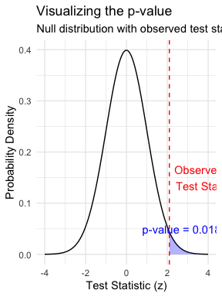
Lecture 4: Understanding P-values
A p-value is the probability of observing the sample result (or something more extreme) if the null hypothesis is true.
Common interpretations: - p < 0.05: Strong evidence against H₀ - 0.05 ≤ p < 0.10: Moderate evidence against H₀ - p ≥ 0.10: Insufficient evidence against H₀
Common misinterpretations: - p-value is NOT the probability that H₀ is true - p-value is NOT the probability that results occurred by chance - Statistical significance ≠ practical significance

Slide 41
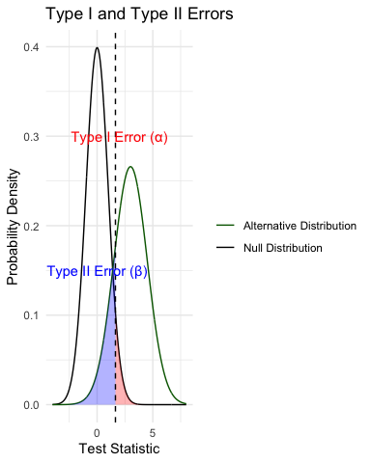
Lecture 4: Type I and Type II Errors
When making decisions based on hypothesis tests, two types of errors can occur:
Type I Error (False Positive) - Rejecting H₀ when it’s actually true - Probability = α (significance level) - “Finding an effect that isn’t real”
Type II Error (False Negative) - Failing to reject H₀ when it’s actually false - Probability = β - “Missing an effect that is real”
Statistical Power = 1 - β - Probability of correctly rejecting a false H₀ - Increases with: - Larger sample size - Larger effect size - Lower variability - Higher α level

Slide 42
Practice Exercise 6: Interpreting P-values and Errors
Given the following scenarios, identify whether a Type I or Type II error might have occurred:
A researcher concludes that a new fishing regulation increased grayling size, when in fact it had no effect.
A study fails to detect a real decline in grayling population due to warming water, concluding there was no effect.
Let’s calculate the power of our t-test to detect a 30 mm difference in length between lakes:
# Calculate power for detecting a 30 mm difference # First determine parameters lake_I3 <- grayling_df %>% filter(lake == "I3") lake_I8 <- grayling_df %>% filter(lake == "I8") n1 <- nrow(lake_I3) n2 <- nrow(lake_I8) sd_pooled <- sqrt((var(lake_I3$total_length_mm) * (n1-1) + var(lake_I8$total_length_mm) * (n2-1)) / (n1 + n2 - 2)) # Calculate power effect_size <- 30 / sd_pooled # Cohen's d df <- n1 + n2 - 2 alpha <- 0.05 power <- power.t.test(n = min(n1, n2), delta = effect_size, sd = 1, # Using standardized effect size sig.level = alpha, type = "two.sample", alternative = "two.sided") # Display results power
Two-sample t test power calculation n = 66 delta = 0.6741298 sd = 1 sig.level = 0.05 power = 0.9702076 alternative = two.sided NOTE: n is number in *each* group

Slide 43
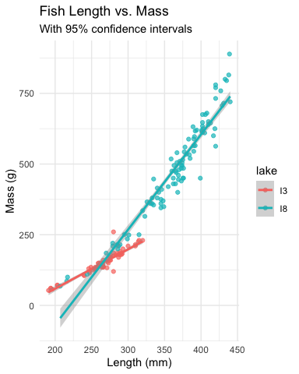
Lecture 4: Summary
Key concepts covered:
Probability distributions model random phenomena
Normal distribution is especially important
Z-scores standardize measurements
Standard error measures precision of estimates
Decreases with larger sample sizes
Used to construct confidence intervals
Confidence intervals express uncertainty
Provide plausible range for parameters
95% CI: mean ± 1.96 × SE
Hypothesis testing evaluates claims
Null vs. alternative hypotheses
P-values quantify evidence against H₀
Consider both statistical and practical significance

Slide 44
Final Exercise: Comprehensive Analysis
Now that we’ve covered the key concepts, let’s perform a complete analysis of the Arctic grayling data:
# Comprehensive analysis of Arctic grayling data # 1. Data visualization length_boxplot <- grayling_df %>% ggplot(aes(x = lake, y = total_length_mm, fill = lake)) + geom_boxplot() + labs(title = "Fish Length by Lake", x = "Lake", y = "Length (mm)") + theme_minimal() # 2. Compare means with t-test length_ttest <- t.test(total_length_mm ~ lake, data = grayling_df) # 3. Length-mass relationship length_mass_model <- lm(mass_g ~ total_length_mm * lake, data = grayling_df) model_summary <- summary(length_mass_model) # 4. Display results length_boxplot
length_ttest
Welch Two Sample t-test data: total_length_mm by lake t = -15.532, df = 161.63, p-value < 2.2e-16 alternative hypothesis: true difference in means between group I3 and group I8 is not equal to 0 95 percent confidence interval: -109.32342 -84.66053 sample estimates: mean in group I3 mean in group I8 265.6061 362.5980
model_summary
Call: lm(formula = mass_g ~ total_length_mm * lake, data = grayling_df) Residuals: Min 1Q Median 3Q Max -151.223 -14.839 -0.764 10.670 153.130 Coefficients: Estimate Std. Error t value Pr(>|t|) (Intercept) -219.3313 47.9087 -4.578 9.30e-06 *** total_length_mm 1.3924 0.1794 7.763 8.88e-13 *** lakeI8 -522.5506 56.5882 -9.234 < 2e-16 *** total_length_mm:lakeI8 1.9738 0.1972 10.009 < 2e-16 *** --- Signif. codes: 0 '***' 0.001 '**' 0.01 '*' 0.05 '.' 0.1 ' ' 1 Residual standard error: 40.93 on 162 degrees of freedom (2 observations deleted due to missingness) Multiple R-squared: 0.9644, Adjusted R-squared: 0.9637 F-statistic: 1461 on 3 and 162 DF, p-value: < 2.2e-16
# 5. Calculate 95% confidence intervals for each lake ci_results <- grayling_df %>% group_by(lake) %>% summarize( mean_length = mean(total_length_mm, na.rm = TRUE), sd_length = sd(total_length_mm, na.rm = TRUE), n = sum(!is.na(total_length_mm)), se_length = sd_length / sqrt(n), t_crit = qt(0.975, df = n - 1), margin_error = t_crit * se_length, ci_lower = mean_length - margin_error, ci_upper = mean_length + margin_error, .groups = "drop" ) # Display confidence intervals ci_results
# A tibble: 2 × 9 lake mean_length sd_length n se_length t_crit margin_error ci_lower <chr> <dbl> <dbl> <int> <dbl> <dbl> <dbl> <dbl> 1 I3 266. 28.3 66 3.48 2.00 6.96 259. 2 I8 363. 52.3 102 5.18 1.98 10.3 352. # ℹ 1 more variable: ci_upper <dbl>
# 6. Visualize regression with confidence intervals regression_plot <- grayling_df %>% ggplot(aes(x = total_length_mm, y = mass_g, color = lake)) + geom_point(alpha = 0.7) + geom_smooth(method = "lm", se = TRUE) + labs(title = "Length-Mass Relationship by Lake", x = "Length (mm)", y = "Mass (g)") + theme_minimal() regression_plot
Based on this analysis: 1. Are there significant differences in fish length between the two lakes? 2. How does the length-mass relationship differ between lakes? 3. What conclusions can you draw about Arctic grayling in these two lakes?

Slide 45
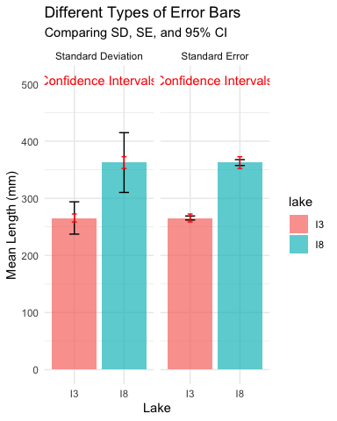
Lecture 4: Error Bars and Their Interpretation
Error bars are graphical representations of the variability of data that show:
The precision of a measurement
The uncertainty around an estimate
A confidence interval for a parameter
Common types of error bars: 1. Standard Error (SE): Shows precision of the mean 2. Standard Deviation (SD): Shows variability in the data 3. Confidence Interval (CI): Shows plausible range for parameter
When interpreting graphs: - Always check what the error bars represent - Non-overlapping 95% CI bars suggest statistically significant differences - Error bars help assess both statistical and practical significance

Slide 46
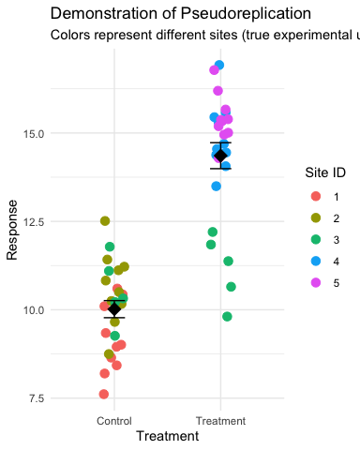
Lecture 4: Sampling and Pseudoreplication
Pseudoreplication occurs when measurements that are not independent are analyzed as if they were independent.
A critical consideration in experimental design
Results in underestimated standard errors and confidence intervals
Leads to inflated Type I error rates (false positives)
Examples of pseudoreplication: - Measuring the same individual multiple times - Treating multiple fish from the same tank as independent - Using multiple data points from a single site
How to avoid pseudoreplication: - Identify the true experimental unit - Use appropriate statistical techniques (e.g., mixed models) - Be clear about the level of replication

Slide 47
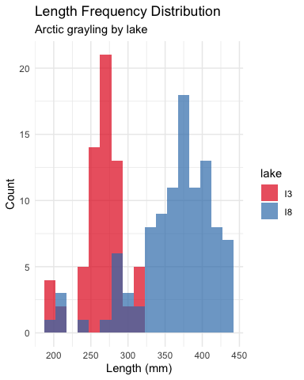
Lecture 4: Practical Applications in Fish Biology
The statistical concepts we’ve covered today are essential for fisheries biologists and ecologists:
Z-scores help identify unusual fish sizes in a population
Standard error quantifies uncertainty in growth rate estimates
Confidence intervals provide plausible ranges for population parameters
Hypothesis testing evaluates effects of management practices
P-values determine significance of environmental impacts
Real-world applications: - Assessing population health and structure - Evaluating effectiveness of fishing regulations - Quantifying relationships between fish size and habitat variables - Predicting impacts of climate change on fish populations - Designing effective conservation strategies

Slide 48
Lecture 4: Next Steps in Statistical Analysis
In future lectures, we’ll explore:
One-sample and two-sample t-tests
Analysis of variance (ANOVA)
Linear regression and correlation
Chi-square tests
Non-parametric methods
Multiple regression and model selection
Mixed effects models
Each method builds on the statistical foundation we’ve established today, applying probability concepts to make inferences from data.
Learning Resources
Practice problems in the textbook (Chapter 4 & 5)
Online resources:
Khan Academy: Probability and Statistics
StatQuest with Josh Starmer (YouTube channel)
R for Data Science (r4ds.had.co.nz)
Office hours: Wednesdays 2-4pm

