Slide 1
Lecture 06
Bill Perry

Slide 2
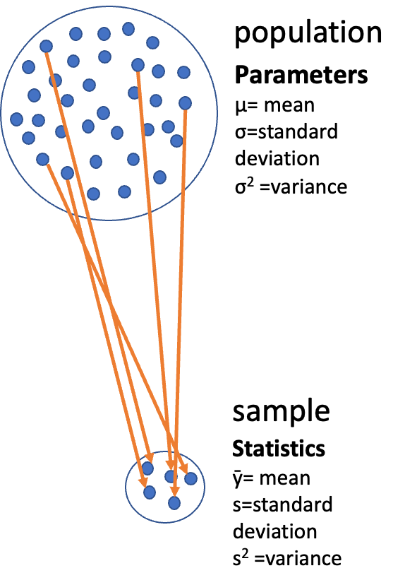
Lecture 6: Review
Covered
Introduction to hypothesis testing
The standard normal distribution
Standard error
Confidence intervals
Student’s t-distribution
H testing
One and Two Sample T Test
p-values

Slide 3
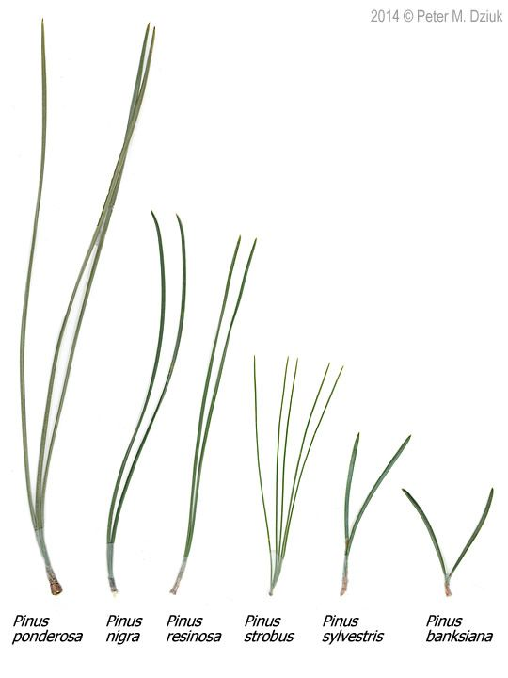
Lecture 6: Overview
The objectives:
p-values
Brief review
H test for a single population
1- and 2-sided tests
Hypothesis tests for two populations
Assumptions of parametric tests

Slide 4

Lecture 6: Statistical hypothesis testing
Major goal of statistics:
inferences about populations from samples…
assign degree of confidence to inferences
Statistical hypothesis testing:
formalized approach to inference
Hypotheses ask whether samples come from populations with certain properties
Often interested in questions about population means
but other questions are of interest

Slide 5
Lecture 6: Statistical hypothesis testing
Useful hypotheses: - Rely on specifying - null hypothesis (Ho) - alternate hypothesis (Ha)
Ho is the hypothesis of “no effect”
two samples from population with same mean
sample is from population of mean = 0
Ha (research hypothesis)
is the opposite of the Ho
or predicts that there is an effect of x on y
but does NOT suggest a direction
-

Slide 6

Lecture 6: Statistical hypothesis testing
Together Ho and Ha encompass all possible outcomes:
For Example:
Ho: µ=0, Ha: µ ≠ 0
mean equals 0 or mean does not equal 0
Ho: µ=35, Ha: µ ≠ 35
mean equals 35 or mean does not equal 35
Ho: µ1 = µ2, Ha: µ1 ≠ µ2
mean of population 1 equals mean of population 2 or it does not
Ho: µ > 0, Ha: µ ≤ 0
can be directional mean is greater than 0 or mean is not equal or less than 0

Slide 7
Lecture 6: Statistical hypothesis testing
Tests assess likelihood of the null hypothesis being true
If the Ho is likely false, then Ha assumed to be correct
More precisely:
the long run probability of obtaining sample value (or more extreme one) if the null hypothesis is true
p(data|Ho) - the probability of observing the data given that the null hypothesis Ho is true
-

Slide 8
Lecture 6: Statistical hypothesis testing
Hypothesis tests
Expressed as p-value (0 to 1)
Interpret p-value as:
probability of obtaining sample value of statistic (or more extreme one) if Ho is true
High p-value:
high probability of obtaining sample statistic under Ho
if the null hypothesis (Ho) were true, you would frequently observe data similar to or more extreme than your sample statistic
your observed results are quite compatible with what the null hypothesis predicts
low p-value: low probability of obtaining sample statistic under Ho
if the null hypothesis (Ho) were true, you would rarely observe data similar to or more extreme than your sample statistic
Your results are unusual under the null hypothesis, suggesting that either you’ve witnessed a rare event or the null hypothesis may be incorrect
-

Slide 9
Lecture 6: Statistical hypothesis testing
Statistical test results:
p = 0.3 means that if I repeated the study 100 times, I would get this (or more extreme) result due to chance 30 times
p = 0.03 means that if I repeated the study 100 times, I would get this (or more extreme) result due to chance 3 times
Which p-value suggests Ho likely false?

Slide 10
Lecture 6: Statistical hypothesis testing
Statistical test results:
At what point reject Ho?
p < 0.05 conventional “significance threshold” (α = alpha or p value)
p < 0.05 means: if Ho is true and we repeated the study 100 times - we would get this (or more extreme) result less than 5 times due to chance

Slide 11
Lecture 6: Statistical hypothesis testing
Statistical test results:
α is the rate at which we will reject a true null hypothesis (Type I error rate)
Lowering α will lower likelihood of incorrectly rejecting a true null hypothesis (e.g., 0.01, 0.001)
Both Hs and α are specified BEFORE collection of data and analysis

Slide 12
Lecture 6: Statistical hypothesis testing
Traditionally α=0.05 is used as a cut off for rejecting null hypothesis
There is nothing magical about 0.05 - actual p-values need to be reported - also need to decide prior to study
p-value range | Interpretation
P > 0.10 | No evidence against Ho - data appear consistent with Ho
0.05 < P < 0.10 | Weak evidence against the Ho in favor of Ha
0.01 < P < 0.05 | Moderate evidence against Ho in favor of Ha
0.001 < P < 0.01 | Strong evidence against Ho in favor of Ha
P < 0.001 | Very strong evidence against Ho in favor of Ha

Slide 13

Lecture 6: Statistical hypothesis testing

Slide 14

Lecture 6: Statistical hypothesis testing
Fisher:
p-value as informal measure of discrepancy between data and Ho
“If p is between 0.1 and 0.9 there is certainly no reason to suspect the hypothesis tested. If it is below 0.02 it is strongly indicated that the hypothesis fails to account for the whole of the facts. We shall not often be astray if we draw a conventional line at .05 …”

Slide 15
Lecture 6: Statistical hypothesis testing
General procedure for H testing:
Specify Null (Ho) and alternate (Ha)
Determine test (and test statistic) to be used
Test statistic is used to compare your data to expectation under Ho (null hypothesis)
Specify significance (α or p value) level below which Ho will be rejected

Slide 16
Lecture 6: Statistical hypothesis testing
General procedure for H testing:
Collect data
Perform test
If p-value < α, conclude Ho is likely false and reject it
If p-value > α, conclude no evidence Ho is false and retain it

Slide 17
Lecture 6: Brief review
Recall…
Major goal of statistics: inferences about populations from samples… and assign degree of confidence to inferences
Statistical H-testing: formalized approach to inference
Relies on specifying null hypothesis (Ho) and alternate hypothesis (Ha
Tests assess likelihood of the null hypothesis being true
Expressed as p-value: probability of obtaining sample value of statistic (or more extreme one) if Ho is true

Slide 18
Lecture 6: Brief review
Recall pine needle example
Probability of getting sample
with ȳ at least as far away from 21 as 35)? - p(ȳ ≤ 3500 or ȳ ≥ 3900)
What about - 1-tailed or 2-tailed test?
Can solve using SND and z-scores

Slide 19
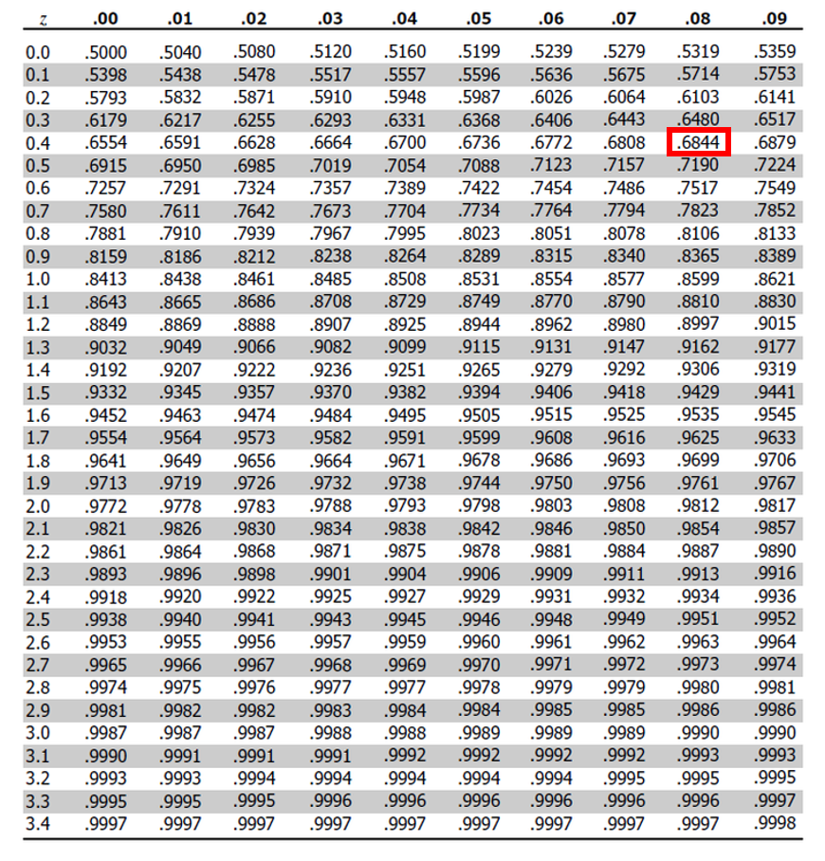
Lecture 6: Brief review
z= (21-35)/40 = -0.48
From z table: p= 0.6368 X 2
p of getting sample as far away from µ as A is = 0.6368 (63.6%)
But - usually can’t use z!
Can use t-distribution instead…

Slide 20
Pine Needle Length: Hypothesis Testing Activity
This activity will guide you through the process of conducting single-sample and two-sample t-tests on pine needle data. We’ll explore how environmental factors like wind exposure might affect pine needle length.
You’ll learn to:
Formulate hypotheses
Test assumptions
Perform t-tests
Visualize data
Report results accurately
Pine needles from trees

Slide 21
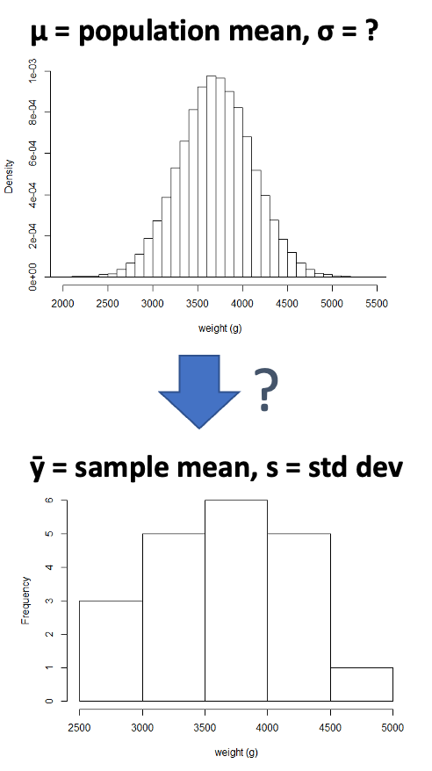
Part 1: Single Sample T-test
A single sample t-test asks whether a population parameter (like $\overset{‾}{x}$) differs from some expected value.
The question: Is the average pine needle length from our windward sample different from 55mm?

Slide 22
How to do this in R
# Install packages if needed (uncomment if necessary) # install.packages("readr") # install.packages("tidyverse") # install.packages("car") # install.packages("here") # Load libraries library(car) # For diagnostic tests library(tidyverse) # For data manipulation and visualization
# Load the pine needle data # Use here() function to specify the path pine_data <- read_csv("data/pine_needles.csv") # Examine the first few rows head(pine_data)
# A tibble: 6 × 6 date group n_s wind tree_no len_mm <chr> <chr> <chr> <chr> <dbl> <dbl> 1 3/20/25 cephalopods n lee 1 20 2 3/20/25 cephalopods n lee 1 21 3 3/20/25 cephalopods n lee 1 23 4 3/20/25 cephalopods n lee 1 25 5 3/20/25 cephalopods n lee 1 21 6 3/20/25 cephalopods n lee 1 16
grayling_df <- read_csv("data/gray_I3_I8.csv")

Slide 23
Part 1: Exploratory Data Analysis
Before conducting hypothesis tests, we should always explore our data to understand its characteristics.
Let’s calculate summary statistics and create visualizations.
Activity: Calculate basic summary statistics for pine needle length
# YOUR TASK: Calculate summary statistics for pine needle length # Hint: Use summarize() function to calculate mean, sd, n, etc. # Create a summary table for all pine needles pine_summary <- pine_data %>% summarize( mean_length = mean(len_mm), sd_length = sd(len_mm), n = n(), se_length = sd_length / sqrt(n) ) print(pine_summary)
# A tibble: 1 × 4 mean_length sd_length n se_length <dbl> <dbl> <int> <dbl> 1 17.7 3.53 48 0.509
# Now calculate summary statistics by wind exposure # YOUR CODE HERE

Slide 24
Part 1: Visualizing the Data
Activity: Create visualizations of pine needle length
Create a histogram and a boxplot to visualize the distribution of pine needle length values.
Effective data visualization helps us understand:
The central tendency
The spread of the data
Potential outliers
Shape of distribution

Slide 25
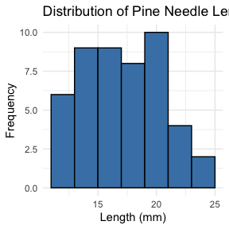
Your Task
# YOUR TASK: Create a histogram of pine needle length # Hint: Use ggplot() and geom_histogram() # Histogram of all pine needle lengths ggplot(pine_data, aes(x = len_mm)) + geom_histogram(binwidth = 2, fill = "steelblue", color = "black") + labs(title = "Distribution of Pine Needle Length", x = "Length (mm)", y = "Frequency") + theme_minimal()

Slide 26
# Boxplot of pine needle length by wind exposure # YOUR CODE HERE

Slide 27
Part 1: Single Sample T-Test
We want to test if the mean pine needle length on the windward side differs from 55mm.
Activity: Define hypotheses and identify assumptions
H₀: μ = 55 (The mean pine needle length on windward side is 55mm) H₁: μ ≠ 55 (The mean pine needle length on windward side is not 55mm)
Assumptions for t-test:
Data is normally distributed
Observations are independent
No significant outliers

Slide 28
Part 1: Testing Assumptions
Before conducting our t-test, we need to verify that our data meets the necessary assumptions.
Activity: Test the normality assumption
Methods to test normality:
Visual methods:
QQ plots or histograms
Statistical tests: Shapiro
Wilk test

Slide 29
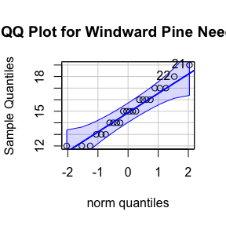
Assumptions in R - qqplots
# Filter for just windward side needles windward_data <- pine_data %>% filter(wind == "wind") # YOUR TASK: Test normality of windward pine needle lengths # QQ Plot qqPlot(windward_data$len_mm, main = "QQ Plot for Windward Pine Needles", ylab = "Sample Quantiles")

Slide 30
[1] 21 22
Shapiro Wilk
# Shapiro-Wilk test shapiro_test <- shapiro.test(windward_data$len_mm) print(shapiro_test)
Shapiro-Wilk normality test data: windward_data$len_mm W = 0.96062, p-value = 0.451
# Check for outliers using boxplot # YOUR CODE HERE

Slide 31
Part 1: Conducting the Single Sample T-Test
Now that we’ve checked our assumptions, we can perform the single sample t-test.
Activity: Conduct a single sample t-test to compare windward needle length to 55mm What is probability of getting sample at least as far from 55mm as our sample mean?
This is our p-value, which helps us decide whether to reject the null hypothesis.
# Calculate summary statistics for windward needles windward_summary <- windward_data %>% summarize( mean_length = mean(len_mm), sd_length = sd(len_mm), n = n(), se_length = sd_length / sqrt(n) ) print(windward_summary)
# A tibble: 1 × 4 mean_length sd_length n se_length <dbl> <dbl> <int> <dbl> 1 14.9 1.91 24 0.390

Slide 32
Your Task
# YOUR TASK: Conduct a single sample t-test t_test_result <- t.test(windward_data$len_mm, mu = 55, var.equal = TRUE ) print(t_test_result)
One Sample t-test data: windward_data$len_mm t = -102.85, df = 23, p-value < 2.2e-16 alternative hypothesis: true mean is not equal to 55 95 percent confidence interval: 14.11050 15.72284 sample estimates: mean of x 14.91667
# Calculate t-statistic manually # YOUR CODE HERE: t = (sample_mean - hypothesized_mean) / (sample_sd / sqrt(n)) # can you do this manually or manually with R?

Slide 33
Part 1: Interpreting and Reporting Results
Activity: Interpret the t-test results
What does the p-value tell us?
Should we reject or fail to reject the null hypothesis?
How to report this result in a scientific paper:
“A two-tailed, one-sample t-test at α=0.05 showed that the mean pine needle length on the windward side (… mm, SD = …) [was/was not] significantly different from the expected 55 mm, t(…) = …, p = …”

Slide 34
Part 2: Two Sample T-Test
Now, let’s compare pine needle lengths between windward and leeward sides of trees.
Question: Is there a significant difference in needle length between the windward and leeward sides?
This requires a two-sample t-test.
Two-sample t-test compares means from two independent groups.
$t=\frac{{\overset{‾}{x}}_{1}−{\overset{‾}{x}}_{2}}{S_{p}\sqrt{\frac{1}{n_{1}}+\frac{1}{n_{2}}}}$
where:
x̄₁ and x̄₂: These represent the sample means of the two groups you’re comparing
s²ₚ: This is the pooled variance, calculated as: s²ₚ = [(n₁ - 1)s₁² + (n₂ - 1)s₂²] / (n₁ + n₂ - 2), where s₁² and s₂² are the sample variances of the two groups.
n₁ and n₂: These are the sample sizes of the two groups.
√(1/n₁ + 1/n₂): This represents the pooled standard error.

Slide 35
Part 2: Exploratory Data Analysis by Group
Activity: Calculate summary statistics grouped by wind exposure Before conducting the test, we need to understand the data for each group.
# YOUR TASK: Calculate summary statistics by wind exposure # Hint: Use group_by() and summarize() group_summary <- pine_data %>% group_by(wind) %>% summarize( mean_length = mean(len_mm), sd_length = sd(len_mm), n = n(), se_length = sd_length / sqrt(n) ) print(group_summary)
# A tibble: 2 × 5 wind mean_length sd_length n se_length <chr> <dbl> <dbl> <int> <dbl> 1 lee 20.4 2.45 24 0.500 2 wind 14.9 1.91 24 0.390

Slide 36
Alternative 1
# Calculate the difference in means # YOUR CODE HERE # Assuming your dataframe is called df group_summary %>% summarize(difference = mean_length[wind == "wind"] - mean_length[wind == "lee"])
# A tibble: 1 × 1 difference <dbl> 1 -5.5

Slide 37
Alternative 2
# Or alternatively using filter and pull: lee_mean <- group_summary %>% filter(wind == "lee") %>% pull(mean_length) wind_mean <- group_summary %>% filter(wind == "wind") %>% pull(mean_length) difference <- wind_mean - lee_mean difference
[1] -5.5

Slide 38
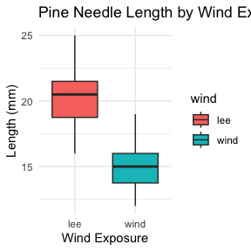
Part 2: Visualizing Group Differences
Activity: Create visualizations to compare the groups Effective visualizations for group comparisons:
Side-by-side boxplots
Violin plots
Error bar plots
# YOUR TASK: Create boxplots to compare groups ggplot(pine_data, aes(x = wind, y = len_mm, fill = wind)) + geom_boxplot() + labs(title = "Pine Needle Length by Wind Exposure", x = "Wind Exposure", y = "Length (mm)") + theme_minimal()

Slide 39
# how can you do this by wind to see both plots

Slide 40
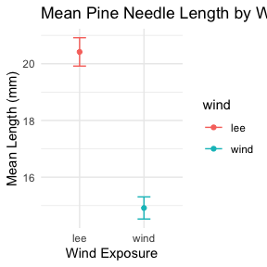
your task
# YOUR TASK: Create a plot using stat_summary to show means and standard errors ggplot(pine_data, aes(x = wind, y = len_mm, color = wind)) + stat_summary(fun = mean, geom = "point") + stat_summary(fun.data = mean_se, geom = "errorbar", width = 0.2) + labs(title = "Mean Pine Needle Length by Wind Exposure", x = "Wind Exposure", y = "Mean Length (mm)") + theme_minimal()

Slide 41
Part 2: Testing Assumptions for Two-Sample T-Test
Activity: Test assumptions for two-sample t-test
For a two-sample t-test, we need to check:
Normality within each group
Equal variances between groups (for standard t-test)
Independent observations
If assumptions are violated:
Welch’s t-test (unequal variances)
Non-parametric alternatives (Mann-Whitney U test)

Slide 42
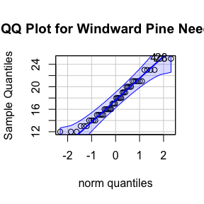
your task
# YOUR TASK: Test normality of windward pine needle lengths # QQ Plot qqPlot(pine_data$len_mm, main = "QQ Plot for Windward Pine Needles", ylab = "Sample Quantiles")

Slide 43
[1] 4 28
# Testing normality for each group # Leeward group lee_data <- pine_data %>% filter(wind == "lee") shapiro_lee <- shapiro.test(lee_data$len_mm) print("Shapiro-Wilk test for leeward data:")
[1] "Shapiro-Wilk test for leeward data:"
print(shapiro_lee)
Shapiro-Wilk normality test data: lee_data$len_mm W = 0.95477, p-value = 0.3425

Slide 44
windward group
# Windward group # YOUR CODE HERE for windward group normality test

Slide 45
Remember you can always do it in one go
# there are always two ways # Test for normality using Shapiro-Wilk test for each wind group # All in one pipeline using tidyverse approach normality_results <- pine_data %>% group_by(wind) %>% summarize( shapiro_stat = shapiro.test(len_mm)$statistic, shapiro_p_value = shapiro.test(len_mm)$p.value, normal_distribution = if_else(shapiro_p_value > 0.05, "Normal", "Non-normal") ) # Print the results print(normality_results)
# A tibble: 2 × 4 wind shapiro_stat shapiro_p_value normal_distribution <chr> <dbl> <dbl> <chr> 1 lee 0.955 0.343 Normal 2 wind 0.961 0.451 Normal

Slide 46
Conduct a Levenes Test
# Test for equal variances # YOUR TASK: Conduct Levene's test for equality of variances levene_test <- leveneTest(len_mm ~ wind, data = pine_data) print(levene_test)
Levene's Test for Homogeneity of Variance (center = median) Df F value Pr(>F) group 1 1.2004 0.2789 46
# Visual check for normality with QQ plots # YOUR CODE HERE

Slide 47
Part 2: Conducting the Two-Sample T-Test
Activity: Conduct a two-sample t-test
Now we can compare the mean pine needle lengths between windward and leeward sides.
H₀: μ₁ = μ₂ (The mean needle lengths are equal) H₁: μ₁ ≠ μ₂ (The mean needle lengths are different)
Deciding between:
Standard t-test (equal variances)
Welch’s t-test (unequal variances)

Slide 48
Based on our Levene’s test result.
# YOUR TASK: Conduct a two-sample t-test # Use var.equal=TRUE for standard t-test or var.equal=FALSE for Welch's t-test # Standard t-test (if variances are equal) t_test_result <- t.test(len_mm ~ wind, data = pine_data, var.equal = TRUE) print("Standard two-sample t-test:")
[1] "Standard two-sample t-test:"
print(t_test_result)
Two Sample t-test data: len_mm by wind t = 8.6792, df = 46, p-value = 3.01e-11 alternative hypothesis: true difference in means between group lee and group wind is not equal to 0 95 percent confidence interval: 4.224437 6.775563 sample estimates: mean in group lee mean in group wind 20.41667 14.91667
# Welch's t-test (if variances are unequal) # YOUR CODE HERE # Calculate t-statistic manually (optional) # YOUR CODE HERE: t = (mean1 - mean2) / sqrt((s1^2/n1) + (s2^2/n2))

Slide 49
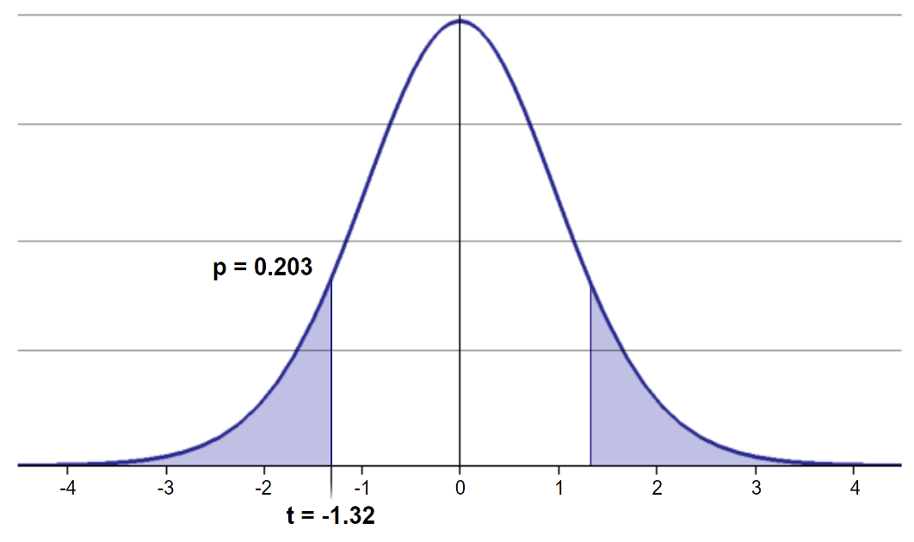
Part 2: Interpreting and Reporting Two-Sample T-Test Results
Activity: Interpret the results of the two-sample t-test
What can we conclude about the needle lengths on windward vs. leeward sides?
How to report this result in a scientific paper:
“A two-tailed, two-sample t-test at α=0.05 showed [a significant/no significant] difference in needle length between windward (M = …, SD = …) and leeward (M = …, SD = …) sides of pine trees, t(…) = …, p = ….”

Slide 50
Part 3: Paired T-Test (Extended Activity)
If we collected data in pairs (same tree, different sides), we would use a paired t-test. How would the analysis differ?
We’d calculate the difference for each pair
Test if the mean difference equals zero
The paired approach often has more statistical power
Paired t-test formula:
$t=\frac{\overset{‾}{d}}{s_{d}/\sqrt{n}}$
where:
$\overset{‾}{d}$ is the mean difference
$s_{d}$ is the standard deviation of differences
$n$ is the number of pairs

Slide 51
Final Activity: Assumptions of Parametric Tests
Common assumptions for t-tests:
Normality: Data comes from normally distributed populations
Equal variances (for two-sample tests)
Independence: Observations are independent
No outliers: Extreme values can influence results
What can we do if our data violates these assumptions?
Alternatives when assumptions are violated:
Data transformation (log, square root, etc.)
Non-parametric tests
Bootstrapping approaches

Slide 52
Summary and Conclusions
In this activity, we’ve:
Formulated hypotheses about pine needle length
Tested assumptions for parametric tests
Conducted one-sample and two-sample t-tests
Visualized data using appropriate methods
Learned how to interpret and report t-test results
Key takeaways:
Always check assumptions before conducting tests
Visualize your data to understand patterns
Report results comprehensively
Consider alternatives when assumptions are violated

Slide 53
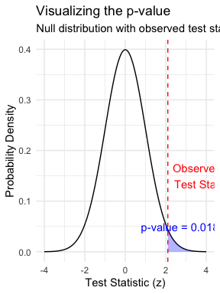
Lecture 5: Understanding P-values
A p-value is the probability of observing the sample result (or something more extreme) if the null hypothesis is true.
Common interpretations: - p < 0.05: Strong evidence against H₀ - 0.05 ≤ p < 0.10: Moderate evidence against H₀ - p ≥ 0.10: Insufficient evidence against H₀
Common misinterpretations: - p-value is NOT the probability that H₀ is true - p-value is NOT the probability that results occurred by chance - Statistical significance ≠ practical significance

Slide 54
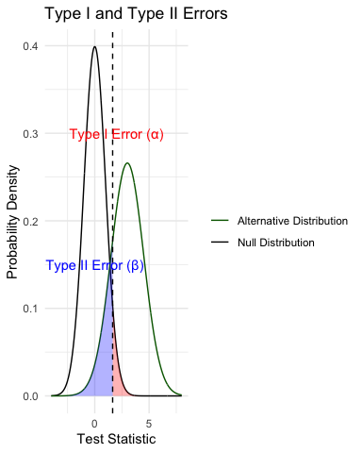
Lecture 5: Type I and Type II Errors
When making decisions based on hypothesis tests, two types of errors can occur:
Type I Error (False Positive) - Rejecting H₀ when it’s actually true - Probability = α (significance level) - “Finding an effect that isn’t real”
Type II Error (False Negative) - Failing to reject H₀ when it’s actually false - Probability = β - “Missing an effect that is real”
Statistical Power = 1 - β - Probability of correctly rejecting a false H₀ - Increases with: - Larger sample size - Larger effect size - Lower variability - Higher α level

Slide 55
Practice Exercise 6: Interpreting P-values and Errors
Given the following scenarios, identify whether a Type I or Type II error might have occurred:
A researcher concludes that a new fishing regulation increased grayling size, when in fact it had no effect.
A study fails to detect a real decline in grayling population due to warming water, concluding there was no effect.
Let’s calculate the power of our t-test to detect a 30 mm difference in length between lakes:
# Calculate power for detecting a 30 mm difference # First determine parameters lake_I3 <- grayling_df %>% filter(lake == "I3") lake_I8 <- grayling_df %>% filter(lake == "I8") n1 <- nrow(lake_I3) n2 <- nrow(lake_I8) sd_pooled <- sqrt((var(lake_I3$total_length_mm) * (n1-1) + var(lake_I8$total_length_mm) * (n2-1)) / (n1 + n2 - 2)) # Calculate power effect_size <- 30 / sd_pooled # Cohen's d df <- n1 + n2 - 2 alpha <- 0.05 power <- power.t.test(n = min(n1, n2), delta = effect_size, sd = 1, # Using standardized effect size sig.level = alpha, type = "two.sample", alternative = "two.sided") # Display results power
Two-sample t test power calculation n = 66 delta = 0.6741298 sd = 1 sig.level = 0.05 power = 0.9702076 alternative = two.sided NOTE: n is number in *each* group

Slide 56
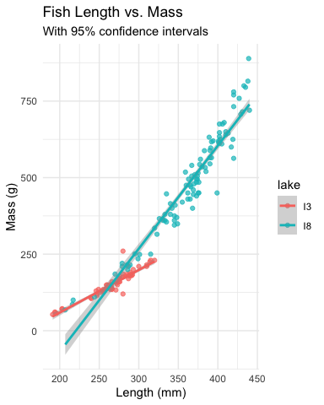
Lecture 5: Summary
Key concepts covered:
Probability distributions model random phenomena
Normal distribution is especially important
Z-scores standardize measurements
Standard error measures precision of estimates
Decreases with larger sample sizes
Used to construct confidence intervals
Confidence intervals express uncertainty
Provide plausible range for parameters
95% CI: mean ± 1.96 × SE
Hypothesis testing evaluates claims
Null vs. alternative hypotheses
P-values quantify evidence against H₀
Consider both statistical and practical significance

Slide 57
Final Exercise: Comprehensive Analysis
Now that we’ve covered the key concepts, let’s perform a complete analysis of the Arctic grayling data:
# Comprehensive analysis of Arctic grayling data # 1. Data visualization length_boxplot <- grayling_df %>% ggplot(aes(x = lake, y = total_length_mm, fill = lake)) + geom_boxplot() + labs(title = "Fish Length by Lake", x = "Lake", y = "Length (mm)") + theme_minimal() # 2. Compare means with t-test length_ttest <- t.test(total_length_mm ~ lake, data = grayling_df) # 3. Length-mass relationship length_mass_model <- lm(mass_g ~ total_length_mm * lake, data = grayling_df) model_summary <- summary(length_mass_model) # 4. Display results length_boxplot
length_ttest
Welch Two Sample t-test data: total_length_mm by lake t = -15.532, df = 161.63, p-value < 2.2e-16 alternative hypothesis: true difference in means between group I3 and group I8 is not equal to 0 95 percent confidence interval: -109.32342 -84.66053 sample estimates: mean in group I3 mean in group I8 265.6061 362.5980
model_summary
Call: lm(formula = mass_g ~ total_length_mm * lake, data = grayling_df) Residuals: Min 1Q Median 3Q Max -151.223 -14.839 -0.764 10.670 153.130 Coefficients: Estimate Std. Error t value Pr(>|t|) (Intercept) -219.3313 47.9087 -4.578 9.30e-06 *** total_length_mm 1.3924 0.1794 7.763 8.88e-13 *** lakeI8 -522.5506 56.5882 -9.234 < 2e-16 *** total_length_mm:lakeI8 1.9738 0.1972 10.009 < 2e-16 *** --- Signif. codes: 0 '***' 0.001 '**' 0.01 '*' 0.05 '.' 0.1 ' ' 1 Residual standard error: 40.93 on 162 degrees of freedom (2 observations deleted due to missingness) Multiple R-squared: 0.9644, Adjusted R-squared: 0.9637 F-statistic: 1461 on 3 and 162 DF, p-value: < 2.2e-16
# 5. Calculate 95% confidence intervals for each lake ci_results <- grayling_df %>% group_by(lake) %>% summarize( mean_length = mean(total_length_mm, na.rm = TRUE), sd_length = sd(total_length_mm, na.rm = TRUE), n = sum(!is.na(total_length_mm)), se_length = sd_length / sqrt(n), t_crit = qt(0.975, df = n - 1), margin_error = t_crit * se_length, ci_lower = mean_length - margin_error, ci_upper = mean_length + margin_error, .groups = "drop" ) # Display confidence intervals ci_results
# A tibble: 2 × 9 lake mean_length sd_length n se_length t_crit margin_error ci_lower <chr> <dbl> <dbl> <int> <dbl> <dbl> <dbl> <dbl> 1 I3 266. 28.3 66 3.48 2.00 6.96 259. 2 I8 363. 52.3 102 5.18 1.98 10.3 352. # ℹ 1 more variable: ci_upper <dbl>
# 6. Visualize regression with confidence intervals regression_plot <- grayling_df %>% ggplot(aes(x = total_length_mm, y = mass_g, color = lake)) + geom_point(alpha = 0.7) + geom_smooth(method = "lm", se = TRUE) + labs(title = "Length-Mass Relationship by Lake", x = "Length (mm)", y = "Mass (g)") + theme_minimal() regression_plot
Based on this analysis: 1. Are there significant differences in fish length between the two lakes? 2. How does the length-mass relationship differ between lakes? 3. What conclusions can you draw about Arctic grayling in these two lakes?

Slide 58
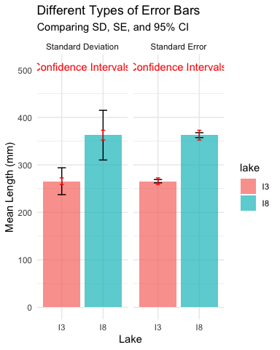
Lecture 5: Error Bars and Their Interpretation
Error bars are graphical representations of the variability of data that show:
The precision of a measurement
The uncertainty around an estimate
A confidence interval for a parameter
Common types of error bars: 1. Standard Error (SE): Shows precision of the mean 2. Standard Deviation (SD): Shows variability in the data 3. Confidence Interval (CI): Shows plausible range for parameter
When interpreting graphs: - Always check what the error bars represent - Non-overlapping 95% CI bars suggest statistically significant differences - Error bars help assess both statistical and practical significance

Slide 59
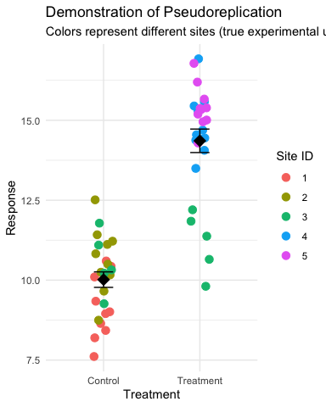
Lecture 5: Sampling and Pseudoreplication
Pseudoreplication occurs when measurements that are not independent are analyzed as if they were independent.
A critical consideration in experimental design
Results in underestimated standard errors and confidence intervals
Leads to inflated Type I error rates (false positives)
Examples of pseudoreplication: - Measuring the same individual multiple times - Treating multiple fish from the same tank as independent - Using multiple data points from a single site
How to avoid pseudoreplication: - Identify the true experimental unit - Use appropriate statistical techniques (e.g., mixed models) - Be clear about the level of replication

Slide 60
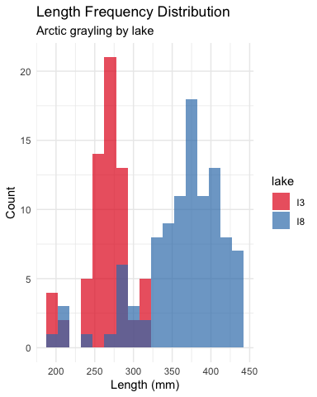
Lecture 5: Practical Applications in Fish Biology
The statistical concepts we’ve covered today are essential for fisheries biologists and ecologists:
Z-scores help identify unusual fish sizes in a population
Standard error quantifies uncertainty in growth rate estimates
Confidence intervals provide plausible ranges for population parameters
Hypothesis testing evaluates effects of management practices
P-values determine significance of environmental impacts
Real-world applications: - Assessing population health and structure - Evaluating effectiveness of fishing regulations - Quantifying relationships between fish size and habitat variables - Predicting impacts of climate change on fish populations - Designing effective conservation strategies

Slide 61
Lecture 5: Statistical hypothesis testing
Major goal of statistics:
inferences about populations from samples assign degree of confidence to inferences
Statistical H-testing:
formalized approach to inference
hypotheses ask whether samples come from populations with certain properties
often interested in questions about population means (but not only)

Slide 62
Lecture 5: Statistical hypothesis testing
Relies on specifying null hypothesis (Ho) and alternate hypothesis (Ha)
Ho is the hypothesis of “no effect”
(two samples from population with same mean, sample is from population of mean=0)
Ha (research hypothesis) the opposite of the Ho

Slide 63
Practice Exercise 10: Formulating Hypotheses
For the following scenarios, write out the null and alternative hypotheses:
Testing if the mean fish length in Lake S 06 is greater than 50 mm.
Testing if there is a difference in mean fish lengths between lakes Toolik and S 06.
Testing if lake E 01 has a higher variance in fish lengths compared to Lake Toolik.
For each scenario, remember that the null hypothesis typically represents “no effect” or “no difference”, while the alternative hypothesis represents what you are trying to demonstrate.

Slide 64
Lecture 5: Statistical hypothesis testing
p = 0.3 means that if study repeated 100 times
would get this (or more extreme) result due to chance 30 times
p = 0.03 means that if study repeated 100 times
would get this (or more extreme) result due to chance 3 times
Which p-value suggests Ho likely false?

Slide 65
Lecture 5: Statistical hypothesis testing
At what point reject Ho?
p < 0.05 conventional “significance threshold” (α)
p < 0.05 means:
if Ho is true - if study repeated 100 times
would get this (or more extreme) result less than 5 times due to chance

Slide 66
Lecture 5: Statistical hypothesis testing
α is the rate at which we will reject a true null hypothesis (Type I error rate)
Lowering α will lower likelihood of incorrectly rejecting a true null hypothesis (e.g., 0.01, 0.001)
Both hypotheses and α are specified BEFORE collection of data and analysis

Slide 67
Lecture 5: Statistical hypothesis testing
Traditionally α=0.05 is used as a cut off for rejecting null hypothesis
Nothing magical about 0.0 - actual p-values need to be reported.
p-value range | Interpretation
P > 0.10 | No evidence against Ho - data appear consistent with Ho
0.05 < P < 0.10 | Weak evidence against the Ho in favor of Ha
0.01 < P < 0.05 | Moderate evidence against Ho in favor of Ha
0.001 < P < 0.01 | Strong evidence against Ho in favor of Ha
P < 0.001 | Very strong evidence against Ho in favor of Ha

Slide 68
Lecture 5: Statistical hypothesis testing
Fisher:
p-value as informal measure of discrepancy betwen data and Ho
“If p is between 0.1 and 0.9 there is certainly no reason to suspect the hypothesis tested. If it is below 0.02 it is strongly indicated that the hypothesis fails to account for the whole of the facts. We shall not often be astray if we draw a conventional line at .05 …”

Slide 69
Lecture 5: Statistical hypothesis testing
General procedure for H testing:
Specify Null (Ho) and alternate (Ha)
Determine test (and test statistic) to be used
Test statistic is used to compare your data to expectation under Ho (null hypothesis)
Specify significance (α or p value) level below which Ho will be rejected

Slide 70
Lecture 5: Statistical hypothesis testing
General procedure for H testing:
Collect data - Perform test
If p-value < α, conclude Ho is likely false and reject it
If p-value > α, conclude no evidence Ho is false and retain it

Slide 71
Tip

Slide 72
Lecture 5: Next Steps in Statistical Analysis
In future lectures, we’ll explore:
One-sample and two-sample t-tests
Analysis of variance (ANOVA)
Linear regression and correlation
Chi-square tests
Non-parametric methods
Multiple regression and model selection
Mixed effects models
Each method builds on the statistical foundation we’ve established today, applying probability concepts to make inferences from data.
Learning Resources
Practice problems in the textbook (Chapter 4 & 5)
Online resources:
Khan Academy: Probability and Statistics
StatQuest with Josh Starmer (YouTube channel)
R for Data Science (r4ds.had.co.nz)
Office hours: Wednesdays 2-4pm

