Slide 1
Lecture 07 H testing and simple tests II
Bill Perry

Slide 2

Lecture 7 - A Brief review
H test for a single population
1- and 2-sided tests
H test for two populations
Assumptions of parametric tests

Slide 3

Lecture 7 overview
What we will cover today:
Assumptions of parametric tests and how to run them
Statistical vs. biological significance - is there a difference
What to do when assumptions fail
Robust tests
Rank-based tests
Permutation tests
Lets work with the Lake Trout data as the weights are pretty cool in this one and will bakc up the main points of this lecture.
This is easily translated into the mice weight data from Vancouver or the pine needle data and we could do those too on the fly if you want….
lake trout

Slide 4
# Install packages if needed (uncomment if necessary) # install.packages("readr") # install.packages("tidyverse") # install.packages("car") # install.packages("here") # Load libraries library(car) # For diagnostic tests library(patchwork) library(tidyverse) # For data manipulation and visualization
# the stuff above controls the output and is also set at the top so dont need here # Load the pine needle data # Use here() function to specify the path df <- read_csv("data/lake_trout.csv") # Examine the first few rows head(df)
# A tibble: 6 × 5 sampling_site species length_mm mass_g lake <chr> <chr> <dbl> <dbl> <chr> 1 I8 lake trout 515 1400 I8 2 I8 lake trout 468 1100 I8 3 I8 lake trout 527 1550 I8 4 I8 lake trout 525 1350 I8 5 I8 lake trout 517 1300 I8 6 I8 lake trout 607 2100 I8

Slide 5
Assumptions of parametric tests
T-tests are parametric tests
Parametric tests: specify/assume probability distribution from which parameters came
Non-parametric tests: no assumption about probability distribution
Mukasa et al 2021 DOI: 10.4236/ojbm.2021.93081

Slide 6
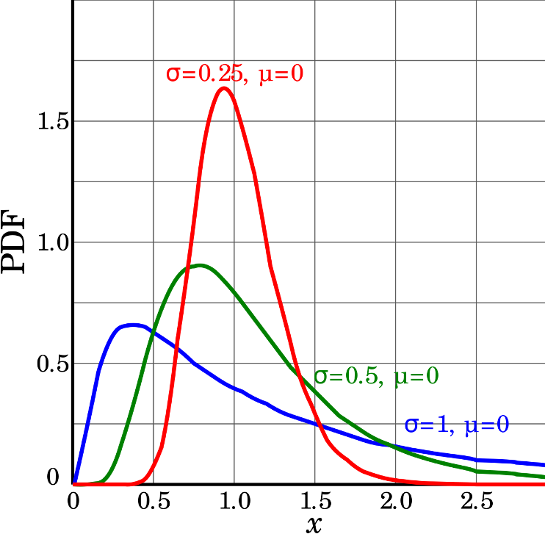
Assumptions of parametric tests
If assumptions of parametric test violated, test becomes unreliable
This is because test statistic may no longer follow distribution
Most parametric tests robust to mild/moderate violations of below assumptions

Slide 7
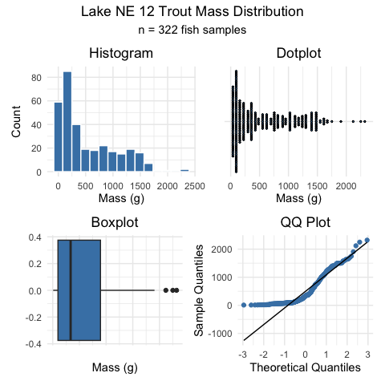
Assumptions of parametric tests
Basic assumptions of parametric t-tests:
Normality, equal variance, random sampling, no outliers
Normality: Samples from normally distributed population
Graphical tests: histograms, dotplots, boxplots, qq-plots
“Formal” tests: Shapiro-Wilk test - sometimes not useful

Slide 8
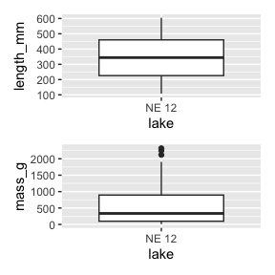
Assumptions of parametric tests
Equal variance: samples are from populations with similar degree of variability
Graphical tests: boxplots
“Formal” tests: F-ratio test
Parametric tests most robust to violations of normality and equal var. assumptions when samples sizes equal
length_plot <- ne12_data %>% ggplot(aes(x=lake, y = length_mm)) +geom_boxplot() mass_plot <- ne12_data %>% ggplot(aes(x=lake, y = mass_g)) +geom_boxplot() length_plot + mass_plot + plot_layout(ncol=1)

Slide 9
Assumptions of parametric tests
Normality, equal variance, random sampling, no outliers
Random sampling:
samples are randomly collected from populations; part of experimental design
Necessary for sample -> population inference
<>

Slide 10
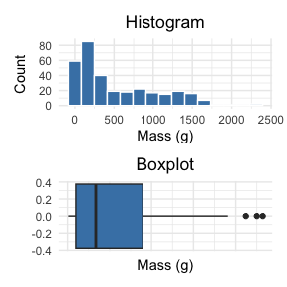
Assumptions of parametric tests
Normality, equal variance, random sampling, no outliers
No outliers: no “extreme” values that are very different from rest of sample
Graphical tests: boxplots, histograms
“Formal tests”: Grubb’s test - no one really does this
Note: outliers also problem for non-parametric tests
ne12_histo_plot+ne12_box_plot+ plot_layout(ncol=1)

Slide 11
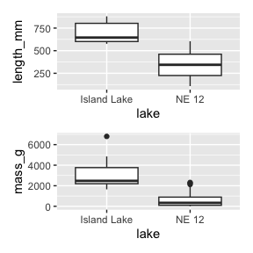
Statistical vs. biological significance
Statistical significance: difference unlikely due to chance
Says nothing about biological significance of difference!
With large sample size can detect very small differences between populations
E.g.: consider 2 lake trout populations are the lengths the same
Island Lake and NE 12
Ho: µ~size A~ = µ~size B~
Ha: µ~size A~ ≠ µ~size B~

Slide 12
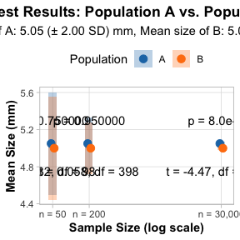
Statistical vs. biological significance
Size of A: 5.05 (± 2.00 SD)mm, size of B: 5.00 (± 2.00 SD)mm
Sample 50, 200, 30,000 individuals from each pop:
n = 50: t = 0.32, df = 98, p-value = 0.75
n = 200: t = 0.058, df = 398, p-value = 0.95
n = 30,000: t = -4.47, df = 59998, p-value = 7.996*10⁻⁶

Slide 13
Statistical vs. biological significance
Finally, statistically significant difference…
Meaningful?
Ecologically significant?
Statistics can’t answer this question
IMPORTANT to report info that can assess biological significance
“A two-tailed, two-sample independent t-test showed significant difference in size between pop. A (4.99 mm ± 1.99 SD) and pop. B (5.06 mm ± 1.99 SD) at á=0.05 (t = -4.47, df = 59998, p-value < 0.0001).”
<!– –>

Slide 14
Assumptions of parametric tests
Basic assumptions of parametric t-tests:
Normality, equal variance, random sampling, no outliers
What to do if assumptions are violated?
ne12_histo_plot+ne12_box_plot+ plot_layout(ncol=1)

Slide 15
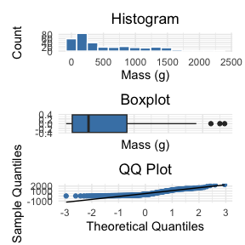
Nonparametric test
t-tests have several assumptions.
Alternative tests, with more relaxed assumptions, are available to statisticians.
In which case would you use the following tests?
Welch’s t-test: when distribution normal but variance unequal
Permutation test for two samples: when distribution not normal (but both groups should still have similar distributions and ~equal variance)
Mann-Whitney-Wilcoxon test: when distribution not normal and/or outliers are present (but both groups should still have similar distributions and ~equal variance)
< –
ne12_histo_plot+ne12_box_plot + ne12_qq_plot + plot_layout(ncol=1)

Slide 16
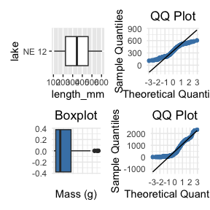
Assumptions of parametric tests
QQ-plots: tool for assessing normality
On x- theoretical quantiles from SND
On y- ordered sample values
Deviation from normal can be detected as deviation from straight line
length_ne12_box_plot <- isl_ne12_df %>% filter(lake =="NE 12") %>% ggplot(aes(x=lake, y = length_mm)) +geom_boxplot() + coord_flip() length_ne12_qq_plot <- isl_ne12_df %>% filter(lake =="NE 12") %>%ggplot(aes(sample = length_mm)) + stat_qq(color = "steelblue") + stat_qq_line() + labs(title = "QQ Plot", x = "Theoretical Quantiles", y = "Sample Quantiles") + theme_minimal() + theme(plot.title = element_text(hjust = 0.5)) (length_ne12_box_plot+ length_ne12_qq_plot) / (ne12_box_plot + ne12_qq_plot)

Slide 17
Assumptions of parametric tests
In some cases, data can be mathematically “transformed” to meet assumptions of parametric tests
this can be done in r and usually involves
log10 transformations
square root transformations
and many others… I will have a description soon
<>
source

Slide 18
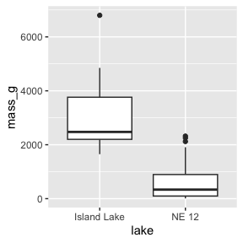
Robust tests
Welch’s t-test
common “robust” test for means of two populations
Robust to violation of equal variance assumption, deals better with unequal sample size
Parametric test (assumes normal distribution)
Calculates a t statistic but recalculates df based on samples sizes and s
mass_ne12_plot

Slide 19
Robust tests
Welch’s t-test
t.test(y1, y2, var.equal = FALSE, paired = FALSE)
will use the Welch approach
T-test
# T test for lenght # Perform standard t-test t_test_length_result <- t.test( length_mm ~ lake, data = isl_ne12_df, var.equal = TRUE # Standard t-test with equal variance assumption ) # Perform Welch's t-test (unequal variances) welch_test_length_result <- t.test( length_mm ~ lake, data = isl_ne12_df, var.equal = FALSE # Welch's t-test )
[1] "Standard t-test results for lenght_mm:"
Two Sample t-test data: length_mm by lake t = 8.616, df = 331, p-value = 2.888e-16 alternative hypothesis: true difference in means between group Island Lake and group NE 12 is not equal to 0 95 percent confidence interval: 270.1939 430.0761 sample estimates: mean in group Island Lake mean in group NE 12 698.200 348.065
[1] "Welch's t-test results for lenght_mm:"
Welch Two Sample t-test data: length_mm by lake t = 9.0183, df = 9.6241, p-value = 5.309e-06 alternative hypothesis: true difference in means between group Island Lake and group NE 12 is not equal to 0 95 percent confidence interval: 263.1673 437.1026 sample estimates: mean in group Island Lake mean in group NE 12 698.200 348.065

Slide 20
# T test for lenght # Perform standard t-test t_test_mass_result <- t.test( mass_g ~ lake, data = isl_ne12_df, var.equal = TRUE # Standard t-test with equal variance assumption ) # Perform Welch's t-test (unequal variances) welch_test_mass_result <- t.test( mass_g ~ lake, data = isl_ne12_df, var.equal = FALSE # Welch's t-test )
[1] "Standard t-test results for mass_g:"
Two Sample t-test data: mass_g by lake t = 14.181, df = 330, p-value < 2.2e-16 alternative hypothesis: true difference in means between group Island Lake and group NE 12 is not equal to 0 95 percent confidence interval: 2266.304 2996.360 sample estimates: mean in group Island Lake mean in group NE 12 3165.0000 533.6677
[1] "Welch's t-test results for mass_g:"
Welch Two Sample t-test data: mass_g by lake t = 5.1368, df = 9.0578, p-value = 0.0006016 alternative hypothesis: true difference in means between group Island Lake and group NE 12 is not equal to 0 95 percent confidence interval: 1473.676 3788.989 sample estimates: mean in group Island Lake mean in group NE 12 3165.0000 533.6677

Slide 21
Rank based tests
Rank-based tests: no assumptions about distribution (non-parametric)
Ranks of data: observations assigned ranks, sums (and signs for paired tests) of ranks for groups compared
Mann-Whitney U test common alternative to independent samples t-test
Wilcoxon signed-rank test is alternative to paired t-test
# Perform Mann-Whitney U test (Wilcoxon rank-sum test) mann_whitney_length_test <- wilcox.test( length_mm ~ lake, data = isl_ne12_df, exact = FALSE, # Use approximation with ties conf.int = TRUE # Calculate confidence interval )
<
[1] "Mann-Whitney U test results length:"
Wilcoxon rank sum test with continuity correction data: length_mm by lake W = 3226, p-value = 7.814e-08 alternative hypothesis: true location shift is not equal to 0 95 percent confidence interval: 262.0000 426.9999 sample estimates: difference in location 357

Slide 22
Rank based tests
Assumptions: similar distributions for groups, equal variance
Less power than parametric tests
Best when normality assumption can not be met by transformation (weird distribution) or large outliers
A: n= 15, y= 8, s= 4 B : n= 15, y= 10, s= 5
Approach A vs. B
T-test df= 28 t= -3.53 p= 0.0014 M-W U (Wilcoxon’s) W= 41 p= 0.002
<
[1] "Standard t-test results for lenght_mm:"
Two Sample t-test data: length_mm by lake t = 8.616, df = 331, p-value = 2.888e-16 alternative hypothesis: true difference in means between group Island Lake and group NE 12 is not equal to 0 95 percent confidence interval: 270.1939 430.0761 sample estimates: mean in group Island Lake mean in group NE 12 698.200 348.065
[1] "Mann-Whitney U test results length:"
Wilcoxon rank sum test with continuity correction data: length_mm by lake W = 3226, p-value = 7.814e-08 alternative hypothesis: true location shift is not equal to 0 95 percent confidence interval: 262.0000 426.9999 sample estimates: difference in location 357

Slide 23
Permutation tests
Permutation tests based on resampling: reshuffling of original data
Resampling allows parameter estimation when distribution unknown, including SEs and CIs of statistics (means, medians)
Common approach is bootstrap: resample sample with replacement many times, recalculate sample stats
Use the perm package

Slide 24
Permutation tests
Ho: µ_{A} = µ_{B}, Ha: µ_{A} ≠µ_{B}
Calculates the differnce ∆ in means between two groups
<!

Slide 25
Permutation tests
Randomly reshuffle observations between groups (keeping n_{NE 12}=323 and n_{Island}=10), calculate ∆
Repeat >1,000 times
Record proportion of the different means i
This is equivalent to p-value and can be used in “traditional” H test framework
For a graphical explanation:
Graphical Explanation

Slide 26
Permutation tests
In R (using ‘perm’ package):
Assumptions: both groups have similar distribution; equal variance
library(perm) # Prepare data for permutation test ne12_perm_data <- isl_ne12_df %>% filter(lake == "NE 12") %>% pull(length_mm) # Randomly sample exactly 25 observations from NE 12 (set seed for reproducibility) set.seed(123) ne12_perm_data <- sample(ne12_perm_data, size = 25, replace = FALSE) island_perm_data <- isl_ne12_df %>% filter(lake == "Island Lake") %>% pull(length_mm) # Calculate the observed difference in means observed_diff <- mean(ne12_perm_data, na.rm = TRUE) - mean(island_perm_data, na.rm = TRUE) # Perform permutation test for difference in means using perm package permTS(ne12_perm_data, island_perm_data, alternative = "two.sided", method = "exact.mc", control = permControl(nmc = 10000))
Exact Permutation Test Estimated by Monte Carlo data: GROUP 1 and GROUP 2 p-value = 2e-04 alternative hypothesis: true mean GROUP 1 - mean GROUP 2 is not equal to 0 sample estimates: mean GROUP 1 - mean GROUP 2 -333.08 p-value estimated from 10000 Monte Carlo replications 99 percent confidence interval on p-value: 0.000000000 0.001059383

