Slide 1
Lecture 04 — Testing Our Hypothesis
The two-sample Welch’s t-test from assumptions to results Bill Perry

Slide 2
Where we left off (Lecture 03)
Wrangling — filter(), select(), mutate(), arrange() as the core tidyverse verbs
Descriptive stats — mean, median, SD, SE with group_by() + summarize()
NA handling — sum(!is.na()) is the safe way to count n
skimr — fast full-dataset overview in one line
Boxplot + jittered points; mean ± SE with stat_summary()
Finding: shady leaves appear heavier, taller, and wider than sunny leaves
Note
✅ Key idea from Lecture 03
We described the pattern in our data. Today we formally test whether that pattern is statistically significant.

Slide 3
Goals for Today
Understand why comparing means is not enough — we need a test
State null and alternate hypotheses formally
Check assumptions before running any test
normality: histogram, QQ plot, Shapiro-Wilk
variance: Levene’s test
Run Welch’s two-sample t-test in R
Read every line of the t.test() output
Report results in scientific writing format
Tip
🖐 Try it yourself
By the end you will run and interpret a complete t-test on our leaf data.
Tools added today:
car — Levene’s variance test
References:
📖 R4DS §3
🌐 Data Carpentry
Today’s naming:
test objects → _model
plots → _plot

Slide 4
Our Hypotheses — A Reminder
Biological prediction:
Shady-side leaves will be larger and heavier — they need more surface area to capture the limited light filtering through the canopy.
Why two-tailed?
We predicted shady > sunny
A one-tailed test would only reject H₀ in that direction
Two-tailed is more conservative and more broadly accepted
If the result is significant two-tailed, it is also significant one-tailed
α = 0.05 — our threshold for rejecting H₀
 | Formal statement
H₀ — null | $μ_{shady}=μ_{sunny}$ — no difference in mean leaf weight
Hₐ — alternate | $μ_{shady}≠μ_{sunny}$ — mean leaf weight differs by side
We use a two-tailed test — we will detect a difference in either direction.

Slide 5
Load Libraries and Data
# Load all packages at the top ---------------------------- library(readxl) # reading Excel files library(tidyverse) # data manipulation + ggplot2 library(skimr) # fast summaries library(car) # Levene's test for variance equality
# Load the leaf data from the data folder ----------------- tree_df <- read_excel("data/2026_06_25_tree_experiment_raw_data.xlsx")
Note
car is the Companion to Applied Regression package. It contains leveneTest(), which we use to check whether our two groups have similar variance.
Install once: install.packages("car")

Slide 6
What We Know So Far
# Quick recap from Lecture 03 ---------------------------- recap_df <- tree_df %>% group_by(side) %>% summarize( n = sum(!is.na(weight_g)), mean_wt = round(mean(weight_g, na.rm = TRUE), 2), sd_wt = round(sd(weight_g, na.rm = TRUE), 2), se_wt = round(sd_wt / sqrt(n), 2) ) recap_df
# A tibble: 2 × 5 side n mean_wt sd_wt se_wt <chr> <int> <dbl> <dbl> <dbl> 1 shady 10 7.8 1.03 0.33 2 sunny 10 3.8 0.79 0.25
RESULTS:
Shady mean: 7.80 g
Sunny mean: 3.80 g
Difference: 4.0 g — a big gap!
But is that gap real, or could it just be sampling noise?
With only n = 10 per group, random chance could produce apparent differences.
We need a formal test to quantify the probability.

Slide 7
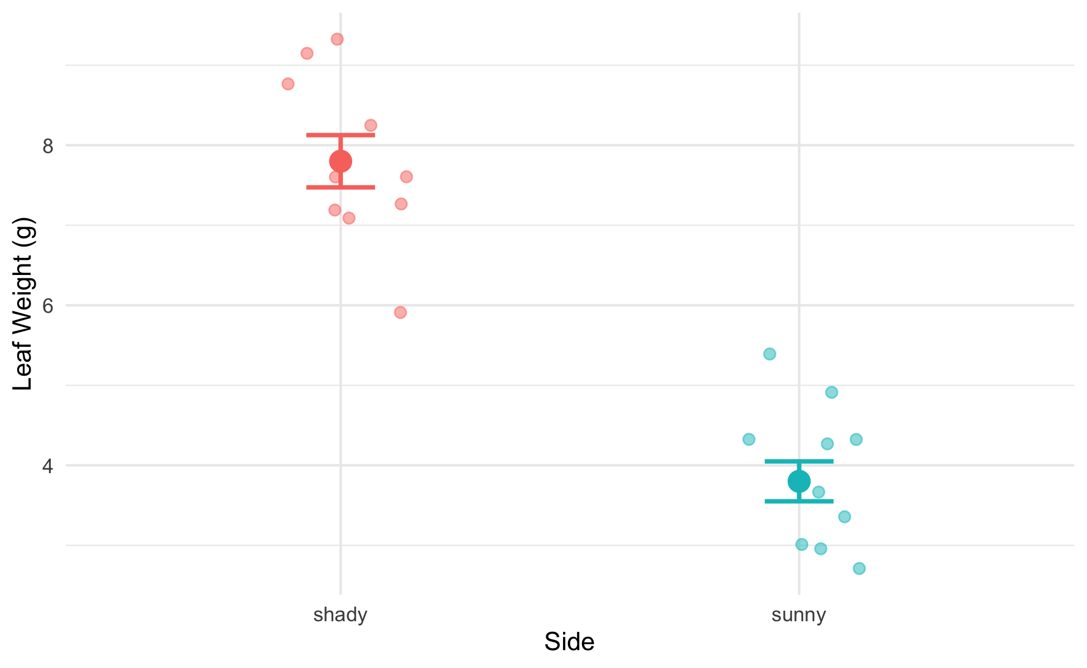
Why Comparing Means Is Not Enough
# Remind ourselves what the data look like --------------- recap_plot <- tree_df %>% ggplot(aes(x = side, y = weight_g, color = side)) + geom_point( position = position_jitter(width = 0.15, seed = 42), alpha = 0.5, size = 2 ) + stat_summary(fun = mean, geom = "point", size = 4) + stat_summary( fun.data = mean_se, geom = "errorbar", width = 0.15, linewidth = 0.9 ) + labs(x = "Side", y = "Leaf Weight (g)") + theme_minimal() + theme(legend.position = "none") recap_plot
The means look different — but:
We only have 10 leaves per group
There is natural variability within each group
The groups’ ranges overlap somewhat
A p-value tells us:
“If H₀ were true, how often would we see a gap this large just by chance?”
Small p → the gap is unlikely to be chance.

Slide 8
What Is a Two-Sample t-Test?
A two-sample t-test compares the means of two independent groups.
It asks: Could both groups plausibly be drawn from populations with the same mean?
The t-statistic is:
$$t=\frac{{\overset{‾}{x}}_{1}−{\overset{‾}{x}}_{2}}{{\text{SE}}_{\text{diff}}}$$
Numerator: the observed difference in means
Denominator: the uncertainty in that difference (SE of the difference)
Large |t| → the difference is large relative to the noise → small p-value
Component | Our context
Group 1 | Shady leaves
Group 2 | Sunny leaves
Measurement | weight_g
H₀ | $μ_{shady}=μ_{sunny}$
Hₐ | $μ_{shady}≠μ_{sunny}$

Slide 9
Why Welch’s? — Don’t Assume Equal Variance
Standard t-test — pools the two variances into one estimate. Requires both groups to have the same population variance.
Welch’s t-test — uses each group’s variance separately. Does not require equal variance.
$$t_{W}=\frac{{\overset{‾}{x}}_{1}−{\overset{‾}{x}}_{2}}{\sqrt{\frac{s_{1}^{2}}{n_{1}}+\frac{s_{2}^{2}}{n_{2}}}}$$
The denominator is the true SE of the difference — no pooling.
Why always use Welch’s?
When variances are equal: almost identical result — minimal loss of power
When variances are not equal: standard t-test gives inflated Type I error (false positives)
Welch’s protects you either way
Tip
Best practice: use Welch’s as your default for all two-group comparisons.
In R: var.equal = FALSE

Slide 10
The Welch’s Formula in Action
# Pull stats and compute t by hand ---------------------- stats_df <- tree_df %>% group_by(side) %>% summarize( n = sum(!is.na(weight_g)), m = mean(weight_g, na.rm = TRUE), s = sd(weight_g, na.rm = TRUE) ) m_sha <- stats_df$m[stats_df$side == "shady"] m_sun <- stats_df$m[stats_df$side == "sunny"] s_sha <- stats_df$s[stats_df$side == "shady"] s_sun <- stats_df$s[stats_df$side == "sunny"] n_sha <- stats_df$n[stats_df$side == "shady"] n_sun <- stats_df$n[stats_df$side == "sunny"] se_diff <- sqrt((s_sha^2 / n_sha) + (s_sun^2 / n_sun)) t_manual <- (m_sha - m_sun) / se_diff cat("Difference in means:", round(m_sha - m_sun, 2), "g\n")
Difference in means: 4 g
cat("SE of difference: ", round(se_diff, 4), "\n")
SE of difference: 0.411
cat("t-statistic: ", round(t_manual, 3), "\n")
t-statistic: 9.733
Step by step:
Difference in means: 7.80 − 3.80 = 4.0 g
SE of the difference: $\sqrt{\frac{s_{shady}^{2}}{10}+\frac{s_{sunny}^{2}}{10}}$
t = difference / SE
The observed difference is ~10 standard errors above zero — very far from what we’d expect if H₀ were true.

Slide 11
Five Steps to a Hypothesis Test
We will always follow this sequence:
Important
Check assumptions BEFORE running the test.
If your data seriously violate assumptions, the p-value from the t-test is unreliable.
With n = 10 per group, our main concern is gross non-normality. The t-test is quite robust to mild departures.
Step | Action
1 | State H₀ and Hₐ
2 | Check normality — histogram/box plot
3 | Check normality — QQ plot + Shapiro-Wilk
4 | Check variance — Levene’s test
5 | Run the test; interpret and report

Slide 12
Step 1 — Hypotheses (Formal)
Null hypothesis:
$$H_{0}:μ_{shady}=μ_{sunny}$$
Shady and sunny leaves have the same mean weight in the population.
Alternate hypothesis (two-tailed):
$$H_{A}:μ_{shady}≠μ_{sunny}$$
The mean leaf weights differ between sides — in either direction.
Significance level: α = 0.05
We will reject H₀ if p < 0.05.
Why state hypotheses first?
Keeps the analysis honest
Prevents “HARKing” (Hypothesizing After Results are Known)
Forces you to commit to a direction (one-tailed) or not (two-tailed) before seeing the data
Our commitment: two-tailed, α = 0.05, before running any test.

Slide 13
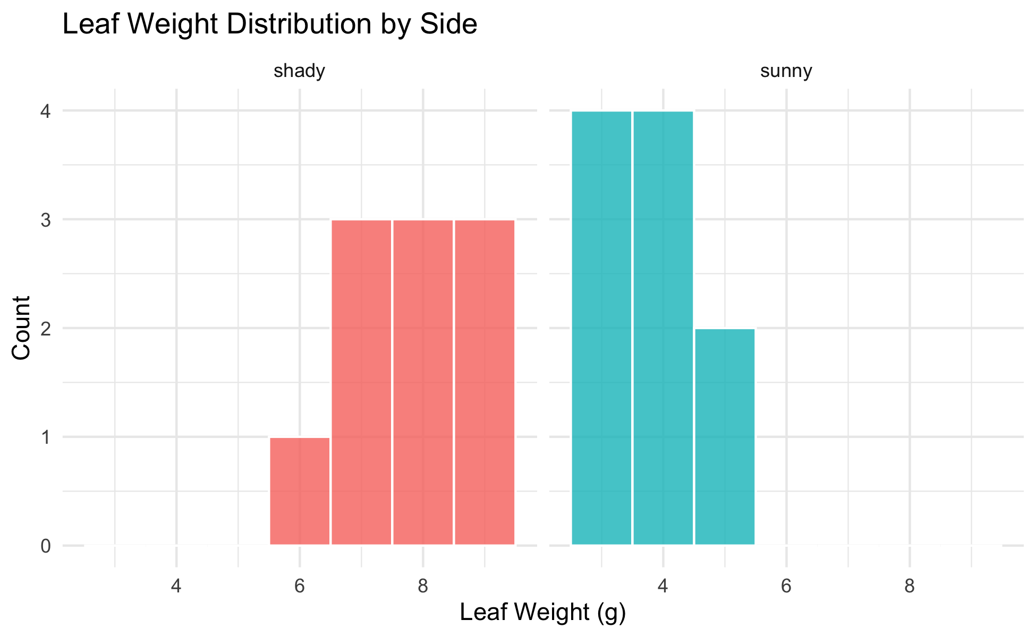
Step 2 — Check Normality: Histogram
# Histogram per group to visually check normality ------- hist_norm_plot <- tree_df %>% ggplot(aes(x = weight_g, fill = side)) + geom_histogram(binwidth = 1, color = "white", alpha = 0.8) + facet_wrap(~side, ncol = 2) + labs( title = "Leaf Weight Distribution by Side", x = "Leaf Weight (g)", y = "Count" ) + theme_minimal() + theme(legend.position = "none") hist_norm_plot
What to look for:
Roughly bell-shaped — not heavily skewed
No obvious bimodal peaks
No extreme outliers
With n = 10 per group, histograms look lumpy — that is normal for small samples.
Histograms are a visual check only. We also use QQ plots and Shapiro-Wilk.

Slide 14
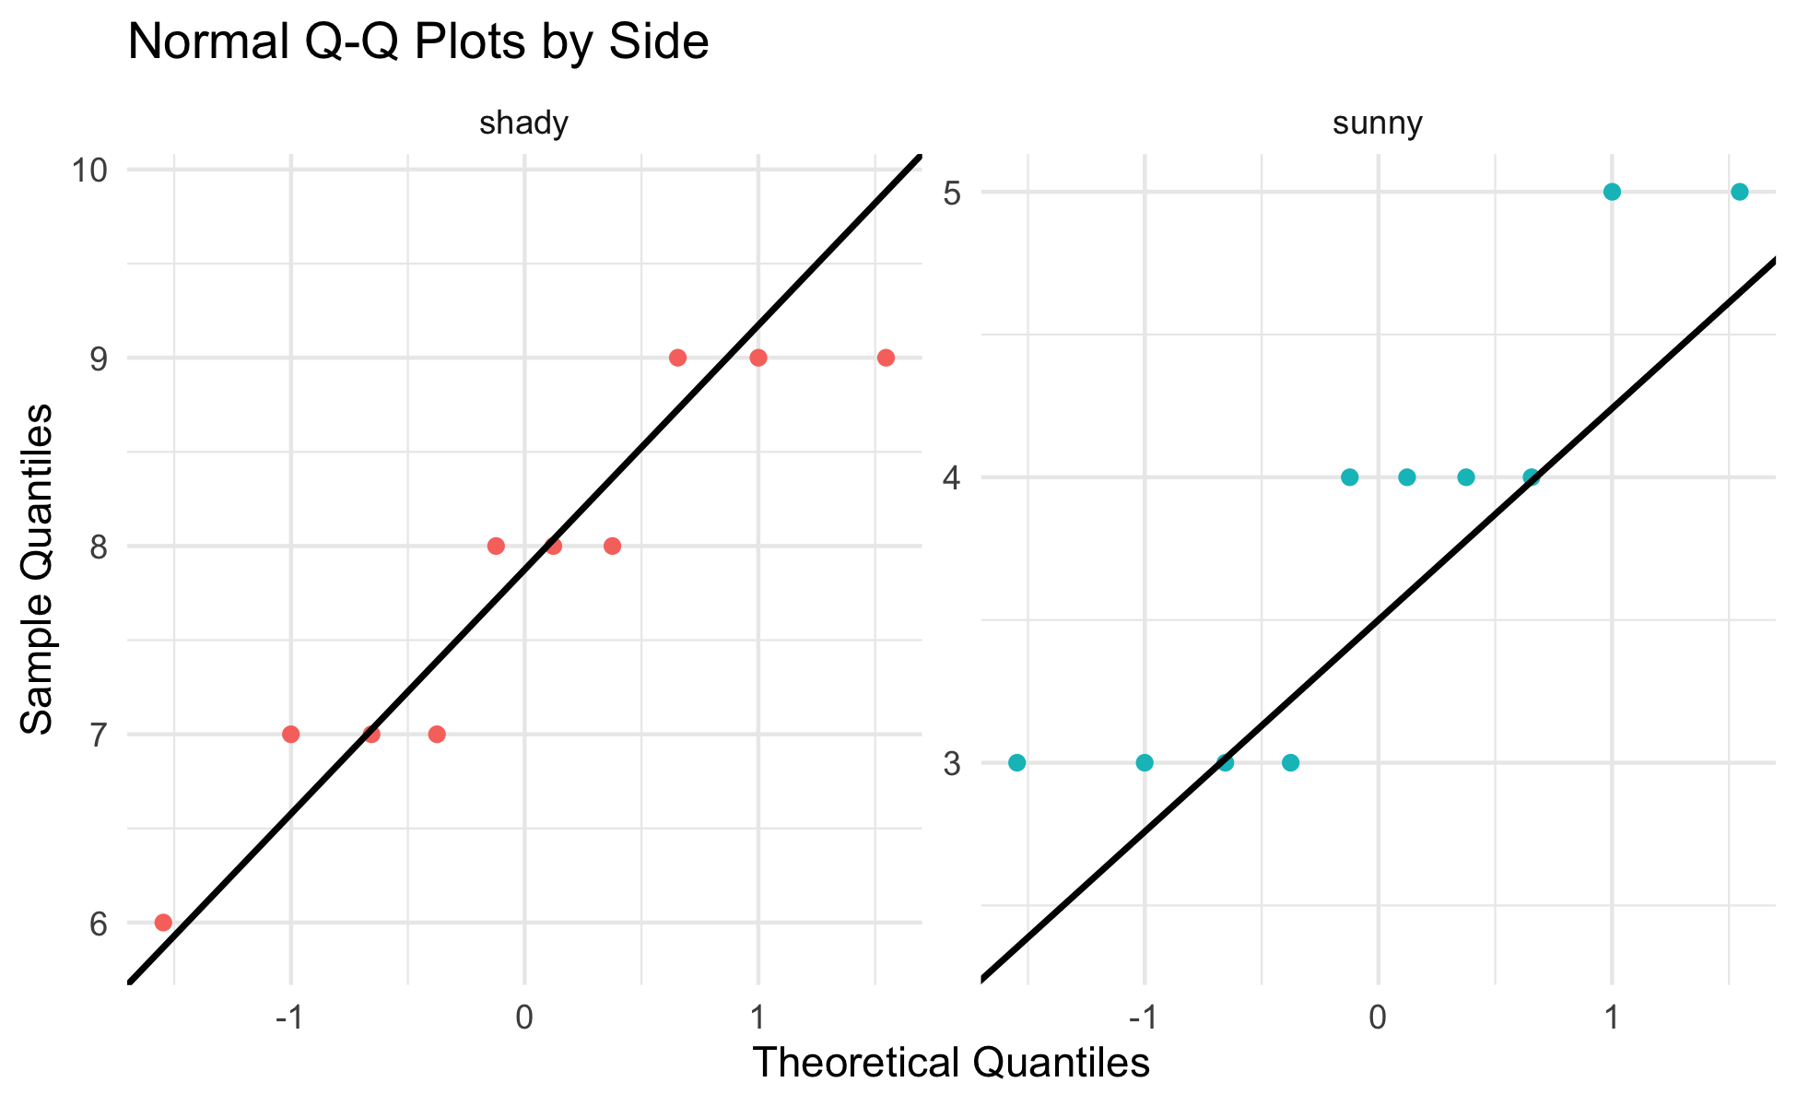
Step 3 — Check Normality: QQ Plot
# Q-Q plot — points should fall along the diagonal line -- qq_norm_plot <- tree_df %>% ggplot(aes(sample = weight_g, color = side)) + stat_qq() + stat_qq_line(color = "black", linewidth = 0.8) + facet_wrap(~side, scales = "free") + labs( title = "Normal Q-Q Plots by Side", x = "Theoretical Quantiles", y = "Sample Quantiles" ) + theme_minimal() + theme(legend.position = "none") qq_norm_plot
How to read a QQ plot:
Points on the line → data follow a normal distribution
Points curving away at ends → heavy tails or skew
With only n = 10, some deviation is expected and acceptable
If points follow the line roughly, we are comfortable proceeding with the t-test.

Slide 15
Step 3 — Check Normality: Shapiro-Wilk Test
# Shapiro-Wilk test for the sunny side ----------------- tree_df %>% filter(side == "sunny") %>% pull(weight_g) %>% shapiro.test()
Shapiro-Wilk normality test data: . W = 0.8197, p-value = 0.02513
# Shapiro-Wilk test for the shady side ----------------- tree_df %>% filter(side == "shady") %>% pull(weight_g) %>% shapiro.test()
Shapiro-Wilk normality test data: . W = 0.89461, p-value = 0.191
Shapiro-Wilk H₀: the data are normally distributed.
p > 0.05 → fail to reject normality → proceed with t-test
p < 0.05 → evidence of non-normality → consider a non-parametric alternative
Important
Small-sample caution:
With n = 10, this test has low power — it rarely detects non-normality even when present. The QQ plot is equally important.

Slide 16
Step 4 — Check Variance: Levene’s Test
# Levene's test — are the variances similar? ----------- leveneTest(weight_g ~ side, data = tree_df)
Levene's Test for Homogeneity of Variance (center = median) Df F value Pr(>F) group 1 0.6 0.4486 18
Levene’s test H₀: the two groups have equal variance.
p > 0.05 → variances are not significantly different
p < 0.05 → variances are significantly different
Our response regardless of the result:
We will use Welch’s t-test (var.equal = FALSE).
Welch’s is valid whether or not the variances are equal. We run Levene’s to understand our data, not to choose our test.

Slide 17
Step 5 — Run the Welch’s t-Test
# Welch's two-sample t-test — unequal variance --------- leaf_ttest_model <- t.test( weight_g ~ side, # formula: response ~ grouping variable data = tree_df, var.equal = FALSE, # Welch's — no pooled variance alternative = "two.sided" # two-tailed test ) leaf_ttest_model
Welch Two Sample t-test data: weight_g by side t = 9.7333, df = 16.834, p-value = 2.514e-08 alternative hypothesis: true difference in means between group shady and group sunny is not equal to 0 95 percent confidence interval: 3.132297 4.867703 sample estimates: mean in group shady mean in group sunny 7.8 3.8
Key arguments:
argument | what it does
weight_g ~ side | compare weight_g between levels of side
var.equal = FALSE | use Welch’s correction
alternative = "two.sided" | two-tailed test
The result is a model object. We decode each line of the output on the next slide.

Slide 18
Reading the t.test() Output
# Extract individual values from the model object ------ cat("t-statistic :", round(leaf_ttest_model$statistic, 3), "\n")
t-statistic : 9.733
cat("df (Welch) :", round(leaf_ttest_model$parameter, 2), "\n")
df (Welch) : 16.83
cat("p-value :", signif(leaf_ttest_model$p.value, 3), "\n")
p-value : 2.51e-08
cat( "95% CI :", round(leaf_ttest_model$conf.int[1], 2), "to", round(leaf_ttest_model$conf.int[2], 2), "g\n" )
95% CI : 3.13 to 4.87 g
cat("Mean shady :", round(leaf_ttest_model$estimate[1], 2), "g\n")
Mean shady : 7.8 g
cat("Mean sunny :", round(leaf_ttest_model$estimate[2], 2), "g\n")
Mean sunny : 3.8 g
Line by line:
output | meaning
t | our calculated t-statistic
df | Welch-Satterthwaite df (non-integer is normal!)
p-value | probability of this result if H₀ is true
95% CI | plausible range for the true difference in means
mean of shady/sunny | the two group means
The 95% CI is the range we could expect to see if we repeated this study many times.

Slide 19
Step 5 — Make a Decision
# State the decision formally -------------------------- # if/else: R checks the condition and runs one of two blocks # We will learn these formally in the functions lecture p_val <- leaf_ttest_model$p.value alpha <- 0.05 if (p_val < alpha) { cat("p =", signif(p_val, 3), "< α =", alpha, "\n") cat("Decision: REJECT H₀\n") cat("Conclusion: leaf weight differs between sides.\n") } else { cat("p =", signif(p_val, 3), ">= α =", alpha, "\n") cat("Decision: FAIL TO REJECT H₀\n") cat("Conclusion: insufficient evidence of a difference.\n") }
p = 2.51e-08 < α = 0.05 Decision: REJECT H₀ Conclusion: leaf weight differs between sides.
Important
What a small p-value means:
If H₀ were true (no real difference), we would get a t-statistic this large or larger less than p × 100% of the time just by chance.
We set α = 0.05 before the test. If p < α, we reject H₀.
What a small p-value does NOT mean:
It is not the probability that H₀ is true
Statistical significance ≠ biological importance
Report the effect size (difference in means) alongside p

Slide 20
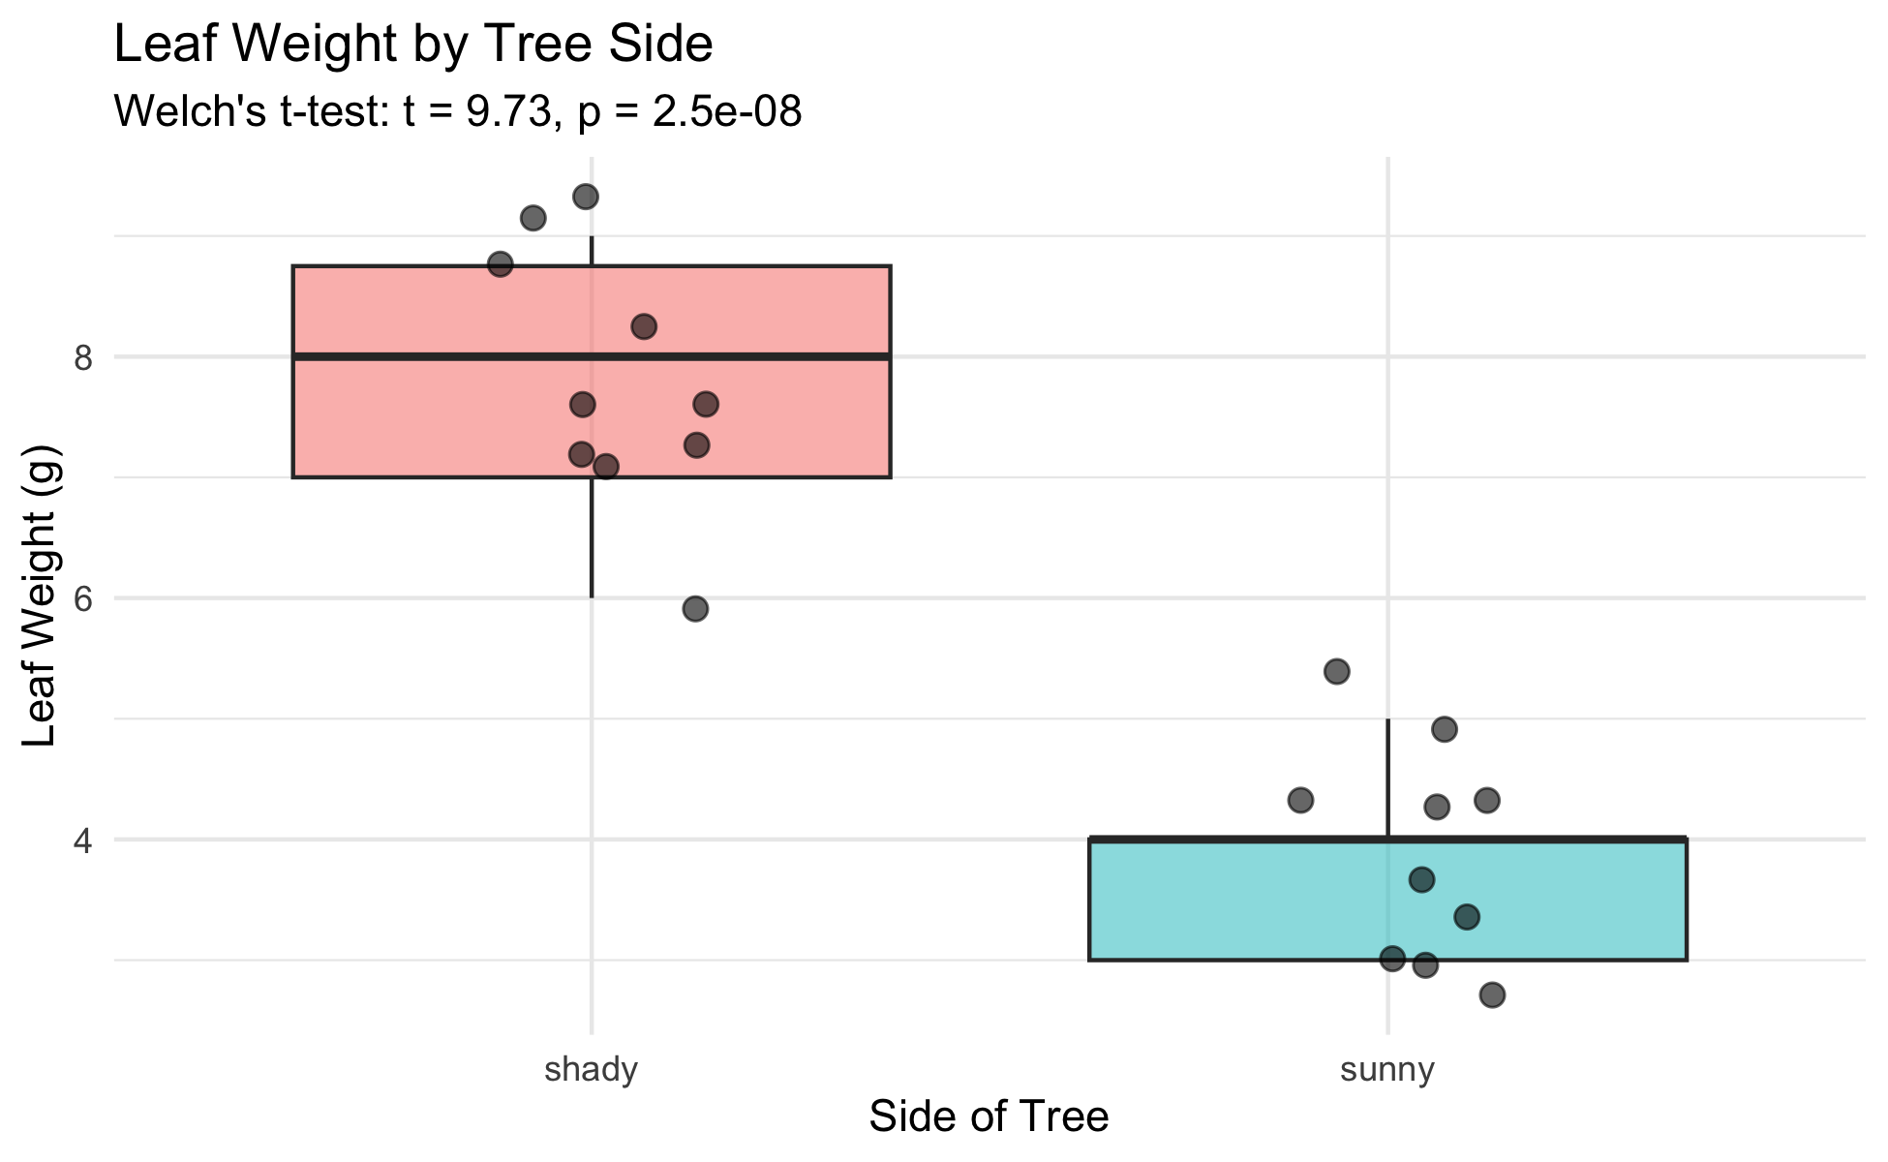
Visualize the Result — Boxplot
# Final boxplot with all points ----------------------- leaf_box_04_plot <- tree_df %>% ggplot(aes(x = side, y = weight_g, fill = side)) + geom_boxplot(alpha = 0.5, outlier.shape = NA) + geom_point( position = position_jitter(width = 0.15, seed = 42), alpha = 0.6, size = 2.5 ) + labs( title = "Leaf Weight by Tree Side", subtitle = paste0( "Welch's t-test: t = ", round(leaf_ttest_model$statistic, 2), ", p = ", signif(leaf_ttest_model$p.value, 2) ), x = "Side of Tree", y = "Leaf Weight (g)" ) + theme_minimal() + theme(legend.position = "none") leaf_box_04_plot
Including the test result in the figure:
subtitle pulls t and p directly from the model object
R fills in the actual numbers automatically
If you re-run with new data, the subtitle updates
Tip
Embedding test statistics in the plot subtitle saves you from copying numbers by hand — and avoids typos in your report.

Slide 21
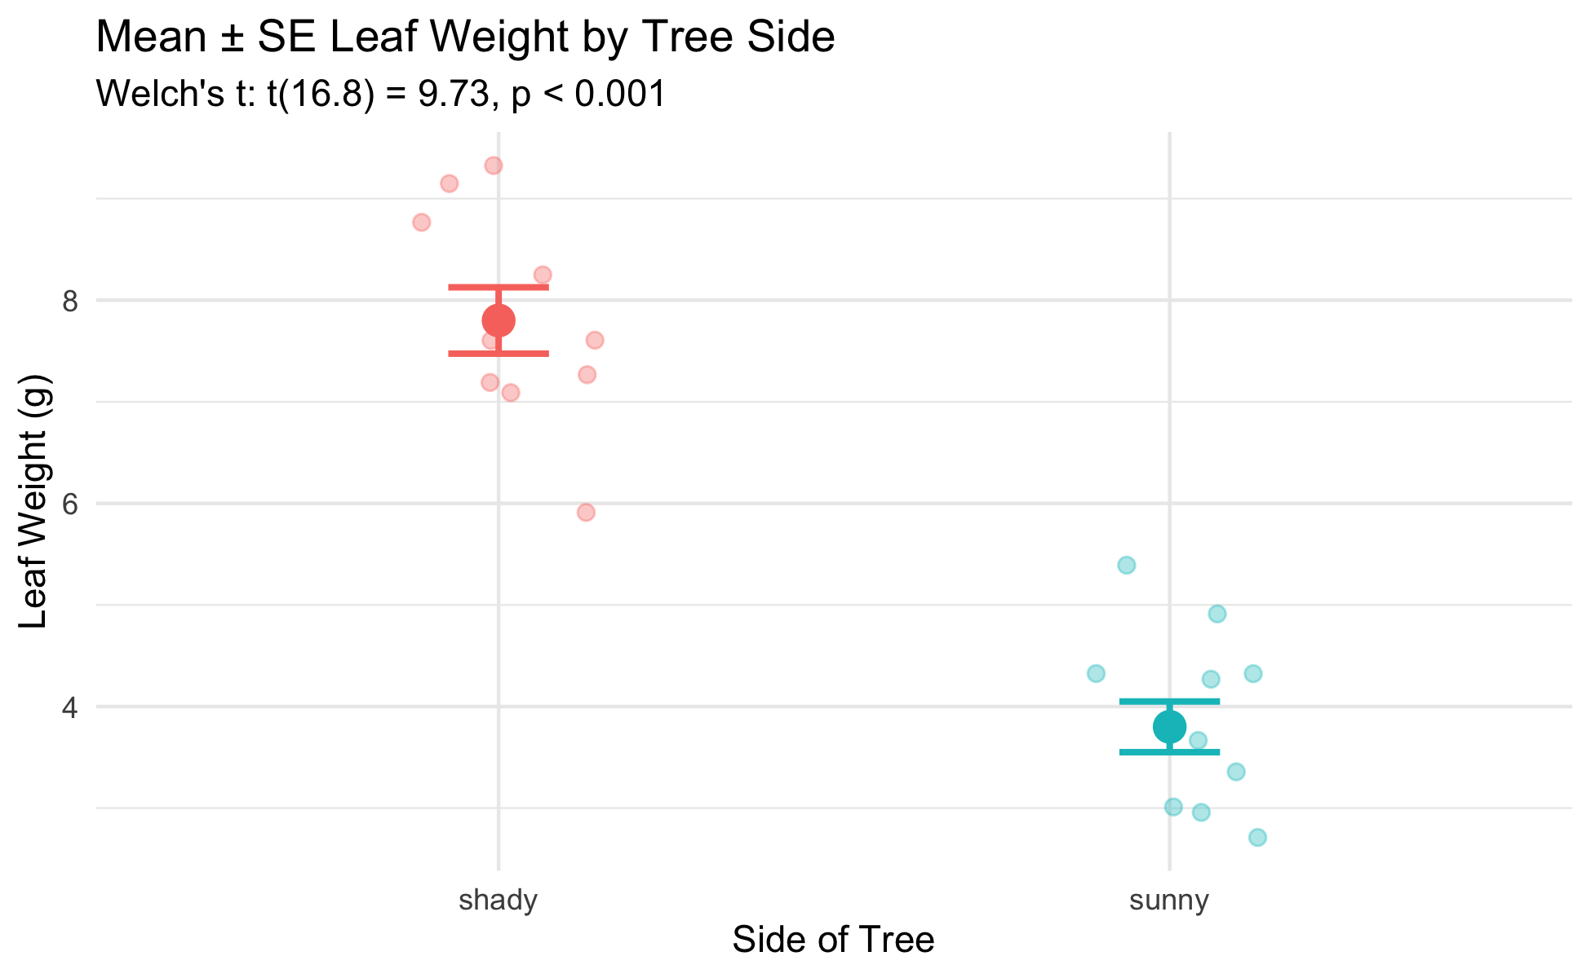
Visualize the Result — Mean ± SE
# Mean ± SE plot with individual points --------------- leaf_mean_se_04_plot <- tree_df %>% ggplot(aes(x = side, y = weight_g, color = side)) + geom_point( position = position_jitter(width = 0.15, seed = 42), alpha = 0.35, size = 2 ) + stat_summary(fun = mean, geom = "point", size = 4) + stat_summary( fun.data = mean_se, geom = "errorbar", width = 0.15, linewidth = 0.9 ) + labs( title = "Mean ± SE Leaf Weight by Tree Side", subtitle = paste0( "Welch's t: t(", round(leaf_ttest_model$parameter, 1), ") = ", round(leaf_ttest_model$statistic, 2), ", p < 0.001" ), x = "Side of Tree", y = "Leaf Weight (g)" ) + theme_minimal() + theme(legend.position = "none") leaf_mean_se_04_plot
What the error bars tell you:
Bars show ± 1 SE — precision of the mean estimate
Non-overlapping bars suggest a significant difference
Rule of thumb:
If error bars overlap by less than half the bar length, the difference is likely significant at α = 0.05. The p-value from the t-test is the definitive answer.

Slide 22
How to Report Results in Science
# Compute reporting values from the model object ------- t_val <- round(leaf_ttest_model$statistic, 2) df_val <- round(leaf_ttest_model$parameter, 1) p_val2 <- signif(leaf_ttest_model$p.value, 2) cat("--- Results sentence ---\n")
--- Results sentence ---
cat("Shady-side leaves were significantly heavier than\n")
Shady-side leaves were significantly heavier than
cat( "sunny-side leaves (Welch's t-test: t(", df_val, ") =", t_val, ", p =", p_val2, ").\n" )
sunny-side leaves (Welch's t-test: t( 16.8 ) = 9.73 , p = 2.5e-08 ).
cat( "Mean ± SE: shady =", round(leaf_ttest_model$estimate[1], 2), "±", round(recap_df$se_wt[recap_df$side == "shady"], 2), "g,\n" )
Mean ± SE: shady = 7.8 ± 0.33 g,
cat( " sunny =", round(leaf_ttest_model$estimate[2], 2), "±", round(recap_df$se_wt[recap_df$side == "sunny"], 2), "g.\n" )
sunny = 3.8 ± 0.25 g.
Standard format:
“[Finding] (Welch’s t-test: t(df) = X.XX, p = X.XXX; mean ± SE: group1 = X.X ± X.X units, group2 = X.X ± X.X units).”
Always include:
Test type (Welch’s t-test)
t-statistic and df
Exact p-value (or < 0.001)
Group means ± SE
Units
Never report “p = 0.000” — write “p < 0.001” instead.

Slide 23
Save Your Plots
# Save both plots to the figures folder ---------------- ggsave( "figures/leaf_weight_boxplot_ttest.png", plot = leaf_box_04_plot, width = 5, height = 5, units = "in", dpi = 300 ) ggsave( "figures/leaf_weight_mean_se_ttest.png", plot = leaf_mean_se_04_plot, width = 5, height = 5, units = "in", dpi = 300 )

Slide 24
Both plots are now in your figures/ folder with the test statistics embedded in the subtitle — ready for a lab report or paper.
Tip
dpi = 300 is publication quality. Use it for any figure that will appear in a paper, poster, or formal report.

Slide 25
What We Learned Today
Concepts:
Why we need a hypothesis test — means alone are not enough
Welch’s t-test — use var.equal = FALSE as the safe default
Two-tailed test — detects differences in either direction
Five-step framework — hypotheses → normality → variance → test → report
Reading output — t, df, p, CI, group means
R skills:
library(car) + leveneTest(y ~ group, data) — variance check
filter() %>% pull() %>% shapiro.test() — normality per group
t.test(y ~ group, data, var.equal = FALSE, alternative = "two.sided")
model$statistic, model$p.value, model$conf.int — extract results
paste0(...) in subtitle — embed test statistics in figures
References:
📖 R4DS §3 — Data Transformation
📖 R4DS §13 — Numbers
🌐 Data Carpentry
Up next — Lecture 05:
Linear regression — predicting leaf area from paper tracing mass
Building a calibration curve with lm()
R², residuals, and assumption checking

