Slide 1
Do Shady Leaves Weigh More? A Two-Sample t-Test
A reproducible write-up of the Worksheets 09–10 analysis Your Name Here

Slide 2
Introduction
Leaves on the shady side of a tree may grow larger and heavier to capture more of the limited light beneath the canopy. We measured the weight (g) of ten leaves from each side of a tree and tested whether mean leaf weight differs between sides.
Null hypothesis (H₀): $μ_{shady}=μ_{sunny}$ — no difference in mean weight
Alternate hypothesis (Hₐ): $μ_{shady}≠μ_{sunny}$ — the means differ
We used a two-tailed test at $α=0.05$.

Slide 3
Methods
We compared the two sides with a Welch’s two-sample t-test (var.equal = FALSE), which does not assume equal variances. Before testing we checked normality within each group with a Shapiro–Wilk test. All analysis was done in R with the tidyverse, and this report was produced in Quarto so that every value below is computed directly from the raw data.

Slide 4
Results
side | n | mean_wt | sd_wt | se_wt
shady | 10 | 7.8 | 1.03 | 0.33
sunny | 10 | 3.8 | 0.79 | 0.25
Table 1. Leaf weight (g) by side of tree (mean, SD, SE).

Slide 5
Mean (shady) | Mean (sunny) | t | df | p-value
7.8 | 3.8 | 9.73 | 16.8 | 2.514428e-08
Table 2. Welch’s two-sample t-test of leaf weight by side.

Slide 6
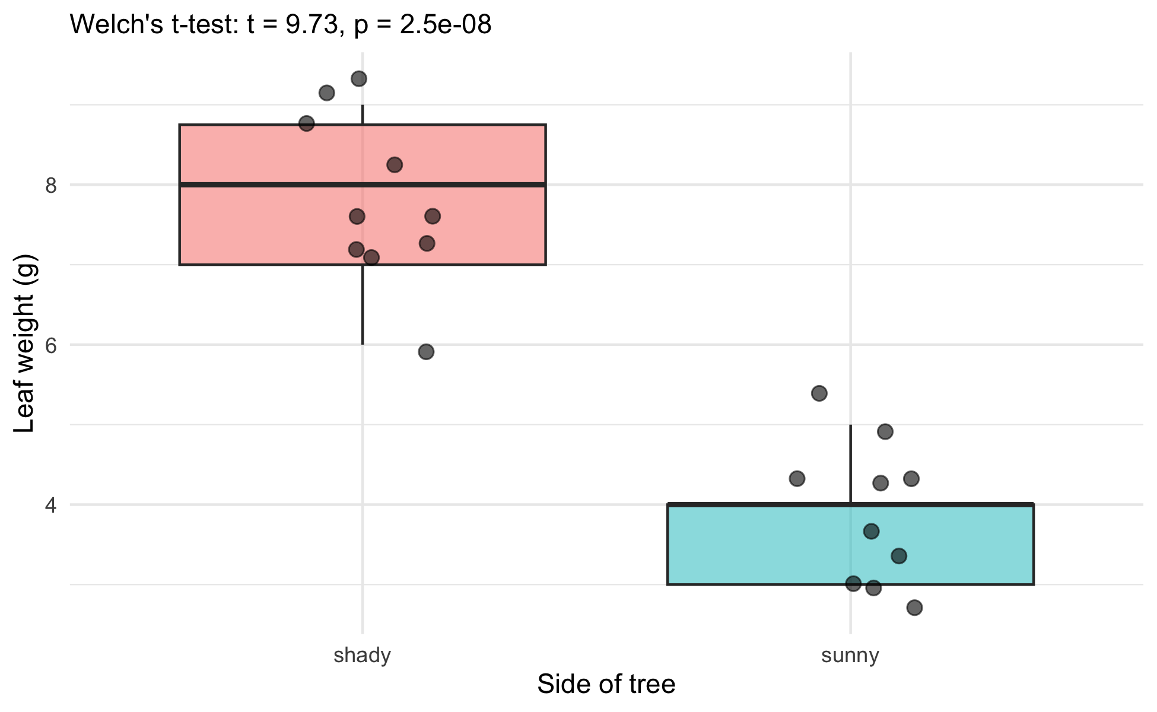
Shady-side leaves were significantly heavier than sunny-side leaves: the group means, SE, and n are in Table 1, and the t, df, and p-value of the Welch’s test are in Table 2. The p-value is below the 0.05 threshold, so the difference is significant.
Note
Every number in Tables 1 and 2 is computed from the raw data when the document renders — nothing was typed or pasted. If a leaf measurement changed, you would fix the data file, press Render, and both tables would update themselves. In a plain script you would retype all of these by hand.
Figure 1. Leaf weight by side of tree. Points show individual leaves; the test result is printed in the subtitle.

Slide 7
Conclusion
At $α=0.05$ we reject the null hypothesis: mean leaf weight differs between the sunny and shady sides of the tree, with shady leaves heavier. This matches the biological prediction that shade leaves grow larger to capture more of the limited light. (Add a sentence of your own interpretation here.)

Slide 8
References
Whitlock, M. & Schluter, D. The Analysis of Biological Data (2nd ed.).
Wickham, H. R for Data Science (2nd ed.) — https://r4ds.hadley.nz/

